Slide 1
PID Sensing and Control Systems
Ara Kourchians

Slide 2
Physical
World
Control
Desired
World

Slide 3
Open Loop
Physical
World
Control
Desired
World
Notes:
Simple autonomous mode that follows a script
Sprinkler system on a timer
Motor + battery
You “trust” that it works and assume ideal conditions

Slide 4
Closed Loop
Physical
World
Control
Sensing
Desired
World
Notes:
Air Conditioners
Airplanes auto-pilot
Drones

Slide 5
??? Loop
Notes:
- Based on the previous definition, is this a closed or open loop system?

Slide 6
Closed Loop
X
Sensing

Slide 7
Closed Loop
X
Sensing
Control
Notes:
- Explain how the students observe where the robot is and come up with a control command to give the robot, but this has a problem….

Slide 8
Closed Loop
X
Sensing
Control
Notes:
This requires training, learning, ‘piloting’
Robot might not drive perfectly straight
Might slip, or be going uphill and will require the driver to manually add more power
So far, the driver has had to learn each robot.. and every robot is different

Slide 9
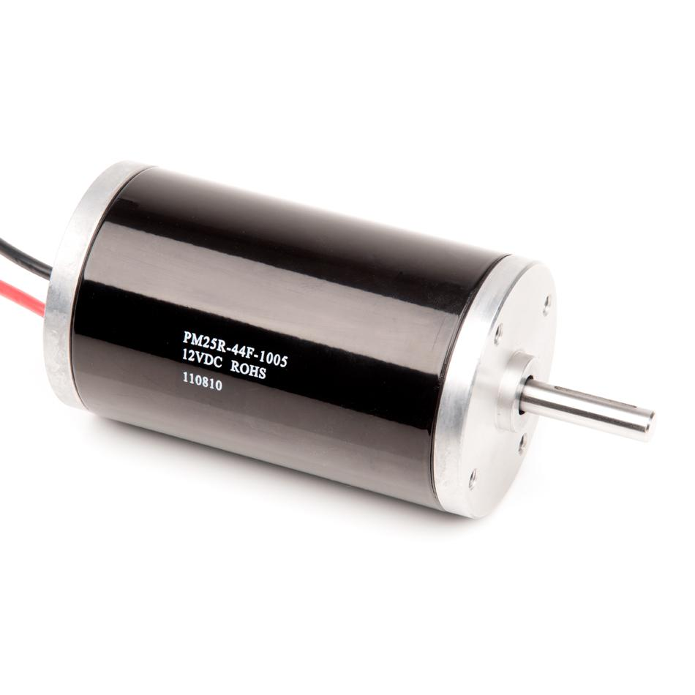
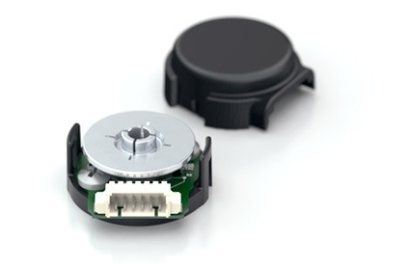
Some terminology
Motor
Encoder
State
Target
Error
Notes:
The story is different for autonomous mode

Slide 10
Autonomous Mode
State
Target
X
Error
Notes:
The story is different for autonomous mode

Slide 11
Autonomous Mode
autonomous.c
State
Target
X
Error

Slide 12
Autonomous Mode
autonomous.c
0
void go()
{
..
robot.drive(X);
..
}
X
Notes:
How do you actually write this in terms of motors and sensors?

Slide 13
Autonomous Mode
autonomous.c
0
void go()
{
..
robot.motors(100);
wait(1_SEC);
robot.motors(0); ..
}
X
Error
X+Error

Slide 14
Autonomous Mode
autonomous.c
0
void go()
{
..
robot.motors(100);
while(encoder < 1000)
{
encoder = robot.read();
}
robot.motors(0);
..
}
X
Error
X+Error
Notes:
You’re going to overshoot when you get to your goal (100% to 0%)

Slide 15
PID Control
0
Error

Slide 16
PID Control
Proportional
Present
P*Error
Integral
Past
I*Sum_of_Errors
Derivative
Future
D*(Error- Last_Error)
+
+
5
2
1
5
1
2
Notes:
PID controllers run in a loop, it’s iterative
Weights of each term depend on the system!
The P, I, and D terms are summed and used as the controller output

Slide 17
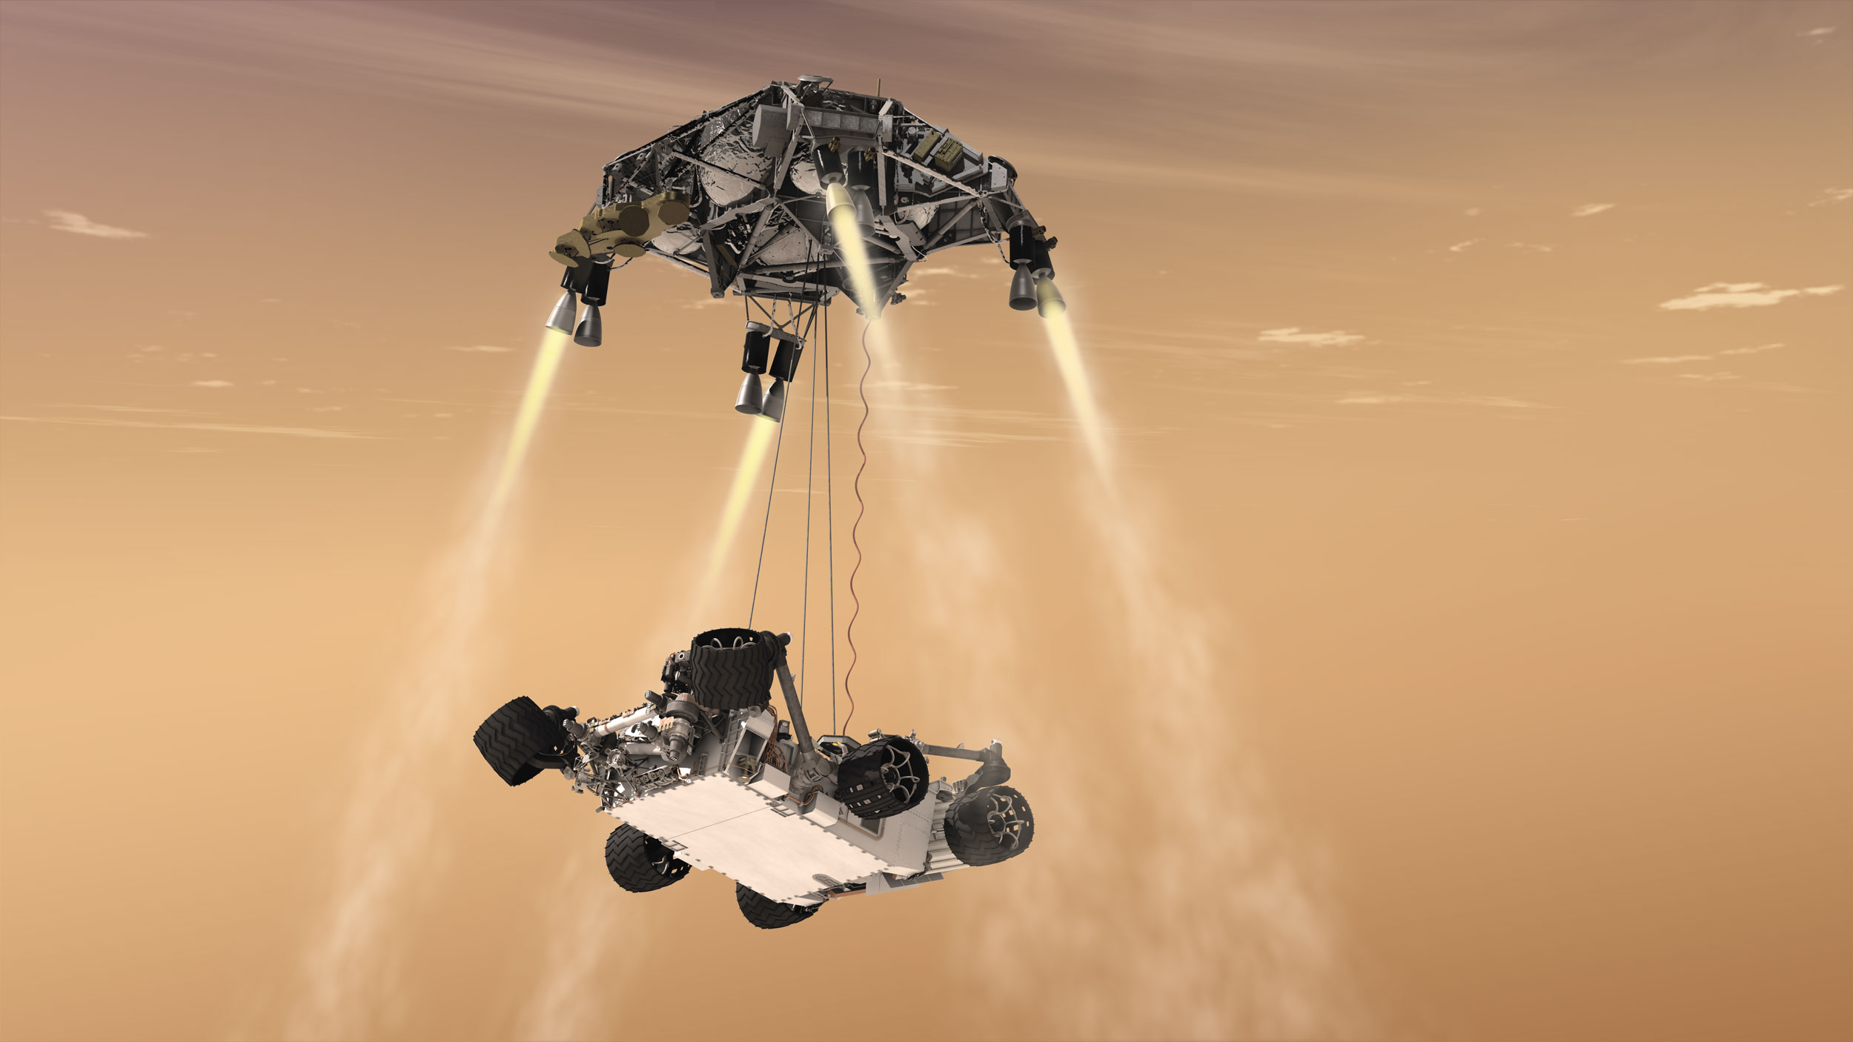
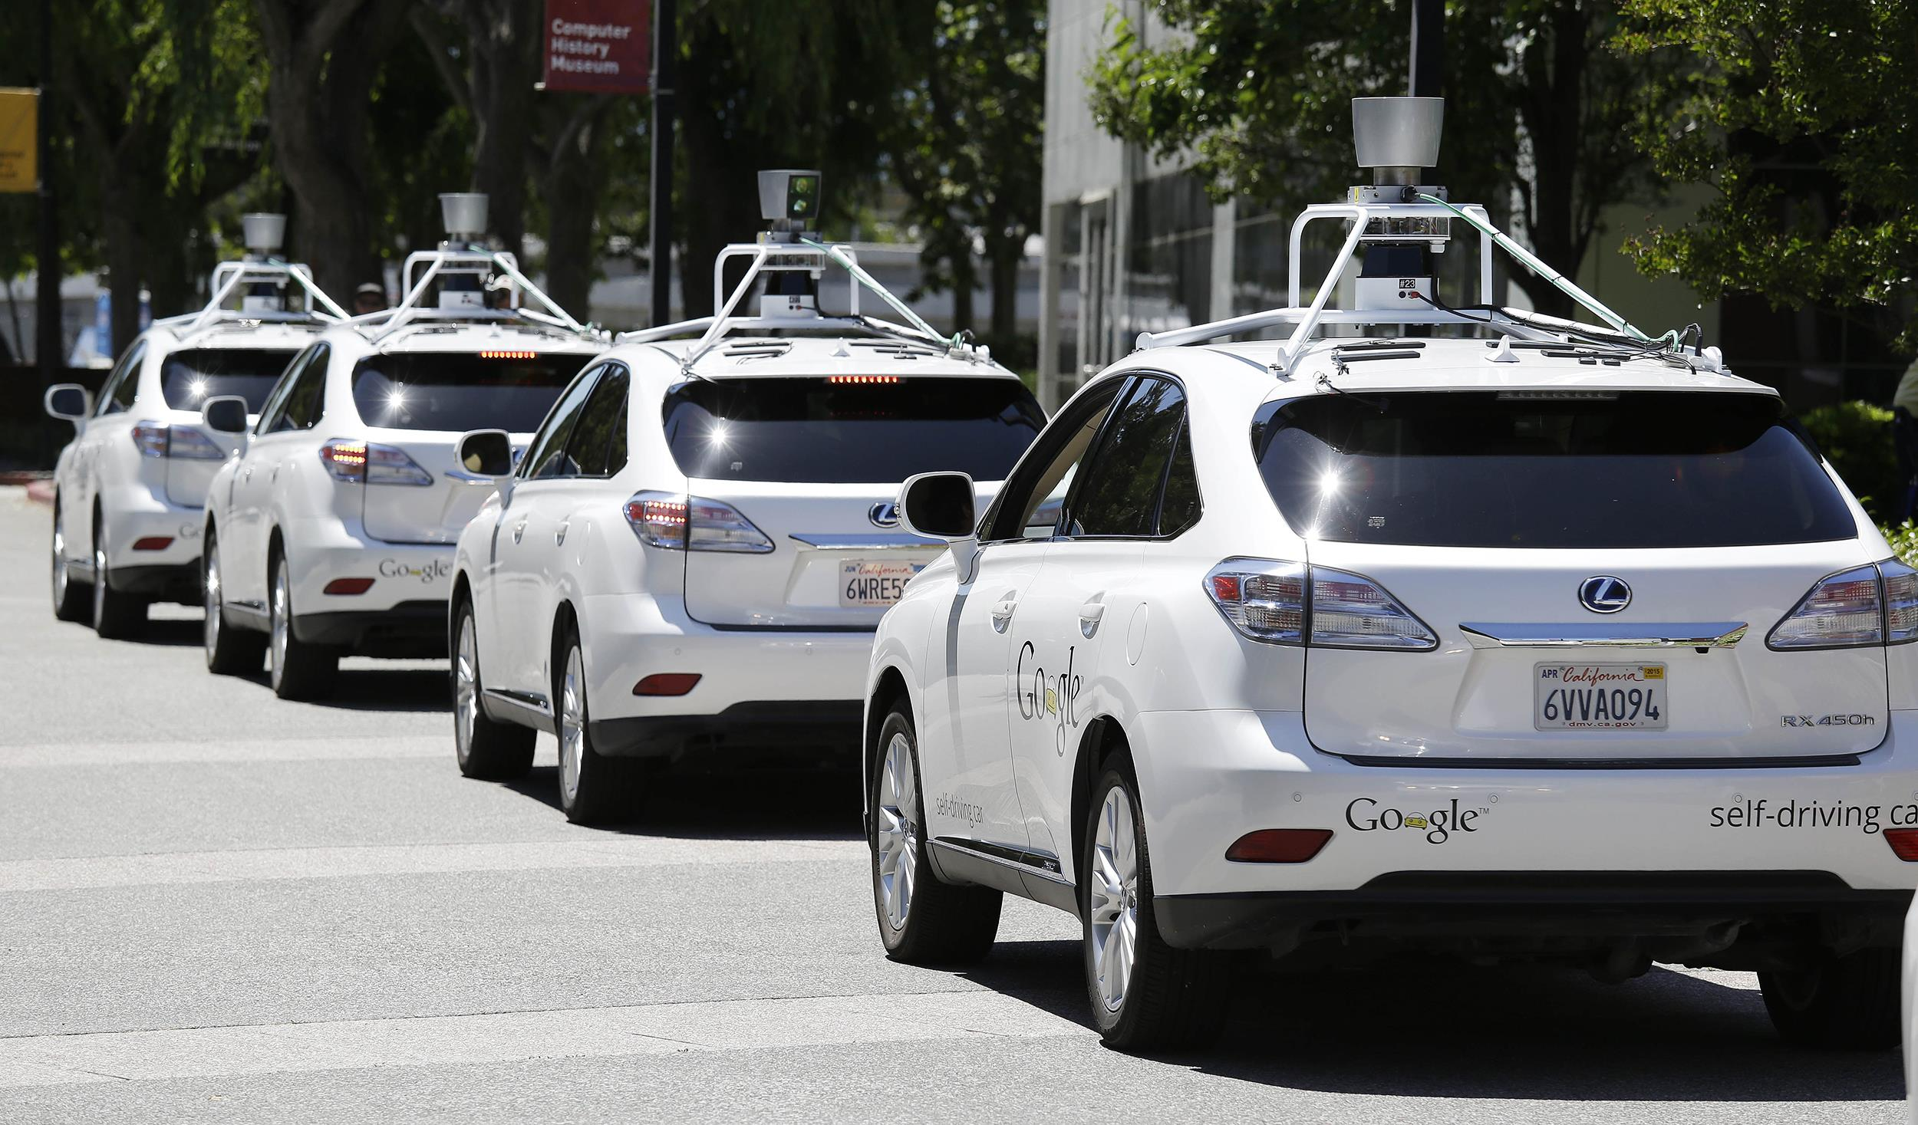
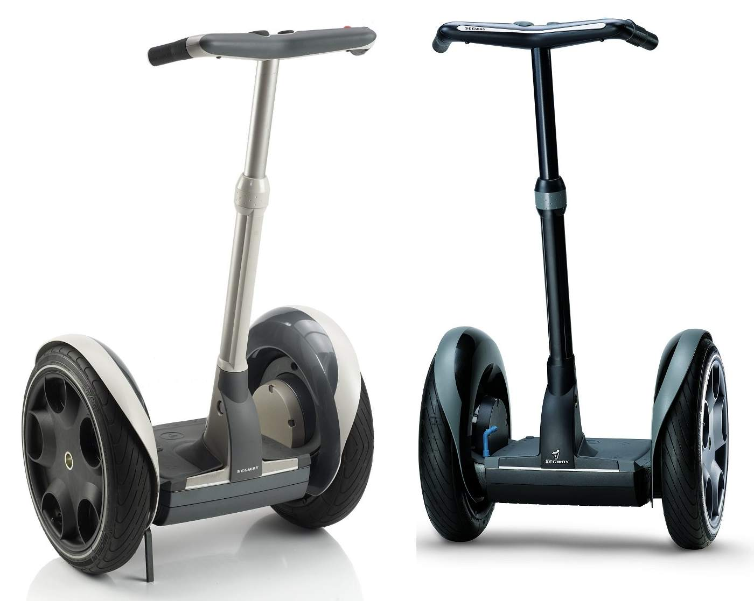
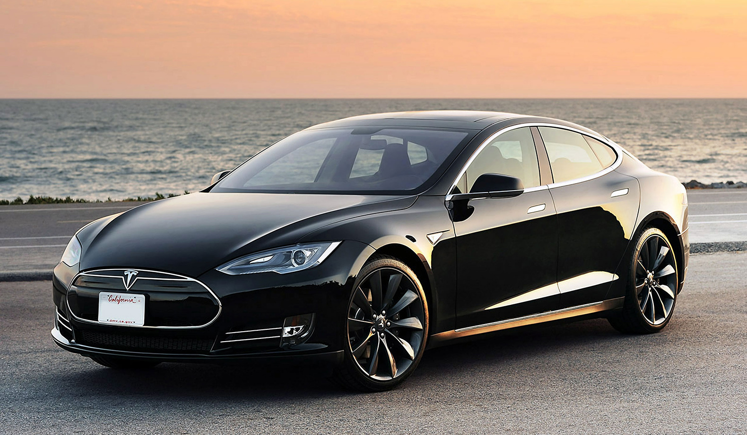
PID in the real world

Slide 18
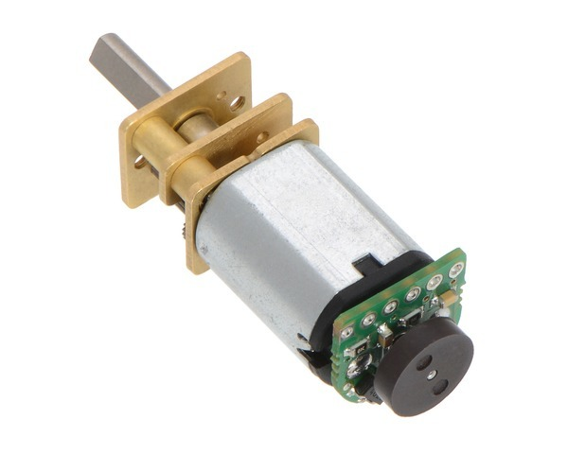
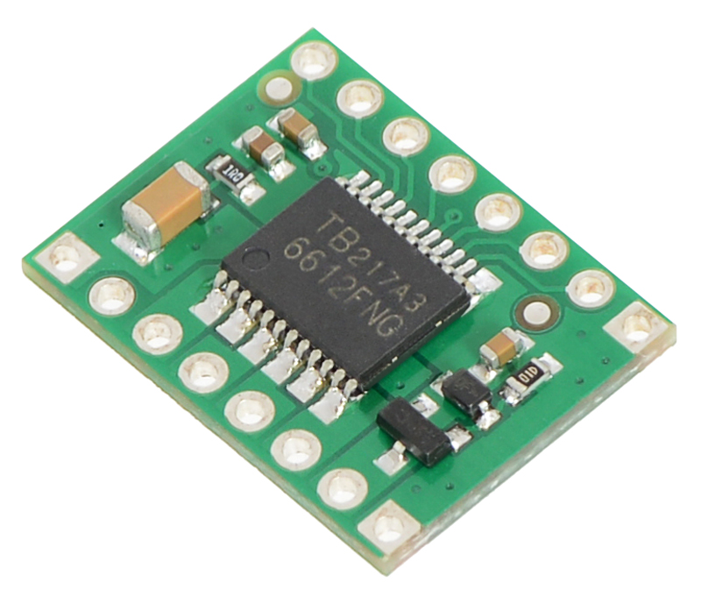
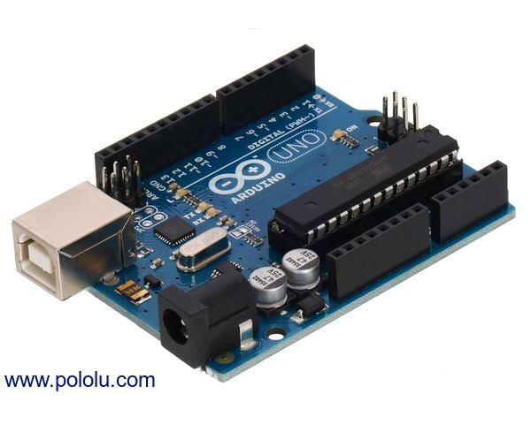
Next Time…
Hardware:
October 1st
Math and Code:
October 8th

Slide 19
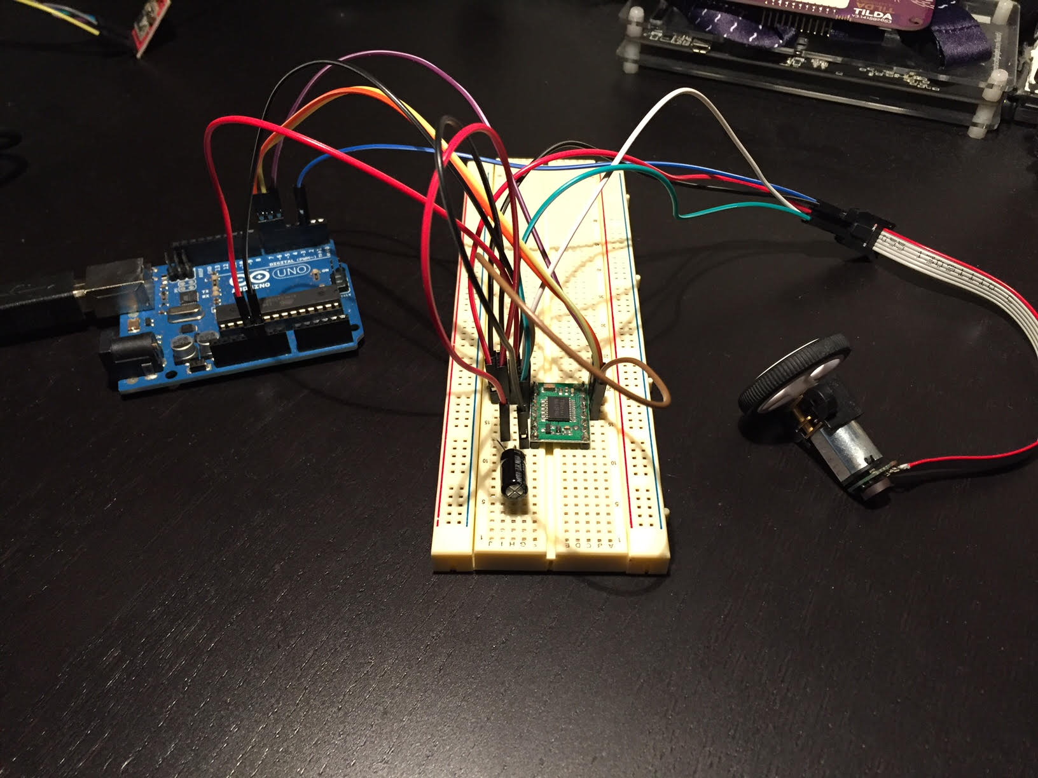
Next Time…

Slide 20
PID
Ara Kourchians

Slide 21
Physical
World
Control
Desired
World

Slide 22
Open Loop
Physical
World
Control
Desired
World
Notes:
Simple autonomous mode that follows a script
Sprinkler system on a timer
Motor + battery
You “trust” that it works and assume ideal conditions

Slide 23
Closed Loop
Physical
World
Control
Sensing
Desired
World
Notes:
Air Conditioners
Airplanes auto-pilot
Drones

Slide 24
??? Loop
Notes:
- Based on the previous definition, is this a closed or open loop system?

Slide 25
Closed Loop
X
Sensing

Slide 26
Closed Loop
X
Sensing
Control
Notes:
- Explain how the students observe where the robot is and come up with a control command to give the robot, but this has a problem….

Slide 27
Closed Loop
X
Sensing
Control
Notes:
This requires training, learning, ‘piloting’
Robot might not drive perfectly straight
Might slip, or be going uphill and will require the driver to manually add more power
So far, the driver has had to learn each robot.. and every robot is different

Slide 28
Some terminology
Motor
Encoder
State
Target
Error
Notes:
The story is different for autonomous mode

Slide 29
Autonomous Mode
State
Target
X
Error
Notes:
The story is different for autonomous mode

Slide 30
Autonomous Mode
autonomous.c
State
Target
X
Error

Slide 31
Autonomous Mode
autonomous.c
0
void go()
{
..
robot.drive(X);
..
}
X
Notes:
How do you actually write this in terms of motors and sensors?

Slide 32
Autonomous Mode
autonomous.c
0
void go()
{
..
robot.motors(100);
wait(1_SEC);
robot.motors(0); ..
}
X
Error
X+Error

Slide 33
Autonomous Mode
autonomous.c
0
void go()
{
..
robot.motors(100);
while(encoder < 1000)
{
encoder = robot.read();
}
robot.motors(0);
..
}
X
Error
X+Error
Notes:
You’re going to overshoot when you get to your goal (100% to 0%)

Slide 34
PID Control
0
Error

Slide 35
PID Control
Proportional
Present
P*Error
Integral
Past
I*Sum_of_Errors
Derivative
Future
D*(Error- Last_Error)
+
+
5
2
1
5
1
2
Notes:
PID controllers run in a loop, it’s iterative
Weights of each term depend on the system!
The P, I, and D terms are summed and used as the controller output

Slide 36
Position Control Using PID

Slide 37
PID Block Diagram
P
Error
I
+
Motor
Output
Target
+
+
Σ
-
+
State
D

Slide 38
PID Block Diagram
P
Error
I
+
Motor
Output
Target
+
+
Σ
-
+
State
D
Encoder

Slide 39
Proportional Control

Slide 40
Proportional Control
Motor = P * Error
0
Error

Slide 41
Proportional Control
Motor = P * Error
100 = 2 * 50
0
Error

Slide 42
Proportional Control
Motor = P * Error
20 = 2 * 10
0
Error

Slide 43
Proportional Control
Motor = P * Error
1 = 2 * 1
0
Error
Notes:
You may never reach it, or overshoot it
VERY system dependent ^
P term would be target distance dependent

Slide 44
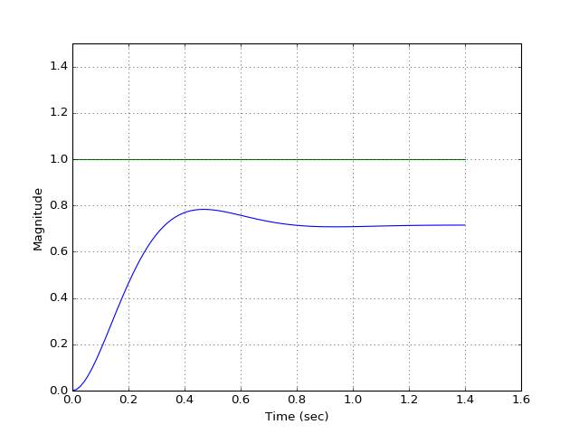
Proportional Control

Slide 45
Integral Control

Slide 46
Integral Control
Error_Sum = Error_Sum + Error
50 = 0 + 50
95 = 50 + 45
115 = 95 + 20
115 = 115 + 0
75 = 115 + -40
25 = 75 + -50
-35 = 25 + -60
-85 = -35 + -50
Motor = I * Error_Sum
25 = 0.5 * 50
48 = 0.5 * 95
56 = 0.5 * 115
56 = 0.5 * 115
38 = 0.5 * 75
13 = 0.5 * 25
-17 = 0.5 * -35
-43 = 0.5 * -85
0
Error
Notes:
You may never reach it, or overshoot it
VERY system dependent ^
P term would be target distance dependent

Slide 47
Integral Control
Error_Sum = Error_Sum + Error
50 = 0 + 50
95 = 50 + 45
115 = 95 + 20
115 = 115 + 0
75 = 115 + -40
25 = 75 + -50
-35 = 25 + -60
-85 = -35 + -50
Motor = I * Error_Sum
25 = 0.5 * 50
48 = 0.5 * 95
56 = 0.5 * 115
56 = 0.5 * 115
38 = 0.5 * 75
13 = 0.5 * 25
-17 = 0.5 * -35
-43 = 0.5 * -85
0
Error
Notes:
You may never reach it, or overshoot it
VERY system dependent ^
P term would be target distance dependent

Slide 48
Integral Control
Error_Sum = Error_Sum + Error
50 = 0 + 50
95 = 50 + 45
115 = 95 + 20
115 = 115 + 0
75 = 115 + -40
25 = 75 + -50
-35 = 25 + -60
-85 = -35 + -50
Motor = I * Error_Sum
25 = 0.5 * 50
48 = 0.5 * 95
56 = 0.5 * 115
56 = 0.5 * 115
38 = 0.5 * 75
13 = 0.5 * 25
-17 = 0.5 * -35
-43 = 0.5 * -85
0
Error
Notes:
You may never reach it, or overshoot it
VERY system dependent ^
P term would be target distance dependent

Slide 49
Integral Control
Error_Sum = Error_Sum + Error
50 = 0 + 50
95 = 50 + 45
115 = 95 + 20
115 = 115 + 0
75 = 115 + -40
25 = 75 + -50
-35 = 25 + -60
-85 = -35 + -50
Motor = I * Error_Sum
25 = 0.5 * 50
48 = 0.5 * 95
56 = 0.5 * 115
56 = 0.5 * 115
38 = 0.5 * 75
13 = 0.5 * 25
-17 = 0.5 * -35
-43 = 0.5 * -85
0
Notes:
You may never reach it, or overshoot it
VERY system dependent ^
P term would be target distance dependent

Slide 50
Integral Control
Error_Sum = Error_Sum + Error
50 = 0 + 50
95 = 50 + 45
115 = 95 + 20
115 = 115 + 0
75 = 115 + -40
25 = 75 + -50
-35 = 25 + -60
-85 = -35 + -50
Motor = I * Error_Sum
25 = 0.5 * 50
48 = 0.5 * 95
56 = 0.5 * 115
56 = 0.5 * 115
38 = 0.5 * 75
13 = 0.5 * 25
-17 = 0.5 * -35
-43 = 0.5 * -85
0
-Error
Notes:
You may never reach it, or overshoot it
VERY system dependent ^
P term would be target distance dependent

Slide 51
Integral Control
Error_Sum = Error_Sum + Error
50 = 0 + 50
95 = 50 + 45
115 = 95 + 20
115 = 115 + 0
75 = 115 + -40
25 = 75 + -50
-35 = 25 + -60
-85 = -35 + -50
Motor = I * Error_Sum
25 = 0.5 * 50
48 = 0.5 * 95
56 = 0.5 * 115
56 = 0.5 * 115
38 = 0.5 * 75
13 = 0.5 * 25
-17 = 0.5 * -35
-43 = 0.5 * -85
0
-Error
Notes:
You may never reach it, or overshoot it
VERY system dependent ^
P term would be target distance dependent

Slide 52
Integral Control
Error_Sum = Error_Sum + Error
50 = 0 + 50
95 = 50 + 45
115 = 95 + 20
115 = 115 + 0
75 = 115 + -40
25 = 75 + -50
-35 = 25 + -60
-85 = -35 + -50
Motor = I * Error_Sum
25 = 0.5 * 50
48 = 0.5 * 95
56 = 0.5 * 115
56 = 0.5 * 115
38 = 0.5 * 75
13 = 0.5 * 25
-17 = 0.5 * -35
-43 = 0.5 * -85
0
-Error
Notes:
You may never reach it, or overshoot it
VERY system dependent ^
P term would be target distance dependent

Slide 53
Integral Control
Error_Sum = Error_Sum + Error
50 = 0 + 50
95 = 50 + 45
115 = 95 + 20
115 = 115 + 0
75 = 115 + -40
25 = 75 + -50
-35 = 25 + -60
-75 = -35 + -40
Motor = I * Error_Sum
25 = 0.5 * 50
48 = 0.5 * 95
56 = 0.5 * 115
56 = 0.5 * 115
38 = 0.5 * 75
13 = 0.5 * 25
-17 = 0.5 * -35
-38 = 0.5 * -75
0
-Error
Notes:
You may never reach it, or overshoot it
VERY system dependent ^
P term would be target distance dependent

Slide 54
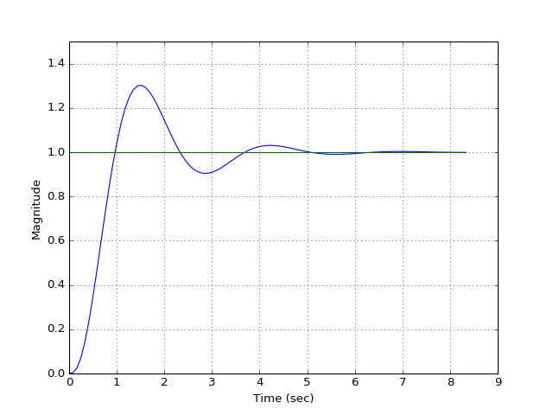
Integral Control

Slide 55
Derivative Control

Slide 56
Derivative Control
Motor = D* (Error – Last_Error)
= 0.5 * (50 – 0)
0
Error
Notes:
You may never reach it, or overshoot it
VERY system dependent ^
P term would be target distance dependent

Slide 57
Derivative Control
Motor = D* (Error – Last_Error)
25 = 0.5 * (50 – 0)
-5 = 0.5 * (40 – 50)
0
Error
Notes:
You may never reach it, or overshoot it
VERY system dependent ^
P term would be target distance dependent

Slide 58
Derivative Control
Motor = D* (Error – Last_Error)
25 = 0.5 * (50 – 0)
-5 = 0.5 * (40 – 50)
-2.5 = 0.5 * (35 – 40)
0
Error
Notes:
You may never reach it, or overshoot it
VERY system dependent ^
P term would be target distance dependent

Slide 59
Derivative Control
Motor = D* (Error – Last_Error)
25 = 0.5 * (50 – 0)
-5 = 0.5 * (40 – 50)
-2.5 = 0.5 * (35 – 40)
0 = 0.5 * (35 – 35)
0
Error
Notes:
You may never reach it, or overshoot it
VERY system dependent ^
P term would be target distance dependent

Slide 60
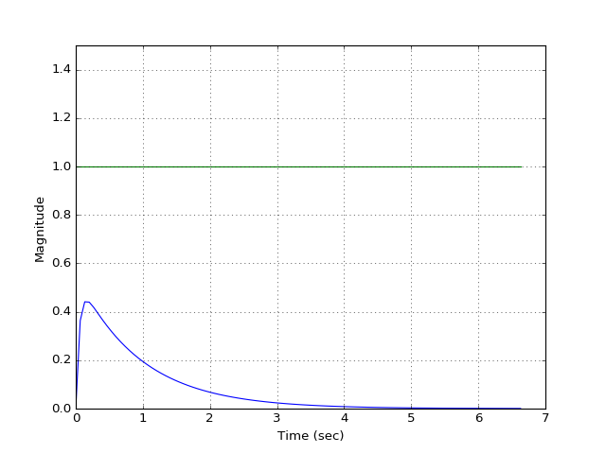
Derivative Control

Slide 61
PID Plot Terminology

Slide 62
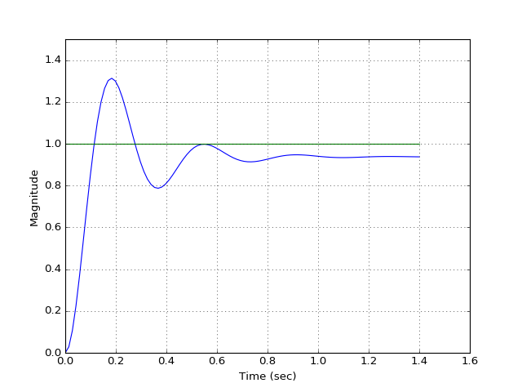
PID Plot Terminology
Overshoot
Steady-State Error
Rise Time
Settling Time

Slide 63
P = 50

Slide 64
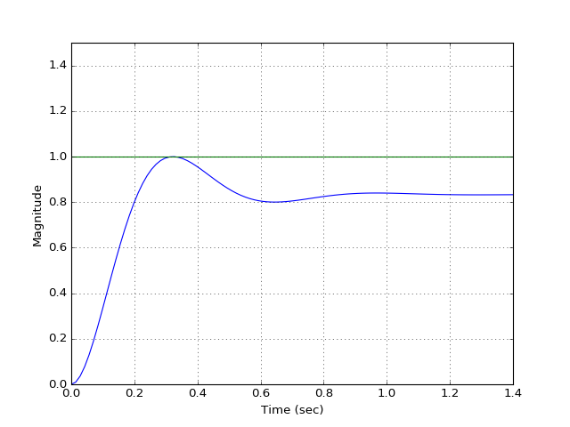
P = 100

Slide 65
P = 300

Slide 66
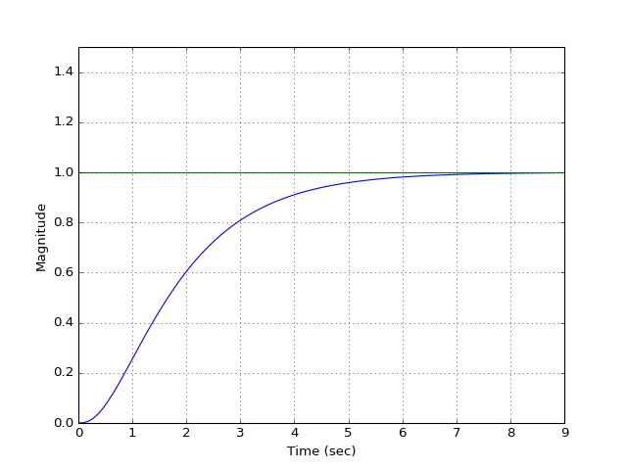
I = 10

Slide 67
I = 50

Slide 68
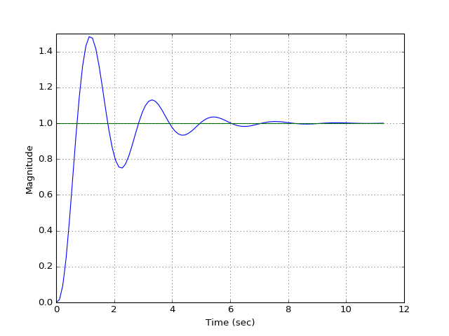
I = 80

Slide 69
D = 10

Slide 70
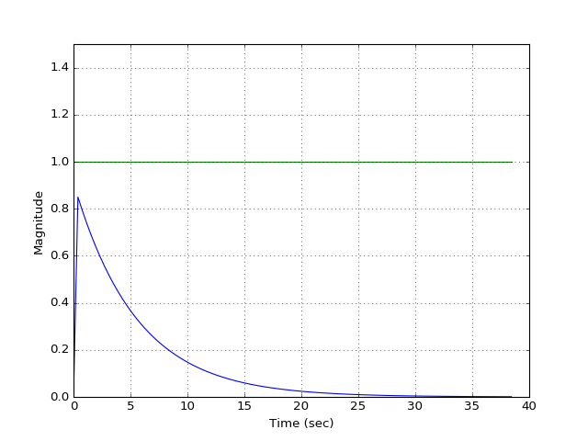
D = 100

Slide 71
PID Tuning Methods

Slide 72
PID Plot Terminology
Overshoot
Steady-State Error
Rise Time
Settling Time

Slide 73
PID Tuning Methods
Parameter Increase | Rise Time | Overshoot | Settling Time | Steady-State Error
Kp |  |  | Small Change
Ki
Kd | Small Change |  |  | Small Change

Slide 74
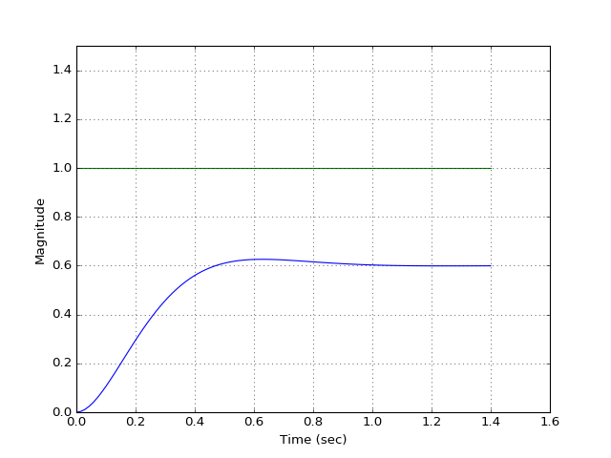
P = 30, I = 0, D = 0

Slide 75
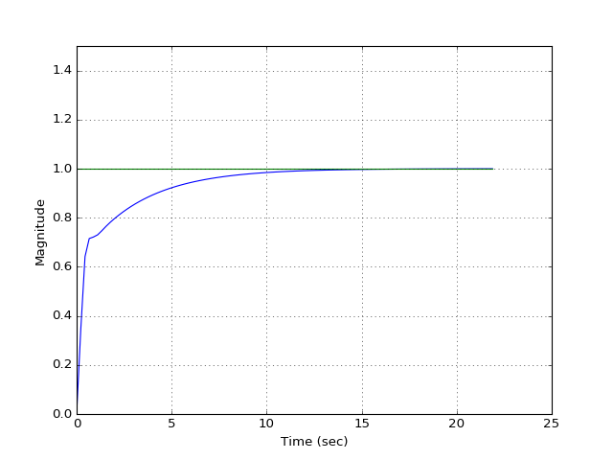
P = 30, I = 15, D = 0

Slide 76
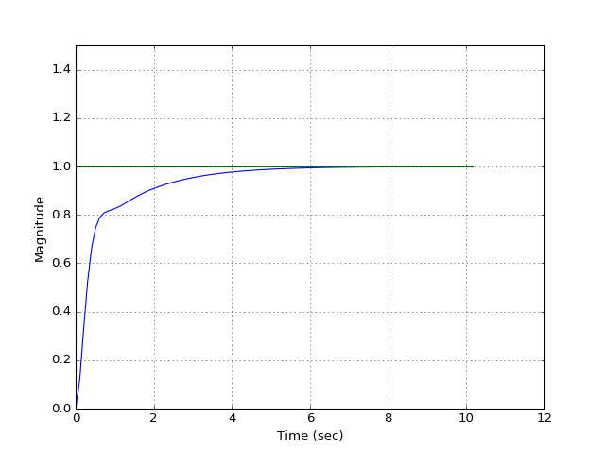
P = 30, I = 30, D = 0

Slide 77
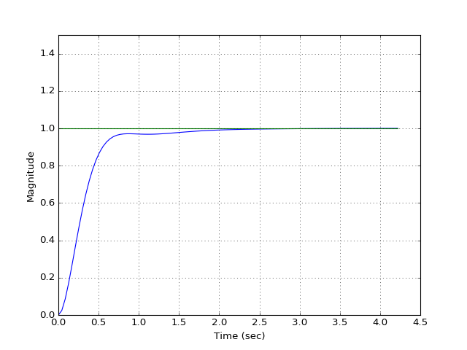
P = 30, I = 60, D = 0

Slide 78
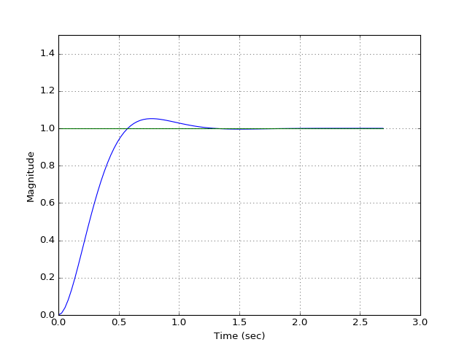
P = 30, I = 80, D = 0

Slide 79
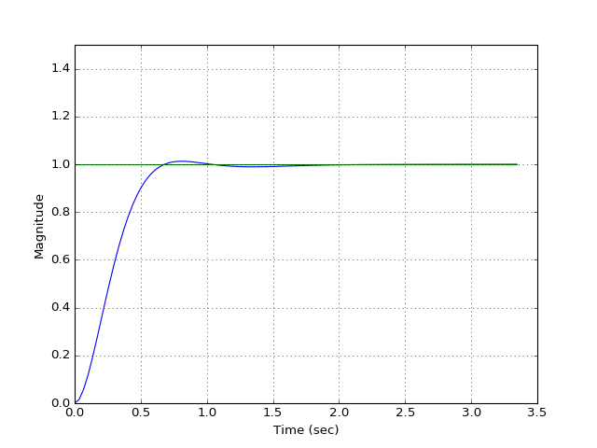
P = 30, I = 70, D = 0

Slide 80
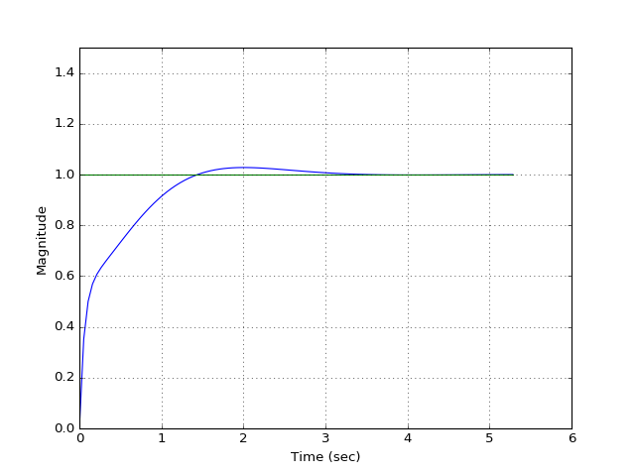
P = 30, I = 70, D = 10

Slide 81
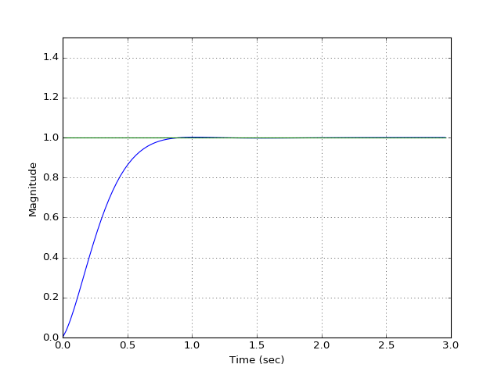
P = 30, I = 70, D = 1

Slide 82
DEMO!

Slide 83
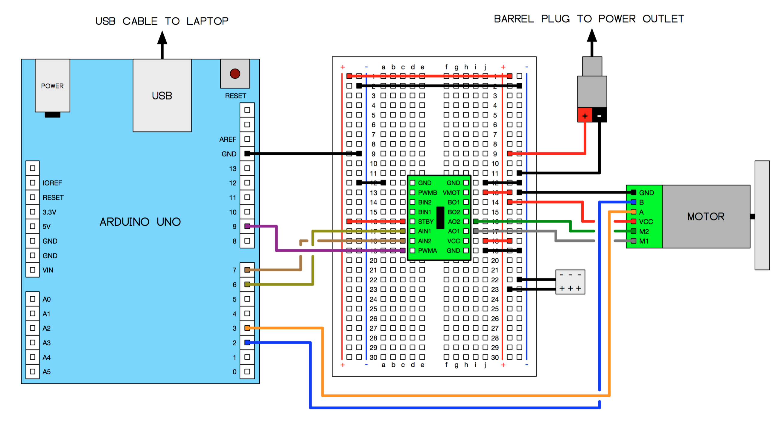
Hardware

