Slide 1
Introduction to Model Fitting and Outbreaks
Cameline N. Orlendo
18th – 20th February 2024

Slide 2
Objectives of the module
Explore the basic principle behind model fitting and parameter estimation.
2. Introduction to parameter estimation techniques (Frequentist and Bayesian approaches) & other methods.
3. Use simple model fitting methods to estimate epidemiological quantities of mathematical models taught in 2.

Slide 3
Introduction to the concept of model fitting in disease modeling

Slide 4
Goal of Model fitting and parameter estimation
Model fitting in disease modeling is a critical step in the development and validation of mathematical models used to understand the dynamics of infectious diseases.

Slide 5
Goal of Model fitting and parameter estimation
Mathematical Models: Disease models are typically formulated using mathematical equations that describe the transmission dynamics of the disease within a population.
RECAP: Why do we need models?
To understand disease dynamics
Predict disease outcomes
Assess intervention strategies
Inform policy decisions
Design public health interventions
Research and development
Risk Assessment and Preparedness

Slide 6


Goal of Model fitting and parameter estimation
Process Model
Parameters
Where do parameter values come from?
$$γ$$
S
I
$$λ$$
Notes:
Parameters may be known from prior research or may need to be estimated from data.

Slide 7
Goal of Model fitting and parameter estimation
Parameters: Mathematical models contain parameters that govern the behavior of the system, such as transmission rates, recovery rates, and population mixing patterns. These parameters may be known from prior research or may need to be estimated from data
The goal for model fitting is to use statistical tools to connect theoretical models to observed real-life data in order to answer specific questions.
Notes:
This process allows researchers to assess the model's ability to accurately capture the observed patterns of disease transmission and to make predictions about future trends and the potential impact of interventions.

Slide 8
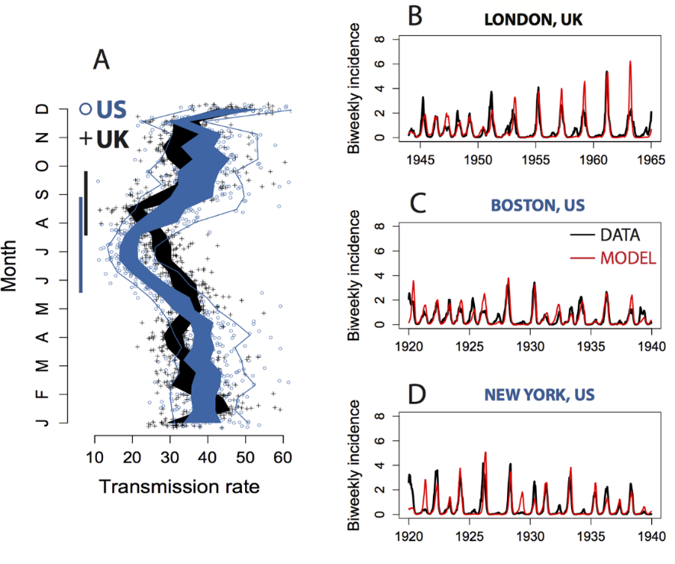
Goal of Model fitting and parameter estimation
To understand the epidemiology of measles prior to vaccine introduction, a simple SIR model was fitted to estimate the monthly transmission parameter shown in figure A.

Slide 9
Goal of Model fitting and parameter estimation
The advantage of estimating interpretable parameters is that fitted models can serve as tools to gain insight into the underlying mechanisms to evaluate different control measures and for prediction and forecasting

Slide 10
Goal of Model fitting and parameter estimation
Some key concepts
The model fitting process involves adjusting the model's parameters to minimize the discrepancy between model predictions and observed data.
This is typically done using statistical techniques such as maximum likelihood estimation (Frequentist approach) or Bayesian inference
During model fitting, an objective function (loss function) is defined to quantify the difference between the model predictions and the observed data. Common objective (loss) functions include the sum of squared errors or the likelihood function.

Slide 11
Goal of Model fitting and parameter estimation
Some key concepts
Parameter Estimation: Model fitting algorithms search for the set of parameter values that optimize the objective(loss) function, resulting in the best fit between the model and the data. These algorithms may use optimization techniques such as gradient descent, genetic algorithms, or Markov chain Monte Carlo (MCMC) sampling.
After fitting the model to the data, it is essential to validate the model's performance using independent datasets or cross-validation techniques. This helps assess the model's ability to generalize to new data and evaluate its predictive accuracy.

Slide 12
Goal of Model fitting and parameter estimation
Some key concepts
Model fitting also provides estimates of parameter uncertainty, which is essential for making reliable predictions and assessing the robustness of model projections.
In some cases, multiple competing models may be considered, and model selection techniques are used to identify the most appropriate model based on criteria such as goodness of fit, parsimony, and predictive performance.
Notes:
Overall, model fitting plays a crucial role in calibrating disease models to real-world data, enabling researchers to better understand disease dynamics, assess the effectiveness of control measures, and inform public health decision-making.

Slide 13
Goal of Model fitting and parameter estimation
Mathematical Models: Disease models are typically formulated using mathematical equations that describe the transmission dynamics of the disease within a population.
Statistical Models: Characterize data and attempts at estimating the probabilistic future behavior of a system based on its past behavior.
Mathematical models determine how the system changes from one state to the other and describes interdependencies of the variables while statistical models on the other hand estimate the probabilistic future behavior of system based on data collected from its past behavior.

Slide 14
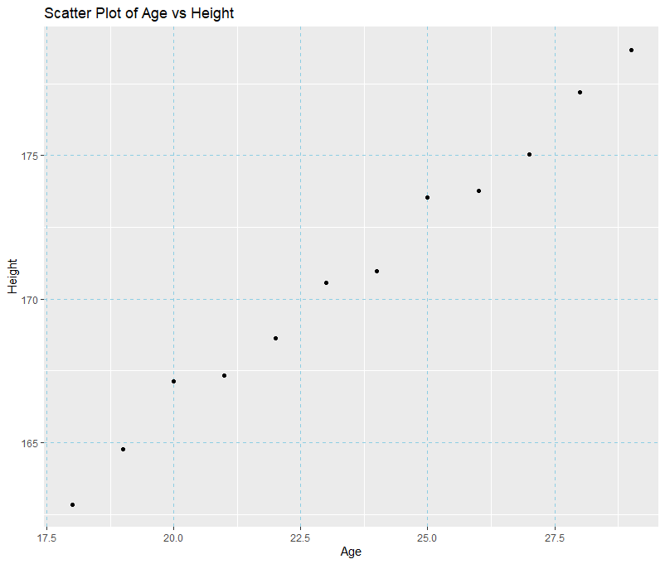
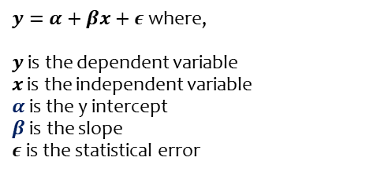
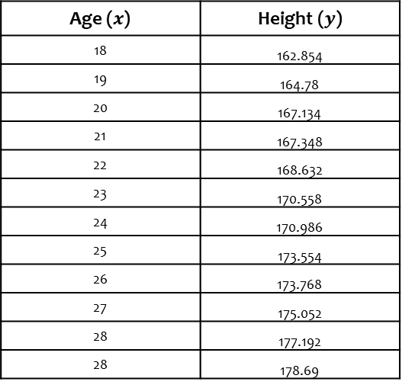
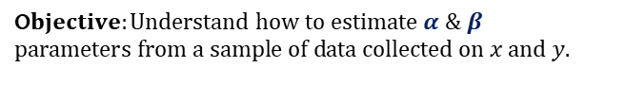
Goal of Model fitting and parameter estimation
Example: Simple model
Age ($x$) | Height ($y$)
18 | 162.854
19 | 164.78
20 | 167.134
21 | 167.348
22 | 168.632
23 | 170.558
24 | 170.986
25 | 173.554
26 | 173.768
27 | 175.052
28 | 177.192
28 | 178.69
$y=α+βx+ε$ where,
$y$ is the dependent variable
$x$ is the independent variable
$α$is the y intercept
$β$ is the slope
$ε$is the statistical error
O$bjective:Understand how to estimate α \& β$
$$parameters from a sample of data collected on x and y.$$
Notes:
## * objective: understand how to estimate a & b parameters from a sample of ## data collected on x and y.

Slide 15
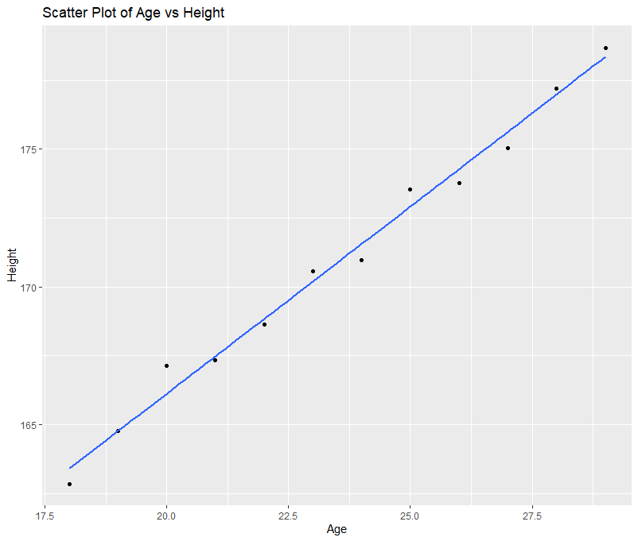
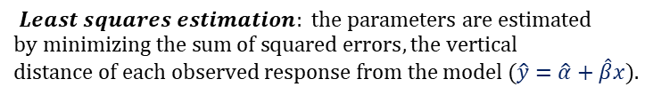
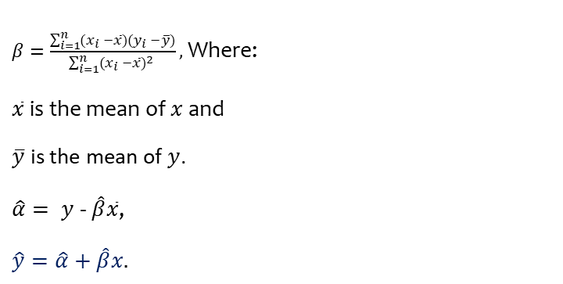
Goal of Model fitting and parameter estimation
Simple Linear model example
$$Least squares estimation: the parameters are estimated$$
$$by minimizing the sum of squared errors, the vertical$$
$distance of each observed response from the model (\hat{y}=\hat{α}+\hat{β}x).$
$β=\frac{\sum_{i=1}^{n}{(x_{i} −\overline{x}})(y_{i} −\overline{y})}{\sum_{i=1}^{n}{(x_{i} −\overline{x}})^{2} },$Where:
$\overline{x}$ is the mean of $x$ and
$\overline{y}$ is the mean of $y$.
$\hat{α}= y$ - $\hat{β}\overline{x}$,
$$\hat{y}=\hat{α}+\hat{β}x.$$
Notes:
## * objective: understand how to estimate a & b parameters from a sample of ## data collected on x and y.

Slide 16
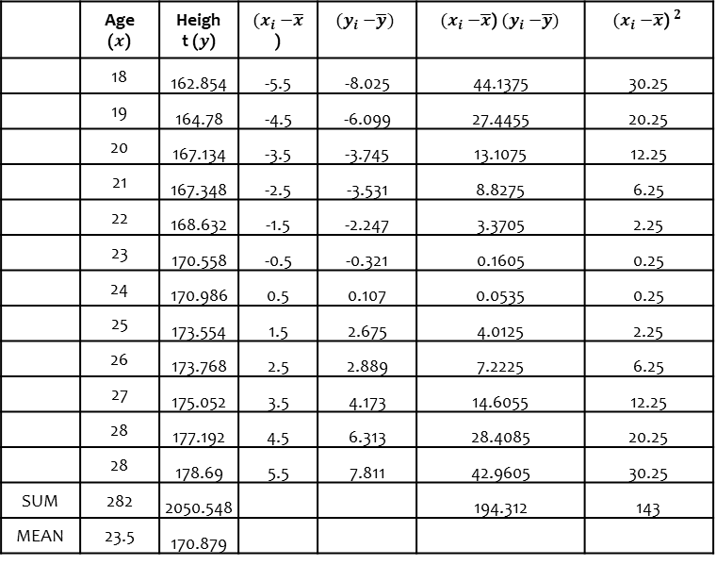
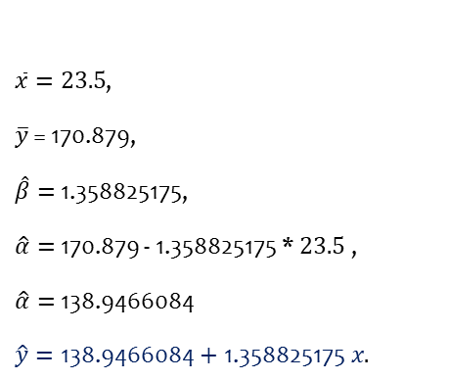
Goal of Model fitting and parameter estimation
Simple Linear model example
 | Age ($x$) | Height ($y$) | ${(x}_{i} −\overline{x}$) | $${(y}_{i} −\overline{y})$$ | ${(x}_{i} −\overline{x}$) ${(y}_{i} −\overline{y})$ | $${{(x}_{i} −\overline{x}\text{)} }^{2}$$
 | 18 | 162.854 | -5.5 | -8.025 | 44.1375 | 30.25
 | 19 | 164.78 | -4.5 | -6.099 | 27.4455 | 20.25
 | 20 | 167.134 | -3.5 | -3.745 | 13.1075 | 12.25
 | 21 | 167.348 | -2.5 | -3.531 | 8.8275 | 6.25
 | 22 | 168.632 | -1.5 | -2.247 | 3.3705 | 2.25
 | 23 | 170.558 | -0.5 | -0.321 | 0.1605 | 0.25
 | 24 | 170.986 | 0.5 | 0.107 | 0.0535 | 0.25
 | 25 | 173.554 | 1.5 | 2.675 | 4.0125 | 2.25
 | 26 | 173.768 | 2.5 | 2.889 | 7.2225 | 6.25
 | 27 | 175.052 | 3.5 | 4.173 | 14.6055 | 12.25
 | 28 | 177.192 | 4.5 | 6.313 | 28.4085 | 20.25
 | 28 | 178.69 | 5.5 | 7.811 | 42.9605 | 30.25
SUM | 282 | 2050.548 |  |  | 194.312 | 143
MEAN | 23.5 | 170.879
$\overline{x}=23.5$,
$\overline{y}$ = 170.879,
$\hat{β}=$1.358825175,
$\hat{α}=$170.879 - 1.358825175 * $23.5$ ,
$\hat{α}=$138.9466084
$$\hat{y}=\text{138.9466084}+\text{1.358825175} x.$$
Notes:
## * objective: understand how to estimate a & b parameters from a sample of ## data collected on x and y.

Slide 17
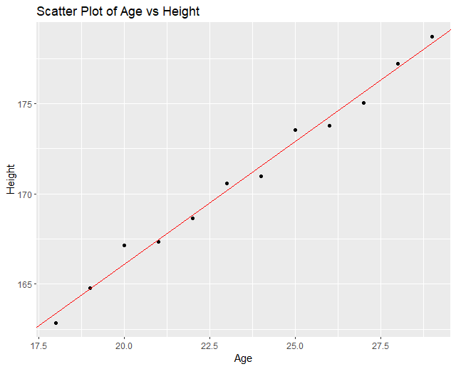
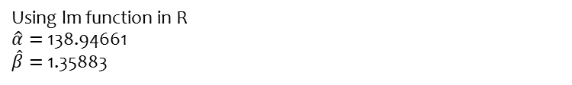
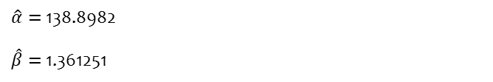
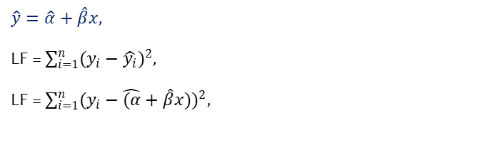
Goal of Model fitting and parameter estimation
Simple Linear model example
$$Least squares estimation: the parameters are estimated$$
$$by minimizing the sum of squared errors, the vertical$$
$distance of each observed response from the model (\hat{y}=\hat{α}+\hat{β}x).$
$$\hat{y}=\hat{α}+\hat{β}x,$$
LF = $\sum_{i=1}^{n}{(y_{i}−\hat{y_{i}}})^{2},$
LF = $\sum_{i=1}^{n}{(y_{i}−\hat{(α}+\hat{β}x)})^{2},$
$\hat{α}=$138.8982
$\hat{β}=$1.361251
Using lm function in R
$\hat{α}=$138.94661
$\hat{β}=$1.35883
Tutorial 1-R script

Slide 18
Goal of Model fitting and parameter estimation
Estimation methods like maximum likelihood, method of moments, or least squares (which is the same as minimum mean squared error - minimizing the total of squared residuals is the same as minimising the mean of them) are ways of estimating the values of parameters of a model, given the data available to us.
Regression analysis is a form of statistical model. Hence there are no differences or similarities as such. An estimation method is needed to fit your regression model. Hence you cannot have a regression model without an "estimation theory" of some sort.

Slide 19
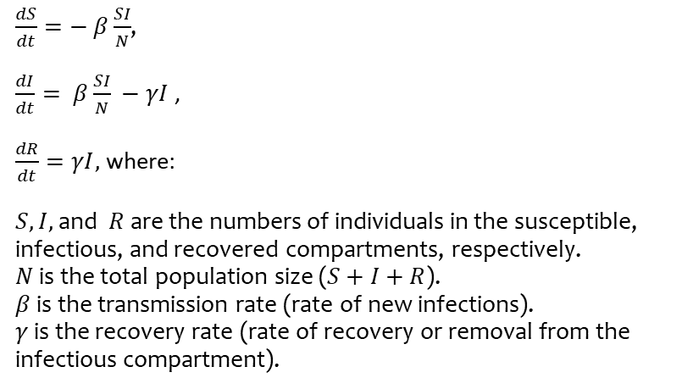
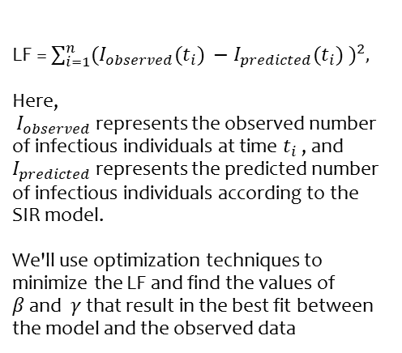
Goal of Model fitting and parameter estimation
Example 2: Least squares estimation to fit a simple SIR disease model to observed data.
$\frac{dS}{dt}=− β\frac{SI}{N}$,
$\frac{dI}{dt}= β\frac{SI}{N} −γI$ ,
$\frac{dR}{dt}=γI,$ where:
$S, I,$and $R$are the numbers of individuals in the susceptible, infectious, and recovered compartments, respectively.
$N$ is the total population size ($S+I+R$).
$β$ is the transmission rate (rate of new infections).
$γ$ is the recovery rate (rate of recovery or removal from the infectious compartment).
LF = $\sum_{i=1}^{n}{(I_{observed}(t_{i}) −I_{predicted}(t_{i}) })^{2},$
Here,
$I_{observed}$ represents the observed number of infectious individuals at time $t_{i}$ ​, and $I_{predicted}$represents the predicted number of infectious individuals according to the SIR model.
We'll use optimization techniques to minimize the LF and find the values of
$β$ and $γ$ that result in the best fit between the model and the observed data
Notes:
Our objective function will be the sum of squared differences between the observed and predicted numbers of infectious individuals over time. Mathematically, it can be expressed as shown on the slide.

Slide 20
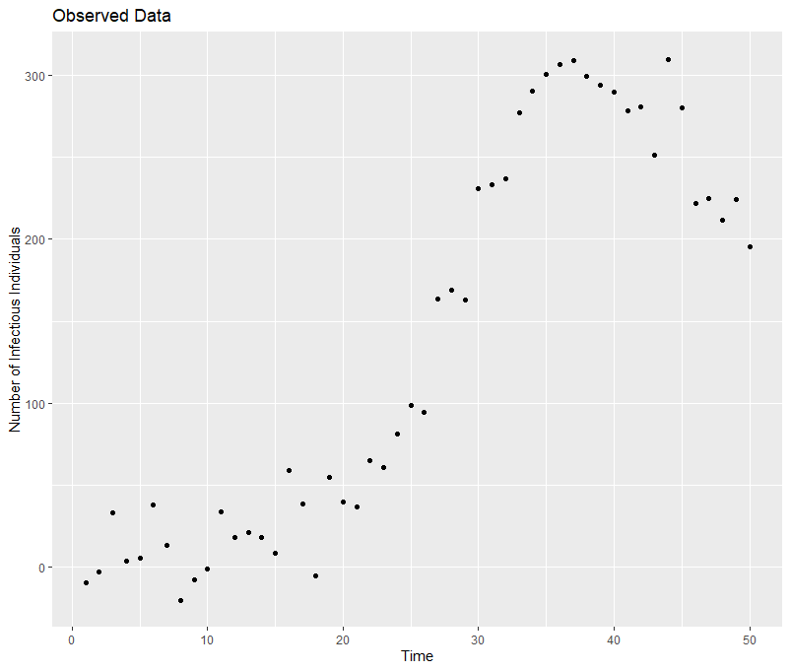
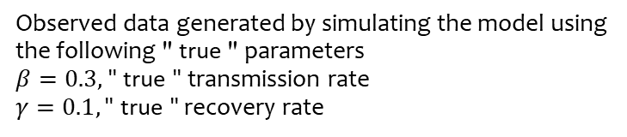

Goal of Model fitting and parameter estimation
Example2: Least squares estimation to fit a simple SIR disease model to observed data.
$\frac{dS}{dt}=− β\frac{SI}{N}$,
$\frac{dI}{dt}= β\frac{SI}{N} −γI$ ,
$\frac{dR}{dt}=γI,$ where:
$N= 1000,$Total population
$$S=N−1,$$
$$I\left(0\right)=1$$
R$\left(0\right)=0$
Observed data generated by simulating the model using the following " true " parameters
$β=0.3,$" true " transmission rate
$γ=0.1,\text{" }\text{true}\text{ "}$ recovery rate
Tutorial 2-R script

Slide 21
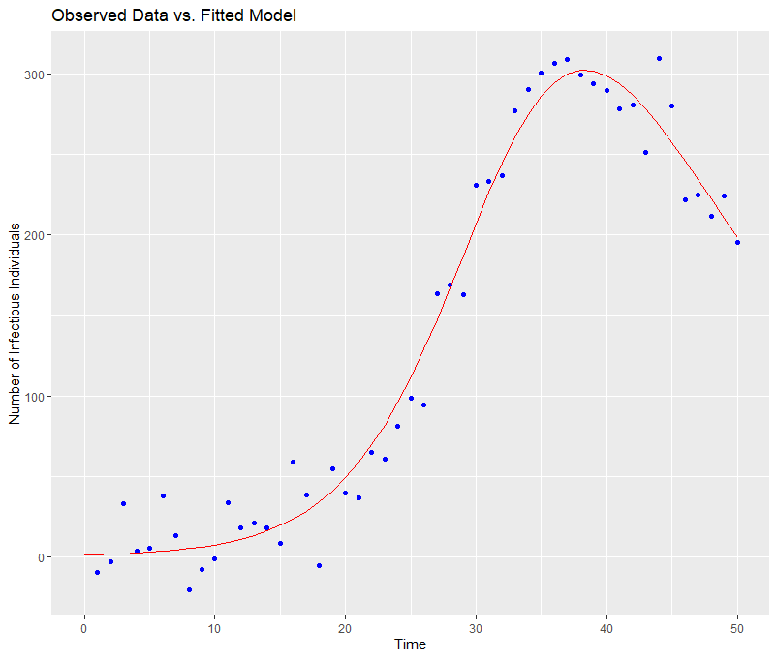
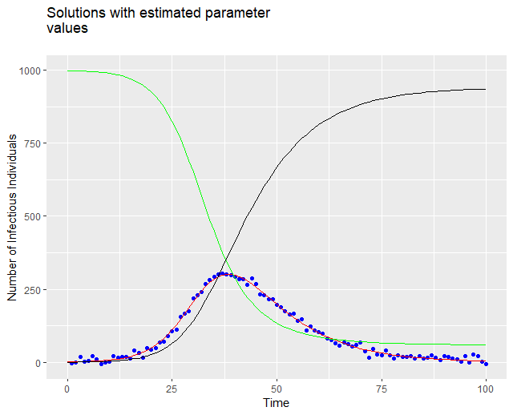

Goal of Model fitting and parameter estimation
Example2: Least squares estimation to fit a simple SIR disease model to observed data.
$\frac{dS}{dt}=− β\frac{SI}{N}$,
$\frac{dI}{dt}= β\frac{SI}{N} −γI$ ,
$\frac{dR}{dt}=γI,$ where:
$N= 1000,$Total population
$$S=N−1,$$
$$I\left(0\right)=1$$
R$\left(0\right)=0$
$\hat{β}=0.29963103,$(estimated) transmission rate
$\hat{γ}=0.09934246,$(estimated) recovery rate
Tutorial 2-R script

Slide 22
Statistical Inference
(Frequentist parameter estimation)

Slide 23
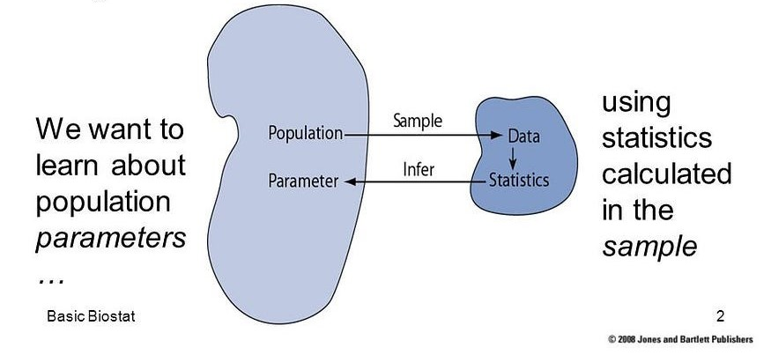
Parameter estimation
Statistical inference: the process of using data analysis techniques to infer properties of an underlying probability distribution based on sample data.

Slide 24
Statistical Inference (Frequentist parameter estimation)
Parametric inference: assumes that the data follow a specific parametric distribution, characterized by a finite number of parameters.
Example: estimate prevalence of disease by binomial distribution with unknown
Non-parametric inference: makes minimal assumptions about the underlying distribution of the data, allowing for greater flexibility and robustness.
Example: estimate median parasite density from experimental data
Semi-parametric inference: combines elements of both parametric and nonparametric approaches, allowing for more flexible modeling while still utilizing some parametric assumptions.
Example: estimate time to death with regression parameter for covariates and
unspecified baseline hazard functions (Cox proportional hazard)

Slide 25
Parameter estimation : paradigms of statistical inference
 | Frequentist Paradigm: | Bayesian Paradigm:
Focus | Emphasizes the long-run properties of estimators and tests based on repeated sampling from a fixed population | Incorporates prior beliefs and updates them with observed data to obtain posterior distributions.
Parameter estimation | parameters are considered fixed but unknown. Estimation involves finding a single point estimate of the parameter that maximizes the likelihood function. | Parameters are treated as random variables with probability distributions representing uncertainty.
Interpretation | Point estimates obtained from frequentist methods represent a single value believed to be close to the true parameter value, with uncertainty typically quantified through confidence intervals. | Provides full probability distributions for parameters, allowing for a comprehensive assessment of uncertainty.
Assumption | Rely on assumptions such as random sampling, large sample sizes, and the asymptotic behavior of estimators. | Require specification of prior distributions

Slide 26
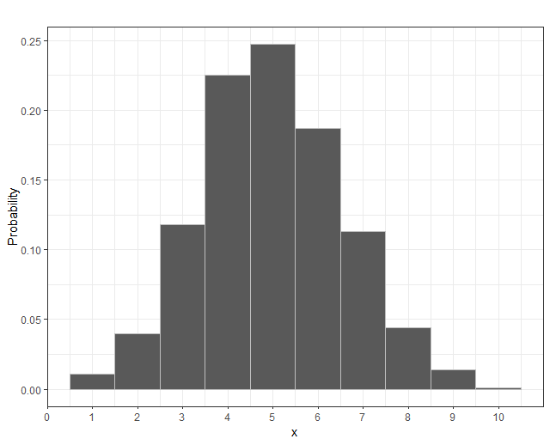
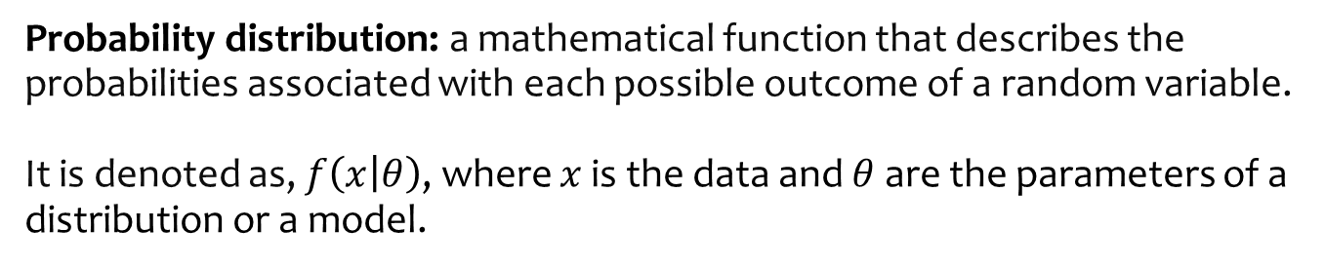
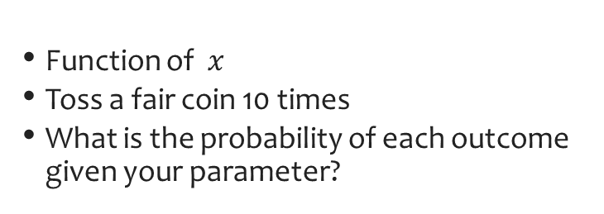
Statistical Inference (Frequentist parameter estimation)
Probability distribution: a mathematical function that describes the probabilities associated with each possible outcome of a random variable.
It is denoted as, $f\left(x | θ\right)$, where $x$ is the data and $θ$are the parameters of a distribution or a model.
Example: PDF, $f(x|θ)=\left({n \atop x}\right)({θ)}^{x}({1−θ)}^{n−x}$
Function of $x$
Toss a fair coin 10 times
What is the probability of each outcome given your parameter?

Slide 27
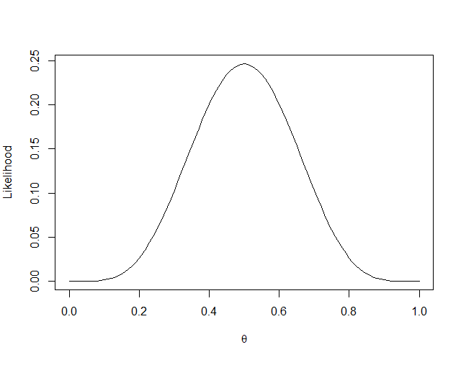
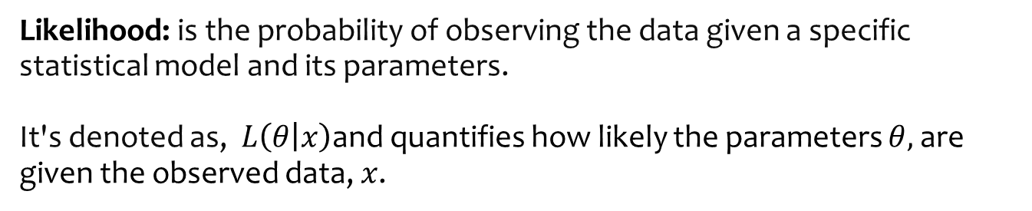
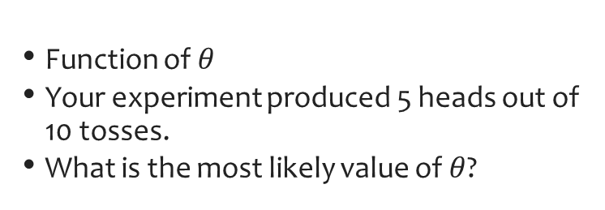
Statistical Inference (Frequentist parameter estimation)
Likelihood: is the probability of observing the data given a specific statistical model and its parameters.
It's denoted as, $L\left(θ | x\right)$and quantifies how likely the parameters $θ,$ are given the observed data, $x$.
Example: Likelihood, $L\left(θ | x\right)= \left({n \atop x}\right)({θ)}^{x}({1−θ)}^{n−x}$
Function of $θ$
Your experiment produced 5 heads out of 10 tosses.
What is the most likely value of $θ$?

Slide 28
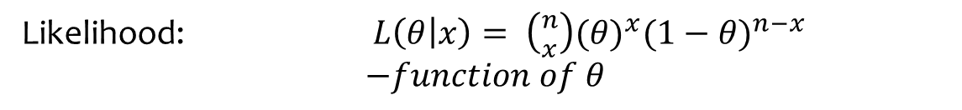
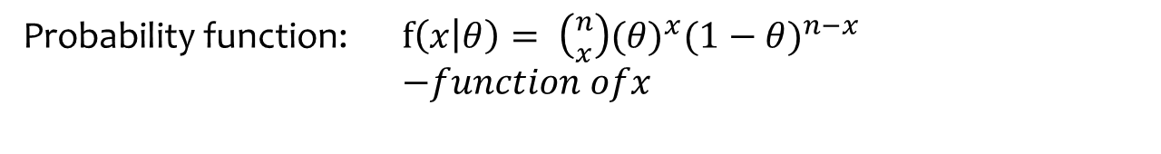
Statistical Inference (Frequentist parameter estimation)
Likelihood:
L(parameter | data) = p(data | parameter)
Not a probability distribution function of x
Likelihood: $L\left(θ | x\right)= \left({n \atop x}\right)({θ)}^{x}({1−θ)}^{n−x}$
$$−function of θ$$
Probability function: $f\left(x | θ\right)= \left({n \atop x}\right)({θ)}^{x}({1−θ)}^{n−x}$
$−function ofx$

Slide 29
Statistical Inference (Frequentist parameter estimation)
Likelihood:
We don’t know true prevalence
Different stakeholders may have different opinions about what the HIV prevalence is
What do we do?
A prevalence study!
28 out of 100 are infected

Slide 30
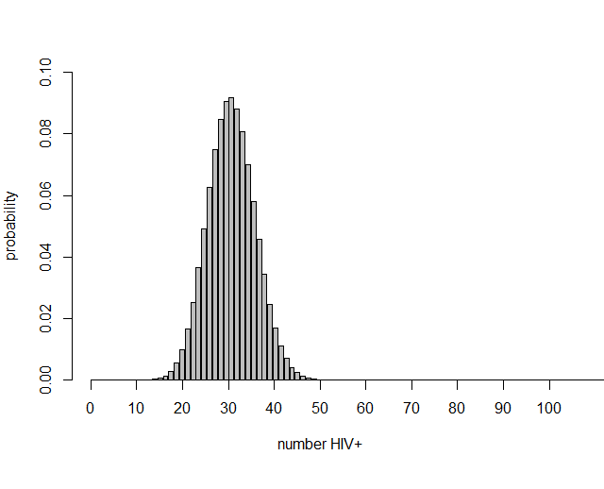
Statistical Inference (Frequentist parameter estimation)
In a population of 1,000,000 people with a true HIV prevalence of 28%, the probability distribution of number of positive individuals if 100 are sampled:
$f(x)=\left({100 \atop x}\right)({0.28)}^{x}({1−0.28)}^{100−x}$

Slide 31
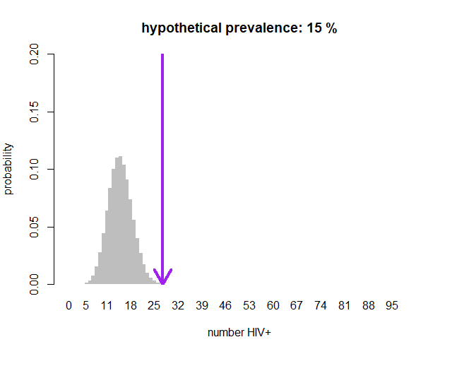
Statistical Inference (Frequentist parameter estimation)
In a population of 1,000,000 people with a true HIV prevalence of 28%, the probability distribution of number of positive individuals if 100 are sampled:
$f(15)=\left({100 \atop 15}\right)({0.28)}^{15}({1−0.28)}^{100−15}=0.0003528457$

Slide 32
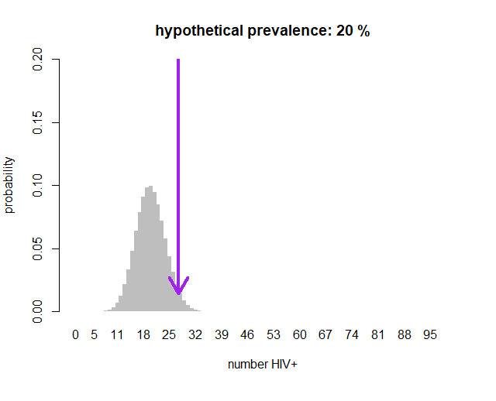
Statistical Inference (Frequentist parameter estimation)
In a population of 1,000,000 people with a true HIV prevalence of 28%, the probability distribution of number of positive individuals if 100 are sampled:
$f(20)=\left({100 \atop 20}\right)({0.28)}^{20}({1−0.28)}^{100−20}=0.01413142$

Slide 33
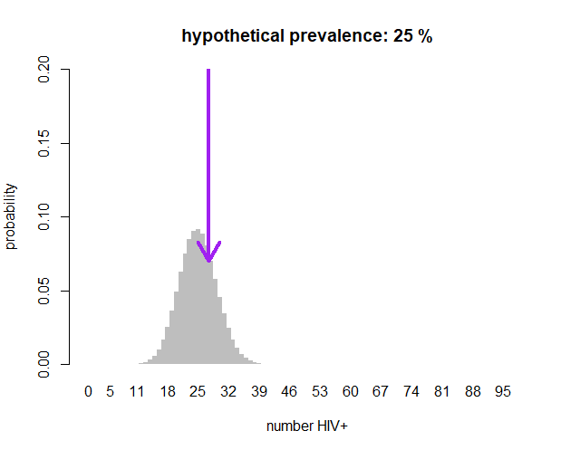
Statistical Inference (Frequentist parameter estimation)
In a population of 1,000,000 people with a true HIV prevalence of 28%, the probability distribution of number of positive individuals if 100 are sampled:
$f(25)=\left({100 \atop 25}\right)({0.28)}^{25}({1−0.28)}^{100−25}=0.07008066$

Slide 34
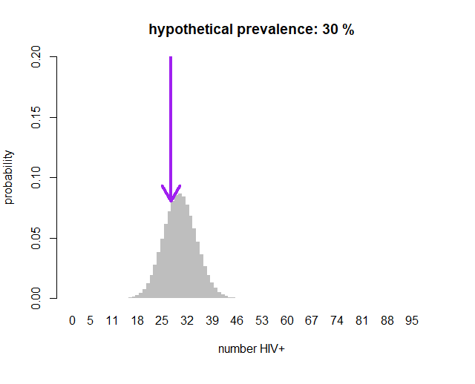
Statistical Inference (Frequentist parameter estimation)
In a population of 1,000,000 people with a true HIV prevalence of 28%, the probability distribution of number of positive individuals if 100 are sampled:
$f(30)=\left({100 \atop 30}\right)({0.28)}^{30}({1−0.28)}^{100−30}=0.08041202$

Slide 35
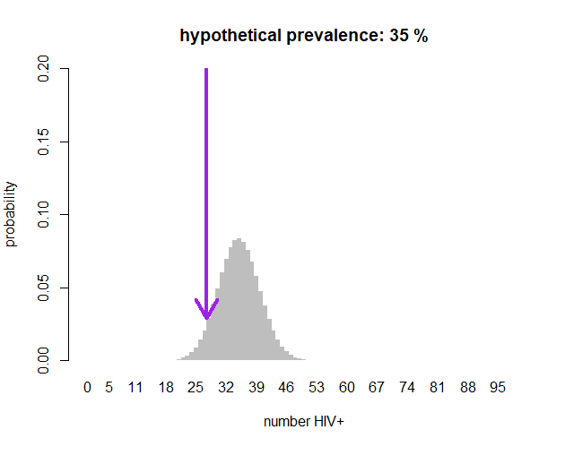
Statistical Inference (Frequentist parameter estimation)
In a population of 1,000,000 people with a true HIV prevalence of 28%, the probability distribution of number of positive individuals if 100 are sampled:
$f(35)=\left({100 \atop 35}\right)({0.28)}^{35}({1−0.28)}^{100−35}=0.02900907$

Slide 36
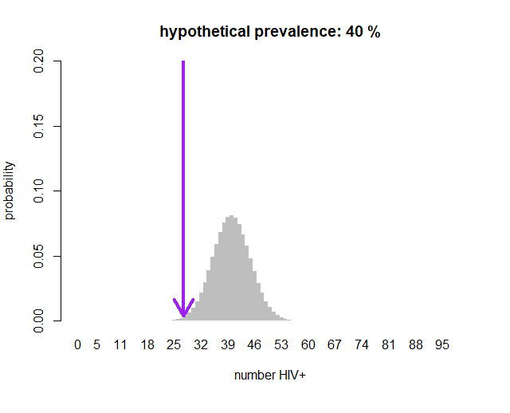
Statistical Inference (Frequentist parameter estimation)
In a population of 1,000,000 people with a true HIV prevalence of 28%, the probability distribution of number of positive individuals if 100 are sampled:
$f(40)=\left({100 \atop 40}\right)({0.28)}^{40}({1−0.28)}^{100−40}=0.003832099$

Slide 37






Statistical Inference (Frequentist parameter estimation)
Which prevalence gives the greatest probability of observing exactly 28/100?
$$0.0003528457$$
$$0.01413142$$
$$0.07008066$$
$$0.08041202$$
$$0.02900907$$
$$0.003832099$$

Slide 38
Statistical Inference (Frequentist parameter estimation)
Which prevalence gives the greatest probability of observing exactly 28/100?
$$0.0003528457$$
$$0.01413142$$
$$0.07008066$$
$$0.08041202$$
$$0.02900907$$
$$0.003832099$$

Slide 39
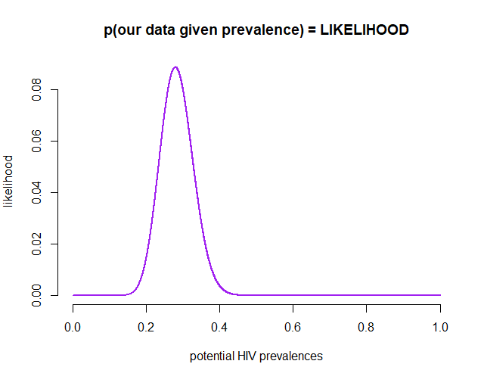

Statistical Inference (Frequentist parameter estimation)
Maximum Likelihood Estimate
Parameter giving the greatest probability of the data having occurred.
What do you think is the MLE here?
MLE = $\frac{28}{100}=0.28$

Slide 40



Statistical Inference (Frequentist parameter estimation)
Deriving the Maximum Likelihood Estimate
maximize
$$L(θ)= \left({n \atop x}\right)({θ)}^{x}({1−θ)}^{n−x}$$
maximize
$$log⁡(L\left(θ\right))=log⁡[\left({n \atop x}\right)({θ)}^{x}({1−θ)}^{n−x}]$$
mimimize
$$l(θ)=−log⁡[\left({n \atop x}\right)({θ)}^{x}({1−θ)}^{n−x}]$$

Slide 41
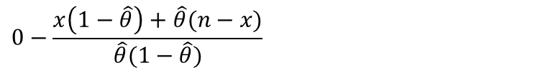







Statistical Inference (Frequentist parameter estimation)
Deriving the Maximum Likelihood Estimate
mimimize
$$l(θ)=−log[\left({n \atop x}\right)({θ)}^{x}({1−θ)}^{n−x}]$$
$$0=−x+\hat{θ}n$$
$$l(θ)=−log[\left({n \atop x}\right)−x logθ −\left(n−x\right)log \left(1−θ\right)]$$
$$\hat{θ}=\frac{x}{n}$$
$$\frac{dl(θ) }{dθ}=0−\frac{x}{θ} −\frac{n−x}{1−θ}$$
The proportion of positives
$$0=−\frac{x}{\hat{θ}}−\frac{n−x}{1−\hat{θ}}$$
$$0−\frac{x\left(1−\hat{θ}\right)+\hat{θ}(n−x)}{\hat{θ}(1−\hat{θ})}$$
$$0=−x+ \hat{θ}x+\hat{θ}n −\hat{θ}x$$

Slide 42
Statistical Inference (Frequentist parameter estimation)
RECAP:
L(parameter | data) = p(data | parameter)
Likelihood function ≠ probability distribution function
PDFs are functions of potential random outcomes
LFs are functions of potential true parameter values

Slide 43
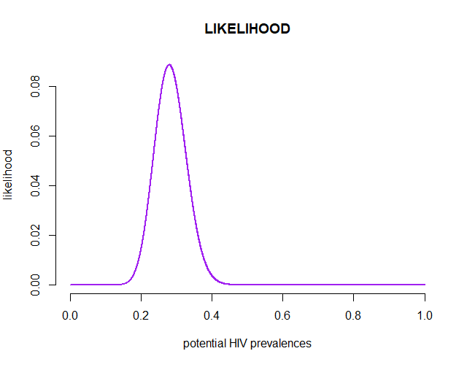

Statistical Inference (Frequentist parameter estimation)
Likelihood example
Maximum Likelihood Estimate
$$\hat{θ}=\frac{x}{n}=\frac{28}{100}=0.28$$

Slide 44
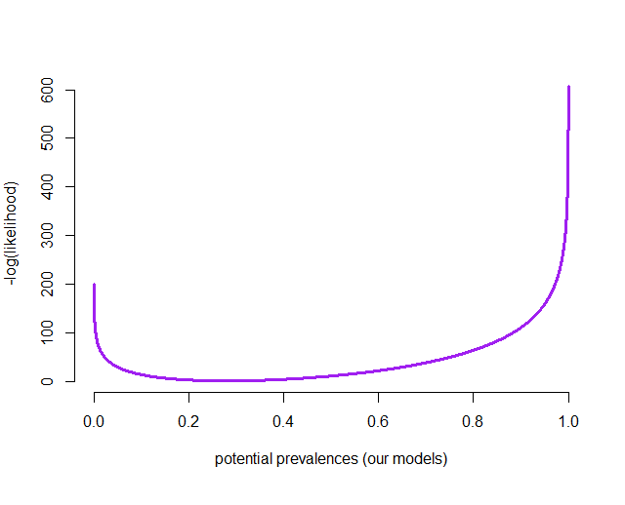
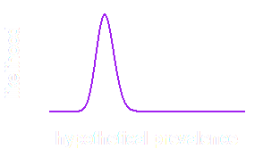

Statistical Inference (Frequentist parameter estimation)
Likelihood example
We usually minimize the -log (likelihood)
Maximum Likelihood Estimate
$$\hat{θ}=\frac{x}{n}=\frac{28}{100}=0.28$$

Slide 45
Statistical Inference (Frequentist parameter estimation)
Likelihood example
We usually minimize the -log (likelihood)
Maximum Likelihood Estimate
$$\hat{θ}=\frac{x}{n}=\frac{28}{100}=0.28$$
Let’s zoom in…

Slide 46
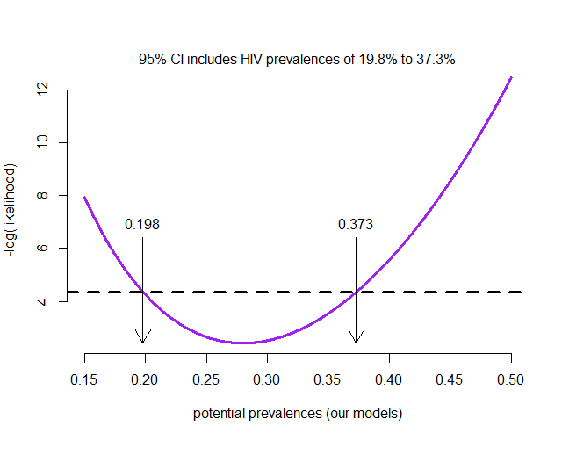
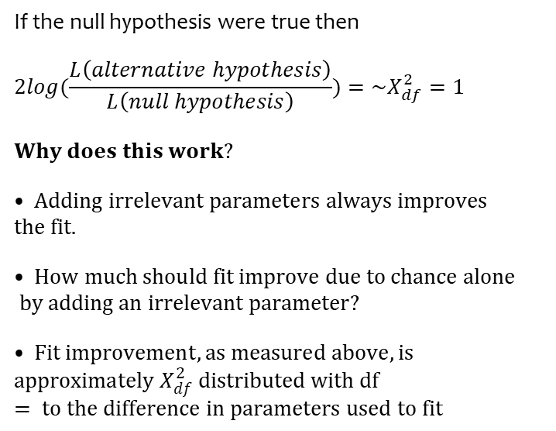
Statistical Inference (Frequentist parameter estimation)
Likelihood ratio test
If the null hypothesis were true then
$$2log⁡(\frac{L\left(alternative hypothesis\right)}{L\left(null hypothesis\right)})=\sim X_{df}^{2}=1$$
$$• Adding irrelevant parameters always improves Why does this work?$$
$$• How much should fit improve due to chance alonethe fit.$$
$$• Fit improvement, as measured above, is by adding an irrelevant parameter?$$
$$approximately X_{df}^{2} distributed with df = to the difference in parameters used to fit$$

Slide 47
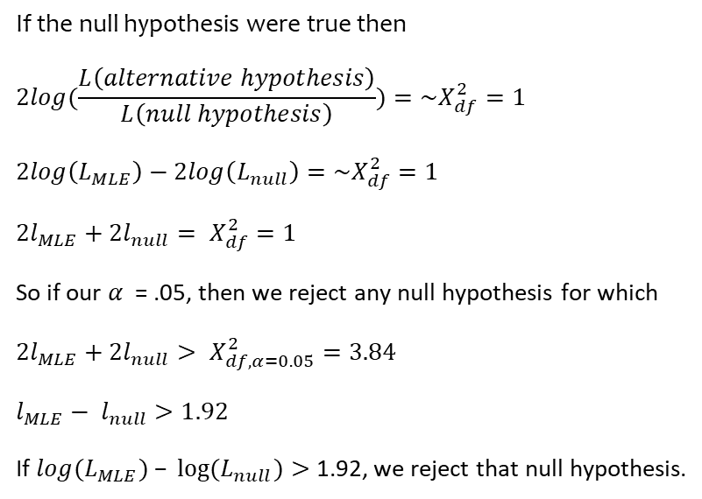
Statistical Inference (Frequentist parameter estimation)
Likelihood ratio test
If the null hypothesis were true then
$$2log⁡(\frac{L\left(alternative hypothesis\right)}{L\left(null hypothesis\right)})=\sim X_{df}^{2}=1$$
$$2log\left(L_{MLE}\right)−2log\left(L_{null}\right)=\sim X_{df}^{2}=1$$
$$2l_{MLE}+2l_{null}= X_{df}^{2}=1$$
So if our $α$ = .05, then we reject any null hypothesis for which
$$2l_{MLE}+2l_{null}> X_{df, α=0.05}^{2}=3.84$$
$$l_{MLE}− l_{null}>1.92$$
If $log⁡(L_{MLE}) – log⁡(L_{null})>$1.92, we reject that null hypothesis.

Slide 48

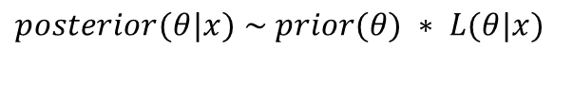
Statistical Inference (Frequentist parameter estimation)
RECAP
Frequentist Paradigm:
What we just did
MLE
Confidence intervals
Classical tests/regression analyses
$$L\left(θ | x\right)= \left({n \atop x}\right)({θ)}^{x}({1−θ)}^{n−x}$$
Bayesian Paradigm:
Prior distributions for parameters
Use the likelihood function to update
Use posterior distributions
$$posterior(θ|x) \sim prior(θ) ∗ L(θ|x)$$

Slide 49
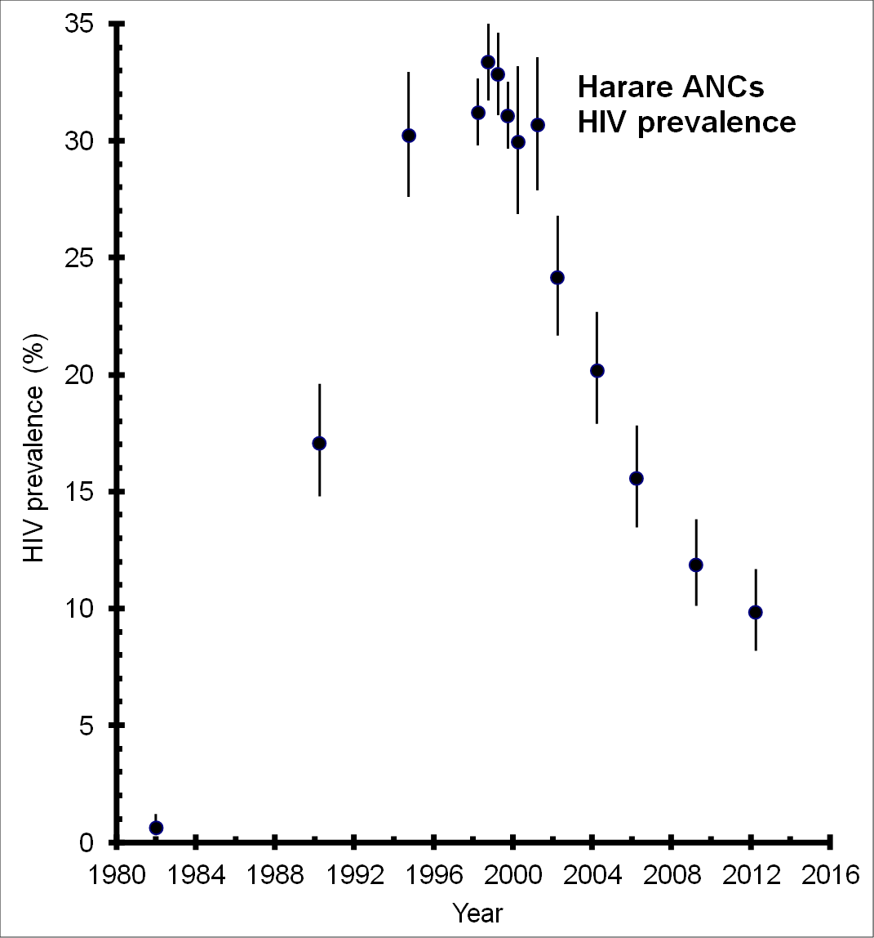

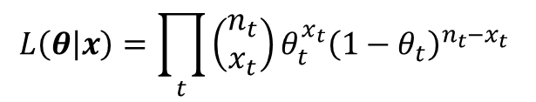
Statistical Inference (Frequentist parameter estimation)
Likelihood
$$L\left(θ | x\right)= \left({n \atop x}\right)({θ)}^{x}({1−θ)}^{n−x}$$
$$L\left(θ | x\right)=\prod_{t}{\left(\begin{aligned}n_{t} \\ x_{t}\end{aligned}\right)θ_{t}^{x_{t}}{\left(1−θ_{t}\right)}^{n_{t}−x_{t}} }$$

Slide 50



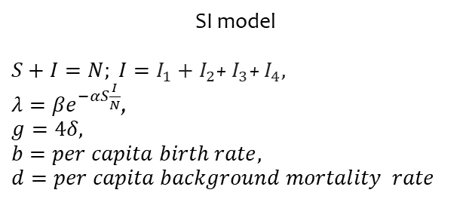












Goal of Model fitting and parameter estimation
MLE Parameter estimation of a HIV SIS model using cross-section prevalence data.
SI model
$S+I=N; I=I_{1}+I_{2}$+ $I_{3}$+ $I_{4},$
$λ=βe^{−αS\frac{I}{N}}$,
$$g=4δ,$$
$$b=per capita birth rate,$$
$$d=per capita background mortality rate$$
$${gI}_{1}$$
$${gI}_{2}$$
$${gI}_{2}$$
$$bN$$
$$S$$
$$λSI/N$$
$$I_{1}$$
$$I_{2}$$
$$I_{3}$$
$$I_{4}$$
$$μS$$
$$μI_{1}$$
$$μI_{2}$$
$$μI_{3}$$
$$μI_{4}$$
Tutorial 3-R script

Slide 51
Statistical Inference (Frequentist parameter estimation)
Likelihood

Slide 52
Statistical Inference (Frequentist parameter estimation)
Advantages of MLE
Practical method for:
estimating parameters
estimating variance of our estimates
Easily adaptable to different probability distributions & dynamic models

Slide 53
Statistical Inference (Frequentist parameter estimation)
Summary
Likelihood is conditional on data, looking at probabilities from different PDFs, with varying parameters
MLE methods use Likelihood Ratio Tests to create confidence intervals
Useful for fitting dynamic models
Tutorial 4-R script

Slide 54
Murakoze Urakoze
Thank you
Danke

