Slide 1
Discourse Parsing for German Twitter
Current status
19th June 2015
Arkadi Schelling

Slide 2
Data Sources
Potsdam Commentary Corpus (PCC)
German newspaper texts annotated with discourse connectives, similar to PDTB
DiMLex
Lexicon with German discourse connectives, alternative spellings and a tag whether the string disambiguously denotes a connective
German Tweets
From April 2014

Slide 3
Roadmap
Data preprocessing
Create flexible data structures and Python objects for analysis
Parse PCC and DiMLex xml-files into these objects
Answer some questions on the given data
Following Lin et. al. (2012)
Parse connective candidates and their context from the raw data
Classify these candidates into being a connective or not
Find attribution spans for the connectives
Classify the discourse relation of the classifier

Slide 4
Current status
Created objects for PCC and DiMLex connectives
Analyzed the connectives themselves
First analysis of Tweets

Slide 5
Discourse connective analysis
PCC: 1098 complete discourse connectives
cont/discont – 96.6/3.4%
single/phrasal – 96.9/3.1%
Number of distinct connectives: DiMLex/PCC – 277/~117, Intersection 83
45 distinct PCC connectives are not in the DiMLex
DiMLex: disambiguous – 54.2%
DiMLex: orthography variants (lowercased) – 765 (397)
First 100kB of Tweets: ~13790 words, ~820 cont connectives, 97% disambi

Slide 6
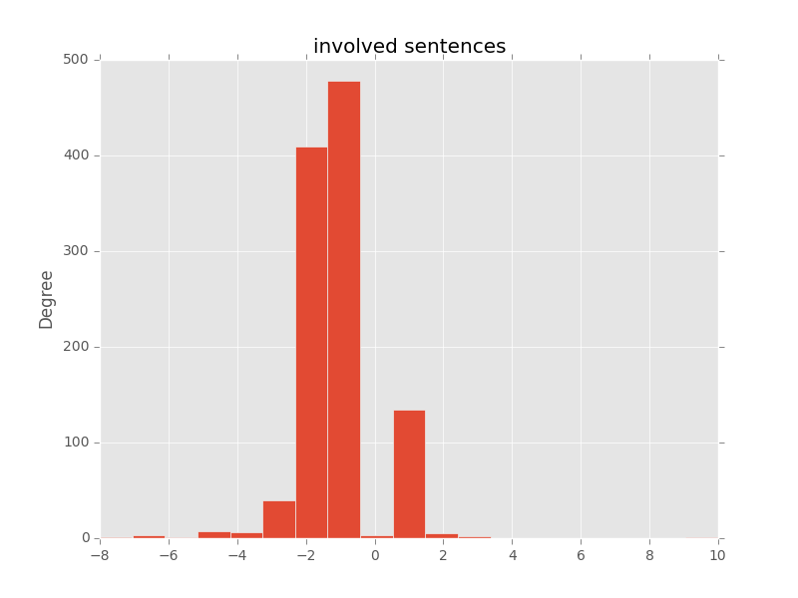
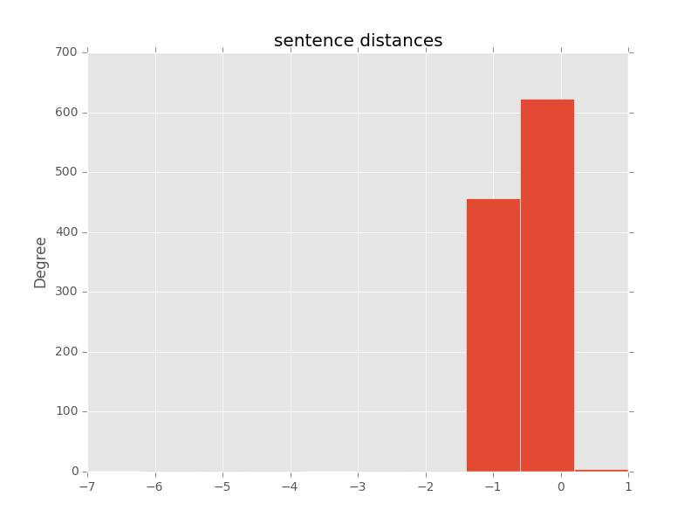
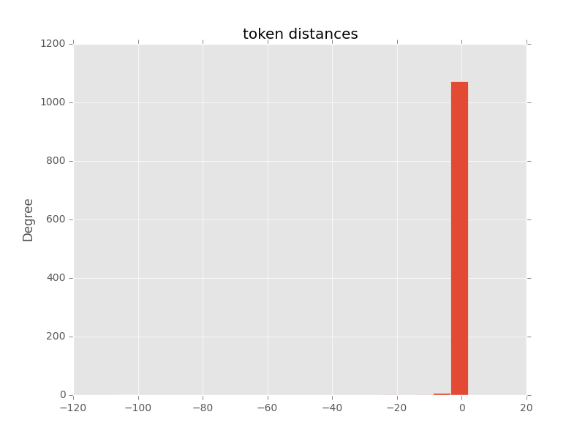
Argument span analysis
Based on PCC
Negative distance to the left, positive to the right

Slide 7
Current questions
How to parse discontinuous connectives?
How to get Tweet discourse trees?
Integrate with Jess and Clay?
How to parse Tweets into syntax?
Feasible to parse all Tweets into syntax trees?

