Slide 1



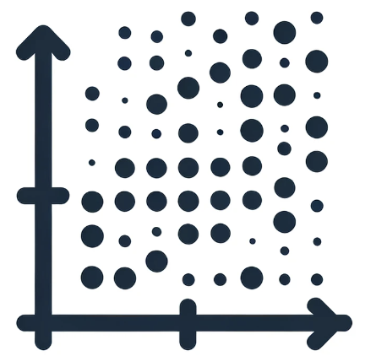





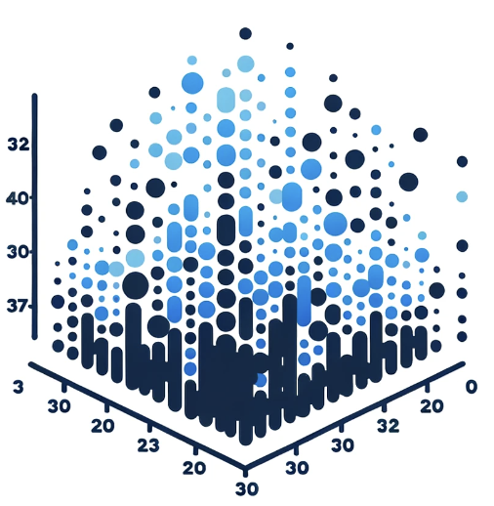

Process Flow of Looking for the Habitable Exoplanets
Clustering Type I
PCA
K-means
Clustering Type II
UMAP
HDBscan
Grouping Candidates
Verification by chatGPT & Reputable website
Finalizing Candidate
PHL’s datasets:
- Habitable exoplanets
- Found exoplanets’ features
Clustering Type III
Cosine Similarity

