Slide 1
JICSCI803 Algorithms and Data Structures March to June 2019

Slide 2
Highlights of Lecture 07
Greedy Algorithms

Slide 3
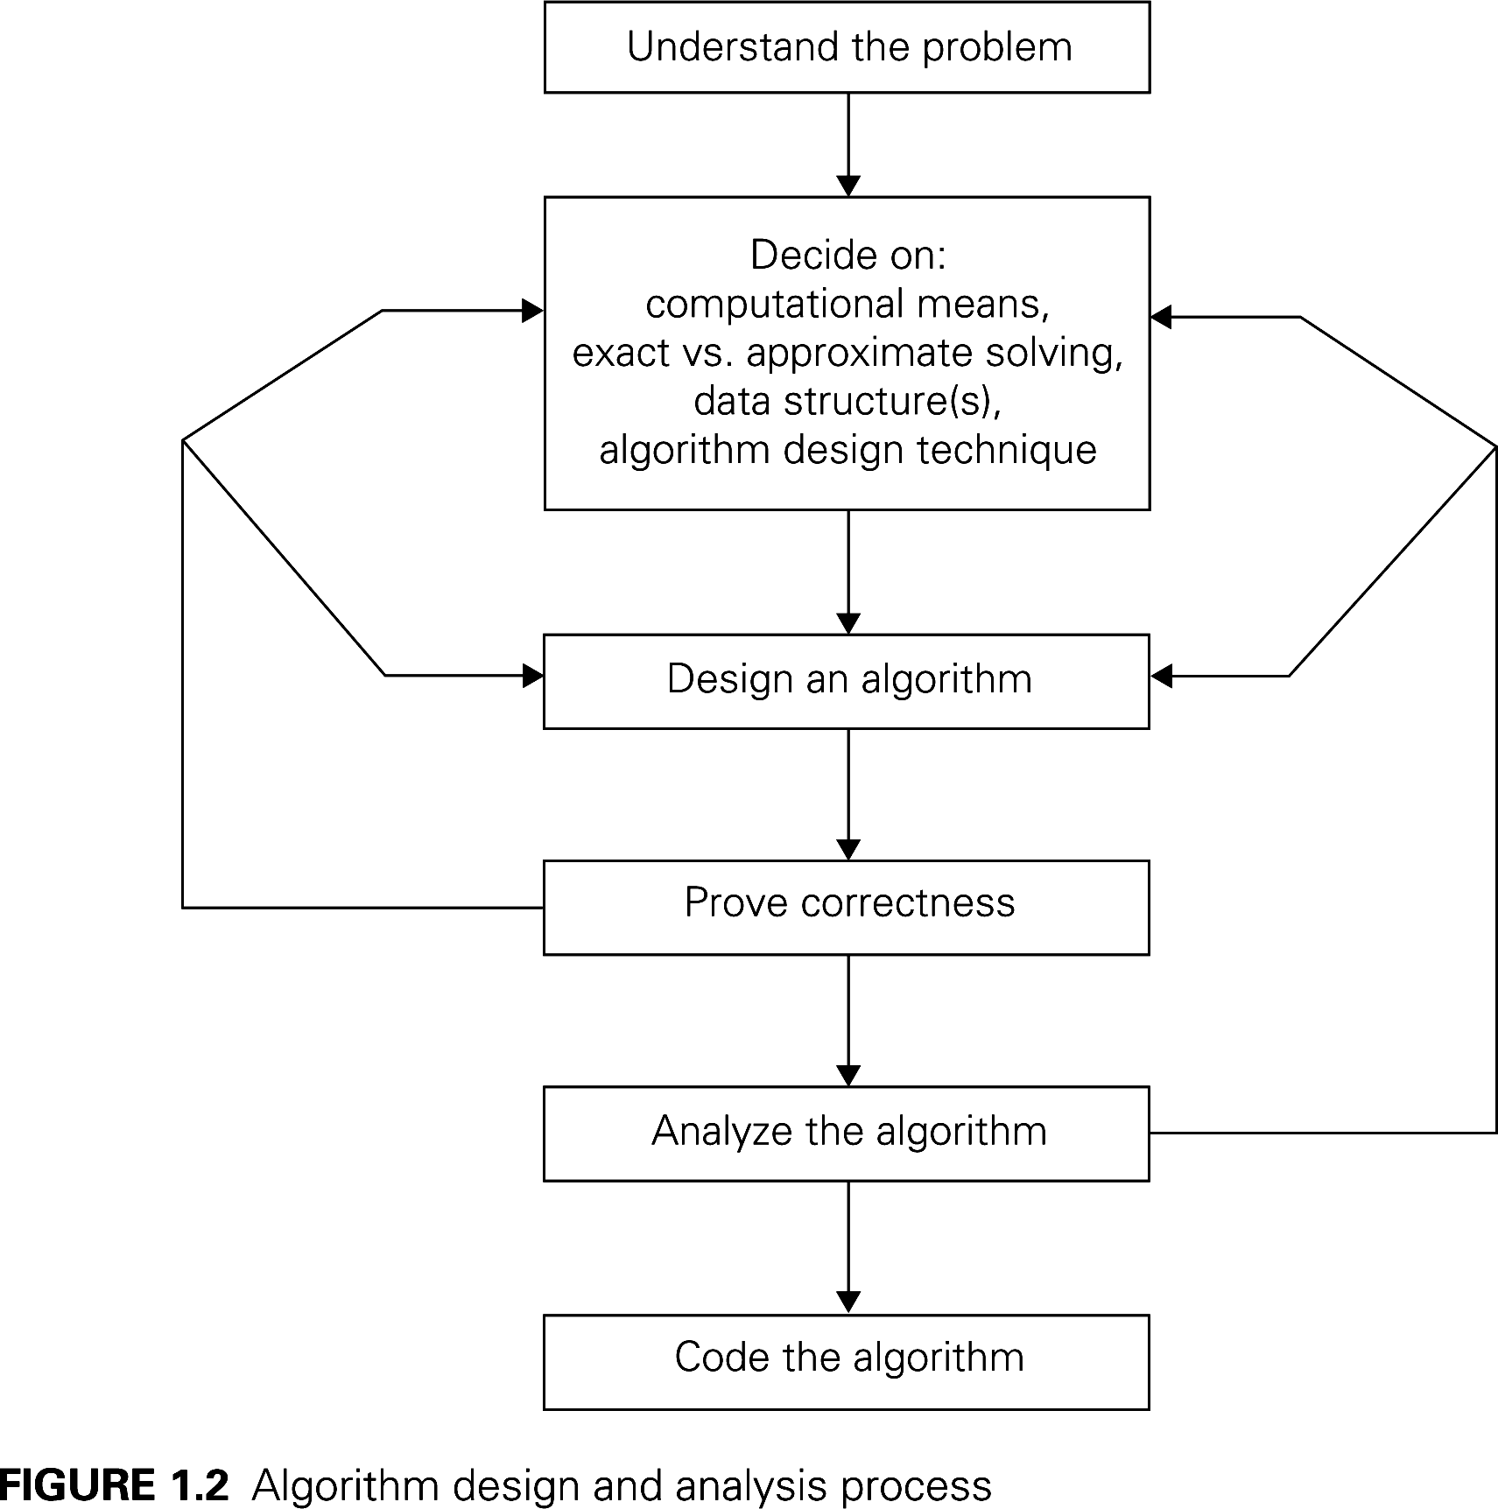
Algorithm Design and Analysis Process

Slide 4
Algorithm Analysis Framework
Measuring an input’s size
Measuring running time
Orders of growth (of the algorithm’s efficiency function)
Worst-base, best-case and average-case efficiency

Slide 5
Characters of Greedy Algorithms
– These algorithms work by taking what seems to be the best decision at each step
– No backtracking is done (once a choice is made we are stuck with it)
– Easy to design
– Easy to implement
– Efficient (when they work)
2

Slide 6
Example 1: Making Change
Problem： Given we have $2, $1, 50c, 20c, 10c, 5c and 1c coins; what is the best (fewest coins) way to pay any given amount?
The greedy approach is to pay as much as possible using the larges coin value possible, repeatedly until the amount is paid.
E.g. to pay $17.97 we pay 8 $2 coins, 1 $1 coin, 1 50c coin, 2 20c coins, 1 5c coin and 2 1c coins(15 coins total).
This is the optimal solution in required number of coins (although this is harder to prove than you might think).
Note that this algorithm will not work with an arbitrary set of coin values.
Adding a 12c coin would result in 15c being made from 1 12c and 3 1c (4 coins) instead of 1 10c and 1 5c coin (2 coins).
3

Slide 7
Greedy Algorithms: selected or rejected method
We start with a set of candidates which have not yet been considered for the solution
As we proceed, we construct two further sets:
Candidates that have been considered and selected
Candidates that have been considered and rejected
At each step we check to see if we have reached a solution
At each step we also check to see if a solution can be reached at all
At each step we select the best acceptable candidate from the unconsidered set and move it into the selected set
We also move any unacceptable candidates into the rejected set
4

Slide 8
Example 2: Shortest Path
Let G = (N, E) be a connected, directed graph consisting of a set of nodes N and a set of directed edges E.
Each edge has a length, the distance from the node at one end of the edge to the node at the other end.
One node is designated the source node
The problem is to find the shortest path from the source node to each of the other nodes
5

Slide 9
Example 2: Shortest Path
Application
In a graph in which edges have costs ..
Find the shortest path from a source to a destination
Surprisingly ..
While finding the shortest path from a source to one destination,
we can find the shortest paths to all over destinations as well!
Common algorithm for single-source shortest paths is due to Edsger Dijkstra

Slide 10
Dijkstra’s Algorithm—DS design
For a graph, G = ( V, E )
Dijkstra’s algorithm keeps two sets of vertices:
S Vertices whose shortest paths have already been determined Q=V-S Remainder
Also
d Best estimates of shortest path to each vertex π Predecessors for each vertex

Slide 11
Predecessor Sub-graph
Array of vertex indices, π[j], j = 1 .. |V|
π[j] contains the predecessor for node j
All j’s predecessors is are π[π[j]], and so on ....
The edges in the predecessor subgraph are ( π[j], j )

Slide 12
Dijkstra’s Algorithm - Operation
Initialise d and π
For each vertex, j, in V
d_{j} = ∞
π_{j} = nil
Source distance, d_{s} = 0
Set S to empty
While V-S is not empty
Sort V-S based on d
Add u, the closest vertex in V-S, to S
Relax all the vertices still in V-S connected to u
Initial estimates are all ∞
No connections
Add s first!

Slide 13
Dijkstra’s Algorithm - Operation
The Relaxation process
Relax the node v attached to node u
Edge cost matrix
If the current best
estimate to v is
greater than the
path through u ..
relax( Node u, Node v, double w[][] )
if d[v] > d[u] + w[u,v] then
d[v] := d[u] + w[u,v]
π[v] := u
Update the estimate to v
Make v’s predecessor point to u

Slide 14
Dijkstra’s Algorithm - Full
Given a graph, g, and a source, s
shortest_paths( Graph g, Node s )
initialise_single_source( g, s )
S := { 0 } /* Make S empty */
Q := Vertices( g ) /* Put the vertices in a PQ */
while not Empty(Q)
u := ExtractCheapest( Q );
AddNode( S, u ); /* Add u to S */
for each vertex v in Adjacent( u )
relax( u, v, w )

Slide 15
Dijkstra’s Algorithm - Initialise
Given a graph, g, and a source, s
Initialise d, π, S,
vertex Q
shortest_paths( Graph g, Node s )
initialise_single_source( g, s )
S := { 0 } /* Make S empty */
Q := Vertices( g ) /* Put the vertices in a PQ */
while not Empty(Q)
u := ExtractCheapest( Q );
AddNode( S, u ); /* Add u to S */
for each vertex v in Adjacent( u )
relax( u, v, w )

Slide 16
Dijkstra’s Algorithm - Loop
The Shortest Paths algorithm
Given a graph, g, and a source, s
shortest_paths( Graph g, Node s )
initialise_single_source( g, s )
S := { 0 } /* Make S empty */
Q := Vertices( g ) /* Put the vertices in a PQ */
while not Empty(Q)
u := ExtractCheapest( Q );
AddNode( S, u ); /* Add u to S */
for each vertex v in Adjacent( u )
relax( u, v, w )
While there are still nodes in Q
Greedy!

Slide 17
Dijkstra’s Algorithm - Relax neighbours
The Shortest Paths algorithm
Given a graph, g, and a source, s
Update the estimate of the shortest paths to all nodes attached to u
shortest_paths( Graph g, Node s )
initialise_single_source( g, s )
S := { 0 } /* Make S empty */
Q := Vertices( g ) /* Put the vertices in a PQ */
while not Empty(Q)
u := ExtractCheapest( Q );
AddNode( S, u ); /* Add u to S */
for each vertex v in Adjacent( u )
relax( u, v, w )
Greedy!

Slide 18
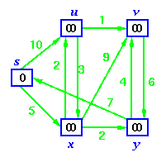
Dijkstra’s Algorithm - Operation
Initial Graph
Source
Mark 0
Distance to all nodes marked ∞

Slide 19
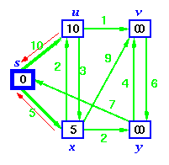
Dijkstra’s Algorithm - Operation
Initial Graph
Source
Relax vertices adjacent to source

Slide 20
Dijkstra’s Algorithm - Operation
Initial Graph
Source
Red arrows show
pre-decessors

Slide 21
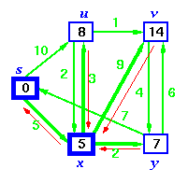
Dijkstra’s Algorithm - Operation
Source is now in S
Sort vertices and choose closest

Slide 22
Dijkstra’s Algorithm - Operation
Relax u because a shorter path via x
exists
Source is now in S
Relax y because a shorter path via x
exists

Slide 23
Dijkstra’s Algorithm - Operation
Change u’s pre-decessor also
Source is now in S
Relax y because a shorter path via x
exists

Slide 24
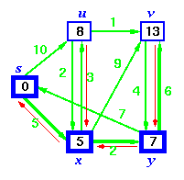
Dijkstra’s Algorithm - Operation
S is now { s, x }
Sort vertices and choose closest

Slide 25
Dijkstra’s Algorithm - Operation
Relax v because a shorter path via y
exists
S is now { s, x }
Sort vertices and choose closest

Slide 26
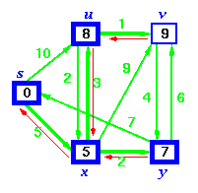
Dijkstra’s Algorithm - Operation
S is now { s, x, y }
Sort vertices and choose closest, u

Slide 27
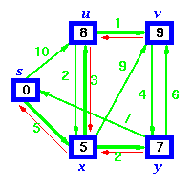
Dijkstra’s Algorithm - Operation
S is now { s, x, y, u }
Finally add v

Slide 28
Dijkstra’s Algorithm - Operation
S is now { s, x, y, u }
Pre-decessors show shortest paths sub-graph

Slide 29
Dijkstra’s Algorithm - Proof
Greedy Algorithm
Proof by contradiction test
Lemma 1
Shortest paths are composed of shortest paths
Proof
If there was a shorter path than any sub-path, then substitution of that path would make the whole path shorter

Slide 30
Dijkstra’s Algorithm – Correctness Proof
Denote
δ(s,v) - the cost of the shortest path from s to v
Lemma 2
If s→...→u→v is a shortest path from s to v, then after u has been added to S and relax(u,v,w[][]) called, d[v] = δ(s,v) and d[v] is not changed thereafter.
Proof
Follows from the fact that at all times d[v] ≥ δ(s,v)
See Cormen (or any other text) for the details.

Slide 31
Dijkstra’s Algorithm - Proof
Using Lemma 2
After running Dijkstra’s algorithm, we assert
d[v] = δ(s,v) for all v
Proof (by contradiction)
Suppose that u is the first vertex added to S for which d[u] ≠ δ(s,u)
Note
v is not s because d[s] = 0
There must be a path s→...→u, otherwise d[u] would be ∞
Since there’s a path, there must be a shortest path

Slide 32
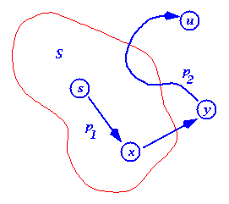
Dijkstra’s Algorithm - Proof
Proof (by contradiction)
Suppose that u is the first vertex added to S for which d[u] ≠ δ(s,u)
Let s→x→y→u be the shortest path s→u, where x is in S and y is the first outside S
When x was added to S, d[x] = δ(s,x)
Edge x→y was relaxed at that time, so d[y] = δ(s,y)

Slide 33
Proof (by contradiction)
Edge x→y was relaxed at that time, so d[y] = δ(s,y) ≤ δ(s,u) ≤ d[u]
But, when we chose u, both u and y where in V-S, so d[u] ≤ d[y] (otherwise we would have chosen y)
Thus the inequalities must be equalities
d[y] = δ(s,y) = δ(s,u) = d[u]
And our hypothesis (d[u] ≠ δ(s,u)) is contradicted!

Slide 34
Dijkstra’s Algorithm - Time Complexity
Dijkstra’s Algorithm
Key step is sort on the edges
Complexity is
O( (|E|+|V|)log|V| ) or
O( n² log n )
for a dense graph with n = |V|

Slide 35
Example 2: Shortest Path
Node 1 is Source
1
10
50
5
2
30
100
10
5
20
4
3
50
6

Slide 36
Example 2: Shortest Path
– 1 to 2, length 35
1
10
50
5
2
30
100
10
5
20
4
3
50
7

Slide 37
Example 2: Shortest Path
– 1 to 3 length 30
1
10
50
5
2
30
100
10
5
20
4
3
50
8

Slide 38
Example 2: Shortest Path
– 1 to 4 length 20
1
10
50
5
2
30
100
10
5
20
4
3
50
9

Slide 39
Example 2: Shortest Path
– 1 to 5 length 10
1
10
50
5
2
30
100
10
5
20
4
3
50
10

Slide 40
Example 2: Shortest Path
Dijkstra’s Algorithm
Uses two sets of nodes S and C
At each iteration S contains the set of nodes that have already been chosen
At each iteration C contains the set of nodes that have not yet been chosen
At each step we move the node which is cheapest to reach from C to S
An array D contains the shortest path so far from the source to each node

Slide 41
Example 2: Shortest Path
• Dijkstra’s Algorithm: An Example
– Step 0 S = {1} C = {2, 3, 4, 5} D = [50, 30, 100, 10]
1
10
50
5
2
30
100
10
5
20
4
3
50
12

Slide 42
• Dijkstra’s Algorithm: An Example
– Step 1 S = {1,5} C = {2, 3, 4} D = [50, 30, 20, 10]
1
10
50
5
2
30
100
10
5
20
4
3
50
13

Slide 43
• Dijkstra’s Algorithm: An Example
– Step 2 S = {1,4,5} C = {2, 3} D = [40, 30, 20, 10]
1
10
50
5
2
30
100
10
5
20
4
3
50
14

Slide 44
• Dijkstra’s Algorithm: An Example
– Step 3 S = {1,3,4,5} C = {2} D = [35, 30, 20, 10]
1
10
50
5
2
30
100
10
5
20
4
3
50
15

Slide 45
Dijkstra’s Algorithm
Function Dijkstra(L[1..n, 1..n]): array [2..n]
array D[2..n]
C = {2, 3, …, n}
for i = 2 to n do
D[i] = L[1, i]
repeat n – 2 times
v = the index of the minimum D[v] not yet selected
remove v from C // and implicitly add v to S
for each w
D[w] = min(D[w], D[v] + L[v, w])
return D
16

Slide 46
Dijkstra’s Algorithm (recorded paths)
Function Dijkstra(L[1..n, 1..n]): array [2..n]
array D[2..n], P[2..n]
C = {2, 3, …, n}
for i = 2 to n do
D[i] = L[1, i]
P[i] = 1
repeat n – 2 times
v = the index of the minimum D[v] not yet selected
remove v from C // and implicitly add v to S
for each w ∈ C do
if (D[w] > D[v] + L[v, w]) then
D[w] = D[v] + L[v, w]
P[w] = v
return D, P
17

Slide 47
Dijkstra’s Algorithm: at start
L = P = D =
∞
∞
∞
∞
∞
50
∞
5
20
∞
1
50
30
∞
∞
50
∞
1
30
100
∞
∞
∞
10
1
100
10
∞
∞
∞
∞
1
10
1
C = {2, 3, 4, 5}
10
50
5
2
30
100
10
5
20
4
3
50
18

Slide 48
Dijkstra’s Algorithm: at start
L = P = D =
∞
∞
∞
∞
∞
50
∞
5
20
∞
1
50
30
∞
∞
50
∞
1
30
100
∞
∞
∞
10
1
100
10
∞
∞
∞
∞
1
10
1
v = 5
C = {2, 3, 4, 5} => {2, 3, 4}
S = {1}
10
50
5
2
30
100
10
5
20
4
3
50
18

Slide 49
Dijkstra’s Algorithm: after iteration 1
L = P = D =
∞
∞
∞
∞
∞
50
∞
5
20
∞
1
50
30
∞
∞
50
∞
1
30
100
∞
∞
∞
10
5
20
10
∞
∞
∞
∞
1
10
v = 4
C = {2, 3, 4}
S = {1,5}
19

Slide 50
Dijkstra’s Algorithm: after iteration 2
L = P = D =
∞
∞
∞
∞
∞
50
∞
5
20
∞
4
40
30
∞
∞
50
∞
1
30
100
∞
∞
∞
10
5
20
10
∞
∞
∞
∞
1
10
v = 3
C = {2, 3}
S = {1,4,5}
20

Slide 51
Dijkstra’s Algorithm: after iteration 3
– L = P = D =
∞
∞
∞
∞
∞
50
∞
5
20
∞
3
35
30
∞
∞
50
∞
1
30
100
∞
∞
∞
10
5
20
10
∞
∞
∞
∞
1
10
v = 2
C = {2}
S = {1,3,4,5}
21

Slide 52
Dijkstra’s Algorithm: Recorded Paths
What does it mean?
Node 1 is source.
The Predecessor of Node 2 is Node 3.
The Predecessor of Node 3 is Node 1 (source).
The Predecessor of Node 4 is Node 5
The Predecessor of Node 5 is Node 1 (source).
P =
3
1
5
1
22

Slide 53
Dijkstra’s Algorithm: Recorded Paths
P =
To 2 – 1, 3, 2
To 3 – 1, 3
To 4 – 1, 5, 4
To 5 – 1, 5
3
1
5
1
22

Slide 54
•
Dijkstra’s Algorithm: Another Example
1
2
2
4
1
3
10
3
2
4
2
5
5
8
4
6
6
1
7
23

Slide 55
•
Dijkstra’s Algorithm: At start
L = P = D =
∞
∞
4
∞
∞
∞
∞
2
∞
∞
∞
∞
∞
∞
1
2
∞
∞
∞
2
∞
∞
∞
1
∞
1
3
∞
∞
∞
∞
∞
1
1
∞
10
∞
2
∞
∞
∞
1
∞
∞
∞
5
8
∞
∞
1
1
∞
∞
∞
∞
4
6
∞
∞
1
∞
v = 4
C = {2, 3, 4, 5, 6, 7}
S = {1}
24

Slide 56
•
Dijkstra’s Algorithm: After step 1
–
L = P = D =
∞
∞
4
∞
∞
∞
∞
2
∞
∞
∞
∞
∞
∞
1
2
∞
∞
∞
2
∞
∞
∞
4
3
1
3
∞
∞
∞
∞
∞
1
1
∞
10
∞
2
∞
∞
∞
4
3
∞
∞
5
8
∞
∞
1
4
9
∞
∞
∞
4
6
∞
∞
4
5
v = 2
C = {2, 3, 5, 6, 7}
S = {1，4}
25

Slide 57
•
Dijkstra’s Algorithm: After step 2
–
L = P = D =
∞
∞
4
∞
∞
∞
∞
2
∞
∞
∞
∞
∞
∞
1
2
–
∞
∞
∞
2
∞
∞
∞
4
3
1
3
∞
∞
∞
∞
∞
1
1
∞
10
∞
2
∞
∞
∞
4
3
∞
∞
5
8
∞
∞
1
4
9
∞
∞
∞
4
6
∞
∞
4
5
v = 5
C = { 3, 5, 6, 7}
S = {1，2，4}
26

Slide 58
•
Dijkstra’s Algorithm: After step 3
–
L = P = D =
∞
∞
4
∞
∞
∞
∞
2
∞
∞
∞
∞
∞
∞
1
2
∞
∞
∞
2
∞
∞
∞
4
3
1
3
∞
∞
∞
∞
∞
1
1
∞
10
∞
2
∞
∞
∞
4
3
∞
∞
5
8
∞
∞
1
4
9
∞
∞
∞
4
6
∞
∞
4
5
v = 3
C = { 3, 6, 7}
S = {1，2，4，5}
27

Slide 59
•
Dijkstra’s Algorithm: After step 4
–
L = P = D =
∞
∞
4
∞
∞
∞
∞
2
∞
∞
∞
∞
∞
∞
1
2
∞
∞
∞
2
∞
∞
∞
4
3
1
3
∞
∞
∞
∞
∞
1
1
∞
10
∞
2
∞
∞
∞
4
3
∞
∞
5
8
∞
∞
1
3
8
∞
∞
∞
4
6
∞
∞
4
5
v = 7
C = {6, 7}
S = {1, 2, 3, 4, 5}
28

Slide 60
•
Dijkstra’s Algorithm: After step 5 – done
–
L = P = D =
∞
∞
4
∞
∞
∞
∞
2
∞
∞
∞
∞
∞
∞
1
2
∞
∞
∞
2
∞
∞
∞
4
3
1
3
∞
∞
∞
∞
∞
1
1
∞
10
∞
2
∞
∞
∞
4
3
∞
∞
5
8
∞
∞
1
7
6
∞
∞
∞
4
6
∞
∞
4
5
v = 7
C = {6}
S = {1, 2, 3, 4, 5, 7}
29

Slide 61
• Dijkstra’s Algorithm: After step 5 – done
– Paths P = D =
To 2: 1, 2
To 3: 1, 4, 3
To 4: 1, 4
To 5: 1, 4, 5
To 6: 1, 4, 7, 6
To 7: 1, 4, 7
1
2
4
3
1
1
4
3
7
6
4
5
30

Slide 62
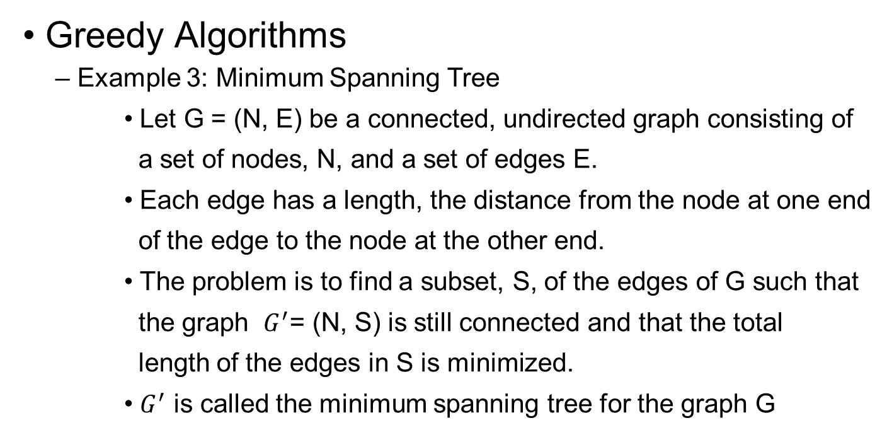
Example 3: Minimum Spanning Tree
31

Slide 63
Example 3: Minimum Spanning Tree
1
1
2
2
3
1
1
2
2
3
4
6
4
5
6
4
3
8
3
4
5
6
4
5
6
4
7
3
4
3
G
7
G
′
7
32

Slide 64
Example 3: Minimum Spanning Tree
– Two possible paths of attack seem possible:
• Start with an empty set S and select at each stage the shortest edge that has been neither selected nor rejected.
• Start at a given node and at each stage select into S shortest edge that extends the graph to a new node
– Strangely, both approaches work
33

Slide 65
Kruskal’s Algorithm
– Start with an initially empty set of edges S.
– Add edges to S
– At each step add the shortest edge to S which
increases the connectedness of the graph.
– Reject a candidate edge if it does not effect the
connectedness of S.
– Stop when the graph is connected.
34

Slide 66
Kruskal’s Algorithm: An Example
• Kruskal’s Algorithm: An Example
• Step 0 - {1} {2} {3} {4} {5} {6} {7}
1
1
2
2
3
1
2
3
4
6
4
5
6
3
8
4
5
6
4
5
6
4
7
3
G
7
G
′
7
35

Slide 67
• Kruskal’s Algorithm: An Example
• Step 1 {1,2} {3} {4} {5} {6} {7}
1
2
2
3
1
1
2
3
4
6
4
5
6
3
8
4
5
6
4
5
6
4
7
3
G
7
G
′
7
36

Slide 68
• Kruskal’s Algorithm: An Example
• Step 2 {2,3} {1,2,3} {4} {5} {6} {7}
1
2
3
1
1
2
2
3
4
6
4
5
6
3
8
4
5
6
4
5
6
4
7
3
G
7
G
′
7
37

Slide 69
• Kruskal’s Algorithm: An Example
• Step 3 {4,5} {1,2,3} {4,5} {6} {7}
1
2
3
1
1
2
2
3
4
6
4
5
6
8
3
4
5
6
4
5
6
4
7
3
G
7
G
′
7
38

Slide 70
• Kruskal’s Algorithm: An Example
• Step 4 {6,7} {1,2,3} {4,5} {6,7}
1
2
3
1
1
2
2
3
4
6
4
5
6
8
3
4
5
6
4
5
6
4
7
3
G
7
G
′
7
39

Slide 71
• Kruskal’s Algorithm: An Example
• Step 5 {1,4} {1,2,3,4,5} {6,7}
1
2
3
1
1
2
2
3
6
4
5
6
4
8
3
4
5
6
4
5
6
4
7
3
G
7
G
′
7
40

Slide 72
• Kruskal’s Algorithm: An Example
• Step 5 {2,5} {1,2,3,4,5} {6,7} - rejected
1
2
3
1
1
2
2
3
6
5
6
4
4
8
3
4
5
6
4
5
6
4
7
3
G
7
G
′
7
41

Slide 73
• Kruskal’s Algorithm: An Example
• Step 5 {4,7} {1,2,3,4,5,6,7} - done
1
2
3
1
1
2
2
3
6
5
6
4
4
8
3
4
5
6
4
5
6
7
4
3
G
7
G
′
7
42

Slide 74
• Kruskal’s Algorithm
– type node = record
node_number: integer
– type edge = record
start: ^node
end: ^node
length: integer
43

Slide 75
Kruskal’s Algorithm
Function Kruskal(N[1..n]: ^node, E[1..e]: ^edge)
sort E by increasing length
S = {}
for i =1 to n do
set[i] = {N[i]}
i = 0
repeat
i = i+1
u = E[i]^.start
v = E[i]^.end
uset = find u in set[]
vset = find v in set[]
if uset != vset then
merge(uset, vset)
add E[i] to S
until S contains n – 1 edges
return S
44

Slide 76
Kruskal’s Algorithm
Function Kruskal(N[1..n]: ^node, E[1..e]: ^edge)
sort E by increasing length
S = {}
for i =1 to n do
set[i] = {N[i]}
i = 0
repeat
i = i+1
u = E[i]^.start
v = E[i]^.end
uset = find u in set[]
vset = find v in set[]
if uset != vset then
merge(uset, vset)
add E[i] to S
until S contains n – 1 edges
return S
44

Slide 77
Kruskal’s Algorithm
KRUSKAL(G):
1 A = ∅
2 foreach v ∈ G.V:
3 MAKE-SET(v)
4 foreach (u, v) in G.E ordered by weight(u, v), increasing:
5 if FIND-SET(u) ≠ FIND-SET(v):
6 A = A ∪ {(u, v)}
7 UNION(u, v)
8 return A
44

Slide 78
Prim’s Algorithm
– Let O be a set of nodes and S a set of edges
– Initially O contains the first node of N and S is empty
– At each step look for the shortest edge {u, v} in E
such that u ∈ O and v ∉ O
– Add {u, v} to S
– Add v to O
– Repeat until O = N
– Note that, at each step, S is a minimum spanning tree
on the nodes in O
45

Slide 79
Prim’s Algorithm: An Example
•
Step 0 -
{1}
1
1
2
2
3
1
4
6
4
5
6
3
8
4
5
6
4
7
3
G
7
G
′
46

Slide 80
Prim’s Algorithm: An Example
•
Step 1 {1, 2} {1, 2}
1
2
2
3
1
1
2
4
6
4
5
6
3
8
4
5
6
4
7
3
G
7
G
′
47

Slide 81
Prim’s Algorithm: An Example
•
Step 2 {2, 3} {1, 2, 3}
1
2
3
1
1
2
2
3
4
6
4
5
6
3
8
4
5
6
4
7
3
G
7
G
′
48

Slide 82
Prim’s Algorithm: An Example
•
Step 3 {1, 4} {1, 2, 3, 4}
1
2
3
1
1
2
2
3
6
4
5
6
4
3
8
4
5
6
4
4
7
3
G
7
G
′
49

Slide 83
Prim’s Algorithm: An Example
•
Step 4 {4, 5} {1, 2, 3, 4, 5}
1
2
3
1
1
2
2
3
6
4
5
6
4
8
3
4
5
6
4
5
4
7
3
G
7
G
′
50

Slide 84
Prim’s Algorithm: An Example
•
Step 5 {4, 7} {1, 2, 3, 4, 5, 7}
1
2
3
1
1
2
2
3
6
4
5
6
4
8
3
4
5
6
4
5
7
3
4
G
7
G
′
7
51

Slide 85
Prim’s Algorithm: An Example
•
Step 5 {7, 6} {1, 2, 3, 4, 5, 6, 7} – done
1
2
3
1
1
2
2
3
6
4
5
6
4
8
3
4
5
6
4
5
6
7
4
3
G
7
G
′
7

Slide 86
Prim’s Algorithm
Function Prim(L[1..n, 1..n])
S = {}
for i = 2 to n do
nearest[i] = 1
mindist[i] = L[i, 1]
repeat n – 1 times
min = ∞
for j = 2 to n do
if 0 ≤ mindist[j] ≤ min then
min = mindist[j]
k = j
add {nearest[k], k} to S
mindist[k] = –1
for j = 2 to n do
if L[j, k] < mindist[j] then
mindist[j] = L[j, k]
nearest[j] = k
return S

Slide 87
Prim’s Algorithm: at start
L = nearest = mindist =
∞
1
∞
4
∞
∞
∞
1
∞
1
∞
2
6
4
∞
∞
1
1
∞
2
∞
∞
5
6
∞
1
∞
4
6
∞
∞
3
∞
4
1
4
∞
4
5
3
∞
8
7
1
∞
∞
∞
6
∞
8
∞
3
1
∞
∞
∞
∞
4
7
3
∞
1
∞
1
1
2
2
3
S = { }
4
6
4
5
6
3
8
4
5
6
4
7
3
G
7

Slide 88
Prim’s Algorithm: after iteration 1
L = nearest = mindist =
∞
1
∞
4
∞
∞
∞
1
∞
1
∞
2
6
4
∞
∞
1
−1
∞
2
∞
∞
5
6
∞
2
2
4
6
∞
∞
3
∞
4
1
4
∞
4
5
3
∞
8
7
2
4
∞
∞
6
∞
8
∞
3
1
∞
∞
∞
∞
4
7
3
∞
1
∞
S = {{1, 2}}
55

Slide 89
Prim’s Algorithm: after iteration 2
L = nearest = mindist =
∞
1
∞
4
∞
∞
∞
1
∞
1
∞
2
6
4
∞
∞
1
−1
∞
2
∞
∞
5
6
∞
2
−1
4
6
∞
∞
3
∞
4
1
4
∞
4
5
3
∞
8
7
2
4
∞
∞
6
∞
8
∞
3
3
6
∞
∞
∞
4
7
3
∞
1
∞
S = {{1, 2}, {2, 3}}
56

Slide 90
Prim’s Algorithm: after iteration 3
L = nearest = mindist =
∞
1
∞
4
∞
∞
∞
1
∞
1
∞
2
6
4
∞
∞
1
−1
∞
2
∞
∞
5
6
∞
2
−1
4
6
∞
∞
3
∞
4
1
−1
∞
4
5
3
∞
8
7
4
3
∞
∞
6
∞
8
∞
3
3
6
∞
∞
∞
4
7
3
∞
4
4
S = {{1, 2}, {2, 3}, {1, 4}}
57

Slide 91
Prim’s Algorithm: after iteration 4
L = nearest = mindist =
∞
1
∞
4
∞
∞
∞
1
∞
1
∞
2
6
4
∞
∞
1
−1
∞
2
∞
∞
5
6
∞
2
−1
4
6
∞
∞
3
∞
4
1
−1
∞
4
5
3
∞
8
7
4
−1
∞
∞
6
∞
8
∞
3
3
6
∞
∞
∞
4
7
3
∞
4
4
S = {{1, 2}, {2, 3}, {1, 4}, {4, 5}}
58

Slide 92
Prim’s Algorithm: after iteration 5
L = nearest = mindist =
∞
1
∞
4
∞
∞
∞
1
∞
1
∞
2
6
4
∞
∞
1
−1
∞
2
∞
∞
5
6
∞
2
−1
4
6
∞
∞
3
∞
4
1
−1
∞
4
5
3
∞
8
7
4
−1
∞
∞
6
∞
8
∞
3
7
3
∞
∞
∞
4
7
3
∞
4
−1
S = {{1, 2}, {2, 3}, {1, 4}, {4, 5}, {4, 7}}
59

Slide 93
Prim’s Algorithm: after iteration 6
L = nearest = mindist =
∞
1
∞
4
∞
∞
∞
1
∞
1
∞
2
6
4
∞
∞
1
−1
∞
2
∞
∞
5
6
∞
2
−1
4
6
∞
∞
3
∞
4
1
−1
∞
4
5
3
∞
8
7
4
−1
∞
∞
6
∞
8
∞
3
7
−1
∞
∞
∞
4
7
3
∞
4
−1
S = {{1, 2}, {2, 3}, {1, 4}, {4, 5}, {4, 7}, {7, 6}}
60

Slide 94
The Simplified Knapsack Problem
• We have a set of n objects and a knapsack.
• Each object has a weight w i
• Each object has a value v i
• The knapsack can hold a total weight W
• We must pack the knapsack with the most valuable load.
• We may break an object into smaller pieces if we wish. I.e.
we can pack a fraction x i of object i where 0 < x i < 1
• Note: If we are not allowed to break objects this becomes a
much harder problem.
61

Slide 95
•
The Simplified Knapsack Problem
– An example:
– n = 5, W = 100
Object
1
2
3
4
5
w
10
20
30
40
50
i
v
20
30
66
40
60
i
Strategy 1: pick the most valuable object
62

Slide 96
•
The Simplified Knapsack Problem
– Pack as much of the most valuable object as you can
– n = 5, W = 100, V = 66
Object
1
2
3
4
5
w
i
10
20
30
40
50
v
20
30
66
40
60
i
x
1.0
i
63

Slide 97
•
The Simplified Knapsack Problem
– Pack as much of the next most valuable object
– n = 5, W = 100, V = 126
Object
1
2
3
4
5
w
10
20
30
40
50
i
v
20
30
66
40
60
i
x
1.0
1.0
i
64

Slide 98
•
The Simplified Knapsack Problem
– And the next most valuable object
– n = 5, W = 100, V = 146
Object
1
2
3
4
5
w
i
10
20
30
40
50
v
20
30
66
40
60
i
x
1.0
0.5
1.0
i
65

Slide 99
•
The Simplified Knapsack Problem
– An example:
– n = 5, W = 100
Object
1
2
3
4
5
w
i
10
20
30
40
50
v
20
30
66
40
60
i
Strategy 2: pick the lightest object
66

Slide 100
•
The Simplified Knapsack Problem
– Pack as much of the lightest object as you can
– n = 5, W = 100, V = 20
Object
1
2
3
4
5
w
i
10
20
30
40
50
v
20
30
66
40
60
i
x
1.0
i
67

Slide 101
•
The Simplified Knapsack Problem
– Pack as much of the next lightest object as you can
– n = 5, W = 100, V = 50
Object
1
2
3
4
5
w
i
10
20
30
40
50
v
20
30
66
40
60
i
x
1.0
1.0
i
68

Slide 102
•
The Simplified Knapsack Problem
– And the next lightest object
– n = 5, W = 100, V = 116
Object
1
2
3
4
5
w
i
10
20
30
40
50
v
20
30
66
40
60
i
x
1.0
1.0
1.0
i
69

Slide 103
•
The Simplified Knapsack Problem
– And, finally, the next lightest object
– n = 5, W = 100, V = 156
Object
1
2
3
4
5
w
i
10
20
30
40
50
v
20
30
66
40
60
i
x
1.0
1.0
1.0
1.0
i
70

Slide 104
•
The Simplified Knapsack Problem
– An example:
– n = 5, W = 100
Object
1
2
3
4
5
w
i
10
20
30
40
50
v
20
30
66
40
60
i
Strategy 3: pick the object with the highest value per unit
weight
71

Slide 105
•
The Simplified Knapsack Problem
– Calculate the value per unit weight v
/ w
i
i
– n = 5, W = 100
Object
1
2
3
4
5
w
i
10
20
30
40
50
v
20
30
66
40
60
i
v
/ w
2.0
1.5
2.2
1.0
1.2
i
i
72

Slide 106
•
The Simplified Knapsack Problem
– Pack as much of the best object as you can
– n = 5, W = 100, V = 66
Object
1
2
3
4
5
w
i
10
20
30
40
50
v
20
30
66
40
60
i
v
/ w
2.0
1.5
2.2
1.0
1.2
i
i
x
1.0
i
73

Slide 107
•
The Simplified Knapsack Problem
– Repeat with the next best object
– n = 5, W = 100, V = 86
Object
1
2
3
4
5
w
i
10
20
30
40
50
v
20
30
66
40
60
i
v
/ w
2.0
1.5
2.2
1.0
1.2
i
i
x
1.0
1.0
i
74

Slide 108
•
The Simplified Knapsack Problem
– And the next best
– n = 5, W = 100, V = 116
Object
1
2
3
4
5
w
i
10
20
30
40
50
v
20
30
66
40
60
i
v
/ w
2.0
1.5
2.2
1.0
1.2
i
i
x
1.0
1.0
1.0
i
75

Slide 109
•
The Simplified Knapsack Problem
– And, finally, the next best
– n = 5, W = 100, V = 164
Object
1
2
3
4
5
w
i
10
20
30
40
50
v
20
30
66
40
60
i
v
/ w
2.0
1.5
2.2
1.0
1.2
i
i
x
1.0
1.0
1.0
0.8
i
76

Slide 110
•
The Simplified Knapsack Problem
– In summary:
Strategy
x
Value
i
Max v
i
0.0
0.0
1.0
0.5
1.0
146
Min w
i
1.0
1.0
1.0
1.0
0.0
156
Max v
i
/ w
i
1.0
1.0
1.0
0.0
0.8
164
– Clearly, the last strategy gives the best results
77

Slide 111
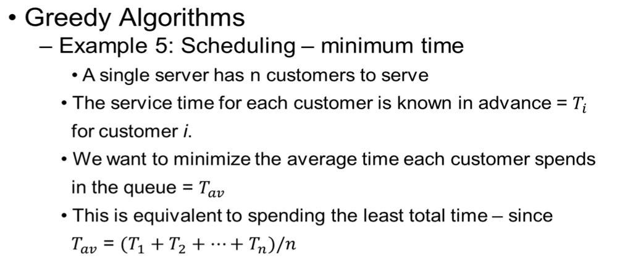
78

Slide 112
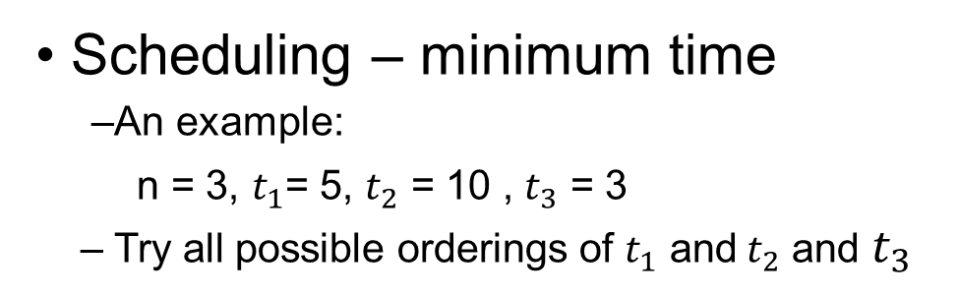
Order
T
1, 2, 3
5 + (5 + 10) + (5 + 10 + 3)
38
1, 3, 2
5 + (5 + 3) + (5 + 3 + 10)
31
2, 1, 3
10 + (10 + 5) + (10 + 5 +3)
43
2, 3, 1
10 + (10 + 3) + (10 + 3 +5)
41
3, 1, 2
3 + (3 + 5) + (3 + 5 + 10)
29
3, 2, 1
3 + (3 + 10) + (3 + 10 + 5)
34
79

Slide 113
• Scheduling – minimum time
– We note that the optimal solution, 29, is obtained by
choosing the customers in order of increasing service
time.
– One example does not constitute a proof that the best
result is obtained by serving in increasing order.
– Let us see if we can prove that this is the best strategy.
80

Slide 114
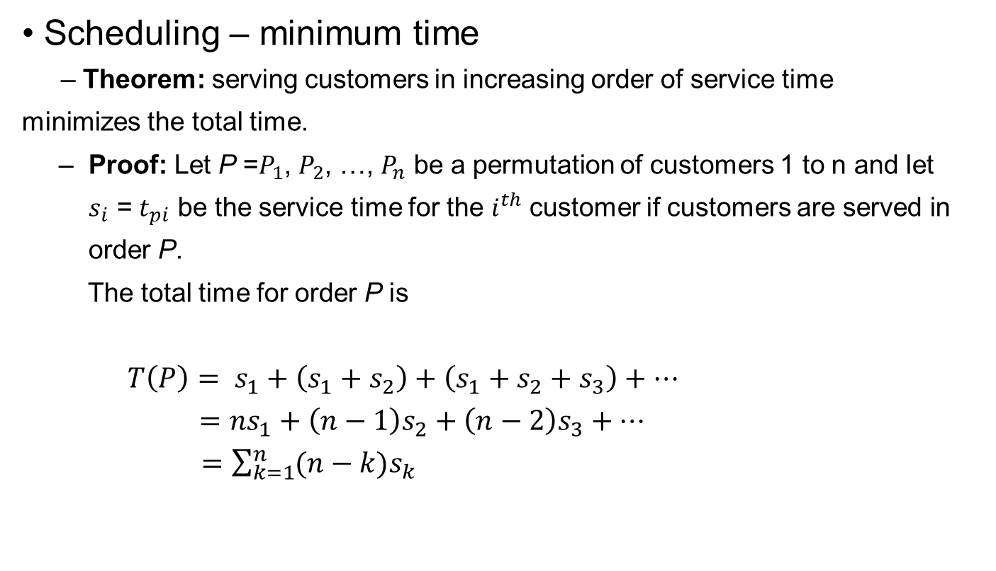
81

Slide 115
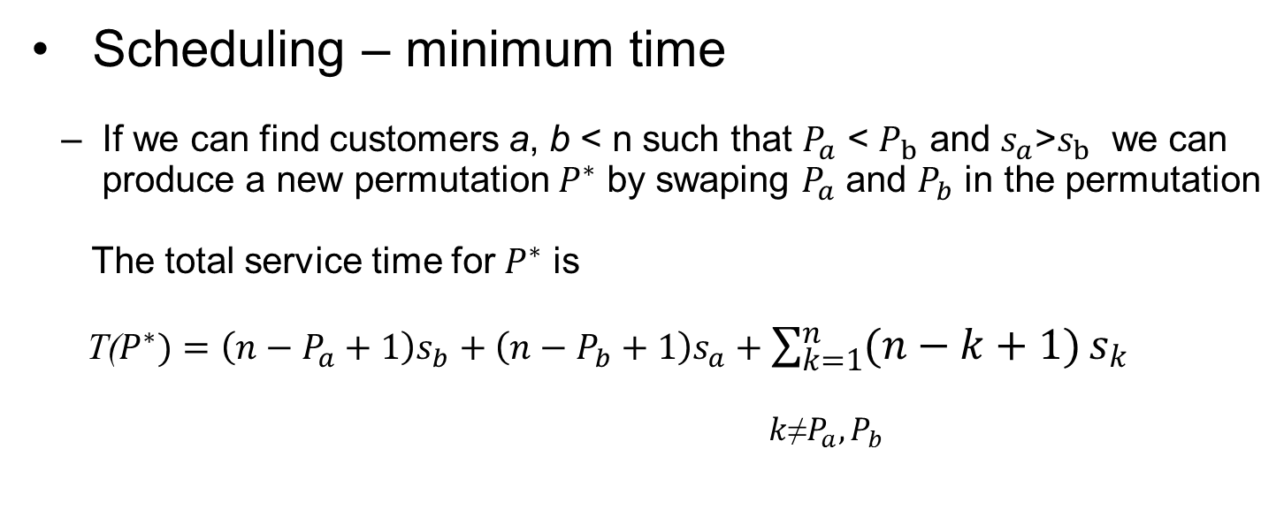
82

Slide 116
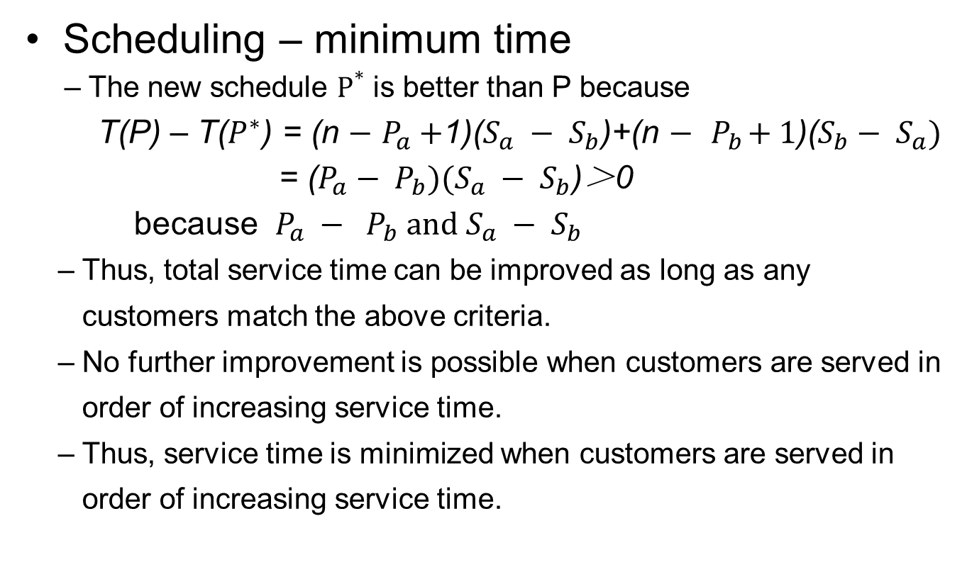
83

Slide 117
• Greedy Algorithms
– Example 6: Scheduling – deadlines
• A single server has n customers to serve
• The service time for each customer is known in advance = 1
• Serving customer i earns a profit p_{i} provided the customer is served before some deadline time d_{i}
• We want to serve the set of customers which maximizes the total profit.
84

Slide 118
•
Scheduling – deadlines
– An example:
n = 4
i
1
2
3
4
p
50
10
15
30
i
d
2
1
2
1
i
– Consider all possible schedules:
Sequence
Profit
Sequence
Profit
1
50
2, 1
60
2
10
2, 3
25
3
15
3, 1
65
4
30
4, 1
80
80
1, 3
65
4, 3
45
85

Slide 119
• Scheduling – deadlines
–A possible approach might be to use the following greedy algorithm
• Find the most profitable job
• Repeatedly add the next most profitable
feasible job until no more feasible jobs exist
• A feasible job is one that can be completed within the deadline requirements
• Once the set has been determined, the order can be set to ensure that all jobs selected are completed within each job’s deadline.
86

Slide 120
•
Scheduling – deadlines
– n = 4
jobs={4, 1}
i
1
2
3
4
p
50
10
15
30
i
d
2
1
2
1
i
– Let us test the algorithm:
• Job 1 is most profitable, select it
• Job 4 is the next most profitable and is feasible, select it
• Job 3 is the next most profitable but is not feasible
• Job 2 is the next most profitable but is not feasible
• There are no more jobs, order the set into deadline order done
87

Slide 121
• Scheduling – deadlines
– This leaves us with two questions remaining:
• Does this algorithm always generate the greatest profit?
• If so, how can it be most efficiently implemented?
88

Slide 122
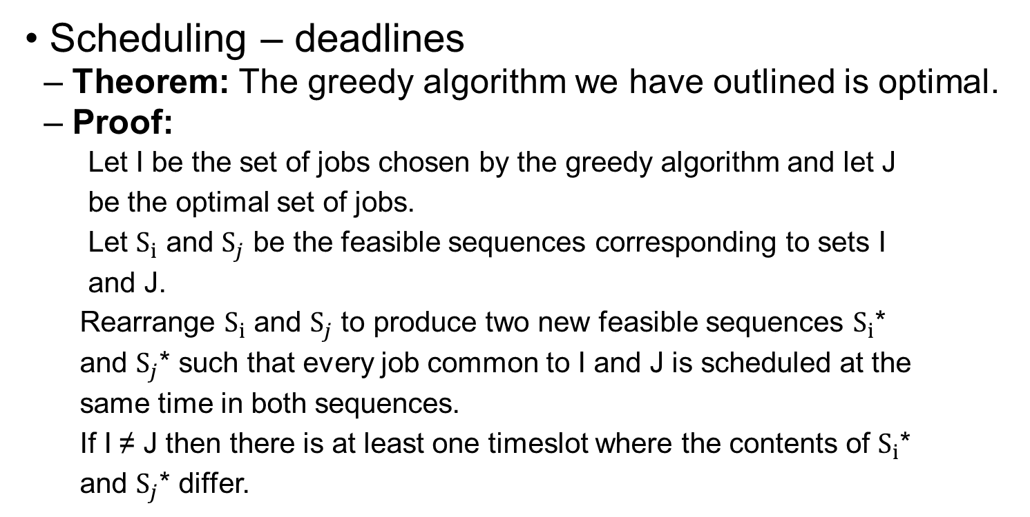
89

Slide 123
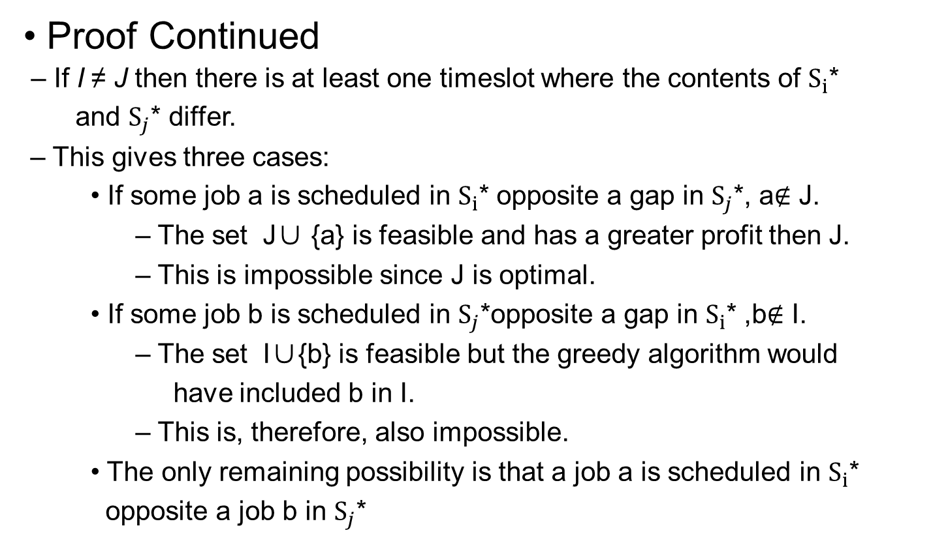
90

Slide 124
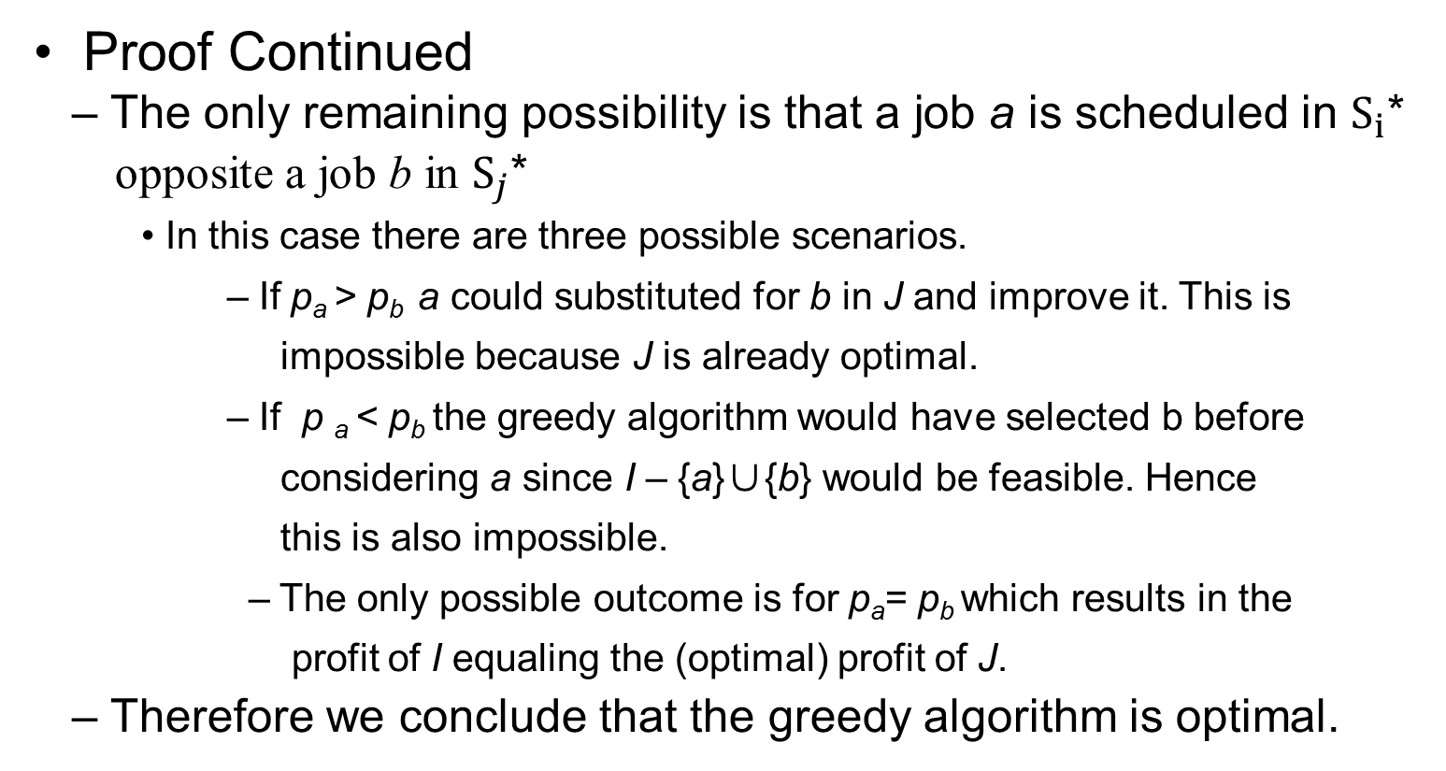
91

Slide 125
• Scheduling – deadlines
– Algorithm 1
• Assume the jobs are ordered in decreasing order of
profit. P1 ≥ P2 ≥ P3... ≥ Pn
• Also assume n > 0 and, d > 0, 1 < i < n
• Finally, assume that we can store sentinel values
before the first elements of the d and J arrays.
92

Slide 126
• Scheduling – deadlines
function sequence(d[0..n])
array J[0..n]
d[0] = 0; J[0] = 0 // insert the sentinel values
k = 1; J[1] = 1 // always choose job 1
for i = 2 to n do
r = k
while d[J[r]] > max (d[i], r) do
r = r – 1
if d[i] > r then
for m = k step –1 to r + 1 do
j[m + 1] = j[m]
j[r + 1] = i
k = k + 1
return k, J[1..k]
93

Slide 127
• Scheduling – deadlines
– E.g. Consider the following jobs:
i
1
2
3
4
5
6
p
20
15
10
7
5
3
i
d
0
3
1
1
3
1
3
i
J
0
1
d[J[i]]
3
– After initialization
94

Slide 128
• Scheduling – deadlines
– E.g. Consider the following jobs:
i
1
2
3
4
5
6
p
20
15
10
7
5
3
i
d
0
3
1
1
3
1
3
i
J
0
2
1
d[J[i]]
1
3
– Try i = 2 – feasible, insert in J in deadline order
95

Slide 129
• Scheduling – deadlines
– E.g. Consider the following jobs:
i
1
2
3
4
5
6
p
20
15
10
7
5
3
i
d
0
3
1
1
3
1
3
i
J
0
2
1
d[J[i]]
1
3
– Try i = 3 – not feasible
96

Slide 130
• Scheduling – deadlines
– E.g. Consider the following jobs:
i
1
2
3
4
5
6
p
20
15
10
7
5
3
i
d
0
3
1
1
3
1
3
i
J
0
2
1
4
d[J[i]]
1
3
3
– Try i = 4 – feasible, insert in J in deadline order
97

Slide 131
• Scheduling – deadlines
– E.g. Consider the following jobs:
i
1
2
3
4
5
6
p
20
15
10
7
5
3
i
d
0
3
1
1
3
1
3
i
J
0
2
1
4
d[J[i]]
1
3
3
– Try i = 5 – not feasible
98

Slide 132
• Scheduling – deadlines
– E.g. Consider the following jobs:
i
1
2
3
4
5
6
p
20
15
10
7
5
3
i
d
0
3
1
1
3
1
3
i
J
0
2
1
4
d[J[i]]
1
3
3
– Try i = 6 – not feasible, done
99

Slide 133
• Scheduling – deadlines
– How fast is this algorithm?
• Initial sort of jobs in order of decreasing profit O(n log n)
• For each job i, we look at each of the i – 1 jobs before it in d
so the inner loop is O(n)
• We examine each of the jobs except the first one (n – 1)
• The main loop is, therefore, O(n²)
• The algorithm is O(n log n) + O(n²) = O(n²)
– Can we do better?
100

Slide 134
• Scheduling – deadlines
– Algorithm 2
• There are l = min(n, max(d i)) slots
• Create sets of slots, F i – one for each feasible timeslot
• Set F i = i, i = 0, l
• For each job in decreasing order of profit try to find the
latest remaining feasible slot in which to schedule the job.
• Merge sets progressively until we run out of jobs or
slots
101

Slide 135
•
Scheduling – deadlines
– E.g. Consider the following jobs:
i
1
2
3
4
5
6
p
20
15
10
7
5
3
i
d
3
1
1
3
1
3
i
F
0
1
2
3
{0}
{1}
{2}
{3}
J
0
0
0
0
– After initialization
102

Slide 136
•
Scheduling – deadlines
– E.g. Consider the following jobs:
i
1
2
3
4
5
6
p
20
15
10
7
5
3
i
d
3
1
1
3
1
3
i
F
0
1
2
3
{0}
{1}
{2}
{3}
J
1
– Step 1: Schedule job 1 at time 3 and merge
103

Slide 137
•
Scheduling – deadlines
– E.g. Consider the following jobs:
i
1
2
3
4
5
6
p
20
15
10
7
5
3
i
d
3
1
1
3
1
3
i
F
0
1
2
3
{0}
{1}
{2, 3}
J
2
1
– Step 2: Schedule job 2 at time 1 and merge
104

Slide 138
•
Scheduling – deadlines
– E.g. Consider the following jobs:
i
1
2
3
4
5
6
p
20
15
10
7
5
3
i
d
3
1
1
3
1
3
i
F
0
1
2
3
{0, 1}
{2, 3}
J
2
1
– Step 3: Try to schedule job 3 at time 1 and fail
105

Slide 139
•
Scheduling – deadlines
– E.g. Consider the following jobs:
i
1
2
3
4
5
6
p
20
15
10
7
5
3
i
d
3
1
1
3
1
3
i
F
0
1
2
3
{0, 1}
{2, 3}
J
2
4
1
– Step 4: Schedule job 4 at time 2 and merge
106

Slide 140
•
Scheduling – deadlines
– E.g. Consider the following jobs:
i
1
2
3
4
5
6
p
20
15
10
7
5
3
i
d
3
1
1
3
1
3
i
F
0
1
2
3
{0, 1, 2, 3}
J
2
4
1
– Step 5: Try to schedule job 5 at time 1 and fail
107

Slide 141
•
Scheduling – deadlines
– E.g. Consider the following jobs:
i
1
2
3
4
5
6
p
20
15
10
7
5
3
i
d
3
1
1
3
1
3
i
F
0
1
2
3
{0, 1, 2, 3}
J
2
4
1
– Step 6: Try to schedule job 6 at time 3 and fail – done
108

Slide 142
• Scheduling – deadlines
– How fast is this algorithm?
• Initial sort of jobs in order of decreasing profit O(n log n)
• For each job i , finding the set containing d and the next
lowest set and merging them takes O( a(2n, n))
• We examine each of the jobs except the first one (n – 1)
• The main loop is, therefore, O(n a(2n, n))
• The algorithm is O(n log n) + O(n a(2n, n)) = O(n log n)
• Note: a(2n, n) is a very slow-growing function
– This algorithm is a great improvement over the previous one.
109

Slide 143
• Greedy Algorithms
– Example 7: The Traveling Salesman Problem
• Let G = (N, E) be a complete, undirected graph consisting of
a set of nodes, N, and a set of edges E.
• Each edge has a length, the distance from the node at one end
of the edge to the node at the other end.
• The problem is to find a subset, S, of the edges of G such that
the graph G = (N, S) is still connected , S forms a cycle
and that the total length of the edges in S is minimized.
• If we view the nodes as towns and the edges as roads this is
equivalent to finding the shortest round-trip route visiting
each town once and returning to the start.
• Can we find a greedy algorithm to solve this problem?
110

Slide 144
• Example 7: The Traveling Salesman Problem
– Consider the following map – with distance matrix
1
25
0
3
10
11
7
25
3
26
3
0
8
12
9
26
6
2
11
10
8
0
9
4
20
15
18
8
11
12
9
0
5
15
7
20
10
9
7
9
4
5
0
18
5
4
3
25
26
20
15
18
0
12
5
9
4
111

Slide 145
• The Traveling Salesman Problem
– A greedy algorithm might be:
• Start at an arbitrary node (node 1)
• At each step visit the nearest node to the current one
• When no more nodes are left, go home
– How good is this algorithm?
112

Slide 146
• The Traveling Salesman Problem
– Move to node 1
1
25
0
3
10
11
7
25
3
26
3
0
8
12
9
26
6
2
11
10
8
0
9
4
20
15
18
8
11
12
9
0
5
15
7
20
10
9
7
9
4
5
0
18
5
4
3
25
26
20
15
18
0
12
5
9
4
113

Slide 147
• The Traveling Salesman Problem
– Move to node 2
1
25
0
3
10
11
7
25
3
26
3
0
8
12
9
26
6
2
11
10
8
0
9
4
20
15
18
8
11
12
9
0
5
15
7
20
10
9
7
9
4
5
0
18
5
4
3
25
26
20
15
18
0
12
5
9
4
114

Slide 148
• The Traveling Salesman Problem
– Move to node 3
1
25
0
3
10
11
7
25
3
26
3
0
8
12
9
26
6
2
11
10
8
0
9
4
20
15
18
8
11
12
9
0
5
15
7
20
10
9
7
9
4
5
0
18
5
4
3
25
26
20
15
18
0
12
5
9
4
115

Slide 149
• The Traveling Salesman Problem
– Move to node 5
1
25
0
3
10
11
7
25
3
26
3
0
8
12
9
26
6
2
11
10
8
0
9
4
20
15
18
8
11
12
9
0
5
15
7
20
10
9
7
9
4
5
0
18
5
4
3
25
26
20
15
18
0
12
5
9
4
116

Slide 150
• The Traveling Salesman Problem
– Move to node 4
1
25
0
3
10
11
7
25
3
26
3
0
8
12
9
26
6
2
11
10
8
0
9
4
20
15
18
8
11
12
9
0
5
15
7
20
10
9
7
9
4
5
0
18
5
4
3
25
26
20
15
18
0
12
5
9
4
117

Slide 151
• The Traveling Salesman Problem
– Move to node 6
1
25
0
3
10
11
7
25
3
26
3
0
8
12
9
26
6
2
11
10
8
0
9
4
20
15
18
8
11
12
9
0
5
15
7
20
10
9
7
9
4
5
0
18
5
4
3
25
26
20
15
18
0
12
5
9
4
118

Slide 152
• The Traveling Salesman Problem
– Move back to node 1
1
25
0
3
10
11
7
25
3
26
3
0
8
12
9
26
6
2
11
10
8
0
9
4
20
15
18
8
11
12
9
0
5
15
7
20
10
9
7
9
4
5
0
18
5
4
3
25
26
20
15
18
0
12
5
9
4
119

Slide 153
• The Traveling Salesman Problem
– Route is 1 to 2 to 3 to 5 to 4 to 6 to1
1
25
0
3
10
11
7
25
3
26
3
0
8
12
9
26
6
2
11
10
8
0
9
4
20
15
18
8
11
12
9
0
5
15
7
20
10
9
7
9
4
5
0
18
5
4
3
25
26
20
15
18
0
12
5
9
4
120

Slide 154
• The Traveling Salesman Problem
– Total distance is 60
1
25
0
3
10
11
7
25
3
26
3
0
8
12
9
26
6
2
11
10
8
0
9
4
20
15
18
8
11
12
9
0
5
15
7
20
10
9
7
9
4
5
0
18
5
4
3
25
26
20
15
18
0
12
5
9
4
– is this optimal?
121

Slide 155
• The Traveling Salesman Problem
– Total distance is 60
1
1
25
25
3
3
26
26
6
2
6
2
11
11
15
15
18
20
8
18
20
8
7
9
10
7
9
10
5
4
3
5
4
3
12
12
5
9
5
9
4
4
– is this optimal? No 58 is.
122

Slide 156
The Traveling Salesman Problem
It is close however.
Is this greedy algorithm at least near optimal?
Let us look at another problem.
123

Slide 157
• The Traveling Salesman Problem
– Consider the following map:
• The greedy algorithm gives path 1 to 2 to 3 to 4 to 1
• With distance 105
• Compared to 13
•
1
1
1
2
1
2
4
4
99
2
99
2
5
5
4
3
4
3
3
3
•
Clearly, the greedy algorithm is not even close to optimal in this
Case！
124

Slide 158
Greedy Algorithms
Good in a wide range of problem classes
Generally, easy to implement
Generally, efficient
Sometimes not very good at all
Clearly, for some sorts of problem we need a different approach from the greedy one
Divide-and-Conquer is such an approach
125

Slide 159
Discussions
1. What is Greedy Strategy.
2. What is the Greedy Algorithm.

Slide 160
Homework
Assignment 2
Implement Prime Algorithm for Minimum Spanning Tree.

