Slide 1
JICSCI803
Algorithms and Data Structures Feb to June 2018

Slide 2
7 Keys to Success in Graduate Study
1. Be proactive – take responsibility for your own grad school experience
2. Establish positive relationships with your
relevant persons in study
3. Embrace your academic community
Know your program requirements and timelines
Create and follow an annual plan
Bring a professional approach to your studies and interactions
7. Seek balance and support in your life

Slide 3
Highlights of Lecture 01
Information on this subject
Importance of this subject
Concept and examples of algorithms
Concept and examples of data structures

Slide 4
Questions about the Subject
What are algorithms?
How to evaluate and compare algorithms?
What is data structures?
What is the role of algorithms and data structures in computer science?
Where the data structures and algorithms come from?
What is the learning outcome of this subject?
What is the ways to learn them?
What is the importance of this subject?

Slide 5
Why Study this Course?
Donald E. Knuth stated “Computer Science is the study of algorithms”
  Cornerstone of computer science. Programs will not exist without algorithms.
Closely related to our lives
Help to guide how others analyze and solve problems
Help to develop the ability of analyzing and solving problems via computers
Very interesting if you can concentrate on this course
Copyright  Li Zimao @ 2007-2008-1 SCUEC

Slide 6
Subject Outcomes
On successfully completing this subject students should be able to:
compare the complexities of algorithms;
Choose and use appropriate data structures and algorithms for a wide class of problems;
make effective use of abstract data types as a design technique and implement abstract data types using C++ classes or C modules or JAVA or Python;
develop and use modules that implement algorithms in a generic manner and which can be reused in different applications

Slide 7
CSCI803 Grading Scheme
ASSESSMENT ITEMS & FORMAT | % OF FINAL MARK | GROUP/ INDIVIDUAL | DUE DATE | SUBJECT LEARNING OUTCOMES
Class participation | 5
Assignments | 35 | Individual | To be advised by the lecturer | 1-4
Final examination | 60 | Individual | Examination Period | 1-4
Bonus is possible for those positive and active students
NOTES: written submissions in LaTex (pdf)

Slide 8
Marks and TFs
Participation and Assignments (40%)
  Participation an 4 Assignments
  To be eligible for a Pass in this subject a student must achieve a mark of at least 40% (i.e. 16/40).
Final Exam (60%)
  To be eligible for a Pass in this subject a student must achieve a mark of at least 40% in the Exam (i.e. 24/60).

Slide 9
Assignment
Assignment 1 is purely written
Assignments 2,3 &4 are programming assignments
  NB: 0 marks if it doesn't compile in the labs
  Very few marks if it doesn't work to spec
  Some of the marks are for suitable choice of data structures and algorithms.
  Deductions for poor clarity/style.

Slide 10
Caution
Please finish your assignments and projects independently.
  If you really meet problems, you can seek help from me or other students, but remember not copying, CHEATING!
Please sign attendance when needed, but remember not signing for others, CHEATING!
Power off (or ring off) your mobile phone
Feedback (positive or negative) is encouraged and welcome, and IMPORTANT. (ask questions!)
Thinking, before, in and after class is encouraged and IMPORTANT.
Copyright  Li Zimao @ 2007-2008-1 SCUEC

Slide 11
Course Prerequisite
Discrete Mathematics
C, Java or other programming languages
Advanced Mathematics
Ability to form problems from a wide range of tasks.
Copyright  Li Zimao @ 2007-2008-1 SCUEC

Slide 12
Name | C | C++ | Java | Python | Others | Level | Value
Shaojun Shen | 0.4 | 0.4 | 0.6 | 0 | none | proficient | 1
Zhihui Zheng | 0.6 | 0.4 | 0.4 | 0.2 | none | master | 0.8
Yafei Li | 0.6 | 0.4 | 0.8 | 0.2 | JS,OC | familiar | 0.6
Mengmeng Duan | 0.6 | 0.6 | 0.4 | 0 |  | understand | 0.4
Daoxuan Lyu | 0.6 | 0.4 | 0.4 | 0 | none | average | 0.2
Ni Wan | 0.6 | 0.4 | 0.4 | 0 | matlab | unknown | 0
Luoling Xu | 0.6 | 0.4 | 0.4 | 0.2 | none
average | 0.571428571 | 0.428571429 | 0.485714286 | 0.085714286
Copyright  Li Zimao @ 2007-2008-1 SCUEC

Slide 13
Pedagogy
  What I hear, I forget.
  What I see, I remember.
  What I do, I understand.
  What does this mean?
Copyright  Li Zimao @ 2007-2008-1 SCUEC

Slide 14
Explanation of Algorithms and Data Structures
Algorithms
  What is an algorithm?
  Where do they come from?
  Why do we study algorithms?
Data structures?
  More than just data?
  An organised collection of data

Slide 15
Explanation of Algorithms and Data Structures
What is an algorithm?
  A set of rules for carrying out some calculation or procedure
  An algorithm should be correct
  An algorithm should terminate
  An algorithm should be efficient

Slide 16
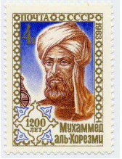
Explanation of Algorithms and Data Structures
Where do algorithms come from?
  Named for the ninth-century Persian mathematician al-Khowârizmî
  Derived from the need to solve a specific problem
  Algorithms do not simply come out of thin air (or out of a textbook)
(image of Al Khwarizmi from http://jeff560.tripod.com/)

Slide 17
Notion: Algorithms
Explanation of Algorithms and Data Structures
  An algorithm is a sequence of unambiguous instructions for solving a computational problem, i.e., for obtaining a required output for any legitimate input in a finite amount of time.
problem
algorithm
“computer”
input
output

Slide 18
Notion: Algorithm
Explanation of Algorithms and Data Structures
More precisely, an algorithm is a method or process to solve a problem satisfying the following properties:
  Finiteness
    terminates after a finite number of steps
  Definiteness
    Each step must be rigorously and unambiguously specified.
    -e.g., ”stir until lumpy”
  Input
    Valid inputs must be clearly specified.
  Output
    can be proved to produce the correct output given a valid can be proved to produce the correct output given a valid input.
  Effectiveness
    Steps must be sufficiently simple and basic.
    -e.g., check if 2 is the largest integer n for which there is a solution to the equation x^{n} + y^{n} = z^{n} in positive integers x, y, and z
Copyright  Li Zimao @ 2007-2008-1 SCUEC

Slide 19
Explanation of Algorithms and Data Structures
Algorithm: A method or process followed to solve a problem. In other words, an algorithm is a finite set of instructions.
In addition, all algorithms must satisfy the following criteria:
It must be correct.
It must be composed of series of concrete steps.
There can be no ambiguity as to which step will be performed next.
It must be composed of a finite number of steps.
It must terminate.
Input/Output: There must be a specified number of input values, and one or more result values.

Slide 20
How to describe the algorithm?
Explanation of Algorithms and Data Structures
Natural language.
Graphic.
Program.
Formal language.

Slide 21
Explanation of Algorithms and Data Structures
Why do we study algorithms?
  To understand how they work
  To be able to know when to use them
  To be able to adapt them to new problems
  To be able to create new algorithms that are better than the existing ones (not all of us)
– Better? In what way?
» Faster
» Less space used
» More general

Slide 22
An example of problem and algorithm
Explanation of Algorithms and Data Structures
The problem of finding the maximum:
Find the maximum from n numbers.
Select a data structure to store n numbers:
list [n], linked list; stack.
Design an algorithm to solve it:
list [n], linked list; stack.
The following algorithm is to find the maximum.
max = list [0];
for (i=1; i<n; i++)
{
if list[i] > max then max = list[i];
}

Slide 23
The program
Explanation of Algorithms and Data Structures
programs: A computer program is viewed as an instance or concrete representation of an algorithm in some programming language.
The distinguishes between an algorithm and a program:
program-- does not have to satisfy (1) (operation system)
Algorithm--may was natural language、graphic、a programming Language
A problem is a function or a mapping of inputs to outputs.
An algorithm is recipe for solving a problem.
A program is an instantiation of an algorithm in a computer programming language.

Slide 24
Algorithm Efficiency
There are often many approaches to solving a problem.
How to choose between them?
At the heart of program design are goals:
To design an algorithm that is easy to understand, code, and debug.
To design an algorithm that makes efficient use of the computer’s resource.
The efficiency measurement will be discussed in coming lecture.

Slide 25
Examples
Is the following a legitimate algorithm?
i ←1
While (i <= 10) do
a ← i + 1
Print the value of a
End of loop
Stop
Copyright  Li Zimao @ 2007-2008-1 SCUEC

Slide 26
Examples of Algorithms – Computing the Greatest Common Divisor of Two Integers
gcd(m, n): the largest integer that divides both m and n.
First try -- Euclid’s algorithm: gcd(m, n) = gcd(n, m mod n)
  Step1: If n = 0, return the value of m as the answer and stop; otherwise, proceed to Step 2.
  Step2: Divide m by n and assign the value of the remainder to r.
  Step 3: Assign the value of n to m and the value of r to n. Go to Step 1.
Copyright  Li Zimao @ 2007-2008-1 SCUEC
Notes:
Gcd(70, 25) = gcd(25, 20) = gcd(20, 5) = gcd (5, 0) = 5
Gcd(60, 24) = gcd(24, 12) = gcd(12, 0) = 12

Slide 27
Methods of Specifying an Algorithm
Natural language
  Ambiguous
  “Mike ate the sandwich on a bed.”
Pseudocode
  A mixture of a natural language and programming language-like structures
  Precise and succinct.
  Pseudocode in this course
    omits declarations of variables
    use indentation to show the scope of such statements as for, if, and while.
    use ← for assignment
Copyright  Li Zimao @ 2007-2008-1 SCUEC

Slide 28
Pseudocode of Euclid’s Algorithm
Algorithm Euclid(m, n)
//Computes gcd(m, n) by Euclid’s algorithm
//Input: Two nonnegative, not-both-zero integers m and n
//Output: Greatest common divisor of m and n
while n ≠ 0 do
r ← m mod n
m ← n
n ← r
return m
Questions:
  Finiteness: how do we know that Euclid’s algorithm actually comes to a stop?
  Definiteness: nonambiguity
  Effectiveness: effectively computable.
Copyright  Li Zimao @ 2007-2008-1 SCUEC

Slide 29
Second Try for gcd(m, n)
Consecutive Integer Algorithm
  Step1: Assign the value of min{m, n} to t.
  Step2: Divide m by t. If the remainder of this division is 0, go to Step3;otherwise, go to Step 4.
  Step3: Divide n by t. If the remainder of this division is 0, return the value of t as the answer and stop; otherwise, proceed to Step4.
  Step4: Decrease the value of t by 1. Go to Step2.
Questions
  Finiteness
  Definiteness
  Effectiveness
  Which algorithm is faster, the Euclid’s or this one?
Copyright  Li Zimao @ 2007-2008-1 SCUEC

Slide 30
Third try for gcd(m, n)
Middle-school procedure
  Step1: Find the prime factors of m.
  Step2: Find the prime factors of n.
  Step3: Identify all the common factors in the two prime expansions found in Step1 and Step2. (If p is a common factor occurring Pm and Pn times in m and n, respectively, it should be repeated in min{Pm, Pn} times.)
  Step4: Compute the product of all the common factors and return it as the gcd of the numbers given.
Question
  Is this a legitimate algorithm?
Copyright  Li Zimao @ 2007-2008-1 SCUEC

Slide 31
Sieve of Eratosthenes
Input: Integer n ≥ 2
Output: List of primes less than or equal to n
for p ← 2 to n do
A[p] ← p
for p ← 2 to ⎣sqrt(n)⎦ do
if A[p] ≠ 0 //p hasn’t been previously eliminated from the list
j ← p* p
while j ≤ n do
A[j] ← 0 //mark element as eliminated
j ← j + p
Example: 2 3 4 5 6 7 8 9 10 11 12 13 14 15 16 17 18 19 20
Copyright  Li Zimao @ 2007-2008-1 SCUEC

Slide 32
What can we learn from the previous 3 examples?
Each step of an algorithm must be unambiguous.
The same algorithm can be represented in several different ways. (different pseudocodes)
There might exists more than one algorithm for a certain problem.
Algorithms for the same problem can be based on very different ideas and can solve the problem with dramatically different speeds.
Copyright  Li Zimao @ 2007-2008-1 SCUEC

Slide 33
Fundamentals of Algorithmic Problem Solving
Understanding the problem
  Asking questions, do a few examples by hand, think about special cases, etc.
Deciding on
  Exact vs. approximate problem solving
  Appropriate data structure
Design an algorithm
Proving correctness
Analyzing an algorithm
  Time efficiency : how fast the algorithm runs
  Space efficiency: how much extra memory the algorithm needs.
Coding an algorithm
Copyright  Li Zimao @ 2007-2008-1 SCUEC

Slide 34
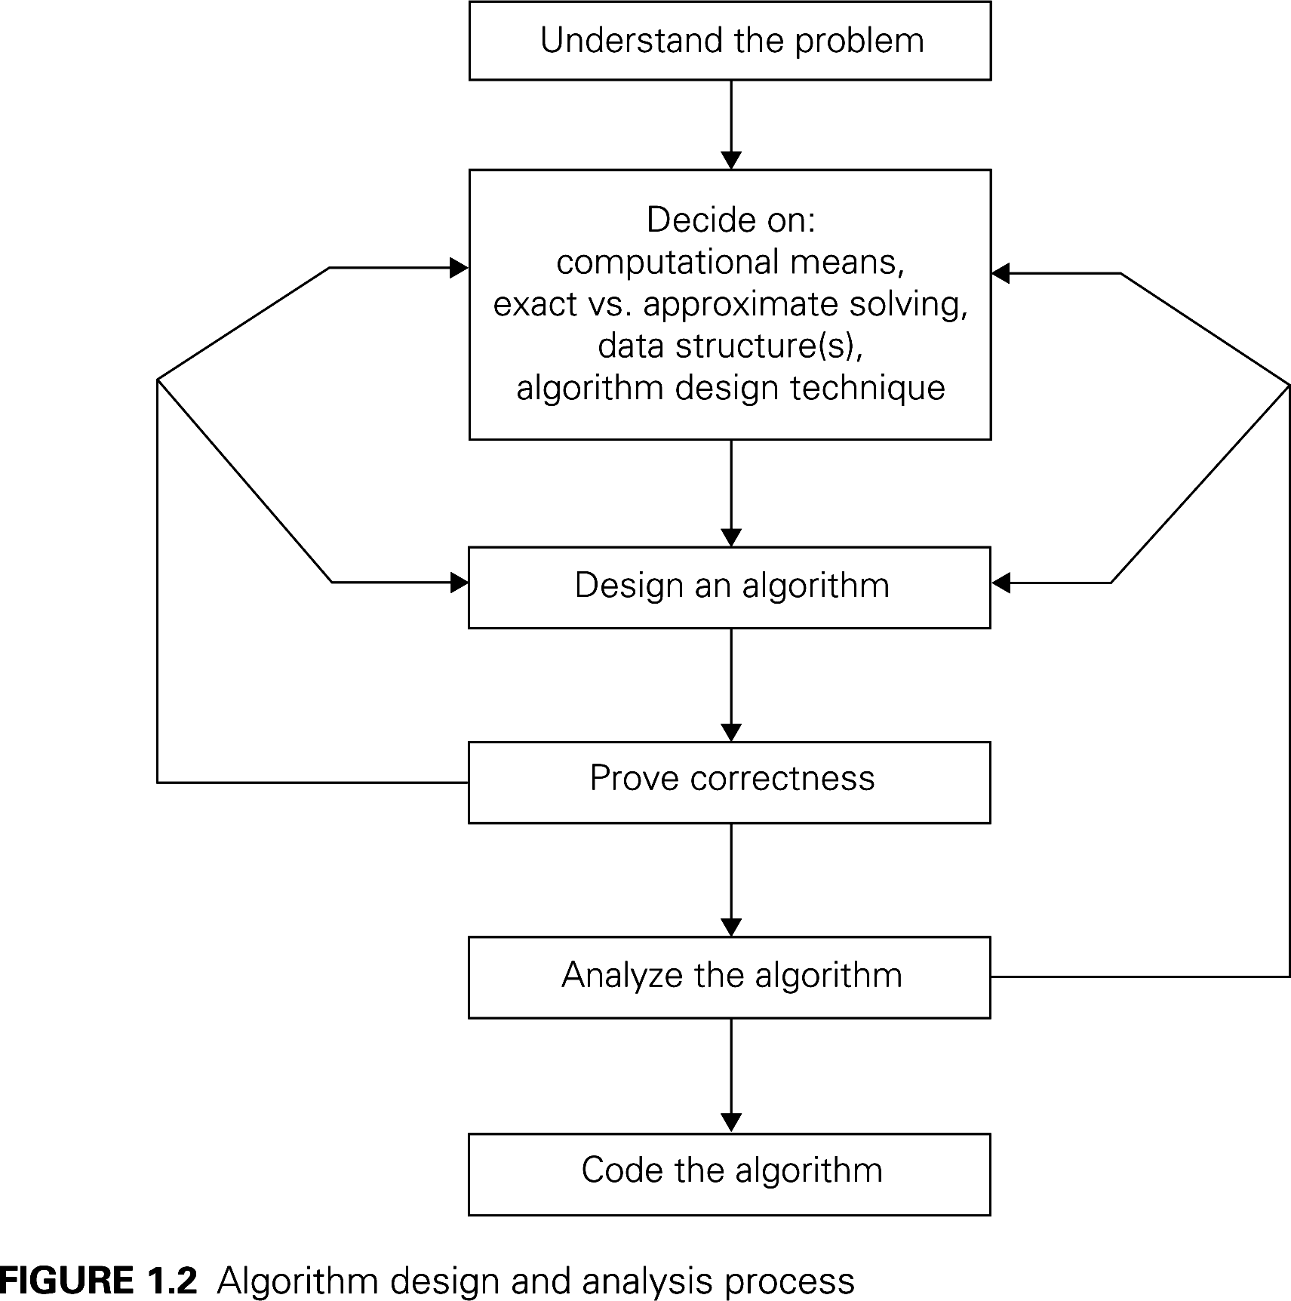
Algorithm Design and Analysis Process
Copyright  Li Zimao @ 2007-2008-1 SCUEC

Slide 35
Two main issues related to algorithms
How to design algorithms
How to analyze algorithm efficiency
Copyright  Li Zimao @ 2007-2008-1 SCUEC

Slide 36
Algorithm Design Techniques/Strategies
Brute force
Divide and conquer
Decrease and conquer
Transform and conquer
Space and time tradeoffs
Greedy approach
Dynamic programming
Backtracking
Branch and bound
Copyright  Li Zimao @ 2007-2008-1 SCUEC

Slide 37
Analysis of Algorithms
How good is the algorithm?
  time efficiency
  space efficiency
Does there exist a better algorithm?
  lower bounds
  optimality
Copyright  Li Zimao @ 2007-2008-1 SCUEC

Slide 38
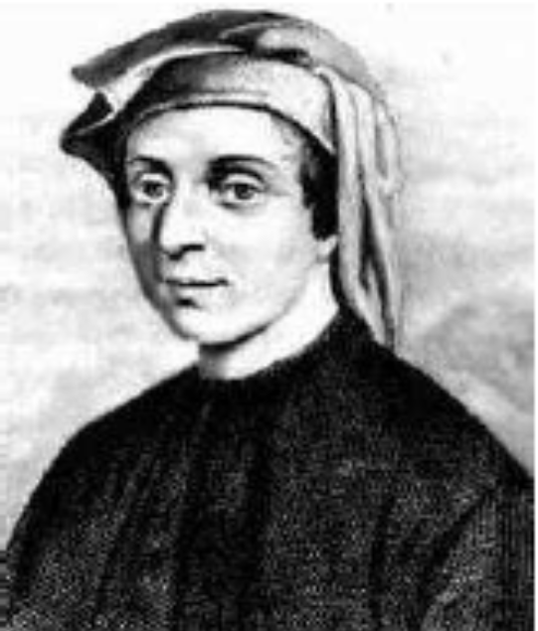
Example: Fibonacci Number
Fibonacci’s original question:
  Suppose that you are given a newly-born pair of rabbits, one male, one female.
  Rabbits are able to mate at the age of one month so that at the end of its second month a female can produce another pair of rabbits.
  Suppose that our rabbits never die.
  Suppose that the female always produces one new pair (one male, one female) every month.
Question: How many pairs will there be in one year?
  1. In the beginning: (1 pair)
  2. End of month 1: (1 pair) Rabbits are ready to mate.
  3. End of month 2: (2 pairs) A new pair of rabbits are born.
  4. End of month 3: (3 pairs) A new pair and two old pairs.
  5. End of month 4: (5 pairs) ...
  6. End of month 5: (8 pairs) ...
  7. after 12 months, there will be 233 rabits
(image of Leonardo Fibonacci from http://www.math.ethz.ch/fibonacci)
Copyright  Li Zimao @ 2007-2008-1 SCUEC

Slide 39
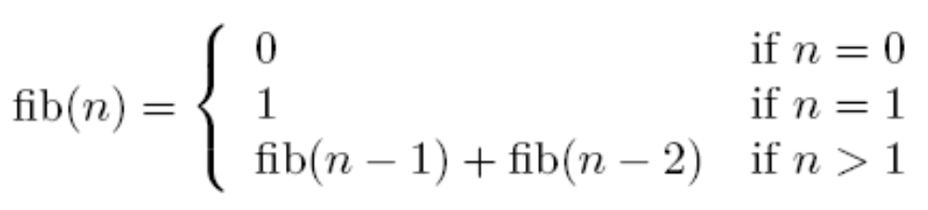
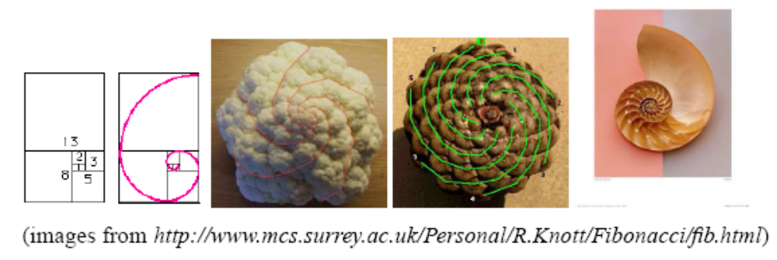
Recurrence Relation of Fibonacci Number fib(n):
{0, 1, 2, 3, 5, 8, 13, 21, 34, 55, 89, 144, …}
Copyright  Li Zimao @ 2007-2008-1 SCUEC

Slide 40
Algorithm: Fibonacci
Problem: What is fib(200)? What about fib(n), where n is any positive integer?
Algorithm 1 fib(n)
if n = 0 then
return (0)
if n = 1then
return (1)
return (fib(n − 1) + fib(n − 2))
Questions that we should ask ourselves.
1. Is the algorithm correct?
2. What is the running time of our algorithm?
3. Can we do better?
Copyright  Li Zimao @ 2007-2008-1 SCUEC

Slide 41
Answer of Questions
Is the algorithm correct?
  Yes, we simply follow the definition of Fibonacci numbers
How fast is the algorithm?
  If we let the run time of fib(n) be T(n), then we can formulate
    T(n) = T(n − 1) + T(n − 2) + 3 ≈ 1.6^{n}
  T(200) ≥ 2¹³⁹
  The world fastest computer BlueGene/L, which can run 2⁴⁸ instructions per second, will take 2⁹¹ seconds to compute. (2⁹¹ seconds = 7.85 × 10¹⁹ years )
  Can Moose’s law, which predicts that CPU get 1.6 times faster each year, solve our problem?
  No, because the time needed to compute fib(n) also have the same “growth” rate
    if we can compute fib(100) in exactly a year,
    then in the next year, we will still spend a year to compute fib(101)
    if we want to compute fib(200) within a year, we need to wait for 100 years.
Copyright  Li Zimao @ 2007-2008-1 SCUEC

Slide 42
Improvement
Can we do better?
  Yes, because many computations in the previous algorithm arerepeated.
Algorithm 2: fib(n)
comment: Initially we create an array A[0: n]
A[0] ← 0,A[1] ← 1
for i = 2 to n do
A[i] = A[i − 1] + A[i − 2]
return (A[n])
Copyright  Li Zimao @ 2007-2008-1 SCUEC

Slide 43
Important problem types
sorting
searching
string processing
graph problems
combinatorial problems
geometric problems
numerical problems
Copyright  Li Zimao @ 2007-2008-1 SCUEC

Slide 44
Example of computational problem: sorting
Statement of problem:
  Input: A sequence of n numbers <a₁, a₂, …, a_{n}>
  Output: A reordering of the input sequence <a´₁, a´₂, …, a´_{n}> so that a´_{i} ≤ a´_{j} whenever i < j
Instance: The sequence <5, 3, 2, 8, 3>
Algorithms:
  Selection sort
  Insertion sort
  Merge sort
  (many others)
Design and Analysis of Algorithms - Chapter 1

Slide 45
Selection Sort
Input: array a[1],…,a[n]
Output: array a sorted in non-decreasing order
Algorithm: for i=1 to n
swap a[i] with smallest of a[i],…a[n]
see also pseudocode, section 3.1
Design and Analysis of Algorithms - Chapter 1
Notes:
The algorithm is given *very* informally here. Show students the pseudocode in
section 3.1.
This is a good opportunity to discuss pseudocode conventions.

Slide 46
Some Well-known Computational Problems
Sorting
Searching
Shortest paths in a graph
Minimum spanning tree
Primality testing
Traveling salesman problem
Knapsack problem
Chess
Towers of Hanoi
Program termination
Design and Analysis of Algorithms - Chapter 1
Notes:
1-4 have well known efficient (polynomial-time) solutions
5: primality testing has recently been found to have an efficient solution
This is a great problem to discuss because it has recently been in the news
(see mathworld news at: http://mathworld.wolfram.com/news/2002-08-07_primetest/
or original article: http://www.cse.iitk.ac.in/primality.pdf)
6(TSP)-9(chess) are all problems for which no efficient solution has been found
it is possible to informally discuss the “try all possibilities” approach that is required
to get exact solutions to such problems
10: Towers of Hanoi is a problem that has only exponential-time solutions (simply
because the output required is so large)
11: Program termination is undecidable

Slide 47
Basic Issues Related to Algorithms
How to design algorithms
How to express algorithms
Proving correctness
Efficiency
  Theoretical analysis
  Empirical analysis
Optimality
Design and Analysis of Algorithms - Chapter 1

Slide 48
Algorithm design strategies
Brute force
Divide and conquer
Decrease and conquer
Transform and conquer
Greedy approach
Dynamic programming
Backtracking and Branch and bound
Space and time tradeoffs
Design and Analysis of Algorithms - Chapter 1

Slide 49
Analysis of Algorithms
How good is the algorithm?
  Correctness
  Time efficiency
  Space efficiency
Does there exist a better algorithm?
  Lower bounds
  Optimality
Design and Analysis of Algorithms - Chapter 1

Slide 50
Why study algorithms?
Theoretical importance
  the core of computer science
Practical importance
  A practitioner’s toolkit of known algorithms
  Framework for designing and analyzing algorithms for new problems
Design and Analysis of Algorithms - Chapter 1

Slide 51
Efficiency
A solution is said to be efficient if it solves the problem within its resource constraints.
-space
-time
.The cost of a solution is the amount of resources that the solution consumes.

Slide 52
Explanation of Algorithms and Data Structures
Data structures – more than just data?
  Organised collection of data
  Represents an abstract data type in an efficient (hopefully) way
– Efficient? In what way?
» Allows for efficient access by the algorithm
» Uses a minimum of storage
Week 1

Slide 53
Definition: A data structure is any data representation and its associated operation
(1) data representation
More typically, a data structure is meant to be an organization or structuring for a collection of data items.
(2) associated operation
Such as: search, print, modify, sort, etc.
e.g. for integer, the operations include +,-,*,/,%,...

Slide 54
Three Steps to select a data structure
Analyze problem, determine the resource constraints
Determine the basic operations that must be supported and quantify the resource constraints for each operation
Select the data structure that best meets these requirements
This three-step approach to selecting a data structure operationalizes a data-centered view to design

Slide 55
cost and benefits
Each data structure has associated cost and benefits.
cost: A data structure requires a certain amount of space to store each data item, a certain amount of time to perform a single basic operation, and a certain amount of programming effort.
benefit: To solve a problem efficiently. A solution is said to be efficient if it solves the problem within the required resource constraints.

Slide 56
Abstract Data Type (ADT, class)
ADT: Defines a data type solely in terms of a set of values and a set of operations on that data type.
Each ADT operation is defined by its inputs and outputs.
Encapsulation : Hide implementation details.

Slide 57
An ADT Example
ADT Complex_Number {
Objects: {a₁+a₂i | a₁, a₂i ∈R }
where R is the set of real
Operations: let x= x₁+x₂i , y= y₁+y₂i
real realpart(x): get the real part of x
real imagpart(x): get the imaginary part of x
complex_number add(x,y): return x+y,
that is (x₁+y₁ )+(x₂+y₂)i
complex_number subtract(x,y): return x-y,
that is (x₁-y₁ )+(x₂-y₂)i
complex_number multiplay(x,y): return x*y,
that is (x_{1*}y₁-x₂*y₂)+(x₁*y₂ +x₂*y₁)i
}

Slide 58
The Data Structure (DS)
The physical implementation of an ADT
the data items have both a logical and a physical form. An ADT is logical form. The implementation of the data item within a data structure is its physical form
Data Type
ADT
type
operations
Data Structure
-Storage space
-Subroutines
Data items:
logical form
Data items:
Physical form

Slide 59
Fundamental data structures
list
  array
  linked list
  string
stack
queue
priority queue
graph
tree
set and dictionary
Copyright  Li Zimao @ 2007-2008-1 SCUEC

Slide 60
0 Related Concepts
1. Data
Number
Text: names, articles, books
Images
Videos
Figures
Functions (methods)
Input => output

Slide 61
1 A Philosophy of Data Structure
The Need for Data Structure
Data structure + Algorithm = Programming
The system development process:
(1) the purpose of the project (input, output)
(2) break the problem down into
management pieces
(3) choose concrete representation for data objects and write algorithm for each
operations on them
(4) developing correctness for programs

Slide 62
Data structures organize data➔ more efficient programes
More powerfull Computers➔ more complex applications
More complex applications demand more calculations.
Complex computing tasks are unlike our everyday experience.

Slide 63
Organizing Data
Any organization for a collection of records can be searched. Processed in any order or modified.
The choice of data structure and algorithm can make the difference between a program running in a few seconds or many days.

Slide 64
Problems, Algorithms, and Programs
Problem: a problem is a task be performed. It is best thought of in terms of inputs and matching outputs.
A problem definition should not include any constraints on how the problem is to be solved.
A problem definition should include constraints on the resources that may be consume by any acceptable solution.
Problem can be viewed as function in mathematical sense
A function is a matching between inputs (the domain ) and outputs ( the range ).
Different inputs are permitted to give the same output.
Any particular input must always result in the same output every time the function is computed using that input.

Slide 65


