Slide 1
JICSCI803 Algorithms and Data Structures March to June 2018

Slide 2
Highlights of Lecture 04
Sort algorithms
Simulations

Slide 3
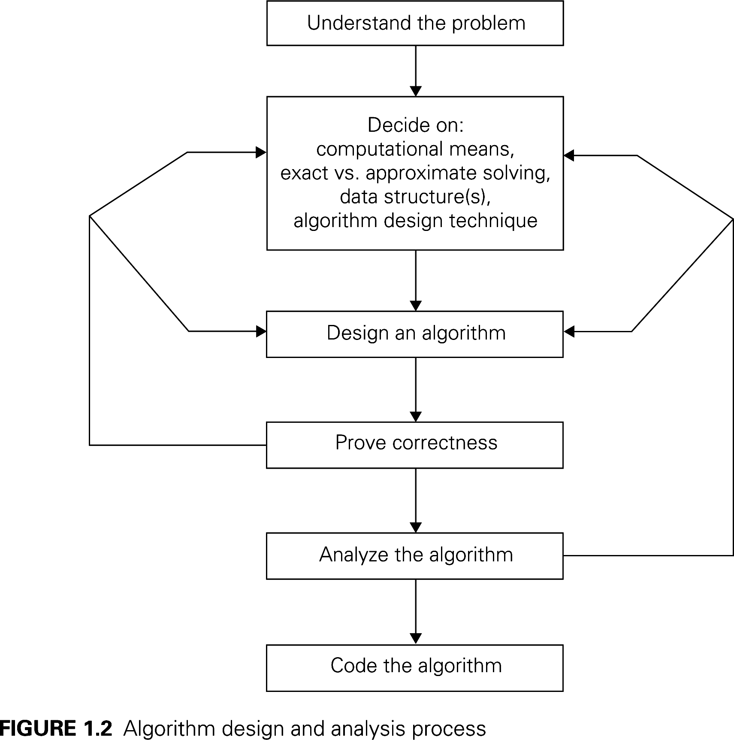
Algorithm Design and Analysis Process

Slide 4
Algorithm Analysis Framework
Measuring an input’s size
Measuring running time
Orders of growth (of the algorithm’s efficiency function)
Worst-base, best-case and average-case efficiency

Slide 5
Sort Algorithms
Problem:
Re-arrange an array A of n numbers to be in non-descending order.
Example
Before sorting:
A = {50, 30, 40, 80, 70, 10, 90, 60}.
After:
A = {10, 30, 40, 50, 60, 70, 80, 90}.

Slide 6
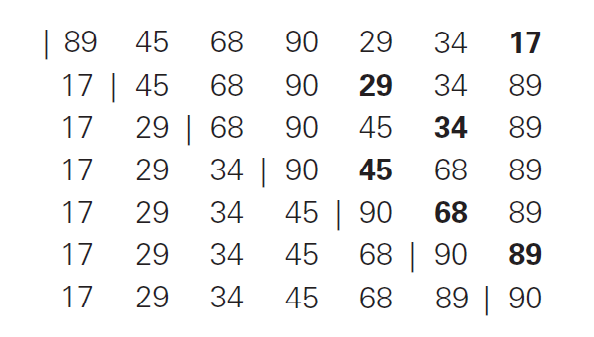
Selection Sort:
Scanning the entire given list to find its smallest element and exchange it with the first element; repeat.
Selection Sort, an example.

Slide 7
Bubble Sort Algorithm
The algorithm performs n − 1 passes. After the i -th pass
(i ≤ n − 1), it is guaranteed that the i -th largest number is moved to its correct position.
Example
Originally: A = {50, 30, 40, 80, 70, 10, 90, 60}.
Pass 1
{30, 50, 40, 80, 70, 10, 90, 60}
{30, 40, 50, 80, 70, 10, 90, 60}
{30, 40, 50, 80, 70, 10, 90, 60}
{30, 40, 50, 70, 80, 10, 90, 60}
{30, 40, 50, 70, 10, 80, 90, 60}
{30, 40, 50, 70, 10, 80, 90, 60}
{30, 40, 50, 70, 10, 80, 60, 90}
The largest number 90 now appears at the end.

Slide 8
Bubble Sort Algorithm
Example (cont.)
From the previous pass: A = {30, 40, 50, 70, 10, 80, 60, 90}.
Pass 2
{30, 40, 50, 70, 10, 80, 60, 90}
{30, 40, 50, 70, 10, 80, 60, 90}
{30, 40, 50, 70, 10, 80, 60, 90}
{30, 40, 50, 10, 70, 80, 60, 90}
{30, 40, 50, 10, 70, 80, 60, 90}
{30, 40, 50, 10, 70, 60, 80, 90}
The second largest number 80 is now at the right place.

Slide 9
Bubble Sort Algorithm
algorithm BubbleSort(A[1..n])
1. for i = 1 to n − 1 /* the i -th pass */
2.
3.
4.
for j = 1 to n − i
if A[j] > A[j + 1]
swap A[j] with A[j + 1]

Slide 10
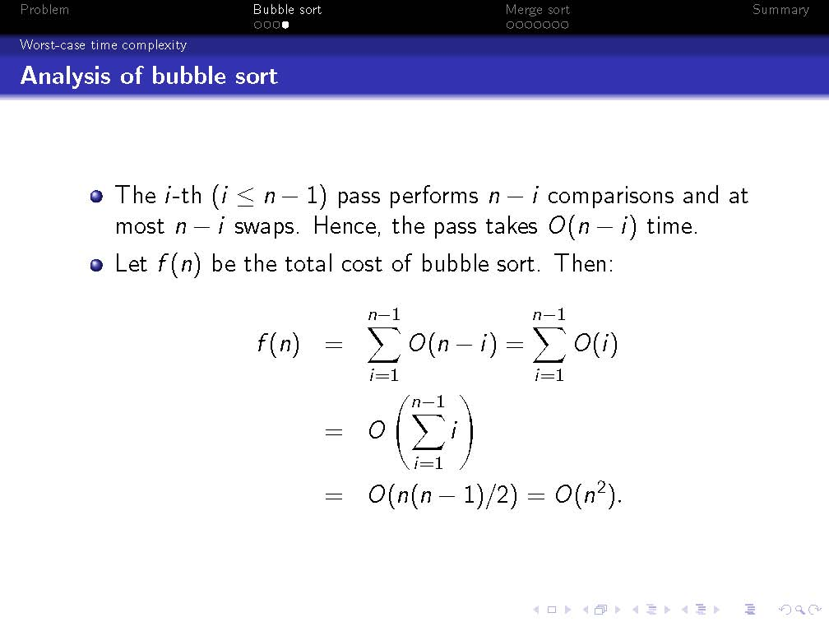

Slide 11
Merge Sort Algorithm
We will improve the running time dramatically to O(n log n) by an algorithm called merge sort. This algorithm is motivated by the observation that two sorted arrays can be merged in linear time.
Example Given
A₁ = {30, 40, 50, 80}, A₂ = {10, 60, 70, 90}
we want to merge them into
A_{merge} = {10, 30, 40, 50, 60, 70, 80, 90}
in O(|A₁| + |A₂|) time.

Slide 12
Merge Two Sorted Arrays
Idea
Merging two sorted arrays
To merge A₁ and A₂, we scan their elements synchronously in ascending order, and move the elements scanned to A_{merge} .
Example (cont.)
1
A₁ = {30, 40, 50, 80}, A₂ = {10, 60, 70, 90}, A_{merge} = {}
A₁ = {30, 40, 50, 80}, A₂ = {60, 70, 90}, A_{merge} = {10}
A₁ = {40, 50, 80}, A₂ = {60, 70, 90}, A_{merge} = {10, 30}
A₁ = {50, 80}, A₂ = {60, 70, 90}, A_{merge} = {10, 30, 40}
A₁ = {80}, A₂ = {60, 70, 90}, A_{merge} = {10, 30, 40, 50}
A₁ = {80}, A₂ = {70, 90}, A_{merge} = {10, 30, 40, 50, 60}
A₁ = {80}, A₂ = {90}, A_{merge} = {10, 30, 40, 50, 60, 70}
A₁ = {}, A₂ = {90}, A_{merge} = {10, 30, 40, 50, 60, 70, 80}
A₁ = {}, A₂ = {}, A_{merge} = {10, 30, 40, 50, 60, 70, 80, 90}
2
3
4
5
6
7
8
9

Slide 13
Merge Sort Algorithm
Merge sort works by first recursively sorting each half of the array, and then merging them.
Example
Originally: A = {50, 30, 40, 80, 70, 10, 90, 60}.
Divide A into two halves:
A₁ = {50, 30, 40, 80}, A₂ = {70, 10, 90, 60}.
Sort each half recursively:
A₁ = {30, 40, 50, 80}, A₂ = {10, 60, 70, 90}.
Merge them into the final sorted order:
A_{merge} = {10, 30, 40, 50, 60, 70, 80, 90}.

Slide 14
Algorithm description
Pseudo-code of merging
algorithm Merge(A₁[1..n₁ ], A₂[1..n₂ ])
/* merge two sorted arrays */
A_{merge} = {}, i = j = 1
while i ≤ n₁ and j ≤ n₂
3.
4.
5.
6.
if A₁[i ] ≤ A₂[j]
append A₁[i ] to A_{merge} , i = i + 1
else
append A₂[j] to A_{merge} , j = j + 1
if i ≤ n₁ then append the unscanned elements of A₁ to A_{merge}
else append the unscanned elements of A₂ to A_{merge}
return A_{merge}

Slide 15
Algorithm description
Pseudo-code of merge sort
algorithm MergeSort(A[1..n])
if n = 1 return A
A₁ = an array containing the first |n/2J numbers of A
A₂ = an array containing the other elements of A
4. A^{t} = MergeSort(A₁)
1
5. A^{t} = MergeSort(A₂)
2
6. return Merge(A^{t} , A^{t} )
1 2

Slide 16
Worst-case time complexity
Analysis of Merge Sort Algorithm
Let f (n) be the (worst-case) time of sorting an array A of size n. If n = 1, f (n) is obviously O(1). Next, we consider n > 1. For simplicity, let us assume that n is a power of 2.
Dividing A into two halves A₁ and A₂ takes O(n) time. Sorting A₁ takes at most f (n/2) time.
Sorting A₂ takes at most f (n/2) time.
Merging the sorted A₁ and A₂ takes O(n) time. Therefore:
f (n) ≤ 2f (n/2) + O(n)
The next slide proves that f (n) = O(n log n).

Slide 17
Problem
Bubble sort
Merge sort
Summary
Worst-case time complexity
Solving f (n) ≤ 2f (n/2) + O(n)
f (n)
≤ 2f (n/2) + O(n)
≤ 2(2f (n/4) + O(n/2)) + O(n) = 4f (n/4) + 2O(n)
≤ 4(2f (n/8) + O(n/4)) + 2O(n) = 8f (n/8) + 3O(n)
...
≤
=
n · f (1) + log n · O(n)
O(n log n)
To think
Prove f (n) = O(n log n) without assuming that n is a power of 2.

Slide 18
Playback of this lecture: The sorting problem.
Bubble sort — worst case O(n²) time. Merge sort — worst case O(n log n) time.

Slide 19
Playback of this lecture:
The sorting problem.
Bubble sort — worst case O(n²) time. Merge sort — worst case O(n log n) time.

Slide 20
Idea of Quick Sort Algorithm
Select a pivot (partition element).
Rearrange the list so that all the elements before the pivot are smaller than or equal to the pivot and that all the elements after the pivot are than the pivot

Slide 21
Quick Sort ：Divide and Conquer
Quicksort an n-element array:
--Divide: Partition the array into two subarrays around a pivot x such that elements in lower subarray≤x≤ elements in upper subarray
--Conquer: Recursively sort the subarrays.
--Combine: Trivial.
Key: Linear-time partitioning subroutine.
Notes:
枢轴, 支点, (讨论的)中心点, 重点

Slide 22
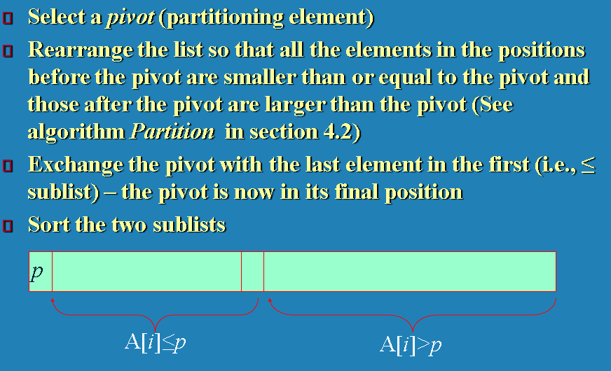
Quick sort, an example
Week 2

Slide 23
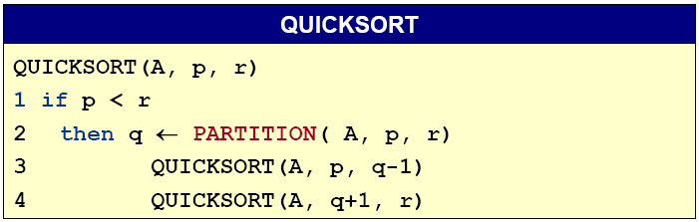
Quick Sort ：Divide and Conquer
Initial call Quicksort(A, 1, n)

Slide 24
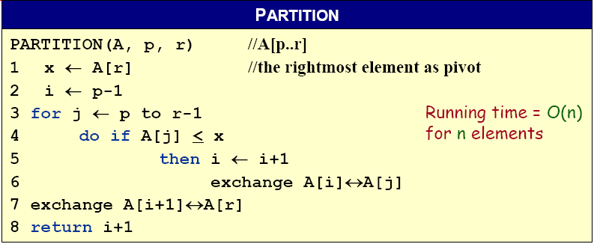
Partitioning subroutine
A[p,…,i]:known to be ≤ pivot
A[j…r]:not yet examined
A[i+1,…,j-1]:known to be > pivot
A[r]:pivot
Notes:
Pivot：枢轴, 支点, (讨论的)中心点, 重点

Slide 25










Example of Partitioning
The operation of Partition on a sample array. Lightly shaded array elements are all with values no greater than x (the pivot). Heavily shaded array elements are all with values greater than x.

Slide 26
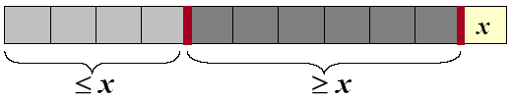
Analysis of quicksort
Assume all input elements are distinct.
In practice, there are better partitioning algorithms for when duplicate input elements may exist.
Let T(n) = worst-case running time on an array of n elements.

Slide 27
Worst-Case of Quicksort
Input sorted or reverse sorted.
Partition around min or max element.
One side of partition always has no elements.
T(n) = T(n - 1) + T(0) + Θ(n)
= T(n - 1) + Θ(1) + Θ(n)
= T(n - 1) + Θ(n)
= Θ(n²) (Arithmetic series)

Slide 28
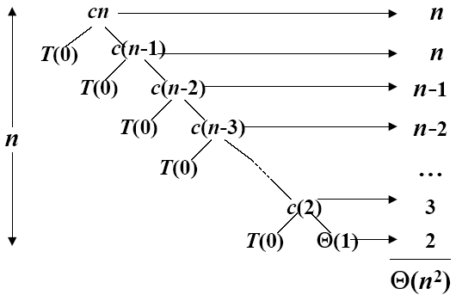
Worst-case recursive tree
T(n) = T(n - 1) + T(0) + Θ(n)
A recursion tree for QUICKSORT in which the Partition procedure always puts only a single element on one side of the partition (the worst case). The resulting running time is Θ(n²)

Slide 29
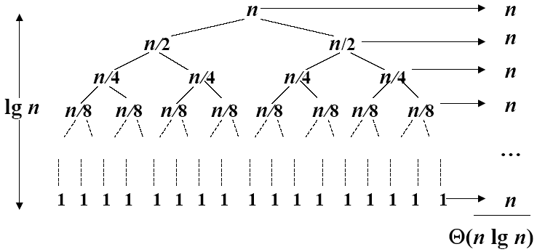
Best Case Partitioning
Θ(nlgn)
A recursion tree for QUICKSORT in which the Partition always balances the two sides of the partition equally (the best case). The resulting running time is Θ(nlgn)

Slide 30
Best-case analysis
If we’re lucky, PARTITION splits the array evenly:
--T(n) = 2T(n/2) + Θ(n) = Θ(nlogn).
What if the split is always 1/10:9/10?
--T(n) ≤ T(9n/10) + T(n/10) + Θ(n)
--What is the solution to this recurrence?
Notes:
Evenly：均匀地

Slide 31
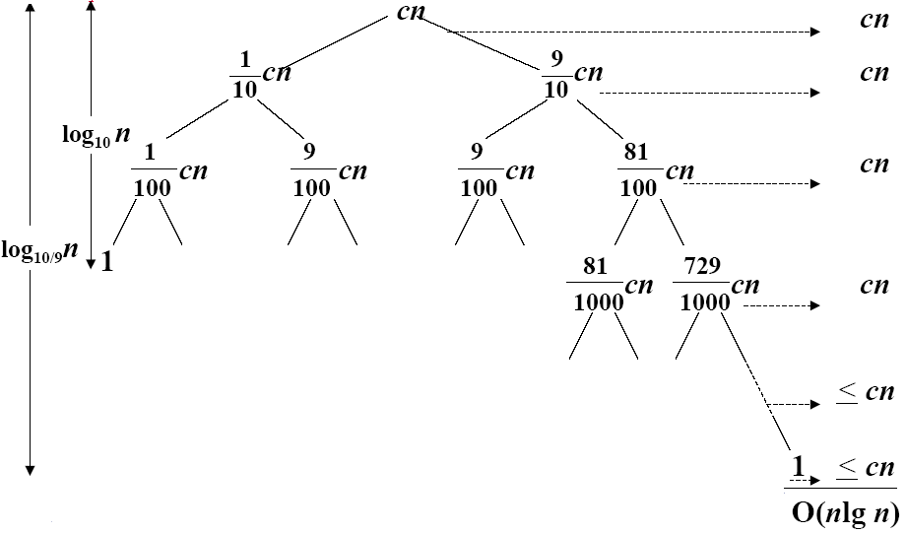
A Recursion tree
Worst case Θ(n²), why we prefer Quicksort to Mergesort
A recursion tree for QUICKSORT in which PARTITION always produces a 9-to-1 split, yielding a running time of O(n lgn)

Slide 32
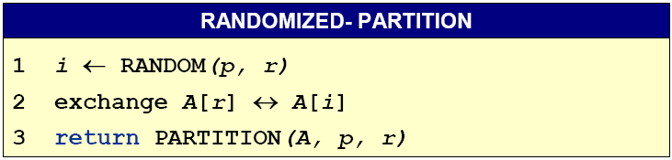
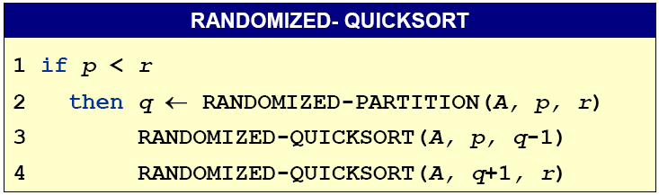
Randomize-Partitioning

Slide 33
Randomized Quicksort
Partition around a random element, i.e., around A[t], where t chosen uniformly at random from {p…r}
expected time is O(n lgn)
Notes:
Uniformly：一律地

Slide 34
Quicksort
Efficient sorting algorithm
--Proposed by C.A.R. Hoare in 1962
--Divide-and-Conquer algorithm
--Sorts “in place” (like insertion sort, but not like merge sort)
--Very practical (with tuning)
--Can be viewed as a randomized Las Vegas algorithm
--Worst-case running time: Θ(n²)
--Expected running time: Θ(nlogn)
--Constant hidden in Θ(nlogn) are small.

Slide 35
•
Heapsort
– Heapsort sorts an array by using the heap property we saw
earlier

Slide 36
Tutorial:
Implement Selection Sort
and Quick Sort in C++
Homework:
Implement Heap Sort
Present the Heap Sort

Slide 37
•
Heapsort
Procedure heapsort(T[1..n])
makeheap(T)
for i = n to 2 step –1do
swap T[1] and T[i]
siftdown(T[1 .. i – 1], 1)

Slide 38
Heapsort
procedure makeheap(T[1..n])
for i = n ÷ 2 to 1 step –1 do
siftdown(T, i)
end for
end

Slide 39
Heapsort
T = [7, 2, 9, 5, 1, 3, 8, 4] makeheap
[7, 2, 9, 5, 1, 3, 8, 4] siftdown 5 - 0 swaps
[7, 2, 9, 5, 1, 3, 8, 4] siftdown 9 - 0 swaps
[7, 2, 9, 5, 1, 3, 8, 4] siftdown 2 - 2 swaps
[7, 5, 9, 4, 1, 3, 8, 2] siftdown 7 - 2 swaps
[9, 5, 8, 4, 1, 3, 7, 2] heap complete

Slide 40
Heapsort
T = [7, 2, 9, 5, 1, 3, 8, 4]
[9, 5, 8, 4, 1, 3, 7, 2] after makeheap
[2, 5, 8, 4, 1, 3, 7, 9] swap 2 and 9
[8, 5, 7, 4, 1, 3, 2, 9] siftdown 2
[2, 5, 7, 4, 1, 3, 8, 9] swap 2 and 8
[7, 5, 3, 4, 1, 2, 8, 9] siftdown 2
[2, 5, 3, 4, 1, 7, 8, 9] swap 2 and 7
[5, 4, 3, 2, 1, 7, 8, 9] siftdown 2
[1, 4, 3, 2, 5, 7, 8, 9] swap 1 and 5
[4, 2, 3, 1, 5, 7, 8, 9] siftdown 1
[1, 2, 3, 4, 5, 7, 8, 9] swap 1 and 4
[3, 2, 1, 4, 5, 7, 8, 9] siftdown 1
[1, 2, 3, 4, 5, 7, 8, 9] swap 1 and 3
[2, 1, 3, 4, 5, 7, 8, 9] siftdown 1
[1, 2, 3, 4, 5, 7, 8, 9] swap 1 and 2 - sorted
•

Slide 41
Heapsort
– Makeheap is in Θ(n log n)
– Siftdown is in Θ(log n)
– Heapsort is inΘ (n log n) + (n – 1) Θ(log n) =Θ(n log n)

Slide 42
Shell Sort
procedure shellsort(T[1..n])
inc = n
while inc > 1 do
inc = inc ÷ 2
for j = 1 to inc do
k = j + inc
while k ≤ n do
done = false
x = T[k]
current = k; previous = current – inc
while previous ≥ j and not done do
if x < T[previous] then
T[current] = T[previous]
current = previous; previous = previous – inc
else
done = true
T[current] = x
k = k + inc

Slide 43
•
Shell sort
T = [7, 2, 9, 5, 1, 3, 8, 4] inc = 4

Slide 44
•
Shell sort
T = [7, 2, 9, 5, 1, 3, 8, 4] inc = 4
[7, 2, 9, 5, 1, 3, 8, 4] sort T[1], T[5] (insertion sort)

Slide 45
•
Shell sort
T = [7, 2, 9, 5, 1, 3, 8, 4] inc = 4
[7, 2, 9, 5, 1, 3, 8, 4] sort T[1], T[5] (insertion sort)
[1, 2, 9, 5, 7, 3, 8, 4] sort T[2], T[6] (insertion sort)

Slide 46
•
Shell sort
T = [7, 2, 9, 5, 1, 3, 8, 4] inc = 4
[7, 2, 9, 5, 1, 3, 8, 4] sort T[1], T[5] (insertion sort)
[1, 2, 9, 5, 7, 3, 8, 4] sort T[2], T[6] (insertion sort)
[1, 2, 9, 5, 7, 3, 8, 4] sort T[3], T[7] (insertion sort)

Slide 47
•
Shell sort
T = [7, 2, 9, 5, 1, 3, 8, 4] inc = 4
[7, 2, 9, 5, 1, 3, 8, 4] sort T[1], T[5] (insertion sort)
[1, 2, 9, 5, 7, 3, 8, 4] sort T[2], T[6] (insertion sort)
[1, 2, 9, 5, 7, 3, 8, 4] sort T[3], T[7] (insertion sort)
[1, 2, 8, 5, 7, 3, 9, 4] sort T[4], T[8] (insertion sort)

Slide 48
•
Shell sort
T = [7, 2, 9, 5, 1, 3, 8, 4] inc = 4
[7, 2, 9, 5, 1, 3, 8, 4] sort T[1], T[5] (insertion sort)
[1, 2, 9, 5, 7, 3, 8, 4] sort T[2], T[6] (insertion sort)
[1, 2, 9, 5, 7, 3, 8, 4] sort T[3], T[7] (insertion sort)
[1, 2, 8, 5, 7, 3, 9, 4] sort T[4], T[8] (insertion sort)
[1, 2, 8, 4, 7, 3, 9, 5] inc = 2

Slide 49
•
Shell sort
T = [7, 2, 9, 5, 1, 3, 8, 4] inc = 4
[7, 2, 9, 5, 1, 3, 8, 4] sort T[1], T[5] (insertion sort)
[1, 2, 9, 5, 7, 3, 8, 4] sort T[2], T[6] (insertion sort)
[1, 2, 9, 5, 7, 3, 8, 4] sort T[3], T[7] (insertion sort)
[1, 2, 8, 5, 7, 3, 9, 4] sort T[4], T[8] (insertion sort)
[1, 2, 8, 4, 7, 3, 9, 5] inc = 2
[1, 2, 8, 4, 7, 3, 9, 5] sort T[1], T[3], T[5], T[7] (insertion sort)

Slide 50
•
Shell sort
T = [7, 2, 9, 5, 1, 3, 8, 4] inc = 4
[7, 2, 9, 5, 1, 3, 8, 4] sort T[1], T[5] (insertion sort)
[1, 2, 9, 5, 7, 3, 8, 4] sort T[2], T[6] (insertion sort)
[1, 2, 9, 5, 7, 3, 8, 4] sort T[3], T[7] (insertion sort)
[1, 2, 8, 5, 7, 3, 9, 4] sort T[4], T[8] (insertion sort)
[1, 2, 8, 4, 7, 3, 9, 5] inc = 2
[1, 2, 8, 4, 7, 3, 9, 5] sort T[1], T[3], T[5], T[7] (insertion sort)
[1, 2, 7, 4, 8, 3, 9, 5] sort T[2], T[4], T[6], T[8] (insertion sort)

Slide 51
•
Shell sort
T = [7, 2, 9, 5, 1, 3, 8, 4] inc = 4
[7, 2, 9, 5, 1, 3, 8, 4] sort T[1], T[5] (insertion sort)
[1, 2, 9, 5, 7, 3, 8, 4] sort T[2], T[6] (insertion sort)
[1, 2, 9, 5, 7, 3, 8, 4] sort T[3], T[7] (insertion sort)
[1, 2, 8, 5, 7, 3, 9, 4] sort T[4], T[8] (insertion sort)
[1, 2, 8, 4, 7, 3, 9, 5] inc = 2
[1, 2, 8, 4, 7, 3, 9, 5] sort T[1], T[3], T[5], T[7] (insertion sort)
[1, 2, 7, 4, 8, 3, 9, 5] sort T[2], T[4], T[6], T[8] (insertion sort)
[1, 2, 7, 3, 8, 4, 9, 5] inc = 1

Slide 52
•
Shell sort
T = [7, 2, 9, 5, 1, 3, 8, 4] inc = 4
[7, 2, 9, 5, 1, 3, 8, 4] sort T[1], T[5] (insertion sort)
[1, 2, 9, 5, 7, 3, 8, 4] sort T[2], T[6] (insertion sort)
[1, 2, 9, 5, 7, 3, 8, 4] sort T[3], T[7] (insertion sort)
[1, 2, 8, 5, 7, 3, 9, 4] sort T[4], T[8] (insertion sort)
[1, 2, 8, 4, 7, 3, 9, 5] inc = 2
[1, 2, 8, 4, 7, 3, 9, 5] sort T[1], T[3], T[5], T[7] (insertion sort)
[1, 2, 7, 4, 8, 3, 9, 5] sort T[2], T[4], T[6], T[8] (insertion sort)
[1, 2, 7, 3, 8, 4, 9, 5] inc = 1
[1, 2, 7, 3, 8, 4, 9, 5] sort T[1..n] (insertion sort)

Slide 53
•
Shell sort
T = [7, 2, 9, 5, 1, 3, 8, 4] inc = 4
[7, 2, 9, 5, 1, 3, 8, 4] sort T[1], T[5] (insertion sort)
[1, 2, 9, 5, 7, 3, 8, 4] sort T[2], T[6] (insertion sort)
[1, 2, 9, 5, 7, 3, 8, 4] sort T[3], T[7] (insertion sort)
[1, 2, 8, 5, 7, 3, 9, 4] sort T[4], T[8] (insertion sort)
[1, 2, 8, 4, 7, 3, 9, 5] inc = 2
[1, 2, 8, 4, 7, 3, 9, 5] sort T[1], T[3], T[5], T[7] (insertion sort)
[1, 2, 7, 4, 8, 3, 9, 5] sort T[2], T[4], T[6], T[8] (insertion sort)
[1, 2, 7, 3, 8, 4, 9, 5] inc = 1
[1, 2, 7, 3, 8, 4, 9, 5] sort T[1..n] (insertion sort)
[1, 2, 3, 4, 5, 7, 8, 9] sorted

Slide 54
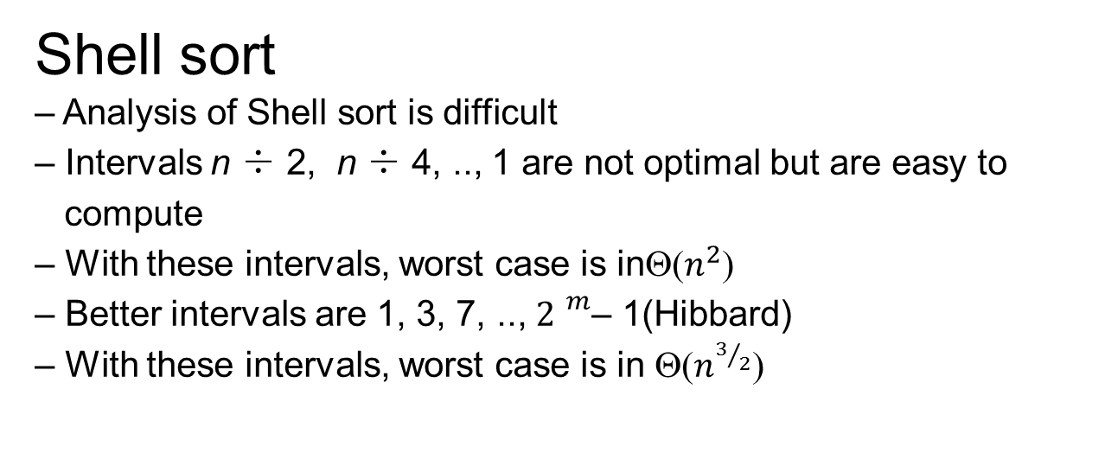
•
Shell sort
– Analysis of Shell sort is difficult
– Intervals n ÷ 2, n ÷ 4, .., 1 are not optimal but are easy to
compute
– With these intervals, worst case is inΘ($n^{2}$)
– Better intervals are 1, 3, 7, .., ${2 }^{m}$– 1(Hibbard)
– With these intervals, worst case is in Θ($n^{3/2}$)

Slide 55
•
Shell sort (Hibbard intervals)
T = [7, 2, 9, 5, 1, 3, 8, 4] inc = 7

Slide 56
•
Shell sort (Hibbard intervals)
T = [7, 2, 9, 5, 1, 3, 8, 4] inc = 7
[7, 2, 9, 5, 1, 3, 8, 4] sort T[1], T[8] (insertion sort)

Slide 57
•
Shell sort (Hibbard intervals)
T = [7, 2, 9, 5, 1, 3, 8, 4] inc = 7
[7, 2, 9, 5, 1, 3, 8, 4] sort T[1], T[8] (insertion sort)
[4, 2, 9, 5, 1, 3, 8, 7] inc = 3

Slide 58
•
Shell sort (Hibbard intervals)
T = [7, 2, 9, 5, 1, 3, 8, 4] inc = 7
[7, 2, 9, 5, 1, 3, 8, 4] sort T[1], T[8] (insertion sort)
[4, 2, 9, 5, 1, 3, 8, 7] inc = 3
[4, 2, 9, 5, 1, 3, 8, 7] sort T[1], T[4], T[7] (insertion sort)

Slide 59
•
Shell sort (Hibbard intervals)
T = [7, 2, 9, 5, 1, 3, 8, 4] inc = 7
[7, 2, 9, 5, 1, 3, 8, 4] sort T[1], T[8] (insertion sort)
[4, 2, 9, 5, 1, 3, 8, 7] inc = 3
[4, 2, 9, 5, 1, 3, 8, 7] sort T[1], T[4], T[7] (insertion sort)
[4, 2, 9, 5, 1, 3, 8, 7] sort T[2], T[5], T[8] (insertion sort)

Slide 60
•
Shell sort (Hibbard intervals)
T = [7, 2, 9, 5, 1, 3, 8, 4] inc = 7
[7, 2, 9, 5, 1, 3, 8, 4] sort T[1], T[8] (insertion sort)
[4, 2, 9, 5, 1, 3, 8, 7] inc = 3
[4, 2, 9, 5, 1, 3, 8, 7] sort T[1], T[4], T[7] (insertion sort)
[4, 2, 9, 5, 1, 3, 8, 7] sort T[2], T[5], T[8] (insertion sort)
[4, 1, 9, 5, 2, 3, 8, 7] sort T[3], T[6] (insertion sort)

Slide 61
•
Shell sort (Hibbard intervals)
T = [7, 2, 9, 5, 1, 3, 8, 4] inc = 7
[7, 2, 9, 5, 1, 3, 8, 4] sort T[1], T[8] (insertion sort)
[4, 2, 9, 5, 1, 3, 8, 7] inc = 3
[4, 2, 9, 5, 1, 3, 8, 7] sort T[1], T[4], T[7] (insertion sort)
[4, 2, 9, 5, 1, 3, 8, 7] sort T[2], T[5], T[8] (insertion sort)
[4, 1, 9, 5, 2, 3, 8, 7] sort T[3], T[6] (insertion sort)
[4, 1, 3, 5, 2, 9, 8, 7] inc = 1

Slide 62
•
Shell sort (Hibbard intervals)
T = [7, 2, 9, 5, 1, 3, 8, 4] inc = 7
[7, 2, 9, 5, 1, 3, 8, 4] sort T[1], T[8] (insertion sort)
[4, 2, 9, 5, 1, 3, 8, 7] inc = 3
[4, 2, 9, 5, 1, 3, 8, 7] sort T[1], T[4], T[7] (insertion sort)
[4, 2, 9, 5, 1, 3, 8, 7] sort T[2], T[5], T[8] (insertion sort)
[4, 1, 9, 5, 2, 3, 8, 7] sort T[3], T[6] (insertion sort)
[4, 1, 3, 5, 2, 9, 8, 7] inc = 1
[4, 1, 3, 5, 2, 9, 8, 7] sort T[1..n] (insertion sort)

Slide 63
•
Shell sort (Hibbard intervals)
T = [7, 2, 9, 5, 1, 3, 8, 4] inc = 7
[7, 2, 9, 5, 1, 3, 8, 4] sort T[1], T[8] (insertion sort)
[4, 2, 9, 5, 1, 3, 8, 7] inc = 3
[4, 2, 9, 5, 1, 3, 8, 7] sort T[1], T[4], T[7] (insertion sort)
[4, 2, 9, 5, 1, 3, 8, 7] sort T[2], T[5], T[8] (insertion sort)
[4, 1, 9, 5, 2, 3, 8, 7] sort T[3], T[6] (insertion sort)
[4, 1, 3, 5, 2, 9, 8, 7] inc = 1
[4, 1, 3, 5, 2, 9, 8, 7] sort T[1..n] (insertion sort)
[1, 2, 3, 4, 5, 7, 8, 9] sorted

Slide 64
•
Shell sort (Hibbard intervals)
T = [7, 2, 9, 5, 1, 3, 8, 4] inc = 7
[7, 2, 9, 5, 1, 3, 8, 4] sort T[1], T[8] (insertion sort)
[4, 2, 9, 5, 1, 3, 8, 7] inc = 3

Slide 65
Shell sort (Hibbard intervals)
T = [7, 2, 9, 5, 1, 3, 8, 4] inc = 7
[7, 2, 9, 5, 1, 3, 8, 4] sort T[1], T[8] (insertion sort)
[4, 2, 9, 5, 1, 3, 8, 7] inc = 3
[4, 2, 9, 5, 1, 3, 8, 7] sort T[1], T[4], T[7] (insertion sort)

Slide 66
Simulation

Slide 67
Applied Algorithms (1)
Simulation
– Two basic kinds:
Discrete Event (models discrete events)
Continuous (models continuous processes)
Each type is suited to different kinds of simulations
– Discrete Event – processes where time-based
events control what is happening.
(e.g. Queues)
– Continuous – processes where there are no
time-based events
Physical processes (e.g. Explosions)

Slide 68
Note: This terminology is not especially
obvious or clear.
– Discrete Event:
Usually used to model discrete events
Time is continuous, events can occur at any point
in time
– Continuous :
Usually used to model a continuous process.
Time is broken into discrete chunks (ticks) events
only occur on a tick

Slide 69
Discrete Event Simulation
– Normally a lot less mathematically complex.
– Usually requires a lot less computer resources.
Queue simulation
– Widely used to evaluate queue-based processes
Shops
Production lines
Industrial processes
–We will look at some simple examples and see how we might implement them.

Slide 70
Scenario 1: a single server queue.
– Customers arrive at random intervals
to be served
– If the server is not busy the customer
will be served immediately
– If the server is busy the customer
will join the end of the (possibly empty) queue.
– When the server has finished with
the customer the next customer (if any)
begins service – first customer in queue.

Slide 71
Scenario 1: Events.
– Customer arrives
– Customer starts service
– Customer ends service and leaves
What we know:
– When each customer arrives
– How long they take to serve
What we want to know:
– How big is the queue on average?
– How busy is the server?
– What proportion of customers have to wait in a queue?

Slide 72
Scenario 1: Data
– Input data is a file consisting of a set of
records containing
Arrival time
Service time
– For each customer
– Sorted by arrival time
0.24 0.55
0.59 0.16
0.90 0.07
1.87 0.69
…

Slide 73
Scenario 1: Manual Simulation
– From the data file we can get a feel for what is happening
– At time 0.00 the simulation starts
The server is idle
The queue is empty
– At time 0.24 the first customer arrives
The server is busy for the next 0.55 (until 0.79)
The queue is empty
– At time 0.59 the second customer arrives
At time 0.59 the second customer arrives
At time 0.59 the second customer arrives
– At time 0.79 the server finishes with customer 1
The server stays busy for the next 0.16 (until 0.95)
The queue is empty

Slide 74
We can represent what is happening with a graph:
Each step up is an arrival.
Step size = service time
When the slanted lines cross the
x-axis a service is complete.
The number of lines above the
axis at any time is the number of
people in the shop.

Slide 75
Starting to design the algorithm.
– Data structures
We need to hold the queue
– What should we put in it?
We need to keep track of the time
We need to know if the server is busy
– If so we need to know when they will finish
We need to know when the next customer will arrive
We need to track statistics

Slide 76
Starting to design the algorithm.
–What does a discrete event simulation look like?
repeat
determine the next event
process the event
until no more events

Slide 77
Starting to design the algorithm.
– Procedures
Initialise the simulation
Process an arrival
Process a service completion
Finish the simulation
– Once the simulation is running how do we decide what to
do next?
Compare the next arrival time with the end of service time

Slide 78
The main program loop
initialise
repeat
if busy = true then
if service_end < next arrival then
process_service_end
else
process_arrival
else
process_arrival
endif
until arrival file is empty and busy = false
finish

Slide 79
Initialise the simulation
time = 0
busy = false
queue = empty
read next_arrival, next_service
– Set up for statistics collection

Slide 80
Process an arrival
time = next_arrival
if busy then
enqueue (next_service)
else
busy = true
service_end = time + next_service
read (next_arrival next_service)

Slide 81
Process a service completion
time = service_end
if queue_empty then
busy = false
Else
service_end = time + dequeue()

Slide 82
What if there is more than one server?
–Two possible situations
One queue for all servers (like a bank)
One queue per server (like a supermarket)

Slide 83
One queue for all servers
–If all servers are busy add arrival to queue
–Otherwise make one of the idle servers busy
–When a server finishes have them serve \
the head of the queue
–Otherwise make them idle

Slide 84
The events we are interested in are now:
– Customer arrives
– Server 1 finishes
– Server 2 finishes
– …
– Server n finishes
How do we keep track of which event will happen next?
Do we really need to know which servers are busy or can
we just keep track of how many are busy?

Slide 85
Keeping track of servers:
– Two possible solutions
An array of servers with busy[i] and end_time[i]
This lets us track who is doing what
Finding what happens next is in O(n)
A heap of end times (smallest on top)
This does not let us track who is doing what
Finding what happens next is O(log n)
Can we get the best of both worlds?

Slide 86
Using a heap
– If we are clever we can store all event times on the heap
– All we need is a way to track what each event is
– One way is to make an event object. This allows us to track the
event type and the server id. It doesn't help us track the idle
servers, so we could store them in a queue.
– If we are really clever we can partition the heap into two parts:
The heap itself
The idle servers
– How do we manipulate the heap as events occur?

Slide 87
Initialise the simulation
time = 0
n_busy = 0
queue = empty
read heap[0], service_time
– Set up for statistics collection

Slide 88
Customer arrives:
time = heap[0]
read heap[0], next_service_time
sift_down(heap, 0)
if n_busy < n_servers then
n_busy = n_busy + 1
heap[n_busy] = time + service_time
sift_up(heap, n_busy)
else
enqueue(service_time)
service_time = next_service_time

Slide 89
Server finishes:
time = heap[0]
if queue_empty then
heap[0] = heap[n_busy]
n_busy = n_busy - 1
else
heap[0] = time + dequeue()
sift_down(heap)

Slide 90
In summary:
– Heap Grows if a customer arrives and a server is idle
– Heap shrinks if a customer is served and the queue is empty
– Heap stays the same size otherwise
If we keep a second array (id) initially filled with integers
0..n we can use it to track who is doing what
– 0 is the next arrival
– 1 is server 1’s completion time
– 2 is server 2’s completion time
– …
– n is server n’s completion time

Slide 91
Customer arrives becomes:
time = heap[0]
read heap[0], next_service_time
sift_down(heap, id, 0)
if n_busy < n_servers then
n_busy = n_busy + 1
heap[n_busy] = time + service_time
sift_up(heap, id, n_busy)
service_time = next_service_time
else
enqueue(next_service_time)

Slide 92
Server finishes:
time = heap[0]
if queue_empty then
swap (id[0], id[n_busy])
heap[0] = heap[n_busy]
n_busy = n_busy - 1
else
heap[0] = time + dequeue()
sift_down(heap, id, 0)

Slide 93
repeat
determine the next event
process the event
until no more events
If the top of the id array is a zero the next event is an
arrival
If the top of the id array is non_zero the next event is a
service completion for server id[0]

Slide 94
Every time we move an entry in the heap we move the
corresponding entry in the id array.
The simulation starts with the first arrival time in heap[0]
and n_busy = 0

Slide 95
Multiple queues
– In this case we have an array of n queues, 1 per server
– When a customer arrives and all servers are busy
we place the customer on one of the queues (which one?)
– When a server finishes we only make them busy if
their queue is not empty
– NOTE: This means that we can have a queue even
if a server is idle.

Slide 96
Priority queues
– How would we handle the situation where customers are given
different service priorities?
One queue for each priority empty the highest priority queue first
This is only efficient if there are a small number of priorities
–What do we do if each priority may be different?
E.g. priority is a float between 0 and 1
0 is the lowest customer priority
1 is the highest priority customer
We have an infinite number of different priorities so we can’t have
a queue for each one.

Slide 97
Priority queues
– The solution is to replace the queue with a heap ordered on
priority
– Each time we remove a customer from the heap we
Move the last entry to the top of the heap
Reduce the heap size by one
Sift down the top entry
– Each time we add a customer to the heap we:
Increase the heap size by one
Add the customer to the end of the heap
Sift up the last entry

Slide 98
Continuous Simulation.
– Often dependent on complex mathematics.
– Often based on gridded algorithms.
Implicit solution
Explicit solution
– Often requires extreme computing resources.
Supercomputers
– We will not be looking at continuous simulation in this subject
but here are a couple of examples to help you understand the
differences.

Slide 99
Examples of continuous simulation: 1
– Mine explosions
Solve 10 differential equations for each of several thousand cells for
every millisecond of the simulated event.
Parallel supercomputer.
Still over 24 hours per run.
– Some videos of the results…

Slide 100
Examples of continuous simulation: 2
– Social simulation
Track the state of individuals in a simulated environment.
– Two entities
Peeps – simulated individuals (not always people)
Cells – simulated locations
– Used to examine response to threat
Spread of disease
Natural disaster
Man-made disaster (terrorist attack)
– Again, lots of time/computer power required.

Slide 101
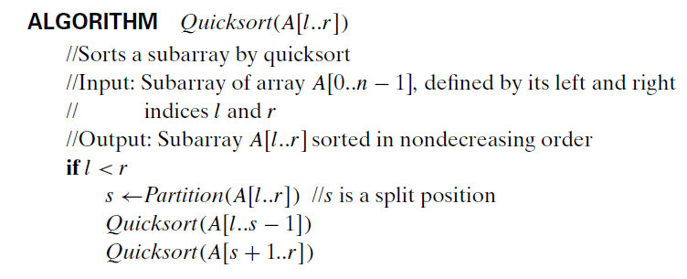
Pseudo code
Quick Sort Algorithm

