Slide 1
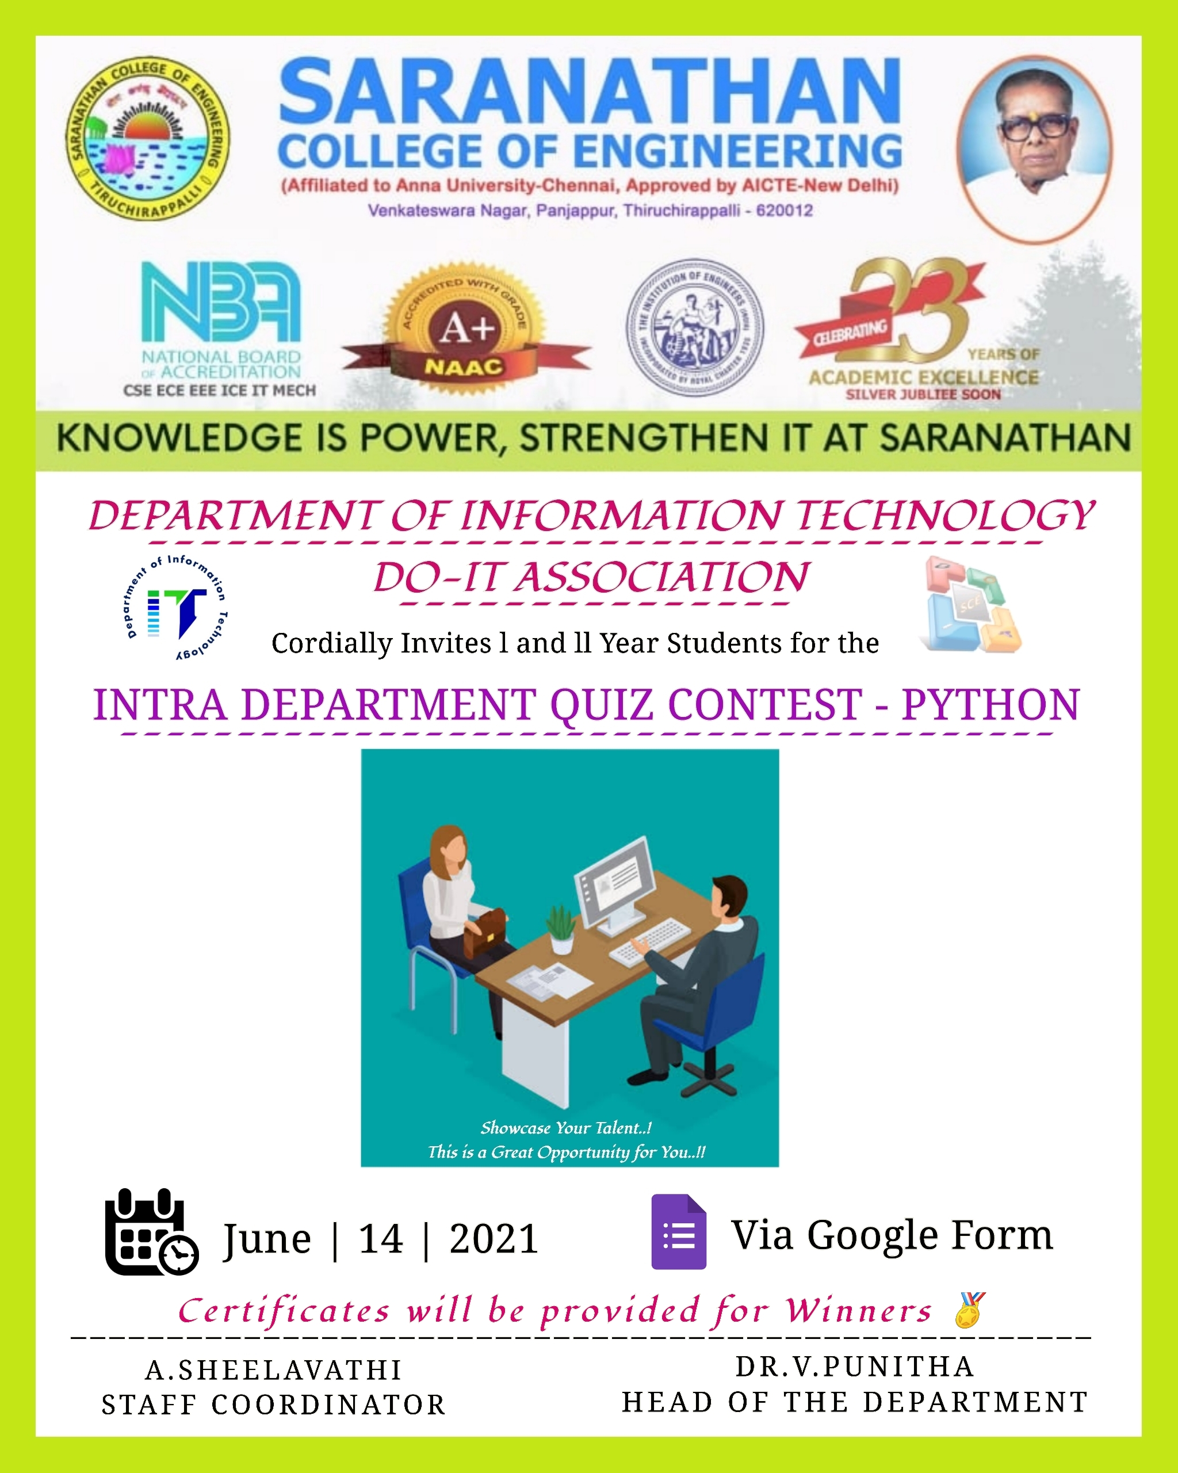
CHATBOT FOR PRICE NEGOTIATING
DEPARTMENT OF INFORMATION TECHNOLOGY
CATEGORY : SOFTWARE
TEAM NAME : INFOTECH TEAM MENTOR :Mrs.J.SANGEETHA PRIYA TEAM LEADER : A.S.ABISHEK
TEAM MEMBERS:
A.MOHAMED AMEEN
A.RATNAKUMAR

Slide 2
OBJECTIVE:
To develop an Web based Chatbot (mobile/web app) to create answers to queries based on Price Negotiable and more FAQs getting added including categorization.
Using Javascript Functions to ensure that the mapping of questions and answers remain maintained every time there is an increase in the dataset i.e.., for Price Negotiation

Slide 3
SOLUTION:
This Negotiation Chatbot is an easy way to help visitors, customers, or even staff get rapid access to information.
Based on the format of question and answers, the chatbot will give the most appropriate answer to whatever the user types in.
The system also learns over time and you can keep question and answers up to date and growing.
Hence we have built a Chatbot within a webpage to provide fast reply to the queries asked the visitors or customers based on the trained data.

Slide 4
OUR IDEA:
We have few ideas to implement,
CONTENT TRANSLATION – This feature helps the user to translate the content to their preferred language.
AUDIO TO TEXT TRANSLATION –This feature helps the user who fins difficulty in typing .For example Visually impaired, Aged people, or illiterate people.
ADMIN ACCESS –This feature helps the Client to train or update the data with recent queries . A separate webpage has been created for this so that the client can login with their credentials and do this by his own without the help of the developer.

Slide 5



TECHNOLOGY STACK:

