Slide 1


Uyir Hackathon - 2025
Level 2 Online Presentation
.
Namma Padhai - நமம பாை த
Comprehensive Road Safety and Traffic Training Web Platform
UYIR - Hackathon2k25 ID : UH_PROFE_0023
Category : Professional
Team Name : NexTurners
Team Leader : RATNAKUMAR A
Team Members' Names : PRAKASH KRISHNA , RADHAKRISHNAN S
Team Mentor : PRAKASH KRISHNA

Slide 2


Slide 3
Problem Statement
Limited access to real-time traffic guidance for the public.
Lack of comprehensive training for traffic personnel
High incidence of fatigue-related accidents.
Insufficient public awareness about road safety laws and practices.

Slide 4
Objective:
To develop a web-based platform named “Namma Padhai” that elevates traffic safety through immersive virtual training, AI-driven guidance, fatigue detection, and impactful safety awareness for traffic personnel and the public with latest blogs and videos.

Slide 5
Methodology:
Training & Simulation: Deliver modules with MCQs and real-time tests, awarding certificates upon completion, using a React-based interface.
AI Chatbot: Develop an LLM-powered chatbot to provide instant answers to traffic queries, enhancing user engagement and knowledge.
Fatigue Management: Use AI to analyze journey inputs, offering personalized route optimization, safety alerts, and fatigue risk assessments.
Road Safety Awareness: Create an interactive page featuring the latest updates, videos & blogs

Slide 6
Novelty /Contribution
Expected Outcome:
Enhanced Training: Traffic personnel will experience a virtual training and will get certification, improving on-ground performance through interactive modules.
Improved Safety: AI-driven support systems provide real-time guidance and personalized safety alerts, promoting safer driving practices.
Execution Difficulties:
AI Integration: Developing reliable AI chatbots and fatigue management requires extensive testing and optimization.
Content Updates: Regularly updating training and safety materials demands ongoing collaboration with traffic authorities and experts.

Slide 7
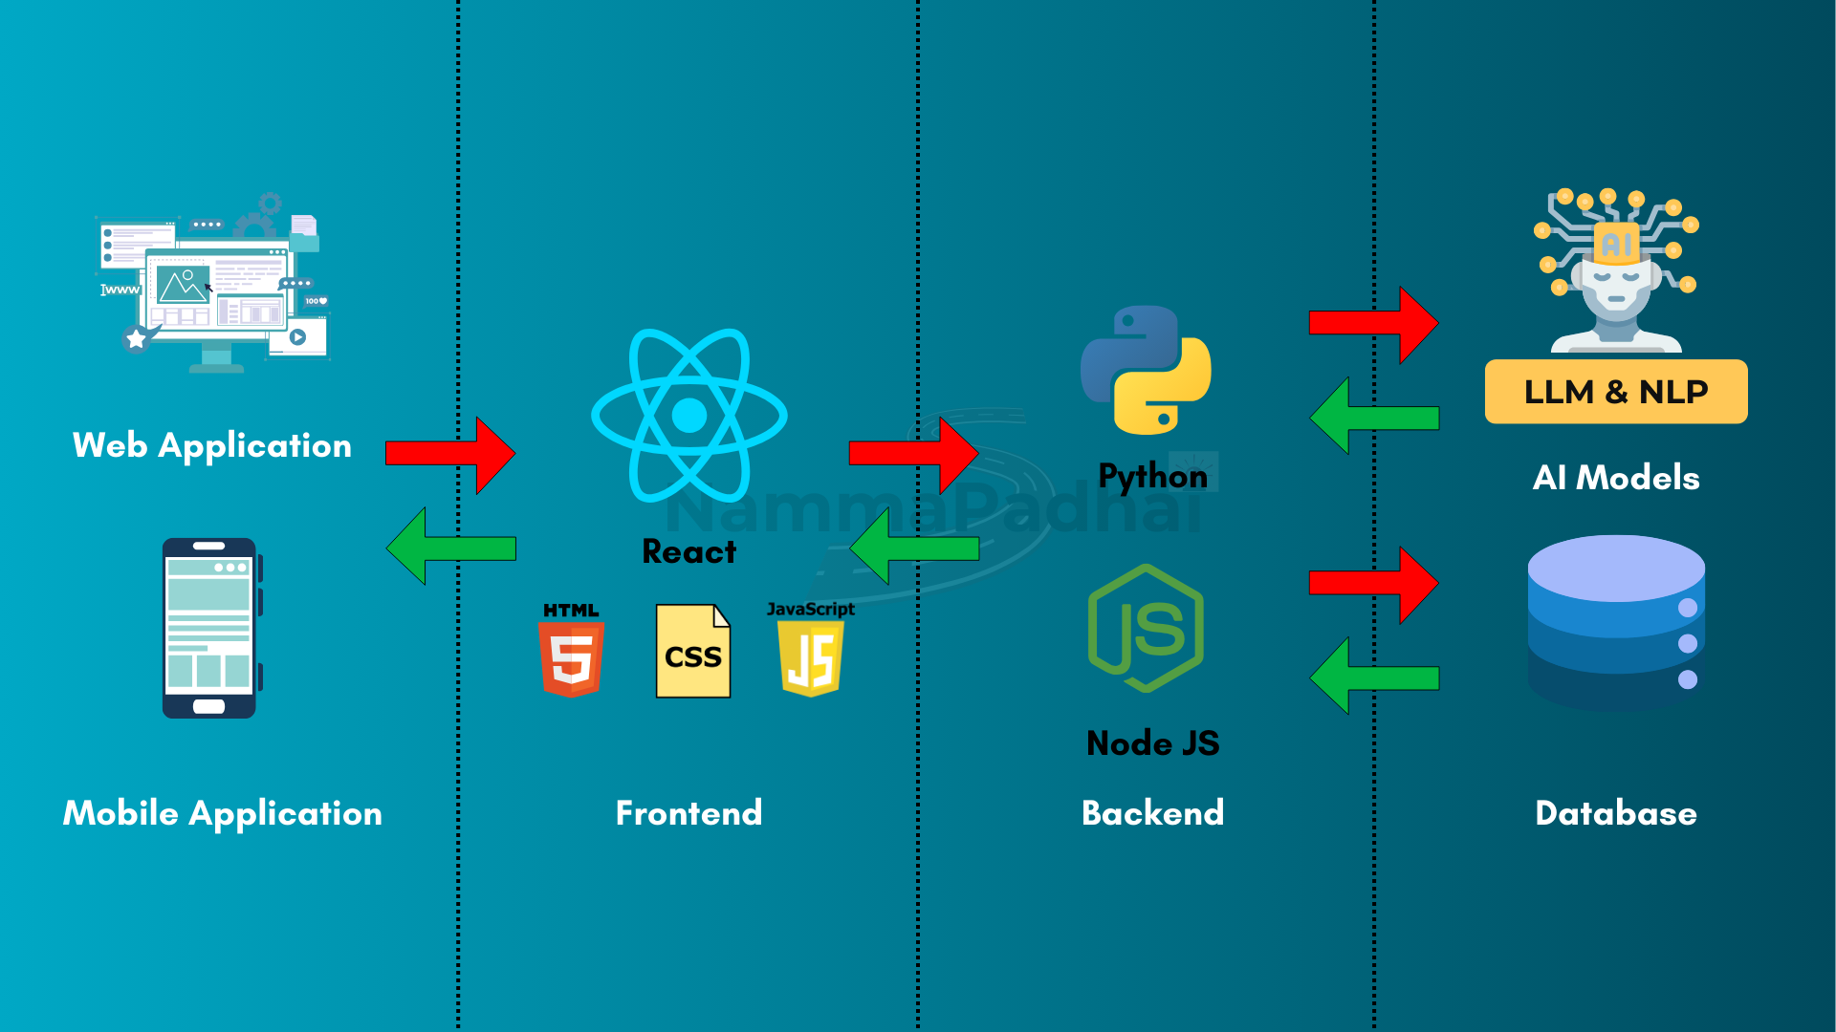
Architecture Diagram & Prototype
Click here to View Prototype
TRL Level: 6-Functional Prototype
Note : Choose “Fit-Width” in top right corner settings for better responsive view

Slide 8
Approximate Estimate of the Cost (If implemented) :
14000 INR - On-Prem 4CPUs & 16GB Mem with 256GB HDD - Linux (or) 8000 INR/month - on cloud
Key Benefits:
Interactive Learning ensure practical and engaging skill-building.
Instant Assistance by AI-powered chatbot
Ensure Safer Journeys by Fatigue Management analyzes.
Increased Awareness by Interactive content for better road safety knowledge.

