Slide 1

International aerial robotics competition 2016
Aerial Robotics Kharagpur (ARK)

Slide 2
Introduction
Funding and Faculty Support from CFER
Grid following using AR Drone
ARK Lab setup for IARC
First IARC participation
First flight of self assembled drone
Self fabricated wooden chassis first flight
100$ Hostel Room Project
MAX Plank Collaboration
Jan 2014
Jan 2015
Jun 2015
Aug 2015
Aug 2015
Sep 2015
April 2016
Sep 2016

Slide 3
Vehicle design
Description | Component
High Level Controller | Raspberry Pi/Odroid
Low Level Controller | ArduPilot Mega
Electronic Speed Controllers | 45A OPTO
Battery | 11.1V/6000 mAh + 11.V/2000mAh
Motors | Turnigy Multi-star, 6 x 850kv BLDC
Propellers | 11 in x 4.7 in
Camera | Logitech 30 FPS, 78 degree FOV, 16: 9
Chasis | Self Fabricated using Wood for fast iterations
ARK Lab in IIT Kharagpur
Notes:
Weight without payload - 645, weight with - 2450
Integration - Integrated multiple sensors and mechanical elements
Craftsmen - self design wooden chassis
Durability - can withstand falling and wear and tear due to repeated iterations. we had used 5 types of chassis for various projects over 1 year, with none surviving more than 10 falls. as a result we decided to switch to a wooden design.
Robustness - Hex design Can withstand payload upto 6kg, current thrust to weight ratio is 2.4. Hex design offers doubled flight time over and more stable altitude hold over a quad design
We have an indoor testing arena with sample grid floor as in IARC arena and two iRobots. We have safety harness to tie up the quadcopter while testing various controls and PID tuning.

Slide 4
simulation
Gazebo Simulation
Notes:
Complete simulation of arena, ground robots, obstacles and quad rotor done using gazebo modelling. Mathematical modelling done in MATLAB to understand reaction to various parameters on force balancing and torque balancing. Also PID controller modelling done on MATLAB.

Slide 5
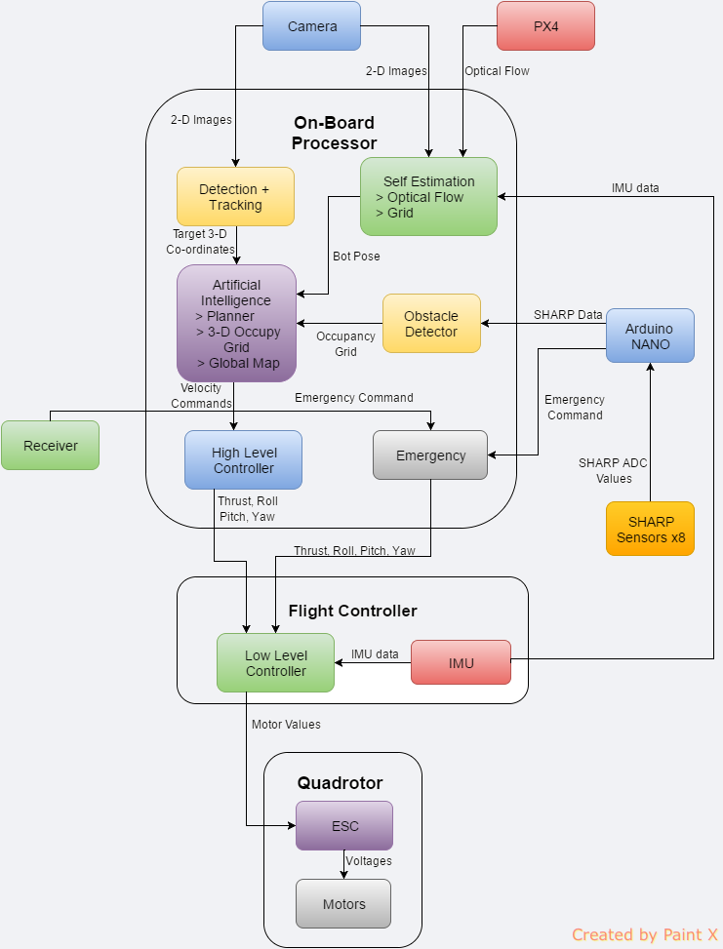
Sytem architecture
Notes:
We designed this architecture to solve the IARC problem statement. Then we began by developing each block as a separate module. The camera and IMU data act as input. The processing block consists of self estimation module that gives quad rotor its localised position. We also interfaced and tried using Pixflow, but it doesn't suitable accuracy for indoor feature less environment. Detection and tracking module allow the quad to interact with ground robots. These 2 modules act as input for our herding AI. Here we tried using 3-D occupancy and global map but they were dropped due to excessive difficulty. We used a reactive obstacle avoidance module to dynamically avoid obstacles along with a greedy herding algorithm to guide ground robots to the target.
The AI passes information to low level controller. We used APM open source framework used for low level flight control.

Slide 6
TRUE VALUE SETUP
True value setup using April Tags and cameras
Notes:
We developed a true value setup to test the accuracy of our indoor localisation system. We used 4 cameras on our arena to get the 3D position of the flying quad. April tag is placed on the quad and its odometer is obtained using April tags ROS package. True values within an accuracy of 5cm can be obtained

Slide 7
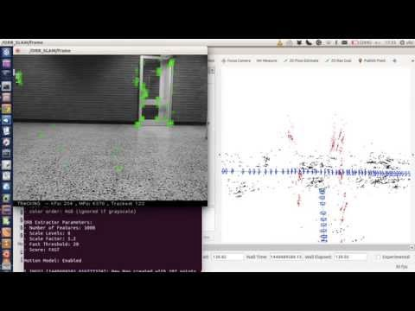
Localisation
Grid based localisation
ORB-SLAM

Slide 8
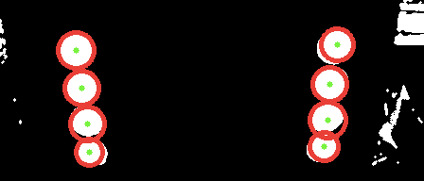
object detection and tracking
Notes:
We tried a variety of feature detectors - SURF, SIFT, SVM, HARR, DLIB, template matching, etc. none of them worked because they were position invariant, scale invariant, skew invariant and due to varying lighting conditions. Hough circle based ellipse detection where we try to detect the ellipse that forms the boundary of the ground robot

Slide 9
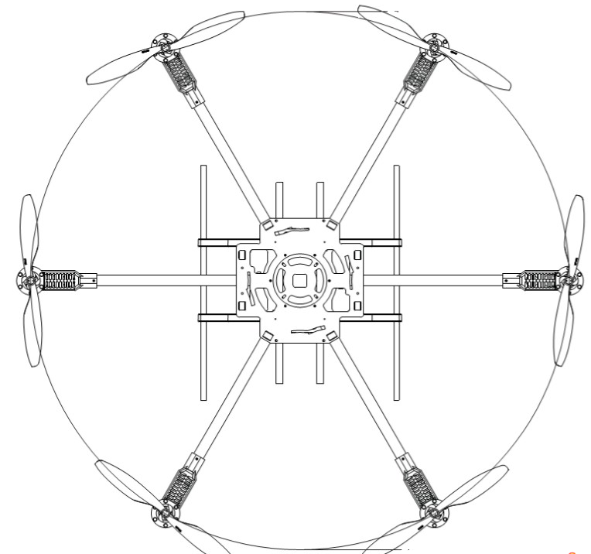
Obstacle avoidance
1
2
6
3
5
4

Slide 10
Herding
Notes:
Greedy algorithm based herding

Slide 11
ROS Architecture
Notes:
Intro to ROS, MAVROS, PID. Also tried PID tuning gradient descent. Modular ROS architecture that works with both simulator and real world environments.

Slide 12
THAnk you
Notes:
Chassis design iterations

