Slide 1
char_junkies
Project Report

Slide 2
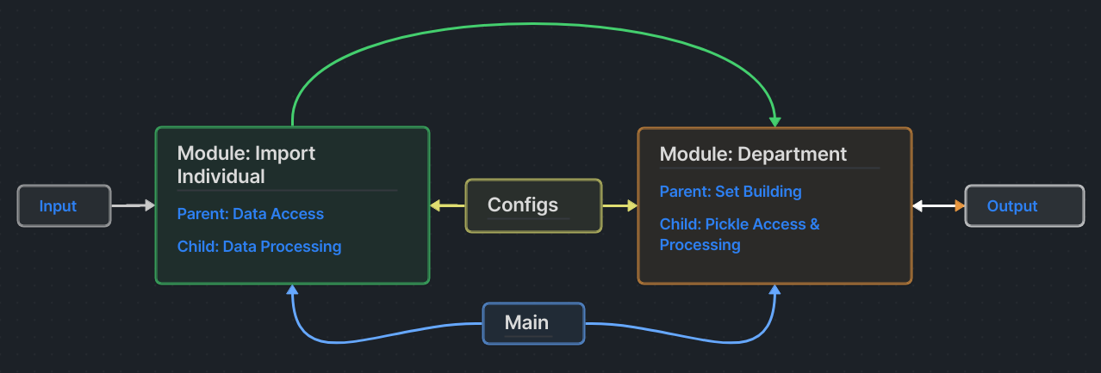
Communication Flow Diagram

Slide 3

GitHub
URL:
  https://github.com/arlemoine/CS340_F_24_char_junkies

Slide 4
Data Format
Input
  One folder per person
    steps.csv : Steps per day for one month.
      Columns: name,dayOfMonth,steps
    age.csv : Age-correct heart rate variability (HRV)
      Columns: name,age
    hrv<DD>.csv : Record HRV and heart rate every hour for entire day. DD represents day of month (i.e. hrv06.csv for the 6th day of month)
      Columns: name,hour,hrv,heartRate
Output
  department#.pickle
    Made up of the summation of all measured persons in the department, their individual data, and department statistics

Slide 5
Progress Task Report - PA1

Slide 6
Module 1: Individuals.py

Slide 7
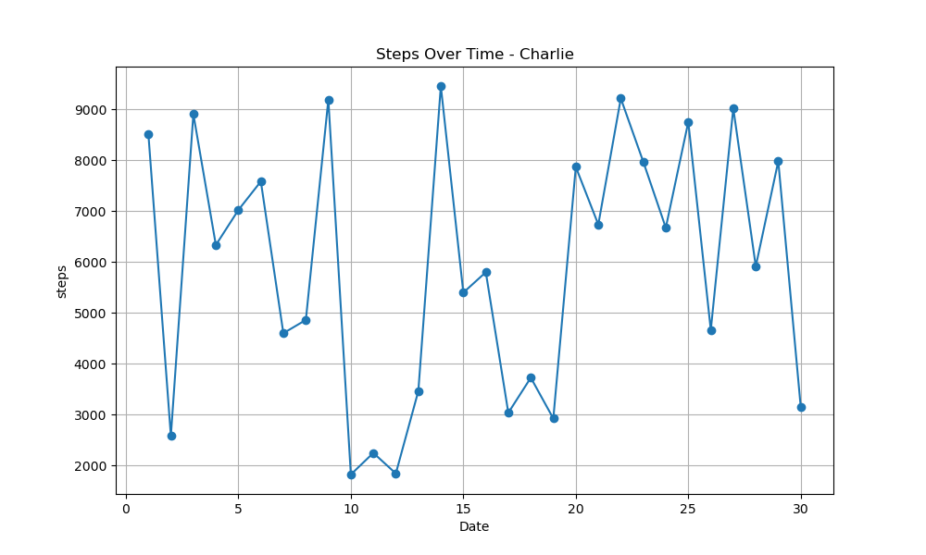
Diagrams

Slide 8
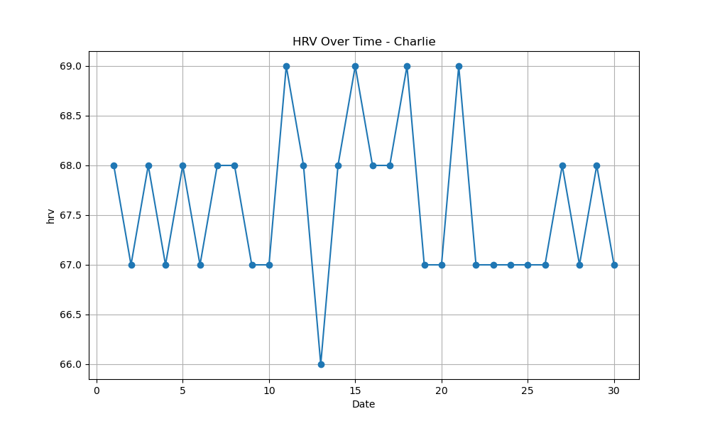
Diagrams

Slide 9
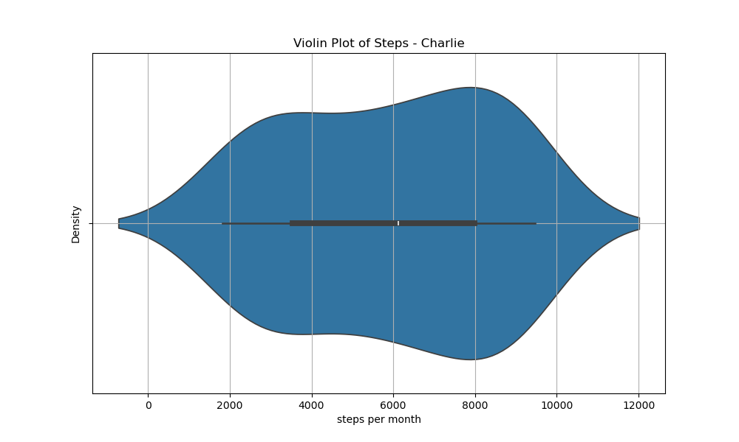
Diagrams

Slide 10
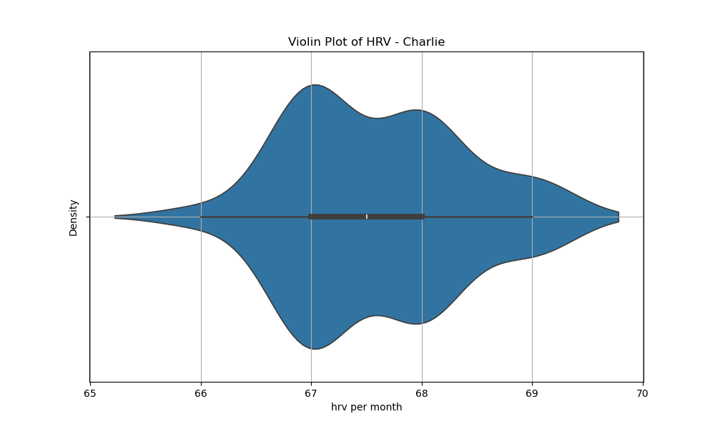
Diagrams

Slide 11
Test Data
charlie
age.csv
name,age
charlie,24
steps.csv
name,dayOfMonth,steps
charlie,1,8523
charlie,2,2587
charlie,3,8911
...
charlie,26,4667
charlie,27,9025
charlie,28,5919
charlie,29,7985
charlie,30,3145
hrvDD.csv
(where DD = day of month)
name,hour,hrv,heartRate
charlie,0,72,62
charlie,1,71,103
charlie,2,73,54
charlie,3,68,101
charlie,4,64,72
...
charlie,20,70,69
charlie,21,69,66
charlie,22,67,60
charlie,23,67,52

Slide 12
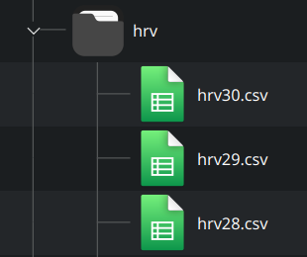
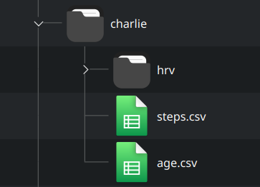
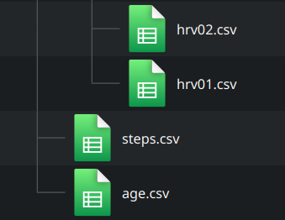
Test Data

Slide 13
Console Output
Average Steps per Day: 5912.3
Average HRV per Day: 67.6
Fitness Score: 1821.01
name dayOfMonth steps
0 charlie 1 8523
1 charlie 2 2587
2 charlie 3 8911
3 charlie 4 6337
4 charlie 5 7025
name dayOfMonth hrv
0 charlie 1 68
1 charlie 2 67
2 charlie 3 68
3 charlie 4 67
4 charlie 5 68
Here are the results in column 'dayOfMonth' for value '3':
name dayOfMonth steps
2 charlie 3 8911
No matching results found for '16' in column 'hrv'.

Slide 14
Log File Example – ‘charlie.log’
charie.log:
2024-11-20 21:26:26,619 - __main__ - INFO - Person created.
2024-11-20 21:26:26,619 - __main__ - INFO - Age (24) extracted from Input/charlie/age.csv
2024-11-20 21:26:26,622 - __main__ - INFO - HRV data loaded from Input/charlie/hrv/hrv01.csv
2024-11-20 21:26:26,623 - __main__ - INFO - HRV data loaded from Input/charlie/hrv/hrv02.csv
2024-11-20 21:26:26,624 - __main__ - INFO - HRV data loaded from Input/charlie/hrv/hrv03.csv
…
…
2024-11-20 21:26:26,650 - __main__ - INFO - HRV data loaded from Input/charlie/hrv/hrv29.csv
2024-11-20 21:26:26,650 - __main__ - INFO - HRV data loaded from Input/charlie/hrv/hrv30.csv
2024-11-20 21:26:26,651 - __main__ - INFO - Step data is loaded.
2024-11-20 21:26:32,884 - __main__ - INFO - Displayed line graph for steps in Steps Over Time.
2024-11-20 21:26:35,516 - __main__ - INFO - Displayed line graph for hrv in HRV Over Time.
2024-11-20 21:26:35,526 - __main__ - INFO - Search results for '3' in column 'dayOfMonth':
2024-11-20 21:26:35,526 - __main__ - INFO - name dayOfMonth steps
2 charlie 3 8911
2024-11-20 21:26:35,534 - __main__ - WARNING - No matching results found for '16' in column 'hrv'.
2024-11-20 21:26:38,556 - __main__ - INFO - Displayed violin plot for steps in Violin Plot of Steps.
2024-11-20 21:26:40,452 - __main__ - INFO - Displayed violin plot for hrv in Violin Plot of HRV.

Slide 15
Progress Task Report - PA2

Slide 16
Team Issues
None

