Slide 1
char_junkies
Project Report

Slide 2
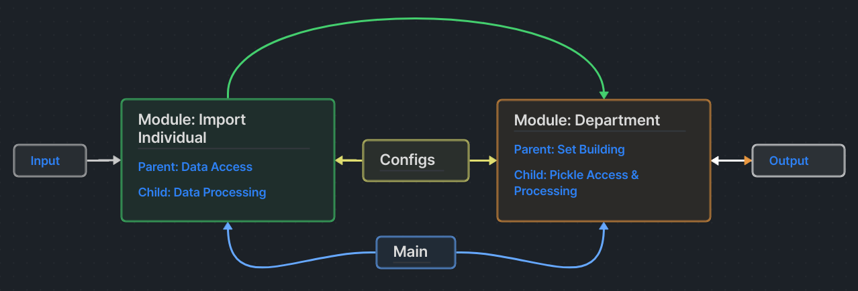
Communication Flow Diagram

Slide 3

GitHub
URL:
  https://github.com/arlemoine/CS340_F_24_char_junkies

Slide 4
Data Format
Input
  One folder per person
    steps.csv : Steps per day for one month.
      Columns: name,dayOfMonth,steps
    age.csv : Age-correct heart rate variability (HRV)
      Columns: name,age
    hrv<DD>.csv : Record HRV and heart rate every hour for entire day. DD represents day of month (i.e. hrv06.csv for the 6th day of month)
      Columns: name,hour,hrv,heartRate
Output
  department#.pickle
    Made up of the summation of all measured persons in the department, their individual data, and department statistics

Slide 5
Progress Task Report

Slide 6
Team Issues
None

