Slide 1
Project Assignment 2
You must exactly follow this template.
Do not change the order and the format.
No background coloring or formatting.
ENTER TEAM NAME HERE
TEAM MEMBERS

Slide 2
DDL QUERIES
Instructions:
- must include ALL queries listed in Queries.sql
- must follow the exact format provided in the template slide

Slide 3
Q#: <Query Name>
Snapshot of the query output:
Description:
SQL Query:
THIS IS A TEMPLATE SLIDE.
USE THIS TEMPLATE AS IS. DO NOT CHANGE THE FORMAT.
JUST ENTER or COPY/PASTE YOUR ANSWER.
The snapshot should include the output message, the table(s) created/affected/related; if table(s) are too big, then just show partially.
You may need to show table(s) before and after executing the query.

Slide 4
DML QUERIES
Instructions:
- must include ALL queries listed in Queries.sql
- must follow the exact format provided in the template slide

Slide 5
Q#: <Query Name>
Snapshot of the query output:
Description:
SQL Query:
THIS IS A TEMPLATE SLIDE.
USE THIS TEMPLATE AS IS. DO NOT CHANGE THE FORMAT.
JUST ENTER or COPY/PASTE YOUR ANSWER.
The snapshot should include the output message, the table(s) created/affected/related; if table(s) are too big, then just show partially.
You may need to show table(s) before and after executing the query.

Slide 6
Credits and References

Slide 7
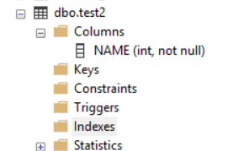
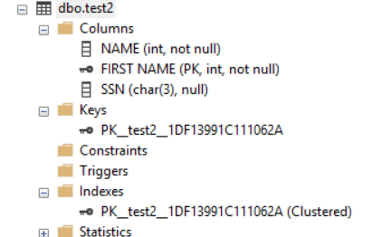
QD2: ALTER TABLE
Snapshot of the query output:
Description: Add 2 new columns “FIRST NAME” as the primary key and SSN of 3 characters in length.
BEFORE
AFTER
ALTER TABLE test2
ADD
[FIRST NAME] INT PRIMARY KEY,
SSN CHAR(3)
This is an example

