Slide 1
FESTIVAL OF AI
Customise Your Life
Building tiny personal tools with AI
Arlen Brower
Computer Science Lecturer · Industry Projects & Placements
Notes:
Timing: 0:00–0:01:30.
Open conversationally: this is a talk and live demo, not a tightly managed workshop. Questions are welcome at any point; if an interesting question takes the session off the planned rails, that is allowed.
Say: “I like computers that feel like mine. I want to show why that power is no longer reserved for people who already know how to program.”

Slide 2
WHO THIS IS FOR
If your software almost fits, this is for you.
Staff · students · researchers · hobbyists · curious non-programmers.
02
Notes:
Timing: 0:01:30–0:04.
This is for people with a small recurring frustration, not necessarily a software idea. Include people whose tools almost fit, people who repeatedly reformat or copy information, and people who have never written code.
Make the promise explicit: nobody will be put on the spot, and following along is optional.

Slide 3
A PERSONAL PHILOSOPHY
Your computer should adapt to you.
Every computer science student should learn to shape their own environment.
03
Notes:
Timing: 0:04–0:06:30.
Give your personal examples: aliases, editor settings, browser changes, templates, or small scripts. The point is not that everyone needs your setup; it is that default software is a starting point.
Say that customising an environment is a way of noticing how you work and making deliberate choices about it.

Slide 4
THE OLD GATE
Customisation used to be a nerd hobby
The old path
Who got in
Command line
Config files
Documentation
Trial and error
Break things
Time to tinker
Technical language
Debugging confidence
Nerds like me
04
Notes:
Timing: 0:06:30–0:09.
Lean into the self-aware “nerdy individuals like me” line. Traditionally, even a tiny personal change required knowing the right vocabulary, finding scattered documentation, editing files, and recovering when something broke.
That culture produced wonderful tools, but it also made the starting cost feel unreasonable for a five-minute annoyance.

Slide 5
WHAT AI CHANGES
Not knowing the syntax is no longer the blocker
You can say
AI can supply
What annoys you
Current steps
One example
Private limits
What success means
Unfamiliar syntax
A working first draft
Plain-language explanations
Small focused changes
05
Notes:
Timing: 0:09–0:12.
For a small, simple, well-specified task, AI often knows the unfamiliar syntax and can explain it. If you do not know how to make a browser extension, you can ask what files are needed, what each one does, and how to load them.
Keep the honest caveat: AI can be confidently wrong. It lowers the cost of trying; it does not remove the need to inspect permissions, use safe information, test behaviour, or stop.

Slide 6
THE SWEET SPOT
Software for one can be deliberately tiny
1
1
1
person
repeated job
useful outcome
Start with your own work, study, hobby, or everyday life.
Choose one moment of friction—not the whole system around it.
Decide what ‘better’ looks like before building anything.
Small enough to understand. Useful enough to earn its place.
06
Notes:
Timing: 0:12–0:14.
Define the sweet spot with the three ones. This is “software for one”: the economics are different because the person who wants it and the person judging it are the same person.
The first version does not need a market, accounts, a framework, or polish. It needs one useful outcome and a failure mode you can tolerate.

Slide 7
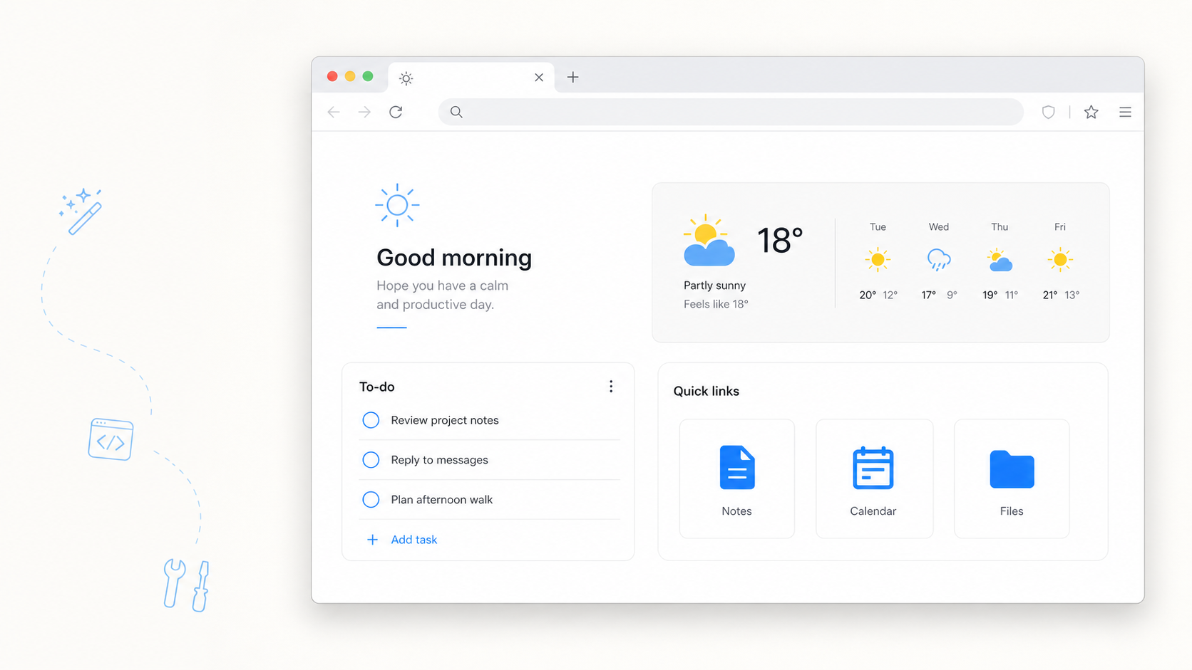
MY BROWSER, MY RULES
What would you want this page to do for you?
A greeting. Tasks. Useful links. Weather. One page that is unmistakably yours.
07
Notes:
Timing: 0:14–0:17.
Use the dashboard as a concrete object: a Firefox new-tab extension with a greeting, a to-do list, links, and weather. Ask the question rhetorically; take quick responses if they come, but do not wait for them.
Say clearly that the image is a concept visual while the live browser demo is the working artifact.
[Sources]
- OpenAI ImageGen; concept dashboard generated 17 August 2026; asset: slides/assets/personal-dashboard-concept.png

Slide 8
START WITH FRICTION
Start with the thing that keeps annoying you
Tiny tools often begin with a sentence you have stopped saying out loud:
“I copy this again.”
“I rearrange this again.”
“I click this again.”
Moving the same information between places, then cleaning it up by hand.
Turning messy notes, lists, or dates into the same useful structure.
Repeating a small sequence because no existing tool fits exactly.
08
Notes:
Timing: 0:17–0:19.
Give one authentic example from your own practice for each phrase. Keep the examples brief and low stakes.
If the room is talkative, invite examples. If not, keep moving. The diagnostic question is simply: “What have I done often enough that I resent doing it by hand?”

Slide 9
YOU DO NOT NEED TO CODE
Your job is to say what good looks like
You bring
AI can bring
Purpose
Examples
Boundaries
Judgement
Tests
Unfamiliar syntax
A first draft
Plain-language explanations
Focused changes
09
Notes:
Timing: 0:19–0:22.
This is the core non-programmer reframing. The audience does not need to become the syntax expert. They do need to be the expert on purpose, examples, boundaries, and what correct behaviour looks like.
Say: “AI can write a line I do not understand yet. My next move is to ask what it does, inspect what it can access, and test the result—not to pretend understanding is irrelevant.”

Slide 10
BYOD, IF YOU LIKE
Watching is fine. Following along is optional.
Just watch
Follow along
Listen for the choices, not the code.
Use any approved AI tool.
How the problem is framed
How the scope shrinks
How tests drive changes
Where I slow down
Name one small irritation
Ask for the smallest version
Use made-up or permitted data
Stop whenever you like
10
Notes:
Timing: 0:22–0:23:30.
This is the only audience-direction slide. State that devices are welcome but not expected. Nobody needs to keep pace with the demo.
Remind anyone following along to use made-up, public, or permitted information—never confidential student, HR, health, client, or research data. Questions can interrupt at any point.

Slide 11
LIVE DEMO
Let’s make my browser work for me
Brief
→
Local page
→
Firefox
→
One change
Describe · build · inspect permissions · test · change · stop
11
Notes:
Timing: 0:23:30–0:35:30.
Switch away from the deck. Show the tiny brief, paste the prepared prompt, and explain only the important clauses: ordinary browser files, local storage, minimum permissions, and no unrequested features.
Load the temporary Firefox extension. Add a task, open a new tab to test persistence, reject a blank task, then make one contained change. Use a prepared checkpoint if generation stalls. End when the tests pass; do not polish.
Questions are welcome and can change the route. Protect roughly five minutes at the end for testing, boundaries, and the closing idea.
[Sources]
- Mozilla MDN, chrome_url_overrides: https://developer.mozilla.org/en-US/docs/Mozilla/Add-ons/WebExtensions/manifest.json/chrome_url_overrides
- Mozilla Extension Workshop, temporary installation: https://extensionworkshop.com/documentation/develop/temporary-installation-in-firefox/

Slide 12
GENERATED OUTPUT IS A DRAFT
Test it—don’t just admire it
Normal
Edge
Safe failure
Add a task, complete it, and open another new tab. It should still be there.
Submit an empty task or only spaces. Nothing should break or be added.
Turn the network off. Tasks and links should work even when weather cannot.
A good prompt asks for tests. A good builder actually runs them.
12
Notes:
Timing: 0:35:30–0:38:30.
Run the three tests yourself. The audience may follow, but there is no pause for an exercise.
Reinforce that “it opened once” is not a meaningful test. AI output is a draft until the normal case, an edge case, and a safe failure have been tried.

Slide 13
THE BOUNDARY MOVES
Adding weather changes more than the screen
LOCAL
CONNECTED
Tasks + links
Weather
→
Stay on the device
Work without a network
Are easy to inspect
Sends a chosen location
Depends on another service
Needs a graceful offline state
13
Notes:
Timing: 0:38:30–0:42.
Ask rhetorically: “What changed besides the screen?” Draw out location data, a third party, network dependency, host permissions, stale results, and offline behaviour.
Explain that the demo avoids automatic geolocation and uses a user-chosen location. Green-light tiny tools that are local, reversible, inspectable, and merely annoying when wrong. Slow down for private data, APIs, broad permissions, secrets, high stakes, or actions that affect other people.
Disclose that temporary Firefox extensions disappear on restart and persistent installation in standard Firefox requires Mozilla signing.
[Sources]
- Open-Meteo API documentation: https://open-meteo.com/en/docs
- Mozilla Support, add-on signing: https://support.mozilla.org/en-US/kb/add-on-signing-in-firefox

Slide 14
ONE IDEA TO TAKE HOME
Change one small system around you
Notice one irritation
Not more software.
The power to shape small systems around you—and the judgement to test them.
Ask for the smallest version
Keep it local + reversible
Test before you trust it
github.com/arlen-brower/festival-of-ai
Notes:
Timing: 0:42–0:45.
Close the loop with the opening philosophy: the goal is not to generate more software for its own sake. It is to notice one small system that almost fits, describe the change clearly, keep the first version contained, and test it.
Leave the resource link on screen. Invite final questions; if the earlier conversation used the remaining time, finish with the quote on the right.

