Slide 1
FESTIVAL OF AI
Customise Your Life
Building tiny personal tools with AI
Arlen Brower
Computer Science Lecturer · Industry Projects & Placements
Notes:
Timing: 0:00–0:02. Welcome the room in one sentence, then say: ‘This is not about building the next big app. It is about the little irritations nobody else will prioritise for you.’ Switch immediately to Firefox and reveal the completed dashboard. Do not explain your biography or the technology yet.

Slide 2
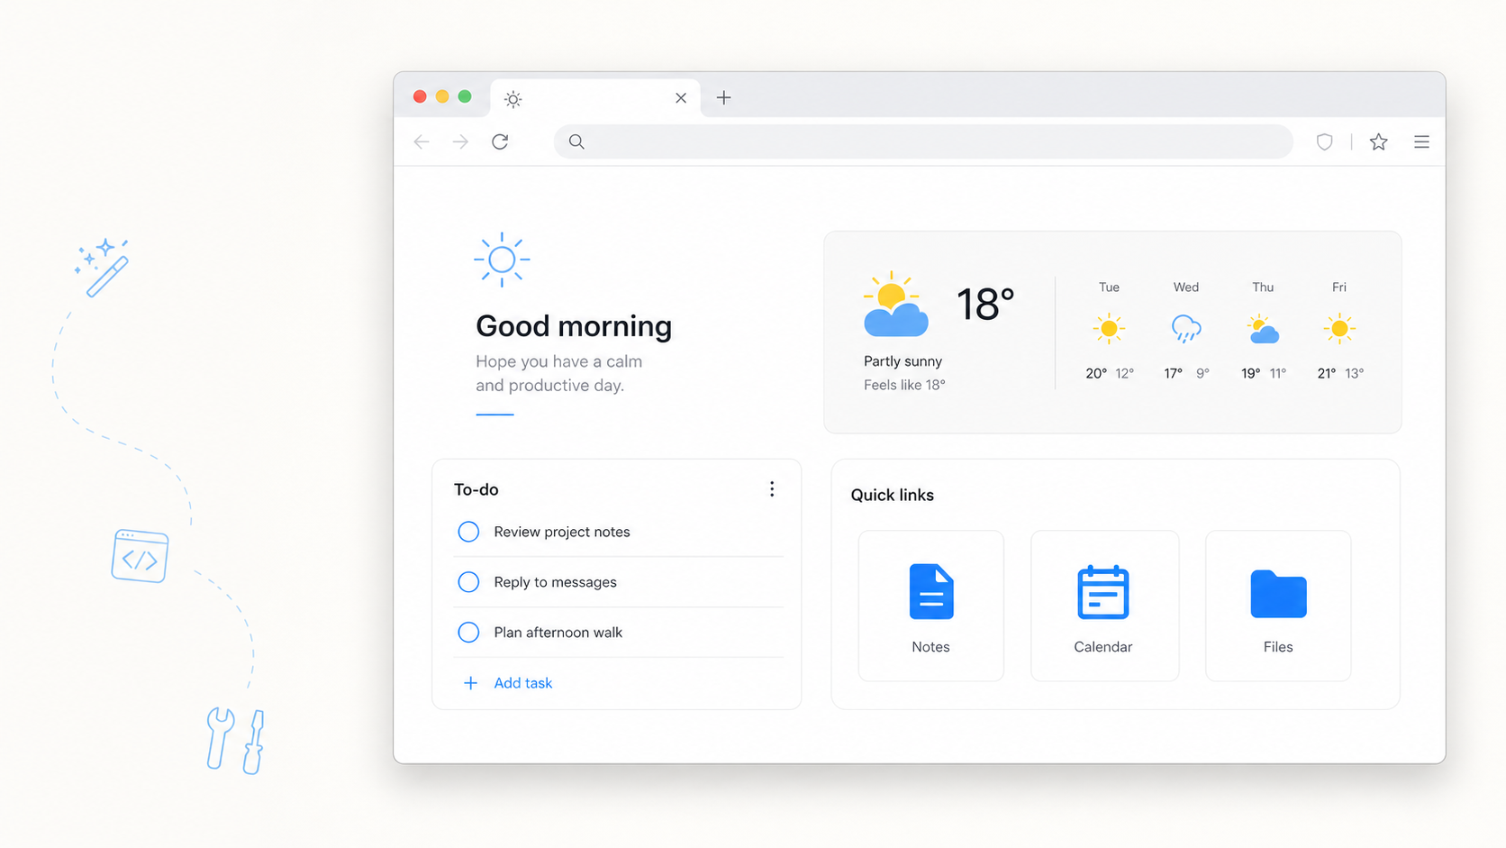
MY BROWSER, MY RULES
What would you want this page to do for you?
A greeting. Three tasks. Useful links. Weather. One thing that is unmistakably yours.
02
Notes:
Timing: 0:02–0:04. Return to this slide after the live before/after reveal. Ask the question and take two or three quick responses. The point is not the weather tile; it is that a page people see every day can reflect their own priorities. Say clearly that the image is a concept visual, while the browser demo is the working artifact.
[Sources]
- OpenAI ImageGen; concept dashboard generated 17 August 2026; prompt recorded in .tmp/slides-build/source-notes.txt

Slide 3
START WITH FRICTION
The little irritations are worth noticing
Good tiny tools often begin with a sentence you have stopped saying out loud:
“I copy this again.”
“I rearrange this again.”
“I click this again.”
Moving the same information between places, then cleaning it up by hand.
Turning messy notes, lists, or dates into the same useful structure.
Repeating a small sequence because no existing tool fits exactly.
03
Notes:
Timing: 0:04–0:06. Give one authentic example from your own work for each sentence. Keep each example under 20 seconds. Emphasise repeated, inspectable, low-stakes friction—not a large organisational transformation.

Slide 4
A USEFUL DEFINITION
Software for one can be deliberately tiny
1
1
1
person
repeated job
useful outcome
Start with your own work, study, hobby, or everyday life.
Choose one moment of friction—not the whole system around it.
Decide what ‘better’ looks like before building anything.
Not a startup. Not polished. Useful enough to earn its place.
04
Notes:
Timing: 0:06–0:08. Define ‘tiny’ using the three ones. The release criterion is not commercial polish; it is whether the tool reliably saves effort or makes the repeated job easier for its intended person.

Slide 5
WORKING WITH AI
Your role is not “be the programmer”
You bring
AI can bring
Purpose
Examples
Boundaries
Judgement
Tests
Unfamiliar syntax
A first draft
Plain-language explanations
Focused changes
05
Notes:
Timing: 0:08–0:12. This is the central reframing for non-programmers. AI can lower the syntax barrier, but it does not know the real purpose, acceptable data, consequences, or definition of correct. Say: ‘You can make consequential choices without understanding every line, but you cannot delegate responsibility for those choices.’

Slide 6
YOUR TURN · NOTICE
What did you do more than twice last week?
Copy · paste · reformat · look up · calculate · rename · repeatedly click
I repeatedly…
Use made-up, public, or permitted information.
06
Notes:
Timing: 0:12–0:14. Give participants about 90 seconds to write two or three candidate irritations. Read the verbs aloud. Tell them explicitly not to paste confidential, student, health, HR, client, or research information into an AI tool during the workshop.

Slide 7
YOUR TINY TOOL
Write the smallest useful brief
When this happens…
I will give it…
It will give me…
Version one must…
Version one will not…
I will know it works when…
07
Notes:
Timing: 0:14–0:18. Leave this slide up while participants fill the core brief. Ask them to include one concrete example. Circulate and reduce scope. If someone proposes a large system, ask: ‘What is the smallest useful moment inside that system?’

Slide 8
PAIR AND SHRINK
What could version one leave out?
Explain your idea in 30 seconds. Your partner asks the question. Then swap.
08
Notes:
Timing: 0:18–0:20. Run this tightly. Give 30 seconds to explain, 20 seconds for the question and answer, then swap. Do not invite reports back yet; preserve momentum for the demo.

Slide 9
LIVE DEMO
Let’s make my browser work for me
Brief
→
Local page
→
New tab
→
One change
Describe · build · inspect permissions · test · change · stop
09
Notes:
Timing: 0:20–0:30. Switch away from the deck. Show the completed brief, paste the prepared prompt, and explain only three clauses: ordinary browser files, local storage/minimum permissions, and no unrequested features. Use a prepared checkpoint if generation stalls. Load the temporary Firefox extension, add a task, open a new tab to test persistence, reject a blank task, then ask the room to choose one contained change. End when the tests pass. Do not polish.
[Sources]
- Mozilla MDN, chrome_url_overrides: https://developer.mozilla.org/en-US/docs/Mozilla/Add-ons/WebExtensions/manifest.json/chrome_url_overrides
- Mozilla Extension Workshop, temporary installation: https://extensionworkshop.com/documentation/develop/temporary-installation-in-firefox/

Slide 10
SIX-MINUTE SPRINT
Choose the kind of progress you need
Clarify it
Try it
Improve the brief. No code required.
Prototype one tile or one tiny job.
Restate assumptions
Remove one feature
Propose three tests
Flag one boundary
One local HTML file
No accounts or packages
Synthetic information
Three manual tests
10
Notes:
Timing: 0:30–0:36. Present these as two equally valid lanes, not technical versus non-technical people. Encourage pairs. A participant who leaves with a sharper brief has made real progress. A dashboard participant should prototype one tile, not an entire productivity suite.

Slide 11
GENERATED OUTPUT IS A DRAFT
Test it—don’t just admire it
Normal
Edge
Safe failure
Add a task, complete it, and open another new tab. It should still be there.
Submit an empty task or only spaces. Nothing should break or be added.
Turn the network off. Tasks and links should work even when weather cannot.
A good brief tells you what to try—and what “wrong” looks like.
11
Notes:
Timing: 0:36–0:40. Partners try one normal, one edge, and one safe-failure case. Ask them to record one requested change or one reason not to continue. Reinforce that ‘it opened once’ is not a meaningful test.

Slide 12
THE BOUNDARY MOVES
Weather changes more than the screen
LOCAL
CONNECTED
Tasks + links
Weather
→
Stay on the device
Work without a network
Are easy to inspect
Sends a chosen location
Depends on another service
Needs a graceful offline state
12
Notes:
Timing: 0:40–0:42. Ask: ‘What changed besides the screen?’ Draw out location data, a third party, host permissions, network dependency, attribution, stale results, and offline behaviour. Explain that the workshop version avoids automatic geolocation and uses a user-chosen location. Also disclose that temporary Firefox extensions disappear on restart and persistent installation in standard Firefox requires Mozilla signing.
[Sources]
- Open-Meteo API documentation: https://open-meteo.com/en/docs
- Mozilla Support, add-on signing: https://support.mozilla.org/en-US/kb/add-on-signing-in-firefox

Slide 13
A QUICK BOUNDARY CHECK
Choose the risk level before you build
GREEN
AMBER
RED
Good workshop candidate
Slow down
Not a quick prototype
Local · reversible
Easy to inspect
Failure is merely annoying
Private information · APIs
Broad permissions
Errors that are hard to notice
Secrets · high stakes
Automatic send/delete/pay
Others affected without review
13
Notes:
Timing: 0:42–0:43. Move quickly. Ask five questions aloud: What leaves the device? How will I notice a wrong result? What can it change or send? Who else is affected? What will need maintenance? Make clear that red does not mean ‘never’; it means not as an improvised 45-minute prototype.

Slide 14
YOUR NEXT 15 MINUTES
Change one small system around you
Remove one feature
Not more software.
The power to change small systems—and the judgement to know when not to.
Challenge the brief
Try one example
Investigate one boundary
github.com/arlen-brower/festival-of-ai
Notes:
Timing: 0:43–0:45. Ask everyone to choose and write one next action. Explicitly say that ‘stop; this is not useful or safe enough’ is also a successful conclusion. Close with the quote on the right. Leave this slide on screen for the final question and resource link.

