Slide 1
IBM HACKATHON PROJECT
COURSE CONTENT SIMPLIFICATION AGENT
Student name: ARLENE KANATTU REGI
College Name: AJ INSTITUTE OF ENGINEERING AND TECHNOLOGY
Department : COMPUTER SCIENCE AND ENGINEERING(ARTIFICIAL
INTELLIGENCE & MACHINE LEARNING)

Slide 2
OUTLINE
Problem Statement
Technology used
Wow factor
End users
Result
Conclusion
Git-hub Link
Future scope
IBM Certifications

Slide 3
PROBLEM STATEMENT
Students face difficulty revising lengthy textbooks and notes for exams. Manually summarizing content into concise, mark-based answers is time-consuming and inefficient.
Solution:
A Course Content Simplifier Agent powered by NLP quickly converts study material into simplified summaries based on mark weight (1, 2, 4, 8, 12 marks). It allows topic-specific search, and query history, helping students revise faster and focus on key concepts.

Slide 4
TECHNOLOGY USED
IBM cloud lite services
Natural Language Processing (NLP)
Retrieval Augmented Generation (RAG)
IBM Granite model

Slide 5
IBM CLOUD SERVICES USED
IBM Cloud Watsonx AI Studio
IBM Cloud Watsonx AI runtime
IBM Cloud Agent Lab
IBM Granite foundation model

Slide 6
WOW FACTORS
This agent will drastically reduce study time, improve exam preparation efficiency, and enhance concept retention by delivering concise, mark- based summaries. It transforms bulky study material into actionable knowledge, making revision faster, smarter, and stress-free for students.
Generates 1, 2, 4, 8, and 12-mark answers instantly.
Semantic Topic Search, quickly retrieves relevant concepts from large textbooks or PDFs.
Stores previous questions and answers for quick access.
By combining AI-powered summarization with semantic search this agent becomes a personal exam assistant, helping students prepare smarter, not harder.

Slide 7
END USERS
Students
Tutors / Teaching Assistants
Course Instructors
Academic Peer Study Groups
Educational Content Creators

Slide 8
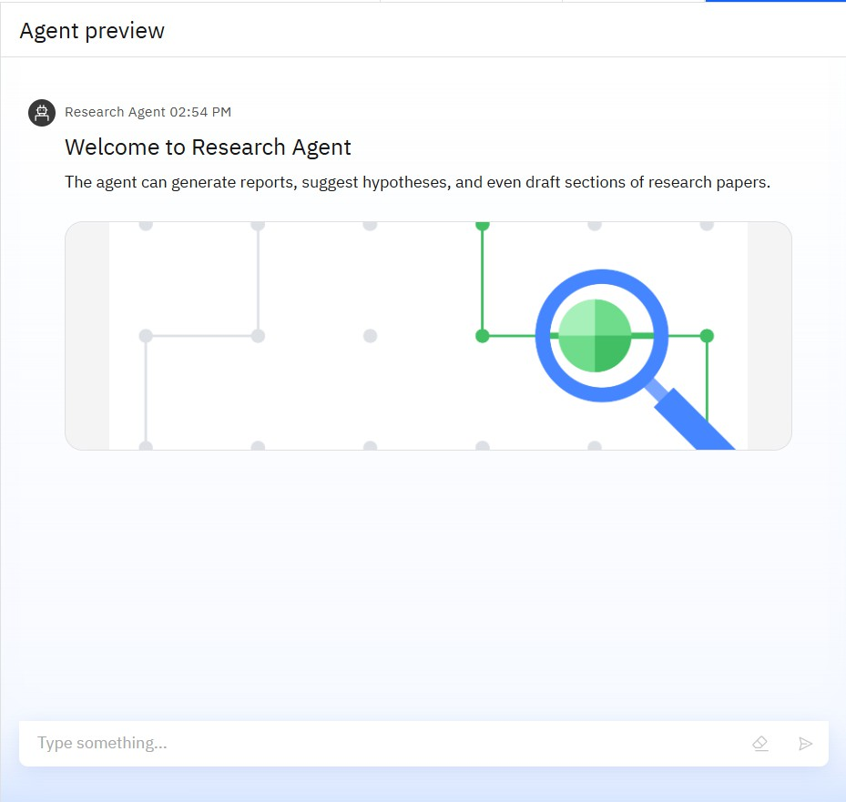
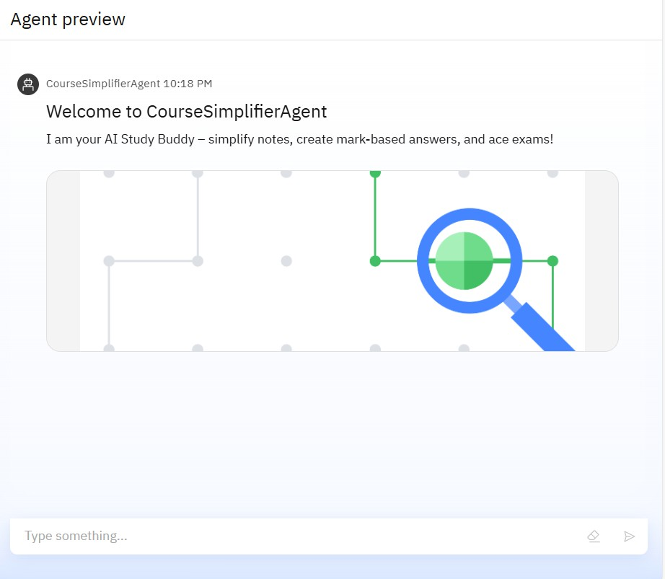
RESULTS

Slide 9
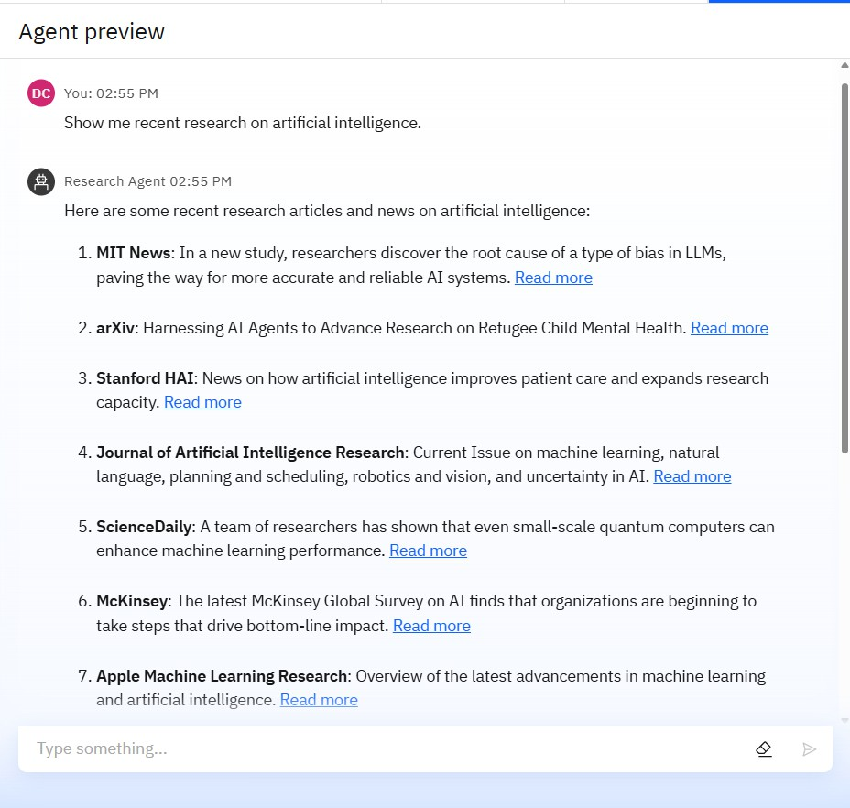
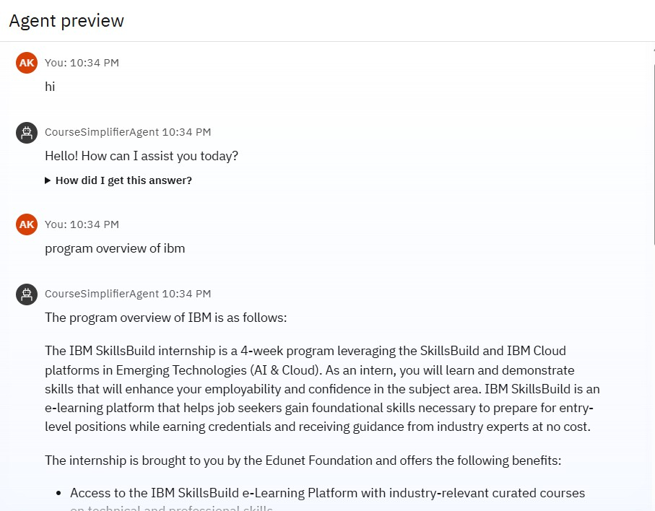
RESULTS

Slide 10
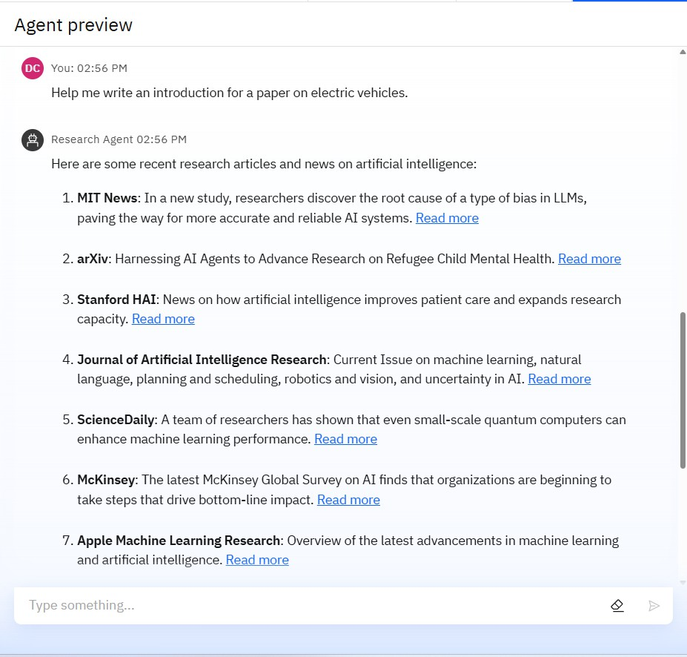
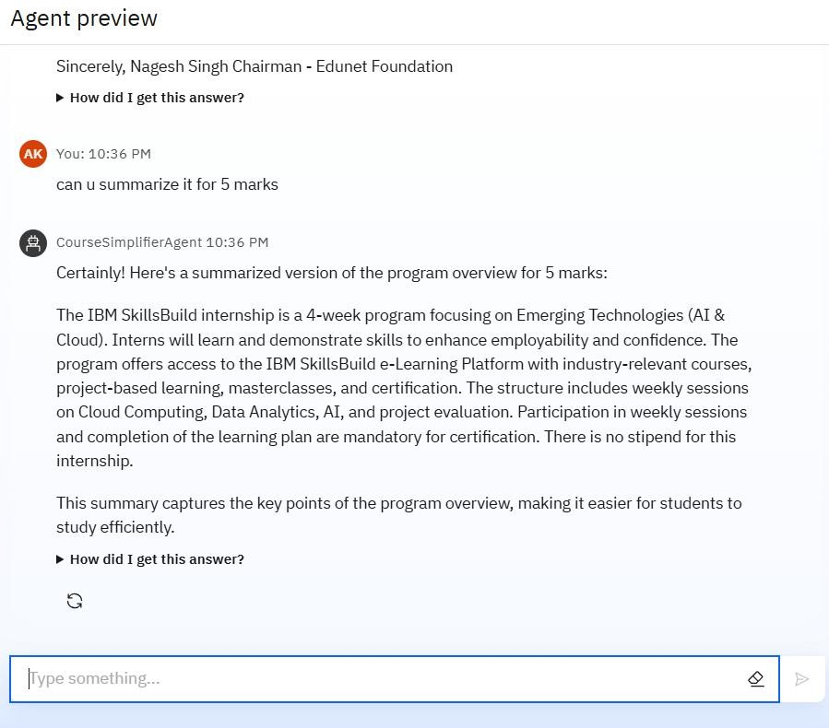
RESULTS

Slide 11
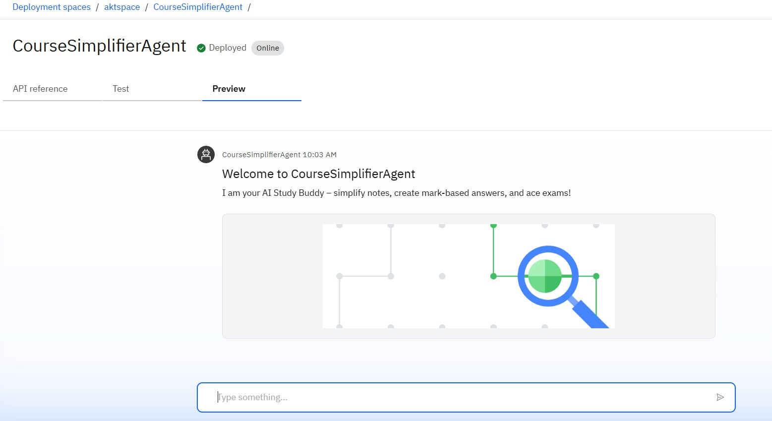
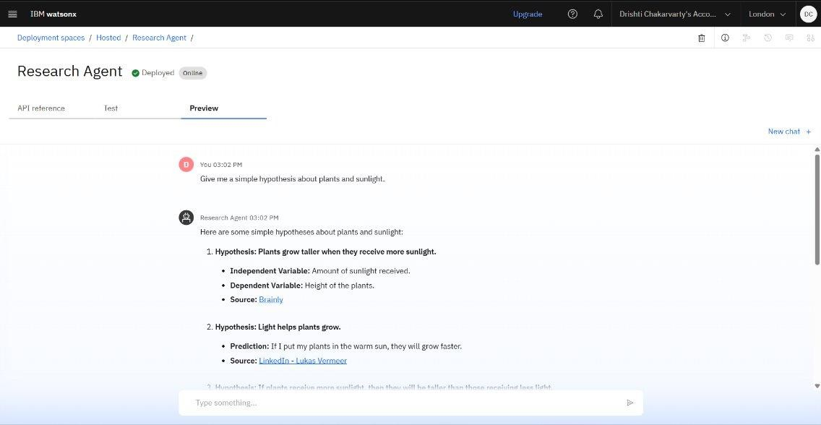
RESULTS
Deployed AI Agent

Slide 12
CONCLUSION
The Course Content Simplifier Agent dramatically cuts revision time by converting complex material into concise, mark-weighted answers tailored for exam preparation.
Integrated semantic search and history tracking ensure learners find and reuse key concepts efficiently, improving retention and understanding.

Slide 13
GITHUB LINK
https://github.com/arlene006/CourseSimplifierAgent.git

Slide 14
FUTURE SCOPE
Voice-Activated Study Assistant
Real-Time Collaborative Learning
AI-Powered Quiz Generation
Integration with LMS & Study
Personalized Learning Recommendations

Slide 15
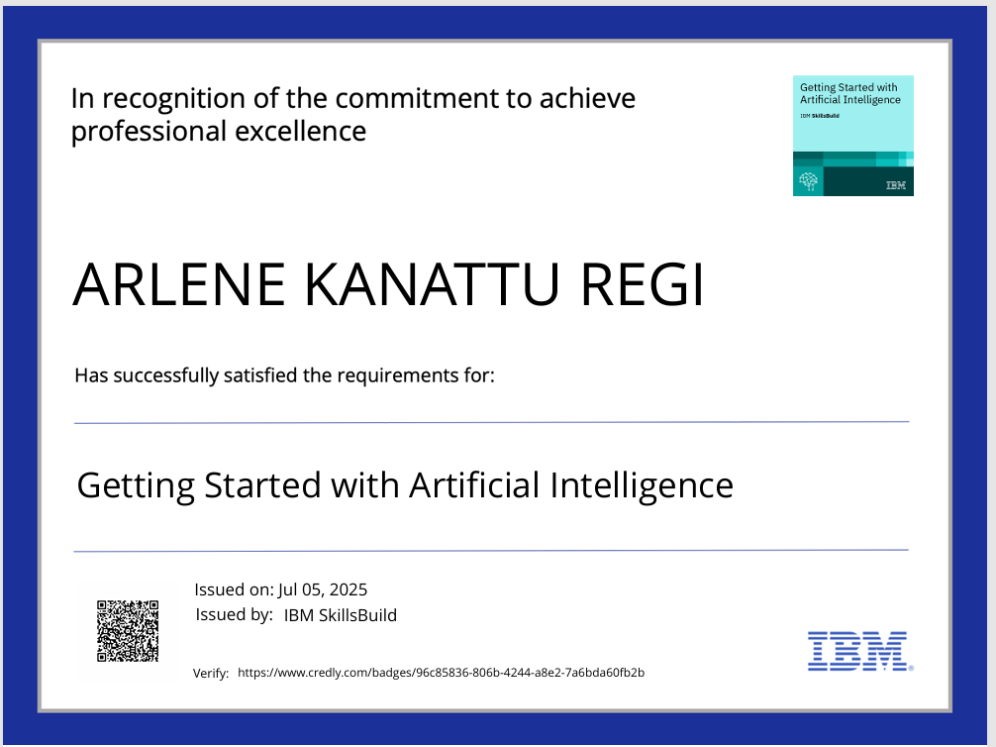
IBM CERTIFICATIONS

Slide 16
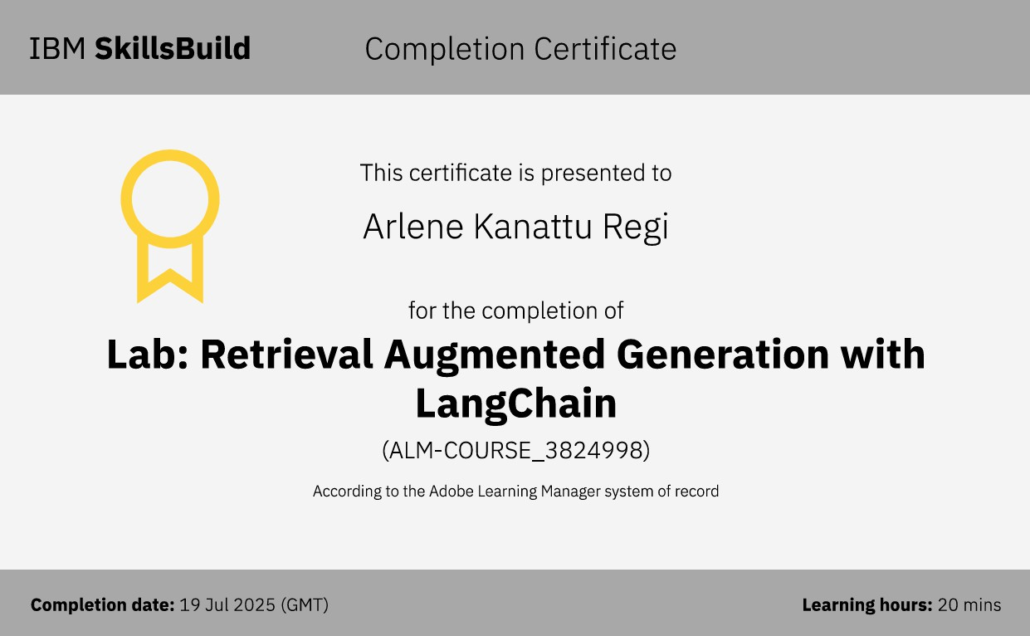

Slide 17
THANK YOU

