Slide 1
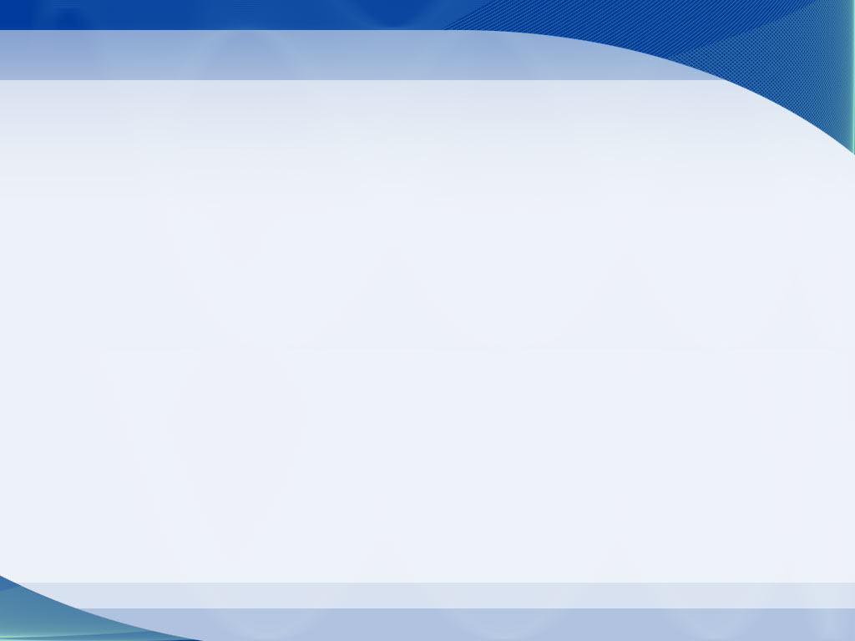
ENSC351 Final Project Demo
Group 20
Pair #38 BAIMING QIAO (301243446)
JIANGLIN FU (301256171)
Pair #39 SHUO CHEN (301242896)
YANGJIE LIU(301267615)

Slide 2
VGA

Slide 3
VGA Phase I
    Implement test functions of drawing various shapes of image.
      Access specific pixel using x-y coordinates, width and height of images, and the initial offset from the buffer.
      Utilize alpha blending mechanism to generate transparent image.
      Perform mmap() function to allocate virtual memory address for pixel information.
      Run test functions to display opened images through screen buffer.

Slide 4
VGA Phase II
    Implement VGA driver to establish the connection between user space and kernel space
      Perform dma_to_pfn function to map the memory between physical address and kernel space.
      Enable access to kernel frame number from user space via remap function.
      Implement functions of file operations to allow the kernel to match test functions from user space.
      Run test functions to display opened images through screen buffer.

Slide 5
VGA Phase III
    Establish connection between keyboard and screen display via VGA transmission.
      Utilize draw_subimage to extract character from ASCII table image that matches the keyboard.
      Set up kermit connection and allocate memory location of it.
      Read the input character at runtime via serial port.
      Consider special cases when the new line is needed or the screen is filled up.

Slide 6
Application Functionality(Keyboard Part)
    Accomplish alphabetical interpretation on keyboard through VGA driver.
    Support several special functions such as changing new lines manually and automatically, delete characters using backspace.
    Simulate console working environment, add input prefix “>>” when the new lines appear, leave certain area space for timer display.
    Decrease processing delay by reducing the times of revisiting global buffer, transport intermediate data into local buffer instead of global buffer directly.

Slide 7
Extra Function Features
    New Line Operation(/n)
    Backspace Operation
    Clear Screen(Automatically)
    Delay Reduction

Slide 8
TIMER

Slide 9
Timer Phase I
Timer_probe:
  function to initialize all the variable that we need (will be called by zedboard when mknod)
  e.g. connect the peripheral device with corresponding driver and allocate timer
  resource address at kernel space
  implement device info like major, minor, (which will be used in insmod)
timer-ioctl :
allow device to issue a system call
  pass input data and able to read and write timer’s data (deal with timer’s read/write ops)
request_irq :
  install interrupt driver, detect interrupts from peripheral device and tell OS to load the ISR
  (only initialized, didn’t use since we don’t use count up mode)

Slide 10
Timer Phase II
Implement timer driver for recording time.
  timer_start:
  to reset timer and enable count up
      for write function: TIMER_WRITE_REG(ops - .h), IOCTL (func from driver)
      reset: LOAD_REG (register offset)
      count up: CONTROL_REG, LOAD0, ENT0 (register mask)
  timer_end:
  CONTROL_REG to stop
  _u32 read_timer:
  TIMER_REG - cast to float while using
  (use above 3 functions as hardware timer)

Slide 11
Timer Phase III
  system time:
      include sysinfo library: uptime
      check sysinfo(&s) != 0, otherwise system time shows max value of the timer
main:
  open driver/image/serial port and store into fd
      Read
      Read(serial_fd, &c, 1) to read char from serial_fd (part)
      change flag to avoid read func always waiting for input char
      flags = fcntl(serial_fd, F_GETFL, 0);
      fcntl(serial_fd, F_SETFL, flags | O_NONBLOCK);
      Write
      Write(serial_fd, &c, 1) to write char into serial_fd (part)

Slide 12
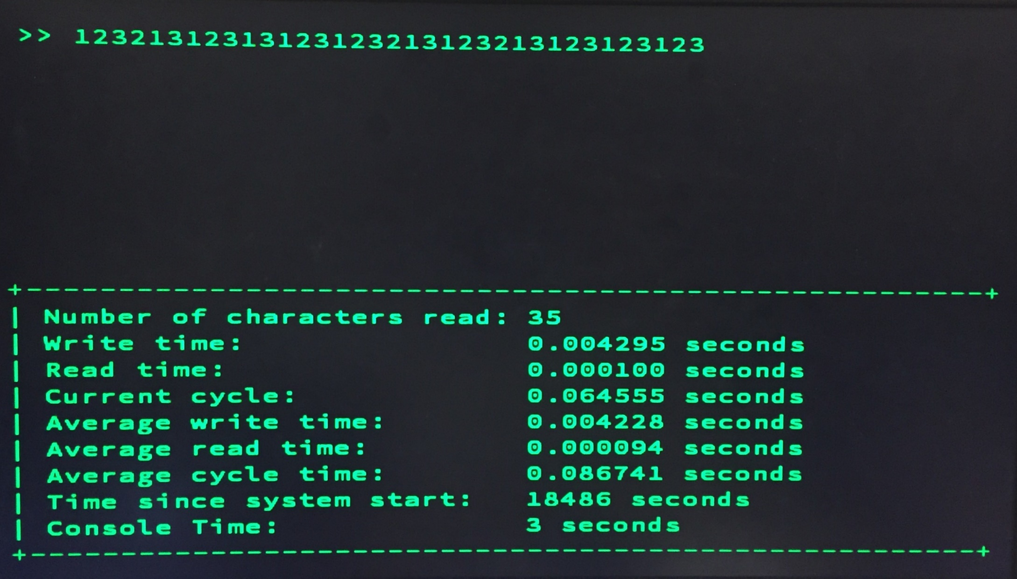
Timer Phase IV

Slide 13
Timer Phase III
  Used (SOFTWARE TIMER) read_timer to record current time value
  Number of characters read: Count++
Read time: time difference before and after read()
Write time: time difference before and after write()
Current cycle: there are some error for this value
Average *** time: sum/count
Time since system start: HARDWARE TIMER sysinfo.uptime()
Console Time: HARDWARE TIMER time(NULL)

