Slide 1

California Housing Price Prediction
Arlene Rivera

Slide 2

Content Overview
Business Problem
Exploratory Data Analysis
Modeling
Limitations
Summary
Data Source: 1990 California Consensus

Slide 3
Business Problem
The goal of this project is to identify the factors that impact housing prices in California. This information is of interest to real estate investors, local sellers, and buyers who seek to understand the market and make informed decisions about their investments or purchases.

Slide 4
Exploratory Data Analysis
Top 10 houses have a median value of $500,001 with homeowners median age being between 27-52 years
Median house value & median income = positive correlation [A] Median house value & distance to coast = negative correlation [B]
As total population increases, so does the count of total bedrooms [C]
House prices increase when location is closer to the coast [D]
* Letters in brackets match to graphs in following slides

Slide 5
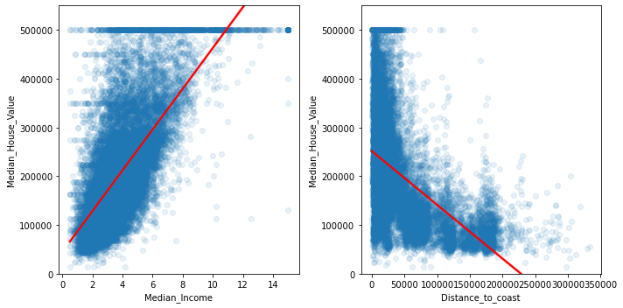
A
B
A: Median House Value to Median Income B: Median House Value to Distance to Coast

Slide 6
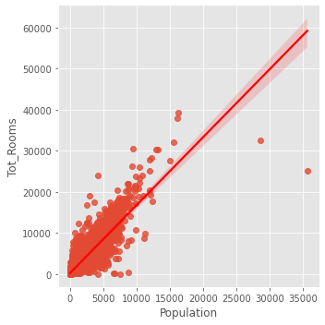
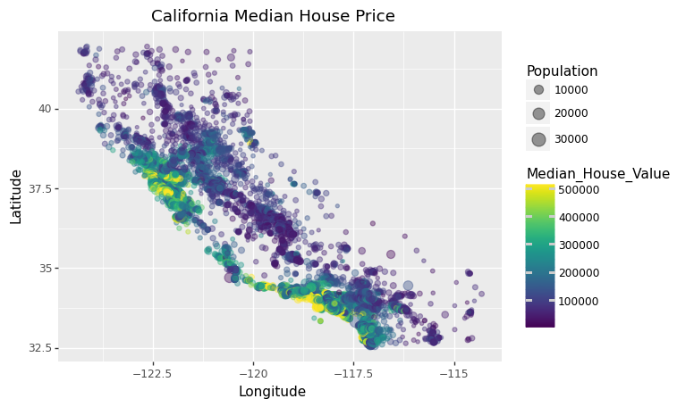
C
D
C: Total Rooms to Population D: Latitude to Longitude

Slide 7
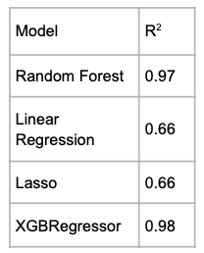
Modeling
4 different models tested using R² values: Random Forest, Linear Regression, Lasso, XGBRegressor
Model used: Random Forest

Slide 8
Limitations
Dataset used is from 1990 census data, meaning that the resulting model may not accurately reflect current trends in housing prices.
There are other factors that can impact the value of a home, such as the condition, age, and size of the property. If the dataset included these variables could provide a more comprehensive understanding of housing prices in real life.

Slide 9
Summary
Key factors of house pricing:
total bedrooms, population, distance to coast, median household income
Random Forest Model is chosen, as the R² value scored highest at 0.97

