Slide 1
MOVIE STUDIO STRATEGY
Genre Returns, International Reach & Studio Benchmarks
An exploratory data analysis of box office, budget, studio, and audience-rating data
Prepared by Kevin | Moringa School Data Science Program

Slide 2
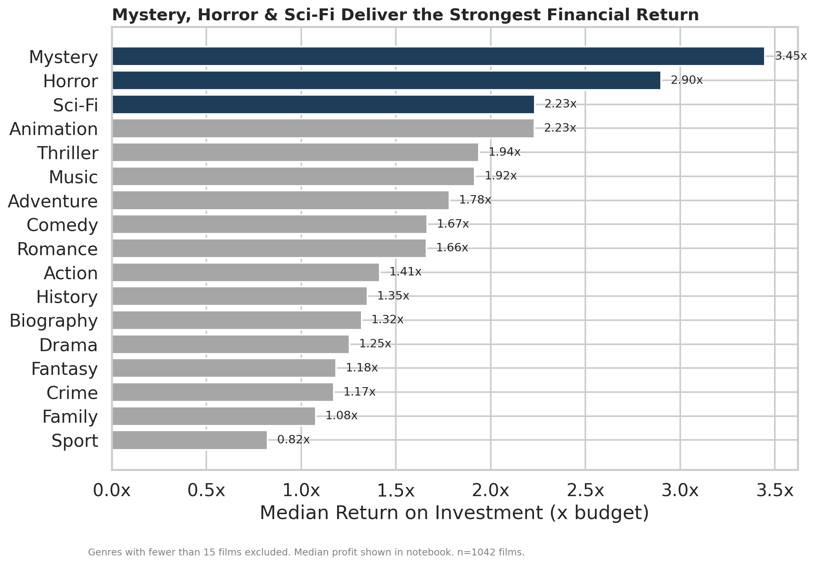
Overview
1
Business Understanding
Three questions the studio needs answered
2
Data Understanding & Cleaning
Sources, ERD, and how the data was prepared
3
Three Key Findings
Genre return, international reach, and studio alignment
1,042
4
Recommendations & Next Steps
major theatrical releases analyzed, with studio + international gross data
What the studio should greenlight first
Movie Studio Strategy
2

Slide 3
Before spending a dollar on production, leadership needs an evidence-based answer to three questions:
Which genres deliver the best financial return? (ROI & median profit)
1
Business
Understanding
Which genres do best with an international audience?
2
THE STAKEHOLDER
The head of our company's brand-new movie studio division.
Which studios perform best, and do they align with the top genres?
3
Movie Studio Strategy
3

Slide 4
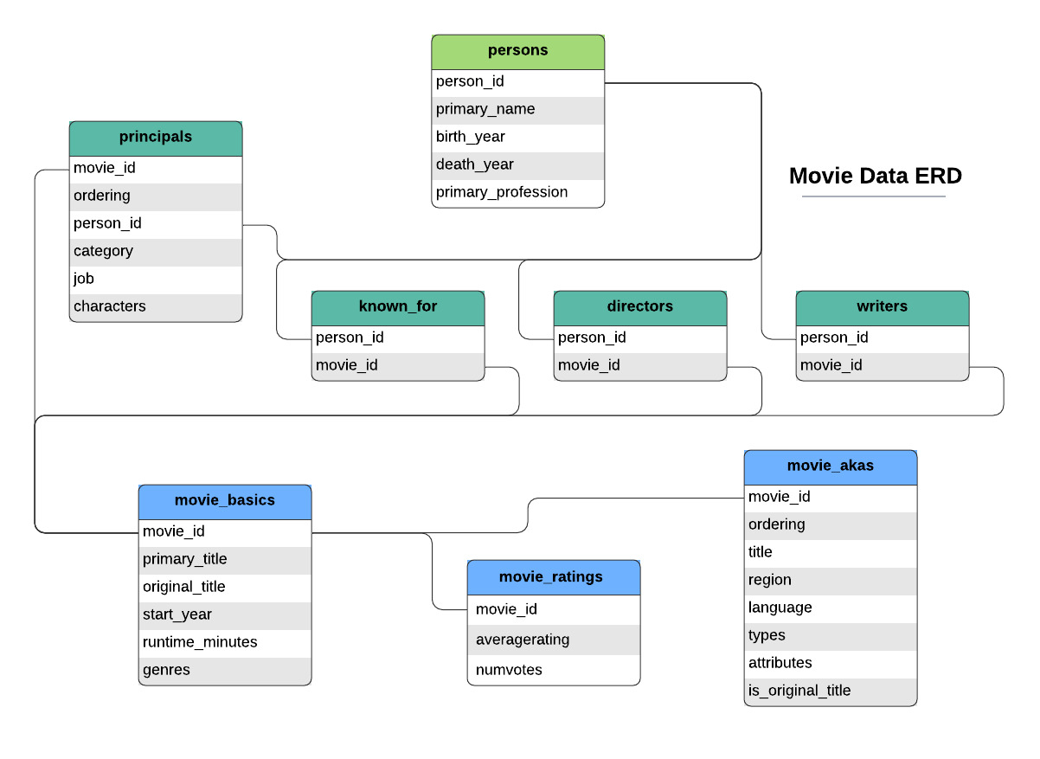
DATA UNDERSTANDING & CLEANING
What We Used, and How We Cleaned It
The Numbers
Budget, domestic/worldwide gross
Box Office Mojo
Studio, foreign gross
IMDB
Genre(s), rating
KEY CLEANING STEPS
Converted currency strings to numeric; parsed release dates
IMDB entity-relationship diagram (movie_basics + movie_ratings tables used)
Dropped $0 placeholder budgets and rows missing a studio
Joined all 3 sources on movie title + release year
Removed duplicate matches; engineered ROI, profit & intl. share
Movie Studio Strategy
4

Slide 5
DATA ANALYSIS — QUESTION 1
Which Genres Deliver the Best Financial Return?
FINDING
Mystery leads with a median ROI of 3.45x and median profit of $56.0M. Horror follows at 2.90x ROI ($42.3M median profit). Sci-Fi and Animation tie for third at 2.23x ROI, though Animation's median profit ($237.8M) is far higher due to bigger budgets and grosses.
RECOMMENDATION
Prioritize Mystery & Horror
Both genres combine strong typical returns with modest average budgets — a lower-risk way to build an early, profitable track record.
Movie Studio Strategy
5

Slide 6
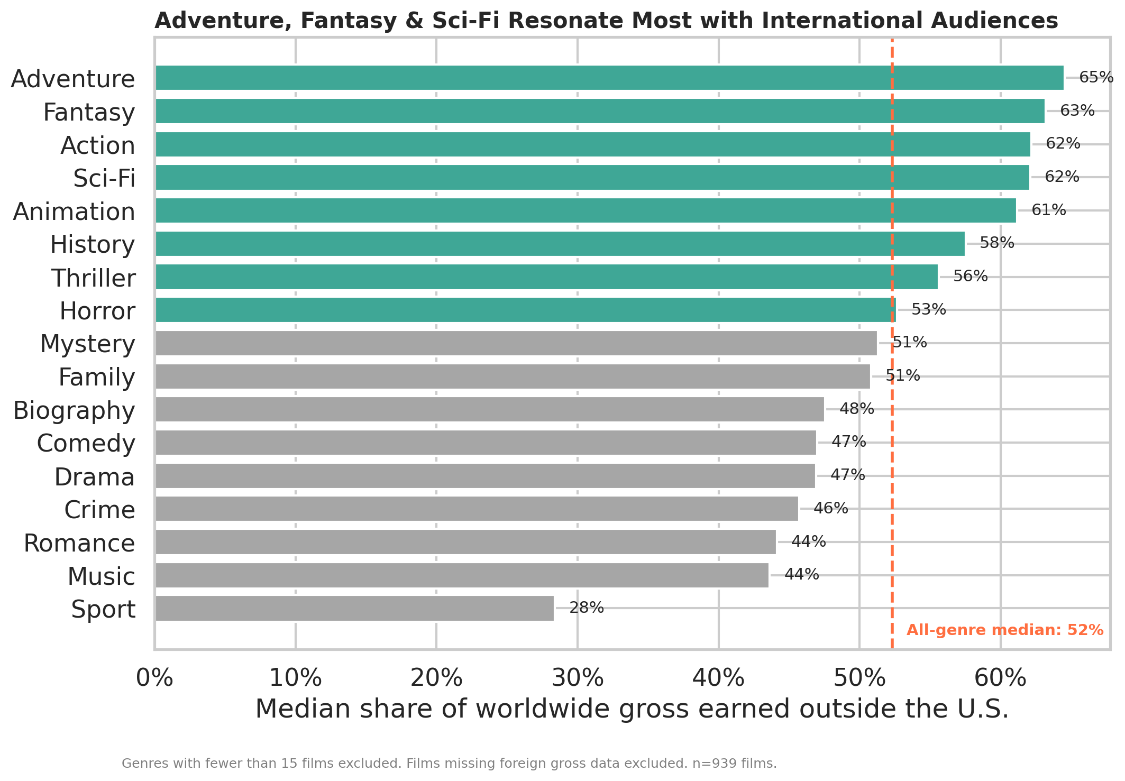
DATA ANALYSIS — QUESTION 2
Which Genres Do Best Internationally?
FINDING
Adventure (65%), Fantasy (63%), Action (62%), Sci-Fi (62%), and Animation (61%) earn well over half their gross outside the U.S. — above the 52% all-genre median. Notably, Horror and Mystery (our top ROI genres) sit right around the median, meaning they don't especially over-index internationally.
RECOMMENDATION
Treat Intl. Reach as a Separate Lever
For global/franchise ambitions, look to Adventure, Fantasy, Sci-Fi & Animation — a different genre set than our top-ROI picks.
Movie Studio Strategy
6

Slide 7
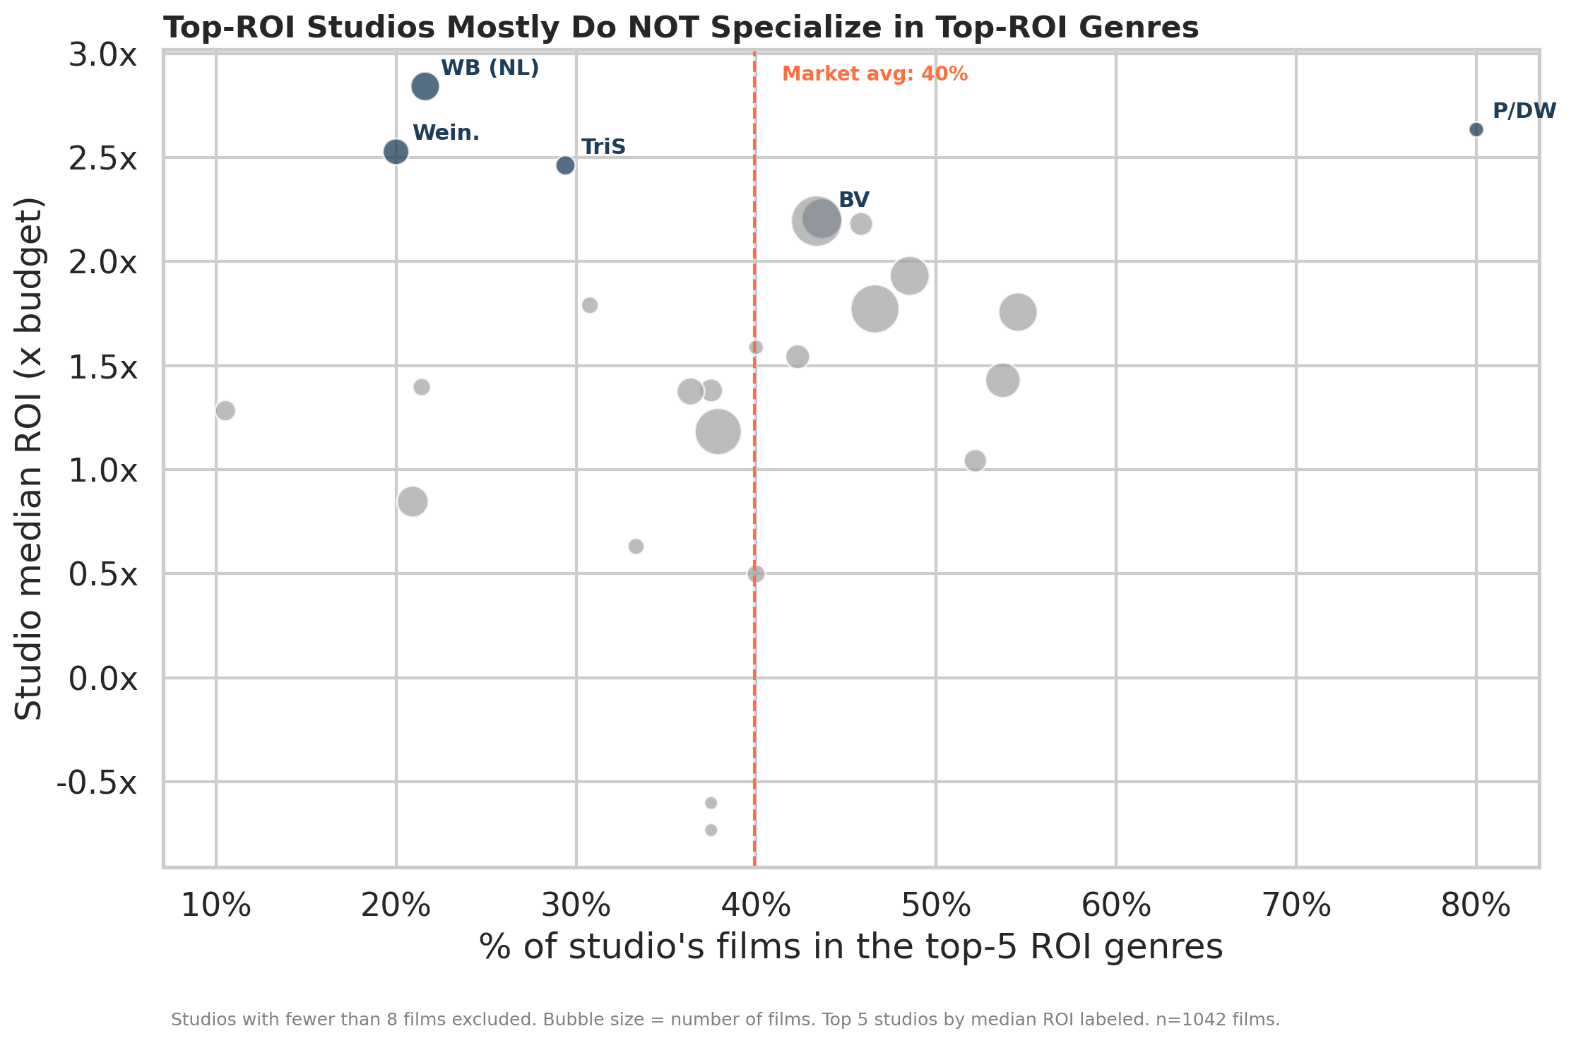
DATA ANALYSIS — QUESTION 3
Do Top Studios Align with Top Genres?
FINDING
The top 5 studios by median ROI are New Line (2.84x), P/DW (2.63x), Weinstein (2.53x), TriStar (2.46x), and Disney/BV (2.21x). But only 2 of those 5 exceed the market-average share of films in our top-5 ROI genres — 3 of the 5 best studios succeeded largely outside those genres.
RECOMMENDATION
Benchmark Execution, Not Just Genre
Studio success and genre choice are only loosely linked. Study New Line & Weinstein's production and marketing playbook directly.
Movie Studio Strategy
7

Slide 8
Recommendations
Our recommended strategy:
01
02
03
FINANCIAL CORE
GLOBAL GROWTH
BENCHMARKING
Mystery & Horror films
Adventure, Sci-Fi, Animation
Study New Line & Weinstein
3.45x / 2.90x median ROI — lower-risk, high-return
60%+ of gross earned outside the U.S.
Top ROI studios that succeed outside the top genres
Movie Studio Strategy
8

Slide 9
NEXT STEPS
Where We Go From Here
Build the interactive dashboard
1
Publish the Tableau dashboard so leadership can filter by genre and studio themselves.
Model additional levers
2
Layer in release timing/season and marketing spend, which this dataset doesn't yet capture.
Incorporate critic scores
3
Add Rotten Tomatoes critic ratings once a reliable join key is available, to add a quality dimension.
Movie Studio Strategy
9

Slide 10
Thank You
Questions?
Kevin
LinkedIn: linkedin.com/in/kevin-profile
Email: kevin@example.com
Movie Studio Strategy
10

