Slide 1
The Turing Machine

Slide 2
Who Is Alan Turing?
Brilliant mathematician born in London in 1912
Worked on deciphering military codes during WW2, most known is the German Enigma machine.
In 1936, Turing had invented a hypothetical computing device known as the ‘Universal Turing Machine’ which was the forerunner to the modern computer
It has been estimated that the efforts of Turing and his fellow code-breakers shortened the war by several years. What is certain is that they saved countless lives and helped to determine the course and outcome of the conflict
In 1952, Alan Turing was arrested for homosexuality – which was then illegal in Britain, in 1954 he was found dead from cyanide poisoning.

Slide 3

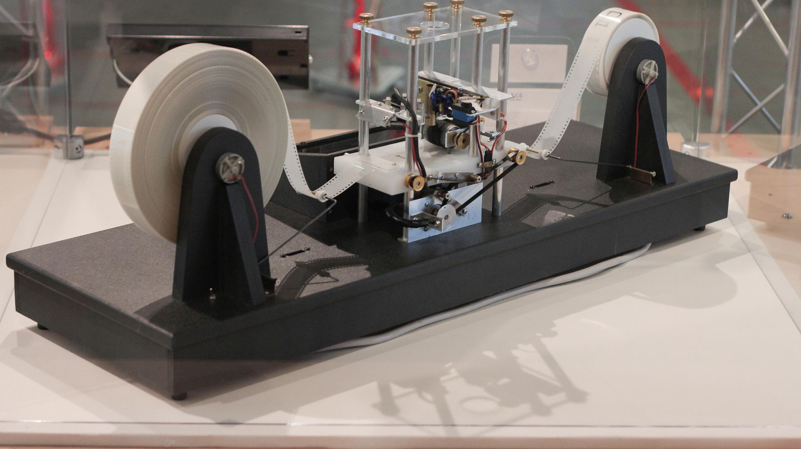
What is a Turing Machine?

Slide 4
A Turing machine is a mathematical model of computation that defines an abstract machine
The machine operates on an infinite memory tape divided into cells
The machine positions its "head" over a cell and "scans”
Based on the symbol and the machine’s own “program”, the machine first writes a symbol (e.g., a digit or a letter) in the cell then either moves the tape one cell left or right
Finally, based on the observed symbol and the machine's own state in the table, either proceeds to another instruction or halts computation
Turing completeness
A programming language that is Turing complete can express all tasks accomplishable by computers; nearly all programming languages are Turing complete

