Slide 1
Best practices for scientific programmers
CBMG688p
Arlin Stoltzfus

Slide 2
My background
Molecular & evolutionary biologist
No formal training in programming or computer science
20 years experience as computational biologist
Computer-based research published in Science, Nature, PNAS, MBE, Genetics
Experience developing various types of software
Heavy-duty Monte Carlo simulation of evolution (C, C++)
Automated analysis pipeline with DB (Perl, R, SQL)
Web-based user application (JavaScript, Perl)
Utilities and disposable scripts (Perl, R)
Cyberinfrastructure such as ontologies and formats (Perl, OWL, XML)
Experience with different project types as leader or participant:
Single developer
Local development team
Distributed development team
Agile-programming “hackathons”
But (and I think this is typical) . . .
Only 5 publications focused on software products or designs
No product ever used by more than a few dozen people

Slide 3
Some things I’ve noticed
The typical scientific software product:
is supposed to do one thing accurately and reproducibly
Has one or a few users
Has a short (project-specific) lifespan
Not optimized for performance (doesn’t need to be)
Not robust to diverse conditions of use
Poorly documented
The typical scientific developer role
Informal part-time (~40 %) w0rk (Hannay, et al., 2009)
Not funded or resourced as a software developer
Not managed as a software developer
Project-specific scope
The typical scientific programmer
Not highly trained in programming
Works alone; or in a loosely organized community
Has skills in high demand for technician or post-doc jobs *
Values programming beyond its tangible rewards
Notes:
* This is like many technical skills. You can get a tech or post-doc job for your skill in running an NMR or a sequencing machine– or for programming. But you will not get a faculty position and you certainly will not get tenure for having this skill.

Slide 4
Best practices
Don’t let the perfect be the enemy of the good
Invest effort strategically, depending on what kind of software you are developig
Notes:
Most programmers will never need to optimize code for speed or memory. You should focus instead on accuracy, readability and interfaces.

Slide 5
Efficiently investing effort in best practices
It works for me today, with my files, on my system. My project is the only use-case. I don’t care about other users or the future.
Provenance (versioning, stamping)
Accuracy (testing)
My tool is useful to others. I might want to re-use or build on it. I want to allow others to validate my results.
Clean interfaces
Modularity
Documentation
My package has hundreds of users. Some colleagues als0 work on the code with me. Maybe I could get funding for this?
Installable package with test data
OS license
Project management infrastructure

Slide 6
Given what scientific programmers actually do, best practices should . . .
Focus primarily on project-relevant goals
Accuracy and robustness
Testing
More testing
Provenance
Revision control
Output stamps
And secondarily on software as re-useable product
Interoperability
Standard interfaces
Robustness in diverse environments
Accessibility to other users like yourself
Readability
Documentation
Open-source license
Maintainability
Revision control
Readability
Community project infrastructure
Notes:
Most programmers will never need to optimize code for speed or memory. You should focus instead on accuracy, readability and interfaces.

Slide 7
A list of best practices
Interface, interface, interface
Modularize
Write code to be understood
Write tests and trap errors
Stamp your output
Use revision control
Make use of prior art
Create an installable package
Make your project open source
Set up a project management infrastructure

Slide 8
1. Interface, interface, interface
Write your interfaces first
Learn to use standard interfaces
Command-line with GNU-style long options
Data interfaces like SQL
File formats
if possible, domain-specific formats (e.g., FASTA, NEXUS)
if not, flexible & auto-parseable formats like
XML files
CSV files
SQL command files
Perl dump files
Think twice before inventing another ad hoc text format
Notes:
Interface vs. implementation

Slide 9
2. Modularize
Modular code facilitates
Readability
Debugging
Documenting code
Reusing code
Refactoring code
Writing effective traps and tests
Break main flow into subroutines
Put re-useable subroutines in a library
Notes:
Interface vs. implementation

Slide 10
3. Write code to be understood
Use informative names
e.g., $codonCount not $var1
To compose names, use a rule
$seq_length_variance = &variance_of(&lengths_of(@seqs))
$seq_length_variance = &variance(&seq_lengths(@seqs));
gnu_style_underscores or oldSchoolCamelCase
Document code internally
Document interfaces and dependencies
Document internal functions (methods)

Slide 11
4. Write tests and trap errors
Error-trapping
Use standard libraries
Trap interface violations
Test return of external procedures
Tests
Use standard libraries, e.g., Test::More (Perl)
Test dependencies
Test routines
Test general routines with arbitrary cases
Test boundary conditions
Test interfaces (error trapping)
Notes:
This is especially important if you already have a package. It has a bunch of files, probably over 1K lines of code. You want to be able to make significant changes to the code, but you want to know if this changes things in unanticipated ways. The test suite will give you that information. The test suite gives you reassurance when you are dealing with users and even with other programmers on your team.

Slide 12
5. Stamp your output
Must do
Author
Date
Code version
Useful
Settings
Inputs
Experimental rationale

Slide 13
6. Use revision control
Using a revision-control system is like having your own archivist to store and retrieve versions. In fact, its even better than that.
Use version control:
Whenever you are on a team
Whenever your file goes through meaningful revisions
Such a system ensures that
All versions are stored and numbered
All information is in a central repository
Only users with permissions can change the repository
All information is access-controlled
SVN, git, and CVS are some current standards
They work with any kind of text file
Notes:
Its like having your own archivist who will tag each version with a message, retrieve any version by number or by date, and even show you differences between versions.

Slide 14
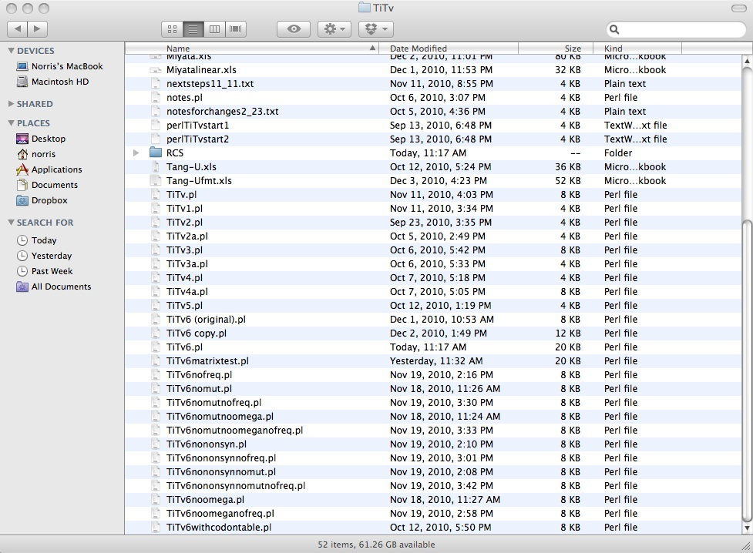
What’s wrong with this picture?
Directory listing for a novice programmer working on the script “TiTv.pl”

Slide 15
Version control concepts
'Module' - a particular set of files that can be checked out together.
'Repository' - where the server (archivist) keeps records. You never touch it yourself, but you need to know the path.
'Revision' - A certain version of a file.
'Tag' - A named milestone in the development of a file or module.
'Branch' - A 'fork' of the module.
Notes:
Here I’m going to introduce some version-control concepts, then (after the lecture part is done) we will do a practical exercise using CVS, a version-control system installed on grace.

Slide 16
Typical usage cycle
cvs update | # update local copy from repository source
 | # edit my_prog.pl
cvs diff my_prog.pl | # see my changes as context diffs
cvs commit my_prog.pl | # commit my changes to repository
cvs update | # update local copy from repository source
 | # create new file my_other_prog.pl
cvs add my_other_prog.pl | # tell cvs to recognize this file
cvs commit my_other_prog.pl | # commit this addition to the repository

Slide 17
4 more recommended practices
7. Make use of prior art
Bio* libraries (e.g., BioPerl)
Utilities (e.g., Data::Dumper, Getopt::Long, XML::Simple)
8. Create an installable package
Include docs, test suite, and sample data
9. Make your project open source
10. Set up a project management infrastructure
Source code repository
Email lists and user forums
Web site
Downloads page
Bug trackers

Slide 18
Lesson: CVS, part 1. setup
To follow the lesson, go github and open up the lesson plan.
Then you can cut and paste into your terminal.
# 1. first lets create a local directory for class materials, with some short-cuts
unix_prompt$ mkdir My_CBMG688P
unix_prompt$ cd My_CBMG688P
unix_prompt$ ln -s /afs/glue.umd.edu/class/fall2012/cbmg/688p/010/public/Lab14 Lab14Link
unix_prompt$ ln –s Lab14Link/Perl class_Perl

Slide 19
Lesson: CVS, part 2. initialize
# 2. init your CVS (first line) and make it easy to remember (next lines)
unix_prompt$ cvs -d ~/cvsroot init
Now we need to ensure that your shell always knows where to find your CVS repository. This is done by setting the $CVSROOT environment variable.
bash users must edit ~/.bash_profile, adding:
export CVSROOT=$HOME/cvsroot
export CVSEDITOR=emacs
tcsh users must edit ~/.cshrc.mine, adding:
setenv CVSROOT $HOME/cvsroot
setenv CVSEDITORemacs
unix_prompt$ source <the_file_you just_edited>
unix_prompt$ echo $CVSROOT

Slide 20
Lesson: CVS, part 3. import module
# 3. now we are ready to create a project using the class files
unix_prompt$ cd My_CBMG688P; mkdir my_cvs
unix_prompt$ cd my_cvs; mkdir Perl
unix_prompt$ cp ../class_Perl/*.pl Perl
unix_prompt$ cvs import -m "My_CBMG688P code" my_cvs `whoami` initial
My_CBMG688P
Lab14Link
class_Perl
my_cvs
Perl
args.pl
array.pl
die.pl
first.pl
My_CBMG688P
Lab14Link
class_Perl
my_cvs
CVS
Perl
CVS
args.pl
array.pl
die.pl
first.pl
Notes:
What we have done here is to import your module into the repository. To be safe, and to check things. We will delete all of this, and then check out the module we made.

Slide 21
Lesson: CVS, part 4. manage revisions
Now we are ready to use CVS to manage versions
Add a new file
“add” the file name
“commit” the initial version
Edit a file (just edit)
“diff” a file
“update” a file

Slide 22
Lesson: stamping your output
Stamping with the code revision
my $version = ‘$Id$’; # single-quotes
Stamping with the date
my $date = `date`; # back-ticks
Stamping with the computer & OS
my $system = `uname -a`; # back-ticks

Slide 23
Lesson: Getopt command-line interface

Slide 24
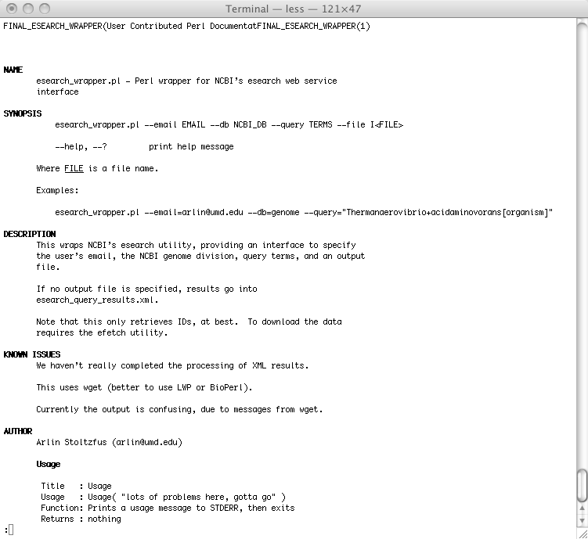
Lesson: documentation (POD)

Slide 25
A list of best practices
Interface, interface, interface
Modularize
Write code to be understood
Write tests and trap errors
Stamp your output
Use revision control
Make use of prior art
Create an installable package
Make your project open source
Set up a project management infrastructure

