Slide 1
Introduction to Cognitive Science
History, methods, and contributing disciplines
Images from Ashcraft, Sobel, Stillings and Thagard & www.wikipedia.org
Notes:
Definition of Cognitive Science
Disciplines
Cognitive Processes
Paradigms
Methods
History of cognitive Science
Handout Explanation

Slide 2
Outline
Scope of Cognitive Science
A Brief History
Overview of Major Concepts
Multidisciplinarity -Contributing Disciplines
Concluding Remarks- How to Become a Cognitive Scientist?

Slide 3
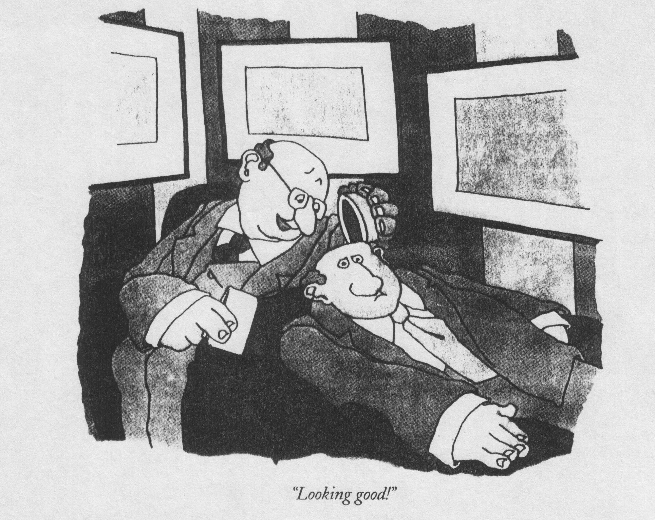

Slide 4
What Is Cognitive Science?
The (interdisciplinary) study of mind and intelligence.
The study of cognitive processes involved in the acquisition, representation and use of human knowledge.
The scientific study of the mind, the brain, and intelligent behaviour, whether in humans, animals, machines or the abstract.
A discipline in the process of construction.
Notes:
The interdisciplinary study of mind and intelligence.
Study of cognitive processes involved in the acquisition, representation and use of
Human knowledge.
Scientific study of the mind, the brain, and intelligent behaviour, whether in humans,
animals, machines or the abstract.
A discipline in the process of construction.

Slide 5
Cognition
Cognition: from Latin base cognitio “know together”
The collection of mental processes and activities used in perceiving, learning, thinking, understanding and remembering.
Notes:
Intelligence as a Natural Category- arising from real life
Cognition – from Latin base cognitio – “know together”
The collection of mental processes and activities used in perceiving, learning,
remembering, thinking, and understanding, and the act of using those processes
IQ tests: g – general intelligence, Spearman (1863-1945) or multiple intelligences
The goal of cognitive science: develop a theory of intelligent
Systems?
The goal of artificial intelligence: passing Turing Test?

Slide 6
Cognitive Processes
Perception – vision, audition, olfaction, tactition..
Attention, memory, learning
Thinking (reasoning, planning, decision making, problem solving ...)
Language competence, comprehension and production
Volition, intentional action, social cognition
Consciousness
Emotions
Imagination
Meta-cognition
...
Notes:
Learning
Memory
Thinking and Reasoning (Planning, Decision Making, Problem Solving ...)
Language
Vision-Perception
Social Cognition
Metacognition
Emotions
Dreaming
Consciousness

Slide 7
Historical Background
Cognitive Science has a very long past but a relatively short history (Gardner, 1985)
Rooted in the history of philosophy
  Rationalism (Plato, Descartes, Leibniz,...)
  vs.
  Empiricism (Aristotle, Locke, Hume, Mill, ...)
  Arithmetic and logic (Aristotle, Kant, Leibniz, Peano, Frege, Russell, Gödel...)
Notes:
“The study of mind remained the province of philosophy until the nineteenth century.” (http://www.semioticon.com/seo/C/cogsci.html#)
Philosophy: rationalism- all phenomena can be understood-knowledge can be acquired by thinking, proof and innate knowledge (Plato, Descartes, Kant, ...) vs empiricism (Aristotle, Locke, Hume, Mill, ...)- phenomena are to be investigated by careful, objective observation;
We derive all knowledge on senses and experience and on the reflections created on these senses, and the associations of events, objects etc. occurring together in experience.
Epistemology- theory of knowledge- its nature, origin (Russell, Frege, Wittgenstein,..)
Nature vs nurture: Innate capacities of the mind-tabula rasa- blank state

Slide 8
Historical Background
Descartes (1596-1650):
  Cartesian Dualism: Distinction between body and mind (soul).
  A rationalist position: Reason (rational thinking) is the source of knowledge and justification.
Reaction by empiricists (Locke, Hume):
  The only reliable source of knowledge is (sensory) experience.
Notes:
Cognitive Science has a very long past but a relatively short history (Gardner, 1985)
Philosophy: rationalism- all phenomena can be understood-knowledge can be acquired by thinking, proof and innate knowledge (Plato, Descartes, Kant, ...) vs empiricism (Aristotle, Locke, Hume, Mill, ...)- phenomena are to be investigated by careful, objective observation;
We derive all knowledge on senses and experience and on the reflections created on these senses, and the associations of events, objects etc. occurring together
İn experience.
Epistemology- theory of knowledge- its nature, origin (Russell, Frege, Wittgenstein,..)
Nature vs nurture: Innate capacities of the mind-tabula rasa- blank state

Slide 9
Historical Background
How to acquire knowledge about the mind?
  Introspection (in philosophy and psychology until late 19th century): Self-reflection. Experimental psychology (19th century - Wundt and his students )
  Behaviorism (as a reaction to the subjectivity of introspection)
Psychological knowledge can only be acquired by observing stimuli and responses (virtually denying the mind.)
      Watson (1913): Behaviorist manifesto.
      Watson, Skinner: Psychology as a science of behaviour.
Notes:
Cognitive Science has a very long past but a relatively short history (Gardner, 1985)
Philosophy: rationalism- all phenomena can be understood-knowledge can be acquired by thinking, proof and innate knowledge (Plato, Descartes, Kant, ...) vs empiricism (Aristotle, Locke, Hume, Mill, ...)- phenomena are to be investigated by careful, objective observation;
We derive all knowledge on senses and experience and on the reflections created on these senses, and the associations of events, objects etc. occurring together in experience.
Epistemology- theory of knowledge- its nature, origin (Russell, Frege, Wittgenstein,..)
Nature vs nurture: Innate capacities of the mind-tabula rasa- blank state

Slide 10
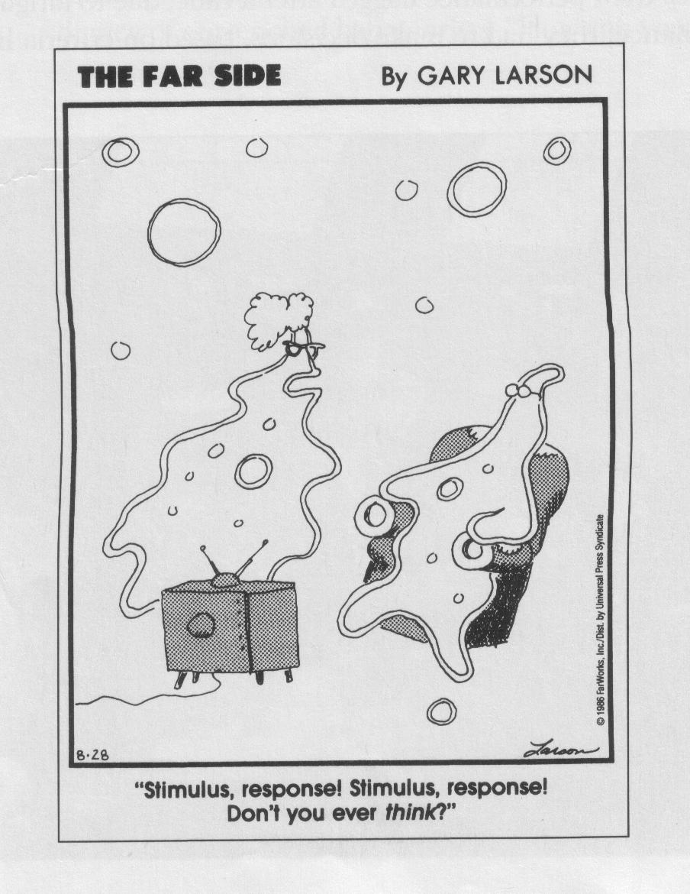

Slide 11
Historical Background
Logical tradition and analytic philosophy
  Axiomatization of artihmetic and logic as formal systems:
  Leibniz, Frege, Russell,...
  Logical positivism: Russell, young Wittgenstein, Schlick, Carnap, Gödel ... (Vienna circle), Ayer (Britain)
Analytic philosophy in support of behaviorism (early 20th cent.)
Analytic philosophy inspiring cognitive science :
    Contributions to computer science
    logic and language as formal systems

Slide 12
Historical Background
The dawn of computers
  Alonzo Church (1936 thesis): everything that can be computed can be computed with recursive functions
  Alan Turing (same time): Turing machine: An abstract machine capable of calculating all recursive functions -> a machine that can campute anything.
  The first machines: early 1940s
  McCulloch and Pitts (1943): "A Logical Calculus of the Ideas Immanent in Nervous Activity": Neuron-binary digit analogy

Slide 13
Historical Background
The dawn of computers
  John von Neumann (1945): Architecture for a stored-program digital computer
  Shannon's information theory (1948): information as medium-independent, abstract quantity.
  Turing (1950) “Computing machinery and intelligence“: Classical article in AI. –> Turing test.

Slide 14
Historical Background
The cybernetics movement
  The study of communication and control
  Rosenblueth, Wiener, Bigelow (1943). "Behavior, Purpose, and Teleology”
  10 conferences from 1946 to 1953 in New York and Princeton
    Thinking is a form of computation
    Physical laws can explain what appears to us as mental

Slide 15
The Birth of Cognitive Science
The first AI conference (1956): Dartmouth College
  Newell & Simon: The first computer programme:
  The Logic Theorist
  “Logic Theory Machine” (1956): "In this paper we describe a complex information processing system, which we call the logic theory machine, that is capable of discovering proofs for theorems in symbolic logic. “
  1st draft of Marvin Minsky's "Steps toward AI"

Slide 16
Birth of Cognitive Science
Concensusal birthday: Symposium on Information Theory at MIT in 1956
(Revolution against behaviourism)
THEME: Is cognition ‘information processing’ (data+ algorithms)?
    Newell & Simon (AI)
The first computer program
    McCarthy, Minsky (AI )
Modelling intelligence
    Miller (Experimental psychology)
"Human Memory and the Storage of Information”: magic number 7
    Chomsky (Linguistics )
Transformational grammar
Notes:
Psychology:
Wundt, Titchener (late 19th century) : study of the conscious mind in lab settings by introspection
James (late 19th century) : bringing insights and intuitions on human mental
Processes, Principles of Psychology..
Ebbinghaus (early 20th century): systematic studies of memory and learning
Linguistics as a systematic discipline about principles of languages
Sapir-Whorf hypothesis: linguistic determinism- language determines
The way we think
Linguistic relativity – distinctions found in a given language will not be
The same as those in any other (1st half of 20th century)
Saussure (early 20th century) langue- system internalized by speakers of a language
Parole – the act of speaking
Behaviourism: (1st half of 20th century) Watson, Skinner, “psyhology as a science of behaviour”..
Artificial Intelligence and Cognitive Psychology (1950s-60s)- The Cognitive Revolution-
The reinstatement of mental processes as the focus of psychology-the computer analogy-
Chomsky- critic of Skinner, language acquisition, language device
Miller- limited capacity of short-term memory
Newell and Simon – simulations of human problem solving
(Miller, Bruner, Minsky, McCarthy, Newell and Simon, Chomsky,...)

Slide 17
Contributing paradigms
Gestalt Psychology
Neurology
Cognitive psychology
Bruner et al. (1956)- A study of thinking

Slide 18
Subsequent developments
  Philosophy:
    Putnam (1960) “Minds and machines” – functionalism
  Cognitive Psychology
    First textbook by Neisser in 1967
    Advances in memory models (60s)
  More AI programs
    Weizenbaum (1967): ELIZA
Simulation of a psychotherapist – simple pattern matching
    Winograd (1972): SHRDLU
AI system with syntactic parsing

Slide 19
Subsequent developments
  Arguments against AI:
    Dreyfus (1972): “What Computer's Can't Do...”
Critique of AI from a phenomenological perspective.
    Searle (1980) "Chinese room" scenario
Does a symbol-manipulation system really understand symbols?

Slide 20
Subsequent developments
  Chomsky’s increasing influence (until lately).
  Cooperation among linguists and psychologists.
  Cognitive Science Journal (1976)
  Cognitive Science Society (1979-Massachusetts)
  Cognitive science programs in more than 60 universities around the world.

Slide 21
Strict cognitivism
Humans possess mental representations.
Mental representations are symbols.
Thinking involves rule-governed transformations over symbols.
-> Cognition is symbolic computation
Rosch: “strict/philosophical cognitivism”
Gardenfors: “High-church computationalism”

Slide 22
Strict cognitivism
Newell and Simon (1976): “Computer Science as Empirical Inquiry: Symbols and Search”
“a physical symbol system [such as a digital computer, for example] has the necessary and sufficient means for intelligent action.”
Fodor: Representational Theory of the Mind (RTM)
Language of thought (LOT) hypothesis: Mentalese
Symbols manipulated formally (syntactically):
‘Meaning ‘ is not relevant (or boils down to syntax).
10/12/09

Slide 23
Inter-/multidisciplinarity
“Cognitive science is the interdisciplinary study of mind and intelligence, embracing philosophy, psychology, artificial intelligence, neuroscience, linguistics, and anthropology.”
(Stanford Encyclopedia of Philosophy)

Slide 24
Disciplines in Cognitive Science
Philosophy
Computer Science - Artificial Intelligence
Psychology – Cognitive Psychology
Linguistics
Neuroscience
Anthropology, Psychiatry, Biology, Education, ...
Notes:
Philosophy
Neuroscience
Computer Science- Artificial Intelligence
Psychology – Cognitive Psychology
Linguistics
(Anthropology, education)

Slide 25
Multidisciplinarity
Computer science and cognitive psychology have been dominant.
Neuroscience had a big impact on the growth.
Still, only 30-50% of the work are multidisciplinary
Nature of multidisciplinary collaborations differ
Notes:
(Schunn et al, 1998) study on Journal Cognitive Science and Cognitive
Science Society Meetings : computer science and cognitive psychology
Dominates. Multidisciplinarity esp. İmpact of neuroscience on the growth
Still only 30-50% of the work are multidisciplinary
Multidisciplinary collaborations
Alternative hypotheses
Different research styles-sometimes too different
Perceived equal status
İnitial agreement and frequent communications important for success

Slide 26
Multidisiplinarity
(Von Eckardt, 2001)
  Localist view: A field is multidisciplinary if each individual research in it is multidisciplinary.
  Holist view: A field is multidisciplinary if multiple disciplines contribute to its research program (a set of goals directed at the main goal).
Notes:
(Von Eckardt, 2001)
A field is multidisciplinary is individual research efforts are multidisciplinary
(localist view)
A field is multidisciplinary if multiple disciplines contribute to the execution
To its research program (elaborate layered set of goals directed at the main
goal).

Slide 27
Philosophy
Philosophy of mind
Philosophical logic
Philosophy of language
Ontology and metaphysics
Knowledge and belief (Epistemology)
Defining the scientific enterprise of cognitive science (Philosophy of science)
Phenomenology
Notes:
“All sciences are born to be branches of philosophy”.
Not only representations (ontology) and knowledge (epistemology) and nature of abstract structures (metaphysics) but also defining the scientific enterprise of
Cognitive science (philosophy of science)
Phenomenology – how things, including our own reasoning appear to our conscious
Experience (Husserl, 1890s) –
A phenomenon is that perception of an object which becomes visible to our consciousness.
Traditionally, metaphysics refers to the branch of philosophy that attempts to understand the fundamental nature of all reality, whether visible or invisible.
The goal of metaphysics, therefore, is to develop a formal ontology, i.e., a formally precise systematization of these abstract objects
Descartes’ legacy
representational theory of mind
do representations have connections to things they represent?
Behaviourism in philosophy-reductionist view(Ryle, Carnap, Wittgenstein)
Everything mentalistic can be reduced to physicalistic dimension
Humans as information processing systems – functionalism
Mental states such as beliefs and mental processes such as decision making
Are nothing but physical states described functionally Comes in flavours: machine functionalism, psychofunctionalism, generic
Brain in a vat: do mental representations intrinsically refer to some
Aspect of outer world?
Qualia: intrinsic experiences – there is something that is like to have this belief, or
To be in pain etc.
Intentional states – aboutness - propositional attitudes – a belief (desire, fear etc) about
A proposition (an assertion) about some aspect of external world...
When can an entity have such a state? Can it be just a computational
Device to predict one’s behaviour?

Slide 28
Philosophy
Metaphysics / philosophy of mind
  materialism/idealism/dualism/identity theory/functionalism
Materialism: Ultimate nature of reality is material/physical
Idealism: Ultimate nature of reality is mental/ideal
Epistemological position
  Rationalism vs. empiricism
Scientific methodology / ontology
  Realism (w.r.t mental phenomena) vs. positivism
Empiricism: experience
Positivism: perception (sense data)
Phenomenology
  Method for studying properties and structures of conscious experience
  Husserl’s (1900) call: “Back to things themselves!”
Notes:
“All sciences are born to be branches of philosophy”.
Not only representations (ontology) and knowledge (epistemology) and nature of abstract structures (metaphysics) but also defining the scientific enterprise of
Cognitive science (philosophy of science)
Phenomenology – how things, including our own reasoning appear to our conscious
Experience (Husserl, 1890s) –
A phenomenon is that perception of an object which becomes visible to our consciousness.
Traditionally, metaphysics refers to the branch of philosophy that attempts to understand the fundamental nature of all reality, whether visible or invisible.
The goal of metaphysics, therefore, is to develop a formal ontology, i.e., a formally precise systematization of these abstract objects
Descartes’ legacy
representational theory of mind
do representations have connections to things they represent?
Behaviourism in philosophy-reductionist view(Ryle, Carnap, Wittgenstein)
Everything mentalistic can be reduced to physicalistic dimension
Humans as information processing systems – functionalism
Mental states such as beliefs and mental processes such as decision making
Are nothing but physical states described functionally Comes in flavours: machine functionalism, psychofunctionalism, generic
Brain in a vat: do mental representations intrinsically refer to some
Aspect of outer world?
Qualia: intrinsic experiences – there is something that is like to have this belief, or
To be in pain etc.
Intentional states – aboutness - propositional attitudes – a belief (desire, fear etc) about
A proposition (an assertion) about some aspect of external world...
When can an entity have such a state? Can it be just a computational
Device to predict one’s behaviour?

Slide 29
Linguistics
Major Components of Analysis
  Phonology
  Morphology
  Syntax
  Semantics
  Discourse and pragmatics
Notes:
Phonology – production and perception of language sounds- phonemes -prosody
Morphology- study of word structure –morphemes
Syntax- study of the structure of sentences
Semantics- study of word meaning
Mental lexicon – mental dictionary of words
Major theories of grammar: Generative framework (Government and Binding
Theory, Minimalist program); Categorial Grammars, HPSG, LFG, Cognitive
Grammar, Case Grammar
Discourse- beyond one sentence – reference; coherence, etc.
Pragmatics – study of language use; how context influences the interpretation
Of meaning- conversational maxims (Grice, relavance etc) and their violations

Slide 30
Linguistics
Areas of cognitive relevance in linguistics:
  Psycholinguistics
    Language acquisition
    Language production and comprehension
    Discourse processing and memory
  Neurolinguistics
    Neurological underpinnings of linguistic knowledge and use
  Computational Linguistics
    A major component of AI
  Cognitive Linguistics
    Prototypes, background cognition, mental spaces, imagery
    Cognitive Grammar
Notes:
Linguistic universals – characteristics that are true of all human languages
Explaining productivity – creativity of language ex
Embedded sentences – recursion
That is the house Jack built.
This is the cheese that lay in the house that Jack built.
Grammar as a descriptive system- set of rules pertaining to language
İnternalized by the speaker of the language, and the linguist’s account of those rules
Contrast with prescriptive rules: Dont split infinitives, etc
Chomsky – competence, I language – your internalized language faculty
performance, E language- what you say
Universal Grammar-specialized fundamental structure for language
İn the brain applicable to all languages

Slide 31
Linguistics
Areas of cognitive relevance in linguistics (cont.):
  Language Universals and Universal Grammar
    The functionalist perspective – language-external explanations
    The formalist perspective – language-internal generalizations
  Competence vs. performance (I-language vs E-language)
  The relation between language and logic
    Grammar as a generative system (axiomatization)
    Knowledge representation and reasoning
  Symbolic representation vs. action
    Semantics vs. pragmatics
    Intentionality
    Speech acts
Notes:
Linguistic universals – characteristics that are true of all human languages
Explaining productivity – creativity of language ex
Embedded sentences – recursion
That is the house Jack built.
This is the cheese that lay in the house that Jack built.
Grammar as a descriptive system- set of rules pertaining to language
İnternalized by the speaker of the language, and the linguist’s account of those rules
Contrast with prescriptive rules: Dont split infinitives, etc
Chomsky – competence, I language – your internalized language faculty
performance, E language- what you say
Universal Grammar-specialized fundamental structure for language
İn the brain applicable to all languages

Slide 32
Artificial Intelligence
Study of intelligent behaviour
Automation of intelligent behaviour
Machines acting and reacting adaptively
How to make computers do things which humans do better
Study and construction of rational (goal and belief-directed) agents
Notes:
Study of intelligent behaviour
Automation of intelligent behaviour
Machines acting and reacting adaptively
How to make computers do things, which humans do better.
Study and construction of rational (goal and belief-directed) agents

Slide 33
Artificial Intelligence
Modeling for Study of Cognition
  Strong AI (duplicating a mind by implementing the right program) vs. Weak AI (machines that act as if they are intelligent)
  aI (the study of human intelligence using computer as a tool) vs Ai (the study of machine intelligence as artificial intelligence)
  Artificial Intelligence and Cognitive Science: a history of interaction
Notes:
Strong AI (duplicating a mind by implementing the right program) vs Weak AI (machines that act as if they are intelligent)
aI (the study of human intelligence using computer as a tool) vs Ai (the study of machine intelligence as artificial intelligence) (Yeap)
Computer as mind – computer as brain

Slide 34
Artificial Intelligence
Advantages of Computational Modeling
  More formal, precise specifications
  Enhance predictive aspects of a theory
  Computer programs are good experimental participants
Notes:
Push predictive aspects of a theory: more formal, precise and abstract specifications than verbal models
Computer programs are good experimental participants
Unify several different classes of facts as compared to hypothesis testing

Slide 35
Cognitive Psychology
Perception, pattern recognition
Attention
Skill acquisition, learning
Memory
Language and thought processes
Reasoning and problem solving
Notes:
Visual and Auditory Cognition: Pattern Recognition
Attention
Skill Acquisition
Memory
Language
Reasoning
Problem Solving
--------Experimental Methods, Statistics, Simulation

Slide 36
Cognitive Psychology
Methods of investigation
  Experimental Methods - lab studies
  Simulations
  Case studies on acquired and developmental deficits
    Dyslexia, autism, agnosia, aphasia, amnesia
    Other disorders, e.g. schizophrenia
Notes:
Case and Lab Studies of Various Disorders
Acquired vs developmental deficits
Dyslexia
Autism
Agnosia – disruption of object recognition
Apraxia- disruption of voluntary action or skilled motor movement
Aphasia – disruption of language capabilities, also agraphia – writing, anomia-
Disruption of word finding
Alexia- recognition of printed letters or words
Acalculia – mathematical abilities
Amnesia – loss of memory ex: Patient HM operated on hippocampus, followed
Up for 14 years...
Because of his epileptic seizures. Severe anterograde amnesia (cant
Learn anything new after the surgery for long-term except motor skills!).
Bipolar disorder, schizophrenia

Slide 37
Neuroscience
Neurocognition/
Cognitive neuroscience/
Cognitive neuropsychology:
  The study of the neurological basis of cognitive processing.
Computational neuroscience:
  Detailed simulation of neuronal mechanisms.
Notes:
Neurocognition, cognitive neuroscience, cognitive neuropsychology
Study of neurological basis of cognitive processing, by measures of normal
Brain functioning and disrupted performance due to brain damage (lesions).
Computational neuroscience
Modeling neurons and the central nervous system by computational techniques

Slide 38
Neuroscience
The Nervous System
  Peripheral (nerve fibers, glands) vs. Central nervous system (brain, spinal cord)
  Brain:
    Cerebral cortex (‘gray matter’)
vs.
    Subcortical areas
  Two hemispheres (left-right); four lobes (frontal, parietal, occipital, temporal)
Notes:
Peripheral (nerve fibers, glands) vs. Central nervous system (brain, spinal cord)
Autonomic Nervous System, the visceral nervous system vs. voluntary- somatic nervous system
Brain: old brain-brain stem: governs basic functions eg. Digestion, balance..
Cerebellum: A large structure located high inside the hindbrain. Connected to the pons, medulla, spinal cord and thalamus. Helps control movement and some aspects of motor learning.
Dorsal: closer to the back Ventral: closer to the front
subcortical areas important for cognition
thalamus- a relay station into the neocortex
corpus callosum: primary bridge between hemispheres
hippocampus (Latin for sea horse): related w. Memory, metabolic regulation
Amygdala: A part of the basal ganglia named for its almond shape. The amygdala is thought to be involved with emotion and memory formation.
Basal Ganglia: A series of subcortical structures in the center of the brain that are principally responsible for motor tasks.
Limbic System: A group of brain structures that work to regulate emotions, memory and certain aspects of movement. Includes the amygdala, hippocampus, cingulate gyrus, septum and basal ganglia.
neocortex- cerebral cortex – convoluted top layer, thickness 1-3mm,
six layered, prefrontal cortex only in primates; total
area when flat: ¼ m² ; gyrus-gyri convolutions
Sulci ( Sulcus): Grooves within the convolutions of cerebral cortex, the deepest of which are sometimes called fissures. -V1 And Secondary Visual cortex: Also called V2,

Slide 39
Neuroscience
Methods of Investigation
  Structural techniques: CAT scan (Computer Axial Tomography); MRI (Magnetic Resonance Imaging)
  Functional techniques: PET scans (Positron Emission Tomography); fMRI (Functional MRI)
  Temporary lesions-> TMS (Transcranial Magnetic Stimulation)
  Electrophysiological Techniques:
    EEGs (Electroencephalograms)
    ERPs (Event Related Potentials)
  Used in combination with neuroimaging techniques
  Used in conjunction with behavioural methods
Notes:
Imaging Techniques for Brain Mapping
structural techniques: CT scan (computerized tomography, CAT-
Computer axial tomography): low intensity x-ray beams scanning the brain
MRI (Magnetic Resonance Imaging): creating an electromagnetic field that
vibrate cells and measure the vibrations via a radio-like receiver. Clearer
resolution, flexible-imaging different types of biological substances, slow.
functional techniques.
more useful for neurocognitive studies, as they can record activity in
reaction to cognitive tasks, might suffer from resolution problems.
PET scans (positron emission tomography): measuring cerebral blood
flow while radioactive isotopes are injected to the body.
fMRI (functional MRI): fast MRI scanners detecting changes in oxygen level.
Ex: a study to see upper (dorsal) frontal cortex was active in spatial working memory
Tasks. Remembering locations or identities of faces just shown after a 9 sec
Delay. In remembering identities, inferior (lower) frontal cortex was more active.

Slide 40
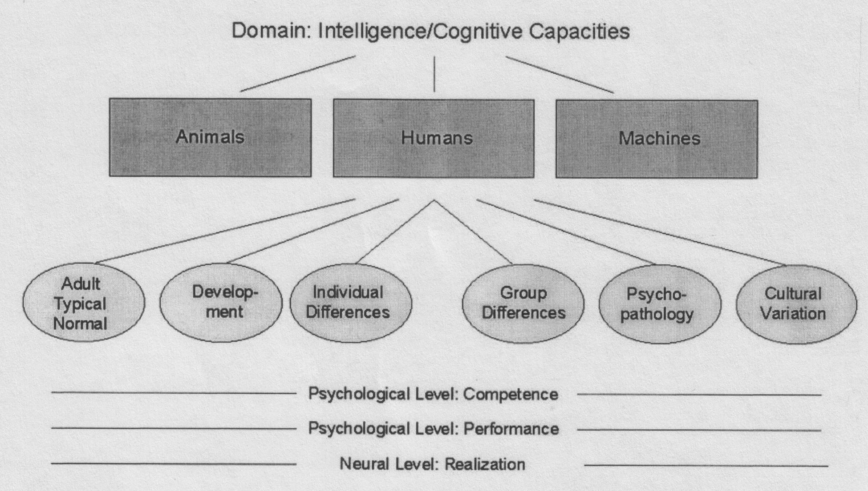
Research Tracks within Cognitive Science
Notes:
See figure

Slide 41
Methods in Cognitive Science
Building theories vs. acquiring data
  Philosophical background: Setting up the domain of discourse / Logical argumentation
  Formalization and mathematical modeling
  Computational modeling
  Hypothesis formation
------------------------------------------------
  Behavioral experiments
  Linguistic data
  Ethnographic data
  Investigating the brain
Notes:
Experimentation (psychology, linguistics, neuroscience)
Computational Modeling (artificial intelligence, computational neuroscience)
Introspection, argumentation, formal logic (philosophy, linguistics)
Ethnography (cognitive anthropology)

Slide 42
Relatively Recent Developmens
Connectionist models of cognition:
A challenge to symbolic models
  Artificial networks of interconnected units ("neurons").
  Parallel rather than serial processing of information.
  Learned associations rather than strict/innate rules
Non-symbolic concept formation
  Prototype theory of concepts (Rosch)
  Representing information with geometrical/topological structures (Gardenfors)
Dynamic and statistical models of cognition
  e.g. versions of Optimality Theory in Linguistics
Theory of multiple intelligences (Gardner 1983)

Slide 43
Relatively Recent Developmens
Increasing role of neuroscience
  On philosophy of mind – Churchlands
  Emergence of new subdisciplines: cognitive neuroscience, computational neuroscience
Embodied brain
  Cognition is not only in the brain. It needs the body.
Re-consideration of the context
  Situated cognition: The brain needs the body + the surrounding world.
  Cognitive anthropology, cognitive informatics
Tackling hard subjects
  Consciousness

Slide 44
Unified Theories of Cognition
Unity behind diversity: The aim of science.
  “... positing a single system of mechanisms- a cognitive architecture- that operate together to produce the full range of human cognition.” (Newell, 1990)
  Bring all parts together.
  Increase rate of cumulation of knowledge.
  Increase applicability.
  Not everyone agrees this is how cognition should be studied.
Notes:
Unify-the aim of science.
“... positing a single system of mechanisms- a cognitive architecture- that operate together to produce the full range of human cognition.” (Newell, 1990)
Bring all parts together to explain the mind.
Increase rate of cumulation of knowledge.
Increase applicability.
Approximate, rather than discriminate.
Cognitive architectures – structure and design – cognitively impenetrable

Slide 45
How to Become a Cognitive Scientist?
No fast and definitive answers.
Be as general and objective as possible in the beginning.
Read, read and read. Develop critical (and fast) reading skills. Read broadly across a number of areas of cognitive science
If possible, form a regularly meeting reading group (can be a general cognitive science reading group or a special interest group).
Develop practical experience with different methods in cognitive science as much as possible.
Read past theses of this department and of other Cogs departments; use the handout as starting point for extra readings. Get reading lists for the PhD specialization exam.
Specializations and indepth expertise comes later, may be in your PhD studies. Do not look upon your Master’s work as final but as foundational.

Slide 46
Concluding Remarks
  All these will take time; be patient; do not get discouraged.
  Take relief in that you are getting into a very interesting discipline.
  Pay attention not only to the results (such as grades) but also to the processes of becoming a cognitive scientist.

