Slide 1
Introduction
Psychology 612

Slide 2
What is Cognitive Science?
Cognitive science is the interdisciplinary study of intelligence and intelligent systems, natural or artificial
- Mathematics (mathematical theory of intelligence)
- Computer Science (computational algorithms of ...)
- Neuroscience (neurophysiological foundations of ...)
- Psychology (behavioral manifestations of ...)
- Philosophy (ontological foundations of …)
- Linguistics (linguistic foundations of …)
- Anthropology (cultural foundations of …)

Slide 3
Interdisciplinary Efforts for Studying Mind
Psychology (cognitive psychology)
  Behavioral experiments (e.g., word recognition)
Biology (neuroscience)
  Physiological experiments (e.g., cell firing)
Philosophy (philosophy of mind)
  Thought experiments (e.g., logical analysis)
Computer Science (artificial intelligence)
  Algorithmic analysis & simulations
Anthropology
  Cross-cultural study of how people think

Slide 4
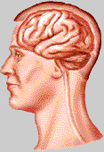
What is Intelligence?
Thesis 1:
Intelligence is a type of computation.
Thesis 2:
The brain is a computing “machine”.

Slide 5
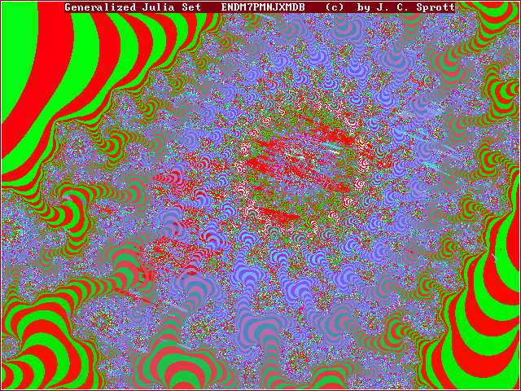


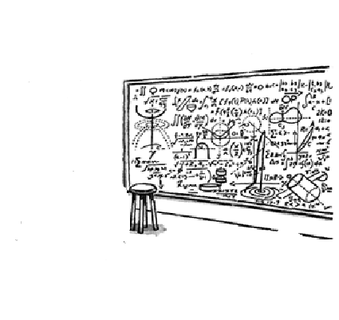

Are these works/evidence of intelligence?

Slide 6
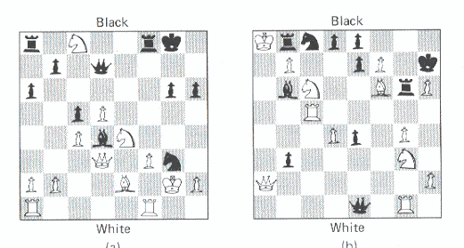
Landmark Events in Cognitive Science
1936: Definition of computation (Turing)
1956: field artificial intelligence born (Minsky & McCarthy)
1960s: Computer chess program (Newell & Simon)
1977: Journal Cognitive Science launched
1979: 1st annual meeting of Cognitive Science Society
1997: IBM Deep Blue beat Kasparov

Slide 7
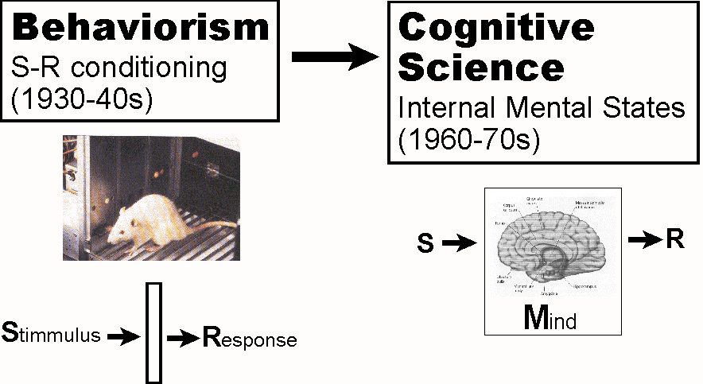
Cognitive Science in a Nutshell
The mind does not exist or is irrelevant
Computational modeling of the black (“mind”) box

Slide 8
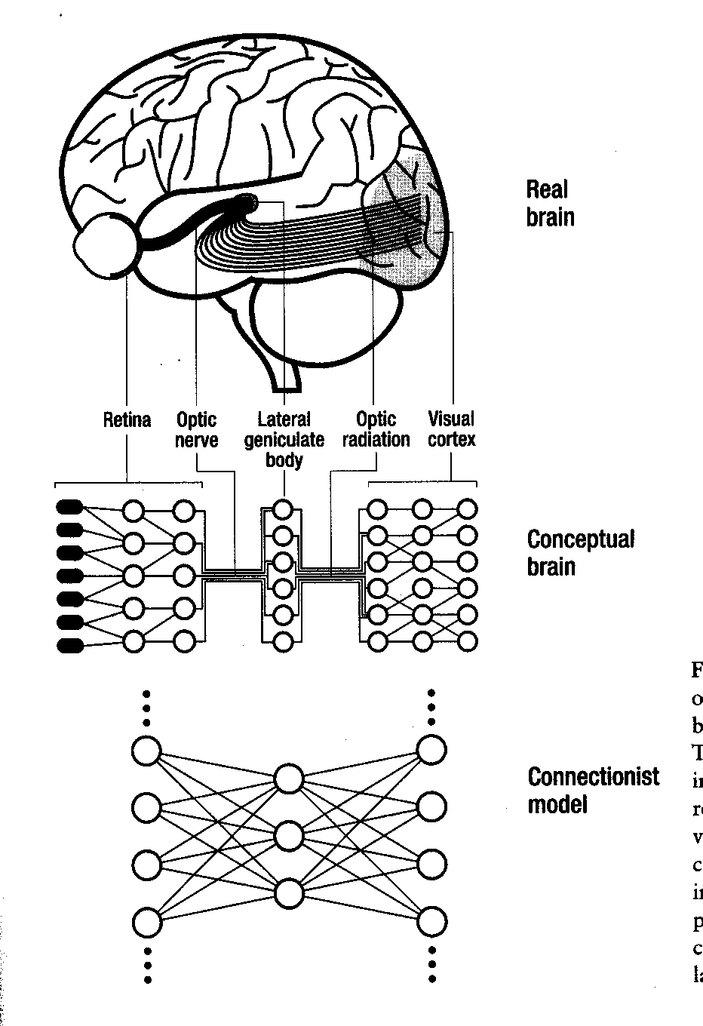
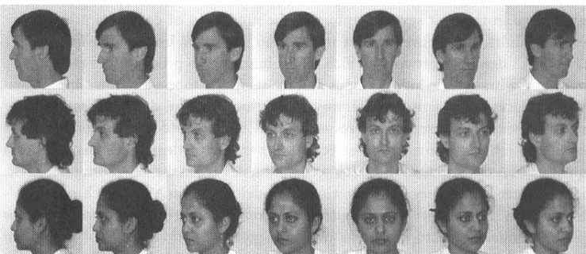
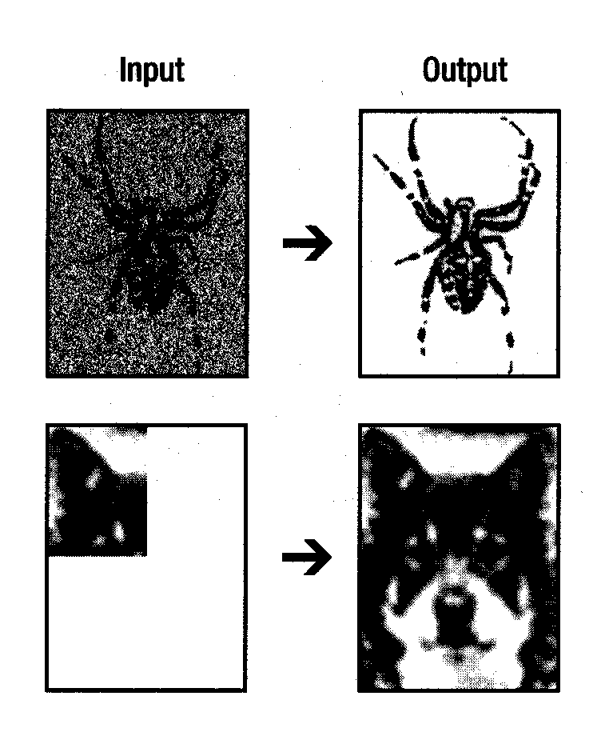
Neural Networks

Slide 9
What Questions in Cognitive Science?
How do we think?
What is the nature of mind?
What is knowledge? How is it possible?
How does the brain create a mind?
  The Mind-Body Problem
Can a computer think?
What is the nature of self? Is it an illusion?
What is consciousness?

Slide 10
Major Players in Cognitive Science
A Turing (Universal Turing Machines) (click)
G Miller (“seven plus or minus two”)
M Minsky & J McCarthy (Artificial Intelligence)
A Newell & H Simon (General Problem Solver)
N Chomsky (Universal Grammar)
D Huble & T Wiesel (feature detecting cells)
D Rumelhart & J McClelland (neural networks)
J Searl (mind and computer)
F Crick & C Koch (neural consciousness)

Slide 11
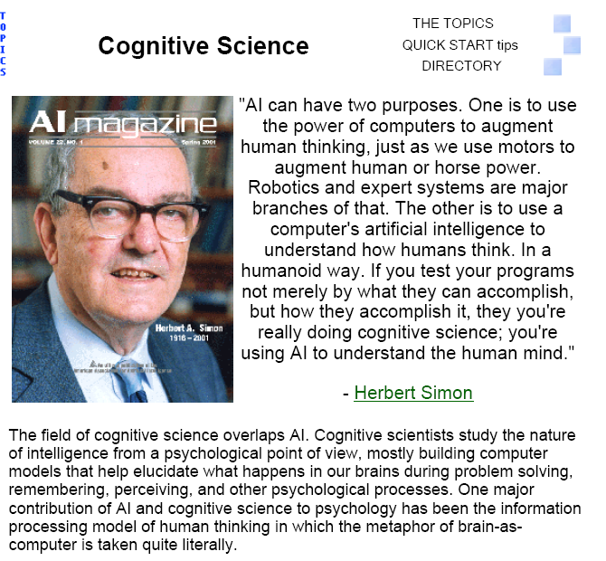
Cognitive Science and H. Simon

Slide 12
Major Applications & Accomplishments
Robotics (e.g., Honda’s humanoid robot project)
Computer vision (e.g., biometric devices)
Voice-activated dialing
Expert system (e.g., credit card evaluation)
IBM’s Deep Thought & Deep Blue (click here)
Google.com’s internet search engine
…..

Slide 13
Despite all the excitement and past accomplishments,
…..,
We have not a single clue about
the tantalizing question of the field:
“How does the mind really work?”
Until we do,...the beat goes on…

