Slide 1
Mathematical Optimization in Stata: LP and MILP
July 18-19, 2013
2013 New Orleans Stata Conference
☆
Choonjoo Lee
Korea National Defense University
bloom.rampike@gmail.com

Slide 2
CONTENTS
I
Motivation
II
Taxonomy of Mathematical Optimization
III
User-written LP and MILP in Stata

Slide 3
I. Motivation
❑ Why use Stata?
❍ Fast, accurate, and easy to use
❍ Broad suite of statistical features
❍ Complete data-management facilities
❍ Publication-quality graphics
❍ Responsive and extensible
❍ Matrix programming—Mata
❍ Cross-platform compatible
❍ Complete documentation and other publications
❍ Technical support and learning resources
❍ Widely used
❍ Affordable
√ Rooms for user to play
http://www.stata.com/why-use-stata/

Slide 4
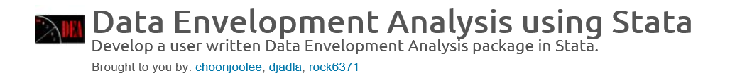
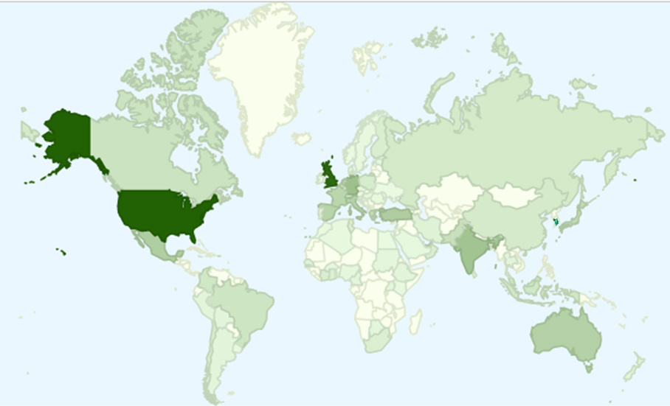
I. Motivation
❑ Why not play with Mathematical Optimization in Stata?
Legend
 | 200+
 | 1+
DEA downloads(application of mathematical optimization.
※Stata program is used in more than 200 countries.(Stata Corp.,2013)
(July 1, 2013)

Slide 5
I. Motivation
❑ Why not play with Mathematical Optimization in Stata?
https://sourceforge.net/projects/deas/

Slide 6
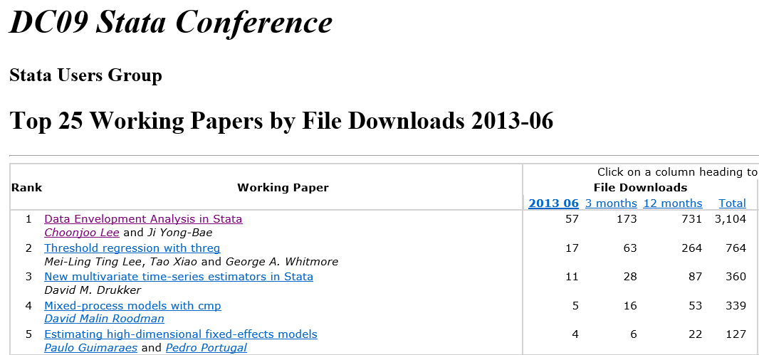
I. Motivation
❑ Why not play with Mathematical Optimization in Stata?
❍ #1 file downloads among Stata Conference files
❍ DEA file ranked at #442 among Authors of works excluding software
by File Downloads 2013-06
http://logec.repec.org/scripts/seritemstat.pf?h=repec:boc:dcon09

Slide 7
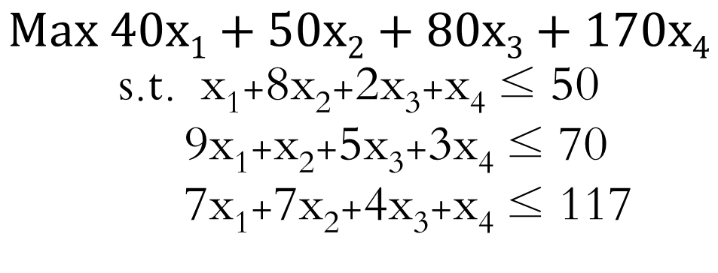
II. Taxonomy of Mathematical Optimization
❑ Mathematical Formulations of Optimization problems
❍ Find the best solutions to mathematically defined problems
subject to certain constraints.
❍ Typical form of mathematical optimization
Max(Min) Objective function
Subject to Constraints.
- For example:
$$Max 40x1+50x2+80x3+170x4$$
s.t. x₁+8x₂+2x₃+x₄ ≤ 50
9x₁+x₂+5x₃+3x₄ ≤ 70
7x₁+7x₂+4x₃+x₄ ≤ 117

Slide 8
II. Taxonomy of Mathematical Optimization
❑ Variants of Mathematical Optimization
Nodes | Branches
Objective Function | (Non)Linear, Convex(Concave), Single(Multiple), Quadratic,…
Constraints | (Un)Constrained
Convexity | Convex(Concave)
Linearity | (Non)linear
Discontinuity | Integer, Stochastic, Network
Uncertainty | Stochastic, Simulation, Robust
Parametric | (Non)Parametric
Boundedness | (Un)Bounded
Optimality | Global(Local), Minimization(Maximization)

Slide 9
II. Taxonomy of Mathematical Optimization
❑ Variants of Mathematical Optimization Model
❍ Convex(objective fcn: convex, constraint: convex)→ Linear Programming
❍ Integer (some or all variables: integer values) → Integer programming
❍ Quadratic(Objective fcn: quadratic) → Quadratic programming
❍ Nonlinear(Objective fcn or constraints: nonlinear) → Nonlinear programming
❍ Stochastic(some constraints: random variable) → Stochastic programming
…

Slide 10
II. Taxonomy of Mathematical Optimization
❑ Solution Techniques for Mathematical Optimization
❍ Optimization algorithms(fixed steps): Simplex algorithm, variants of Simplex, …
❍ Iterative methods(converged solution): Newton’s method, Interior point methods, Finite difference, Numerical analysis, Gradient descent, Ellipsoid method, …
❍ Heuristics(approximated solution): Nelder-Mead simplicial heuristic, Genetic algorithm, Differential Search algorithm, Dynamic relaxation, …
Source: Park, S(2001), Wikipedia

Slide 11
II. Taxonomy of Mathematical Optimization
❑ Mathematical Optimization Codes in Stata
❍ optimize( ) : Mata’s function; finds coefficients (b₁, b₂,…, b_{m}) that maximize or minimize f (p₁, p₂,…,p_{m}), where p_{i} = X_{i} b_{i}.
❍ moptimize( ) : Mata’s and Stata’s premier optimization routine; the routine used by most of the official optimization-based estimators implemented in Stata.
❍ ml( ) : Stata’s command; provides most of the capabilities of Mata’s moptimize(), and ml is easier to use; ml uses moptimize() to perform the optimization.
Source: Stata, [M-5] p.617
☞ Stata focused on Quadratic, Stochastic programming; Iterative(numerical), Stochastic, Parametric methods

Slide 12
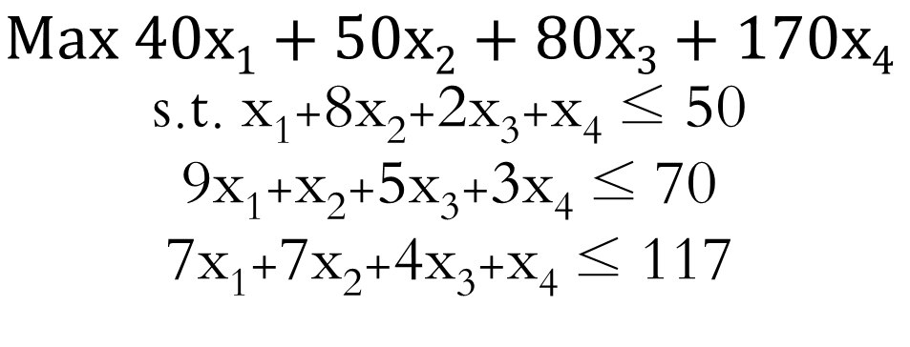
III. User-written LP and MILP in Stata
❑ The User Written Command “lp”
❍ Optimization Problem
$$Max 40x1+50x2+80x3+170x4$$
s.t. x₁+8x₂+2x₃+x₄ ≤ 50
9x₁+x₂+5x₃+3x₄ ≤ 70
7x₁+7x₂+4x₃+x₄ ≤ 117
❍ Data Input in Stata
x1 | x2 | x3 | x4 | rel | rhs
40 | 50 | 80 | 170 | = | 0
1 | 8 | 2 | 1 | <= | 50
9 | 1 | 5 | 3 | <= | 70
7 | 7 | 4 | 1 | <= | 117

Slide 13
III. User-written LP and MILP in Stata
❑ The User Written Command “lp”
❍ Program Syntax
lp varlists [if] [in] [using/] [, rel(varname) rhs(varname) min max intvars(varlist) tol1(real) tol2(real) saving(filename)]
rel(varname) specifies the variable with the relationship symbols. The default option is rel.
rhs(varname) specifies the variable with constants in the right hand side of equation. The default option is rhs.
min and max are case sensitive. min(max) is to minimize(maximize) the objective function.
intvars(varlist) specifies variables with integer value.
tol1(real) sets the tolerance of pivoting value. The default value is 1e-14. tol2(real) sets the tolerance of matrix inverse. The default value is 2.22e-12.

Slide 14
III. User-written LP and MILP in Stata
❑ The User Written Command “lp” for LP problem
❍ Result: lp with maximization option.
. lp x1 x2 x3 x4,max

Slide 15
III. User-written LP and MILP in Stata
❑ The User Written Command “lp” for MILP problem
❍ Result: lp with intvars(x4) option.
. lp x1 x2 x3 x4,max intvars(x4)

Slide 16
III. User-written LP and MILP in Stata
❑ Remarks
❍ The code is not complete yet and waits for your upgrade. And there are plenty of rooms to play and work for users.
❍ lp code using optimization algorithm is available at https://sourceforge.net/projects/deas/

Slide 17
References
Lee, C.(2012). “Allocative Efficiency Analysis using DEA in Stata”,San12 Stata Conference.
Lee, C.(2011). “Malmquist Productivity Analysis using DEA Frontier in Stata”, Chicago11 Stata Conference.
Ji, Y., & Lee, C. (2010). “Data Envelopment Analysis”, The Stata Journal, 10(no.2), pp.267-280.
Lee, C. (2010). “An Efficient Data Envelopment Analysis with a large Data Set in Stata”, BOS10 Stata Conference.
Lee, C., & Ji, Y. (2009). “Data Envelopment Analysis in Stata”, DC09 Stata Conference.

Slide 18
Thank You !

