Slide 1
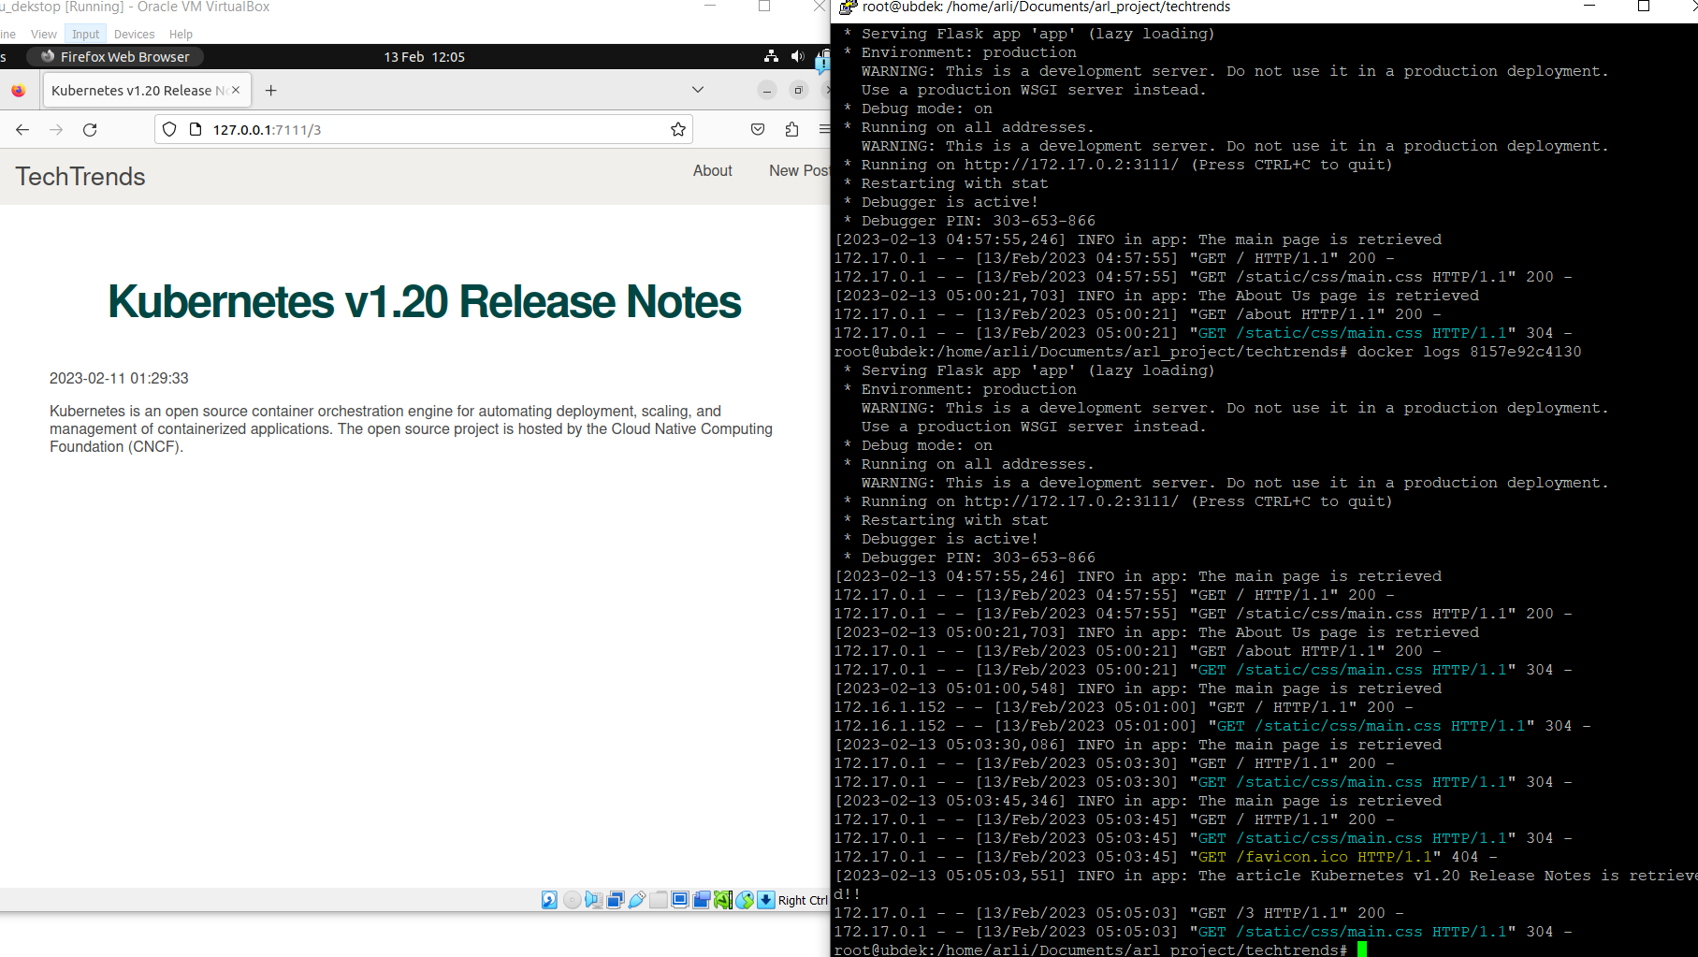
Using VirtualBox

Slide 2
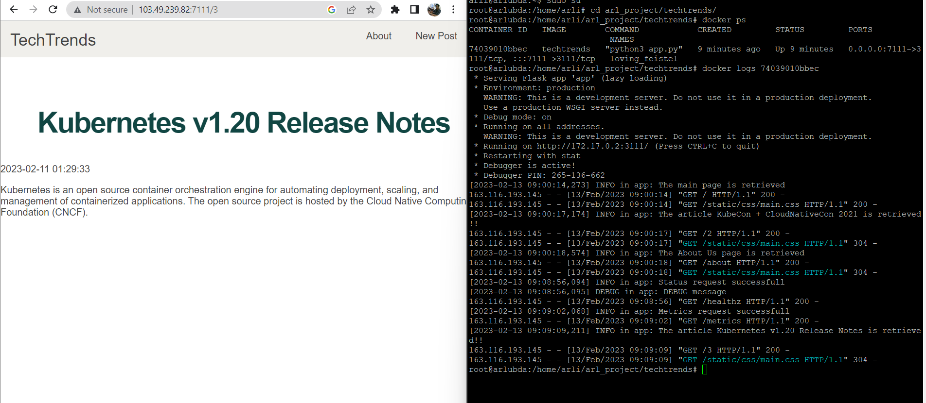
Using VPS for flexible development

