Slide 1

Before Github Action

Slide 2
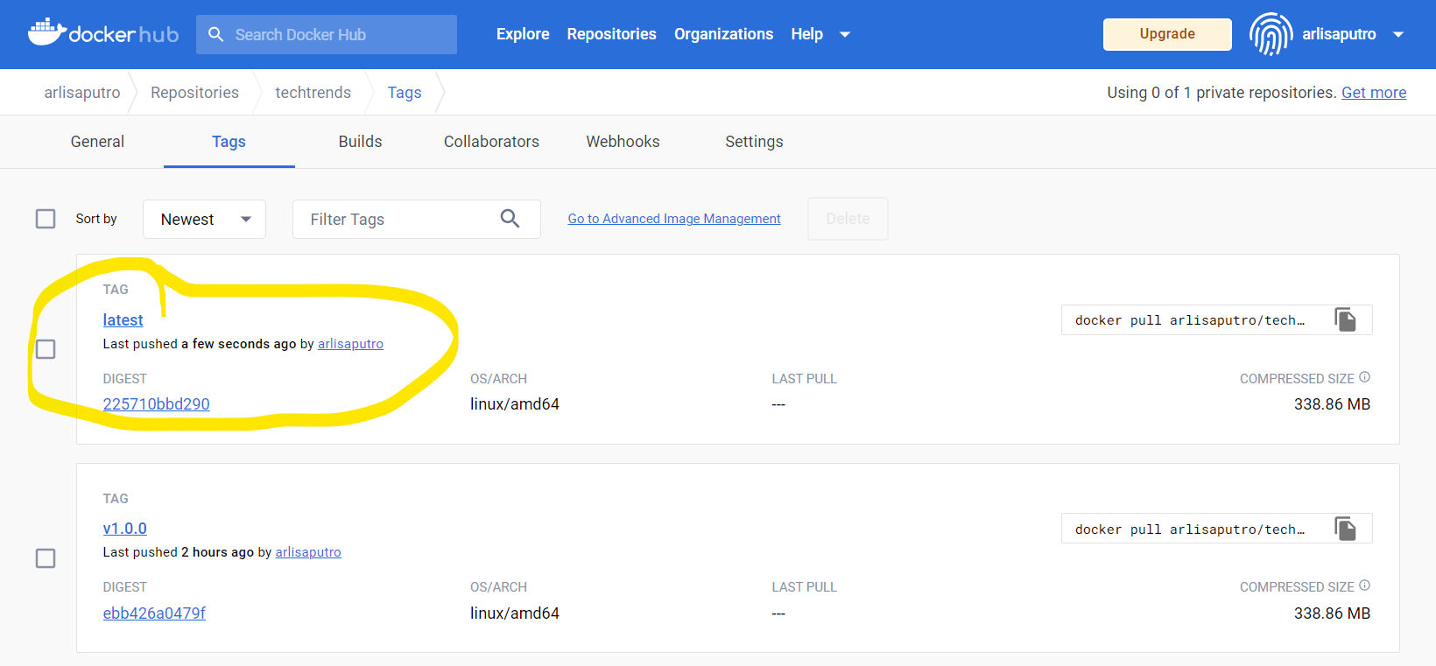
After Github Action

