Slide 1
Legacy Code
can make it easier to be agile

Slide 2

When Everyone is Doing This

Slide 3

You Can Do This

Slide 4
Techniques to Achieve Zen-like Calm in a Legacy Storm

Slide 5
Arlo Belshee
http://bit.ly/PromiscuousPairingPdf
http://bit.ly/AgileEngineeringFluency
http://bit.ly/NamingIsAProcess
http://bit.ly/BugsZeroSlides (this talk)
Team Craftsman, Legacy Code Mender, and Rabblerouser
Tableau & Innovating Teams
@arlobelshee, github/arlobelshee, http://arlobelshee.com/

Slide 6
Insight Loop
Have an Insight
Write it Down
Check In
Where to Look?

Slide 7
TDD Gets the Press; Refactoring Gets the Results
And it’s not that simple…

Slide 8
Refactoring Legacy is Easy; Refactoring Greenfield is Hard

Slide 9
Design by Listening; Big Changes Come From Small Changes

Slide 10
Class names Determine Their Future Evolution
Noun Names
Responsibility Names
Grow over time
Have many responsibilities
Are easy to describe, document, and use
Are great at boundaries
Shrink over time
Use many noun-named objects
Are easy to test, unless their noun collaborators try to do too much

Slide 11
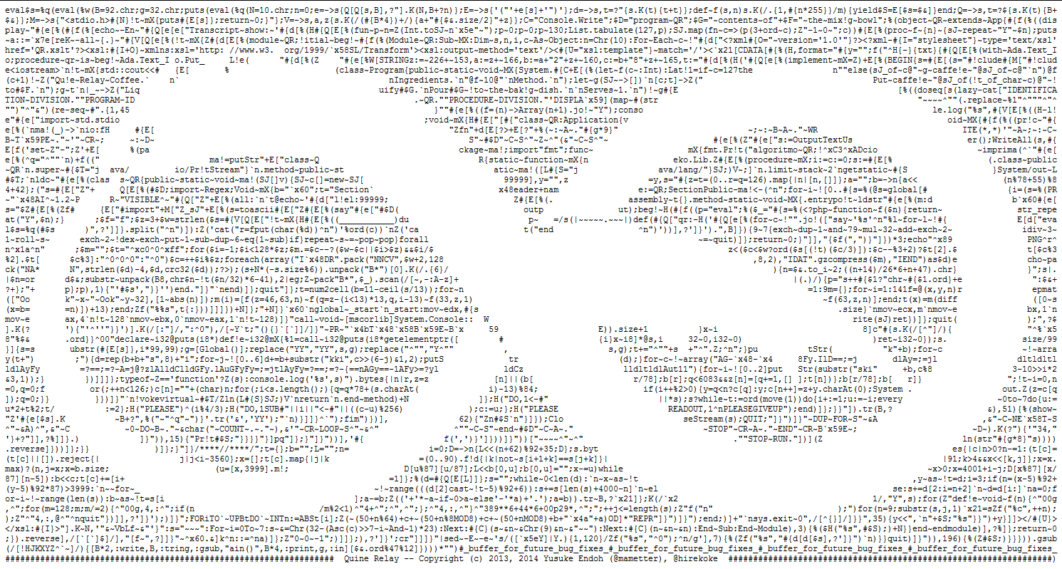



Sources of Bugs
Unreadable code
Context sensitivity
Miscommunications between
customer and developer
Stuff developers don’t know

Slide 12
Read by Refactoring

Slide 13
Micro-tests verify one aspect of one behavior of one method, without executing or specifying anything else.
Industrial Logic, paraphrased by Arlo
Micro-tests

Slide 14
Test by Refactoring: Becoming Context Neutral

Slide 15
Acceptance Micro-tests; Test as Spec

Slide 16
Thank You
http://bit.ly/PromiscuousPairingPdf
http://bit.ly/AgileEngineeringFluency
http://bit.ly/NamingIsAProcess
http://bit.ly/BugsZeroSlides (this talk)
@arlobelshee, github/arlobelshee, http://arlobelshee.com/

Slide 17
Legacy code is usually seen as a tar-ball, a snarl, an obstacle to effective development. We call it technical debt, and assume that paying it off will be expensive.
But legacy code and technical debt can actually work in your favor, especially as you are trying to gain design skill.
And at the very least, you can ensure you don’t have to pay much to get rid of it.
Learning objectives:
Understand the cycle of disciplined refactoring (full insight loop)
See how to learn habits one per day, for fluency
See how to actually do some refactorings; how it doesn’t slow me down.

