Slide 1

School of Computing and Information Technology
Course Delivery
M.Tech - II Semester
Python
Seaborn Visualization Tool
By
Lokesh AR
R19TCS13

Slide 2
Definition:
Seaborn is built on top of Python core visualization Matplotlib library and it serves as complement not replacement.
Features :
Built in Themes.
Visualizing Univariate and bivariate data
Fitting and visualizing linear Regression Models.
Plotting statistical time series data.
Seaborn works well with numpy and pandas Data Structures.
comes with built in Themes for styling Matplotlib Graphics.

Slide 3
Installation:
Pip Install seaborn
Conda install seaborn
Dependencies :
Python 2.7 or Higher
Numpy
Scipy
Pandas
Matplotlib
How to Import :
Import pandas as pd
From matplotlib import pyplot as plt
Import seaborn as sb

Slide 4
Datasets:
Seaborn comes with important Datasets when seaborn as installed.
You can load the dataset using load_dataset()
get_dataset_names() : you can get the list of datasets using this function.
import seaborn as sb
print sb.get_dataset_names()
['anscombe', 'attention', 'brain_networks', 'car_crashes', 'diamonds', 'dots', 'exercise', 'flights', 'fmri', 'gammas', 'iris', 'mpg', 'planets', 'tips', 'titanic']
Example for Importing Dataset:
Import seaborn as sb
Df=sb.load_dataset(‘tips’)
Print(df.head())
total_bill tip sex smoker day time size
0 16.99 1.01 Female No Sun Dinner 2
1 10.34 1.66 Male No Sun Dinner 3
2 21.01 3.50 Male No Sun Dinner 3
3 23.68 3.31 Male No Sun Dinner 2
4 24.59 3.61 Female No Sun Dinner 4

Slide 5
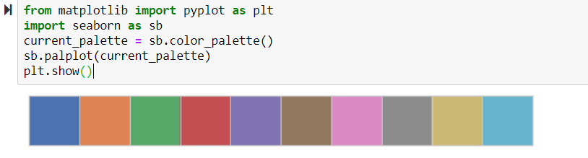
Color Pallets:
Seaborn provides a function color_pallete() which can be used while plotting and give meaning full value .
from matplotlib import pyplot as plt
import seaborn as sb
current_palette = sb.color_palette()
sb.palplot(current_palette)
plt.show()
Here seaborn.palplot() function plots the color along the horizontal array.

Slide 6
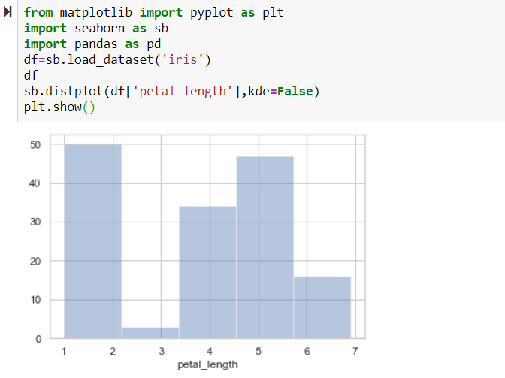
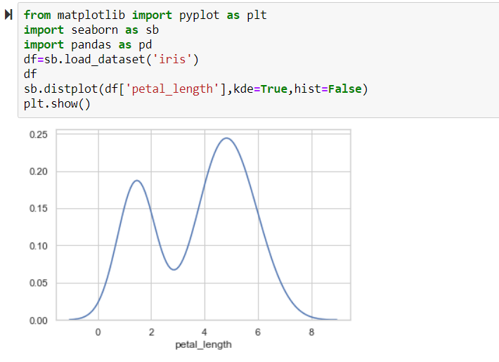
Plotting Univariate Distribution:
Distplot():
Distrubution of data is univariate.
Seaborn.distplot()
Parameters :
data {Series ,1d array of a list}
Bins { Specification of hist bins}
Hist :{ bool ie True/False}
Kde : {bool ie True/False}
Example:
import pandas as pd
import seaborn as sb
from matplotlib import pyplot as plt
df = sb.load_dataset('iris')
sb.distplot(df['petal_length'],kde = False)
plt.show()
Here, kde flag is set to False. As a result, the representation of the kernel estimation plot will be removed and only histogram is plotted.

Slide 7
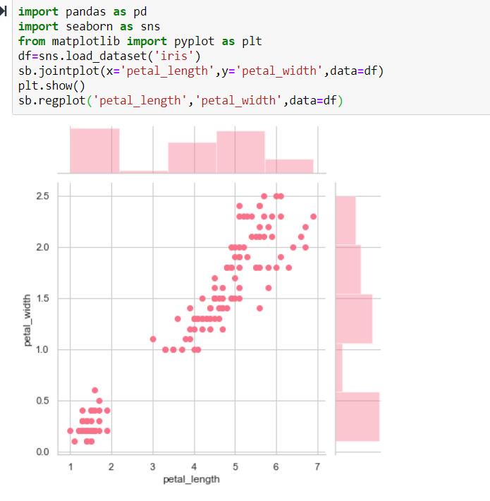
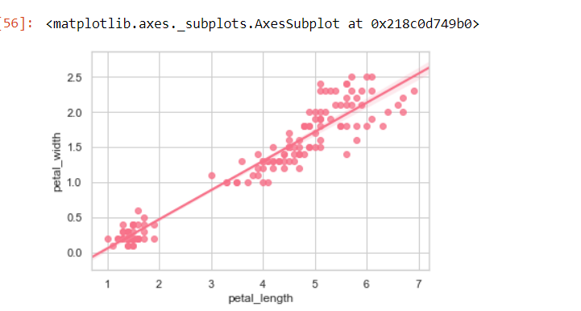
Plotting Bivariate Distrubution:
Bivariate distribution is used to determine relation bet two Variables.
Scatter_plot():
import pandas as pd
import seaborn as sb
from matplotlib import pyplot as plt
df = sb.load_dataset('iris')
sb.jointplot(x = 'petal_length',y = 'petal_width',data = df)
plt.show()
Params :
X,Y : Strings
Data: Dataframe, optional
Kind: { “scatter” | “reg” | “resid” | “kde” | “hex” }

Slide 8
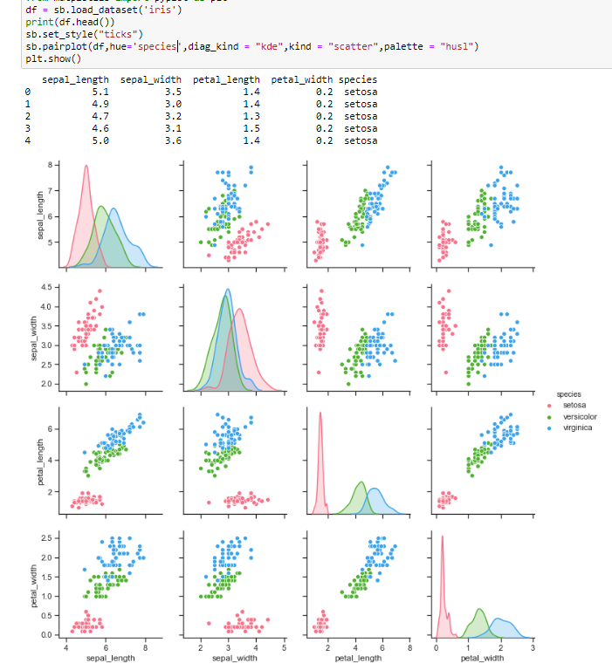
Multiple Pairwise Bivariate Distributions
Pairplot() :Datasets under real time study contains many variables
And should be analyzed.
Pairplot() function will be used to plot multiple pairwise distributions.
sns.pairplot()
Parameters:
Data: dataframe.
Hue : Main Variable in data.
Pallette: set of different colors
Kind : non-diagonal elements {scatter,reg}
Diag_kind: diagonal elements {hist,kde}
import pandas as pd
import seaborn as sb
from matplotlib import pyplot as plt
df = sb.load_dataset('iris')
sb.set_style("ticks")
sb.pairplot(df,hue = 'species',diag_kind = "kde",kind = "scatter",palette = "husl")
plt.show()

Slide 9
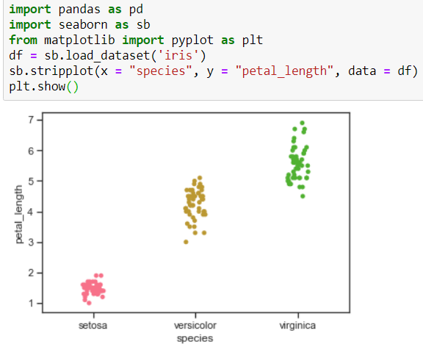
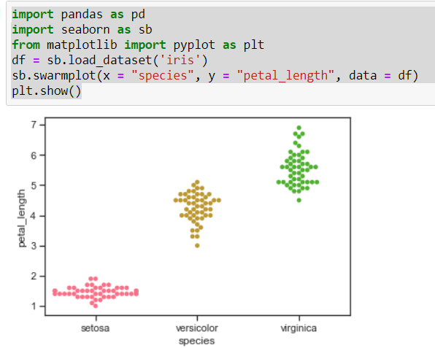
Categorical Plots:
When data is under categorical , we use stripplot(),Swarmplot()
Sripplot():
import pandas as pd
import seaborn as sb
from matplotlib import pyplot as plt
df = sb.load_dataset('iris')
sb.stripplot(x = "species", y = "petal_length", data = df)
plt.show()
Swarmplot():
import pandas as pd
import seaborn as sb
from matplotlib import pyplot as plt
df = sb.load_dataset('iris')
sb.swarmplot(x = "species", y = "petal_length", data = df)
plt.show()

Slide 10
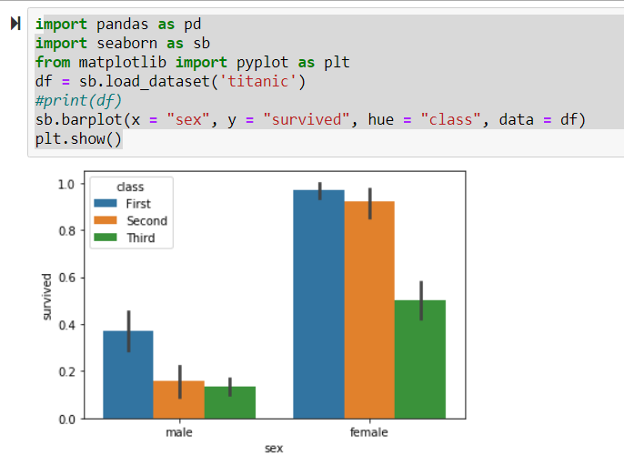
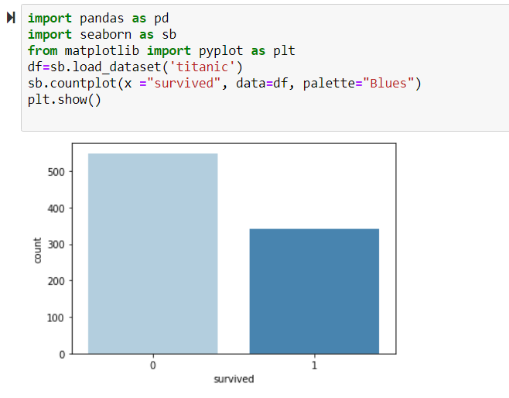
Barplot()
Barplot shows the the relation between categorical variable and continuous variable
import pandas as pd
import seaborn as sb
from matplotlib import pyplot as plt
df = sb.load_dataset('titanic')
#print(df)
sb.barplot(x = "sex", y = "survived", hue = "class", data = df)
plt.show()
Countplot()
Special case of barplot() is countplot is to show number of
observations in each category.
import pandas as pd
import seaborn as sb
from matplotlib import pyplot as plt
df = sb.load_dataset('titanic')
sb.countplot(x = " class ", data = df, palette = "Blues");
plt.show()

Slide 11
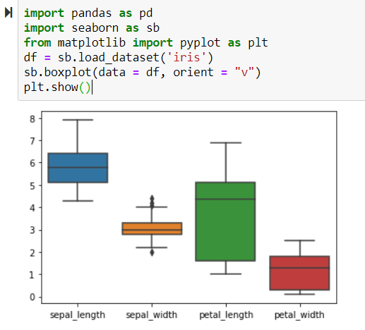
Boxplot()
Boxplot() displays wide-form of variety in data.
import pandas as pd
import seaborn as sb
from matplotlib import pyplot as plt
df = sb.load_dataset('iris')
sb.boxplot(data = df, orient = "v")
plt.show()

Slide 12
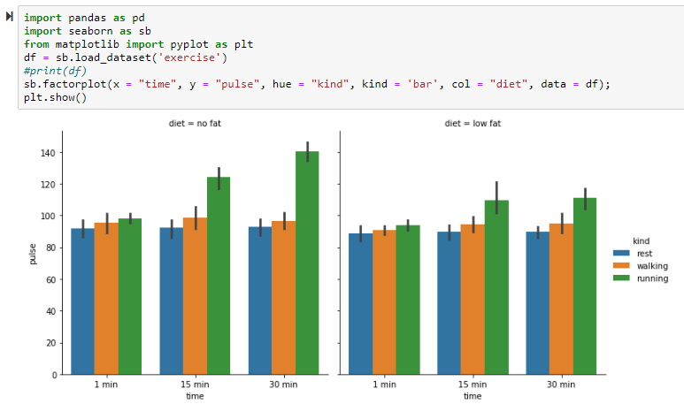
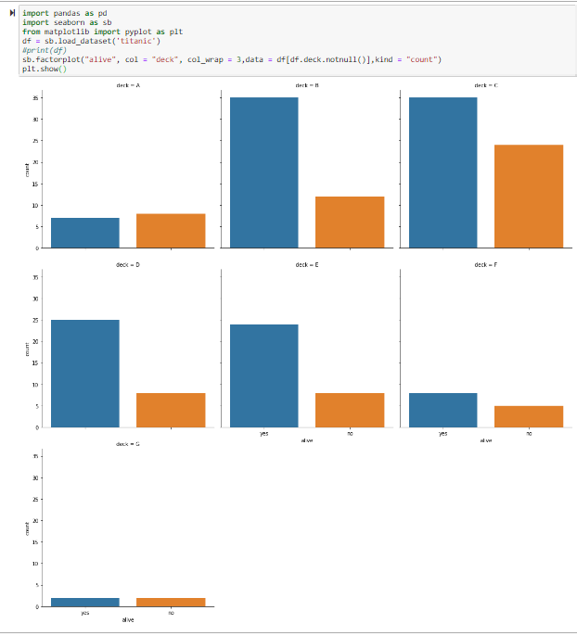
FacetGrid()
kind : {point, bar, count, box, violin, strip}
The advantage of using Facet is, we can input another variable into the plot.
The above plot is divided into two plots based on a third variable called ‘diet’ using the ‘col’ parameter.
import pandas as pd
import seaborn as sb
from matplotlib import pyplot as plt
df = sb.load_dataset('exercise')
#print(df)
sb.factorplot(x = "time", y = "pulse", hue = "kind", kind = 'bar', col = "diet", data = df);
plt.show()
import pandas as pd
import seaborn as sb
from matplotlib import pyplot as plt
df = sb.load_dataset('titanic')
#print(df)
sb.factorplot("alive", col = "deck", col_wrap = 3,data = df[df.deck.notnull()],kind = "count")
plt.show()

Slide 13
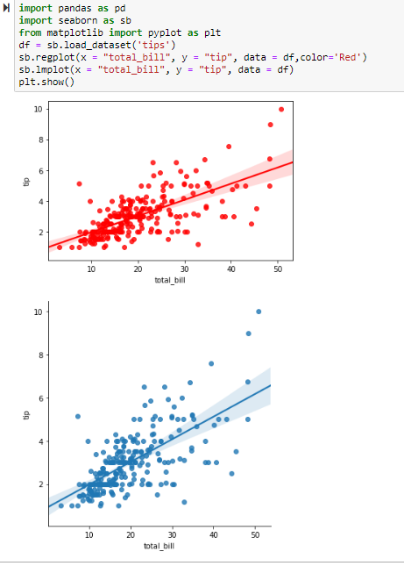
Linear Regression Plots
There are 2 functions available regplot() and implot().
Regplot(): Accepts x and y variables in variety of formats(arrays,Pandas,series objects,
refrence to variables in pandas dataframe).
Implot(): Accepts x and y variables and must be as strings
import pandas as pd
import seaborn as sb
from matplotlib import pyplot as plt
df = sb.load_dataset('tips')
sb.regplot(x = "total_bill", y = "tip", data = df)
sb.lmplot(x = "total_bill", y = "tip", data = df)
plt.show()

Slide 14
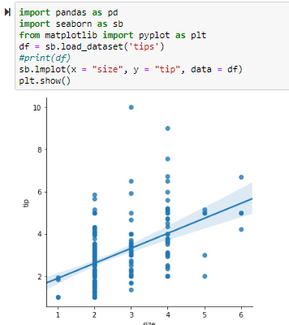
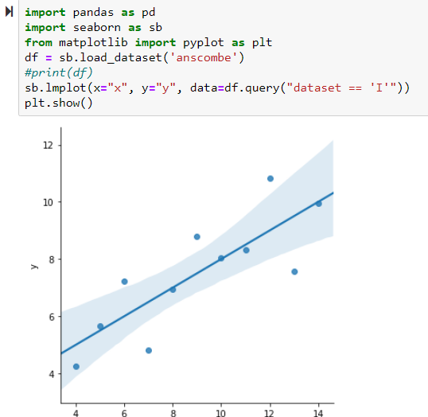
import pandas as pd
import seaborn as sb
from matplotlib import pyplot as plt
df = sb.load_dataset('tips')
sb.lmplot(x = "size", y = "tip", data = df)
plt.show()
import pandas as pd
import seaborn as sb
from matplotlib import pyplot as plt
df = sb.load_dataset('anscombe')
print(df)
sb.lmplot(x="x", y="y", data=df.query("dataset == 'I'"))
plt.show()
import pandas as pd
import seaborn as sb
from matplotlib import pyplot as plt
df = sb.load_dataset('anscombe')
sb.lmplot(x = "x", y = "y", data = df.query("dataset == 'II'"),order = 2)
plt.show()

Slide 15
Thank you

