Slide 1
Embedded Linux
Incorporating AI Models with Kernel Modules
Notes:
Hello and welcome to the Linux for Embedded Systems lecture. This is the seventh lecture of the course.

Slide 2
Goal
To discuss user-level communication with kernel modules and to present an example of an AI model integration with a kernel module.
Notes:
The aim of this lecture is to:
Discuss user-level communication with kernel modules
Present an example to support an AI model integrated with a kernel module

Slide 3
Summary
Introduction
The sysfs file system
The Llama AI model
Building Linux support for integrating AI models with kernel modules
Notes:
First, we will quickly outline how user and module level communication can be implemented.

Slide 4
Summary
Introduction
The sysfs file system
The Llama AI model
Building Linux support for integrating AI models with kernel modules
Notes:
First, we will quickly outline how user and module level communication can be implemented.

Slide 5
Introduction
The communication between user level and module level can be implemented through
The virtual file system (VFS) interface, where the user-level application invokes VFS API to access the device file
Through a RAM-based filesystem known as sysfs that allows exporting kernel data structures to the user level
Notes:
The communication between user-level and module-level can be implemented using two methods:
The virtual filesystem (VFS) interface, where the user-level application invokes the virtual filesystem application programming interface (API) to access the device file
Or through a RAM-based filesystem known as “sys fs” that allows exporting kernel data structures to the user-level

Slide 6
Summary
Introduction
The sysfs file system
The Llama AI model
Building Linux support for integrating AI models with kernel modules
Notes:
Now, let’s take a look at the “sys fs” filesystem.

Slide 7
The sysfs File System
/sysfs
/block
/bus
/class
/dev
/devices
/firmware
/fs
/fsl_opt
/kernel
/config
/debug
gpio
…
/fscaps
…
/module
/power
GPIOs 0-31, platform/209c000.gpio, 209c000.gpio:
gpio-9 (usb_otg1_vbus ) out lo
GPIOs 32-63, platform/20a0000.gpio, 20a0000.gpio:
gpio-44 (wlan-en-regulator ) out lo
gpio-49 (kim ) out lo
GPIOs 64-95, platform/20a4000.gpio, 20a4000.gpio:
gpio-66 (time_sync ) out lo
GPIOs 96-127, platform/20a8000.gpio, 20a8000.gpio:
gpio-108 (usb_otg2_vbus ) out lo
GPIOs 128-159, platform/20ac000.gpio, 20ac000.gpio:
gpio-132 (phy-reset ) out lo
GPIOs 160-191, platform/20b0000.gpio, 20b0000.gpio:
gpio-160 (led0 ) out lo
gpio-162 (2194000.usdhc cd ) in lo
GPIOs 192-223, platform/20b4000.gpio, 20b4000.gpio:
RAM-based file system containing directories/files that are created by the Linux Kernel
Each directory/file contains information about portions of the Kernel that are set visible to the user.
The content is not defined by any specific APIs.
Kernel developers can export any information that is needed.
Notes:
The “sys fs” is a RAM-based filesystem containing directories and files that are created by the Linux kernel. Each directory and file contain information about portions of the kernel that are set visible to the user. The content is not defined by any specific API and kernel developers can export any information that is needed.
We can see the information held about the “gpio” file in this example.

Slide 8
The sysfs File System
Users can read/write the kernel objects exported through sysfs.
Depending on the specific purpose of the kernel object, read/write operations corresponds to object-specific behaviors.
Example /sys/class/gpio
It provides user-level access to general purpose I/Os (GPIO).
It contains
Two control files, export and unexport, to decide which GPIO is accessible to the user
One directory for each user-accessible GPIO, storing the direction file whose content defines whether the GPIO is an input or an output, and a value file whose content is the value to be written to the output GPIO or the value read from an input GPIO
Notes:
Users are able to read and write the kernel objects exported through “sys fs”.
Depending on the specific purpose of the kernel object, the read and write operations correspond to object-specific behaviors.
For example, “sys / class / gpio”:
It provides user-level access to general purpose I/Os.
It contains two control files called “export” and “un-export”. These files decide which GPIO is accessible by the user.
It also contains one directory for each user-accessible GPIO. This directory stores the direction file, whose content defines if the GPIO is an input or an output, and the value file, whose content is the value to be written to the output GPIO or the value read from an input GPIO.

Slide 9
The sysfs File System: Controlling GPIOs
The user can write to GPIOs by
Exporting the GPIO, e.g., 105: echo 105 > /sys/class/gpio/export
Setting the direction: echo "out" > /sys/class/gpio/gpio105/direction
Writing the desired value: echo 1 > /sys/class/gpio/gpio105/value
The user can read from GPIOs by
Exporting the GPIO, e.g., 105: echo 105 > /sys/class/gpio/export
Setting the direction: echo "in" > /sys/class/gpio/gpio105/direction
Reading the GPIO value: cat /sys/class/gpio/gpio105/value
Notes:
There are a few ways in which the GPIO can be controlled.
The user can write to GPIOs by:
Exporting the GPIO: For example, “pipe echo 105 into sys / class / gpio / export”
Setting the direction: For example, “pipe echo out into sys / class / gpio / gpio105 / direction”
Writing the desired value: For example, “pipe echo one into sys / class / gpio / gpio105 / value”
The user can also read from the GPIOs by:
Exporting the GPIO: This would be the same as the previous example.
Setting the direction: For example, “pipe echo in into sys / class / gpio / gpio105 / direction”
Reading the GPIO value: For example, “cat sys / class / gpio / gpio105 / value”

Slide 10
Adding Entries to the sysfs File System
Entries that can be added to the sysfs file system are the directory and files.
To add a new directory to the sysfs file system:
A new Kernel object may be defined using the kobject data structure.
The object may be added to the file system using the kobject_create_and_add() function.
When no longer needed, the above may be destroyed using the kobject_put() function.
struct kobject {
char *k_name;
char name[KOBJ_NAME_LEN];
struct kref kref;
struct list_head entry;
struct kobject *parent;
struct kset *kset;
struct kobj_type *ktype;
struct dentry *dentry;
};
Notes:
Entries that can be added to the “sys fs” are directories and files.
In order to add a new directory to the “sys fs”, a new kernel object needs to be defined using the “k object” data structure, as shown here.
The object shall be added to the filesystem using the “k object create and add” function.
When it is no longer required, the above shall be destroyed using the “k object put” function.

Slide 11
Adding Entries to the sysfs File System
To add a new file to the sysfs file system within a directory corresponding to a Kernel object
A new Kernel object attribute may be defined using the kobj_attribute data structure.
The new file may be added using the sysfs_create_file() function.
struct kobj_attribute {
struct attribute attr;
ssize_t (*show)(struct kobject *kobj,
struct kobj_attribute *attr,
char *buf);
ssize_t (*store)(struct kobject *kobj,
struct kobj_attribute *attr,
const char *buf,
size_t count);
};
Function executed when the file is read
Function executed when the file is written
Notes:
In order to add a new file to the “sys fs” within a directory corresponding to a kernel object, a new kernel object attribute needs to be defined using the “k object attribute” function, as shown in this example. It also illustrates which parts of the code are run when the file is read or written to.
The new file is added using the “sys fs create file” function.

Slide 12
Using sysfs and VFS API
The usage of sysfs and the VFS API depends on the designer intentions.
The sysfs file system can be used to provide device-specific/or subsystem-specific functionalities that cannot be mapped easily into the VFS API.
For example, to select and program a desired GPIO or to select the clock frequency scaling behavior
The sysfs file system and the VFS API can be used concurrently to satisfy different purposes, for example
The VFS API is used to communicate with a specific device modeled as a file.
The sysfs file system is used to provide debug information.
In the following slides, the above concepts will be put to work to support a specific hardware device: the on-board CPU temperature sensor.
Notes:
The usage of the “sys fs” and the virtual filesystem API depends on the intentions of the designer.
The “sys fs” can be used to provide device-specific or sub-system specific functionalities that cannot be mapped easily into the virtual filesystem API. For example, to select and program a desired GPIO, or to select the clock frequency scaling behavior.
The “sys fs” and the virtual filesystem API can be used concurrently, to satisfy different purposes. For example, the virtual filesystem API is used to communicate with a specific device modeled as a file, while the “sys fs” is used to provide debug information.
In the following slides, these concepts will be put at work to support a specific hardware device: the “on-board CPU temperature sensor”.

Slide 13
Summary
Introduction
The sysfs file system
The Llama AI model
Building Linux support for integrating AI models with kernel modules
Notes:
Now, let’s take a look at the AI model we are going to use.

Slide 14
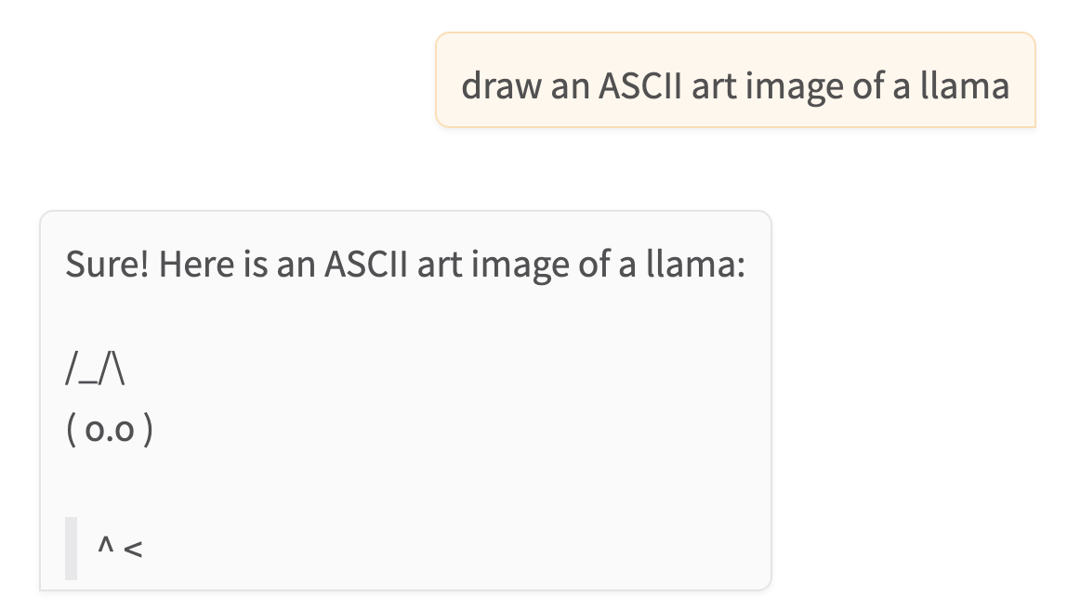
The Llama AI Model
Llama is a set of open-source AI large language models, designed for research and experimentation.
Llama is developed by Meta AI, with the first release in 2023.
Models come in different sizes, based on the number of parameters.
Notes:
Llama Is a family of open-source large language models, developed by Meta.

Slide 15
What is a Large Language Model (LLM)?
LLMs are AI models that are trained on a massive corpus of text.
LLMs are designed for language processing tasks, such as text generation.
An LLM can be fine-tuned for a specific task. It may be guided by a human-provided prompt.
ChatGPT is probably the most well-known and widely used LLM to date.
Notes:
Large language models predictively generate human readable text, based on a model of a large corpus of textual data.

Slide 16
Deployment Model for LLM
An LLM may be deployed locally (i.e. on-device) or remotely (i.e. on the cloud).
There are relative advantages and disadvantages to each approach.
We intend to deploy an LLM locally on a Raspberry Pi device.
We will use the llama.cpp project, which is an open-source inference library that runs with Llama models. llama.cpp supports multiple backend targets including Arm.

Slide 17
Comparing Deployment Models for LLM
Advantages of local deployment:
✅ enhances privacy, since all data remains on-device
✅ appropriate for low bandwidth or limited connectivity environments
✅ no recurring API costs
✅ LLM is under our control, no third-party involvement post-deployment
Disadvantages of local deployment:
❌ local compute not as powerful, so smaller models and slower inference times
❌ LLM uses limited local resources (CPU/RAM/storage) impacting other services
❌ model updates would require on-device reconfiguration
Notes:
There are always tradeoffs, when considering whether to deploy AI on-device (locally) or in the cloud (remotely).

Slide 18
Why might an AI model be used in an Embedded System?
real-time data analysis and response, e.g. factory control system
edge processing, avoiding sensitive data transfer across the internet, e.g. wearable health tracker
high-level smart features, e.g. schedule-learning thermostat
human-friendly textual responses, e.g. chatbot user interface
Notes:
We consider various use case scenarios for integrating an AI model into an embedded system.

Slide 19
Benefits and Drawbacks of AI Integration
Benefits
✅ AI gives flexibility for adapting to unseen inputs and scenarios.
✅ More cynically, AI is good for marketing, since AI features are attractive to consumers.
Drawbacks
❌ Can we trust AI-generated content and decisions? Are safeguards in place?
❌ AI is resource intensive, so may not be viable in the device budget / power envelope.
Can you think of other benefits and/or drawbacks?
Notes:
Again, there are tradeoffs when considering whether AI is appropriate.

Slide 20
Llama Deployment on Raspberry Pi
This slide gives an overview of the practical lab associated with this module.
Using a custom Yocto layer, we will download, build and install llama.cpp for Raspberry Pi
We also need to download a pre-trained Llama model, ensuring this model isn’t too large for our SD-card storage and RAM. Models for llama.cpp are in the gguf format, which can be obtained from online repositories like huggingface.
We want to run our LLM as a background service, in user-mode.
We will interact with it via some kind of utility tool, which queries temperature data from a kernel module, then uses this to construct an LLM input prompt.
We never run AI models in kernel space – since they are too big, too unpredictable, and too slow.

Slide 21


Deployment Component Diagram
llama server
sends prompt to
command script
reads
device file
outputs text to
defines
user space
kernel space
kernel module
Notes:
This slide shows the various components involved in the system we will set up in the associated practical lab.

Slide 22
Summary
Introduction
The sysfs file system
The Llama AI model
Building Linux support for integrating AI models with kernel modules
Notes:
Now, we will take a look at how we can build Linux support for the “on-board temperature” sensor, along with AI integration.

Slide 23
Building Linux Support for the On-Board Temperature Sensor
We will develop a simple Linux module for the Raspberry Pi on-board temperature sensor that makes use of the sysfs file system..
The same loadable Kernel module will use the thermal component of Linux to read and provide the user the last temperature read from the sensor.
Notes:
We are going to develop Linux support for the “on-board temperature” sensor which will make use of both the thermal system API and “sys fs”.

Slide 24
Module Data Structure Definition
static struct kobject *temp_kobject;
static struct kobj_attribute temp_attribute = __ATTR(value, 0444, temp_show, NULL);
Kernel object for adding a directory entry to sysfs
Kernel object attribute
Name of the file
File access right
Functions invoked when the file is read/written
Notes:
This is an example definition of a module data structure.
This code declares a kernel object for adding a directory entry to “sys fs”.
The final line assigns the kernel object attribute, called `value’. The arguments for this are the name of the file, the file access rights, and the functions invoked when the file is read or written to.

Slide 25
Module Initialization Function
static int __init temp_init(void)
{
int error = 0;
temp_kobj = kobject_create_and_add("temp", kernel_kobj);
if (!temp_kobj)
return -ENOMEM;
error = sysfs_create_file(temp_kobj, &temp_attribute.attr);
if (error) {
pr_err("temp: failed to create sysfs file\n");
kobject_put(temp_kobj);
}
pr_info("temp module loaded\n");
return error;
}
Notes:
Now we will look at the module initialization function.

Slide 26
Module Initialization Function
static int __init temp_init(void)
{
int error = 0;
temp_kobj = kobject_create_and_add("temp", kernel_kobj);
if (!temp_kobj)
return -ENOMEM;
error = sysfs_create_file(temp_kobj, &temp_attribute.attr);
if (error) {
pr_err("temp: failed to create sysfs file\n");
kobject_put(temp_kobj);
}
pr_info("temp module loaded\n");
return error;
}
Insert the new file in the Linux sysfs
Notes:
Now we will look at the module initialization function.

Slide 27
Module Initialization Function
static int __init temp_init(void)
{
int error = 0;
temp_kobj = kobject_create_and_add("temp", kernel_kobj);
if (!temp_kobj)
return -ENOMEM;
error = sysfs_create_file(temp_kobj, &temp_attribute.attr);
if (error) {
pr_err("temp: failed to create sysfs file\n");
kobject_put(temp_kobj);
}
pr_info("temp module loaded\n");
return error;
}
error handling
logging
Notes:
Now we will look at the module initialization function.

Slide 28
Module Clean-up Function
static void __exit temp_exit(void)
{
kobject_put(temp_kobj);
pr_info("temp module unloaded\n");
}
Remove the temp directory from sysfs.
Notes:
This is how the module “clean up” function is implemented.
The module is marked as free. The character device is then removed from the kernel. Finally, the “temp” directory is removed from “sys fs”.

Slide 29
Module Read Function
Function executed when the user reads /sys/kernel/temp/value
static ssize_t temp_show(struct kobject *kobj, struct kobj_attribute *attr, char *buf)
{
struct thermal_zone_device *tz;
int temp_millic, ret;
tz = thermal_zone_get_zone_by_name("cpu-thermal");
if (IS_ERR(tz))
return sysfs_emit(buf, "Error: cannot find default thermal zone\n");
ret = thermal_zone_get_temp(tz, &temp_millic);
if (ret)
return sysfs_emit(buf, "Error: cannot read temp\n");
return sysfs_emit(buf, "%d\n", temp_millic / 1000);
}
The temperature sensor reading is supplied via a kernel function call.
Reading is translated to string and sent to sysfs file
Notes:
In the module “read” function, the temperature is read as an integer, converted to a string and sent to sysfs

Slide 30
Interfacing the Module with AI
We run the LLM as a sporadic utility (llama_cli) which takes prompts as command-line arguments.
It might be better to run the LLM as a service. A long-running background service allows us to build up context for the LLM. Also it means we incur lower latency for each query.
However there is a constant background resource overhead.
How do we start the background service? Probably using a script (systemd or initrc) at bootup time.

Slide 31
Querying the AI
Now we can define a command – ai_temp – that reads the kernel module data exposed via sysfs, sends a prompt to the AI service if it’s running, and reports the textual answer back
to standard output, on the command line, and
in the system logs – for record-keeping – important for auditability of AI.
The practical lab shows how this command might be implemented as a shell script.
Notes:
This concludes the seventh and final lecture on Linux for Embedded Systems.

