Slide 1
Introduction to Keil Studio Pack for VS Code and CMSIS

Slide 2
Syllabus
This module will cover the following:
CMSIS Overview
RTOS Support
VS Code CMSIS Integration
High-level vs. low-level coding

Slide 3
Quite a bit of content is based on the existing slides from Lecture 7, but with important corrections/updates

Slide 4
Common Microcontroller Software Interface Standard (CMSIS)
Vendor-independent hardware abstraction layer for Arm processors and microcontrollers
Provides a set of software components, tools, and workflows that encourages software reuse, and speeds up development/prototyping times
Improves software portability across different Arm processors and microcontrollers
Low-level Programming
Higher-level Programming
Configure a Cortex-M by directly accessing registers in address space
Configure a Cortex-M by using CMSIS libraries and APIs
*(unsigned int *)NVIC_INT_ENABLE = 0x01;
API
NVIC_EnableIRQ(Timer_IRQn);
Arm Cortex-M Processor
Arm Cortex-M Processor
Cortex-M0
Cortex-M4

Slide 5
What is standardized by CMSIS?
Functions to access, e.g., NVIC, System Control Block (SCB), and System Tick timer
Enables an interrupt or exception: void NVIC_EnableIRQ(IRQn_Type IRQn)
Sets pending status of interrupt: void NVIC_SetPendingIRQ(IRQn_Type IRQn)
Access to special registers, e.g.:
Read PRIMASK register: uint32_t __get_PRIMASK(void)
Set CONTROL register: void __set_CONTROL(uint32_t value)
Functions to access special instructions, e.g.:
REV: uint32_t __REV(uint32_t value)
NOP: void __NOP(void)
Names of system initialization functions, e.g.:
System initialization: void SystemInit(void)

Slide 6
Benefits of CMSIS
Easier to port application code from one Arm-based processor/microcontroller to another Arm based processor/microcontroller
Easier to reuse the same code between different Arm-based processors/microcontrollers
Better compatibility when integrating third-party software components, since all third-party components (such as applications, embedded OS, middleware, etc) can share the same CMSIS interface
Better code density and smaller memory footprint, since the code in CMSIS has been optimized and tested

Slide 7
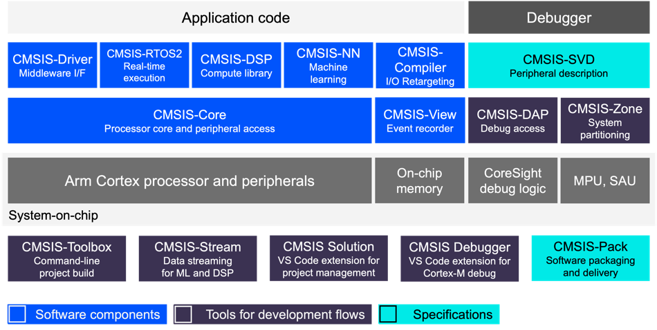
CMSIS Components
CMSIS comprises the following components:
CMSIS-Core: Implements a basic run-time system
CMSIS-RTOS2: API that enables consistent software layers for real-time processing
CMSIS-NN: Collection of neural network kernels for machine learning
CMSIS-DSP: A rich collection of optimized DSPs for compute
CMSIS-Driver: Generic driver interfaces for peripherals often found in embedded systems
CMSIS-SVD: Enables detailed views of device peripherals with current register state
CMSIS-DAP: Standardized interface to the CoreSight Debug Access Port
Image taken from:
https://arm-software.github.io/CMSIS_6/latest/General/index.html#validation

Slide 8
CMSIS-RTOS2
CMSIS RTOS2 is the standard real-time operating system API within the CMSIS ecosystem
Enables application code to be:
Independent of any RTOS implementation
Portable across devices
Easier to maintain and reuse
Key features:
Thread management (create and manage threads)
Synchronisation (mutexes, semaphores, events)
Communication (message queues, shared memory)
Timing (delays and sleep, software timers)

Slide 9
RTX5
RTX5 is the reference RTOS implementation for CMSIS-RTOS2
Small footprint
Deterministic kernel (important for real time characteristics!)
Optimised for Cortex-M microcontrollers
Fully integrated into the CMSIS ecosystem

Slide 10
CMSIS-Driver
Defines a standard peripheral driver interface for embedded systems.
GPIO
UART/USART
SPI
I2C
Ethernet
USB Device/Host
CAN
NAND storage
Wi-Fi
Each driver typically provides:
Initialisation
Data transfer
Event handling
Capability discovery
Middleware, such as TCP/IP stacks, USB stacks, file systems, etc, can be written once, and reused across platforms.

Slide 11
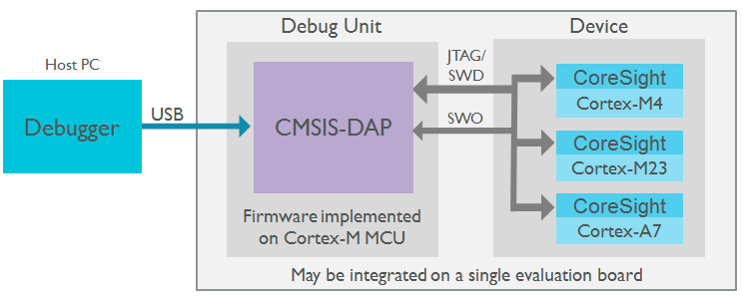
CMSIS-DAP
Interface firmware for the debug unit that connects the debug port to USB
Debugger can connect via USB to debug unit and device
Debug unit connected to target via JTAG/SWD
CoreSight Debug and Trace Unit on CPU
Multi-core debugging

Slide 12

VS Code
Visual Studio Code is a lightweight, extensible, cross-platform development environment widely used for embedded, cloud, and desktop software development.
It’s a single environment for:
Editing, building, debugging, device configuration, and access to documentation
It enables integration of:
Toolchains, debug probes, build systems, and CMSIS workflows

Slide 13
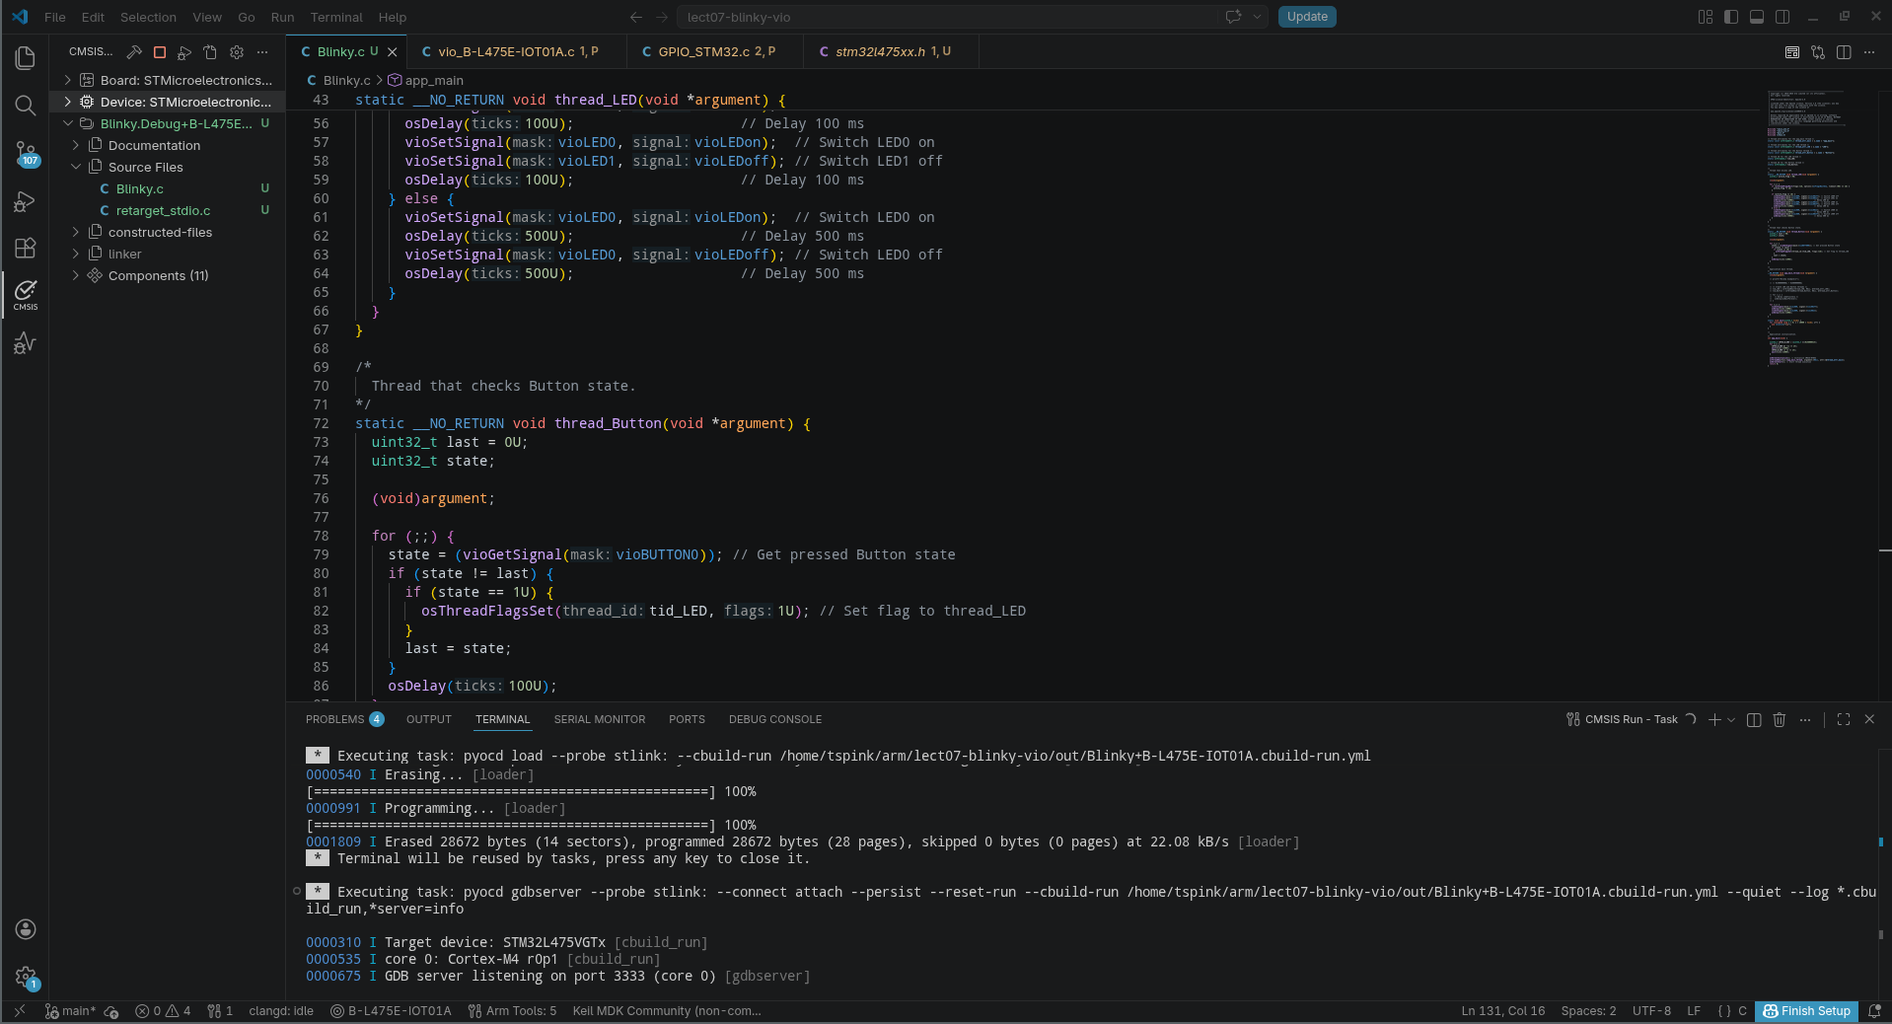
Keil Extensions for VS Code
Keil Studio extensions transform VS Code into a CMSIS-aware embedded development environment for Arm-based microcontrollers.
Native support for the whole CMSIS workflow
Device and board awareness
Discovery, board support files, peripheral and startup configuration
Project management
Creation and management of CMSIS solutions
Toolchain configuration
Debug and Run
Integration with supported debug probes
Flash programming
Rapid prototyping!

Slide 14
CMSIS Solution
CMSIS Solution (*.csolution.yml)
Project (*.cproject.yml)
Project (*.cproject.yml)
Software Layers
Configuration
Application Code
Middleware
CMSIS Software Packs
(Device + Middleware)
Toolchain & Build
(Compiler + Linker)

Slide 15
CMSIS Packs
CMSIS Packages provide reusable software and metadata:
Device support
Startup code
Peripheral definitions
Drivers
Middleware
Example projects
Documentation

Slide 16
CMSIS Enabled Platforms
Any platform powered by a Cortex-M or entry-level Cortex-A processor!
STMicroelectronics
STM32L4
NCP Semiconductors
Microchip SAM family
Nordic Semiconductor
Silicon Labs
Texas Instruments
… and more!

Slide 17
High-level vs. low-level programming
High-level
Advantages:
Higher productivity (less development time/effort)
Portability across devices
Code is easier to read and maintain
Allows code reuse
Rapid prototyping of applications
Disadvantages:
Potentially less optimized code
Additional translation time from source code to machine code
Level of abstraction may not provide all functionality
Low-level
Advantages:
More optimized code and higher memory efficiency
Less translation time from source code to machine code
Direct interaction with hardware
Disadvantages:
Less portability from one device to another
Code is more difficult to read, reuse, and maintain
Low productivity/greater effort required

Slide 18
High-level vs. low-level programming
Low-level: Blinking an LED by manipulating MCU registers
A GPIO peripheral can be directly accessed by reading/writing specific memory addresses.
int app_main(void) {
uint32_t *GPIO_B_ODR = (uint32_t *)(0x48000414); // GPIO Port B Output Data Register
for (;;) {
*GPIO_B_ODR &= ~(1 << 14); // Clear PB14
wait(1000); // Wait 1s
*GPIO_B_ODR |= (1 << 14); // Set PB14
wait(1000); // Wait 1s
}
return 0;
}

Slide 19
High-level vs. low-level programming
High-level: Blinking an LED with the CMSIS API
A GPIO peripheral can be controlled with CMSIS function calls
void app_main_thread(void *argument) {
for (;;) {
vioSetSignal(vioLED0, vioLEDoff); // Turn the LED off
osDelay(1000); // Wait 1s
vioSetSignal(vioLED0, vioLEDon); // Turn the LED on
osDelay(1000); // Wait 1s
}
}

