Slide 1




Performance Study on CPU-based Machine Learning with PyTorch
Smeet Chheda, Tony Curtis, Eva Siegmann, Barbara Chapman
IACS, Stony Brook University

Slide 2
Agenda
Introduction: Machine Learning
Software Stack and Communications Setup
oneDNN
CPU, Compiler and BLAS Libraries
Evaluation:
benchDNN
Models Used
Single Node
Multi Node
ARM Compiler Performance
Remarks
Conclusion
Acknowledgements

Slide 3
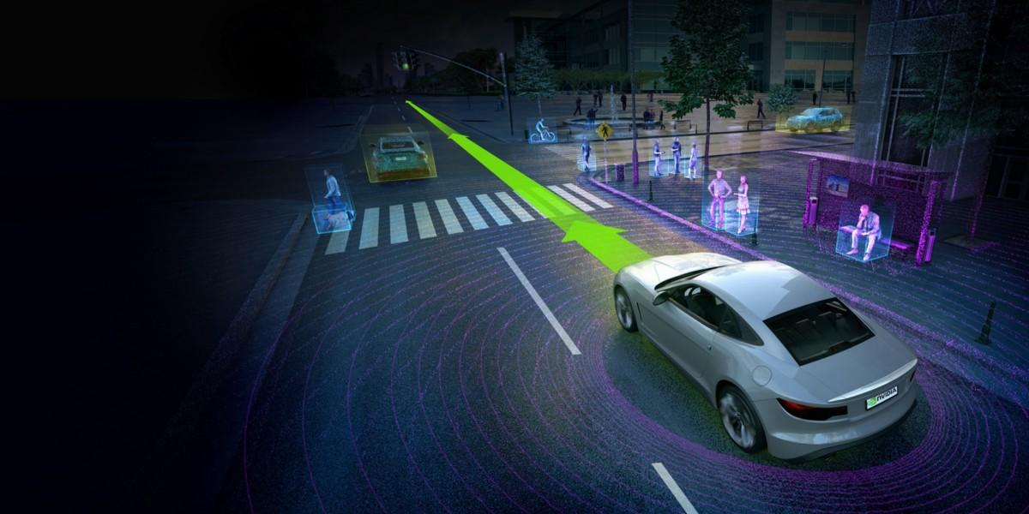

Introduction: Machine Learning
ML algorithms and models are being continuously developed and deployed in multiple places.
PyTorch is a popular open source machine learning library based on the Torch library.
It provides fast tensor computations with gpu acceleration and reverse-mode automatic differentiation through autograd.
Easy to use.

Slide 4
Software Stack and Communications setup
Library versions are cloned from GitHub or downloaded from respective websites (Python, PyPI) and kept consistent across all environments.
Library | Version
Python | 3.8.2
Numpy | 1.22.4
PyTorch | 1.10.0
Torchvision | 0.11.0
oneDNN | 2.4.3
Horovod | 0.24.3
Cluster | Compiler | UCX | MPI | Interconnect
Ookami | Fujitsu | - | Fujitsu MPI* | Infiniband HDR 100
Ookami | ARM / LLVM / GNU | 1.11.2 | Open MPI v4.1.2 | Infiniband HDR 100
Stampede2 | GNU | - | Intel MPI v19.0.9 | Intel Omni-Path 100Gb/s
*Fujitsu MPI is based on Open MPI v4.0.1

Slide 5
oneDNN
oneAPI Deep Neural Network Library (oneDNN) is an open-source cross-platform performance library of basic building blocks for deep learning applications. The library is optimized for Intel Architecture Processors, Intel Processor Graphics and Xe Architecture graphics.
It includes highly vectorized and threaded building blocks for implementation of convolutional neural networks (CNNs) and recurrent neural networks (RNNs) with C and C++ interfaces. This project is created to help the DL community innovate on the Intel(R) processor family.
PyTorch is built with oneDNN v2.4.3 support (formerly known as MKL-DNN)
Fujitsu achieved this by creating an aarch64 version of xbyak JIT assembler.
xbyak_aarch64 and xbyak_translator_aarch64 have been primarily developed to enable assembly coding with full SVE support and porting oneDNN to aarch64.
Their work has been upstreamed and can be used directly.

Slide 6
CPU, Compiler and BLAS Libraries
Cluster | CPU | Compiler | BLAS Library | Compiler Flags
Ookami | Fujitsu A64FX | Fujitsu compiler v4.7 | SSL2 | -Nclang -Kfast -Knolargepage -lpthread
Ookami | Fujitsu A64FX | Arm v22.0.1 | Arm Performance Libraries v2022.0.1 | -O3 -pthread -mcpu=a64fx -mtune=a64fx
Ookami | Fujitsu A64FX | GNU v11.2.0 | OpenBLAS v0.3.19 | -O3 -pthread -mcpu=a64fx -mtune=a64fx
Ookami | Fujitsu A64FX | LLVM v16.0.0 | OpenBLAS v0.3.19 | -O3 -pthread -mcpu=a64fx -mtune=a64fx
Rusty | Intel Xeon Gold 6148 (40 cores) | GNU v10.3.0 | OpenBLAS v0.3.19 | -O3 -lpthread -mtune=skylake-avx512
Rusty | Intel Xeon Gold 6148 (40 cores) | Intel Compiler v2022.0.1 | MKL v2022.0.1 | -O3 -lpthread -mtune=skylake-avx512
Popeye | Intel Xeon Platinum 8358 (64 cores) | Intel Compiler v2022.0.1 | MKL v2022.0.1 | -O3 -lpthread -mtune=icelake-server
Stampede2 | Intel Xeon Platinum 8160 (48 cores) | GNU v9.1.0 | MKL v19.1.1 | -O3 -lpthread -mtune=skylake-avx512

Slide 7
Evaluation: benchDNN
./benchdnn --DRIVER [COMMON-OPTIONS] [DRIVER-OPTIONS] PROBLEM-DESCRIPTION
benchdnn is an extended and robust correctness verification and performance benchmarking tool for the primitives provided by oneDNN.
benchdnn itself is a harness for different primitive-specific drivers.
We evaluate the convolution driver in performance mode.
Direction={forward with bias, backward with bias}
Configuration={f32, u8s8s8} (f32 : 32 bit float, s8 : signed int8_t, u8 : unsigned uint8_t)
Run configuration: OMP_NUM_THREADS=8

Slide 8
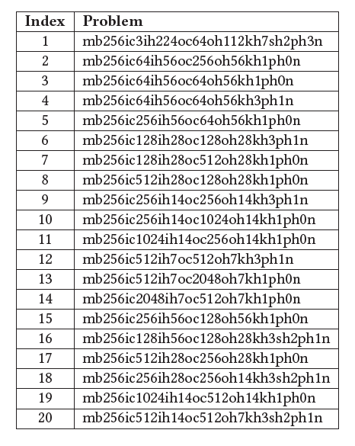
Evaluation: benchDNN
Entry | Description
mb | Mini batch size
ic, oc | Input and output channels
id, ih, iw | Input depth, height and width
od, oh, ow | Output depth, height and width
kd, kh, kw | Kernel depth, height and width
sd, sh, sw | Stride depth, height and width
pd, ph, pw | Front, top and left padding
n | Descriptor name

Slide 9
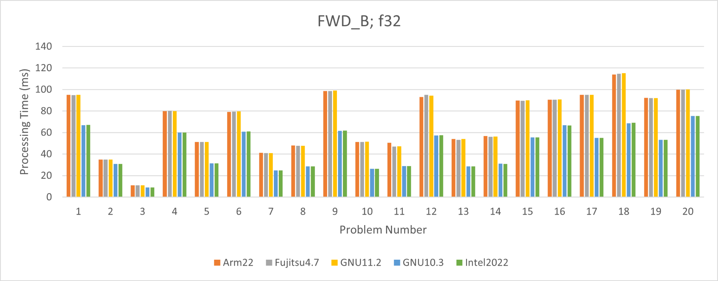
Evaluation: benchDNN (contd)
Blue and green bars represent runs on Intel Xeon Gold 6148.
Orange, Grey and Yellow bars represent runs on Fujitsu A64FX

Slide 10
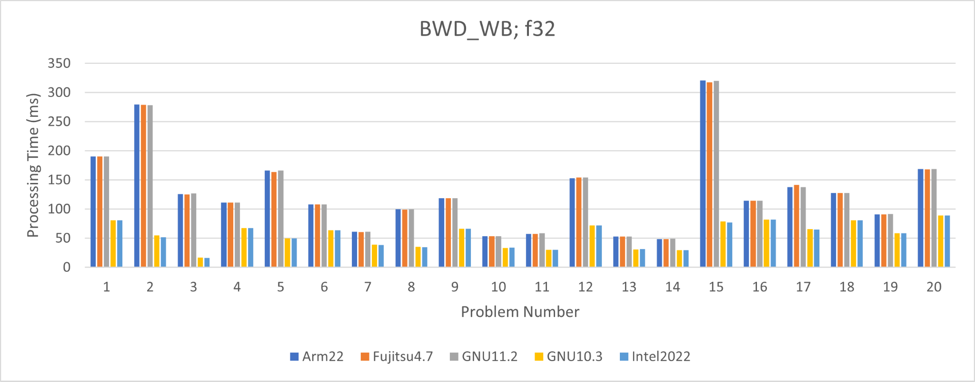
Evaluation: benchDNN (contd)
Yellow and light-blue bars represent runs on Intel Xeon Gold 6148.
Blue, Orange and Grey bars represent runs on Fujitsu A64FX

Slide 11
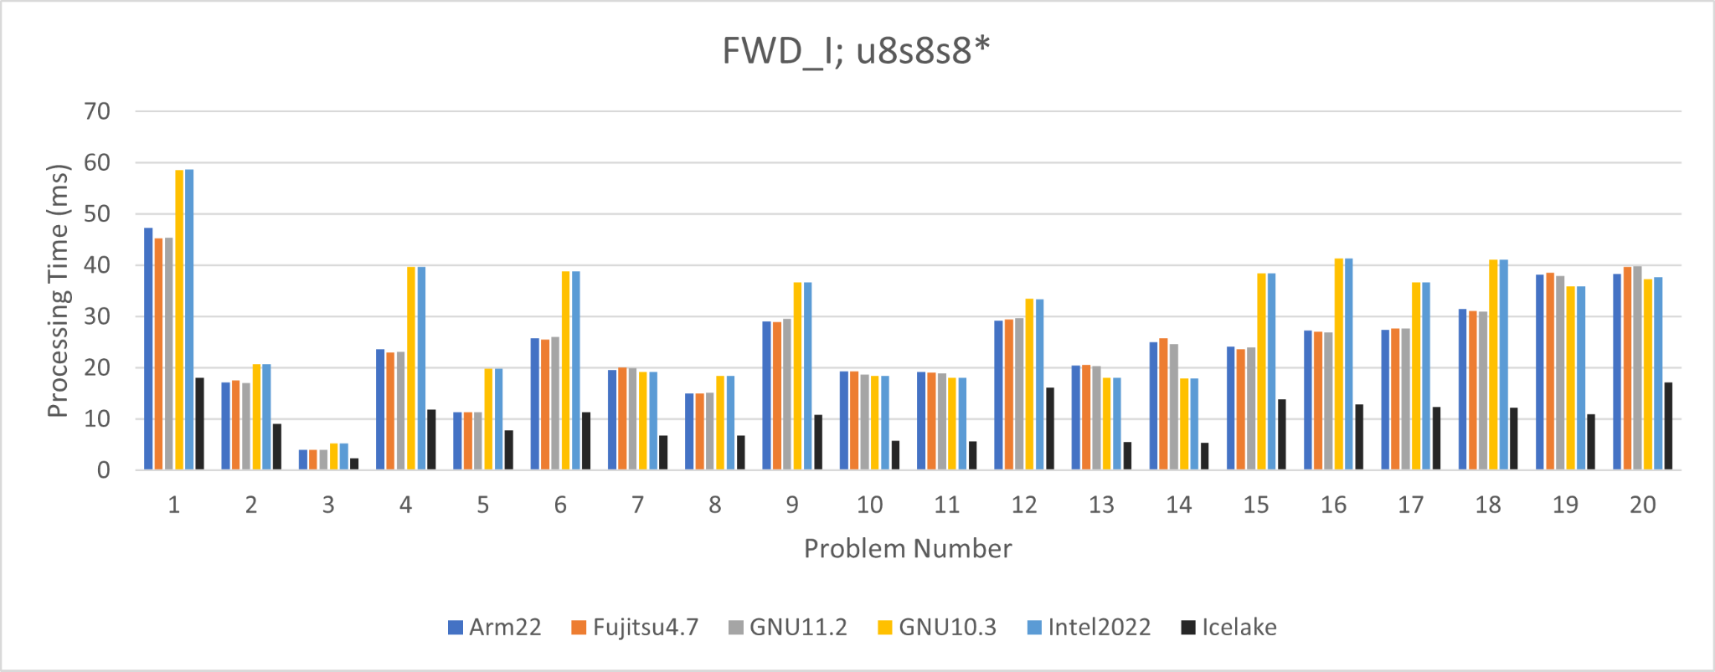
Evaluation: benchDNN (contd)
Yellow and light-blue bars represent runs on Intel Xeon Gold 6148.
Black bar represents Intel compiler on Intel Xeon Platinum 8358 (Icelake)
Blue, Orange and Grey bars represent runs on Fujitsu A64FX

Slide 12
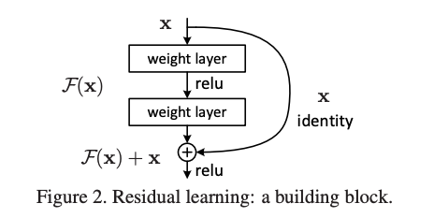
Evaluation: Models used
We evaluate the performance of 3 different deep residual networks.
ResNet 34 (21.79M), ResNext 50-32x4d (25.02M), Wide ResNet 101 (126.88M)
Easy to convert to block format and therefore they can take advantage of optimized oneDNN kernels.
Other models in torchvision do not support block formats at the moment
Unsupported operators for example, concatenation
Image courtesy of He, Kaiming, et al. "Deep residual learning for image recognition." Proceedings of the IEEE conference on computer vision and pattern recognition. 2016.

Slide 13

Evaluation: Single Node
Task: Image Classification
Dataset: Photo, Art Painting, Cartoon, Sketch (PACS*) - 4 domains, 7 classes, 9991 images
Training : 6101 images Transforms : Resizing, Horizontal Flips, Color Jittering, Gray scaling, tensor conversion, normalization
Evaluation : 3942 images Transforms : Resizing, tensor conversion, normalization
Model training & inference can be improved by using different memory formats (NCHW default, NHWC, nChw16c - mkldnn block format)
Using TCMalloc for memory allocation.

Slide 14
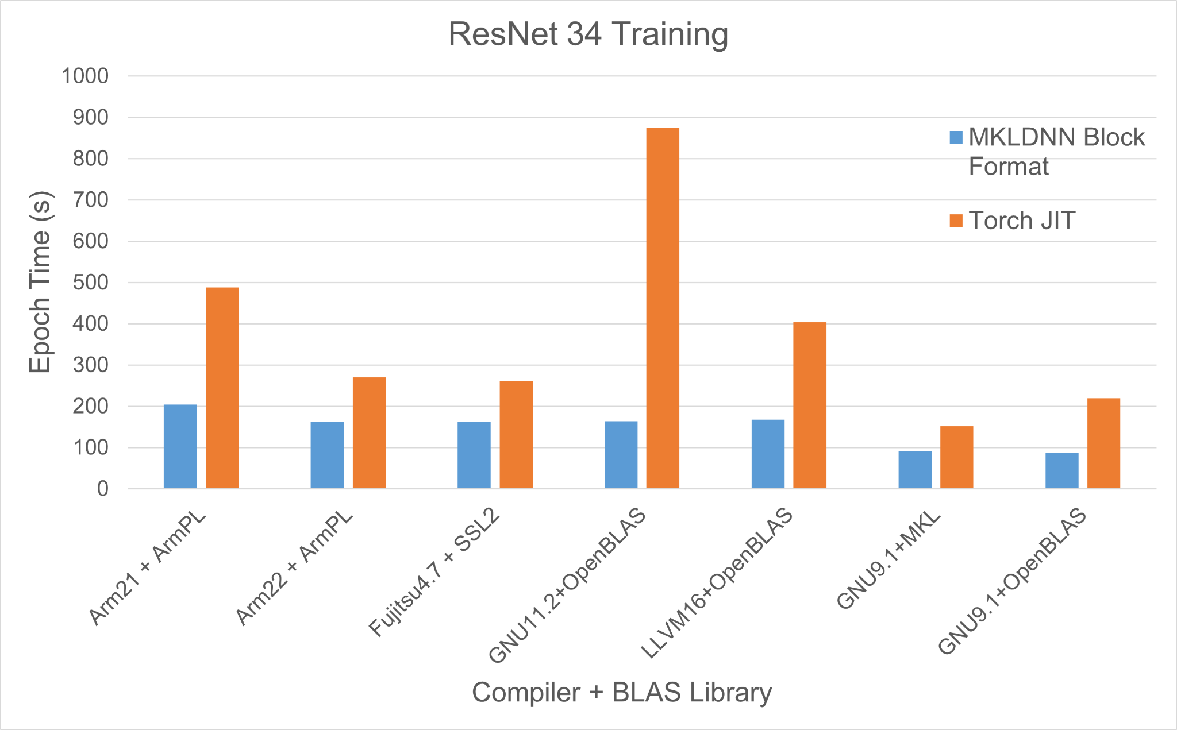
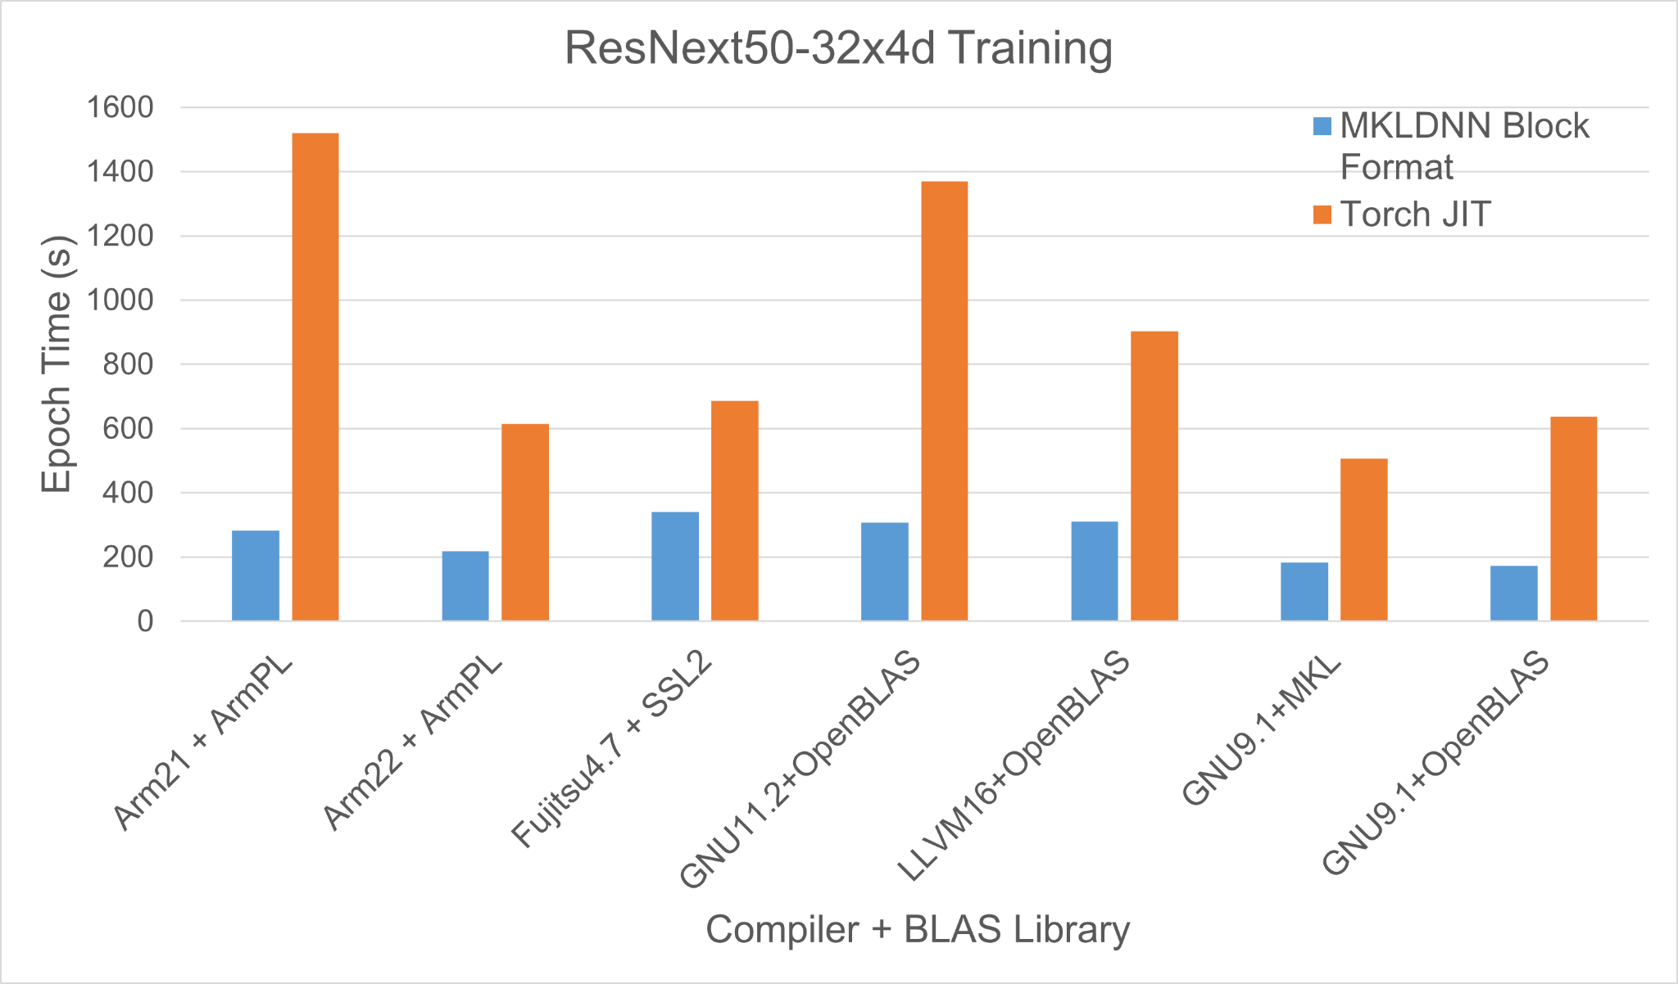
Evaluation: Single Node
Training Time per Epoch (lower is better)

Slide 15
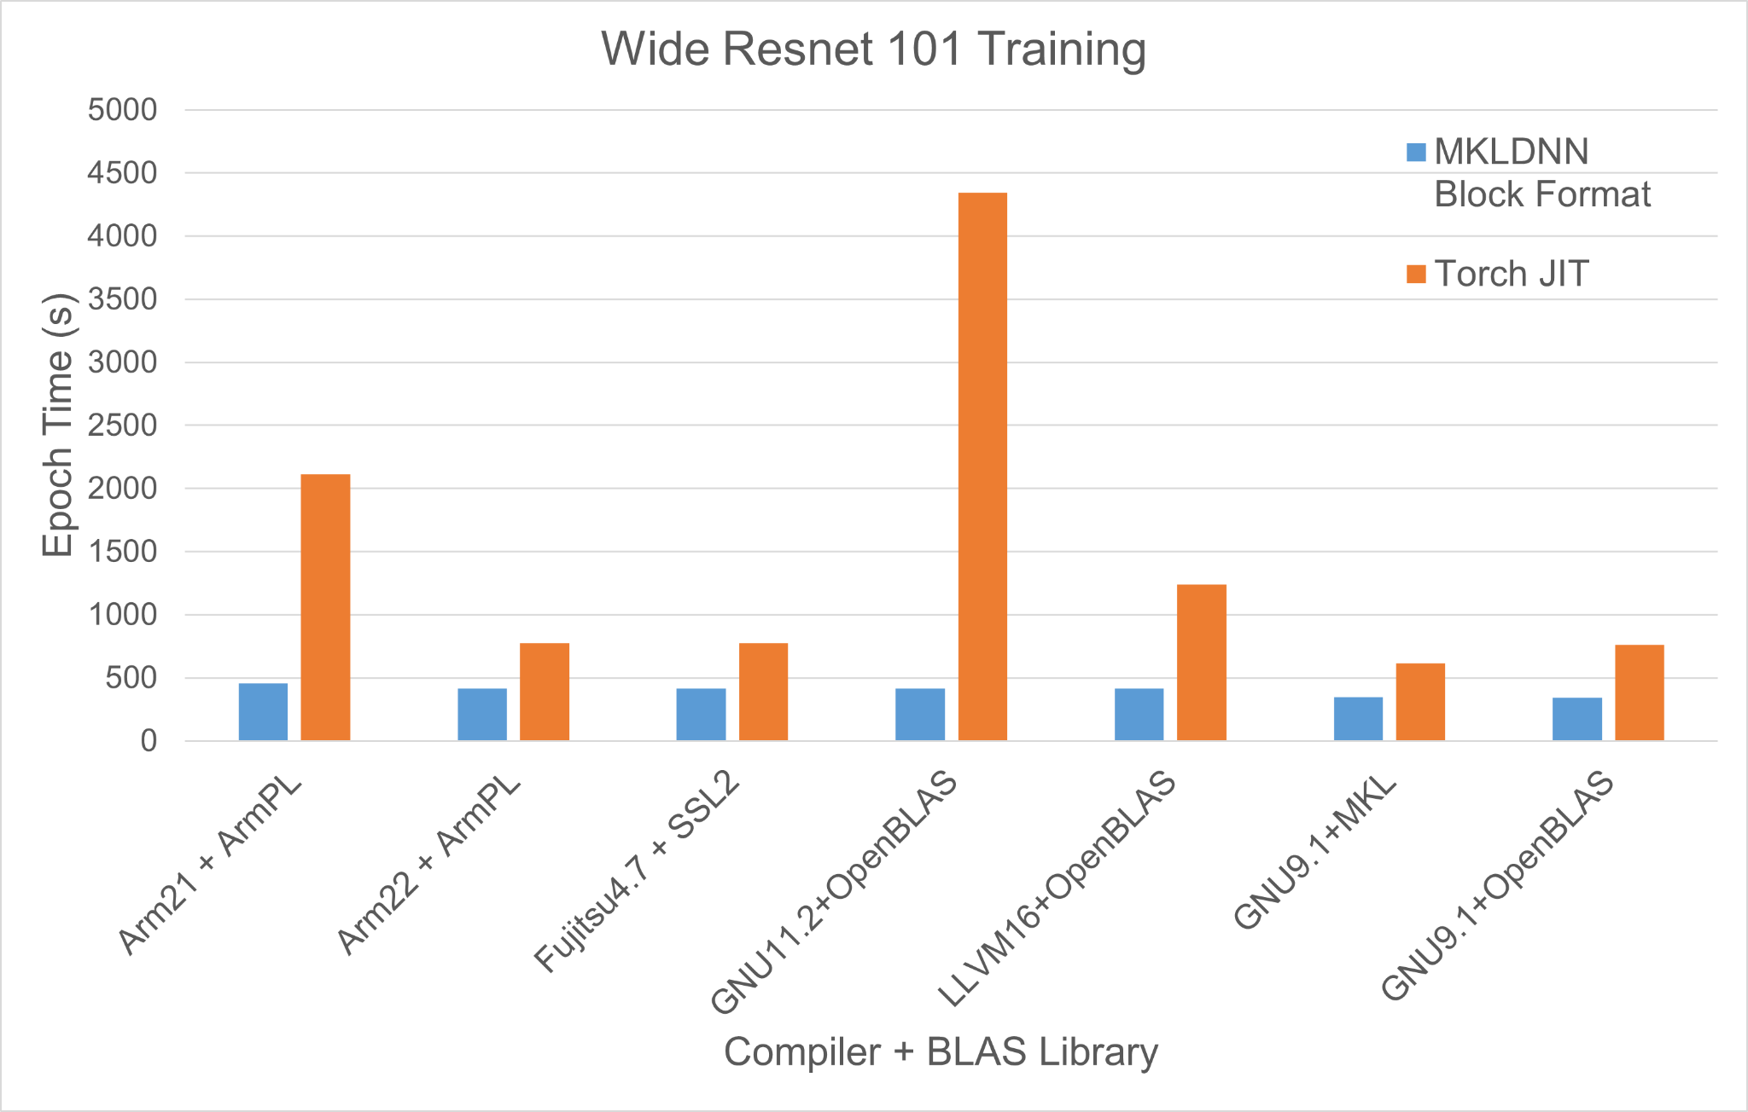
Evaluation: Single Node
Training Time per Epoch (lower is better)

Slide 16
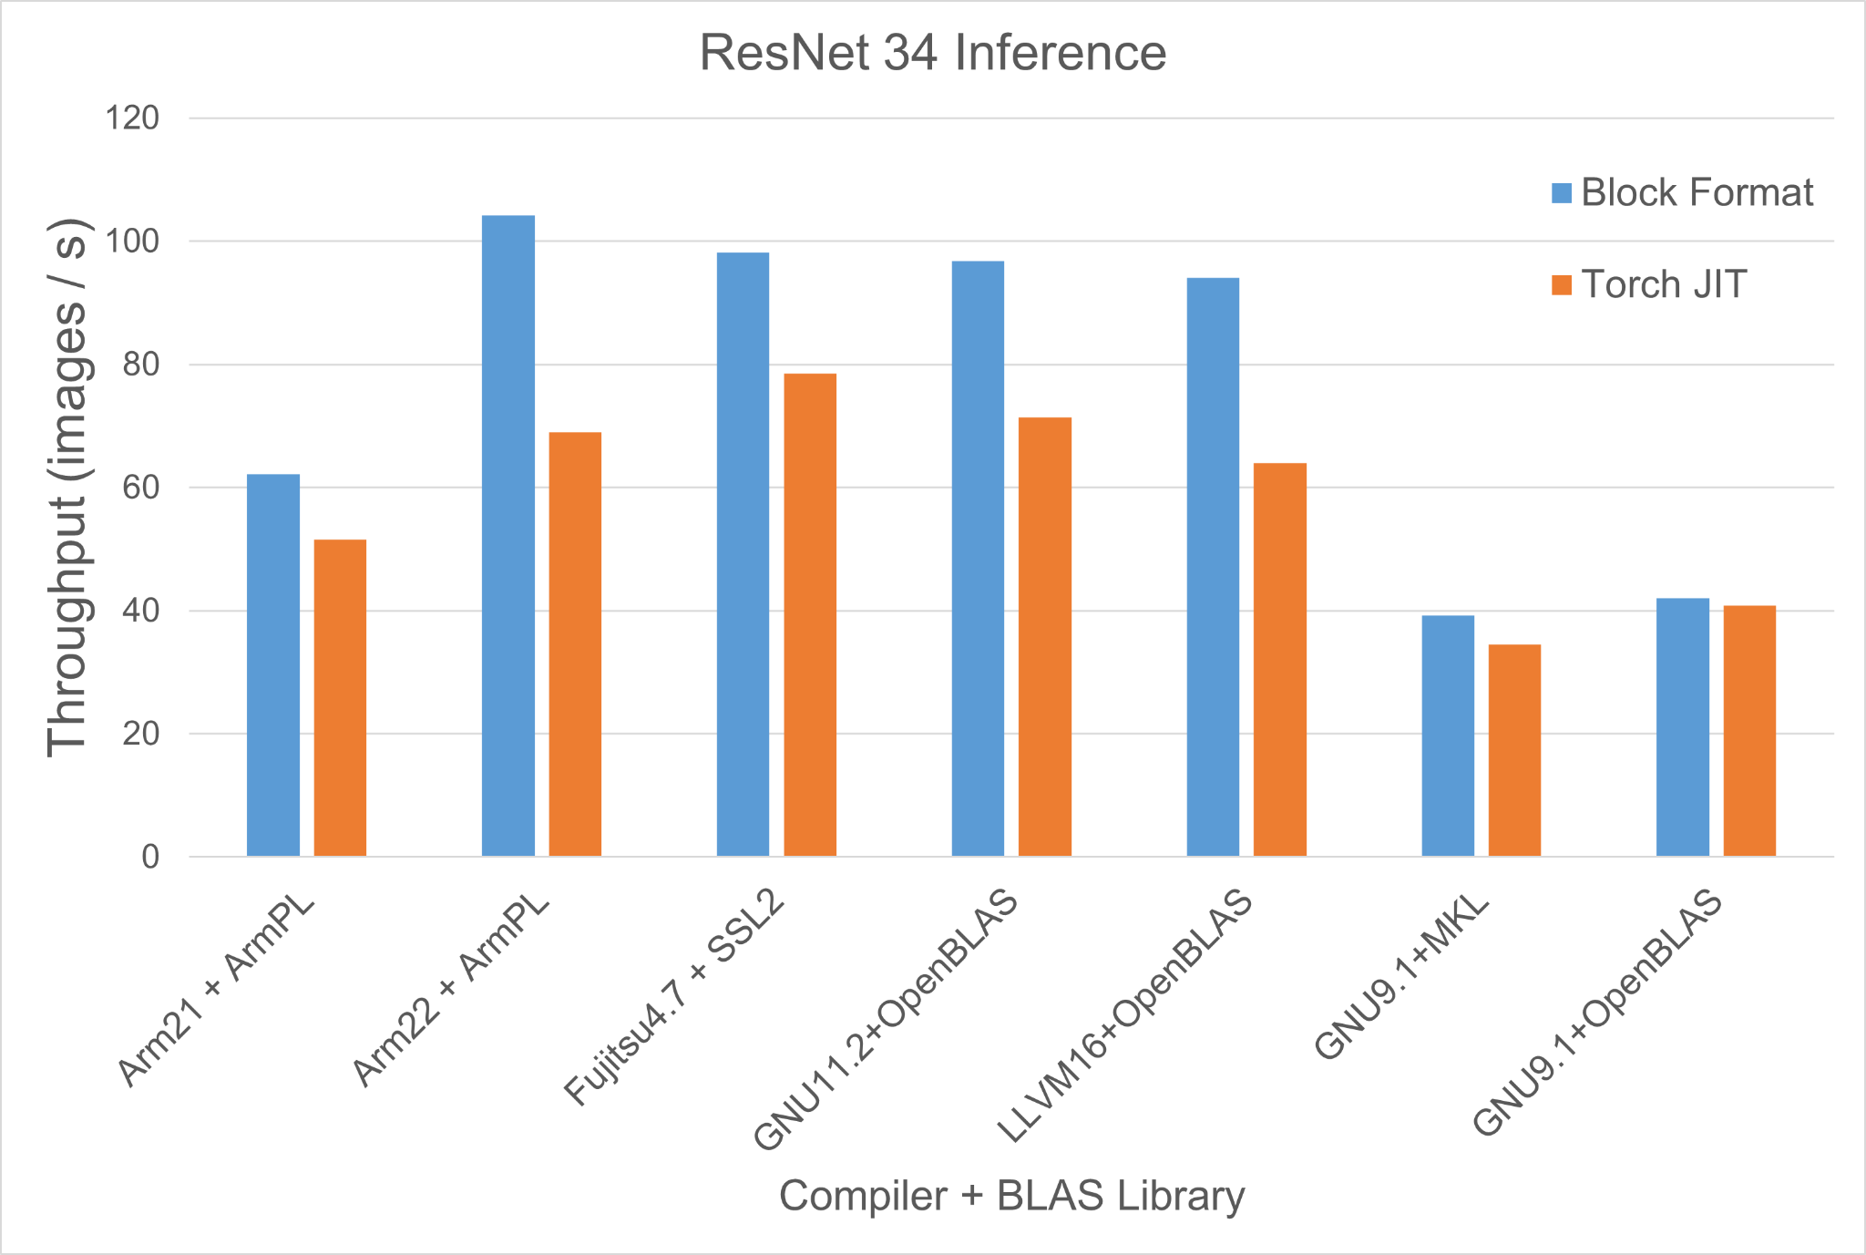
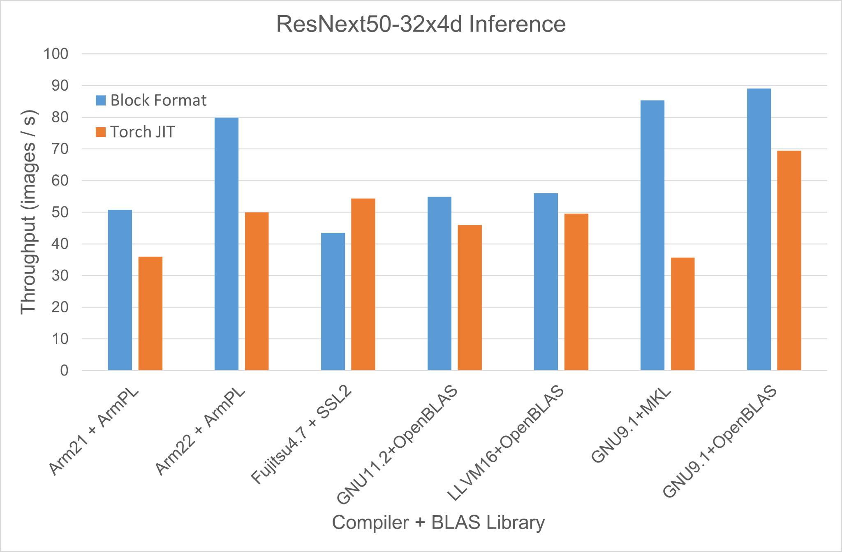
Evaluation: Single Node
Inference Throughput (higher is better)

Slide 17
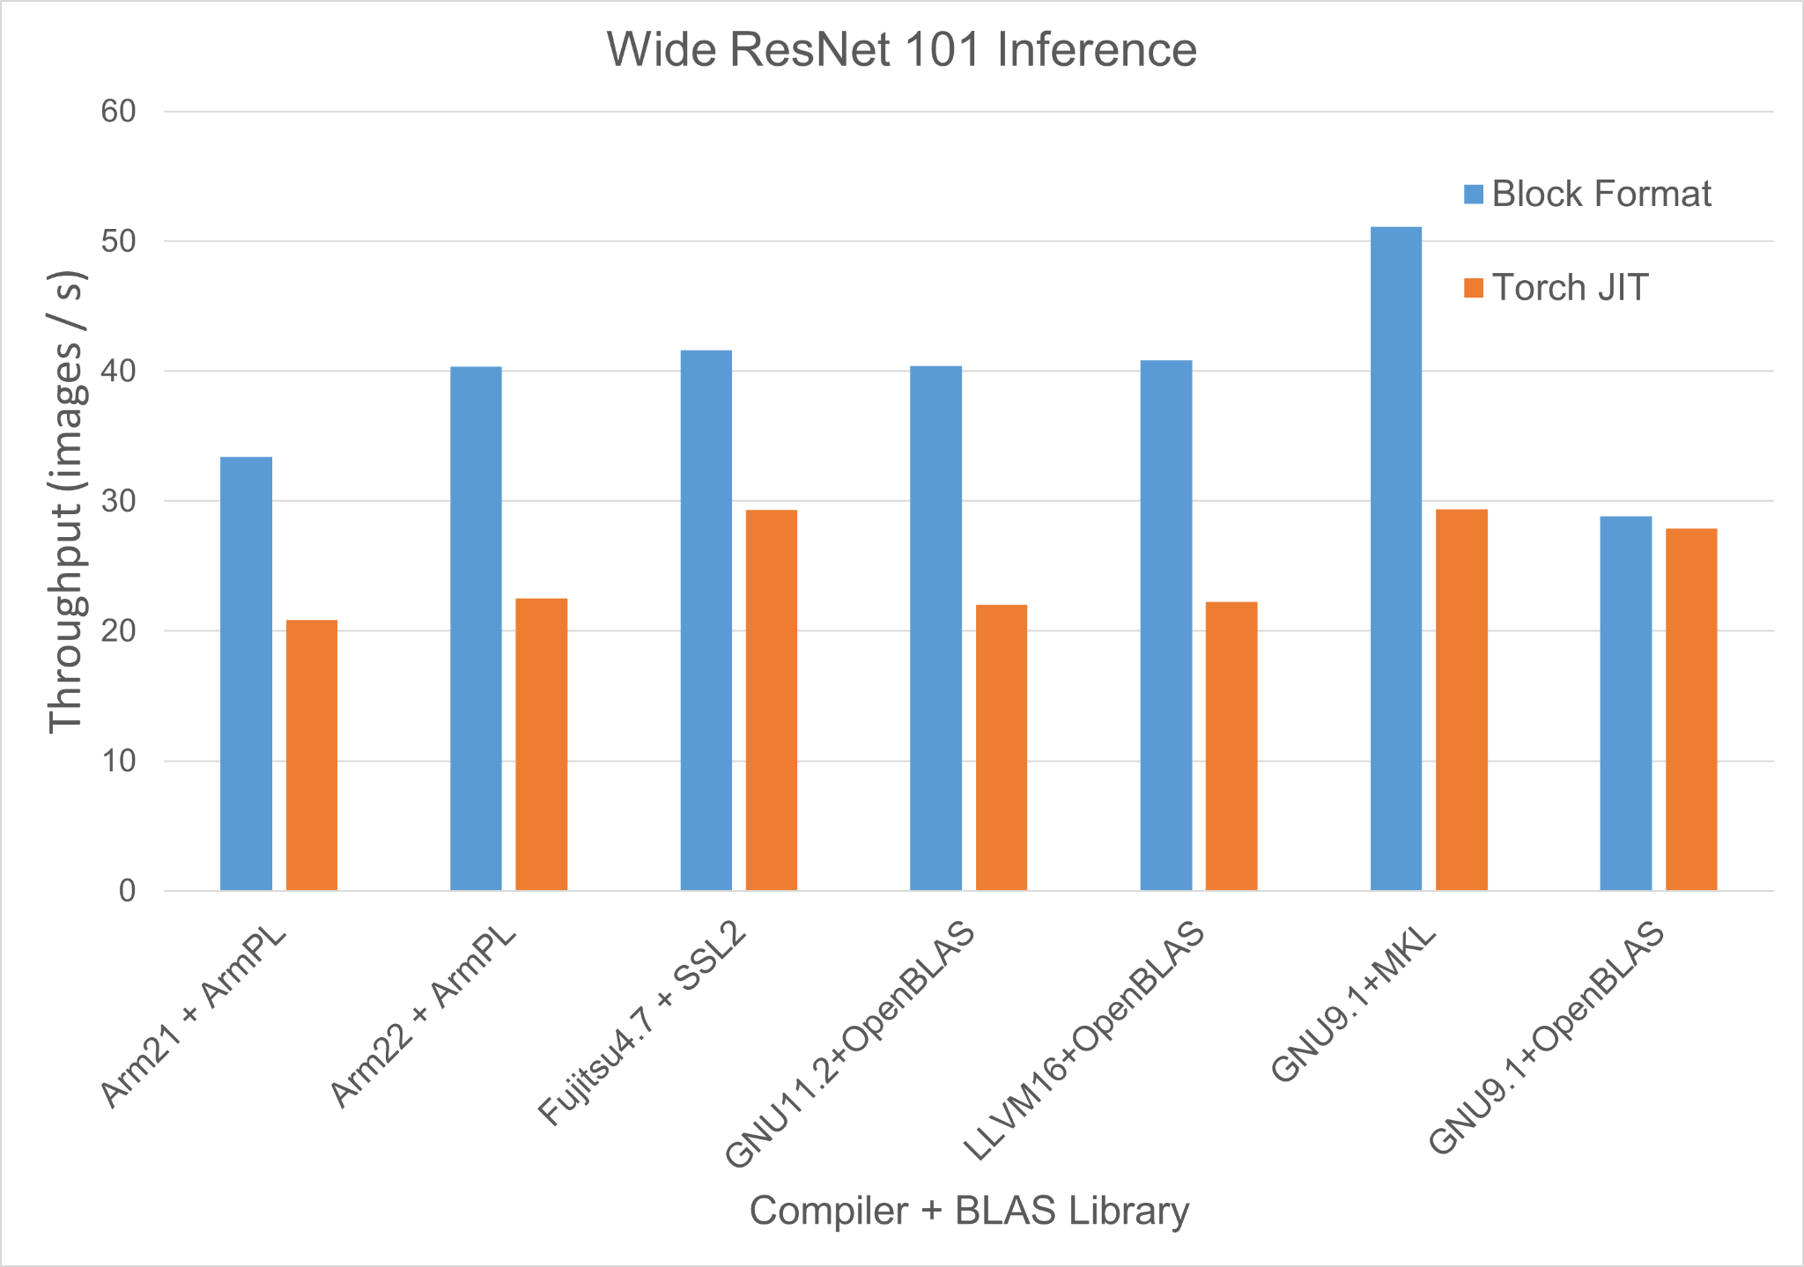
Evaluation: Single Node
Inference Throughput (higher is better)

Slide 18
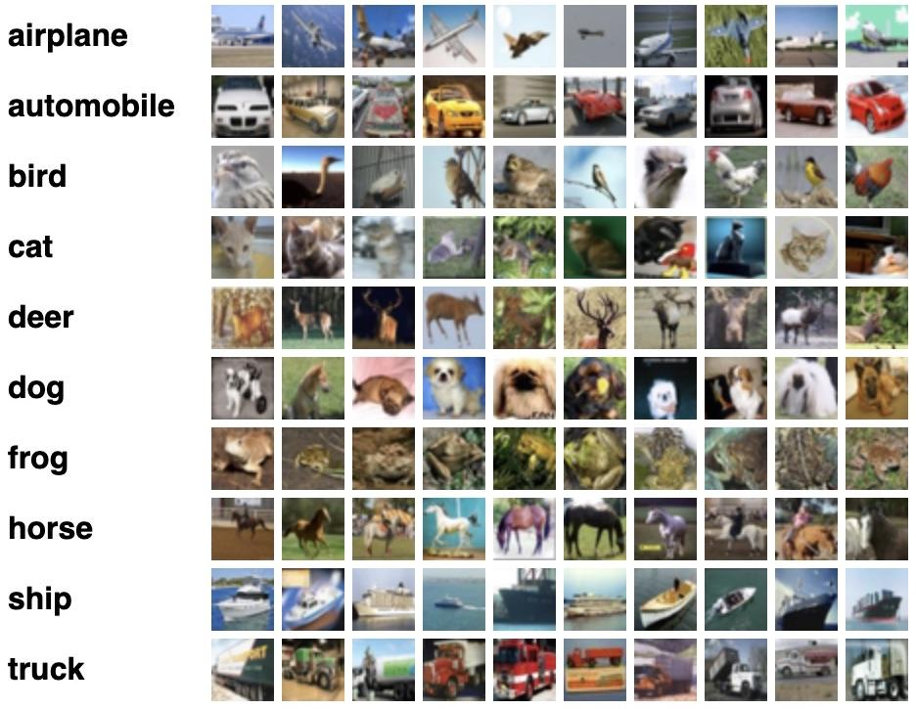
Evaluation: Multi Node
Dataset: CIFAR-10* - 10 classes, 60000 images
Train batch size = 128 images
Training : 50,000 images Transforms : Resizing, tensor conversion, normalization
Evaluation : 10,000 images Transforms : Resizing, tensor conversion, normalization
Process mapping achieved by --map-by flag
Weak-scaling runs upto 128 nodes

Slide 19
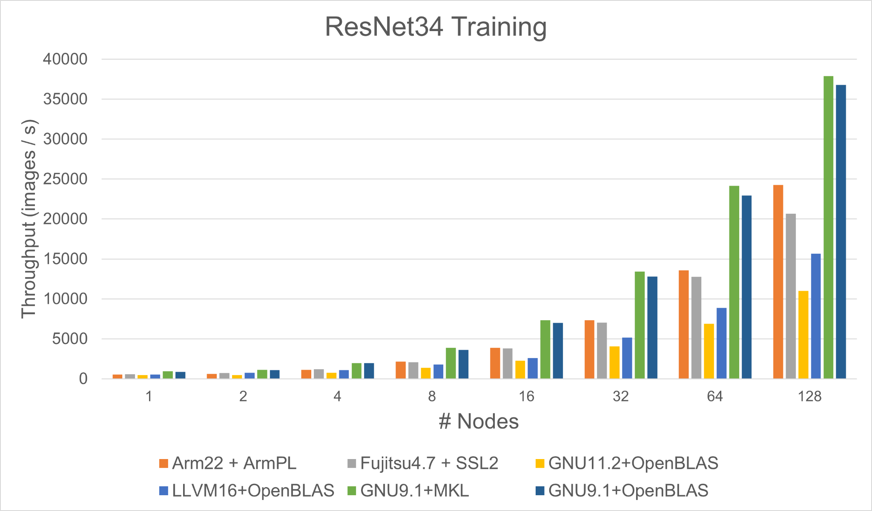
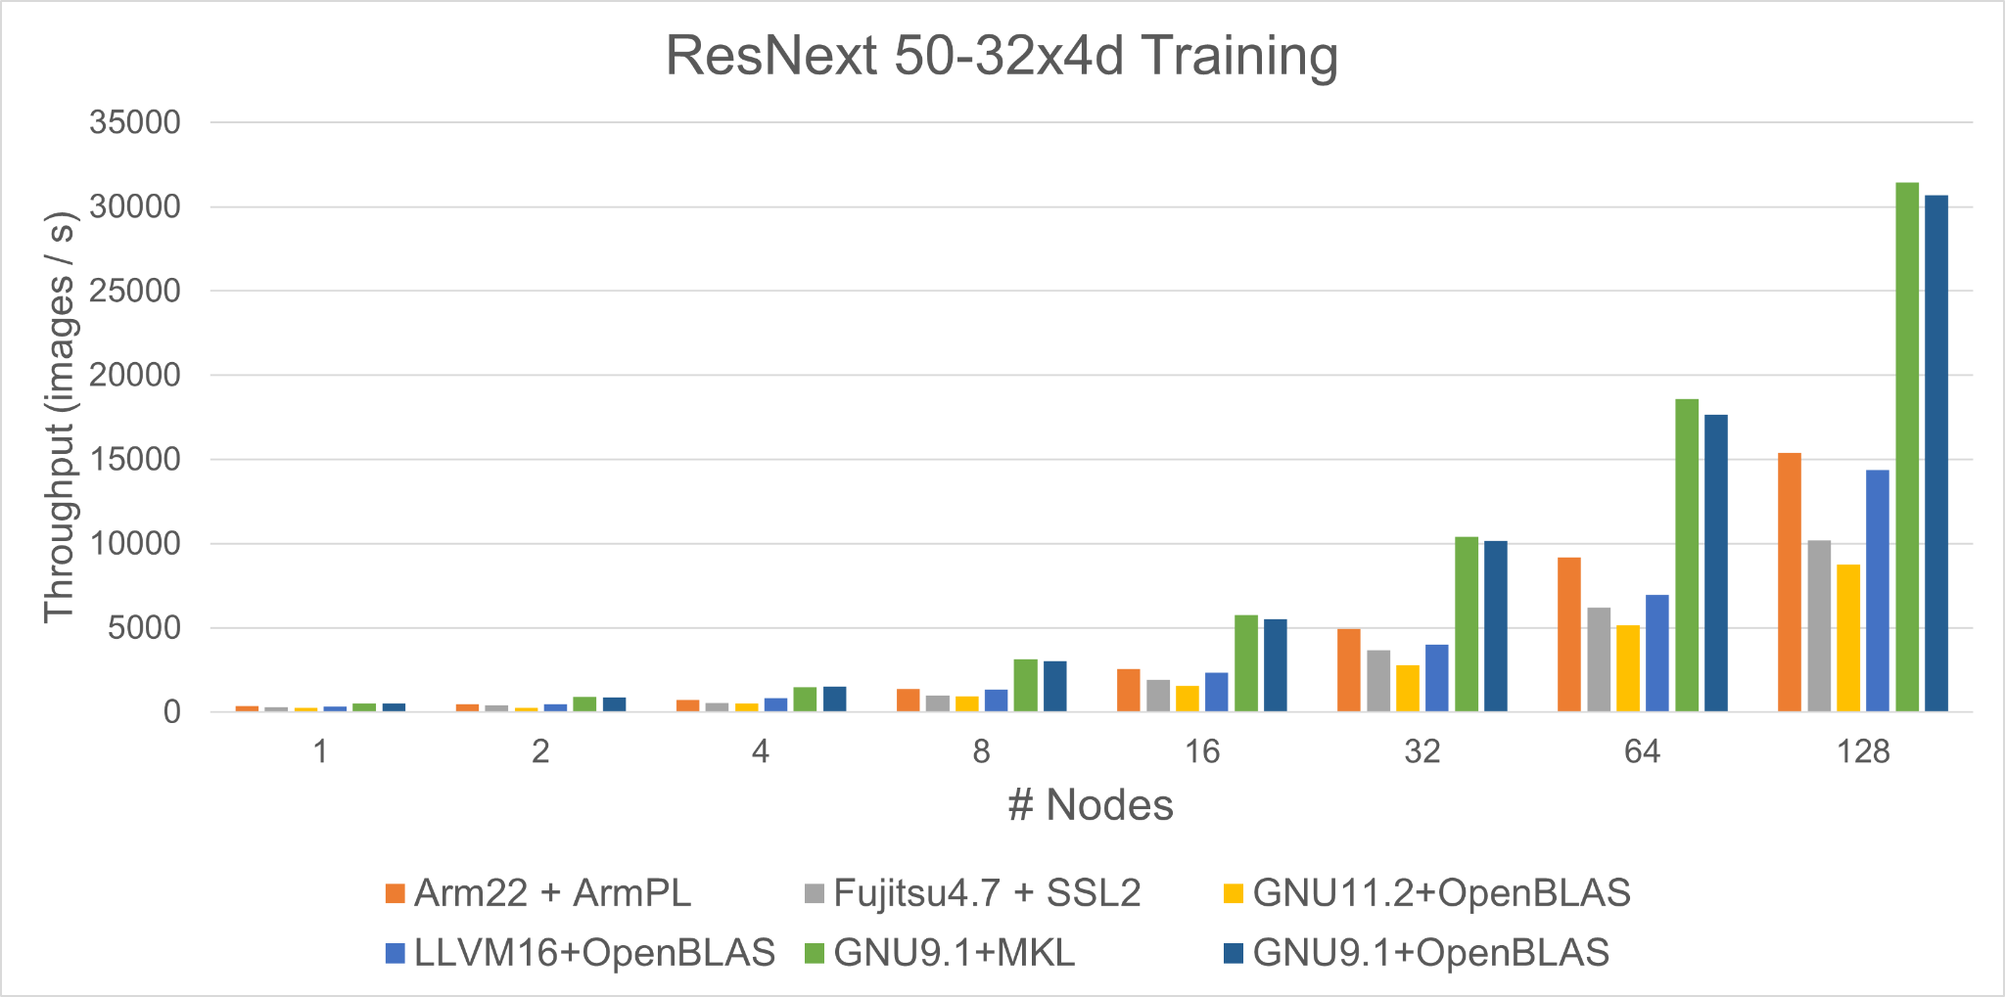
Evaluation: Multi Node
Training Throughput (higher is better)

Slide 20
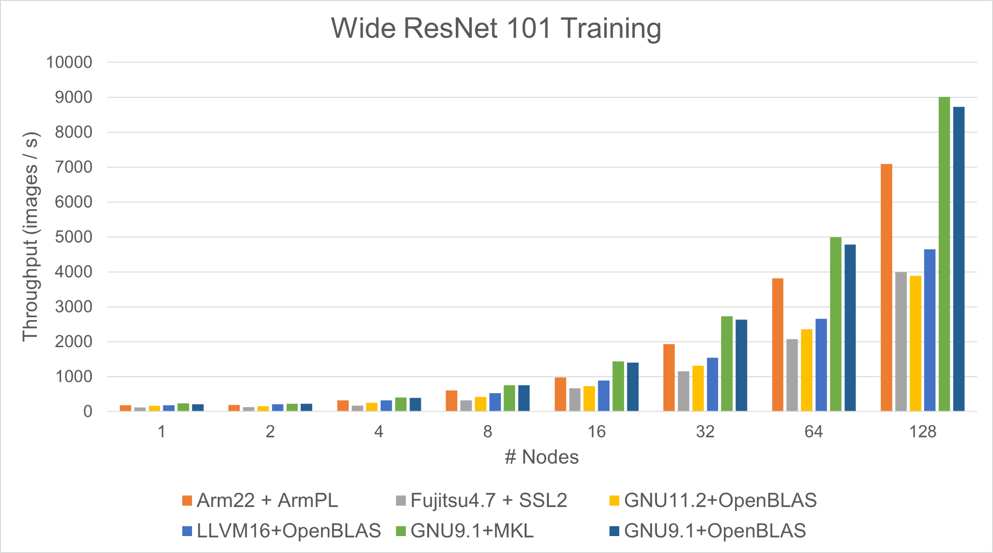
Evaluation: Multi Node
Training Throughput (higher is better)

Slide 21
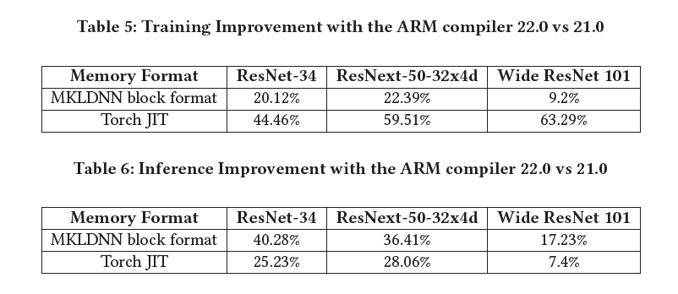
Evaluation: ARM Compiler improvements
We see a significant performance improvement for the ARM compiler environment.
The following tables show the improvement in training times and inference throughput with the new ARM compiler

Slide 22
Observations
ARM toolchain delivers high throughput when scaled but tuning is required.
Transforms applied to images increase the memory usage of the application and one must be careful while running their application on A64FX. One may tune batch size and transforms as needed.
The new ARM compiler environment (22.0) has significant improvements compared to the previous major version (21.0).
GCC-compiled PyTorch does not scale as expected and this warrants a thorough investigation.
512 bit SVE optimized kernels perform comparably with AVX512 optimized kernels in benchDNN.
As seen in the benchdnn results, backward passes are significantly slower for some problems on A64FX compared to Skylake.
The VNNI instructions of the extended AVX512 ISA show significant reduction in processing time.
Notes:
CEES Computing the Sky at Extreme Scales
(CEED discretization is Computational Engineering and Energy sciences)

Slide 23
Conclusion
A64FX processor can be used to scale ML workloads, and a tuned environment plays a crucial role.
Performance of applications are dependent on the compiler used to build the stack.
Poor overlap of computation and communication. Improving this can better help scale applications on the Ookami cluster.
Missing evaluation of PyTorch’s native DistributedDataParallel framework.
Missing evaluation of other models and benchmark applications such as large language models.
Notes:
Not a uniform model today! MPI is a library; omp is compiled; cude proprietary API

Slide 24
Acknowledgments
The authors would like to thank Stony Brook Research Computing and Cyberinfrastructure, and the Institute for Advanced Computational Science at Stony Brook University for access to the innovative high-performance Ookami computing system, which was made possible by a 5M National Science Foundation grant (1927880).
The software was tested, in part, on facilities run by the Scientific Computing Core of the Flatiron Institute.
The authors acknowledge the Texas Advanced Computing Center (TACC) at The University of Texas at Austin for providing HPC resources that have contributed to the research results reported within this paper.
The authors would like to thank the Ookami project and the community for their support. The authors also thank Géraud Krawezik for providing access to compute resources and helpful discussions in setting up the environment at the Flatiron Institute.

Slide 25
Thank you!

