Slide 1
TrustZone Features in Cortex-M33

Slide 2
Learning Objectives
Define TrustZone and state why single processor isolation is important.
Outline the memory partition of the processor when TrustZone Security Extension is implemented.
Outline the function call mechanism between both TrustZone worlds
Outline the instructions for switching between states
Describe the Attribution units including their functions and outline the SAU registers.
Outline the security requirements addressed by TrustZone

Slide 3
Outline
Motivations
Definition of TrustZone
Secure an d Non-secure worlds
Attribution units
Security requirements addressed by TrustZone

Slide 4
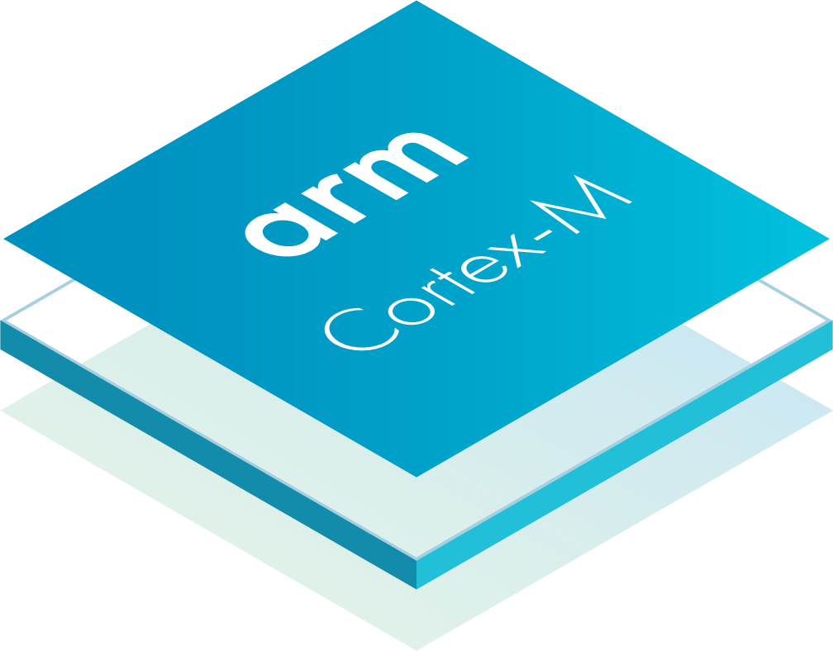
Introduction: Motivation
Two CPUs isolated from each other
IoT devices and embedded systems face the demand for Secure asset protection.
Assets that need protection could be:
Communication Protection
Data protection
Firmware protection
Operation protection
Tamper protection
One method is to isolate data and assets that need security in a different processor.
Is there a better way?
Notes:
Communication Protection: using cryptography and other authentication methods to prevent unauthorized access to data being transferred.
Data Protection: for secret data such as keys, certificates, passwords, biometric data, and personal information
Firmware Protection: prevents against IP theft and reverse engineering of firmware
Operation protection: to maintain critical service from malicious intentional failure
Tamper protection: prevents the protection system from being by-passed

Slide 5

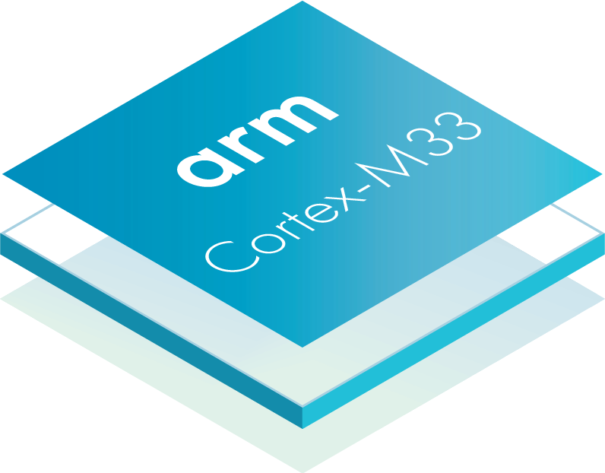
Introduction to TrustZone
What is TrustZone?
TrustZone technology for ARMv8-M is a Security Extension that is implemented to provide Trusted Execution Environments for improved system security in a wide range of embedded applications to prevent untrusted applications from accessing security critical resources.
TrustZone technology for ARMv8-M is an optional

Slide 6

One processor isolation: Benefits
Secure and Non-secure worlds exist in one processor
Switching is done in hardware with following advantages
faster transitions
improved power efficiency
Lower device cost
Efficient isolation
Industry standard
Developer friendly
ability to service interrupt requests while running Secure code is critical.
Non-secure
Secure
Firmware
Secure services
Data
Secure firmware
Firmware
Secure data
Peripherals
Memory
CPU resources

Slide 7
TrustZone in Cortex-M vs Cortex –A (1)
TrustZone technology is not a new concept –
Available on Arm Cortex-A series processors for several years
Now extended to cover ARMv8-M processors.
Non-secure
Secure
Firmware
Secure services
Data
Secure firmware
Firmware
Secure data
Peripherals
Memory
CPU resources

Slide 8
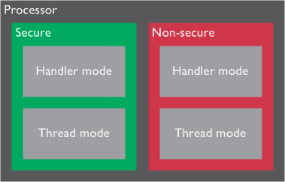
TrustZone in Cortex-M vs Cortex –A (2)
TrustZone technology for ARMv8-M and in Arm Cortex-A processors appear to be similar at a high level .
Secure and Non-secure states
Non-secure software able to access to Non-secure memories only.
TrustZone technology for ARMv8-M is designed with small energy-efficient systems in mind.
In ARMv8-M Secure and Normal worlds are memory map based and the transitions takes place automatically in exception handling code.

Slide 9
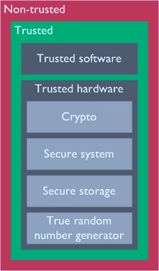
Two worlds: memory partitioning
Secure (Trusted) and Non-secure (Non-trusted) software can work together,
Non-secure applications cannot directly access Secure resources.
Non-secure applications have to go through APIs provided by Secure software,
APIs implement authentications to decide if access to the Secure service is permitted.
Examples of security critical components include:
A Secure boot loader.
Secret keys.
Flash programming support.
High value assets.
Notes:
Why use Logical Effort?
This method gives the ability to estimate a delay so that we can design with the least propagation delay.

Slide 10
Memory Partition
When TrustZone Security Extension is implemented the
4GB memory space is partitioned into Secure and Non-secure memory regions.
The Secure memory space is further divided into two types:
Secure
Non-secure callable
Cortex-M standard 4GB linear address map
Example partition with TrustZone
0xFFFFFFFF
Various, CPU controlled
System region
System components
and debug
0xE0000000
Secure
Device region
Off-chip peripherals
Non secure
0xA0000000
Secure
RAM region
Off-chip memory
Non secure
0x60000000
Peripheral region
Peripherals
Secure
Non secure
0x40000000
SRAM region
SRAM
Secure
Non secure
0x20000000
Secure
CODE region
Program flash
Non secure
0x00000000

Slide 11
Secure World (S)
Secure addresses define memory and peripherals that are only accessible by Secure software or Secure Requesters.
Non-secure Callable (NSC)
NSC is a special type of Secure location. This memory holds a Secure Gateway (SG) instruction that enables software to transition from Non-secure to Secure state.
When a Non-secure code calls a Secure code, SG marks it if it is a valid branch target.
NSC memory regions contain tables of small branch veneers (entry points).
Secure Gateway(SG) instruction prevents Non-secure applications from branching into invalid entry points.

Slide 12
Function call mechanism
When a Non-secure program calls a function in the Secure side:
The first instruction in the API must be an SG instruction.
The SG instruction must be in an NSC region, which is defined by the Secure Attribution Unit (SAU) or Implementation Defined Attribution Unit (IDAU).
The reason for introducing NSC memory is to:
Secure program code containing binary data can be securely placed in a Secure region without direct exposure to the Normal world, and can only be accessed using valid entry points in NSC memory.
Memory
Secure
API
Non-secure callable
SG
Non-secure
Non-secure applications

Slide 13
Function call mechanism: Non-secure to Secure
Non-secure memory
Secure memory (Non-secure callable)
NonSecureFunc: BL Func_A_Entry
<Non-secure code>
Func_A_Entry
: SG
<Secure code>
BXNS lr
Call
Enter Secure state
Return to NS

Slide 14
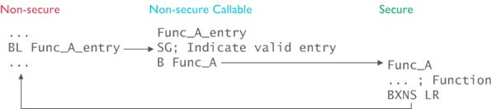
Function call mechanism: Non-secure to Secure
Func_A resides in the Secure world

Slide 15
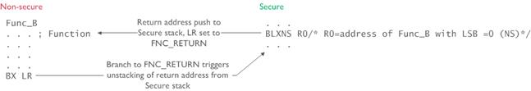
Function call mechanism: Secure to Non-secure
Func_B resides in the Non-secure world

Slide 16
Instructions for switching between states
SG
Secure gateway.
Used for switching from Non-secure to Secure state at the first instruction of Secure entry point.
BXNS
Branch with exchange to Non-secure state.
Used by Secure software to branch or return to Non-secure program.
BLXNS
Branch with link and exchange to Non-secure state.
Used by Secure software to call Non-secure functions.

Slide 17
Non-secure (NS)
Non-secure addresses define memory and peripherals accessible by all software running on the device.
Non-secure transactions are those that
Originate from Requesters operating as, or deemed to be, Non-secure or
From Secure Requesters accessing a Non-secure address.
Non-secure transactions are
Can only access NS addresses, and
NS transactions are denied access to Secure addresses.

Slide 18
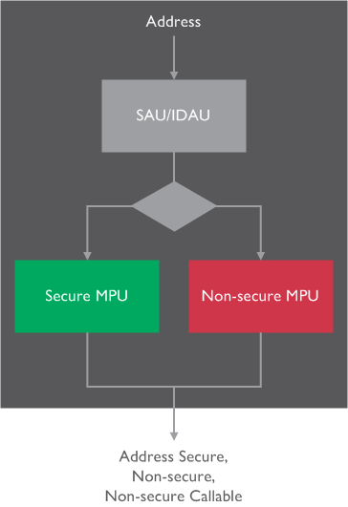
Attribution units (SAU and IDAU)
Secure Attribution Unit (SAU) or Implementation Defined Attribution Unit (IDAU) control the Security state of the memory region.
SAU is internal while IDAU is external
The number of SAU regions is defined during the implementation of the processor. The SAU is disabled at reset.

Slide 19
Attribution units (SAU and IDAU)
If no SAU regions are defined, or the SAU is disabled, and no IDAU is included in the system
then the entire memory address space is defined as Secure and the processor is not able to switch to Non-secure state.
Any attempt to switch to Non-secure state results in a fault. This is the default state of the processor.

Slide 20
Attribution units (SAU and IDAU)
The designer of a microcontroller or SoC device divides the memory spaces into Secure and Non-secure areas.
Software defines some of the regions using the Secure Attribution Unit (SAU), or by device-specific controller logic that is connected to a special Implementation Defined Attribution Unit (IDAU) interface on the processor.
The memory partitioning is also used to define peripherals as Secure or Non-secure.

Slide 21
Attribution units (SAU and IDAU)
The SAU and IDAU also define region numbers for each of the memory regions. The region numbers are 8-bit, and are used by the Test Target(TT) instruction to allow software to determine access permissions and security attribute of objects in memory.
The SAU is only implemented if the ARMv8-M Security Extension is included in the processor. The number of regions that are included in the SAU can be configured to be either 0, 4 or 8.
The SAU can only be programmed in Secure state. Regions are programmed using the SAU Region number Register (SAU_RNR), SAU Region base Address Register (SAU_RBAR), and SAU Region Limit Address Register (SAU_RLAR). The SAU can be enabled using the SAU Control Register (SAU_CTRL).

Slide 22
SAU register summary
Each of the SAU registers is 32 bits wide.
Address | Name | Type | Reset value | Processor Security state | Description
0xE000EDD0 | SAU_CTRL | RW | 0x00000000 | Secure | SAU Control register
 |  |  |  | Non-secure | RAZ/WI
0xE000EDD4 | SAU_TYPE | RO | 0x0000000x | Secure | SAU Type register. Indicates the number of available regions
 |  |  |  | Non-secure | RAZ/WI
0xE000EDD8 | SAU_RNR | RW | UNKNOWN | Secure | SAU Region Number Register. Selects a region.
 |  |  |  | Non-secure | RAZ/WI
0xE000EDDC | SAU_RBAR | RW | UNKNOWN | Secure | SAU Region Base Address Register
 |  |  |  | Non-secure | RAZ/WI
0xE000EDE0 | SAU_RLAR | RW | UNKNOWN | Secure | SAU Region Limit Address Register
 |  |  |  | Non-secure | RAZ/WI

Slide 23
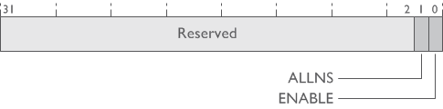
SAU_CTRL register
SAU_CTRL register characteristics:
Bits | Field | Description
[31:2] | Reserved - read as 0 | Reserved
1 | ALLNS | All Non-secure. When SAU_CTRL.ENABLE is 0 this bit controls if the memory is marked as Non-secure or Secure.
0 | ENABLE | Enable. Enables the SAU.

Slide 24

SAU_TYPE register
Bits | Field | Description
[31:8] | Reserved-read as 0 | -
[7:0] | SREGION | SAU regions. The number of implemented SAU regions.

Slide 25

SAU_RNR register
Bits | Field | Description
[31:8] | Reserved - read as 0 | -
[7:0] | REGION | Region number. Indicates the SAU region that SAU_RBAR and SAU_RLAR accesses.

Slide 26

SAU_CTRL register
Bits | Field | Description
[31:5] | BADDR | Base address. Holds bits [31:5] of the base address for the selected SAU region.
[4:0] | Reserved - read as 0 | -

Slide 27
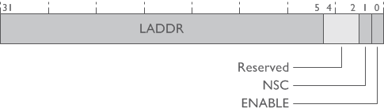
SAU_RLAR register
Bits | Field | Description
31:5 | LADDR | Limit address [31:5]. Bits [4:0] of the limit address are defined as 0x1F
4:2 | RES0 | -
1 | NSC | 0 Region is not Non-secure callable1 Region is Non-secure callable
0 | ENABLE | 0 SAU region is enabled1 SAU region is enabled

Slide 28
IDAU interface, IDAU, and memory map
The IDAU is used to indicate to the processor if a particular memory address is Secure, Non-secure Callable (NSC), or Non-secure, and provides the region number within which the memory address resides.
It can also mark a memory region to be exempted from security checking, for example, a ROM table.
The IDAU interface in general is processor-specific. However, there is a high similarity between the IDAU interfaces on different Cortex-M processors.

Slide 29
Security requirements addressed by TrustZone
Security which could mean many different things can include, but is not limited to:
Communication protection
Prevents data transfers from being visible to, or intercepted by unauthorized parties and might include other techniques such as cryptography.
Data protection
Prevents unauthorized parties accessing secret data that is stored inside devices.
Firmware protection
Prevents on-chip firmware from being reverse engineered.
Operation protection
Prevents critical operations from malicious intentional failure.

Slide 30
Security requirements addressed by TrustZone
Tamper protection
In many security sensitive products, anti-tampering features are required to prevent the operation or protection mechanisms of the device from being overridden.
Data protection
Sensitive data can be stored in Secure memory spaces and can only be accessed by Secure software. Non-secure software can only gain access to Secure APIs providing services to the Non-secure domain, and only after security checks or authentication.
Firmware protection
Firmware that is preloaded can be stored in Secure memories to prevent it from being reverse engineered and compromised by malicious attacks. TrustZone technology for ARMv8-M can also work with extra protection techniques. For example, device level read-out protection, a technique that is commonly used in the industry today, can be used with TrustZone technology for ARMv8-M to protect the completed firmware of the final product.

Slide 31
Security requirements addressed by TrustZone
Operation protection
Software for critical operations can be preloaded as Secure firmware and the appropriate peripherals can be configured to permit access from the Secure state only. In this way, the operations can be protected from intrusion from the Non-secure side.
Secure boot
The Secure boot mechanism enables you to have confidence in the platform, as it will always boot from Secure memory.

