Slide 1
Introduction to Graphics and Mobile Gaming

Slide 2
Module Syllabus
Introduction to Graphics Processing
The Fundamentals of 3D Objects
Vertices, Primitives, Color and Texture, Lighting
3D Coordinate Systems
How Data is Processed
Rendering Pipeline
Graphics APIs: Open Graphics Library (OpenGL), OpenGL ES, and Vulkan
Open GL ES and Vulkan Pipelines
Graphic Processing Unit (GPU)
Use of Game Engines
What is a Game Engine?
Unity
Notes:
In this module, we provide a brief view of this course and introduce you to the basics of 3D graphics. We will describe what 3D data is and how it is processed inside a GPU.
We will also introduce the OpenGL ES along with Vulkan API and explain how rendering is pipelined inside an Arm Mali GPU.
Finally, we will introduce the basic concept of a game engine and how it can accelerate the game development process.

Slide 3
Introduction to Graphics Processing
Graphics processing includes:
Creating pictures and videos
Displaying image data
Processing data received from the physical world
Graphics processing has been widely used in:
Movies and animation
Video games
Graphic design
Advertising

Slide 4
Introduction to Graphics Processing
Graphic processing requires knowledge on a wide range of topics including:
Graphics Application Programming Interfaces (APIs)
Shader programming
Graphic Processing Unit (GPU) programming
Vector graphics processing
3D modeling
Sprite graphics
User Interface (UI) design
Notes:
A wide range of techniques are used in graphics processing, including:
Graphics Application Programming Interface (API), which interacts with the Graphic Processing Unit (GPU) to render 2D and 3D vector graphics efficiently and productively, e.g., OpenGL, OpenGL ES, DirectX
Shader programming, which depicts levels of depth perception or darkness in 3D modeling and produces special effects for image and videos
GPU programming, which uses a dedicated processor to accelerate the creation and manipulation of images
Vector graphics processing, which processes images using polygons
3D modeling, which presents object (sprite) surfaces mathematically in three dimensions
Sprite graphics, which process a 2D or 3D image or animation and integrate it into a large scene
User Interface (UI) design, which ensures that users interact with the graphics as simply and efficiently as possible

Slide 5
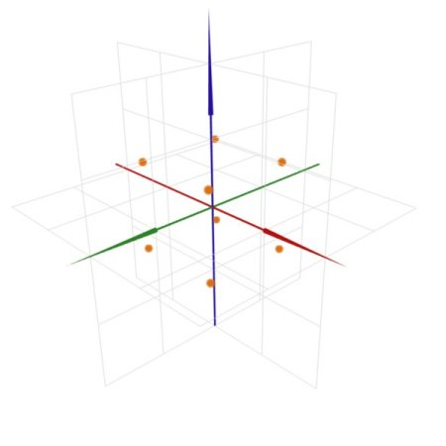
The Fundamentals of 3D Objects
Start with a set of points, or vertices, defined by their spatial coordinates [x, y, z]
Notes:
This section provides a short introduction to the fundamentals of 3D objects and defines 3D data.
The first point to note is that everything starts from vertices. Vertices joined together can make a shape. Vertices are usually presented in 3D as [x, y, z]. The image shows the eight vertices of a cube.

Slide 6
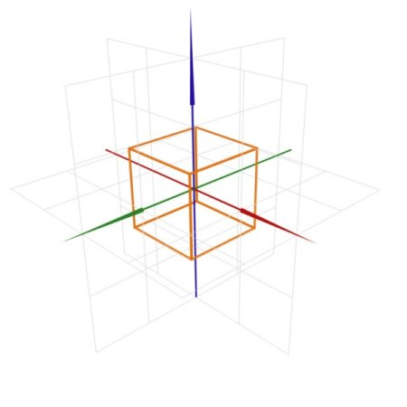
The Fundamentals of 3D Objects
Start with a set of points, or vertices, defined by their spatial coordinates [x, y, z]
The points are linked into a series of primitives, most often triangles, that represent the original shape
Notes:
With vertices, we can construct primitives (usually points, lines, or triangles). We use triangles in preference to quads and N-gons because they are always flat and simpler to process in hardware. Even if the software API includes quad or N-gon support, it is usually broken into triangles for the hardware. In this image, the vertices construct a cube with six faces, which can also be presented as twelve triangles.

Slide 7
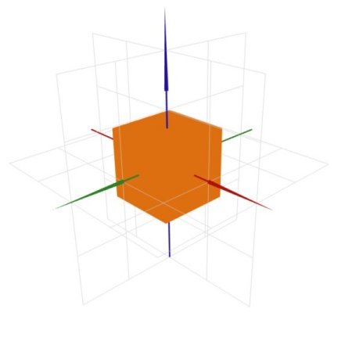
The Fundamentals of 3D Objects
Start with a set of points, or vertices, defined by their spatial coordinates [x, y, z]
The points are linked into a series of primitives, most often triangles, that represent the original shape
The faces of the triangles are filled in with colors and/or textures
Notes:
Once we have the primitives, we can add effects, such as colors and textures, to the primitive’s faces. In this image, the six faces of the primitive are textured with an orange color.

Slide 8
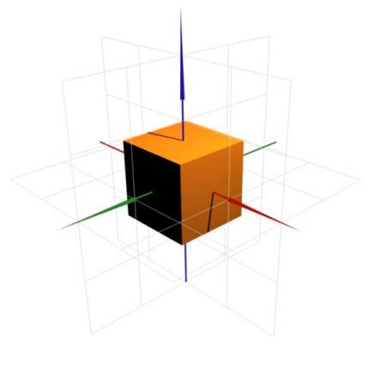
The Fundamentals of 3D Objects
Start with a set of points, or vertices, defined by their spatial coordinates [x, y, z]
The points are linked into a series of primitives, most often triangles, that represent the original shape
The faces of the triangles are filled in with colors and/or textures
Lighting and shadow significantly improve the visual effect, and our ability to accurately interpret the 3D shape of the scene
Notes:
Finally, we need to give the primitive light and shadows to make it look more real.
The art of 3D graphics is smoke and mirrors, approximations, all designed to fool the human eye. Textures are just ways of changing the surface appearance, often designed to mimic a particular material, such as brick, wood, etc. Additional effects and colors can give the illusion of lighting, shadows, etc.

Slide 9
3D Coordinate Systems
3D programs commonly use a number of concurrent coordinate representations
Object-space
Used for inter-object locations
Notes:
Now we need to present the object in our viewport. This is similar to using a camera to take a picture of a scene.
Object-space coordinates (also known as model-space coordinates) are typically relative to a local origin used just for that object. This enables a single model to be reused in multiple locations without keeping multiple copies of the vertex data in memory. In this image, the coordinates are fixed at the center of the object. However, the object-space coordinates are not the picture as seen by our eyes.

Slide 10
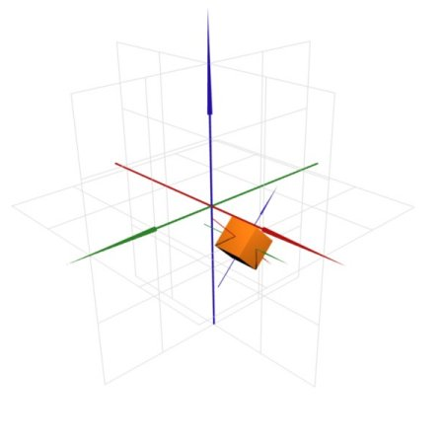
3D Coordinate Systems
3D programs commonly use a number of concurrent coordinate representations
Object-space
Used for inter-object locations
Eye-space
Translates world-space to place camera at origin
Camera looking down negative Z-axis
Notes:
The eye-space coordinates (also known as world-space or eye-coordinates) are the location of each object, which are transformed into the 3D coordinates that the viewer sees.
Finally, we will perform a 2D projection, converting the 3D world-space coordinates into pixels seen by the viewport. This is known as the geometry transform process, and it creates the final picture we see on the screen.

Slide 11
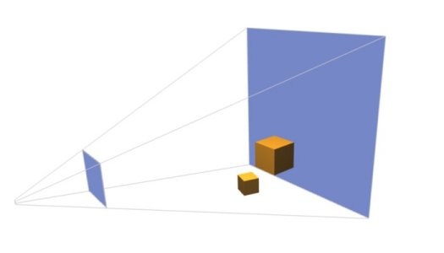
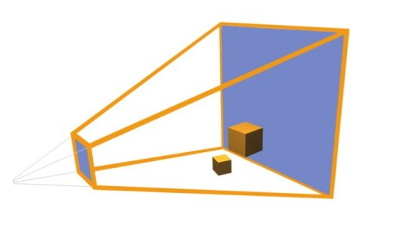
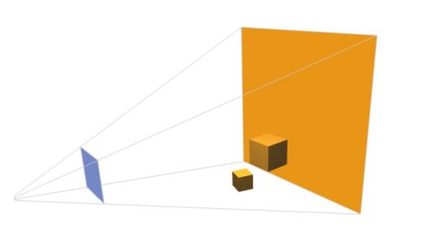
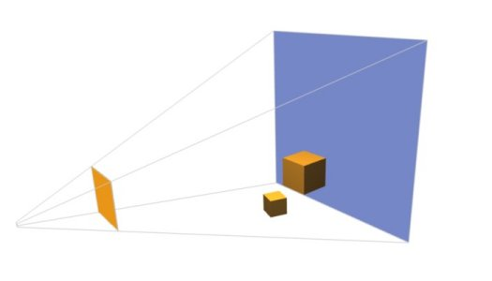

3D Coordinate Systems: Fitting a 3D Scene on a 2D Screen
Application defines a viewing frustum
Encodes desired camera field-of-view and viewing distance
Do not want to spend resources rendering off-screen objects
Primitives partially in the frustum are clipped
Primitives completely outside the frustrum are culled
Far clip-plane
Viewing frustum
Near clip-plane
Notes:
(Animated slide)
This picture explains the geometry transform process, which renders a 3D description of the world onto a 2D flat surface, the viewport (typically the entire screen, or a window in the host OS).
First, the developer configures a projection matrix that determines what objects are visible (the viewing frustum). The viewing frustum is defined by a near clip-plane (or image-plane) and far clip-plane and a pair of viewing angles (vertical and horizontal). Only objects inside the region described by this frustum are displayed to the user.
Here, we are trying to convince the human viewer that the image is indeed 3D, so their perception of perspective is important, i.e., things further away should look smaller. The camera configuration is therefore typically configured as shown in the image: a large square-sided conical viewing frustum. Some applications desire parallel projection (or orthographic projection) in which objects further away are not smaller. This is possible too; it just needs a different projection configuration.
Because we do not want to spend resources rendering off-screen objects, we will clip any objects partly in the frustum (i.e., we only draw the parts that are actually visible) and cull any object completely outside the frustum (i.e., we don’t draw the object at all).
Anything beyond the far plane is culled to reduce processing because you don’t want to process triangles that are unlikely to add to the image’s quality. It is quite common to apply a backdrop image, such as a sky, to the far plane, or to use a fog effect so that everything beyond the far plane vanishes into the fog. The near plane (image plane) stops objects too close to the view port from obliterating the image.

Slide 12

3D Coordinate Systems
3D programs commonly use a number of concurrent coordinate representations
Clip-space
Normalized version of eye-space
Everything between [-1, -1, -1] and [+1, +1, +1] is visible
Screen-space
Projection of 3D eye-space onto a 2D plane, the viewport
Notes:
After the projection, we have the image shown on this screen.
To recap, the object-space coordinates (also known as model-space coordinates) are typically relative to a local origin used just for that object. This enables a single model to be reused in multiple locations without keeping multiple copies of the vertex data in memory. The eye-space coordinates (also known as world-space or eye-coordinates) are the transformed location of each object into the 3D coordinates that the viewer sees. Finally, the 2D projection converts the 3D world-space coordinates into pixels seen by the viewport.

Slide 13
3D Coordinate Systems: Coordinate Space Conversion
Conversion process can be defined as a series of transformations:
Object XYZW
Model Transform
World XYZW
View Transform
Eye XYZW
Screen XY (Z)
Viewport Transform
Clip XYZ
Projection Transform
Notes:
This diagram gives a slightly more technical version of the geometry transform process, indicating critical changes that vertex data typically passes through before getting rendered. After the picture is clipped, a model transformation is performed to include things like rotation, scaling, translation, and skew.
From a hardware perspective, the rendering process may be different from what’s shown above and is decided by the graphics API, e.g., Open GL ES. Graphics APIs vary in terminology, and how much control they give the developer over each of these stages, but the principles of these three transforms exist within all graphics APIs:
Step 1: Take the model co-ordinates and put through a number of model transformations. This places the object at the correct place in the world with respect to the viewer.
Step 2: Take the eye-coordinates through a set of transforms to map the viewable objects (more on the next slide) with respect to the camera. This is typically a normalized step, meaning dimensions are typically scaled to -1 to +1.
Step 3: Take these normalized co-ordinates and convert them into pixel co-ordinates, based on the configuration of the viewport (resolution, aspect ratio).
The reason for the additional W in the vertex data is to allow more transformations between co-ordinate spaces to exist. The extra pseudo-dimension means that we can use some mathematical tricks with 4×4 matrices to express translations that we cannot do with only 3×3 matrices. The mathematics is beyond the scope of this course, but there are plenty of good books on the subject.
OpenGL 1.1 fixed function pipelines use a combined Model and Projection transform, so skip the World XYZW function and move directly from the object coordinates to the eye coordinates. We will learn more about OpenGL in the following slides.

Slide 14
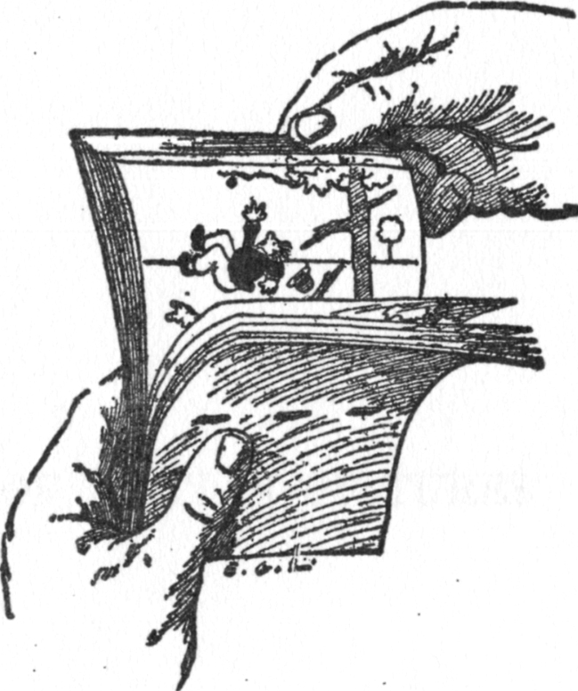
Rendering Pipeline
Real-time rendering operates on the same principle as a flip-book toy
If still frames are rendered fast enough, the illusion of smooth animation is maintained:
Ideally, we want to render at display refresh rate – typically 60 frames per second (FPS)
Flip book
Notes:
From a hardware perspective, real-time rendering operates on the same principle as a flip-book toy. By flicking through screen frames, our eyes turn images into videos.
This means that the faster we can render a frame, the smoother the animation will be. In practice, 60 frames per second (FPS) is fast enough for human eyes (even though the human eye and brain can interpret up to 1000 FPS).
Picture credit: https://en.wikipedia.org/wiki/Flip_book

Slide 15
Rendering Pipeline
Rasterization renderers operate on a three-stage processing pipeline:
Application process – defines what to render and how to render it
Geometry process – handles the processing of all vertices
Pixel process – handles the processing of all fragments
Framebuffer – stores the output of the pixel processing stage
The actual rendering pipeline is defined by the programming API
Application
Geometry Processing
Pixel Processing
Framebuffer
Notes:
The rendering process usually involves three stages, application process, geometry process, and pixel process, before it is stored in the framebuffer and displayed on the screen. The 3 stages are known as 3-stage pipeline in hardware.
The application process defines what to render and how to render it via the graphics API (in our case, OpenGL ES). It handles input, physics, artificial intelligence updates, and corresponding animation update. For example, it can define:
The list of vertices describing the shape of each object
The list of indices describing which vertices make up which primitives
The configuration of transformation matrices and viewport
The description of textures, lighting conditions, etc.
The geometry process handles the processing of all of the vertices and primitives. It includes object-space to clip-space conversion and the generation of other application-defined per-vertex data. It processes all vertices in isolation, such as apply transformation to position, and calculates the additional per vertex data payload.
The pixel process processes fragments such as the coloring of single pixels on screen. It is also responsible for:
Rasterizing each primitive into pixel coverage
Submitting pixels that hit a sample point inside the primitive to the fragment processing stage
Producing a color for each fragment submitted to the shader
Subjecting fragments to fragment operations to test their validity before being written to the framebuffer
Finally, the framebuffer stores the output of fragment processing.

Slide 16
Graphics APIs: OpenGL and OpenGL ES
Open GL is an Application Programming Interface (API) used to render 2D and 3D vector graphics. It…
Draws 2D and 3D graphics
Standardizes the rendering pipeline
Works cross-language
Works cross-platform
Can be implemented entirely on a Graphics Processing Unit (GPU)
OpenGL ES
Subset of OpenGL
Designed for embedded systems
Used for smartphones, tablets, video game consoles
Widely implemented on mobile OS
Notes:
Open GL is an API for rendering 2D and 3D vector graphics.
It defines the standards of the rendering pipeline, such as OpenGL1.0 , 2.0, 3.0, 4.0, etc . It also provides a rich set of functions and libraries for drawing 2D and 3D graphics.
It is cross-language, since it has many language bindings, e.g., C binding by iOS and Java/C binding by Android. This allows it to be cross-compiled and implemented on multiple operating systems such as iOS and Android.
Open GL is designed to be implemented entirely on a GPU, which gives better design integrity and compiling simplicity.
The OpenGL ES is a subset of OpenGL designed for embedded systems and mobile devices, such as smartphones, tablets, and some video game consoles. These devices generally require lower power consumption. Mobile OS such as Android and iOS are the primary platforms used.
This course will focus on OpenGL ES 2.0 version

Slide 17
Graphics API: Vulkan
Vulkan is one of the newer APIs that targets high-performance graphics application with explicit control of all the hardware resources (memory, shaders, etc.):
Draw 2D and 3D graphics
Reduce driver overhead
Work as an unified API framework
Use multi-threading and multiprocessing
Take advantage of the multicore architecture
Allow developers to extract the maximum performance of their graphical applications
Notes:
In addition to OpenGL and OpenGL ES, we have Vulkan, which is one of the newer APIs that targets high-performance graphics application with explicit control of everything. It can:
Draw 2D and 3D graphics like OpenGL
Reduce driver overhead in comparison to other APIs
Work as an unified API framework so that you can use it in mobile, desktop, console, server, and embedded systems
Use multi-threading and multiprocessing
Allow developers to extract the maximum performance of their graphical applications

Slide 18
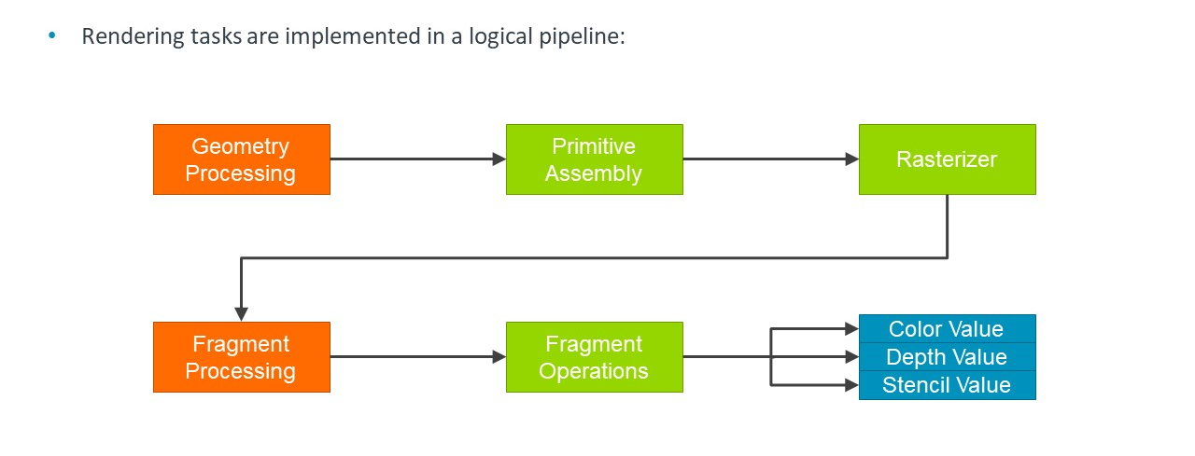
OpenGL ES Pipelines: 1.0 /2.0
Rendering tasks are implemented in a logical pipeline:
Notes:
This slide is a more complete (although still high level) view of the OpenGL ES 1.1 and OpenGL ES 2.0 graphics pipelines, although they differ in relation to the information in the blue boxes (GL ES1.1 is based around fixed-function blocks, whereas GL ES2.0 is based around programmable shaders).
The Orange blocks are programmable stages in OpenGL ES 2.0, the green blocks are fixed functions, although often configurable (on/off/mode select), and the blue blocks show the outputs of the render.
The Geometry Processing block operates on each vertex and translates it from model-space coordinates into eye-space coordinate.
The Primitive Assembly block takes groups of vertices and converts them into primitives: points, lines, and triangles in the case of OpenGL ES. This stage also determines which primitives are visible, discarding primitives that are outside the viewing frustum or single-sided and facing away from the view-port.
The Rasterizer block converts each primitive into a group of pixels (known as fragments because each pixel is only a fragment of the whole primitive raster).
The Fragment Processing block calculates each fragment’s color and depth (distance from camera) and decides whether it should have been drawn or not.
The Fragment Operations block performs a standard set of operations on each fragment:
Pixel ownership: Does this program own this pixel? If not, it is discarded and not drawn
Scissor test
Stencil test
Depth test: Is this pixel visible based on stencil and what we have drawn already?
Blending for partially transparent pixels
Dithering to hide rendering artifacts on low color-depth displays
Color Value is the value written into the Color Buffer output display color for this fragment.
Depth Value (also the Z-value) is the value written into the Depth Buffer (the distance from the viewer). This value is used to discard pixels that are further away from the viewer than the current pixel.
Stencil Value is the updated stencil value that is written back into the Stencil Buffer. This is used to allow per-pixel stencil testing.
The Application can control which of the output values are actually written, or it can choose to discard the fragment entirely.
This pipeline is similar to early desktop pipelines (OpenGL 2, DirectX 9). However, the latest version of the desktop OpenGL (v4) and DirectX (v11) have five programmable stages rather than the two found here.
Note that this is the idealized pipeline as described by the Open GL standard. In reality, we try and move as many of the fixed function fragment operations, such as scissor testing and an early depth-test, before the Fragment Processing block. This is to throw out pixels that are not visible, before we spend valuable Fragment Processing resources on them.

Slide 19
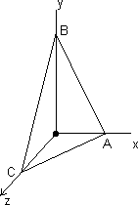
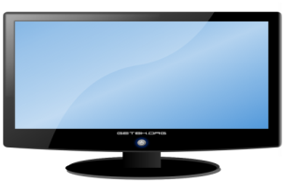
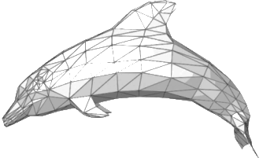

OpenGL ES 2.0 Pipeline
Geometry processing
Pixel processing
3D meshes
Primitives
(triangles)
Primitives in
screen space
Fragments
(pixels)
Colored
fragments
Mixed pixels
Framebuffer
Vertices
Vertex shader
Viewport clipping
Rasterizing
Fragment shader
Test and blending
Framebuffer updating
Programming entry
Programming entry
Geometry data
(xyz, color of vertex, etc.)
Texturing, lighting
(RGB, depth, etc.)
Notes:
This diagram illustrates the rendering process with the object generated at each stage.
Starting with geometry processing, the CPU sends the GPU the 3D meshes that are composed of a large number of vertices that go into the vertex shader. The vertex shader receives the location of the vertex in xyz format and assembles them as primitives (triangles), while passing other data (e.g., color) to the next process.
The triangles are then transformed from object space into world space (or eye space). We also need to create a viewport in which those triangles outside the near and far clip planes get clipped and culled, and the remaining triangles are projected onto the 2D screen space.
The triangles in the 2D screen space are then rasterized by the rasterizer, which turns the triangles into a group of pixels (also known as fragments). After rasterization, we move from the geometry processing to the pixel processing.
The fragments are loaded into the fragment shader, which performs the texturing and lighting using the data (e.g., RGB, depth) passed from the vertex shader and produces the fragments with colors.
The colored pixels generated from all primitives are then mixed and merged together. This is known as testing and blending.
Finally, the pixels are stored in the framebuffer, which is updated at a fixed rate (typically 60 FPS), and displayed on the screen.
In OpenGL ES 2.0, the vertex shader and fragment shader are the only two stages that are programmable. The geometry data, including the vertex coordinate and color, will be sent to the vertex shader. The texturing and lighting information will be sent to the fragment shader. Later we will see how to write a program to the vertex and fragment shader, respectively.
As the OpenGL API defines the rendering pipeline, the GPU has to be designed to implement the pipeline in its hardware architecture.
Pic src:
https://en.wikipedia.org/wiki/Polygon_mesh#/media/File:Dolphin_triangle_mesh.png
https://en.wikipedia.org/wiki/Dolphin#/media/File:Comdolph.jpg

Slide 20
OpenGL ES 3.2/Vulkan Pipeline
Rendering pipeline has evolved to support new use cases:
Compute shading
Vertex shading
Primitive assembly 1
Tessellation control shading
Geometry shading
Primitive assembly 2
Tessellation evaluation shading
Tessellator
Rasterizer
Early fragment operations
Fragment shading
Late fragment operations
Color value(s)
Depth value
Stencil value
Notes:
The newest APIs such as OpenGL ES 3.2 and Vulkan have made the rendering pipeline to evolve to support new use cases.
For instance:
we can compute shaders outside the pipeline and take advantage of the GPU architecture to speed up this process
the use of the tessellation to allow the GPU to programmatically subdivide meshes
Geometry stage to create or destroy primitives
Multiple render target (MRT) that provides support for multiple framebuffer color attachments
As a result of all these, more points can be accommodated in the pipelines that end up speeding up the rendering of a scene

Slide 21
Graphics Processing Unit (GPU)
A Graphics Processing Unit (GPU) is a dedicated hardware designed to accelerate the creation of images and videos in a framebuffer
Widely used in PCs, smartphones, game consoles, and embedded systems
Higher performance parallel computing
Standard APIs
High-performance computing General-purpose GPU ( GPGPU)
Examples include GeForce Series from Nvidia, Radeon Series from AMD, et al.
Lower power consumption, e.g., Arm Mali GPU for mobiles
Hardware architecture based on API features
Notes:
To accelerate the creation of images, the GPU uses dedicated hardware for fast image processing.
GPUs are widely used in PCs, smartphones, game consoles , embedded systems, etc. A GPU usually provides a much higher performance than a CPU in parallel computing (such as processing images and pixels) due to its dedicated and multi-processor architecture.
A GPU is usually programmed through standard APIs such as Open GL, although different vendors may have their own programming API for their specific architectures, e.g., Nvidia’s CUDA. GPUs can be used for many high-performance computing applications, e.g., scientific computing. These are known as General-purpose GPUs (GPGPUs).
Well-known examples of desktop GPUs include GeForce Series from Nvidia and Radeon Series from AMD. However, the increasing popularity of smart devices has led to the development of low-power GPUs, e.g., the Arm Mali GPU, to meet the requirements of low power and increased battery life.
The hardware architecture of a GPU is usually based on desirable software API features, e.g., OpenGL ES1.0.

Slide 22
Graphic Processing Units: A GPU is not a CPU
CPU
Single thread
Expensive pipeline stalls and memory access latency
Logic complexity
Large cache
GPU
Max overall throughput
Highly parallelizable
Single Instruction Multiple Data
Single Program Multiple Data
Stream processing
Read-only inputs and write-only outputs
Each stream task is computationally independent
Notes:
A GPU can be different from a CPU in many ways.
First, a CPU is designed to make a single thread run as fast as possible, whereas a GPU is designed to maximize overall computation throughput.
In a CPU, pipeline stalls and memory access latency can be very expensive because they dramatically affect the overall performance. However, when a GPU is processing, the individual thread latency is not considered as important as it is in CPU. This is because the rest of the threads can run in parallel, independently, without reducing too much of the system performance.
Moreover, the logic complexity of a CPU keeps increasing to reduce the probability per cost of stall, whereas the high parallelizability of a GPU can achieve better performance by increasing the number of processing units while maintaining their simplicity.
On the memory side, a CPU uses a large amount of cache memories to avoid memory misses. However, in a GPU design, a large cache is not commonly used, since each core can operate on its own private memory, with fast access and low latency (although L2 cache is usually used as a shared memory).
Moreover, a GPU can always perform more Single Instruction Multiple Data or Single Program Multiple Data for maximized parallelization.
Stream processing is slightly different because the process usually involves read-only inputs and write-only outputs, and each stream task is computationally independent.

Slide 23
Graphics Processing Unit: Driving Forces
Graphical Content
Modern mobile devices
Complex applications and games
Navigation applications, virtual reality displays, browsers, etc.
User Interfaces
Screen resolutions
Runs smoothly
Images, Videos, Compositions
Merge media from other sources
Compositions from many sources, e.g., camera and videos
Machine Learning
Arm Mali-G77 GPU is giving a 60% improvement in ML applications
Notes:
Several factors are driving the evolution of GPUs.
The first is the increasing amount of graphical content in development. As modern smartphones and tablets are becoming more like general purpose computers, more graphic content will be processed and displayed on mobile devices. The increasing demand for 2D and 3D games, navigation applications, virtual reality displays, Internet browsers, etc. are all requiring higher performance GPUs.
User Interfaces (UIs) are another driving force. Today, nearly all UIs are rendered using the GPU. The increasing screen resolutions are now too high to render the UI in the CPU. Meanwhile, UIs must run smoothly at high frame rates. A GPU provides a ubiquitous means to accelerate the rendering.
Images, videos, and compositions require GPUs to provide the flexibility to merge media from other sources and process the composition of traditional UI and gaming content with more sources such as camera and video.
And finally, machine learning, that is becoming common nowadays. GPUs are helping to accelerate the process of computing extensive workloads of information to save energy and increase performance of machine learning applications, like the Arm MALI-G77, which is giving a 60% improvement in ML applications

Slide 24
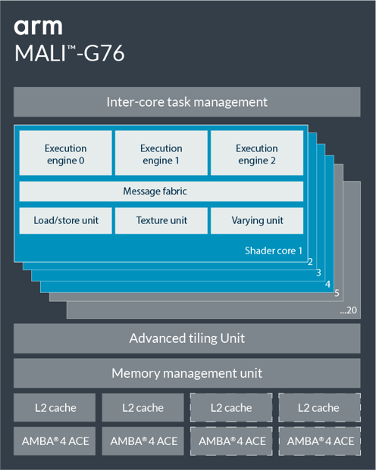
An Example of Mali GPU: Mali-G76 GPU
Third generation of the Bifrost architecture
Maximum 20 shader cores (SC)
Wider execution engines with double the number of lanes
Performance
Complex graphics and machine-learning workloads
API support
OpenGL ES 1.1, 2.0, 3.1, 3.2 OpenCL 1.1, 1.2, 2.0 Full profile Vulkan 1.1
Shared L2 cache with 2 or 4 slices
Usage in SoC
Kirin 980/990/990 5G, Exynos 9 9820/9825/980, Helio G90/G90T
Notes:
ARM Mali series GPUs are designed for mobile devices, which require lower energy consumption, while maintaining a satisfactory performance for mobile applications.
Arm Mali-G76 is the latest Bifrost-based GPU for the premium market, containing new, wider execution engines with double the number of lanes. It also implements int8 dot-product operations to target machine-learning workloads. The GPU contains a maximum of 20 shader and has a shared L2 cache that is configurable, in 2 or 4 slices. Moreover, it offers support for current APIs such as OpenGL, OpenCL, and Vulkan. Currently, Mali-G76 is used in chips including Exynos 9 9820/9825/980 from Samsung, Helio G90/G90T from MediaTek, and Kirin 980/990/990 5G from HiSilicon.

Slide 25

Another Example of Mali GPU: Mali-G77 GPU
First generation of the Valhall architecture
Warp-based execution model
New instruction set with operational-equivalence to Bifrost
Dynamic instruction scheduling in hardware
Configurable 7 to 16 shader cores
Single execution engine per shader core
Configurable 2 to 4 slices of L2 cache
512 KB to 4 MB in total
Texture mapper – 4 texture element (texel) per cycle
Supports OpenGL/Vulkan/OpenCL
This GPU is used in Exynos990
MALI™-G77
Inter-core task management
Control/Scheduler
Register File
Control
Register File
Datapath
Datapath
Messaging
Shader core
Shader core 1
2
…6
7
8
…16
Advanced Tiling Unit
Memory management unit
L2 cache
L2 cache
L2 cache
L2 cache
AMBA©4 ACE
AMBA©4 ACE
AMBA©4 ACE
AMBA©4 ACE
Notes:
The Arm Mali-G77 GPU is based on the Valhall architecture. This slide lists some of the key features of Mali-G77.
The Mali-G77 GPU is one of the latest in the series. It contains a maximum of 16 shader cores (SC) for better parallel computing. It supports most graphic and high-performance computing APIs, including Vulkan 1.1, OpenGL ES 1.1, 1.2, 2.0, 3.0, 3.1,3.2 and OpenCL 1.1, 1.2,2.0 Full Profile: Currently, Mali-G77 GPU is used in chips like Exynos 990 from Samsung. Mali-G77 GPU is used in high-performance computing applications from high-fidelity gaming to augmented reality, and it gives a 60% improvemet in machine learning applications for mobile devices
Reading material:
https://community.arm.com/developer/tools-software/graphics/b/blog/posts/introducing-arm-mali-g77-with-new-valhall-architecture

Slide 26




What is a Game Engine?
A game engine is a software framework that facilitates the design and implementation of 2D and 3D games
A game engine typically includes:
2D and 3D rendering engine
Physics engine
Audio engine
Animation
Artificial intelligence
Based on graphics API
Notes:
Although OpenGL provides an easy-to-use API for graphics processing, it is still too basic for game development. The development of a game usually requires a much more powerful engine to facilitate the design of more complex computation such as graphical animations, physics, and audios.
A game engine usually refers to a software framework that facilitates the design and implementation of 2D and 3D games. A game engine cannot work on its own, but it usually uses a graphics API (such as OpenGL or Vulkan) for creating and manipulating graphics in its lower levels. There are a number of commercial game engines that are widely used in game development. We show some of the most popular game engines and will examine their details in the following game modules.

Slide 27
Unity Game Engine
Unity is a cross-platform game engine developed by Unity Technologies
Launched in 2005
Based on C++ at runtime and C# for Unity Scripting API
Creates games and 3D scene experiences
Large share in the mobile gaming market
Free to use as long as you make less than $100,000 in revenue
Notes:
In this course, we are going to use the Unity game engine.
Unity is a cross-platform engine launched in 2005 at Apple Inc.’s Worldwide Developers Conference. Based on C++ and C#, Unity allows you to easily develop games and 3D scene experiences.
Furthermore, it is one of the most popular game engines used by developers worldwide due to its constant updates and being free to use as long as you make less than $100,000 in revenue with your products.

