Slide 1
Introduction to Graphics APIs Vulkan and OpenGL ES

Slide 2
Module Syllabus
Introduction to OpenGL ES
Introduction to Vulkan
Comparison of OpenGL versus other Application Programming Interfaces (APIs)
Standard workflow of an Android application
Example code
Notes:
In this module, we will take a look at a number of graphics Application Programming Interfaces (APIs).
We will compare some of these APIs and then see how OpenGL ES and Android are related.

Slide 3
Graphics APIs
There are a number of graphics APIs in the market that provide developers the tools and functionality required to create graphics applications.
This module will focus on OpenGL ES and Vulkan, but also take a brief look at some others:
OpenGL
DirectX/Direct3D
OpenVG
Mantle
Metal
WebGL
Notes:
There are a number of graphics APIs in the market that provide developers the tools and functionality required to create graphics applications.
We are going to focus on OpenGL ES and Vulkan, but also take a brief look at some others, including OpenGL, DirectX/Direct3D and OpenVG.
It is also worth mentioning a few more:
Mantle is a low-level API focused on rendering graphics for 3D video games. Developed by AMD and DICE, the API was originally designed as an alternative to OpenGL and Direct3D. It supports both Windows and Linux operating systems and has the primary aim of utilizing CPUs and GPUs more efficiently for gaming applications.
Metal is another low-level API concerned with rendering graphics for applications. Developed by Apple and released in iOS 8, it provides a similar level of functionality to OpenGL and OpenCL (Open Computer Language) combined. The API is iOS/Mac device specific and can not be developed on other platforms.
Finally, WebGL is a JavaScript API that renders 2D and 3D graphics for the web (compatible web browsers). Developed by Khronos Group, the API does not require the use of any plugins as it is integrated into the web standards of the compatible browser.

Slide 4
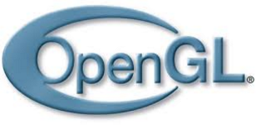
OpenGL
Open Graphics Library is an application programming interface (API):
Used for developing and rendering application graphics
Popular graphics API in the industry
Provides tools for the development of thousands of applications.
Industry standard
Cross-language and cross-platform
Implemented entirely on GPU
Wealth of documentation available
Stable
Scalable
Notes:
OpenGL stands for Open Graphics Library and is an API conventionally used for developing and rendering application graphics.
It is used by many different developers due to its portability and cross-compatibility with a number of platforms and hardware, while still providing reliable and consistent results. It is cross-language, as it has many language bindings such as C binding by iOS and Java/C binding by Android. This allows it to be cross-compiled and implemented on multiple operating systems such as iOS and Android.
The API is designed to be implemented entirely on the GPU, which gives better design integrity and compiling simplicity.
There is also a wealth of documentation available for developers, making it easy to pick up and learn.

Slide 5
Brief History of OpenGL and OpenGL ES
1992: Original OpenGL v1.0 released, with base API for the rendering of computer graphics and had a fixed development pipeline
2004: OpenGL v2.0 released, with the addition of shaders to the originally fixed pipeline
2008: OpenGL v3.0 released, with a deprecation mechanism
2010: OpenGL v4.0 released, introduced new features such as a tessellation shader and improvements to transform feedback.
Notes:
The initial version of OpenGL (OpenGL v1.0) was released in 1992. It provided a base API for the rendering of computer graphics and had a fixed development pipeline.
OpenGL v2.0 came with the addition of shaders to the originally fixed pipeline. This allowed developers to write their own methods.
OpenGL v3.0 provided a deprecation mechanism that helped simplify any future versions of the API. Some things that could be disabled (marked as deprecated) include fixed method vertex and fragment processing.
OpenGL v4.0 did not alter the API much, but introduced a few new features such as a tessellation shader and improvements to transform feedback.

Slide 6

OpenGL ES
Subset of OpenGL API
Focuses on rendering graphics for embedded systems such as smartphones, gaming consoles, etc.
Lightweight and flexible version of OpenGL
More adept for the current market, such as mobile phones, tablets, and other embedded systems.
“The most widely deployed 3D graphics API in history” https://www.khronos.org/opengles/
Cross-language and multi-platform
Notes:
OpenGL ES stands for Open Graphics Library for Embedded Systems and is a subset of the OpenGL API. Initially released in July 2003 by the Khronos Group, its focus is rendering graphics for embedded systems such as smartphones, gaming consoles, etc. It is a more lightweight and flexible version of OpenGL and is suitable for the mobile phone, tablet, and other embedded systems markets.
Another positive aspect of OpenGL ES is its cross-language and cross-platform capabilities. This opens up the API to a much wider audience than others, which are confined to certain OS, hardware, or languages.

Slide 7
OpenGL ES Version Comparison
OpenGL ES 1.x
Subset of OpenGL API
OpenGL ES 2.x
Released in 2007
Removed majority of fixed-function rendering in the pipeline
OpenGL ES 3.x
Backward compatible with OpenGL ES 2.0
Improvements on texture compression and other texture-related aspects
Better multitexture support and inclusion of vertex buffer objects
Lightweight and targeted toward embedded systems
Released in 2003
Fixed development pipeline
Replaced it with programmable stages (shaders)
Released in 2012 with its latest update in 2019
More support for shader development
Deprecation mechanism made future APIs simpler
Not backward compatible with OpenGL ES 1.x
Notes:
When jumping from OpenGL ES 1.x to OpenGL ES 2.x, it is clear that there is a difference in the level of customization. We will briefly touch on this difference now and go into it in more depth in next module.
OpenGL ES 1.x versions provided a fixed development pipeline and a specific set of functions, or fixed functions, that the developer could use in order to create their graphics. This somewhat limited the capability of complex effects to the standard of the fixed functions.
OpenGL ES 2.x versions introduced a programmable pipeline and shaders – will discuss shaders in depth later on too.
There is a significant difference in the level of customization when jumping from OpenGL ES 1.x to OpenGL ES 2.x:
OpenGL ES 1.x versions provided a specific set of functions, or fixed functions.
OpenGL ES 2.x versions introduced programmable shaders.
OpenGL ES v1.0 was based on the original OpenGL API. However, it was stripped down and focused more on embedded systems, with efficiency being its primary concern.
OpenGL ES v2.0 then followed, also making use of programmable shaders and adding them to the pipeline.
OpenGL ES v3.0 provided new features that enabled more effective texture compression, more visual effects, etc.

Slide 8
OpenGL ES Version Comparison
OpenGL ES 1.x
Subset of OpenGL API
OpenGL ES 2.x
Released in 2007
Removed majority of fixed-function rendering in the pipeline
OpenGL ES 3.x
Backward compatible with OpenGL ES 2.0
Improvements on texture compression and other texture-related aspects
Better multitexture support and inclusion of vertex buffer objects
Lightweight and targeted toward embedded systems
Released in 2003
Fixed development pipeline
Replaced it with programmable stages (shaders)
Released in 2012 with its latest update in 2019
More support for shader development
Deprecation mechanism made future APIs simpler
Not backward compatible with OpenGL ES 1.x
Notes:
It is important to let you know that OpenGL ES 1.x and 2.x is becoming less relevant to the industry. Therefore, we would like you to keep in mind to always check the newer versions of them so that you can take advantage of new features.

Slide 9
OpenGL ES versus OpenGL
OPENGL
Full graphics rendering API
Wider range of features
Can produce high-quality and complex graphics
Cross-language and cross-platform
Cannot run in embedded devices because of its nature
OPENGL ES
Lightweight graphics rendering API
Focus on efficiency in embedded systems
Consumes less space on smaller devices
Cross-language and cross-platform
Notes:
OpenGL ES is a stripped-down version of the original OpenGL API. This makes it a more lightweight API and very suitable for embedded systems that have lower capacity limits.
It also has extensions in terms of functionality that, paired with the lightweight nature of the ES API, make it more suitable for rendering graphics on embedded systems, like mobile phones.

Slide 10
DirectX/Direct3D
Collection of APIs used for handling graphics and media processes on Windows OS
Direct3D – part of the DirectX collection
Renders 3D graphics on Windows systems
Supports a number of graphics development features: mipmapping and shaders
Supported by Windows
Competitor of OpenGL
Notes:
DirectX is a collection of APIs used for handling graphics and media processes on Windows-based systems. DirectX version 1.0 was released in September 1995 by Microsoft as part of their Windows OS. One of the APIs included in the DirectX collection is Direct3D, released June 1996. Direct3D is concerned with rendering 3D graphics for applications on Windows systems. It supports a number of key features, crucial to graphics development such as mipmapping and shaders. DirectX is only supported on Windows, leaving it mainly targeting PCs and other machines that run Windows. The DirectX collection (primarily Direct3D) is also a competitor of OpenGL.

Slide 11
OpenGL versus Direct3D
OpenGL
Direct3D
Wider range of features
Cross-language and cross-platform
Wide range of features
Proprietary license
Full graphics rendering API
Full graphics rendering API
Open standard license
Includes implementation of the hardware
Requires application to manager the hardware
Only compatible with Windows-based systems
Notes:
OpenGL and Direct3D are two APIs that compete in the graphics rendering for applications market. As a result of this, modern GPUs typically implement a version of both APIs. Both of them can provide full graphics rendering API with wider range of features. Both can produce high-quality and complex graphics with a large library, which may take up a lot of space.
One major advantage of OpenGL is that it is cross-platform, meaning it is compatible with a number of devices/systems, whereas Direct3D is only compatible with Windows-based systems.
Apart from that, OpenGL uses an open standard license, while Direct3D is based on proprietary license. Open GL has also included the implementation of the hardware, whereas Direct3D expects application to manage the hardware.
In the mid-1990s, the Fahrenheit project attempted to bring the two APIs together; however, this was unsuccessful, and the two remain competitors in the market.

Slide 12
OpenVG
Open Vector Graphics library
Provides an interface for the creation of 2D vector graphics with libraries such as Flash and SVG
Conventionally used for mobile and media devices
Designed with the intention of creating more visually appealing UIs and passing the computation onto the GPU
Notes:
OpenVG stands for Open Vector Graphics library and provides an interface for the creation of 2D vector graphics with libraries such as Flash and SVG. Initially released in August 2005, OpenVG primarily targets mobile/portable devices that require acceleration of vector graphics, while maintaining solid performance with low power usage. Also aims to enable the creation of more visually appealing UIs and hands off computation to the GPU.

Slide 13
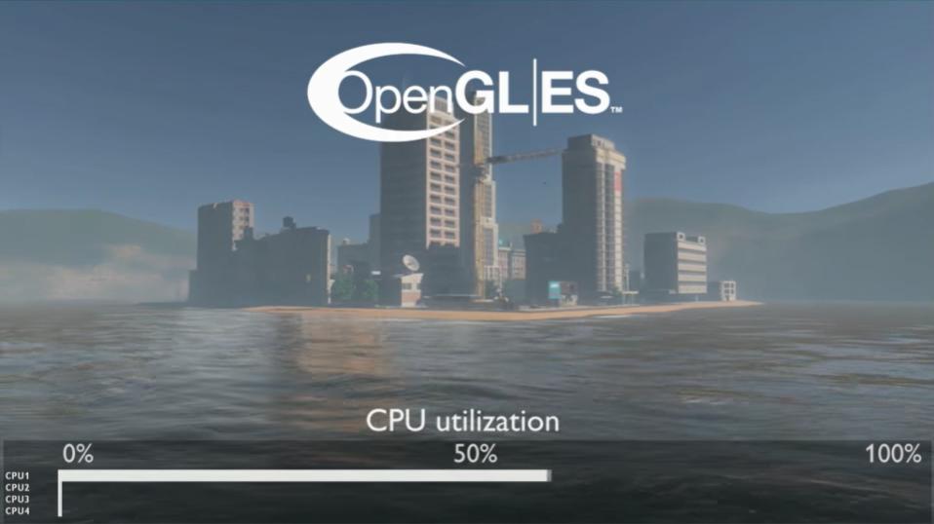
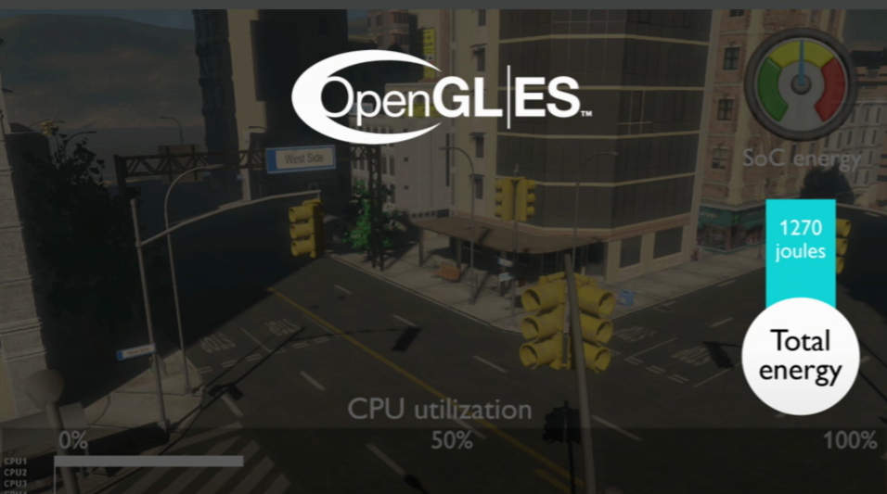
Vulkan
Vulkan is a cross-platform graphics and compute API from the Khronos group released in 2016
What’s so special about Vulkan?
Notes:
Vulkan is a cross-platform graphics and compute API with explicit control over the GPU; it was developed by the Khronos group in 2016 with a recent update in 2020.
Before explaining what’s so special about Vulkan, I would like you to appreciate these snapshots from a demo where a scene is rendered using OpenGL ES in a multicore architecture.
The image on the left shows that the first CPU was used in an average of 50% during the rendering, and the image on the right shows how much energy was needed for this (in this case, 1270 joules).
But now look what happens when we switch to Vulkan.

Slide 14
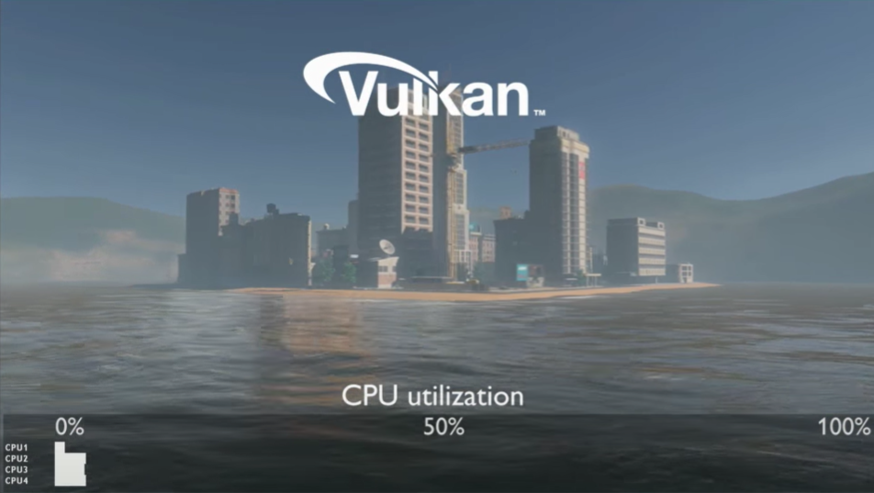
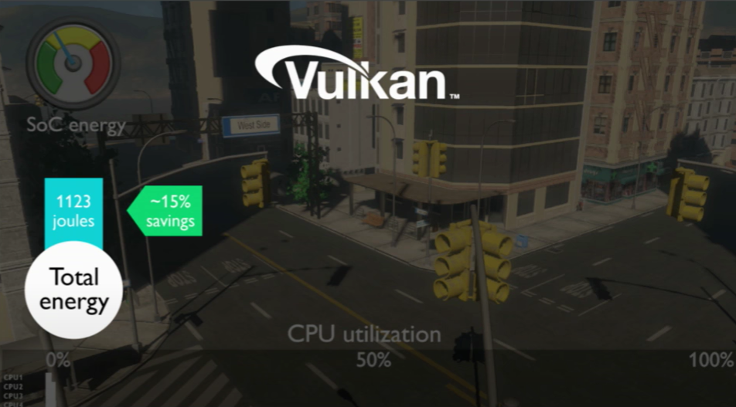
Vulkan
Vulkan exploited the characteristic of the multicore architecture giving a reduction of power consumption and optimization of CPU utilization
Notes:
By doing this, we can observe that the workload in the first CPU has been reduced, and rather than having one processor doing the whole task, we have split the work across four cores. As a result, approximately 15% of energy was saved in the device without the need of lowering the quality of the scene. But how is this even possible?
We will not be going into deep details of the Vulkan API in this course, but at least, we will look at its high-level features and how they improve the performance of graphical applications in comparison to OpenGL and OpenGL ES.

Slide 15
Why Vulkan was developed?
It has become apparent that these APIs (OpenGL/OpenGL ES) are reaching the end of their life cycles
The inherited weight that these APIs have carried over 25 successful years in the industry makes it difficult to maintain and take advantage of modern GPUs that are now highly programmable and compute capable
These APIs still:
Use single-threaded execution
Use models that are far away from how hardware works
Waste effort to generate synchronous model for asynchronous GPUs
Increase complexity to hit good paths in the driver
Industry desires for explicit control over GPU, to provide the capability of maximizing performance for the application developer
Giving more “explicit” access to HW to a developer means more complexity. "Greater powers" come with “greater responsibilities.” The Vulkan driver does not protect from errors that an app developer makes.
Notes:
Some of you might wonder what was the need of developing a newer API in this time. Although new releases of OpenGL and OpenGL ES will still appear in the future and work fine, it has become apparent that these APIs are reaching the end of their life cycles.
The inherited weight that these APIs have carried over 25 successful years in the industry makes them difficult to evolve, and so these APIs still
Use single-threaded execution
Use models that are far away from how hardware works
Waste effort to generate synchronous model for asynchronous GPUs
Increase complexity to hit good paths in the driver
Moreover, there has been a desire for explicit control over GPU, to provide the capability of maximizing performance for the application developer.

Slide 16

Features of Vulkan API
A unified API framework
Reduced driver overhead
Support for multi-threading and multi-processing
SPIR-V
Loadable Layers
Render-pass
C++
C++
C++
Notes:
The following slides will introduce some of the features of Vulkan API and a comparison between these with OpenGL(ES)
evolved from the AMD’s Mantle API, Vulkan provides us with a unified API framework.
Developers will always want to avoid investing extra effort and resources in rewriting their code for a different platform.
Although, OpenGL and OpenGL ES are fairly close to do this, Vulkan provides one API for mobile, desktop, console, server, and embedded systems for making cross-platform development far easier.

Slide 17
Features of Vulkan API
A unified API framework
Reduced driver overhead
Support for multi-threading and multi-processing
SPIR-V
Loadable Layers
Render-pass
App
driver
Hardware
C++
C/C++
driver
GPUs
C/C++
driver
GPUs
C/C++
Notes:
Vulkan reduces the driver overhead.
Before we explain that, remember that a driver is software that makes the communication possible between your graphical application and your hardware (a graphics card).
OpenGL ES uses a synchronous rendering model, in other words, the API calls must behave as if all earlier API calls have already been processed. Unfortunately in modern GPUs, workloads are processed asynchronously, and the synchronous model is just an illusion made by the driver, which ends up doing more work than it should be doing.
On the other hand, Vulkan uses an asynchronous rendering model that avoids the driver to be overused thanks to rendering queues, explicit scheduling, and explicit synchronization.

Slide 18
Features of Vulkan API
A unified API framework
Reduced driver overhead
Support for multi-threading and multi-processing
SPIR-V
Loadable Layers
Render-pass
thread
CPUs
App
CPUs
thread2
Thread3
Thread1
Thread4
App
Notes:
One of the main advantages of Vulkan is the support for multi-threading and multi-processing. In OpenGL ES, we use a single-threaded rendering model, which limits the use of multiple CPU cores in the rendering pipeline, but in Vulkan, we are allowed to use multi-threaded rendering model to split the work across different CPUs. As a result, applications that used to suffer from overhead end up having a considerable reduction in CPU time and power.

Slide 19
Features of Vulkan API
A unified API framework
Reduced driver overhead
Support for multi-threading and multi-processing
SPIR-V
Loadable Layers
Render-pass
GLSL
SPIR-V
010
1010
0100
C
Shader
Shader
Notes:
Vulkan uses SPIR-V intermediate language that enables you to apply a common language front end. SPIR-V is a multi-API that works for parallel compute and graphics.
Using SPIR-V means that there is no front-end compiler in the Vulkan driver making the shader compilation faster in comparison to GLSL shaders. In addition, using an intermediate language means that you don’t have to ship your shader source code with your application (for instance, source code will be obfuscated, which means that your code in shaders will be harder to reverse-engineer).
Don’t worry if you are not sure about what is a shader; we will look into them in the following lectures.

Slide 20
Features of Vulkan API
App release
A unified API framework
Reduced driver overhead
Support for multi-threading and multi-processing
SPIR-V
Loadable Layers
Render-pass
apk
App
layer
apk
App release
apk
Notes:
OpenGL ES uses extensive runtime error checking, which increases the driver overheads in applications, but Vulkan doesn’t require the driver to implement runtime error checking. Instead, it enables you to load software layers in development for testing and debugging from multiple vendors. A major advantage is that you can remove them afterward and reduce the driver CPU load.

Slide 21
Features of Vulkan API
A unified API framework
Reduced driver overhead
Support for multi-threading and multi-processing
SPIR-V
Loadable Layers
Render-pass
Tiled memory
RAM
Notes:
According to the Khronos group, “A render pass represents a collection of attachments, sub-passes, and dependencies between the sub-passes and describe how the attachments are used over the course of the sub-passes.”
So basically render passes allow you to define commands and drawings where you have sub-passes, which execute graphics or computing commands.
The special thing about rendering-passes is that you can specify everything ahead of time while having multiple sub-passes.
What we mean by that is that you can select what to do with the data, which is stored in the tiled memory. For instance, throw it away or keep it. As a result, you can optimize the rendering of various post-processing effects.
For example, let’s say that we want to apply x, y, and z post-processing effects to a scene. You could do three pass-renders and, inside each of them, execute a sub-pass with a subsequent post-processing effect, but this approach will need to reload the data from the memory every time, increasing your time of rendering.
But let’s say that you decide to execute the post-processing effect in one render-pass. In this case, what you will see is that the driver is taking advantage of the data, which is stored in the tiled memory, and as a result, your sub-passes are processed so much faster.
A tile-based renderer such as the MALI GPU results in reducing even more the driver load.
Link->
https://www.khronos.org/assets/uploads/developers/library/2018-vulkan-devday/02-RenderPass-Subpass.pdf

Slide 22
In this course
Vulkan is harder to learn than OpenGL
Labs and lectures are based on OpenGL ES API
Students can enjoy the creation of graphics
Understanding Vulkan API requires prior knowledge that you will gain from this course
Visit these links once you have finished this course:
https://developer.arm.com/solutions/graphics-and-gaming/apis/vulkan
https://github.com/KhronosGroup/Vulkan-Samples
https://www.khronos.org/blog/vulkan-releases-unified-samples-repository
Notes:
Vulkan has many pros, but it is not a panacea; the learning curve is more difficult compared with OpenGL ES. In this course, labs and lectures are based on OpenGL ES API; we have done this so that students can enjoy more the aspect of the graphics rather than focusing on the GPU architecture when programming. Nevertheless, we encourage students to review the Vulkan API once that they have completed this course.
In addition, Arm and Khronos are currently developing tutorial and samples that you will find useful for your future education.

Slide 23
EGL
EGL refers to Khronos Native Platform Graphics Interface or Embedded-System Graphics Library.
EGL is used as an interface between a Khronos graphics API (OpenGL ES, OpenGL, etc.) and the platform’s windowing system.
It provides functionality for the creation of surfaces that graphics libraries can draw on.
Notes:
EGL refers to Khronos Native Platform Graphics Interface or Embedded-System Graphics Library and is an interface between Khronos rendering APIs (OpenGL ES, OpenGL, etc.) and a native platform window system. It provides functionality for the creation of surfaces that the graphics libraries can draw on, creates and manages graphics contexts for APIs, and handles synchronization of rendering.

Slide 24
Android and OpenGL ES
Android is the most widely installed operating system on mobile devices.
Need/desire for more advanced applications and graphics
OpenGL ES provides a wide range of tools.
Android provides support for the development of graphics applications using OpenGL ES.
Android and OpenGL ES are ideal for collaboration.
Notes:
This course will use OpenGL ES to develop the Android operating system. Here are some reasons why:
Android is the most commonly installed operating system on smartphones worldwide.
As a craving for these devices grows, so does the need for more complex user applications and graphics.
OpenGL ES is perfect for this as it is specially designed to create complex graphics in the most efficient manner on embedded devices.
Android provides a large amount of support for the development of graphics applications using the OpenGL and OpenGL ES API. This support is provided through the framework and native development tools. These combined factors make it the ideal OS to use when learning to develop graphics using OpenGL ES.

Slide 25
Typical Android Application
An Android Application typically has two parts:
Android side – typically written in Java
Native side – typically written in C/C++
The Android side typically sets up the surface and handles any setup that is specific to the application.
The native side hosts the code that renders a scene.

