Slide 1
Texturing and Lighting

Slide 2
Module Syllabus
Loading and Using Textures
Different Types of Lighting
Brief Introduction to Normals

Slide 3
What is a Texture?
A texture is simply an image that a model/object displays.
Textures can come in many different sizes/resolutions, and an array of file formats.
Textures allow a model/object to represent many different colors.
Notes:
We have seen that we can create objects and give them a color, such as the red triangle we created in the previous lab. But graphics’ colors and decoration are typically more complex and visually appealing than that. This is where textures come in.
A texture is simply an image that we wish to have a model/object display. Textures come in many different sizes and resolutions, and in an array of file formats. They allow a model/object to represent a number of colors and patterns that are richer than the bland, red triangle.

Slide 4
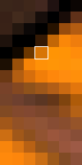
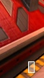

What is in a Texture?
A texture is a 2D image that represents the surface of an object:
Made up of a grid of pixels or texels.
Each pixel is defined with a certain color:
There are a number of color formats.
RGB565
Notes:
Essentially, a texture is a 2D image made up of a grid of pixels or texels, in which each pixel is defined by its color components. The term texel describes a texture storage element, as opposed to pixels (picture elements), but they are generally the same thing. The dimensions of this image are the texture’s resolution; generally, the high the resolution, the better the quality of the texture/image.
There are a variety of different color formats that textures can follow. In computer graphics. Pixels are typically stored in an RGB-format. In the example, we can see how the RGB values are split into an “RGB565” format. Some formats also include an alpha section in order to convey transparency.

Slide 5
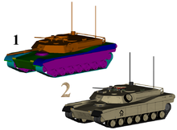
Texture Mapping
Texture mapping is the act of applying a texture to an object.
A 2D texture is mapped to each vertex of the object.
Notes:
How do we make our object display a texture?
Texture mapping is the process of applying a texture to an object. In a very trivial sense, we have a 2D texture map, and we map it to each vertex of the object.
There are a number of different methods for applying textures to models. As one example, we will take a look at UV mapping.
Picture credit: https://en.wikipedia.org/wiki/File:Texturedm1a2.png

Slide 6
UV Mapping
UV mapping is the process of applying a texture map to a 3D model.
The axes are labelled U and V, because X, Y and Z are used to symbolize coordinates in the 3D model.
Start with a 2D texture map that will simply be a canvas of the image on which the object is to be applied.
Then place the object on the 2D texture map, unraveled, so that it is flat on the texture map.

Slide 7
UV Mapping
The image is then projected onto the corresponding parts of the model.
Finally, the model is wrapped back up and the model will be 3D with the 2D texture mapped on to it.

Slide 8
OpenGL ES and Textures
OpenGL ES has a number of functions designed for handling textures.
They work in a very similar way to the shader and program functions explored in previous modules.
A look at some of the most important ones follows.
Notes:
Since we are focusing on developing graphics using OpenGL ES, we need to look at what support it provides for using textures.
OpenGL ES provides a number of functions that developers are able to use when handling textures. They work in a very similar way to the shader and program functions we looked at in earlier modules. There are quite a few functions provided in this area, but we will look at the most important ones.

Slide 9
OpenGL ES: Texture Functions
First of all, much like the shader and program functions, texture objects are created to provide a handle to refer to:
glGenTextures(1, &textureId);
Then activate a texture
glActiveTexture(GL_TEXTURE0);
Bind the texture object
glBindTexture(GL_TEXTURE_2D, textureId);
Notes:
First of all, much like the shader and program functions, we create a texture object so we have a handle to refer to. We do this using the function “glGenTextures()”, its parameters are the number of textures to generate and a place to put them.
We can then activate a texture using the function “glActiveTexture()”, its parameter is an enum referring to a particular texture, so for this example we choose “GL_TEXTURE0”.
Next, we can bind a specific unit type to the texture object using the function “glBindTexture(GL_TEXTURE_2D, textureId)”. We have two choices for this unit type: GL_TEXTURE_2D or GL_TEXTURE_CUBE_MAP. In this example, we select GL_TEXTURE_2D as it is the most common. This means that any subsequent texture GL operations will happen to the texture that we created in “glGenTextures()”.

Slide 10
OpenGL ES: Texture Functions
Finally, load the texture:
glTexImage2D(GL_TEXTURE_2D, 0, GL_RGBA, 3, 3, 0, GL_RGBA, GL_UNSIGNED_BYTE, pixels);
A number of other functions can help when handling textures, but these important ones will feature in the lab.
Notes:
Finally, we can load the texture using the “glTextImage2D()” function. This function takes a lot of parameters so we will take a look at what these are:
The first parameter the function requires is the texture unit upon which we wish to act. This is followed by the mipmap level number. (Note that we will look at mipmapping in more depth in later modules/labs.) Next is the internal format that we should use. In OpenGL ES 2.0, the internal format and the format of the image must be the same, because there is no conversion method. This is why parameter 7 is the same as this one. Parameters 4 and 5 represent the width and height of the image. In this case it is a 3 x 3 image as it would have taken too long to manually write the RAW format for a bigger image. Parameter 6 is the border you would like around the image, this has to be 0 on OpenGL ES. The final two parameters are the type of the data we are going to use and then the data itself.

Slide 11
Lighting
In computer graphics, scenes are commonly rendered with a simulation of light:
This makes the scene look more realistic.
There are a number of different lighting types:
Diffuse light
Ambient light
Specular light
Notes:
Now that we know how to make objects and give them textures, what else can we include in our scene to provide more realism and graphical complexity?
In computer graphics, scenes are commonly rendered including a simulation of light. This makes the scene look much more realistic and accentuates its 3D nature.

Slide 12
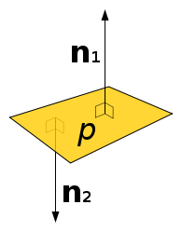
Normals
Most lighting models need to know which way all of the polygons in the scene are facing.
However, there are two reasons not to use the information that highlighted which way the vertices were facing:
There is no mechanism in an OpenGL ES shader to get at this information.
Specifying this information separately gives the developer greater flexibility.
Surface normals (also called normals) are used to encode the required information.
Notes:
Most lighting models need to know which way all of the polygons in the scene are facing. For example, if we know a light is pointing from a certain direction, in order to know whether a polygon should be lit by that light we must know if it's facing towards the light or not. You may be think that the system should know which way the polygon is facing because we specified it: we specified the vertices with the correct winding to show which way we wanted them to face and we provided a transformation to move the polygons to the correct place.
There are two reasons why we don't use this information:
There is no mechanism in an OpenGL ES shader to get at this information.
Specifying this information separately allows us to do a lot more things by not being strictly accurate.
We use what are known as surface normals, or just normals, to encode the required information. For every vertex in the scene, we provide a vector which points perpendicularly from the surface it represents.

Slide 13
Surface Normals
A surface normal is typically a vector that points perpendicularly away from the surface that it represents.
Surface normal
Notes:
A surface normal is typically a vector which points perpendicularly away from the surface that it represents. These will become a useful attribute later, as they enable more effective and efficient use of lighting and mapping.

Slide 14
Vertex Normals
A vertex normal points away (perpendicularly) from each vertex of an object.
Vertex
normals
Notes:
A vertex normal points away (perpendicularly) from each vertex of an object. Like surface normals, vertex normals are used in a number of different graphics-related topics, such as lighting models and shading techniques.

Slide 15
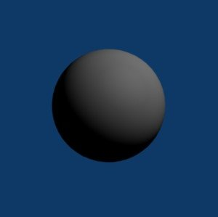
Diffuse Light
Diffuse light/diffuse reflection is the act of light reflecting from a surface in many different directions, due to the surface not being perfectly flat.
Light source
Notes:
The first type of lighting we will look at is diffuse lighting, or diffuse reflection.
Diffuse reflection is the act of light being reflected from a surface in many different directions. This is caused by the surface not being perfectly flat and is commonly used in computer graphics.

Slide 16
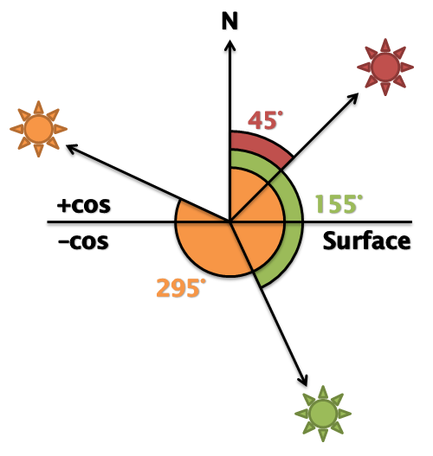
Diffuse Light
The developer needs to know whether light coming from a specific source will hit the face of a polygon.
This can be done by using the dot product to calculate the cosine of the angle between the source of the light and the surface normal.
If the return value of the dot product is between cos(90) and cos(-90), then the light is hitting the correct side of the polygon.
Notes:
If we think of a simple example of directional light, we want to work out whether the light would touch the face of our polygon or not. If we store the direction of the light as a vector, we can perform a simple calculation that will give us that data. The dot product of two normalized vectors will give you the cosine of the angle between those vectors.
Note: The dot product provides the angle between the sources of the vectors. We have reversed the direction of the light direction in the shader.
Therefore, the dot product of the light direction and the surface normal will give us the cosine of the angle between those vectors. If this angle is between -90° (270°) and 90°, the light is on the correct side of the polygon. Since the return value of dot is actually the cosine of the angle, we actually want to check to see if it's between cos(90°) and cos(-90°) or in fact just greater than zero (cos(90°) = cos(-90°) = 0).

Slide 17
Diffuse Light
This diagram shows that the dot product of any vector that is on the front face of the surface will be positive.
This creates a binary effect as to whether the light is hitting a face surface or not.
By using the angle to control the intensity of the light, the surface would be brighter when the surface is more directly facing the light.
Notes:
Figure shows that the dot product of any vector on the front face of the surface will be positive. N** is the normal to the surface, and the other three vectors represent lights (with their directions reversed so that the dot product gives the correct angle). For the red and orange lights, the dot product returns cos(45°) and cos(295°) respectively, which are both positive values. The dot product of the normal and the green light vector is cos(155°), a negative number.
This would give us a binary on or off for our light, but we can do better than that. If we use the angle to directly control the intensity of the light, the surface will be brighter when the surface is more directly facing the light (e.g. cos(0°) = 1) reducing as the angle increases (e.g. cos(80°) = 0.17).
Again, looking at figure 2, the dot product of the red light and the normal (cos(45°) = 0.71) is greater than the dot product of the orange sun and the normal (cos(295°) = 0.42).

Slide 18
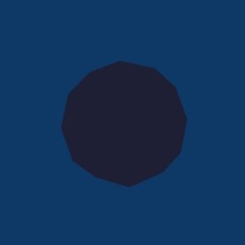
Ambient Light
Ambient lighting is a fixed amount of light that affects every object within a scene.
In the real world, everything gets a bit of light via reflections.
Real world
Black if no second order rays
Notes:
Another type of lighting we will look at is ambient light.
Ambient lighting is a fixed amount of light that affects every object in the scene. This is used because in the real world, things are very rarely completely black. Light reflects off all objects, so that areas that are not in direct view of a light source still get touched by reflections. Modeling these interactions is known as global illumination.

Slide 19
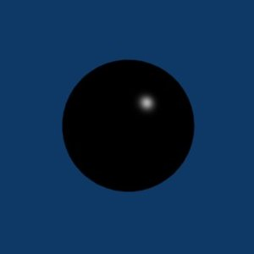
Specular Light
Specular light/specular reflection only reflects in one direction, unlike diffuse reflection. This creates the effect of a bright spot of light on an object or model.
Light source
Notes:
The final type of lighting we will look at is specular light or specular reflection.
In contrast to diffuse reflection, which is split across many directions, specular reflection only reflects in one direction. This creates the effect of a bright spot of light on an object or model, and is very commonly used in computer graphics.

Slide 20
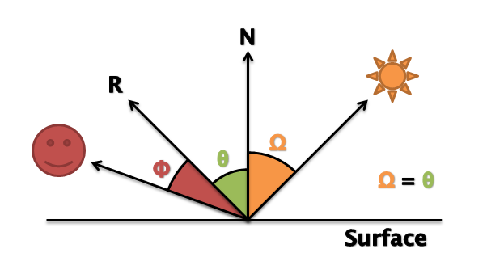
Specular Light
A shiny metallic surface and a matte wooden surface would look different, even if the light direction, intensity, and eye position are the same.
Just using diffuse and ambient lighting wouldn’t show this difference.
Specular light will show the difference by taking the amount of light that is reflected towards the eye into account.
Obtain the dot product of the vector that represents the direction the light is reflecting and the inverse eye direction.
Notes:
In a simple example of specular light, a shiny metallic surface and a matte wooden surface of the same color will look different, even if the light direction, light intensity, eye position and surface orientation are the same. Even after using diffuse and ambient light, as we have so far, those two surfaces would still look the same. Adding specular light will take into account the amount of light reflected from the surface directly towards the eye.
We can do this by first finding out which way the light is reflecting off the surface, and then calculating the dot product of that vector and the inverse eye direction.
Figure shows that if we find a reflection vector R where Ω = Θ, we can use this with the inverse eye direction to find Φ. We can use Φ to control the intensity of specular light reflecting from the surface, to simulate how much light is being reflected directly towards the eye.

Slide 21
Lighting Strength
The intensity of a light hitting a surface is dependent on the similarity of the light vector and surface normal.
The intensity of reflected light is dependent on the similarity of the eye vector and the reflection vector.
Eye vector
Surface
normal
Reflection
vector
Light
vector
Notes:
The intensity of light hitting a surface is dependent on the similarity of the light vector and surface normal.
The intensity of reflected light is dependent on the similarity of the eye vector and the reflection vector.

Slide 22
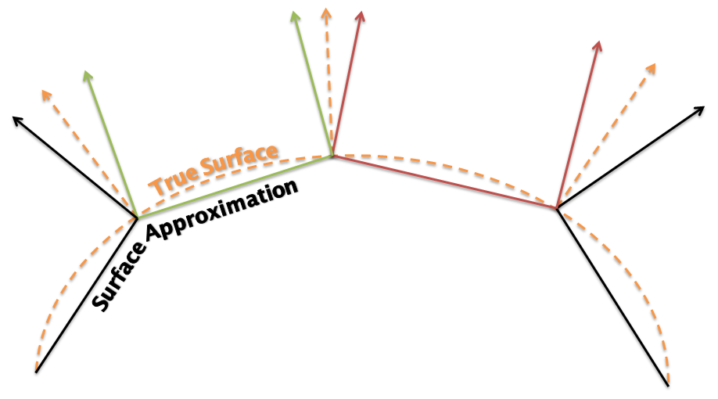
Normals
If normals are perpendicular to the polygon in the scene, then the polygons will be lit and individually visible.
But this would leave a very rigid and blocky shape.
However, if the normal were perpendicular to the original or true surface, the lighting will provide a more accurate representation of the shape.

