Slide 1
Performance Optimization and Programming Techniques

Slide 2
Module Syllabus
Mapping Techniques
Vertex Buffer Objects
Mipmapping
Texture Compression
Graphical Assets
Android APK and File Loading

Slide 3
Complexity vs. Performance
A big issue with the development of graphics for mobile devices is finding a balance between complex and dynamic graphics, and performance.
For a scene to look realistic, it often requires a large number of vertices and calculations, which means that performance suffers.
On the other hand, too much focus on performance means that the graphics may have to suffer.
This issue can be dealt with via a number of methods.
Notes:
As mobile devices are becoming more popular, and applications are consumed by more people, developers have to find a balance between complex-dynamic graphics and application performance.
There is an ever-present trade-off between performance and detail. If we want a scene to look realistic, it generally requires a large number of vertices and calculations. This diminishes the performance of the graphics/application. However, if we simply focus on keeping the performance at an optimal level, this may diminish the visual appeal of the graphics.
A balance of the two is good, and there are some methods we can use in order to achieve the best balance.

Slide 4
Methods for Increasing Performance and Complexity
Bump mapping
Normal mapping
Vertex Buffer Objects (VBOs)
Mipmapping and compressed textures

Slide 5
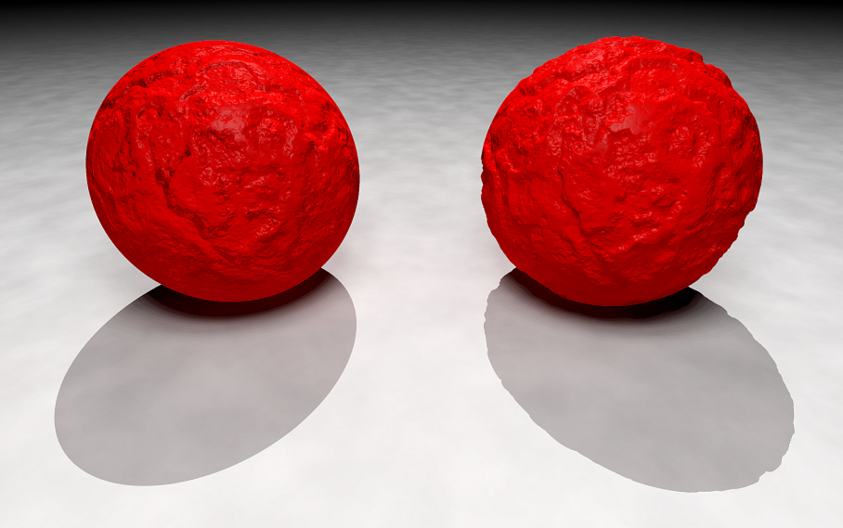
Bump Mapping
Bump mapping is a method used to simulate bumps and divots on an object’s surface.
This is accomplished without altering the model itself. Instead, bump mapping uses light on surface normals to create the illusion of displacements on the model.
Notes:
Bump mapping is a method commonly used in the rendering of graphics. It is used to simulate the bumps and divots on an object’s surface, without actually altering the model itself. Instead, it uses lighting and surface normals to create the illusion of displacements on the model.
As we can see in the image here, the model on the left is a perfect sphere, whereas the model on the right has bumps. These bumps are created by the lighting interacting with created surface normals.
Picture source: https://en.wikipedia.org/wiki/Bump_mapping#/media/File:Bump_map_vs_isosurface2.png

Slide 6
Normal Mapping
Normal mapping is an implementation of bump mapping.
This is achieved without the use of any extra polygons, meaning, not only is it more graphically complex, it is also comparably better in terms of performance.
Essentially, a complex geometry is crafted using surface normals and is then applied to a simple geometry.
Notes:
Normal mapping is an implementation of bump mapping. Normal mapping is achieved without the use of any extra polygons. This means that not only is it more graphically complex, it is also comparably better in terms of performance. A complex geometry is created, which includes the direction of all the surface normals. The normals are then saved in a texture and applied to a simple geometry, making it look more realistic.

Slide 7
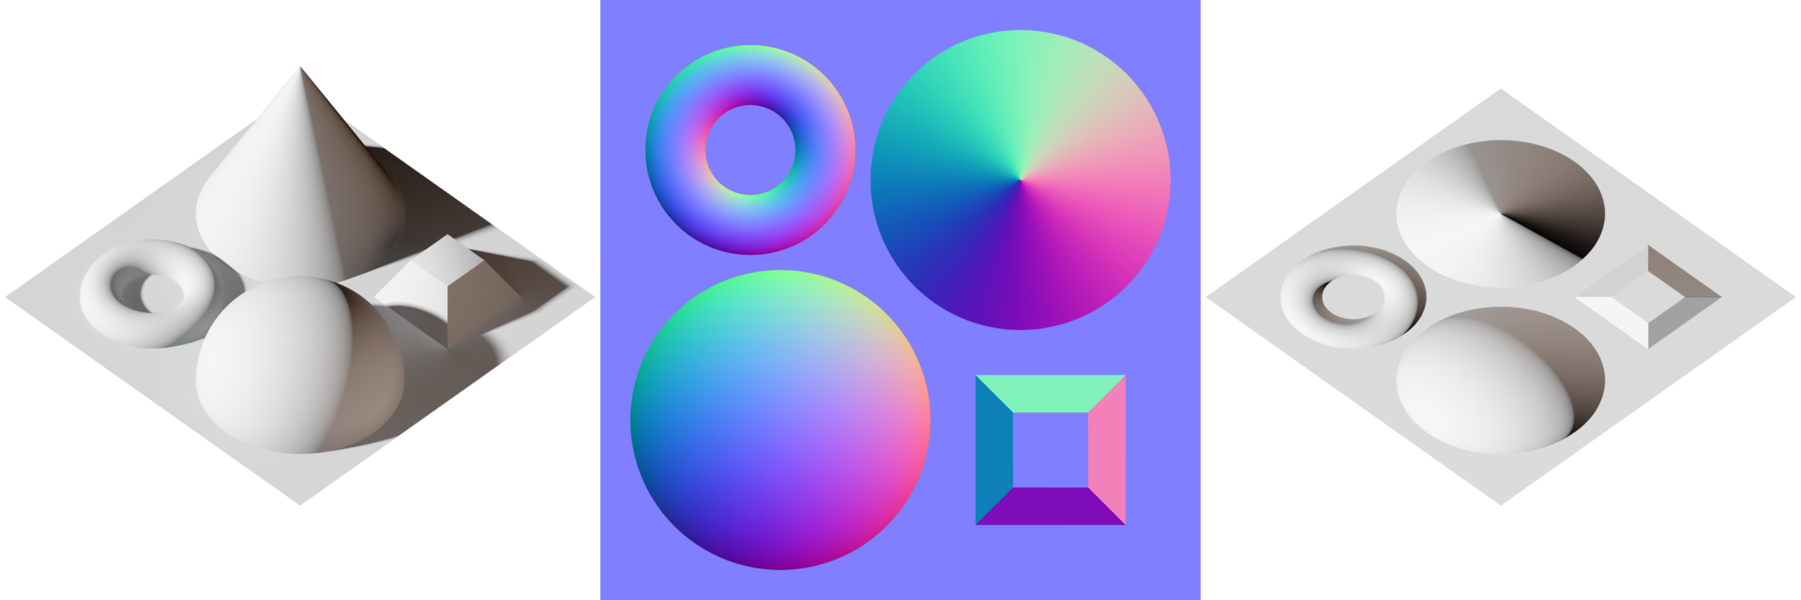
Normal Maps
A normal map is a regular texture that determines what the surface normal will be for each pixel:
Scene
Normal map
(calculated from the scene)
Applied to a flat surface
Notes:
A normal map is a regular texture, but instead of defining what color a pixel will be on screen, it determines what the surface normal will be for each pixel.
The red, green and blue channels in the texture tell you the X, Y and Z components of the normal direction respectively.
Picture source: https://en.wikipedia.org/wiki/Normal_mapping#/media/File:Normal_map_example_with_scene_and_result.png

Slide 8
Vertex Buffer Objects (VBO)
Because this course looks at mobile programming for Android phones, the amount of bandwidth that the application will use must be considered.
Bandwidth use can be reduced by implementing Vertex Buffer Objects (VBOs).
Typically, attributes are stored in main memory, then uploaded to the GPU for every frame to be rendered.
VBOs allow for a single data upload.
Notes:
As mentioned, because we focus in this course on development for mobile phones, we always have to consider the amount of bandwidth that our application/graphics consume. A method that reduces bandwidth consumption is the implementation of Vertex Buffer Objects (VBOs).
Without VBOs, attributes such as vertex position, color and normals are defined in main memory. They are then uploaded to the GPU in every frame so that the scene can be rendered. But by utilizing VBOs we simply upload the data once, meaning it does not need to occur in each frame. This massively cuts down on the consumption of bandwidth.

Slide 9
VBO Functions
OpenGL ES provides a number of functions to ease use of VBOs in the application.
The first helpful function is the generate buffer command:
This line generates a new vertex buffer object and returns its ID.
It takes two parameters: an int representing the number of buffers to be created, and a pointer to an array that will hold their IDs.
glGenBuffer(2, vboBufferIds[0]);

Slide 10
VBO Functions
Another useful function is the bind buffer command:
This function selects a buffer as the active vertex buffer object.
It takes two parameters: a predefined enum target, and one of the buffers from the buffer array:
GL_ARRAY_BUFFER or GL_ELEMENT_ARRAY_BUFFER
glBindBuffer(GL_ARRAY_BUFFER, vboBufferIds[0]);
Notes:
Another function we can make use of is the bind buffer command:
“glBindBuffer(…);”
The function selects a buffer as the active vertex buffer object.
It takes two parameters: a predefined enum target, and one of the buffers from our buffer array. The two possible enum targets are: GL_ARRAY_BUFFER and GL_ELEMENT_ARRAY_BUFFER. These are used for vertices and indices, respectively. If we do not call the bind buffer function, then OpenGL ES assumes we do not wish to use VBOs and will instead upload the data each frame.

Slide 11
VBO Functions
The final function examined in this module is the buffer data function.
This function uploads data to the active vertex buffer object just selected.
It takes four parameters: one of the predefined enum targets, the size of the vertex buffer, the data to be stored in the buffer, and another enum telling OpenGL ES how the buffer will be used:
GL_STATIC_DRAW, GL_DYNAMIC_DRAW, AND GL_STREAM_DRAW
glBufferData(GL_ARRAY_BUFFER, vertexBufferSize, cubeVertices, GL_STATIC_DRAW);
Notes:
The buffer data function uploads data to the active vertex buffer object we just selected.
It takes four parameters: one of the predefined enum targets, the size of the vertex buffer, the data we wish to store in the buffer, and finally another enum telling OpenGL ES how we intend to use the buffer. There are three options for the 4 (enum) parameter. These are: GL_STATIC_DRAW, GL_DYNAMIC_DRAW, AND GL_STREAM_DRAW.
GL_STATIC_DRAW: only modify the data once and it will be used multiple times
GL_DYNAMIC_DRAW: modify the buffer numerous times and then use it to draw numerous times
GL_STREAM_DRAW: only modify it once but it is only used a few times as well

Slide 12
Mipmapping
Mipmapping is a technique that takes an original, full-scale, high resolution image and generates several lower-res images to accompany the original image in a set.
Each image is a power of two smaller than its predecessor.
For example, one image, but different resolutions: a 512 x 512 pixel version, a 256 x 256 pixel version, a 128 x 128 pixel version, etc.
How is this useful in graphics development?

Slide 13
Mipmapping
If a texture was, say, 512 x 512 pixels, the developer may wish to use it on a particular object that might not be the same pixels size.
OpenGL ES would try to fit a 512 x 512 pixel texture to a smaller shape, which is not very efficient.
But if the same texture was available in many different sizes, scaling down by a power of two each time, then the developer could apply the texture that is the most suitable size for that object.

Slide 14
Compressed Textures
It is possible to provide OpenGL ES with compressed textures that have a much smaller file size than uncompressed version, therefore saving bandwidth.
An example is the Ericsson Texture Compression (ETC) format:
Works on most GPUs
Industry is moving towards use of ASTC as the main format:
Greater compression results than ETC
Notes:
Another method we can implement in order to reduce the use of bandwidth is compressed textures.
In a similar use to that of a ZIP file, we can provide OpenGL ES with compressed textures that have a much smaller file size than the uncompressed version, therefore saving bandwidth.
A commonly used format for texture compression is the Ericsson Texture Compression (ETC) format. A newer and increasingly popular format is the Adaptive Scalable Texture Compression (ASTC) format, which provides better results than ETC, in terms of compression, but it is not widely supported yet..

Slide 15
Generating ETC Compressed Textures
First, compress the texture:
This can be done using the Mali Texture Compression Tool.
Open the tool and click “compress selected images”:
A dialog box shoulder appear: change the tab to “ETC1/ETC2”.
Make sure the PKM, slow, ETC1 and perceptual options are selected, then press ok.
The tool should produce a .pkm file for each of the textures selected.
These are the compressed textures required.
Notes:
First, we must compress our textures using the Mali Texture Compression Tool. Unfortunately, much software doesn't support opening .raw files, as this format doesn't include the width and height of the image. So we suggest that you convert your images to a more common format, such as bmp, png or jpeg.

Slide 16
ETC File Format
File format name and version
Padded width
Width
0
1
2
3
4
5
6
7
8
9
10
11
12
13
14
15
Blank
Padded height
Height

Slide 17


Adaptive Scalable Texture Compressin (ASTC) Format
Block-based texture compression
Lossy compression is a form of compression that is irreversible as some data is lost in the process.
2D and 3D textures
Low compression
High compression
Notes:
Adaptive Scalable Texture Compression (ASTC) format is a block-based texture compression algorithm. It is also a Lossy compression algorithm which means that the process is irreversible and any data lost in the process cannot be retrieved.
ASTC supports the compression of both 2D and 3D textures.
We will not delve in to this too much as we are primarily focusing on ETC, but it is important to know there are other methods available.
Picture source: https://en.wikipedia.org/wiki/Lossy_compression#/media/File:Ruby-LowCompression-Tiny.jpg

Slide 18
Block-based Compression
The image is split up into blocks.
The decoder can then figure out which texels are in which block:
The decoder can also determine where they can be found in memory.
Provides a fixed rate of bits per pixel
Each block has two values:
Texel footprint: the number of pixels/texels it covers
Data size: the number of bits the block takes up in memory
Notes:
In block-based compression, the image is split up into blocks so that the decoder can figure out which texels are in which block, and where they can be found in memory.

Slide 19
Graphical Assets
In the labs so far, scenes and objects have been manually created and stored in source files.
In the real world, graphics developers use modeling tools to create scenes.
The models created can be used as assets in this course’s application.

Slide 20

Graphical Assets
A digital asset is anything that can be accessed in binary format included in a creation/project.
In the field of computer graphics, this could be an image, a model, an animation, etc.
Commonly used to eliminate the lengthy process of manually creating things
Wood texture asset
Notes:
A graphical asset is anything that we are able to include in our creation/project, and are sometimes referred to as digital assets, Such assets could be e.g. an image, a model, an animation, etc. and are commonly used to eliminate the lengthy process of manually creating things.

Slide 21
Loading Assets
There are a number of libraries and methods used to load assets for graphics development.
The library examined in this course is the Open Asset Importer Library.
Notes:
Loading assets can sometimes be an awkward process; however, there are a number of libraries created for the purpose of OpenGL ES asset loading.
We will take a look at the Open Asset Importer Library, which we will use in the lab to load assets.

Slide 22
Open Asset Importer Library
The Open Asset Importer Library is an open-source library that provides support and functionality for loading 3D model formats.
It enables the developer to load assets and include them in scenes without manually creating them.
Written in C++
Notes:
The Open Asset Importer Library is an open-source library that provides support and functionality for loading 3D model formats. It enables us to load assets into a format that OpenGL ES is able to access, thus enabling us to include them in our scenes without manually creating them. The library is written in C++ and can be incorporated into our native code.

Slide 23
Open Asset Importer Library
The Open Asset Importer Library can load a number of formats.
Assets are converted into a standard format.
Different model formats can store a variety of different features:
Geometry
Normals
Textures
Materials

Slide 24
Android Application Package: APK
The Android Application Package (APK) is a file format used to deploy applications to Android systems.
This file will contain, precompiled, everything the application needs to run, including:
Classes
Assets
Libraries
Notes:
The Android Application Package (APK) is a file format that is used to deploy applications to Android systems.
In order to create an APK file, an Android program is compiled and its parts are packaged into a file.
We can install these APKs onto Android devices either by copying the file across to the device, or using an IDE such as Eclipse (with ADT – Android Development Tools plugin) we can run the APK on the device.

Slide 25
Android File Loading
Developers often want to load assets, e.g., models or textures, from a file into an application.
Assets can be extracted into three main types of locations:
Private locations
Public locations
Temporary locations
Notes:
Often, we will want to load assets from a file into our application; these assets could be in the form of textures for some of your models or even the models themselves if you have been using modelling software to generate content.

Slide 26
Extracting to a Private Location
A private location is one that can only be accessed by a particular application.
Data stored here is usually sensitive and/or things that the developer does not want everyone to access.
However, note that if the developer has root permissions for a device, they could still access this type of directory, so it should not be assumed to be fully secure.

Slide 27
Extracting to a Public Location
A public location is one that can be accessed by numerous applications.
Data stored in a public directory is data used by a number of applications, e.g.:
Music
Pictures
Downloads

Slide 28
Extracting to a Temporary Location
A temporary location should not be used for permanent storage.
Data stored here should generally be for the short term, because Android will delete the folder when it fills up.

