Slide 1
Introduction to Mobile Gaming

Slide 2
Introduction to Mobile Gaming

Slide 3
Module Syllabus
The History of Video Games
Introduction to Game Engines
Game Development Languages and Platforms

Slide 4
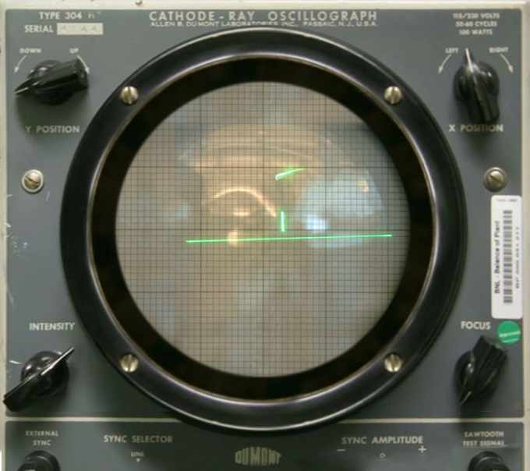
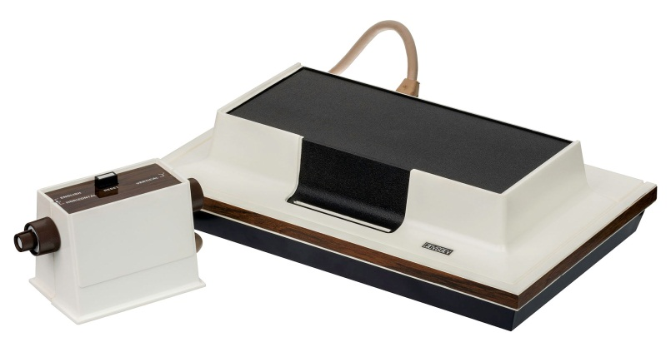
Video Games: A Historical Look
Tennis for Two was developed in 1958.
A number of academic projects followed.
The Magnavox Odyssey: 1972
Computer Space, (the first video games cabinet): 1971
Tennis For Two
The Magnavox Odyssey
Notes:
Tennis for two is widely considered to be the first true video game and was developed in 1958 by American physicist William Higinbotham at Brookhaven National Laboratory. This was done by using a Donner Model 30 analog computer. It simulated a game of tennis on an oscilloscope. It took approximately three weeks to build. It did not garner a good reception, and thus was largely seen as an isolated incident. A number of other isolated projects took place, but none really gained ground.
Spacewar was designed at MIT in 1961 by Steve Russell. A two player game, the goal was to destroy the opposition spaceship. Later students added additional physics and features were added. It never reached commercial distribution as the cost of hardware was far too expensive to consider.
Ralph Baer and television company Magnavox signed a contract to produce the Magnavox Odyssey. The device was revolutionary, but didn’t garner much publicity due to lack of marketing and a high price point of $100.
Nolan Bushnell, an avid fan of Spacewar, worked with several students at the University of Utah to create numerous video games. With his experience in pinball arcades, he created a coin operated game called Computer Space. Though it was a failure commercially, it paved the way for Nolan to create Atari.
Picture credits: https://commons.wikimedia.org/wiki/File:Magnavox-Odyssey-Console-Set.jpg, https://commons.wikimedia.org/wiki/File:Tennis_For_Two_on_a_DuMont_Lab_Oscilloscope_Type_304-A.jpg

Slide 5
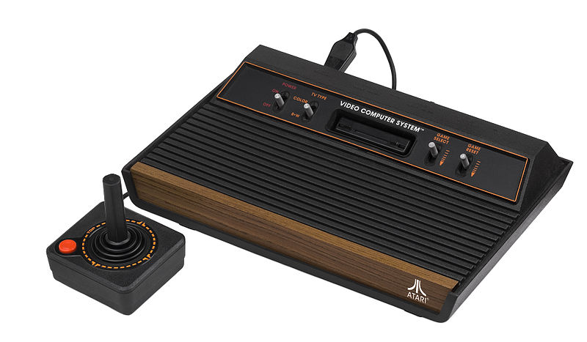
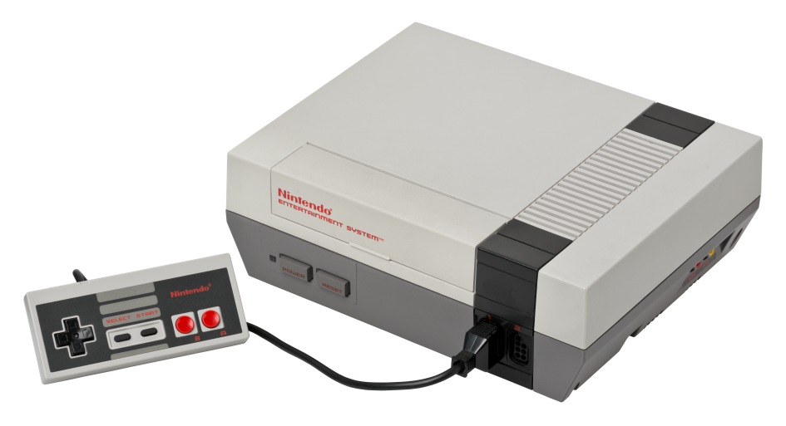
Video Games: Next Generation
Atari was formed in 1972; Atari 2600 was released in 1977.
Pong was released in 1976.
Nintendo Entertainment System was released in 1983.
Master System was released in 1985.
Atari 2600
Nintendo Entertainment System (NES)
Notes:
Atari and Pong are synonymous with the origins of video games, and they helped launch the industry in 1976.
With the 1977 release of the Atari Video Computer System (referred to today as the Atari 2600), gaming in the home became a reality.
Nintendo, a toy and card game manufacturer, developed the Nintendo Entertainment System (NES) in 1983. The system saved the game industry from the economic crash it had suffered earlier in the year. The rampant success of the NES meant that at times Nintendo owned more than 90% of the gaming market.
From this success, other competitors saw that the video game market was a lucrative one. Sega, an amusement device company, released the Master System in 1985. While it did not garner the level of commercial success that the NES had, it did kick start the competitive console market that is still in place today.
Picture credits: https://commons.wikimedia.org/wiki/File:NES-Console-Set.png, https://commons.wikimedia.org/wiki/File:Atari-2600-Wood-4Sw-Set.jpg

Slide 6

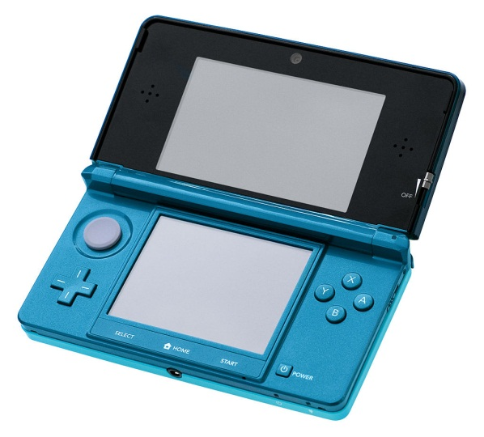
Video Games: From Then to Now
Each generation of home consoles has been more successful than its predecessors.
Many technological innovations caused huge leaps in the capability of video games.
The transition from 2D to 3D added complexity to games.
Games are now playable anywhere in the world.
Optical Media boosted the potential of 3D video games.
The Nintendo 3DS
Notes:
Console sales increased by roughly one third as compared to the previous generation. During this time, the video game industry has embraced many technological changes, such as changes in storage media from cartridge to optical media to digital media.
Games such as Wolfenstein 3D (1992), Ridge Racer (1994), Battle Arena Toshinden (1995) and Super Mario 64 (1995), proved that 3D environments and gameplay were not just viable but great experiences.
The rise of mobile/tablet gaming and the prominence of dedicated handheld devices have allowed consumers to play games anywhere, with interconnectivity being a prominent feature of today’s smart devices.
Picture credits: https://commons.wikimedia.org/wiki/File:Atari-2600-Wood-4Sw-Set.jpg, https://commons.wikimedia.org/wiki/File:DVD-Video_bottom-side.jpg

Slide 7


Video Games: A Modern Pastime
More than 70% of households play video games.
The market has substantially increased throughout the years.
Rise of independent development
Game engines have contributed to the increased quality of games.
The Wii sold over 100 million units.
Games like Minecraft have helped to grow the independent gaming scene.
Notes:
The 2015 ESA report states that more 70% of households play video games worldwide, with over 50% of US households having a dedicated gaming console. There are also over a billion iOS devices.
Starting as a gadget for those with the means to afford it, gaming is now ubiquitous modern entertainment. Constant growth in the medium and technological advancements have kept it ahead of the curve.
The rise of independent development has been brought around by low barrier to entry, as well as robust tools that assist with all areas of game development. This has allowed for high quality games to be created by teams as small as one person.
Picture credits: https://account.mojang.com/documents/brand_guidelines, http://www.publicdomainpictures.net/view-image.php?image=24835&picture=video-game-controllers&large=1

Slide 8


Game Engines: Middleware of Creativity
Before game engines, games were typically designed from the ground up as single entities.
Reusing resources is a key point.
Video game engines’ popularity rose with 3D computer graphics.
Maturing technology in game engines has allowed for an increase in scope.
The Utah teapot
Game Engines have seen use in medical and architectural fields.
Notes:
Game engines have existed almost as long as games themselves, but were initially very limited in scale and flexibility. This meant that, typically, games were made as singular entities from scratch. Companies would occasionally develop their own in-house engines to use with first-party software, but due to rapidly advancing technology and techniques, would not be able to re-use the majority of assets created.
Third-party game engines would not rise to real prominence until 1993, when id Software released id Tech 1, used to create the wildly influential Doom. Many more engines began to emerge, such as Voxel, Build and Quake engine to name a few. All had their own pros and cons.
3D gaming engines really came into their own with the release of id Tech 2 and Unreal in the late 1990s, bringing games like Deus Ex and Unreal Tournament to the fore.
As game engine technology has matured, the scope of their application has improved.
Picture credits: https://commons.wikimedia.org/wiki/File:Croc.5.3.10.a_gb1.jpg, https://commons.wikimedia.org/wiki/File:Utah_teapot.png

Slide 9
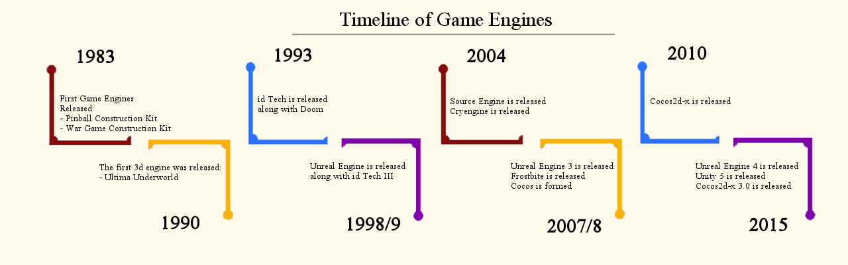
The Current State of Game Engines
There are dozens of game engines available on the market.
Unity, Unreal and Cocos2d-x are some of the most commonly used.
Most modern games are created using a game engine.
Game engines are becoming more portable.
Notes:
Currently there are game engines that are available for almost every possible use-case, including some that are beyond the scope of gaming. For example, Unreal offers visualization of architectural design and medical training.
Unity, Unreal and Cocos2d-x hold the majority market share for all console, PC and mobile gaming.
Due to their ease of use and creative flexibility, game engines have become by far the most popular way of creating and producing games.

Slide 10
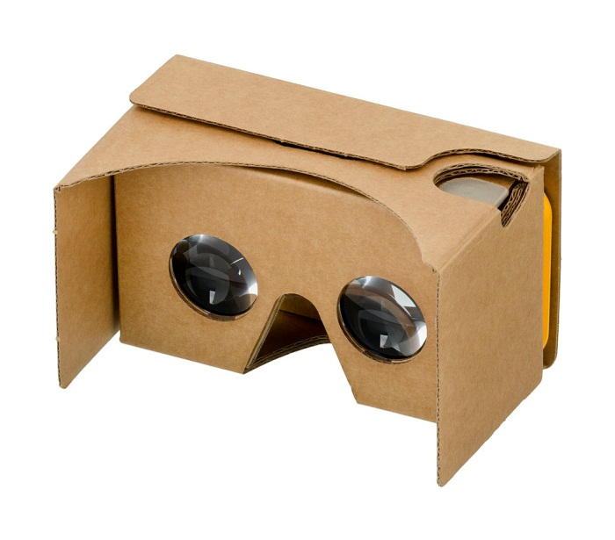
Games Development: Platforms
Currently development focuses on three major platforms: Console, PC and Mobile
When designing, all three platforms must be considered.
Including controls, player behaviour, performance, accessibility, and new ways of playing.
Google Cardboard
Notes:
At present, the three major platforms are Console, PC and Mobile. These different platforms have their individual hardware variations (e.g., different consoles, different PC configurations, different phones) that also factor into development. You see many games that run well on a PS4 but not on an XBOX One, and vice versa.
Always consider, as early as possible, the different design methodologies for every platform that you want to work with. Bottlenecks in processing power, viewport size and different control schemes will become issues if not considered.
With the advent of VR and AR, the fundamental mechanics of a game will need to be considered and potentially altered in order to avoid discomfort for the user.
Other considerations: What is the typical audience for each platform? What is the expected price point?
Image credit: https://en.wikipedia.org/wiki/File:Google-Cardboard.jpg

Slide 11



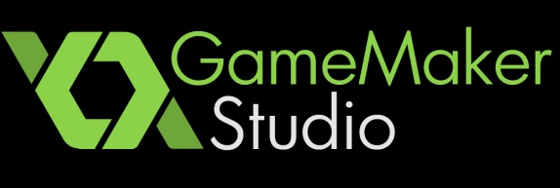
Flagship Software
Most engines have risen to prominence through flagship software. Below are some software applications that are synonymous with each engine.
Kerbal Space Program
Cities: Skylines
Pillars of Eternity
Rust
Rocket League
Street Fighter V
Shenmue III
Unreal Tournament
Risk of Rain
Undertale
Spelunky
Downwell
Final Fantasy Record Keeper
JoJo’s Bizarre Adventure
Clash of Kings
Tales of Asteria
Notes:
Many engines have built huge communities and developer bases, which have allowed for top products to be released for each engine. This in turn brings more developers to the engine to utilize it.
Above are examples of flagship software for the primary engines. It is good practice to sample each game’s demos, to get a feel for their range and scope.

Slide 12

Game Engines: Pros and Cons
Every engine has pros and cons.
Unreal Engine is predominantly specialized for first person games.
Unity is flexible and easily adapted to multiple platforms.
GameMaker: Studio is a very good entry level learning tool.
Cocos2d-x is completely open source and free.
Notes:
Each game engine will be tailored to suit certain use cases and appeal to certain audiences. Every engine has pros and cons, and researching these is invaluable in picking your engine(s) of choice.
Unreal Engine is predominantly specialized for first person games. It currently boasts unrivalled visuals, but does not boast some other engines’ ease of portability.
Unity is flexible and easily adapted to multiple platforms. However, rt does not provide you access to source code unless you pay for it.
GameMaker: Studio is a very good entry level learning tool, but lacks the performance strength that other game engines have. It also cannot create 3D games easily.
Cocos2d-x is completely open source and free, and is specialized for mobile.

Slide 13

Games Development: Coding Languages
Choosing the correct development language to work with is very important.
Lots of considerations
A large number of game engines have their own proprietary language set.
C++ and C# are two of the most popular choices.
Notes:
A key aspect of game creation is to work with the correct development language.
Lots of considerations need to be taken into account: staff language familiarity, target platforms, execution speed.
A large number of game engines have their own proprietary language set with them. Unity uses C#, Cocos2d-x has a Java/C++ base.
C++ is one of the most popular choices due to its high performance, object-orientated basis and scalability.

Slide 14
Unity: Multi-Platform Portability
Unity enables a developer to deploy 2D or 3D games across Mobile, Desktop, Console and VR devices.
Unity has a large developer community
Built-in Physics and Graphics Rendering
Notes:
Unity enables a developer to deploy 2D or 3D games across Mobile, Desktop, Console and VR devices.
Unity has a very large developer community to help beginners, as well as an asset store that contains a lot of ready-to-use assets
Unity uses Phys-X as its base physics engine, as well as being compatible with both Open GL, Open GL ES and Direct 3D. It also supports a wide range of 3D model formats from 3DS Max, Blender and Maya to name a few.

