Slide 1
Game Graphics

Slide 2
Module Syllabus
History of Graphics
2D Sprites
3D Modeling
Mapping

Slide 3
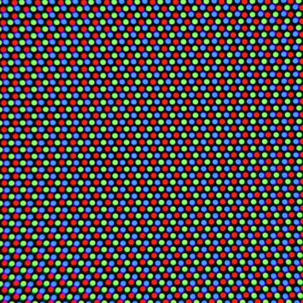
Graphics: History of Hardware
In the 1980s, a typical home computer had 16kb of RAM. Video chips didn’t have their own memory, so shared with the CPU. Typical screen resolution was 320 x 200 pixels (64,000 pixels total). One bit color (black and white) used 8k of memory, which is half of a typical machine. There were three methods of generating color with these limitations.
Notes:
To get perspective on how rapidly the capability of graphics units has grown, look at the timeline of graphics technology in games from the 1980s until now. In the early 1980s, a typical home computer had 16kb of RAM, which was shared across all applications.
With this in mind, consider that supplying one bit color (black and white) to a display used 8k of memory, which is half of the typical machine’s memory. Four bit colors (16 colors) took 32k which was more than most home computers had.
This meant that engineers designed different ways to generate color within games, including color cells (Commodore 64, Sinclair and NES), NTSC artifact coloring (Apple 2 Computer) and TIA driven graphics (Atari).

Slide 4
Color Cells: Commodore and NES
Arguably was the most popular form of generating color.
It worked by dividing the screen into 8x8 “cells”.
This method cost 1k of extra memory.
However, colors could not cross cells, as shown in the second example on this slide.
Another option was to use multi-color mode.
Notes:
This method divided the screen into cells (typically 8x8 pixels). You could change the color of each cell on a 1bit color basis (on or off).
This method cost 1k of extra memory, taking the one-bit color processing up to 9k.
Another option was to use multi-color mode. Multi-color mode halved the number of pixels used in each cell (making each pixel 2x1 in actual size), but doubled the colors allowed to be used from two to four. This allowed for greater color range.

Slide 5
NTSC Artefact Coloring: Apple 2 Computers
Apple 2 computers were quite complex, being among the first to have a color palette. Screen divided into sections of seven pixels. Each section assigned eight bits of memory. The PAL bit swaps the color of the seven pixels from green/pink to orange/blue.
0
0
1
0
0
1
0
0
PAL
P
0
0
Monochrome display
0
0
0
1
0
0
1
0
0
1
1
P
0
Color display
1
0
0
0
1
1
0
1
1
1
0
P
0
1
0
Color display
1
0
1
1
0
1
0
0
1
0
0
P
0
1
1
Color display
Notes:
Apple 2 computers were very complex systems that were among the first to have a color palette. This was done using a method called NTSC artefact coloring, which allowed pulses produced by NTSC televisions to be transferred into visible pixels.
Each portion of the screen was assigned eight bits of memory over seven pixels, which were lined up in a row. The eighth bit, or PAL bit, would allow for the swapping of the color palette from green/pink to orange/blue. This allowed for six colors to be displayed on the screen. While this may not be considered a feat today, the Apple 2 had 4k of memory originally.

Slide 6
TIA Driven Graphics: Atari
The TIA (Television Interface Adaptors) video chip in Atari. This chip used real-time drawing pixels onto the screen from left to right, line by line. This created serious hardware limitations and was seen as a very inefficient, and buggy way to draw graphics.
Pixels were drawn one at a time from left to right.
Notes:
The Atari 8-bit systems had their own custom chips called Television Interface Adaptors (TIA).
The TIA worked by scanning (real-time drawing) pixels on the television one at a time. It was highly inefficient at the time, due to a limitation in certain values which meant that black lines were produced in order to allow for full color.

Slide 7
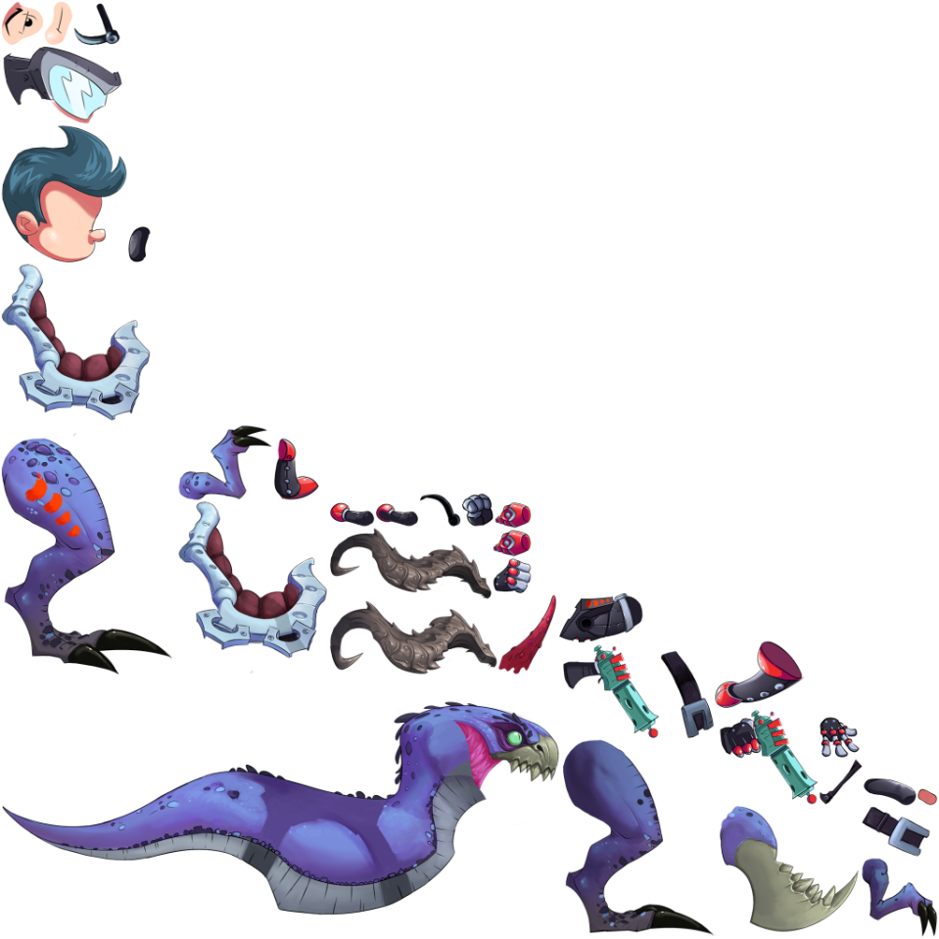
Sprites
Sprites were originally a way to composite multiple images together using hardware. This optimization became unnecessary as processor speed improved. Today, sprites refer to the 2D images themselves. Various techniques have been implemented to modernize the application of sprites within games.
Sprite sheets allow for complex sprites to be combined into a single image.
Notes:
Sprites were originally a method of compositing multiple images together using hardware. The chief methods have been identified in the previous three slides.
As processor speed improved, this became more of a favored art style than a method of optimization.
Various techniques have been implemented to modernize the application of Sprites within games: stylesheets, billboarding and rotoscoping to name a few. 2D sprites are also used in 3D games to produce effects, which is a much more efficient way to draw graphics.

Slide 8
2D Images: Characteristics
Images can be defined by their type, size, channel information and color depth. The most commonly used types are as follows:
PNG is typically used for most modern images as it supports up to 64 bits of color and lossless data compression.
Format | Compression | Color Depth | Translucency
.BMP | None/Poor | 1,2,4,8,16,32 | Second Image
.JPG | Lossy/Good | 8,12,24 | No
.GIF | Poor | 1,2,3,4,5,6,7,8 | No
.PNG | Lossless/Good | 1,2,4,8,16,32,64 | Yes
Notes:
Modern sprites are typically in a 2D image format as seen here. There are some exceptions, such as sprites that are drawn computationally (e.g., geometric shapes).
PNG is typically used for most modern images, as it supports up to 64 bits of color and lossless data compression. It also has translucency (also known as an alpha channel), which is important for overlaying sprites onto a scene.

Slide 9
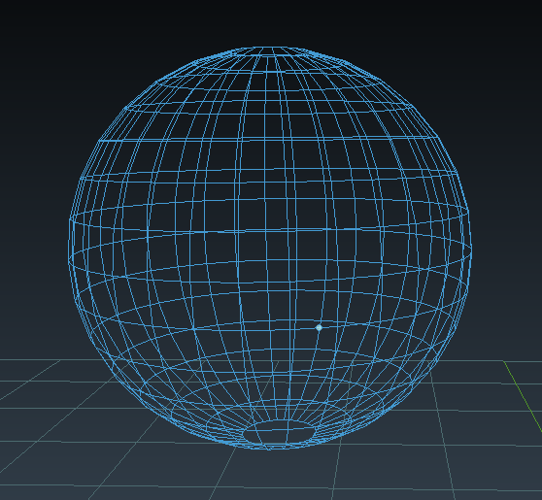
Polygons
Through the 1980s, graphics processing power grew exponentially. Advancements in the 1990s brought about 3D polygons. A polygon is defined from a set of vertices. Meshes and models are formed from multiple vertices. Low Poly models are made from a low number of vertices, and therefore a low number of polygons.
A wireframe sphere, made up of 482 vertices.
Notes:
Technological leaps meant that processing power available for graphics grew exponentially year on year.
Throughout the 1990s, the implementation and refinement of 3D graphics, specifically 3D polygons, came to the fore.
A polygon is created from at least three vertices (where two lines meet) to form a shape. A Tetrahedron has four vertices, which is the smallest number possible in a 3D polygon. A series of polygons are put together to form a mesh, or a model.

Slide 10
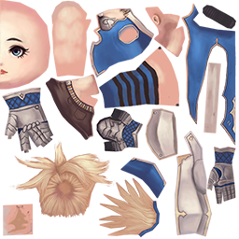
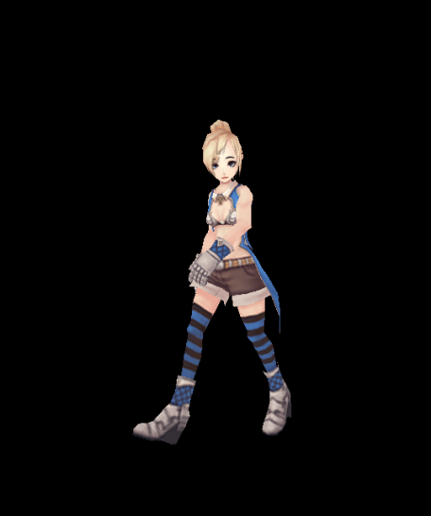
2d Images: Textures
In 3D games, images play an important role in texturing 3D objects. The example on the right shows how a single image contains textures for a skeletal model. UV/UVW is the method usually used to map textures to 3D objects.

Slide 11
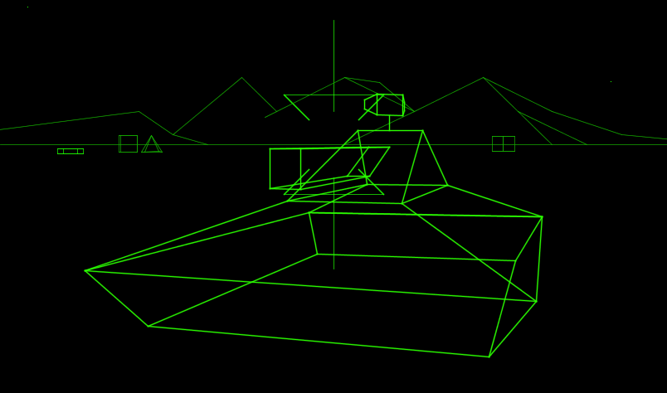
Polygons in Games
One of the first games using 3D polygons was Battlezone. The rise of modular PCs allowed the use of VGA graphics in games. Games like Super Mario 64, Final Fantasy 7, Crash Bandicoot and Ridge Racer were early commercial successes that mastered 3D polygons.
Atari’s Battlezone (1980) was made from 3D polygons.
Notes:
Games like Battlezone and Elite were limited to wireframe representations of polygonal models, due to the hardware’s inability to shade the polygons.
Flat shading was brought into the fore during the mid 1980s but was very difficult to achieve due to immensely underpowered hardware. The first was I, Robot.
Because game developers would sacrifice frame rate to achieve this effect, late 80s games like F/A Interceptor and Microsoft Flight Simulator 3 ran at very low framerates.
PCs able to support VGA graphics allowed for games like Doom, Quake and Unreal to be powerful benchmarks.
Consoles soon developed the capability to render polygons, though the limit that was still placed on polygon count meant that early 3D games have not aged aesthetically well. But 3D games had hit the mass market without shortcuts or shortcomings.
Image Credit: http://www.stupey.com/Battlezone/screenshot3.png

Slide 12
3D Modeling
3D modeling is the technique of developing a three-dimensional object by mathematically setting vertices. This is typically done with specialist software. For performance considerations you want as few vertices as possible Good artistic design, accurate UV modeling and competent 3D modeling allow a creator to overcome low poly models.

Slide 13
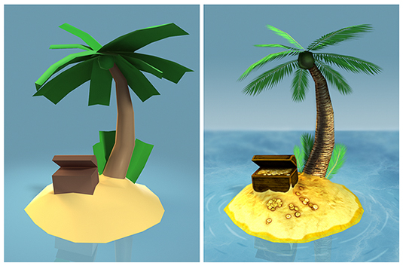
Low Polygon Models
It is possible to create aesthetically pleasing low poly models.
The primary goal is to eliminate overdraw.
In this example, it is essential to use good artistic direction and various lighting effects.
The above model is 334 polygons.
Notes:
We have talked about creating low polygon models and their importance to performance.
Look to eliminate overdraw; which is duplicate vertices and vertices that the camera will not see. This will help to save memory capacity and computing time.
Image credit: http://cdn.mos.cms.futurecdn.net/89a96f07878b252c564a6966995db332.jpg

Slide 14
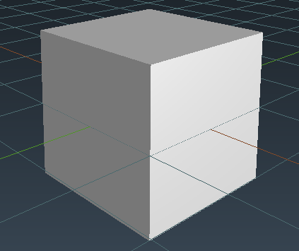
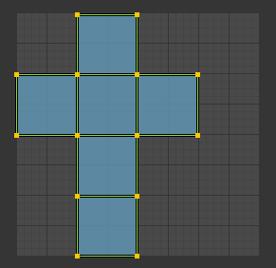
UV Mapping: Overview
A UV is a set of two-dimensional coordinates for textures that define how an image texture is connected to the surface mesh. UV coordinates have values between 0.0 and 1.0. Typically, UV mapping is completed within a third party 3D modeling tool. Utilizing 3D modeling competency and skilful UV mapped textures, it is possible to optimize performance.
A cube
The unwrapped UV coordinates of the above cube
Notes:
A UV is a set of two-dimensional coordinates for textures that define how an image texture is connected to the surface mesh.
UV coordinates have values between 0.0 and 1.0. With 0.0, 0.0 denoting the bottom left corner and 1.0, 1.0 the top right. If a coordinate is outside of this range, it usually means that the texture is being repeated.
Typically, UV mapping is completed within a third party 3D modeling tool, such as 3DS Max or Blender.

Slide 15
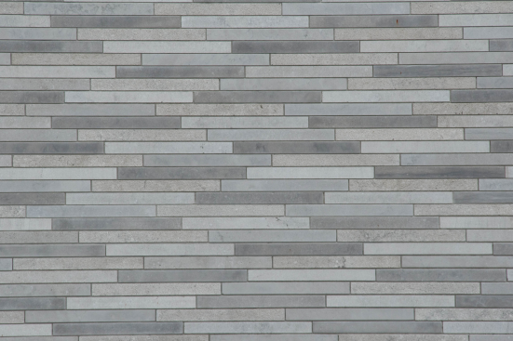
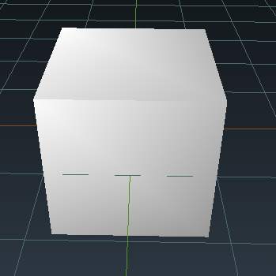
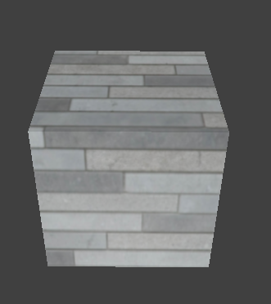
Diffuse Mapping
Texture mapping is specifically mapping a 2D image to the UV coordinates of a 3D model. Diffuse maps are the most widely used type of texture map. The diffuse map essentially paints the color onto the UV coordinates. In modern games, this is combined with other maps to create more definition.

Slide 16
Static Lighting: Light Mapping
Light mapping works in conjunction with diffuse mapping. Typically occurs with a 3D modelling program. Bakes or renders the model’s UV map when lighting is applied. This new texture overwrites the existing diffuse map. This pre-computation of shadows and lighting saves a great deal of compute time as opposed to doing it in real-time.

Slide 17
Dynamic Lighting: Real-time Lighting
Dynamic lighting is set within the game code and is rendered at runtime. Lighting and shadows should be updated immediately as a result. Typically shadows and character lighting are dynamic to achieve better realism. Dynamic lighting, as you may expect, is very computationally expensive.
Notes:
Dynamic lighting is set within the game engine and is rendered at runtime, allowing for lighting to be changed according to the position of the assets. This can be computationally expensive.

Slide 18
Lighting: Dynamic versus Static
Static Lightmaps
Dynamic Lighting
Increased render performance
Ambient occlusion allows increased complexity
Typically looks better than dynamic
Dynamic shadows and lighting allow greater realism
Much more code control
Looks more consistent than static
The best way to add lighting to your game is to use a mix of both static and dynamic.

Slide 19
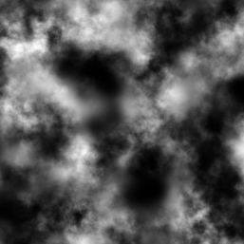
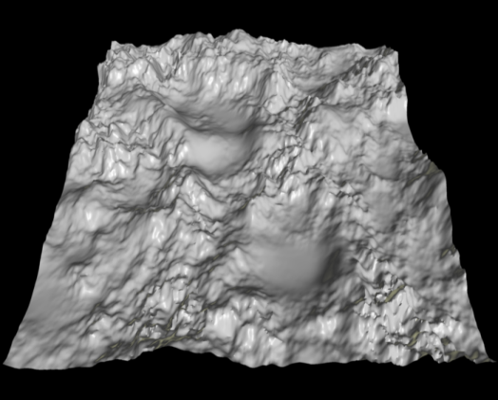
Height Mapping
Typically a greyscale image (though can be color) that represents elevation data in a 3D model.
The heightmap contains a single channel, with black representing the floor and white representing the maximum height.
Color maps allow for a greater range of height, as greyscale allows for only 256 heights.
Heightmaps are very simple to create but difficult to master.
A 2D height map and its 3D rendered terrain

Slide 20
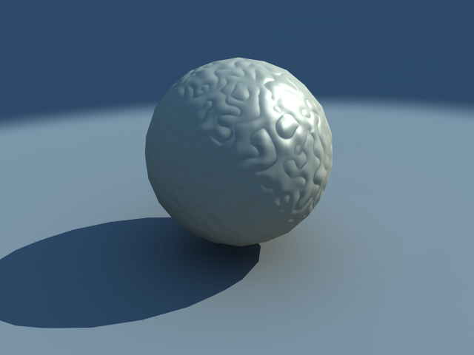

Normal/Bump/Displacement Mapping
A technique for creating detail on the surface of geometry. Bump/normal mapping is the earliest form of this technique. The detail created is fake. Detail created via grey scale for bump mapping, and RGB values for normal mapping. Displacement maps add resolution and physically manipulate the image when applied.
A bump map, notice the shadows?
A displacement map, notice the shadows?
Notes:
Image source: https://www.vray.com/vray_for_3ds_max/tutorials/vray_for_3ds_max_tutorials/displacement_mapping/tn_ex_bump.jpg
Image source: http://vraydoc.narod.ru/vray150sp1/ex_displ.png

Slide 21
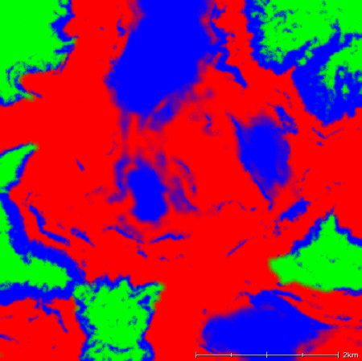
Alpha Mapping
Areas of the 3D mesh are designated to be translucent through either greyscale or RGB values. Typically used to map multiple textures seamlessly in an environment. The RGB values can be blended together to merge multiple textures together
An RGB-based alpha map

Slide 22
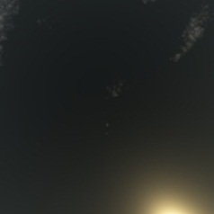
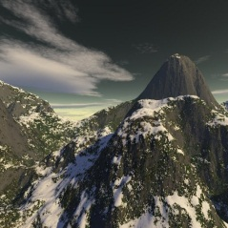
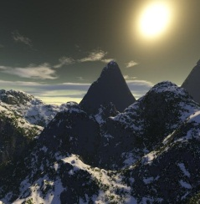
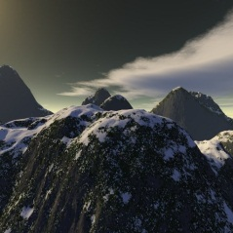
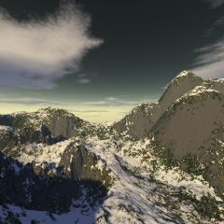
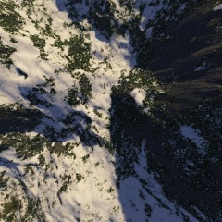
Skyboxes in Games
A skybox is one of the many forms of cube maps used in games. It’s a method for creating immersion within the world by enclosing levels within a cube/cuboid or sphere. Memory efficient, but tend to be static. Techniques like parallax scrolling allow for multiple layers of skybox to allow for a sense of depth.
A cuboid Skybox

Slide 23
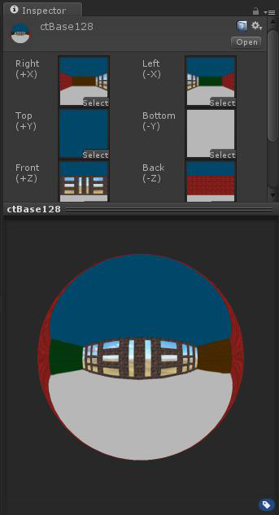
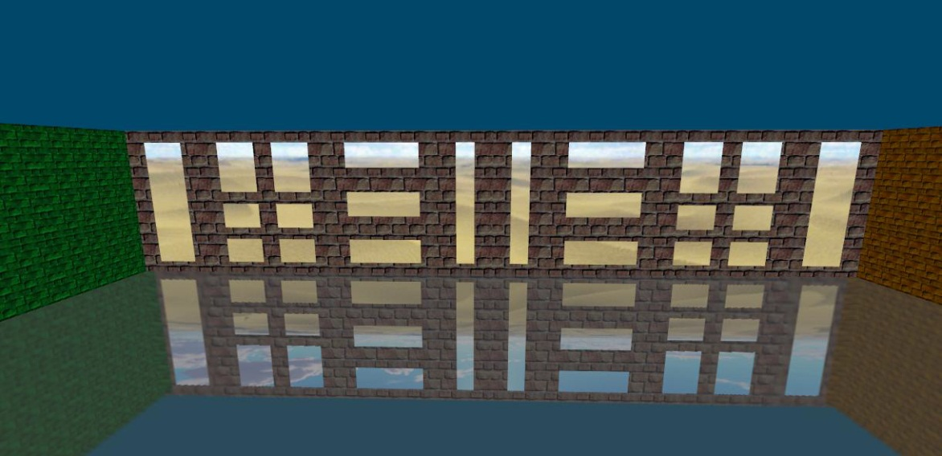
Cubemaps
Cubemaps are essential for many parts of environment mapping, not just skyboxes. Local cubemaps are a very efficient and accurate way of representing reflections. Other uses include global scene illumination, projection textures and specular highlighting.
Reflections using local cubemaps

Slide 24
Importance of External Resources
3D modeling, graphics programming and image editing are very time and resource intensive and can eat into your planning timeline.
To assist, there are a huge number of free open-source images and 3D models around the web.
Some are listed below:
https://3dwarehouse.sketchup.com/index.html
http://tf3dm.com/
http://texturelib.com/
http://www.turbosquid.com/

