Slide 1
Video Game Design

Slide 2
Module Syllabus
General Principles of Software Design Theory
Key Game Components
The Game Loop
Example Game Breakdown: Super Mario Bros.
Platform Considerations
Project Considerations

Slide 3
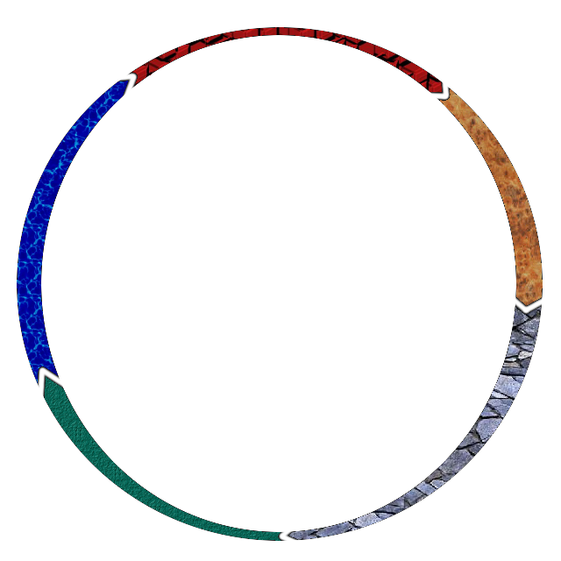
Software Development Process
Planning
Various software development processes exist to split development into distinct phases.
Teams are usually divided among the phases of software development processes.
A wide range of methodologies exist.
Gaming development tends to focus on rapid prototyping and agile development.
Analysis
Maintenance
Design
Implementation
A typical software development life cycle
Notes:
A software development process is typically a number of work phases which are used by engineers and developers. There are usually five phases, which are planning, analysis, design, implementation, and maintenance. This can vary from project to project.
Gaming development has tended to use rapid-prototyping and agile development, as these methods facilitate a quicker turnaround for releasing a game to market while still maintaining a high quality.

Slide 4

Game Development Process: Iterative Development
Video games are more complex than most software applications. Therefore, a more iterative prototyping methodology is favored. Pre-planning and pre-production are essential for success. Iterative design is becoming more and more commonplace.
Review
Planning
Testing
Prototyping
Typically, this iterative methodology would run multiple times per development week.
Notes:
Iterative prototyping allows for focus on regular testing, which facilitates problem solving and playability issues.
This type of prototyping needs pre-planning and pre-production, to allow for crisis management and changes in creative direction.

Slide 5




Object Orientated Components
Break down and distil game into the following categories:
Properties
Functionality
Consider if/how each component relates to the others. Use this to create a design document.
Example: Mario brick block
What are its properties?
Size, movement, physics, texture
What is its functionality?
Update (state, contents), draw, destroy
How does this item relate to others?
Mario, powerups, coins
Notes:
Part of the pre-planning process of iterative development is to break down and distil your game components down into their properties and functionality. The relationships among all components should be considered as well. The eventual aim is to create a design document for your team to use for reference. While this will usually be iterated upon, it is an essential starting point for creating base reference material for your game.
Consider the example of the Mario brick block from Super Mario Bros. 1. What are its properties, its size? Does it move? What other physics properties does it have? Look at the above example. Are there any missing properties, functionalities or relationships?

Slide 6
Grouping Game Objects
Update Process
Object
Objects within a game layer can be grouped together:
This makes updating/drawing faster or easier.
Grouping in a layer allows for centralized control. Decentralized control is also possible. It is useful to update game objects in the same order each time.
Object
Object
Update Process
Object
Update Process
Notes:
If defined within a layer, a single process can update a number of game objects at the same time. This allows for easy coordination of behaviors between multiple objects. For example, the update process could take multiple enemies that are using the same movement, and update their movement using the same process. The downside is that it can be cumbersome to manage multiple objects that differ in certain behaviors.
Decentralized control is the opposite of this. Each object is assigned its individual behaviors, but inter-object interaction can be difficult to handle.
These methods can be combined within your game; just take in to consideration what is suitable for each object.

Slide 7
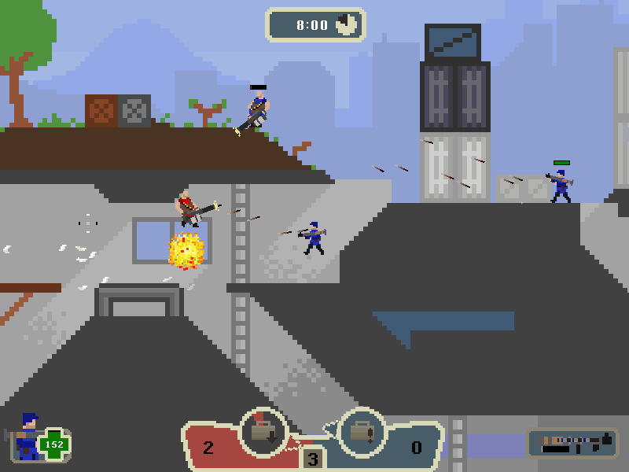
Game Objects: 2D Games and Groupings
2D game scenes tend to have a standard set of groupings:
Background | Sprite nodes | Static nodes | Text labels (overlay information)
Drawn first Should be size of perspective view | Drawn in front of background Movable and animated | Drawn in front of sprites Typically makes the terrain of a level | Drawn in front of entire scene Displays information/selectable menu items
Sprite nodes
Background
Static nodes
Text labels
Notes:
For 2D games, the draw order follows a similar structure: background -> sprites nodes -> static nodes -> text labels. This is not a strict order, as on occasion static notes will need to be drawn behind sprites, e.g., if a player dies and falls off screen, it will need to be drawn in front of the static nodes it falls beneath.
Image credit: http://small-games.info/s/f/g/gang_garrison_2_1.jpg

Slide 8
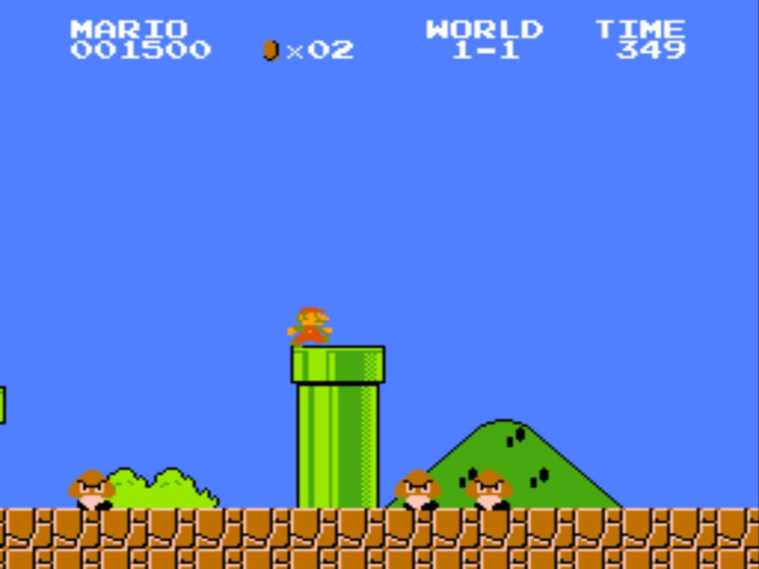
Breaking It Down: Super Mario Bros.
Background
Information overlay
Sprite Nodes
Static Node
Super Mario Bros. World 1-1 (Nintendo, 1985)
Notes:
Consider the first level of the classic game Super Mario Bros. This follows a similar structure to our previous example. The sprite nodes sit behind the static nodes. For example, if a piranha plant emerges from the green pipe and appears in front of the static node, then the user would see the piranha plant at all times.

Slide 9
Breaking It Down: Class Diagram
All groupings are superclasses, and each component will fall into one of these superclasses. Draw a class diagram based on previous classification of properties. An example class diagram is shown, but this isn’t the only possible method.
Sprite
PlayerCharacter
AICharacter
PlayerMario
PlayerLuigi
AIGoomba
AIKoopa
Notes:
Using superclasses and subclasses, we can create a class diagram for all of our game components. This will form the basis of your relationship diagram.
The example show cascades down to individual game objects. This is a key way to identify common functions between classes and objects.
The example shown is one way of doing this, but there are other methods that might be more suitable for your game.

Slide 10
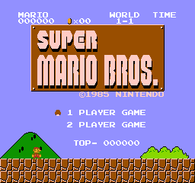
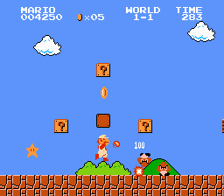
Breaking It Down: Identifying Groupings
TitleScreenLayer
Level1Layer
1 of:
16 of:
1 of:
0 or 1 of:
Dynamic Array of:
0 to N of:
PlayerMario
StaticGround
TextInfoLabel
PlayerMario
StaticGround
SpriteFireball
TextInfoLabel
Background
PlayerBigMario
AIGoomba
TextSplashMsg
TextMenuItem
PlayerFireMario
AIGoombaFlat
SpriteFireballExp
Background
SpriteMushroom
AIKoopa
SpriteCoins
SpriteFireFlower
SpriteShell
SpriteStar
StaticCoins
SpriteOneUp
Notes:
As you can see above, even basic designs can be very complex in terms of groupings.
Take a look at this diagram and understand the instances of each grouping. There can only ever be 0 or 1 instances of the player character, whether that is regular Mario, big Mario or fire flower Mario.

Slide 11
Breaking It Down: Update/Render Game Objects
Now consider the order of update/render functions for each of the game objects:
Level1Layer
Update
Render
Update Background
Update Player
Update Fireball
Update Enemies
Update Powerups
Update Coins
Update Score
Draw Background
Draw Sprites
Draw Temporary Animations
Draw score, lives and splash messages

Slide 12
Work on Your Game Idea
Try to create class and relationship diagrams for your own game idea:
What are the key game objects?
What are their properties?
How do they relate to one another?
How are they grouped together?
How are they updated?

Slide 13
Game Objects: From 2D to 3D Games
3D games are much more complex than 2D games:
A third dimension adds a potentially huge impact on overall performance.
Physics in 2D has three degrees of freedom; in 3D it has six degrees of freedom.
2D sprites are most commonly (one or many) image files. 3D sprites are models that are UV-wrapped in textures.
The processes behind lighting, cameras, AI and even sound are made more complex in 3D programming.
Notes:
Two translations (X, Y axes) and one rotation (Z); three translations (X, Y, Z) and three rotations (X, Y, Z).

Slide 14
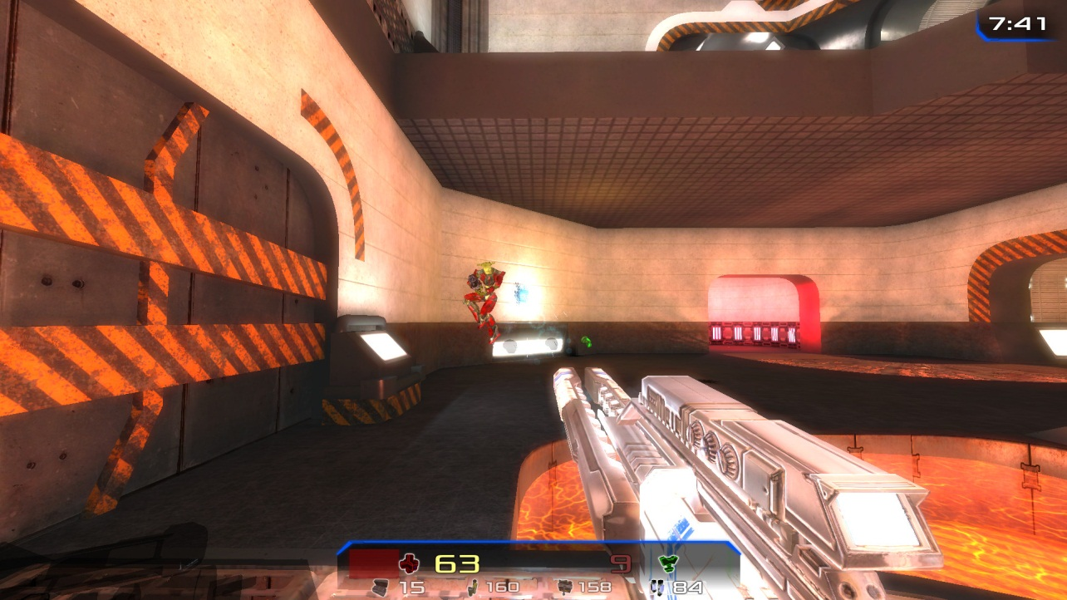
Game Objects: 3D Games
Skybox/ background | Level geometry | Model | Texture | Camera | Lighting | Effects | Text overlay
Six image files | 3D static meshes | 3D sprite objects | 2D images | Perspective or orthogonal | Specular, ambient, diffuse | Particle systems | Score, time, ammo
3D models
-
3D meshes
Lighting
Text labels
Notes:
Image credit:https://upload.wikimedia.org/wikipedia/commons/thumb/b/b9/Xonotic_Game_Play_-_Silent_Siege.jpg/800px-Xonotic_Game_Play_-_Silent_Siege.jpg

Slide 15
The Game Loop
The game loop is the main code of your game:
Three phases: initialize, update and render
Many different implementations on the game loop are possible.
Basic game loop:
This simple loop isn’t hardware specific. In the context of the code above, the framerate is number of times display_game() is called per second. Game speed is number of times update_game() is called per second.
bool game_is_running = true; while( game_is_running ) { update_game(); display_game();
}
Notes:
The game loop is the main code of your game. Generally, the three phases are initialize, update and render.
The initialize phase is used to do any game setup and prepare the environment for the update and draw phases. Here you should create your main entities, prepare the menu, detect default hardware capabilities, and so on. This will be used anytime there is a level/scene change.
The update phase is used to prepare all of the assets and objects to be drawn within the scene. This is also where physics, transformations, stat changes, and other similar operations/functions belong.
The draw phase is where all of this information is put onto the scene. This code will draw/translate the information defined in the update phase onto the screen.

Slide 16
The Game Loop: Frames per Second and Game Speed
A game’s frames per second (FPS) is the number of times the update-render loop runs per second.
The previous slide’s code runs as fast as it can. FPS will be determined by work to be done and platform speed.
It is key to run the game at a consistent speed, regardless of hardware. The aim is to limit the FPS so that it is stable.
Update
Render
U
R
U
R
U
R
U
R
U
R
1 Second
1 Frame per Second
1 Second
5 Frames per Second

Slide 17
The Game Loop: Sleep
U
R
Sleep
Aim to complete all processing and rendering within a specified time (16ms per frame for 60FPS). Will need to implement sleep to achieve constant framerate.
To achieve constant game speed, both sleep and frameskips need to be implemented. Achieving constant game speed may mean dropping rendering frames.
1/10 Second
1 Frame
1 Frame
1 Frame
10 frames per second
U
R
Overtime
U
U
R
S
U
Frame skip
Overtime
An example of achieving constant game speed through variable FPS
Notes:
When we don’t need to do anything, we just tell the game loop to go to sleep for the remaining time period and wake up when the next cycle is due. If we don’t do this, the game will run more quickly than intended. By introducing the sleep time we achieve constant frame rate.

Slide 18
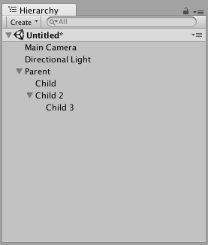
Unity: Hierarchy
In Unity, all game objects are displayed under the Hierarchy window Here Unity will enable a developer to create parent-child relationships between game objects You will also be able to attach the same function to multiple objects
Notes:
In Unity, all game objects are displayed under the Hierarchy window Here Unity will enable a developer to create parent-child relationships between game objects. This creates classes and subclasses between objects.
You will also be able to attach the same function to multiple objects

Slide 19
Unity: Scenes
Scenes in Unity are containers for game objects A scene will be a localized instance for each game object Scenes can simply be thought as a container for all of the in-game physics, logic and other interactions to take place
Notes:
Scenes in Unity are containers for game objects A scene will be a localized instance for each game object, if you wish to use multiple game objects, you will need to create multiple instances of the same object
Scenes can simply be thought as a container for all of the in-game physics, logic and other interactions to take place

Slide 20
Project Considerations
Solo projects for 3D games are time consuming and frustrating. A project will hit brick walls; how these are dealt with these problems will dictate how successful a project is. Making stand-out games in today’s market is incredibly difficult. Aspects of video game design will be completely new and have a steep learning curve (3D modeling, programming, advanced lighting, AI). Without meticulous planning, a project will almost certainly fail.

Slide 21
Project Considerations: The Importance of Planning
The importance of planning cannot be overstated. A design document is essential and should be detailed. Conduct risk assessments and find contingency plans for issues that may arise. Plan to develop a short demo of your fully featured game. Create a timeline for your project, with ideal milestones. Remember: iterative development!

