Slide 1
3D Effects, Architecture and Performance Considerations

Slide 2
Module Syllabus
Advanced 3D Effects
Animations
Particle Effects
Bloom
Other Effects (Hardware Tessellation, Tress Effects, etc.)
Physics
Advanced Coding Practice
Garbage Collection
Boxing/Unboxing

Slide 3
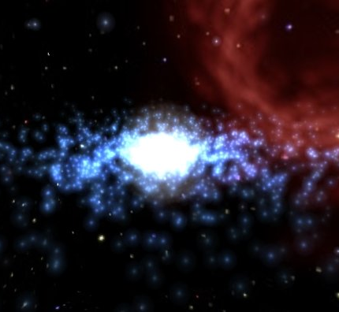
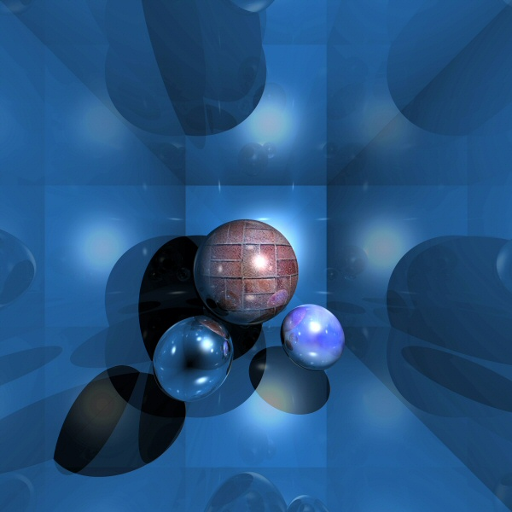
Advanced 3D Effects
Graphical fidelity and advanced artistic techniques have been core to modern games.
Techniques exist to impress, but also to cover polygonal limitations.
Advanced 3D effects should never be put into the initial prototypes of a game.
Notes:
Techniques like bloom, motion blur, chromatic aberration, film grain and lens flare exist to impress, but also to cover polygonal limitations.
Advanced 3D effects should never be put into the initial prototypes of a game, because they can be memory intensive and create issues that are hard to isolate.

Slide 4
Animations: Overview
Animation varies between media
A typical cartoon animates at 12 FPS.
Films tends to run at 24/48 FPS.
TVs run at 25/60 FPS.
Games tend to be locked at either 30/48/60 FPS.
Animation sits within the update/render loop, locking it to that FPS.
Notes:
The difference between games and other media is that the former is real-time and the latter is offline.

Slide 5
Animations: Production
A number of different animation techniques exist; choose one that is most suitable for a particular design:
Sprite sheet animation
Skeletal animation
Data-driven animation
Physics animation
Particle animation
3D animations are designed within 3D modeling programs like Maya or Blender. Animations are controlled via the gaming code/engine.
Notes:
Choose an animation techniques that is most suitable for your design:
Sprite Sheet Animation: 2D animation that is formed on a single image
Skeletal Animation: represented with both surface skin and a linked (and invisible) skeletal rig
Data-Driven Animation: maps motions from an actor (human or otherwise) to a virtual character
Physics Animation: mathematically based movement. Requires large computational cost but is more realistic.
Particle Animation: uses a large number of very small assets to reproduce special effects

Slide 6
Animations: Coding
Animations will usually be included in the game loop, whether it is something as simple as translating a new sprite position to rendering particle effects.
An example of animations within the game loop:
void HelloWorld::update(float delta)
{
auto position = sprite->getPosition();
position.x -= 250 * delta;
if (position.x < 0 - (sprite->getBoundingBox().size.width / 2))
{
position.x = this->getBoundingBox().getMaxX()
+ sprite->getBoundingBox().size.width / 2;
}
sprite->setPosition(position);
}
Notes:
The above moves a sprite along its X axis by 250 * delta until it is off of the screen.
This is a very simple example.

Slide 7
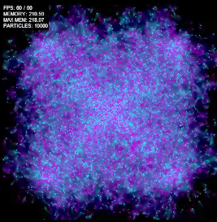
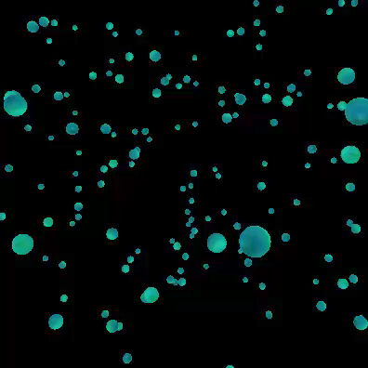
Particle Effects: Overview
Example of 2D particle effects
Particle effects are complex effects that are made from multiple smaller particles. The particle represents a point in 3D space.
Particle physics involve taking the particles and applying a force to them, e.g., leaves blowing in the wind.
Particle systems are containers that contain the emitters and particles.
Example of 3D particle effects
Notes:
Particle effects are complex effects that are made from multiple smaller particles. Particles are various generated assets: lines, pixels, polygons, 3D meshes or models.
Particle systems are a set of particles controlled by routines that allow them to act autonomously. Particle systems are dynamic, allowing for changes in form, direction and position.

Slide 8
Designing Particle Systems
Particle systems can be computationally expensive. They need to be designed with care.
Define certain parameters before creating a particle system:
Is the system permanent (e.g., a waterfall) or temporary (e.g., an explosion or fire)?
Does the particle system need to be 2D or 3D?
What physics are applied to the particles?
How many particles are being produced per frame?
Notes:
What physics are you applying to your particles? Are you limiting the emitter range? What directions can the particles travel in? Is gravity affecting particles? Are they affected by collision detection?

Slide 9

Particle Effects in the Game Loop
As mentioned previously, particle systems need to be managed carefully.
If particles are allowed to emit without end, they will cause a memory leak.
Consider setting levels of detail to help with memory management.
Sometimes consider putting a condition around your update loop.
Notes:
Every frame needs to do three things: create new particles, manage existing particle functions and render the particles. These parameters can be set in either the code or in your editing software.
If particle systems are allowed to run without end, they will cause a memory leak. This will lead to slowdown and eventually the crashing of your application. So ensure that each particle is temporary.

Slide 10
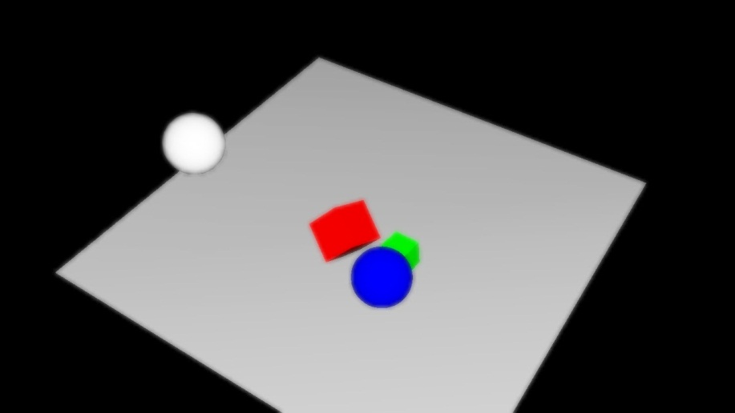
Bloom
Bloom is a shader used to represent how real-world camera perspectives work.
Outcast and Ico were two of the first games to use bloom.
A common way to achieve bloom is through coding in Gaussian Blur. Example:
float luminance; float middleGrey; float threshold; void main() { vec3 color = texture2D(inputImage, gl_TexCoord[0].st).rgb; color *= (middleGrey / luminance ); color *= 1.0 + (color / (threshold * threshold) ); color -= 0.5; color /=(1.0 + color); gl_FragColor.rgb = color; }

Slide 11
3D Camera Control
Early on, define whether the camera is third person, first person or free form. Each will have different design considerations.
If third person or first person, camera must be fixed to the player character so that the two move together.
Also, either fix the camera’s field of view, or have it variable to the device’s viewport.

Slide 12
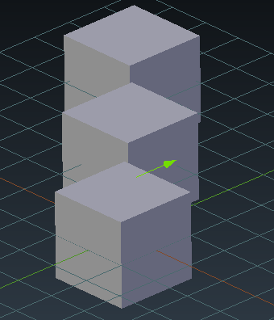
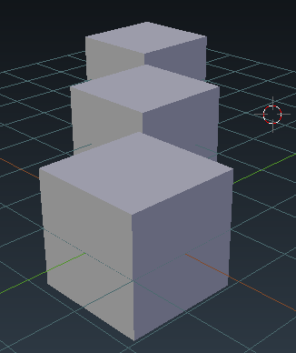
Perspective Considerations
Decide whether to use orthographic or perspective camera.
Define what is and is not visible by the camera.
Set the FoV, clipping planes and screen ratio.
Decide whether to use billboarding.
Orthographic Camera
Perspective Camera

Slide 13
Introduction to Physics
Physics are implemented in a game when realism is required.
The two predominant types of physics simulation are rigid body simulation and soft body simulation.
Physics are typically created through code-based computation.
A physics engine is used to manage the data flow of physics calculations.
Notes:
Physics are created through code-based computations that detect the physics within the scene, the collision detection of meshes/models and the deformation of any assets.
Typically due the computational complexity of physics calculations, a physics engine is used to manage the data flow of physics calculations.

Slide 14
Maths, Maths, and More Maths
To code physics, it helps to get to grips with complex mathematical computations.
The kinematics of the object should be calculated initially.
It is imperative that physics are calculated independent of framerate.
delta
Physics simulation rate
lag
Frame rate
updated
now
Notes:
To code physics yourself, getting to grips with complex mathematical computations is beneficial. Familiarization with Newton’s Laws of Motion for example, can help with force/mass calculation.

Slide 15
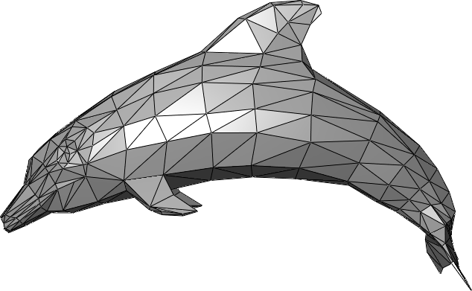
Physics Bodies: Rigid Bodies
There are two predominant types of physics bodies: rigid bodies and soft bodies.
Rigid bodies are solid, inflexible objects. These tend to form the majority of physics objects in a game.
Rigid body inflexibility is the key simplification when compared to soft bodies.
Notes:
The kinematics of the object should be calculated. This is the motion of the rigid bodies, but without the calculation of mass or force.
It is imperative that physics are calculated independent from the framerate but are rendered within the update loop.

Slide 16
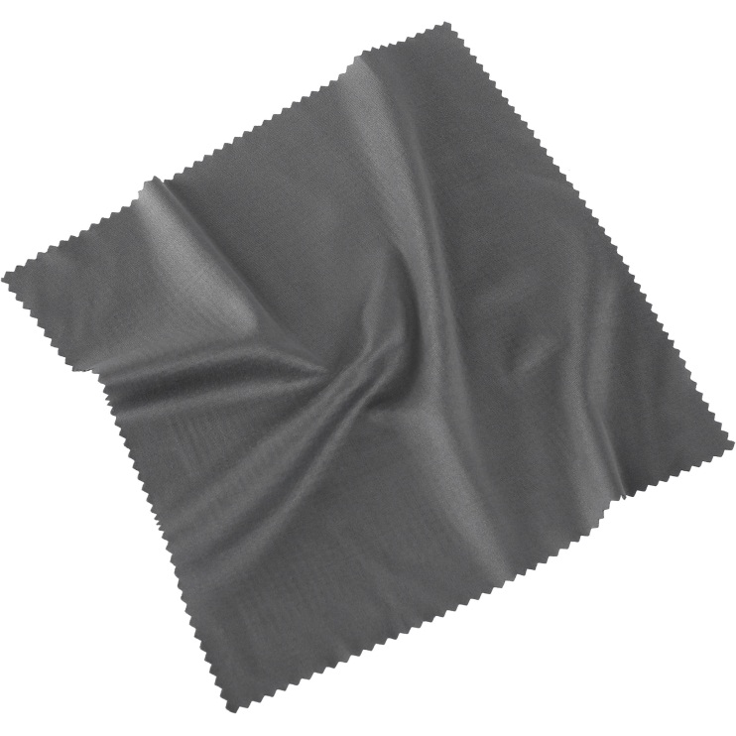
Physics Bodies: Soft Bodies
A soft body allows the game object to change its shape according to external forces acting upon it.
Common soft body examples are cloth, balloons and some fluids.
Kinematics and collision detection are far more complex for soft bodies.

Slide 17
Contacts/Joints
Contacts/joints are formed by applying constraints to the motion of rigid bodies.
This allows for collisions to affect objects differently, depending on constraints.
The attached bodies will need to have their physics adjusted so that the collisions do not affect their connection.

Slide 18

Collisions
Collisions are simple to implement at a basic level, but very difficult to accurately represent.
The objective is to check if objects collide with each other every time they move.
Typically bounding volumes are applied to each object, and the code checks whether the volumes intersect.
Two of the popular types of bounding volumes are: OBB: Orientated Bounded Boxes AABB: Axis-Aligned Bounding Boxes
Axis-aligned bounding box
Oriented bounding box
Bounding circle

Slide 19
AABB: Axis-Aligned Bounding Boxes
AABB are simple bounding boxes that are aligned with the axes of the co-ordinate system.
Due to their simplicity, they are preferred for simple static objects that don’t require many transformations.
They regularly do not fit their underlying geometry as tightly.
The disadvantage of AABBs is that they have to be recalculated when the game object is translated.

Slide 20
OBB: Orientated Bounded Boxes
OBB are more advanced than their AABB counterparts, because they align themselves to the underlying geometric coordinates.
OBBs are complex because they will need to adjust their position as well as run collision checks.

Slide 21
Performance Considerations of Physics
Soft body physics are far more performance intensive than rigid body physics.
Results will need to be repeated, so ensure that physics are frame-rate independent.

Slide 22
Are Physics Necessary for Your Game?
It’s important to note that in-depth physics aren’t necessary for all games.
Simplistic kinetic movement can be enough.
Determine early on what levels of physics a project will need.
Implement small amount of physics work at a time.

Slide 23
Performance Optimization: Gathering Information
If you can’t measure it, you can’t improve it.
Tools such as Mali Graphics Debugger, or other performance profilers, can provide visualization.
Determining the source of performance issues can be complex.
Notes:
Determining the source of performance issues is complex. Try enable effects, lighting, and other game objects to narrow down the source of issues.

Slide 24
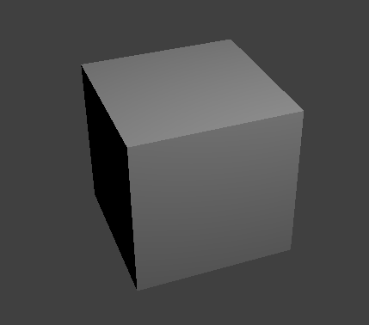
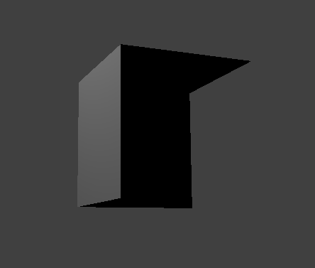
Overdrawing
Overdrawing is the rendering of polygons that are never seen.
This can be prevented by framing a scene in a way that allows for a minimum number of pixels to be drawn.
Overdrawing can be difficult to calculate exactly, but there are numerous tools that assist with this.
This cube has half of its faces removed, but when rotated correctly, it is fully visible as a 3D object.
Notes:
Overdrawing is when polygons are rendered that are never seen, causing additional computation to be done. This can be especially problematic on mobile platforms which need more resource management considerations.

Slide 25


Garbage Collection
Garbage collection is the colloquial term for managing memory for data sets that are out of scope.
Some languages, such as C++, do not have this. Consider their implementation.
Implementing can create an overhead in memory, performance and the complexity of the language.

Slide 26
Other Techniques
Macrotexturing: batching multiple textures onto a single image
Batching: If a number of actions or objects have similar properties, they can execute their properties across one data structure.
Render limiting: not all assets need to be rendered for every frame
One Second
FPS
One Frame
UI Update
Updating the UI every two frames would not be noticeable but would improve performance.
Notes:
If you are running a game at 60 FPS, try updating some assets only every second or third frame.

