Slide 1
Mixed Reality

Slide 2
Module Syllabus
What is Virtual Reality (VR)?
History of VR
Types and Hardware within VR
Economics
Current Products
Developing with VR
Interaction and Gameplay within VR
Best Practices in VR
What is Augmented Reality (AR)?
History of AR
SLAM
Depth camera sensors (Triangulation, Structured light, Time of flight, neural networks)
AR Frameworks
The Future of AR (Industries & Cloud)
Notes:
In this lecture, we will cover a range of topics related to mixed reality, including virtual reality and augmented reality.

Slide 3
Mixed reality: VR/AR the Next Frontier?
Mixed reality refers to the merging of the real world with the digital one. Augmented and Virtual reality are the primary candidates to achieve this.
Virtual reality (VR) has been highly vaunted as the next great technological step in video games.
VR and Augmented Reality (AR) have started finding their way into our everyday lives.
VR promises the possibility of unparalleled immersion.
AR promises to blend the digital world with our perception of reality.
Notes:
Mixed reality refers to the merging of the real of world with the digital one. In these years, two concepts have been recognized as the means to achieve this (augmented reality and virtual reality).
Virtual Reality (VR) has been highly vaunted as the next great technological step in video games, following on from 3D games, optical media, and cloud computing.
VR and Augmented Reality (AR) have started finding their way into our everyday lives. They have started to be widely used for commercial training in the medical and military fields.
VR promises the possibility of unparalleled immersion by creating experiences that envelop one or more of the user’s senses.
AR promises to blend the digital world with our perception of reality.

Slide 4
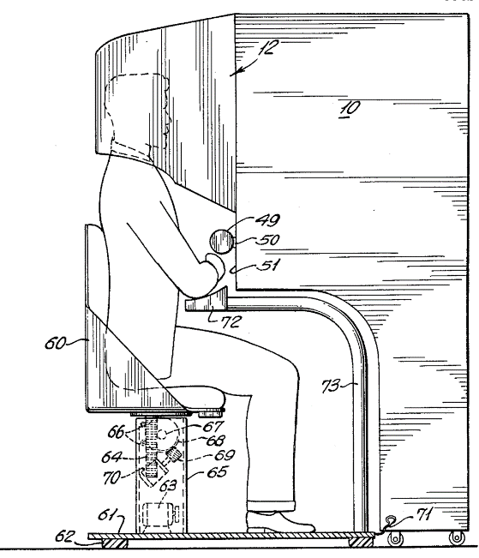
History of VR
The first use of a digital virtual reality system was Morton Heilig’s Sensorama, in the late 1950s. Ivan Sutherland, with the help of his student Bob Sproull, created what is considered the first virtual reality head-mounted display system in 1968. In 1977, MIT researchers developed the Aspen Movie Map, which was a crude virtual simulation of Aspen, Colorado.
Sensorama
Notes:
Image source: https://upload.wikimedia.org/wikipedia/commons/thumb/a/ae/Sensorama_patent_fig5.png/640px-Sensorama_patent_fig5.png

Slide 5
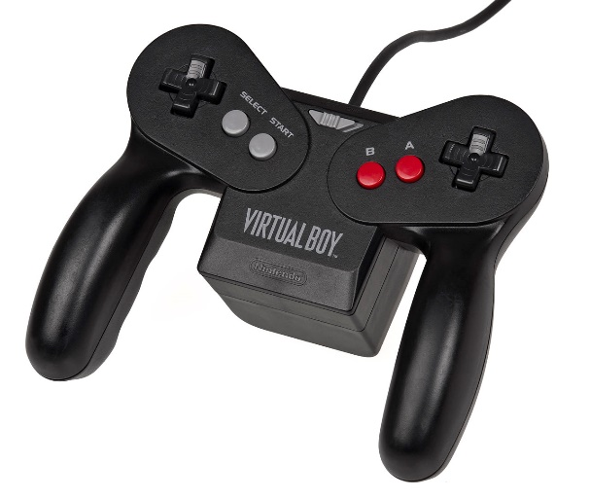
History of VR
Virtual reality gaming started to take shape in the early 1990s. In 1992, Jonathan Waldern, a PhD researcher, launched Virtuality, the first mass-produced, networked, multiplayer VR location-based entertainment system. Nintendo jumped into the VR gaming scene in 1995 with the HMD gaming system Virtual Boy.
The Virtual Boy used a controller with a headset, which led to uncomfortable user experiences.
Notes:
Image credit: http://i.imgur.com/zgmSD.jpg

Slide 6
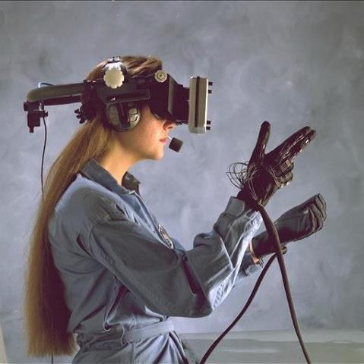
Types of VR Systems
There are a number of different systems that VR can follow:
Immersive VR: These systems are often equipped with a Head-mounted Display (HMD)
Non-immersive VR: A system in which only a subset of senses are subsumed, or the senses are only partially subsumed
Telepresence: A technology links remote sensors in the real world with the senses of a human operator
Distributed VR: A simulated world that runs not on one computer system, but on several
A historical example of immersive VR
Notes:
Image credit: https://blogs-images.forbes.com/martinzwilling/files/2011/10/300px-AC89-0437-20_a.jpg

Slide 7
Current VR/AR Products
Name | Features
HTC Vive | Tethered device, 90Hz refresh rate, 1080 × 1200 resolution lens, accelerometer, magnetometer, 360-degree positional tracking
Oculus Rift S | Tethered device, 80Hz refresh rate, Fast-switch LCD 2560 × 1440 per eye, accelerometer, laser position sensor, 5 built-in cameras
PlayStation VR | Tethered device,120Hz refresh rate, 960×RGB×1080 per eye, accelerometer, gyroscope, PlayStation Eye tracking system
Oculus Quest | Untethered device, 72Hz refresh rate, PenTile OLED 1400 x 1600 per eye, accelerometer, gyroscope, 4 built-in cameras, 128 GB of memory, 6 degrees of freedom
Hololens 2 AR | Untethered device, see-through holographic lenses, 2K 3:2 light engines in each eye, 1080p video, Head tracking, Eye tracking, 6 degrees of freedom
Google Cardboard | For untethered devices, works with Galaxy S6 phones. Phone-specific specs.

Slide 8
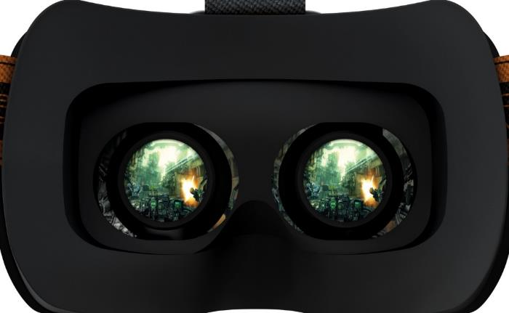
Working with VR: Games
Development for VR has largely revolved around shorter experiences. Most experiences are changing the very fundamental aspects of typical game design. Graphical fidelity, framerate and locomotion need to work seamlessly and perfectly.
Notes:
Development for VR has largely revolved around shorter experiences, as users are not yet accustomed to wearing the headsets for long periods.
Most experiences are working with very fundamental aspects of game design: reduced UI, basic controls, and especially graphical fidelity.
Graphical fidelity, framerate and locomotion need to work seamlessly and perfectly. If there are any issues, there are real consequences to the user experience.

Slide 9
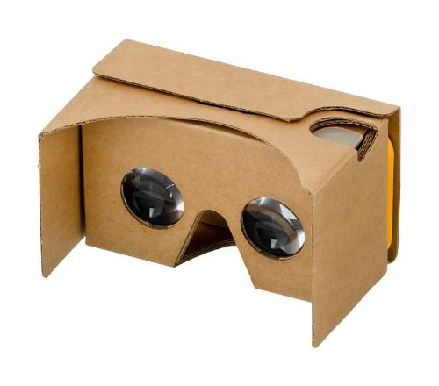
Mobile VR
Mobile VR utilizes existing mobile phone hardware as the viewport and processing unit. This allows the VR headset to utilize the different hardware features of mobile phones, such as the on-board accelerometers. It is important to note that, due to the varying resolution of mobile phones, most Mobile VR headsets are limited to a few models.
Notes:
Img src: https://en.wikipedia.org/wiki/File:Google-Cardboard.jpg
Mobile VR utilizes existing mobile phone hardware as the viewport and processing unit. This allows the VR headset to utilize the different hardware features of mobile phones, such as the on-board accelerometers. It is important to note that, due to the varying resolution of mobile phones, most Mobile VR headsets are limited to a few models.

Slide 10
Mobile VR
The accelerometer is a built-in electronic component that measures tilt and motion.
The gyroscope is a built-in electronic component that measure rotational motions.
The integration of these sensors in a VR headset, like the Oculus Quest, can be used for head tracking.
Note that, due to a mobile device’s relatively low CPU power, care must be taken when considering latency and performance, techniques such as Asynchronous Spacewarp and Timewarp have been developed to reduce latency and increase frames in VR applications.
Notes:
The accelerometer is a built-in electronic component that measures tilt and motion.
The gyroscope is a built-in electronic component that measure rotational motions.
The integration of these sensors in a VR headset, like the Oculus Quest, can be used for head tracking. Note that, due to a mobile device’s relatively low CPU power, care must be taken when considering latency and performance, techniques such as Asynchronous Spacewarp and Timewarp have been developed to reduce latency and increase frames in VR applications.

Slide 11
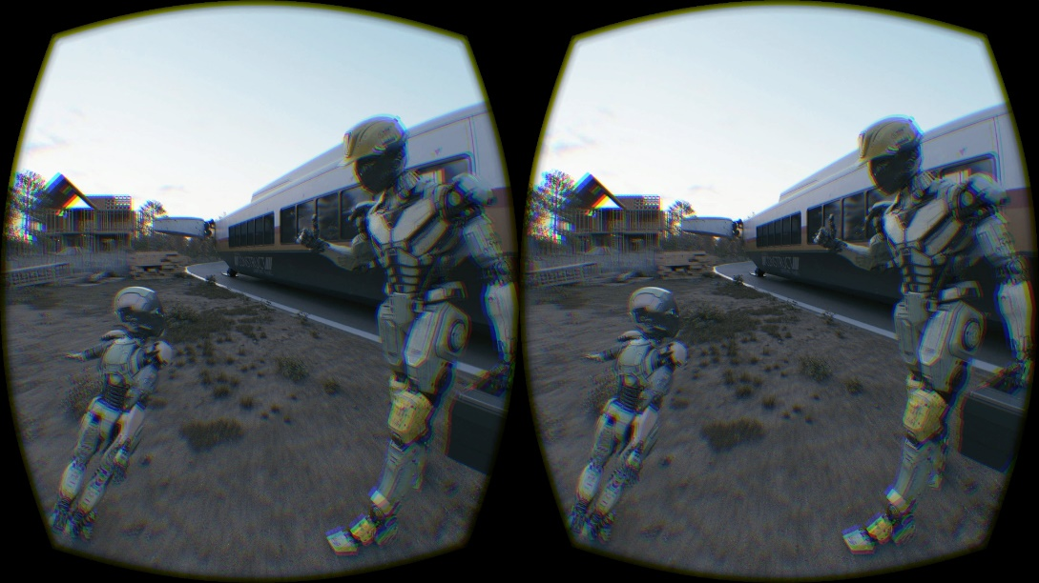
The VR Rendering Pipeline
A general rendering pipeline works by uploading the geometry of an object, generating a right/left views and merging these into a final side-by-side image.
The pipelines have been designed to minimize rendering latency. Double wide rendering has been implemented into Unity’s VR pipeline.
Double wide rendering allows an optimized pipeline for VR
Notes:
Image source: http://i.imgur.com/o22zN9o.jpg
A general rendering pipeline works by uploading the geometry of an object, generating a right/left views and merging these into a final side-by-side image.
The pipelines have been designed to minimize rendering latency. Double wide rendering has been implemented into Unity’s VR pipeline.

Slide 12
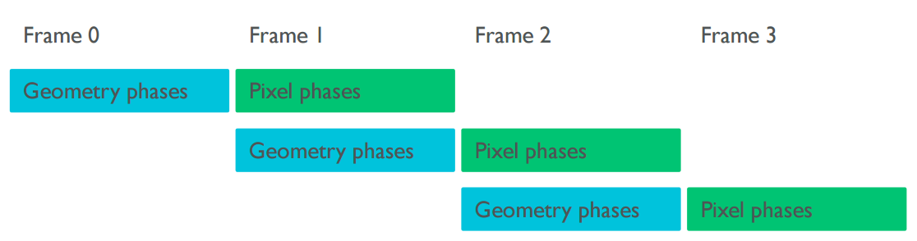
Frame Pipelining
Increases latency, but also increases throughput Vertex work is typically bandwidth bound: low ALU/Load-store ratio Overlapping with pixel work increases utilization
Notes:
The graphics pipeline can be spread over multiple frames; this is a common practice. CPUs often already have their own buffering, which can be piped off to the GPU.
Typically, all the geometry processing is completed in one frame; then, fragment processing is completed on the next frame. Pixel and geometry processing take place on every frame. Geometry processing uses much less bandwidth than pixel processing. The ratio of maths to load store instructions is very low, so lots of loading/storing. The rendering is now two frames long, which is an increase in latency.
First, the application will render two images to the eye buffer. This is simply two straightforward perspective projections. Next, the application needs to take the lenses into account. This is done via the display buffer, which uses lens magnification, chromatic aberration, and some redundant panel area to accurately portray the scene.

Slide 13
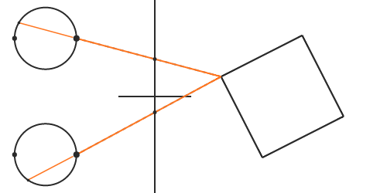
Fundamentals of Stereoscopic Rendering
Stereoscopic rendering is not as simple as putting two slightly different images side-by-side. Stereoscopic vision defines where game objects and visual cortex are, when multiple images need to reach two destinations. The light produced in the scene will need to travel in the same direction as the light that would have been reflected off the object.
Notes:
Stereoscopic rendering is not as simple as putting two slightly different images side-by-side. Stereoscopic vision defines where game objects and visual cortex are, when multiple images need to reach two destinations. The light produced in the scene will need to travel in the same direction as the light that would have been reflected off the object.

Slide 14
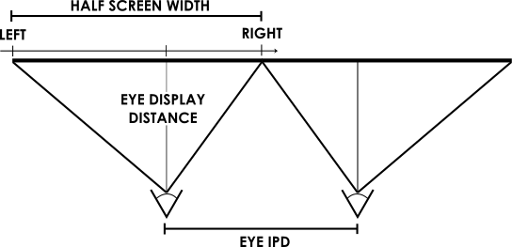
Fundamentals of Stereoscopic Rendering
The projection of the image can be done by drawing a line from each vertex of the game object to the location of the pupil. An issue arises when, in a stereo rendering setting, each eye needs a different projection matrix. Obtain the projection matrix for one eye by creating a pyramid:
Notes:
When, in a stereo rendering setting, each eye needs a different projection matrix, an issue arises because the viewer’s eyes are probably not centred on their respective halves of the screen. If they were, the projection matrix would be symmetric.
We obtain the projection matrix for one eye by creating a pyramid, defined by the four corners of that eye’s screen half and the eye's distance from the screen. This becomes a frustum.

Slide 15
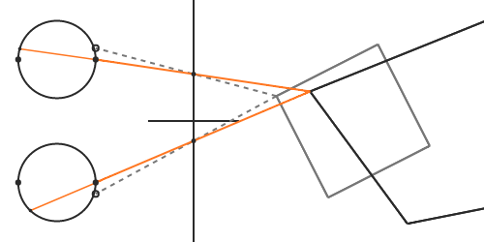
Calibrating Eye Tracking
For the fundamentals of stereoscopic rendering to work, it is assumed that the application/device knows the exact location of the viewer’s pupils. When a viewer’s interpupillary distance (IPD) is slightly different than the population average of 64 millimeters, eye tracking is needed.
Misalignment between viewer’s IPD and virtual camera separation. The presumed IPD is wider than the actual, causing a distorted image.
Notes:
For the fundamentals of stereoscopic rendering to work, it is assumed that the application/device knows the exact location of the viewer’s pupils. When a viewer’s interpupillary distance (IPD) is slightly different than the population average of 64 millimetres, eye tracking is needed.

Slide 16
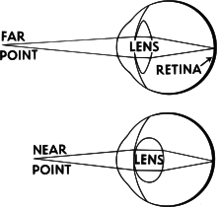
Calibrating Eye Tracking
The correct solution requires eye tracking. Some headsets install a pair of sensors that can detect the viewer’s gaze at a high rate. Headsets without eye tracking will need to ensure that the viewer’s focus is somewhat fixed or known. Accommodation has the effect of making objects that are out of focus appear blurry, while objects in focus remain sharp.
Eye accommodation. The eyes’ lenses change their focal length based on the distance to observed object.
Notes:
While some headsets include sensors to detect the viewer’s gaze at a high rate, this is not yet commonplace.
Headsets without eye tracking ensure that focus is fixed or known, for instance, by placing important content at a certain distance from the viewer.
Alternatively, it is possible to reach approximate solutions by placing the virtual cameras at the eye centers, as opposed to lying on the pupils.
Accommodation, i.e., the fact that the eyes’ lenses have to change focal length based on the distance to observed objects, is a mechanism that works closely together with vergence. It has the effect of making objects that are out of focus appear blurry, while objects in focus remain sharp.

Slide 17
Lenses
Lenses also introduce a whole new set of issues for the developer to handle. Points on the image plane are shifted from where they would be without lenses. Lenses will distort the light such that it no longer travels in a straight line. This mismatch causes users to perceive a distorted shape. To understand how to correct this, first, we need to understand what the lenses do so that this can be undone.
Notes:
So far, we have ignored the elephant in the room: You cannot possibly focus on a display that is close to your face. That is why we need lenses. Unfortunately, introducing lenses also introduces a whole new set of issues to handle, such as chromatic aberration (color fringing), astigmatism (variation in focus), and geometric distortions where points on the image plane are shifted from where they would be without lenses.
First of all, our simple projection model breaks down. Even if our virtual cameras perfectly coincide with the viewer’s pupils, the lenses will distort the light such that it no longer travels in a straight line. When our visual system traces rays back, it will do so assuming that they did go in a straight line, and they will intersect at a location different than where we intended. This mismatch causes us to perceive a distorted shape.

Slide 18
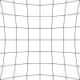
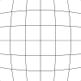
Distortion
The lenses on an HMD cause something called pincushion distortion. The inverse of a pincushion distortion is a barrel distortion. Distortion can be implemented as a post-processing effect using fragment shaders.
Pincushion distortion
Barrel distortion
Delete Post
Notes:
On an HMD, lines may bend inward toward the center of the image, producing what is known as a pincushion distortion. The degree to which the lines bend depends on the optical properties of each lens.
Pincushion distortion is more broadly known as geometric lens distortion, and it is most commonly corrected in software using an inverse distortion. After rendering the scene to each eye, the resulting image is distorted before it is presented on the display. When the distorted image is viewed through the lenses, the software distortion and the lens distortion will act against each other and the user will perceive straight lines.
The inverse of a pincushion distortion is called a barrel distortion, and it has the effect of blowing lines radially outward. A perfect inverse distortion would require knowledge of the exact optical properties of the lens. These properties are often unknown or simply not disclosed by the manufacturer, and we resort to a model of a handful of parameters that can be iteratively tweaked to give the best result for a specific lens.
Distortion can be implemented as a post-processing effect using fragment shaders. After rendering the scene to an offscreen texture, we can run a fragment shader—one for each eye—over a quad that covers each eye’s half of the display. The interpolated position inside the quad is transformed by applying the distortion and mapping the result to image coordinates.

Slide 19
Distortion Shaders
Distortion shader scales the incoming coordinates to correct aspect ratio. Distortion will also cause the image to shrink, wasting much of the available screen real-estate in the process. This can be corrected by rendering to a framebuffer of a higher resolution than the viewport.
in vec2 position;
void main()
{
vec2 q = (position - distortion_centre);
float r2 = dot(q, q);
float r4 = r2 * r2;
vec2 radial = u * (k1 * r2 + k2 * r4);
vec2 tangential = vec2(
p2 * (r2 + 2.0*u.x*u.x) + 2.0*p1*u.x*u.y,
p1 * (r2 + 2.0*u.y*u.y) + 2.0*p2*u.x*u.y);
vec2 distorted = position + radial + tangential;
vec2 texel = vec2(0.5) + 0.5 * distorted
fragColor = texture2D(eyebuffer, texel);
}
In its simplest form, the distortion shader would look like this.
Notes:
There are some further details that we should note.
First, the shader will need to scale the incoming coordinates to correct aspect ratio. This is necessary since we want the distortion to be circular when presented on the display, but the quad might be stretched to be non-square depending on the size of the display. Furthermore, the distortion will also cause the image to shrink, wasting much of the available screen real-estate in the process. The latter can be corrected by rendering to a framebuffer of a higher resolution than the viewport it will be presented on, at the expense of performance.

Slide 20
Chromatic Aberration
Because the lens is like a prism, different wavelengths of light are refracted by different amounts. This is called chromatic aberration. Chromatic aberration gives a noticeable red or blue color fringe around objects. To correct for this, each wavelength of light emitted from our display needs to be distorted differently. This is difficult to do in software, so approximate a solution by distorting the red, green, and blue output channels separately.
Notes:
Because the lens is like a prism, different wavelengths of light are refracted by different amounts. This is called chromatic aberration. Chromatic aberration gives a noticeable red or blue color fringe around objects. To correct this, each wavelength of light emitted from our display needs to be distorted differently. This is difficult to do in software, so approximate a solution by distorting the red, green, and blue output channels separately.

Slide 21

Anti-aliasing
Anti-aliasing is a technique for reducing “jaggies.” Anti-aliasing is a method that fools the eye into thinking the jagged edge is smooth. On Mali, 4x MSAA requires hardly any extra computational cost.
Notes:
Anti-aliasing is a technique for reducing jaggies: step-like lines that should otherwise appear smooth.
Jaggies appear because the display doesn’t have enough resolution to represent a line as smooth to the human eye. This becomes much more apparent with VR because the eyes are focused much closer to the display.

Slide 22
Multiview Rendering and Multi-sampling
Multiview rendering allows draw calls to render to several layers of an array texture simultaneously.
VR applications need to render all their scenes twice from different view angles, in order to create the illusion of depth.
const GLsizei NumSamples = 4;
const GLsizei NumViews = 2; GLuint TexDepth = CreateDepthTexture(...);
GLuint TexColor = CreateColorTexture(...); GLuint framebuffer;
glGenFramebuffers(1, &framebuffer);
glBindFramebuffer(GL_DRAW_FRAMEBUFFER, framebuffer);
glFramebufferTextureMultisampleMultiviewOVR(GL_DRAW_FRAMEBUFFER, GL_DEPTH_ATTACHMENT, TexDepth, 0, NumSamples, 0, NumViews);
glFramebufferTextureMultisampleMultiviewOVR(GL_DRAW_FRAMEBUFFER, GL_COLOR_ATTACHMENT0, TexColor, 0, NumSamples, 0, NumViews);
Code sample for initializing the multiview attachment
Notes:
The vertex shader can tell what layer it is writing to so that the rendering results can be different for each layer. This can be very useful for VR applications in which rendering the same scene from two different positions is necessary.
VR applications need to render all their scenes twice, from different view angles, in order to create the illusion of depth. The GL_OVR_multiview extension addresses this issue, by allowing one draw call to render to multiple texture layers of an array texture, removing the overhead of setting up multiple draw calls.
This extension also supports rendering to multi-sampled surfaces.

Slide 23
Calibrating Head Tracking
Head tracking allows the display to update its objects so that it understands that the user is moving the viewport. Once proper head tracking has been established, the issue of locomotion in VR will need to be addressed. As mentioned previously, accelerometers and gyroscopes are used for accurate head tracking.
Notes:
Without head tracking, the image that the user views through the viewport can become distorted, or changed in an unnatural way, when the viewport is moved.

Slide 24
Locomotion in Virtual Reality
Movement in VR is one of the primary causes of VR sickness. VR sickness is similar to motion sickness in both symptom and cause. A number of methods have been tried to solve in-game locomotion. Large devices, such as omnidirectional treadmills, have been designed to solve this problem.
Notes:
Two primary causes of sickness in VR users are (1) not achieving the target framerate and (2) movement.
Think of the feeling of reading a book while in a moving car; this is similar.
Methods tried to solve in-game locomotion include teleportation and even no locomotion at all.
Large devices, such as omnidirectional treadmills, are expensive and unlikely to gain traction.

Slide 25
Locomotion in Virtual Reality (continued)
The most common application of locomotion is teleportation, which eliminates motion sickness and dizziness. Teleportation is typically implemented via a quick fade to black, moving the character to the desired position, and fading back up. To use regular locomotion (simulated walking), it should be very basic: no head bobbing, and disabling left/right free rotational movement.
Notes:
The most common application of locomotion is teleportation, which eliminates motion sickness and dizziness. Teleportation is typically implemented via a quick fade to black, moving the character to the desired position, and fading back up. To use regular locomotion (simulated walking), it should be very basic: no head bobbing, and disabling left/right free rotational movement.

Slide 26
Clock Locking
This is done for stability reasons Also saves power, but not as much as reducing work Consider clocking as low as possible Beware of overloading the CPUs
Use multiple threads
Notes:
Samsung Gear VR is an example of a device that allows clock locking. This is done for stability reasons, as it stops the CPU from having a memory leak or having diminished performance. The functionality of clock locking will vary from device to device.
Clock locking does save power, but it is not as effective as simply reducing the workload on the CPU.

Slide 27
Framerate
Framerate, or a lack of consistent one, is another huge cause of discomfort in VR. Must hit a consistently high framerate, which is higher than the refresh rate of the device in use. For most devices, this framerate will need to be 60 FPS. This is because a too low framerate will cause judder or shakiness, as the application tries to catch up to the device’s new position, which is refreshing the display more frequently than the application is.
Notes:
Framerate, or a lack of consistent one, is another huge cause of discomfort in VR. Must hit a consistently high framerate, which is higher than the refresh rate of the device in use. For most devices, this framerate will need to be 60 FPS. This is because a too low framerate will cause judder or shakiness, as the application tries to catch up to the device’s new position, which is refreshing the display more frequently than the application is.

Slide 28
Bandwidth
Geometry
Cull/reduce where acceptable
Make models as simplistic as possible
Images
ASTC compression methods
AFBC (automatic) compression methods

Slide 29
Interaction and Controls
A number of different peripherals can be used within VR. This needs careful consideration, as the control schemes vary wildly. The HTC Vive has two wands that allow 360-degree freedom of hand movement in a virtual space, as well as the ability to grab game objects and interact with them. The Oculus Rift and a few other devices are compatible with conventional gaming controllers. The Samsung Gear VR and Google Cardboard have very basic interaction due to their lack of native peripherals.
Notes:
A number of different peripherals can be used within VR. This needs careful consideration, as the control schemes vary wildly. The HTC Vive has two wands that allow 360 degree freedom of hand movement in a virtual space, as well as the ability to grab game objects and interact with them. The Oculus Rift and a few other devices are compatible with conventional gaming controllers. The Samsung Gear VR and Google Cardboard have very basic interaction due to their lack of native peripherals.

Slide 30
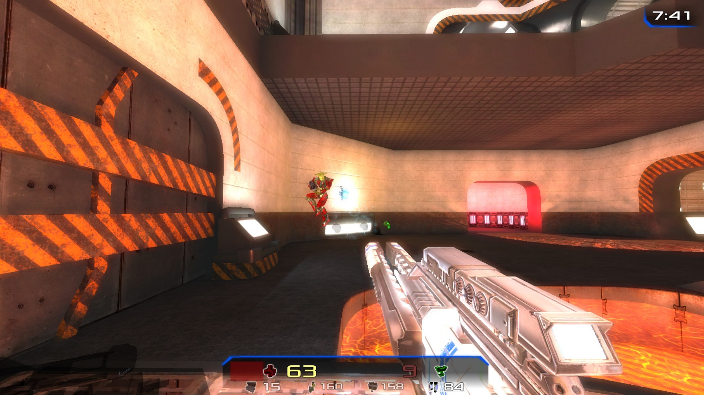
Interaction and Controls
Consider the example of FPS below. How would it control with different control schemes? Could you make it work, with even basic controls, without discomfort?
Notes:
Image credit: https://upload.wikimedia.org/wikipedia/commons/thumb/b/b9/Xonotic_Game_Play_-_Silent_Siege.jpg/800px-Xonotic_Game_Play_-_Silent_Siege.jpg

Slide 31
Best Practices: Summary
Ignoring these basic points can lead to user discomfort, dizziness, and disorientation:
Correct rendering using distortion shaders, projection matrices, and anti-aliasing
Ensure constant and consistent framerate
Correct head tracking that always responds to the user’s movements
Assess whether movement is necessary. If it is, implement carefully
UI elements should be a part of the 3D world and not a separate layer
Notes:
Ignoring these basic points can lead to user discomfort, dizziness, and disorientation:
Correct rendering using distortion shaders, projection matrices, and anti-aliasing
Ensure constant and consistent framerate
Correct head tracking that always responds to the user’s movements
Assess whether the movement is necessary. If it is, implement carefully
UI elements should be a part of the 3D world and not a separate layer

