Slide 1
Hardware Platforms for IoT

Slide 2
Syllabus
This module will cover the following
What is a hardware platform
Types of memory
Power saving techniques
Types of sensors
Analog-to-digital conversion
Notes:
We will by explaining what a hardware platform is and what the design involves. We will then discuss the different types of memories that can be encountered in microcontrollers and study power saving techniques. We will continue our journey by examining different types of sensors and finish with a discussion about analog-to-digital conversion.

Slide 3
What is a hardware platform?
A set of compatible physical components that determine the functionality of a device
Key characteristics
Integrated platforms
Main platform with extension
Dictates what type of software can be run on a particular device
Same functionality might be programmed once for different platforms, but the compiler must produce machine language that can be executed by the specific target platform
Memory
CPU
BLE Transceiver
MCU
GPU
Memory
ADC
DSP
MCU
IMU
Notes:
Programs must be built specifically for a particular type of platform. This is where the compiler turns the code into platform-specific machine language.
Hardware platforms can be integrated, as we see here in the middle column, where the CPU, GPU, and an inertial measurement unit (IMU) are collocated on the same board.
Sometimes it is convenient to modularize the design into a main platform to which one or more extension platforms are connected. In the example above, the main platform hosts a microcontroller (MCU), a digital signal processor (DSP) that processes information received from an analog-to-digital converter (ADC) that, for instance, captures audio signals. A Bluetooth Low Energy (BLE) extension platform is attached that has its own MCU and a radio transceiver.

Slide 4
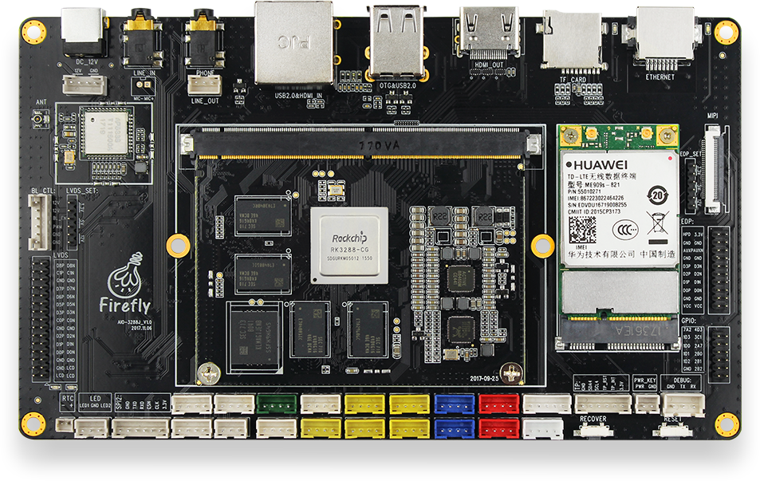
Designing a hardware platform
Application type/cost
→ choice of CPU/GPU
Energy constraints
→ line power/battery
Connectivity
→ Ethernet/4G/BLE
I/O → Serial/GPIO
Debugging
→ JTAG/Serial
4G modem
Wi-Fi/BLE
GPIO
Debug serial
SPI
I²C
Integrated CPU/GPU
Notes:
Several factors influence the design of a hardware platform. Depending on the application type, constraints, and budget, different types of microcontrollers or CPUs are adopted. For more specialized applications, GPUs and DSPs may also be added. Whether the platform is expected to be line-powered or battery-powered will further influence the choice of computing modules.
Another factor considered in the design is the type of connectivity intended to be used with the target application. Choices vary between wired and different type of wireless solution that not only depend on the desired throughput, but also on the energy constraints imposed.
How the system will interact with peripheral influences the choice of I/O. Options include general purpose I/O (GPIO) and different types of Serial interfaces, e.g., Inter-Integrated Circuit (I2C), Serial Peripheral Interface (SPI), etc.
Nonetheless, debugging options should be also factored in.

Slide 5
Microcontroller architectures
MCUs typically implement the Harvard architecture
Integrated circuit with processing unit(s), memory block, analog/digital I/O, and interfaces to peripherals
Processing is undertaken by computational modules (ALU) and control units
ALU
Instruction memory
Control unit
Data memory
I/O
Notes:
In the Harvard architecture, separate storage and signal pathways exist for instructions and data.
In the last module we looked at the differences between CPUs, MCUs, and embedded systems. You will remember that an MCU extends the functionality of a CPU that typically handles instruction fetching and decoding, and processes instructions through an ALU. MCUs incorporate on the same chip the CPU functionality, together with instruction and data memories, and different I/O.

Slide 6
Types of memory
Depending on the purposes served, different types of memories are embedded into MCUs
EEPROM: Non-volatile memory used for data storage; byte erasable
Flash: Non-volatile memory used to store code; block erasable
DRAM: Volatile data memory; high storage density
SRAM: Static RAM; volatile but has remanence; faster than DRAM
Notes:
Different memory options exist to serve code and data storage in Harvard architectures.
The EEPROM is usually used to store persistent data, given its non-volatile properties, but the contents can be electronically reprogrammed.
Flash memory is faster than EEPROM as it is block erasable that makes it more suitable for storing program code that must be run even after the device has been power cycled.
DRAM stands for Dynamic Random-access Memory consisting of capacitors and transistors. Because the electric charge of the capacitors decays over time, it has to be refreshed to avoid data loss. DRAM is however volatile, i.e., the data stored is lost when the circuit is unpowered.
Unlike DRAM, SRAM does not need to be refreshed periodically due to the bistable latching circuitry it implements. It is also much faster than DRAM but also more expensive.

Slide 7
Memory limitations
Due to size and cost constraints, MCUs have limited memory
Example: STM32L053C6
  Based on Arm Cortex-M0+ architecture
  64KB Flash, 2KB EEPROM, 8KB SRAM
Although Flash memory is much larger than SRAM, only 64KB are available for the program that is relatively little
Architecture optimization such as compressed instruction sets and compiler optimization techniques are used to reduce program size
Flash (program)
SRAM (data)
EEPROM
(data)
Notes:
MCUs have memory size limitations that constraint the size of the program that can be uploaded. Here is an example of an MCU implementing the ultra-low-power Arm Cortex-M0+ architecture that we may encounter, for e.g., in wearable devices. Note the instruction memory available is limited to 64KB.
To handle this, architecture optimizations such as compressed instruction sets are adopted, while further software-based optimization can be used at code compilation time to reduce the size of the program.

Slide 8

Energy consumption
Example: Two MCUs operating at 5V nominal voltage, each powered by a 2Ah battery
  M1 operates continuously, consumes 0.1W
  M2 idle 90% of time, consumes 1W when active
The total energy budget is 10Wh. Both MCUs have a lifetime of 100h.
Recall that
Power (Watts) = Voltage (Volts) • Current (Amperes)
Several factors influence the energy consumption of a hardware platform, including
  Power drained by MCU during operation
  What fraction of the time the MCU is active
  Heat dissipation and environment temperature (that may require cooling)
However, a processor that drains more power P, but is less frequently active might be more energy efficient. We can compute energy E consumed over a period T as
$$E=\int_{0}^{T}{P\left(t\right)dT}$$
Notes:
As hardware platforms for IoT are often battery powered, energy consumption is an important aspect. This is primarily impacted by the behavior of the MCU including the power consumption during active periods and how frequently the MCU is active. Additional energy might be consumed for cooling purposes that depend on environmental conditions, but also on how much heat the MCU dissipates during operation. Therefore optimization can be performed along these three directions.
A more power-hungry processor is not necessarily less energy efficiency, if it is idle most of the time. We can determine the energy consumed by an MCU with the formula shown above.
Let’s consider an example with two MCUs, one that is active all the time and consumes 0.1W, the other is active only 10% of the time and consumes 1W when active. If both run at a nominal voltage of 5V and are powered by a 2Ah battery, the lifetime of both will be 100 hours.

Slide 9
Power saving
Different techniques can be implemented to reduce energy consumption
Switching off peripherals when not in use, e.g., wireless interfaces if no TX/RX
Implementing MCU sleep modes that turn off (part of) functionality when not required
Adaptive voltage/frequency scaling to reduce/enhance computing performance as required
Power consumption optimization at program compilation time (software)
Power-efficient circuit design (manufacturing)
Notes:
Different power saving techniques, including switching odd peripherals when they are not required or putting the MCU in a sleep mode that temporarily disables some functionality in order to reduce active time and thus the power consumption. Wireless interfaces can be also switched off when not engaged in communications. For instance, BLE implements such functionality and Wi-Fi also has a power-saving mode by which a device wakes up a RF transceiver periodically to send/receive data.
Another approach in modern is that of reducing and enhancing performance depending on the complexity of the task executed. This can be done through dynamic voltage or frequency scaling.
Further power saving can be achieved through software, by compiling to optimized byte code that minimizes energy usage.
Nonetheless, power saving can be taken into account from the chip design stage. For instance, smaller chips with fewer transistors consume less energy. This is possible with Reduced Instruction Set Computing (RISC) architectures, whereby large operations are processed in small and simple blocks. Keeping the instruction set simple also helps.

Slide 10
Sleep modes
Multiple low-power/sleep modes available in modern MCU
MCU does not process data all the time
Example: STM32L0 devices implement five low-power modes
Each low-power mode brings different power consumption reduction at the cost of a performance penalty
Wake-up time increases as performance decreases – MCU needs to respond to interrupts
The number of wake-up sources decreases as performance decreases
 | LPRun | Sleep | LPSleep | Stop | Standby
Performance | 1 | 2 | 3 | 4 | 5
Power consumption | 4 | 5 | 3 | 2 | 1
Wake-up time | 2 | 1 | 4 | 3 | 5
Wake-up sources | 1 | 2 | 3 | 4 | 5
(1) Best; (5) Worst
Notes:
MCUs typically handle variable workloads and as a result they do not need to process data all the time. This presents an opportunity for improving the power efficiency, especially for IoT devices that run on batteries and must have a reasonable life time. Hence, different low-power modes exist that influence how much of the MCU functionality is enabled and to how many stimuli the MCU responds.
The price to pay for higher power efficiency (lower energy consumption) is performance, i.e., how fast the MCU processes data. Performance is also measured in terms of wake-up time, that is, how long it takes an MCU to respond to interrupts when operating in a particular low-power mode.
Here is an example of the STM32 series of MCUs that are based on the Arm Cortex-M architecture. These implement five different low-power modes, namely low-power run, sleep, low-power sleep, stop, and standby. Each table row shows the performance in terms of one of the key parameters discussed, with (1) indicating best and (5) worst. Observe that different performance/power consumption trade-offs can be achieved.

Slide 11
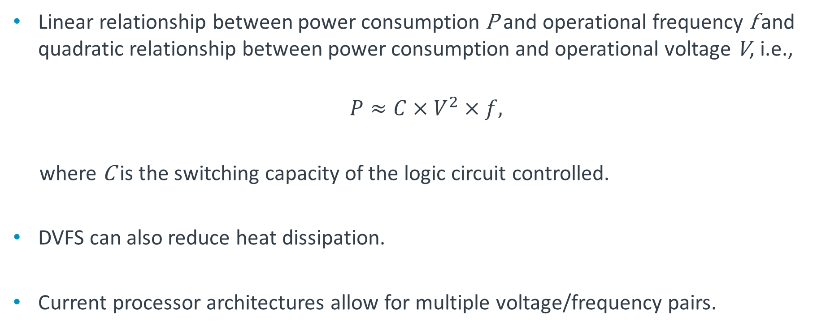
Dynamic voltage and frequency scaling (DVFS)
Linear relationship between power consumption P and operational frequency f and quadratic relationship between power consumption and operational voltage V, i.e.,
$$P≈C×V^{2}×f,$$
where C is the switching capacity of the logic circuit controlled.
DVFS can also reduce heat dissipation.
Current processor architectures allow for multiple voltage/frequency pairs.
Notes:
Workload conditions are often variable, so it is appropriate to adapt MCU performance to the workloads, to reduce energy consumption. Power consumption is directly proportional to the operational frequency and the square of the operational voltage. Therefore, modern architectures employ multiple voltage/frequency pairs to scale up/down these parameters and thereby reduce power consumption. For instance, the Arm big.LITTLE architecture offers 18 valid voltage/frequency pairs.

Slide 12
Sensors
Sensors are devices that measure a particular property of the environment and convert that into an electrical output
Typically, sensors have a linear function between the physical property measured and the electrical output
The sensitivity of a sensor indicates the minimum value of the measured input that can produce a certain output signal
An analog-to-digital converter employed to turn a sensor output into signals that can be processed by MCUs
Different physical phenomena underpin the operation of sensors, e.g., the piezoelectric effect (accumulation of electric charge when mechanical pressure is applied)
Notes:
Sensors are objects that convert a physical quantity into an electrical output (e.g., voltage). The sensitivity of a sensor indicates the minimum input that will produce a given output value, e.g., a microphone will need a certain minimum sound field strength to produce a 1mV voltage.
If the output of the sensor is analog, ADCs are used to covert this into a signal that can be processed digitally by DSPs or MCUs.
The core underlying the principle of sensing is derived from a certain physical phenomenon; for instance, the Hall effect produces a voltage difference when a perpendicular magnetic field is applied across an electrical conductor; the piezoelectric effect produces a voltage when mechanical pressure is applied; the photoelectric effect produces an electrical current when a photo hits a boundary interface between two semiconductor materials.

Slide 13
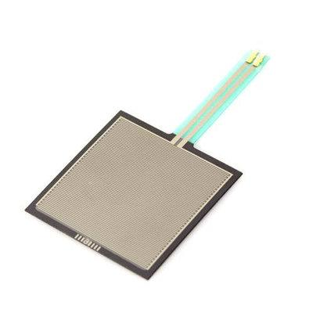
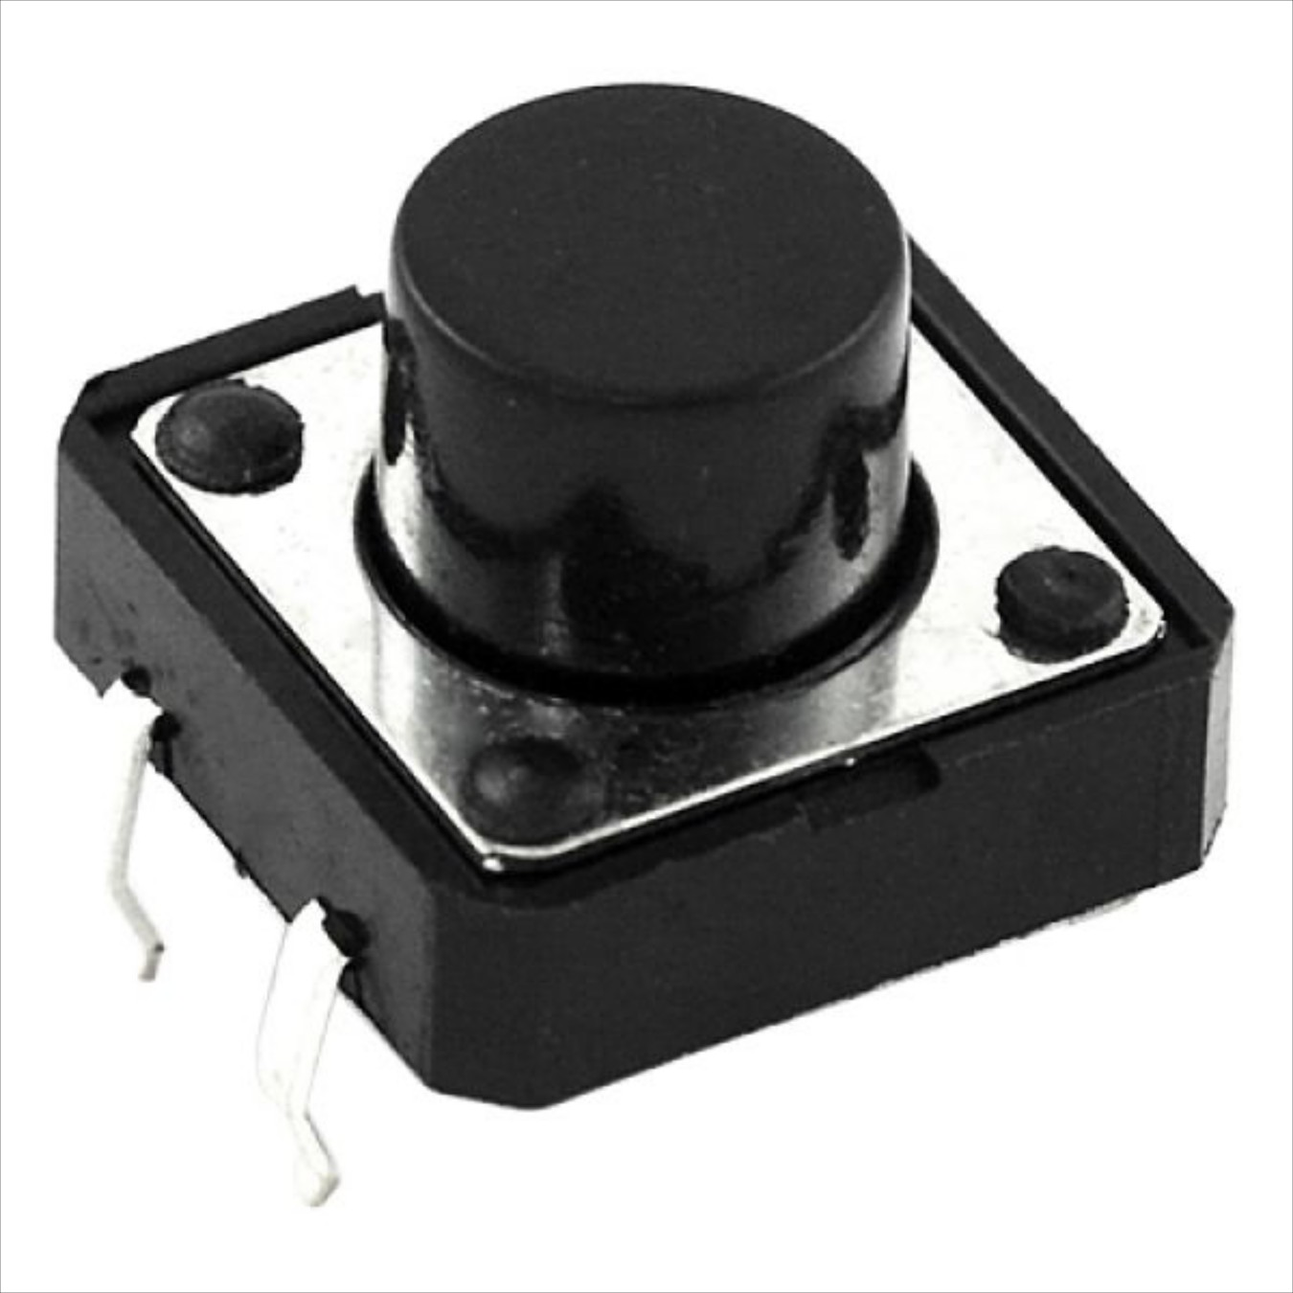
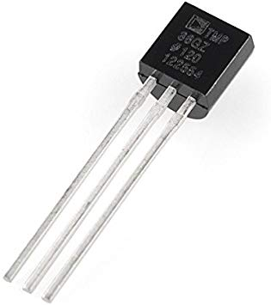
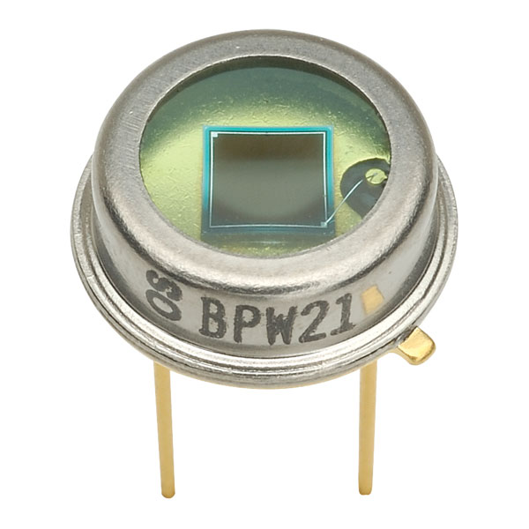
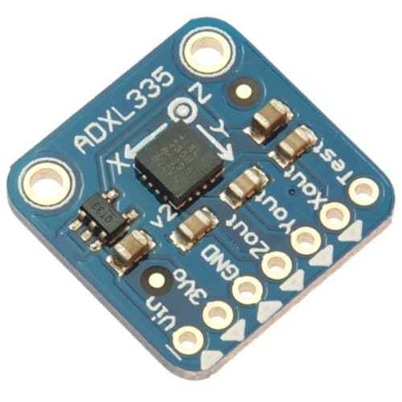
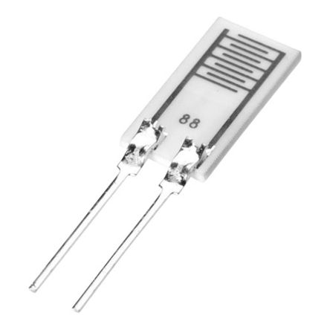
Types of sensors
Push-button/switch
Temperature
Acceleration
Pressure
Optical/photodiode
Humidity
Notes:
Here are some examples of the different types of sensors that can be integrated with embedded systems, each of which exploits a different physical effect.

Slide 14
Input/Output
I/O defines how an MCU can interact with the environment
Different I/O protocols are available
Universal Asynchronous Receiver/Transmitter (UART) – two wires to send/receive data between devices
Serial Peripheral Interface (SPI) – any number of bits can be sent/received without interruption
Inter-Integrated Circuit (I²C) – combines features of UART and SPI
General purpose I/O (GPIO) – controllable by user at run time.
MCU
UART
SPI
GPIO
I2C
Notes:
I/O is required to be able to sense the environment and interact with it. A range of interfacing and communication protocols exist, such as simple serial TX/RX protocols such as UART that allows two devices to exchange data in the form of packets, asynchronously, using only two wires, at speeds up to 115200 baud. A UART transmitter converts parallel data from the MCU into serial data before transmission. A UART receiver performs serial-to-parallel data conversion at the receiving device. Data flows from the Tx pin of the transmitting UART to the Rx pin of the receiving UART.
More sophisticated peripherals such as wireless transceivers may use protocols such as SPI to communicate with the MCU. This establishes a master-slave relationship, by which any amount of data can be transmitted in a continuous stream in both directions according to a clock discipline (synchronous). Data can be transferred without interruption. In a single-master/single-slave configuration, the pin configuration is as follows:
Master Output/Slave Input (MOSI): Used by master to send data to the slave
Master Input/Slave Output (MISO): Used by slave to send data to the master
Clock (SCLK): Clock signal distributed by master
Slave Select/Chip Select (SS/CS): Used by master to select to which slave to send data (multiple slaves can be connected in parallel, or daisy chained if the master has a single SS pin available)
I2C works like UART, in the sense that data is sent in packets, but in a synchronized fashion (like in SPI). Two wires are used between a master and a slave (though the master can support multiple slaves): Serial data (SDA) is used for data exchange; Serial clock (SCL) is used to carry the clock signal. Packets are delimited by start and stop conditions and the first 7–10 bits are used to identify a slave (address). These are followed by a read/write bit (indicating whether the master is sending to a slave or requesting data. Eight-bit data frames follow, each of which is immediately followed by a 1-bit ACK/NACK to verify correct reception.
GPIO is less restrictive, as it allows the system designer or integrator to define the behavior of the I/O.

Slide 15
GPIO
Can be set up to accept or source different logic voltage levels, through which MCU can control peripherals or receive external input/interrupts.
If pins are configured for interrupts, they can be used to wake-up from low-power/sleep modes.
Can be grouped into a GPIO port and controlled as such.
Pulse-width modulation (PWM) employed when the linear processes must be controlled (e.g., fans)
Limited to low-current applications → transistors and relays used to help drive higher current loads.
Notes:
General-purpose input/output is a digital signal pin whose behavior can be controlled by the user either to output a certain voltage level (usually low or high), so as to drive a peripheral, or to serve as an input, e.g., to receive readings from a sensor (temperature, accelerometer, etc.). GPIO pins can also be used to receive interrupts that, for instance, can trigger a wake-up when the MCU is in a specific sleep mode.
GPIO pins can also be grouped into a port (typically with eight pins) and be subsequently controlled as a group through dedicated instructions.
To control linear processes, for instance in motors, pulse-width modulation is applied to the GPIO output.
GPIO output typically produces low currents (in the order of milliamps to tens of milliamps). If higher currents are desired to drive peripherals such as motors, additional circuitry based on transistors and relays is used to amplify the output.

Slide 16
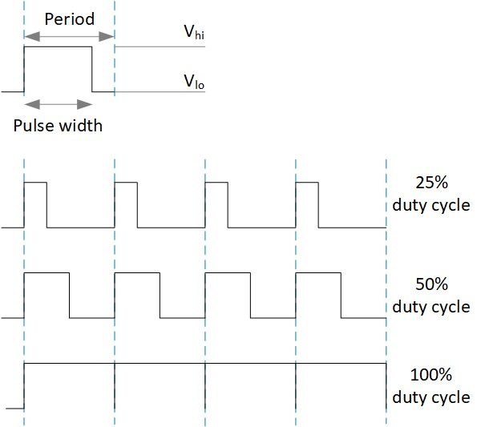
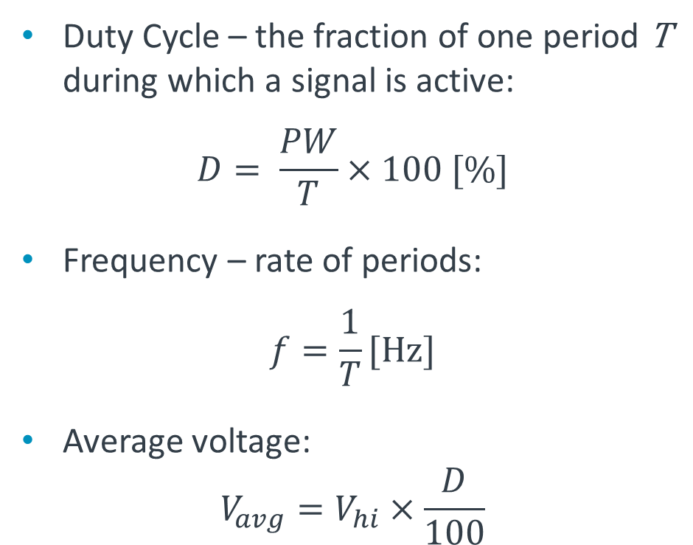
Pulse-width modulation
Reducing average power output by switching on/off at high rates
Duty Cycle – the fraction of one period T during which a signal is active:
$$D= \frac{PW}{T}×100 [\%]$$
Frequency – rate of periods:
$$f=\frac{1}{T}[\text{Hz}\text{]}$$
Average voltage:
$$V_{avg}=V_{hi}×\frac{D}{100}$$
Notes:
PWM is typically used when an MCU needs to output a variable voltage. By switching between high and low voltage levels (0V) very fast and controlling the duration for which the signal is active (pulse width) between two switching events, it is possible to control the average output voltage. The fraction between the pulse width (PW) and period (T) is called a duty cycle. The period is the inverse of the frequency.
The average voltage is thus obtained by multiplying the high voltage level with the duty cycle.

Slide 17
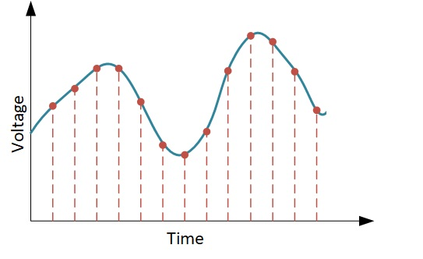
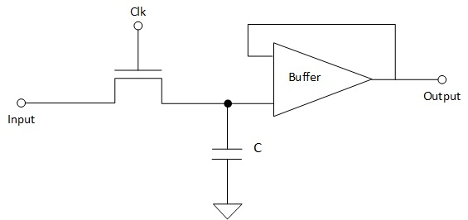
Analog-to-digital conversion
Sensors sometimes output continuous signals; microcontrollers require discrete input
Sampling
Sample and hold circuit
Sampling involves taking snapshots of an input at discrete time instants
The inverse of the period between two sampling instances is called the sampling frequency
Stores electric charge in a capacitor
A clock-controlled switching device, e.g., a field effect transistor (FET)
A buffer amplifier to ensure voltage across capacitor is proportional to the input
Notes:
ADC is required to transform the analog output of a sensor into a discrete-valued signal that can be processed by a microcontroller. This process is known as sampling and involves recording the input signal’s amplitude at discrete time intervals. The period between two samples is dictated by the sampling frequency (that plays a crucial role in reconstruction, as we will see shortly).
Sampling can be achieved with a sample and hold circuit that loads a voltage in a capacitor, as provided by a transistor disciplined by a clock running at the sampling frequency. An operational amplifier acting as a buffer is used to transfer the recorded voltage to the output and ensure the voltage across the capacitor is proportional to the input.

Slide 18
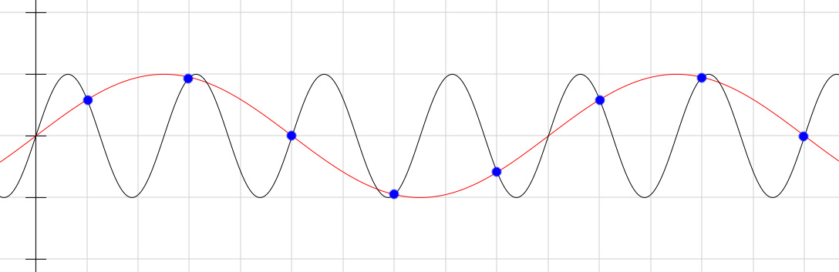
Aliasing
Different signals becoming indistinguishable when sampled
Impossible to reconstruct the original input if the sampling frequency is too small.
Nyquist criterion: sampling frequency should be at least twice the highest spectral component of the sample signal to avoid aliasing.
Notes:
The phenomenon by which two sampled signals cannot be differentiated is known as aliasing. Reconstruction of a signal that was subject to aliasing can lead to a version that is different to the original.
To avoid this, ADC designers must take into account the Nyquist criterion. This proves theoretically that an input signal that has meaningful spectral components above half the sampling frequency will be subject to aliasing. The spectrum of a signal is a representation of a waveform in the frequency domain. Considering that any signal can be decomposed into a sum of sine waves with different frequencies (spectral components), meaningful ones are those whose amplitude exceeds some threshold.

Slide 19
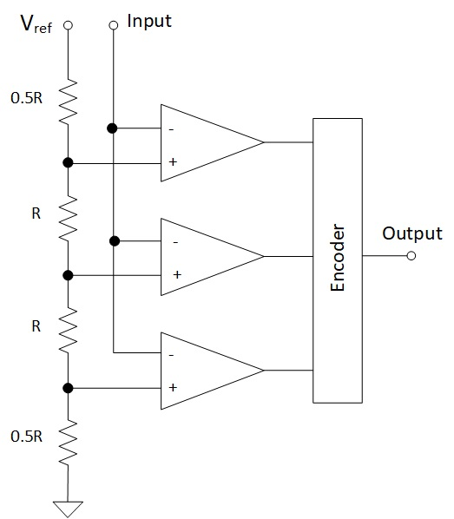
Quantization
Sampling is only one part of analog-to-digital conversion
Mapping sampled values to countable sets
3-bit quantizer
The sampled signal may result in a large number of discrete values
Quantization maps such large sets to smaller ones that are countable
This allows representing a signal on a finite number of bits, but often introduces errors
The sampled signal is fed to a bank of operational amplifiers that compare it to fractions of the maximum reference voltage
Notes:
ADC consists of sampling and quantization. The second step is meant to restrict the sampled values to a countable set that can be represented on a number of bits. This is achieved either by rounding on truncation of sampled values to the nearest element of the quantization set. Inherently this introduces some error that also impacts on the reconstruction.
The schematic shown on the right is a 3-bit quantizer that uses three comparators to match the input to one of eight possible voltage levels in the range [0,V_{ref}].

Slide 20
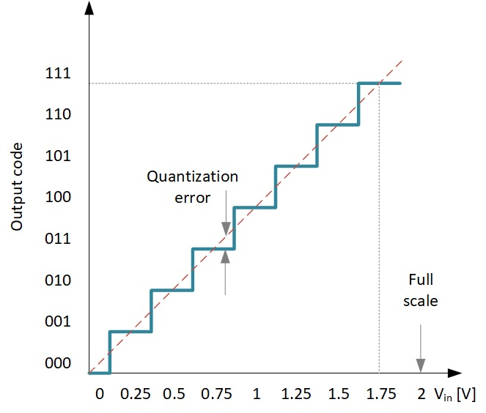
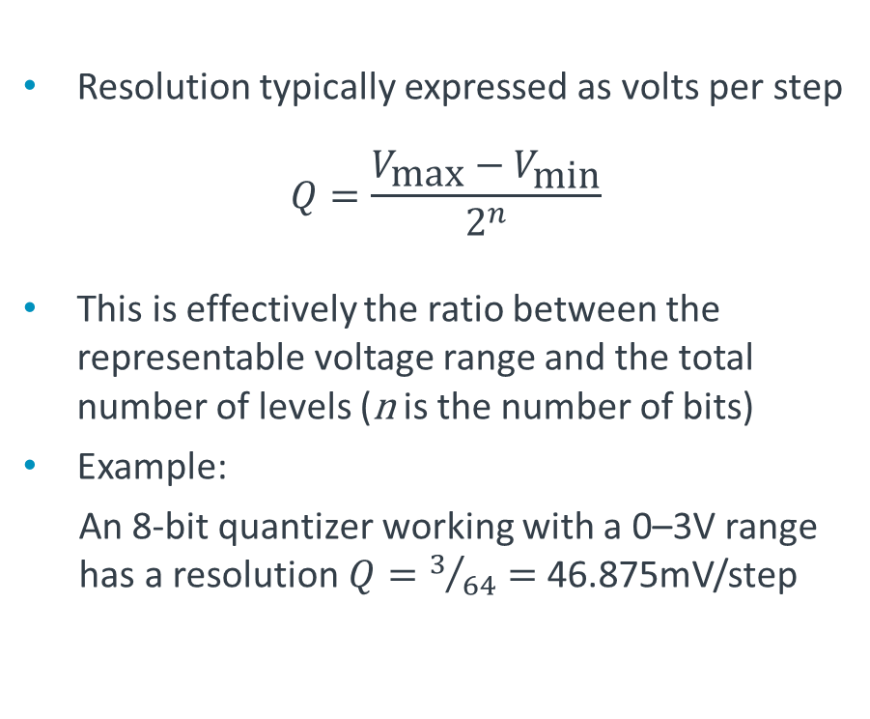
ADC resolution
The number of bits used to represent a sample value
The larger the number of bits, the better the precision
Quantization error of a 3-bit ADC
Resolution typically expressed as volts per step
$$Q=\frac{V_{\text{max}}−V_{\text{min}}}{2^{n}}$$
This is effectively the ratio between the representable voltage range and the total number of levels (n is the number of bits)
Example:
An 8-bit quantizer working with a 0–3V range has a resolution $Q=3/{64}=$ 46.875mV/step
Notes:
The number of bits used to quantize the sampled analog signal dictates the precision of the ADC. As such the resolution of a quantizer is computed as the ratio between the voltage range and the number of levels that can be represented.
This process introduces quantization errors that is typically computed by subtracting the output of an ideal ADC from the output of a DAC that performs the inverse process. The quantization error is typically in the range ± FS/2^{n+1} (where FS is the full scale).

Slide 21
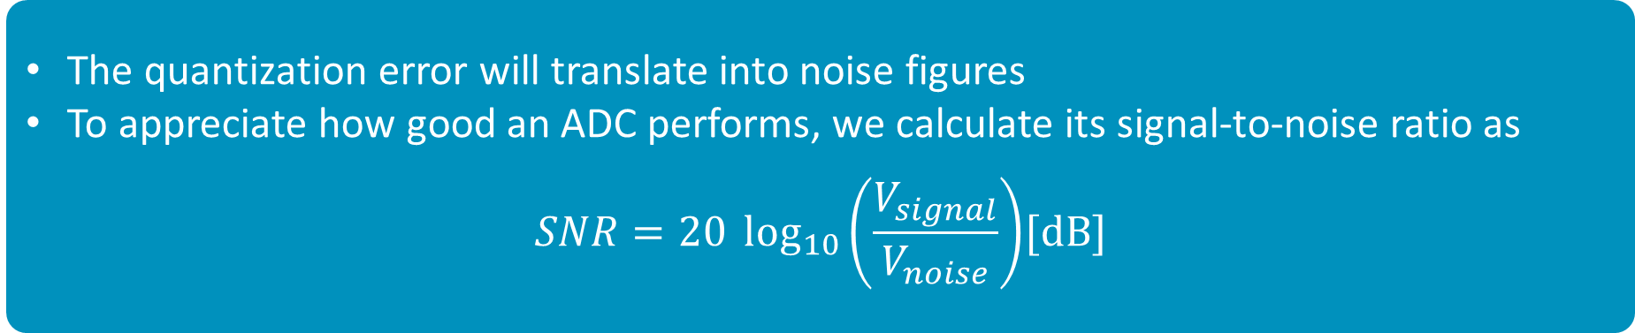

Signal-to-noise ratio (SNR)
The quantization error will translate into noise figures
To appreciate how good an ADC performs, we calculate its signal-to-noise ratio as
$$SNR=20 \log_{10}\left(\frac{V_{signal}}{V_{noise}}\right){[\text{dB}]}$$
The SNR of an ideal n-bit ADC is
$$SNR=n⋅6.02+1.76$$
Example: Ideal 8-bit convert has an SNR of 49.92dB
Notes:
To assess the goodness of an ADC, designers usually measure the impact of the quantization error through the signal-to-noise ratio that is effectively the ratio between the signal voltage range and the amplitude of the noise.
An ideal ADC can be characterized by an SNR value as expressed above.

Slide 22
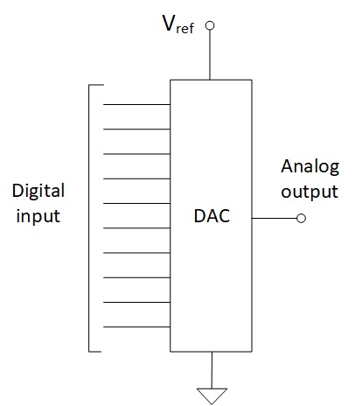
Digital-to-Analog Conversion (DAC)
The inverse process of converting a digital signal into its analog equivalent
This is typically a continuous voltage, but certain DACs are also able to produce complex waveforms
Sometimes digital to analog conversion can be emulated through PWM, for instance to continuously ramp up a voltage in order to drive a motor
DAC performance indicators include:
  Dynamic range: difference between the largest and smallest signals produced
  Resolution: number of output levels that can be reproduced
  Total harmonic distortion and noise introduced to the reproduced signal
Notes:
Digital-to-analog converters translate a digital signal into the corresponding analog voltage. Some DACs can also produce complex waveforms.
In some applications it can be more convenient to use PWN instead of introducing additional DAC circuitry; for instance when the output of an MCU is only meant to drive the input to a motor or gradually decrease a voltage to dim an LED.
There are several metrics that quantify the performance of DACs and some of these are application dependent. Some important ones include the dynamic that represents the difference between the extreme values of the voltage that can be produced. Another indicator is the resolution that, similar to ADC, measures how many levels can be reproduced at the output. In some applications, such as audio and video, this also determines the “depth.” THD + N is a measurement of the percentage of harmonic distortion and noise present in a reproduced signal.

Slide 23
Coming next
Module | Contents
The Arm Cortex-M4 Processor Architecture | Processors vs. architectures Cortex-M4 features Cortex-M4 registers
Interrupts and Low Power Features | What are interrupts Exception handlers Timing analysis Program design with interrupts
Introduction to the Mbed Platform | Mbed Overview Mbed OS Mbed SW/HW Development Kit CMSIS
Notes:
In the following modules, we will study the Arm Cortex-M4 processor architecture, discuss interrupts and low power features, and introduce the Mbed Platform.

