Slide 1
IoT Connectivity
Part II

Slide 2
Syllabus
This module will cover the following
Wireless Local Area Networks (WLAN)
IEEE 802.11 based WLANs
IEEE 802.11 enhancements
Low-power Wide Area Networks (LPWAN)
LoRaWAN
Narrow-band IoT (NB-IoT)
Notes:
We will start by examining wireless local area networking (WLAN) technology, specifically looking at IEEE 802.11 based WLANs (that are also known as Wi-Fi). We will then investigate a low-power wide area networking (LPWAN) paradigm, focusing on two distinct technologies: LoRaWAN and NB-IoT.

Slide 3
Wireless Local Area Networks (WLANs)
Computer networking technology spanning limited areas (home, office buildings, campus), where devices communicate wirelessly
The concept emerged in the 1970s, with the design of ALOHAnet, the first wireless packet data network interconnecting different islands in Hawaii
Core idea of pure ALOHA:
  A station that has data to send, transmits immediately (no need to control who transmits)
  If the message collided (i.e., was not acknowledged), retransmit “later”
  Problem: channel time wasted on collisions and on back-off
Subsequent WLAN protocols refine this idea by using slotted channels and listening for the medium to be idle before a transmission attempt
Notes:
In the previous module we looked at short range wireless technology that is referred to as Wireless Personal Area Networking (WPAN). In what follows, we first look at Wireless Local Area Networks (WLANs), whose range extends to hundreds of meters and which can support higher data rates. This is usually encountered in home and office buildings and can underpin smart home automation devices.
WLANs date back to the 1970s when researchers sought to interconnect the Hawaiian Islands without telephone lines. The solution was a wireless packet data networking protocol called ALOHAnet.
The way in which devices work with ALOHA is to transmit a data packet as soon as that arrives to the transmission queue, without checking if another transmission is already ongoing. If that is the case and the packet delivery proves unsuccessful due to collision, the sender would not receive an ACK that indicates a retransmission is required. Retransmission involves back-off, but how much time a node experiencing a failed transmission should wait was not specified. This clearly should depend on the number of contenders and the amount of traffic they need to send, but optimization was not considered.
Limitations aside, ALOHA became the foundation for subsequent WLAN technology that became mainstream.

Slide 4
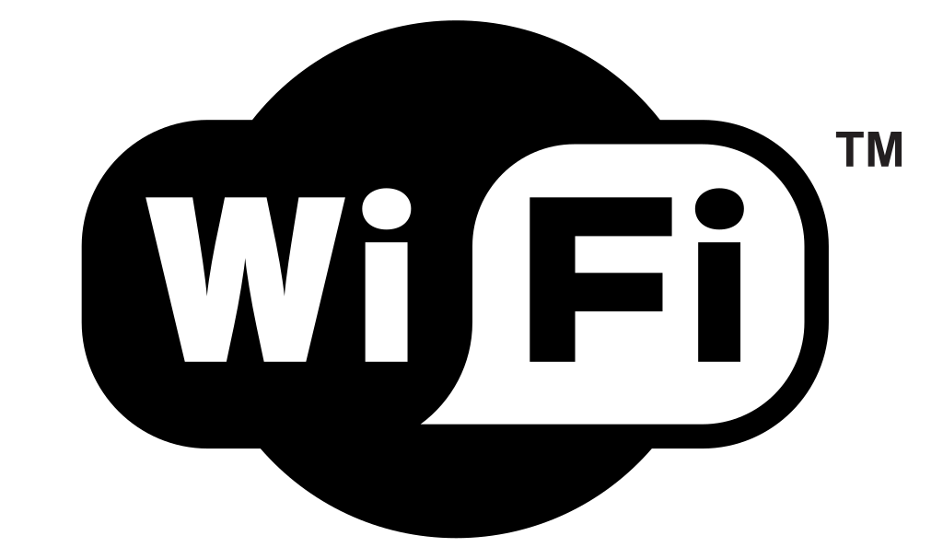
WLANs based on IEEE 802.11
Wireless networks following the IEEE 802.11 specification are currently the de facto WLAN technology
Different protocols in the IEEE 802.11 family bundled together under the Wi-Fi trademark
Two modes of operation: infrastructure and ad-hoc
Infrastructure is the default mode
  An Access Point (AP) may schedule the transmission of different stations during a contention free period
  Most commonly, channel access is decentralized and stations responsible for own behavior
  AP manages time synch (through beacons), association, and authentication
Different nodes may play some roles of an AP in ad-hoc mode (e.g., periodic beaconing)
Notes:
The de facto WLAN technology in use today follows the IEEE 802.11 family of standards that are frequently marketed under the Wi-Fi trademark.
802.11 networks can operate in two distinct modes: infrastructure and ad-hoc. The former is the default and the most used mode of operation, whereby an access point device act as an “arbiter,” i.e., all communication takes place via it. The AP can support contention free operation (scheduled), whereby it periodically polls client’s stations for transmission. The widely spread mode of operation, is contention-based, whereby stations are responsible for their individual behavior, while all contend for accessing the channel using the same set of parameters, as we will discuss next. The AP, however, is still in charge of keeping the stations synchronized, advertising the presence of the network (Basic Service Set – BSS), associating and authenticating client that connect to a network.
In contrast, in ad-hoc mode, the role of an AP is shared, that is a station advertises an Independent SS (IBSS) for others to join, but this role can be swapped among participants.

Slide 5
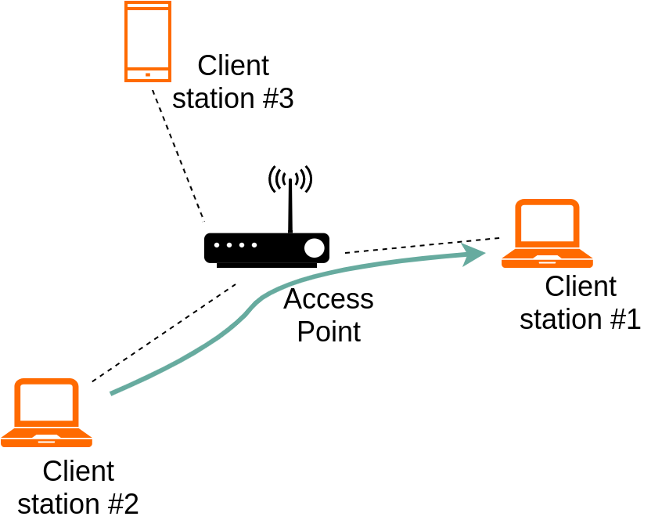
Infrastructure IEEE 802.11 networks
Networks allowed to operate in the following ISM bands:
  2.4GHz (802.11b/g) – three non-overlapping 20MHz channels; max bitrate: 54 Mb/s (OFDM)
  5GHz (802.11a) – 12–28 channels (depending on the country); shorter range; bit rate: up to 108 Mb/s (when two 20MHz channels bonded)
Local and external communication always through the AP
Notes:
IEEE 802.11 WLANs operate in the license exempt bands, namely 2.400–2.500GHz and 4.915–5.825GHz. The default channel width is 20MHz. 12 (13 in Europe and 14 in Japan) logical channels are used in the 2.4GHz, but only 3 (respectively 4) of these are non-overlapping. Many more non-overlapping channels are in the 5GHz band, but availability depends on the regional regulation and deployment scenario (indoor/outdoor).

Slide 6
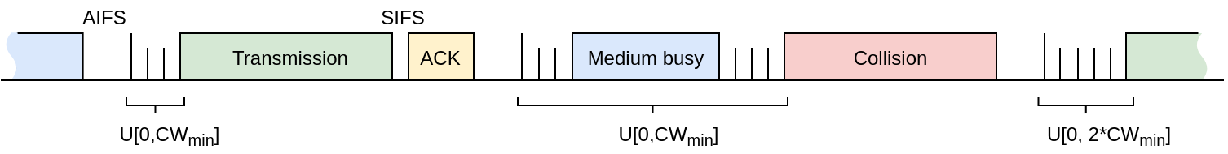
Medium access
Channel time slotted (idle or busy slots)
Carrier Sense Multiple Access with Collision Avoidance (CSMA/CA) – listen before TX
Binary exponential back-off (BEB) – if unsuccessful, stations double the average time they wait before next transmission attempt
Several contention parameters regulate access to the channel:
  Arbitration Interframe Space (AIFS), min and max Contention Windows (CW); number of packets transmitted upon an attempt (Transmission Opportunity – TXOP)
Notes:
Most Wi-FI networks stations use a CSMA/CA protocol to access the physical channel that is logically divided into slots (a slot may be empty and have a fixed duration, e.g., 9μs, or occupied with a transmission). With CSMA/CA the medium is sensed for ongoing transmission and contention for access only begins once the channel was sensed idle for an Arbitration Interframe Space (AIFS), e.g., 34μs for some types of traffic. If the channel is still idle after this interval, the stations with packets to transmit enter a back-off process, by which they initialize a counter with a random number uniformly distributed between 0 and the current Contention Window (CW), and decrement this counter every slot. When the counter reaches zero, a station transmits. A successful transmission is followed by an acknowledgement with SIFS time (e.g., 16μs). In case the counters of two or more stations reach zero simultaneously, their transmission results in a collision, hence none of them receives an ACK. In that case the contention window is double and the process is restarted (binary exponential back-off). Stations reset their contention windows to the initial value (CW_{min}) after a successful transmission and never double this beyond a maximum value (CW_{max})
Upon a channel access, a station may be allowed to send a burst of packets, each of which is followed by ACKs and separated by SIFS. This is called a transmission opportunity.

Slide 7
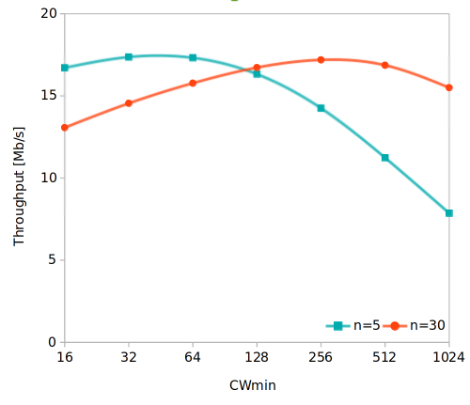
Throughput performance
By default, the contention parameters are fixed, irrespective of the number of stations and traffic volume → channel time wasted or high collision rate, hence the suboptimal throughput
Example: n = 5 and 30 stations transmitting 1,500-byte frames at 24Mb/s
Default CW_{min} = 16 yields sub-optimal performance
AP may be able to compute optimal configurations and distribute these periodically (every 100ms) via management frames (beacons)
Notes:
Unfortunately, these contention parameters have been fixed by the standard and do not reflect all the network conditions (number of contenders, volume of traffic they generate). Therefore, the medium is often underutilized or channel time wasted with collisions.
In this example, we examine the Throughput performance of a WLAN with 5 and 30 transmitters respectively, when the CW_{min} parameter is varied. You can see that the optimal value is much higher than the standard default one (16) and the total throughput achievable is almost independent of the number of contenders.
The AP could assess the channel conditions, find the optimal contention parameters, and distribute these via beacon frames. This is, however, left to the manufacturers, as the standard only defines the means for distribution.

Slide 8
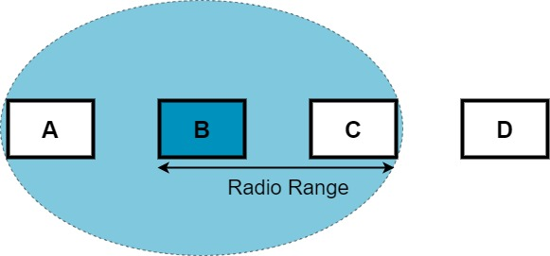
Hidden terminals
Stations whose transmissions cannot be detected by other stations, but which may collide with these at an intended receiver.
Example: Station B transmits to C; Station D is unable to carrier sense the transmission of B (out of range), so may also attempt to transmit to C → frame collision.
Notes:
Due to limited transmission range and carrier sensing, two pathological scenarios may emerge. One of them is the hidden terminal problem whereby two transmitting stations that may be sending packets to the same destination (or whose transmission can interfere with each other at a receiver) cannot carrier sense one another. If they both assess the channel as idle and transmit at the same time, this can result in collisions that degrade throughput performance.

Slide 9
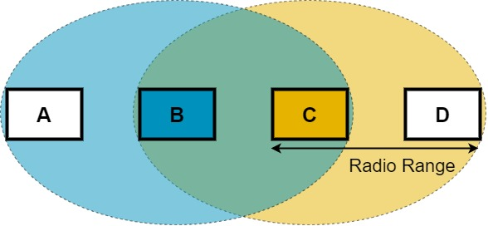
Exposed terminals
Stations that carrier sense the activity of others and defer transmission, although their frames would not collide at their respective destinations.
Example: Station B is transmitting to A; Station C senses B’s activity and concludes it cannot transmit to D, hence defers → channel time potentially wasted.
Notes:
Another problem inherent to carrier sensing based protocols is that of exposed terminal. Here two stations that have packets to transmit to destinations that are far apart may carrier sense each other and thus unnecessarily defer transmissions. Again, channel time is wasted.

Slide 10
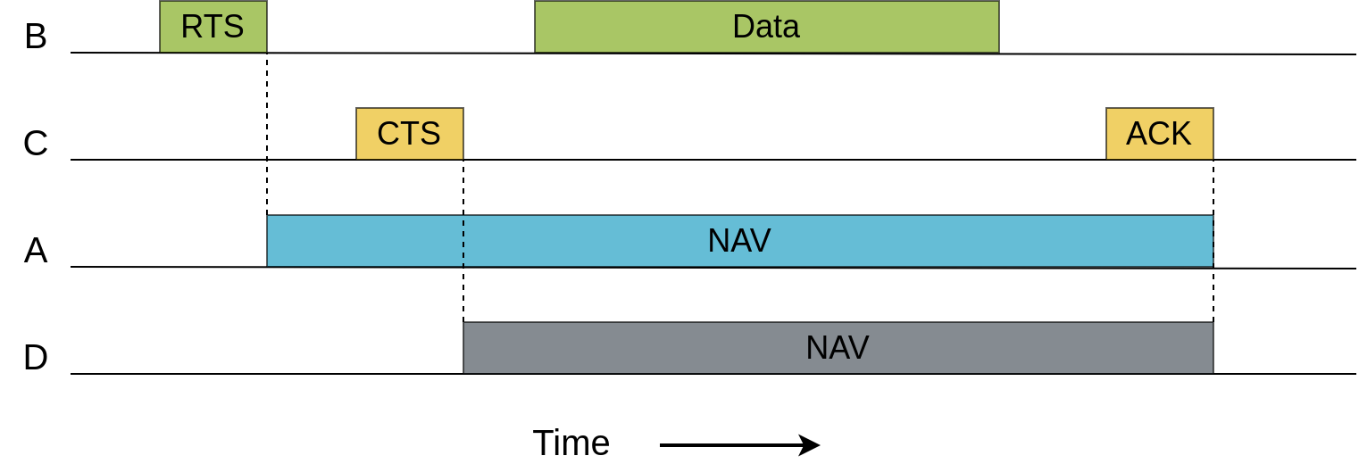
Request to Send/Clear to Send mechanism
RTS/CTS control frames introduced to mitigate these problems
Additional overhead introduced that may reduce performance in the absence of hidden/exposed terminals
Particularly useful when multiple packets are sent upon the same channel access (burst or frame aggregation)
Notes:
These circumstances can be circumvented through a signaling mechanism known as RTS/CTS, whereby a station “reserves” the channel prior to transmission. Specifically, it will first send an RTS to the destination that allows all other stations that overhear this packet to set their network allocation vector (NAV) accordingly, taking note of how long the channel will be occupied.
The intended receiver responds with a CTS that has the same channel reservation effect on stations overhearing this packet.
The downside of this approach is that RTS and CTS introduce additional overhead, especially when the data packets are sent at very high rates (and are thus short). On the other hand, this can be particularly useful when transmission comprises of multiple packets, via the TXOP mechanism we discussed or frame aggregation, which we will explain next.
The NAV may also allow stations to enter a power saving state.

Slide 11
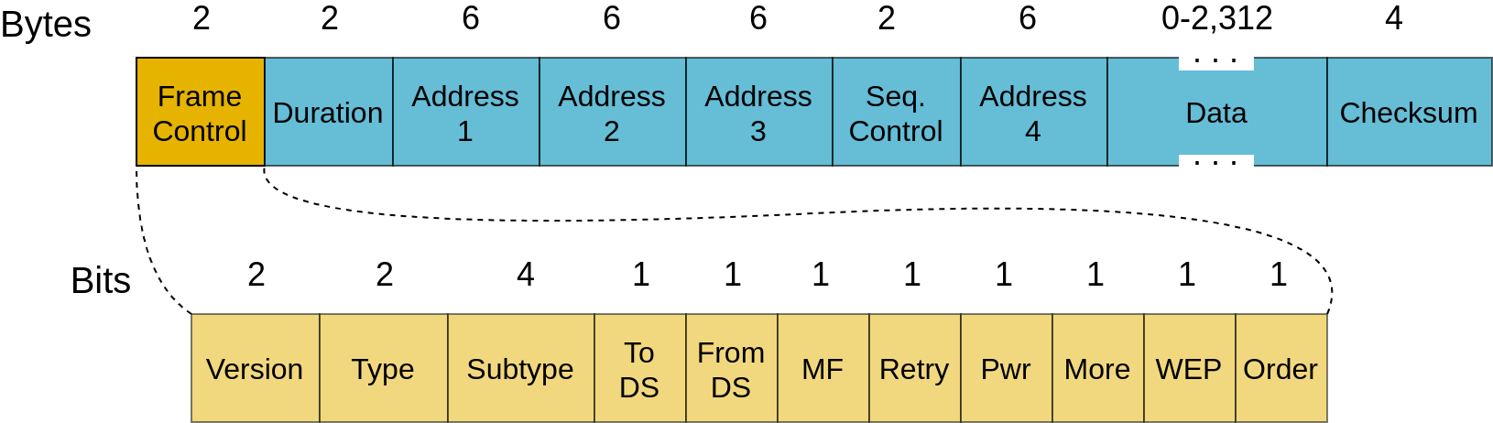
IEEE 802.11 frame structure
Scope of addresses changes depending on the operation mode (infrastructure/ad-hoc) and direction of packet (to/from AP)
Address 1: Destination/BSSID
Address 2: Source/BSSID
Address 3: Destination/Source
Address 4: Used only in WDS mode (bridge)
Notes:
This is how an 802.11 frame looks like. You will note that the frame can have four address fields, though only three of these are mostly used. The 4th is reserved for wireless distribution systems (WDS), i.e., bridging. The scope of the other changes depending on whether the frame is to/from the network (i.e., distribution system – DS) that is identified by a BSS identifier (BSSID) – typically the MAC address of the access point.
The frame control contains a number of flags that signal whether more fragments (MF) should be expected when a payload was fragmented, whether the current frame is a retransmission, power control, or wired equivalent security (WEP), and so on, which we will discuss in a different module.
The duration field can be used by other stations to set their NAV.

Slide 12
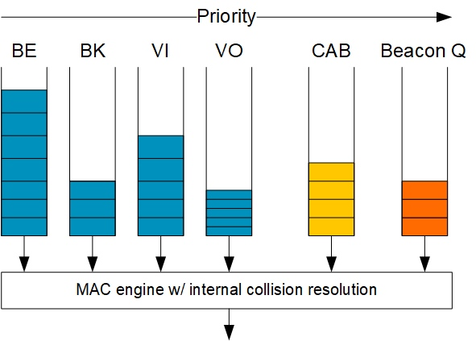
Statistical differentiation of traffic in IEEE 802.11
Random access protocol → strict latency guarantees difficulty to guarantee
Latest specification mandates different queues and different contention parameters for different traffic types
Four “Access Categories” (AC):
  Best Effort (BE), Background (BK), Video (VI), Voice (VO)
Internal collision resolution mechanism
Multicast traffic (content after beacon – CAB) and beacons take priority
Notes:
Different types of traffic (e.g., voice, video, email, bulk data transfers, etc.) have different performance requirements in terms of latency and throughput. To address this 802.11 introduces four access categories (AC) and packets of different types are mapped to one of these queues (if the Type of Service field in their IP headers is marked accordingly).
Higher priority queues have smaller contention windows and use shorter AIFS. Collisions between the different queues may still happen, hence an internal collision mechanism is mandated to avoid a frame that is unnecessarily released over the air. Instead, if an internal collision happens, the frame from the queue with the highest priority is transmitted. Beacons and multicast traffic is not subject to internal collision resolution but will always be sent straight away at the scheduled time, if the channel is idle.

Slide 13
IEEE 802.11n enhancements
Wider bandwidth through channel bonding (up to 40MHz)
Spatial multiplexing through Multiple Input Multiple Output (MIMO)
  Up to four spatial streams (concurrent transmissions between pair of devices)
More spectrally-efficient modulation and coding schemes, hence higher data rates, e.g., 8 bits per symbol quadrature amplitude modulation (64-QAM) – up to 65Mb/s per single stream, or 72.2Mb/s if shorter guard between packets
Lower MAC overhead through frame aggregation
Selective retransmissions
Notes:
A number of protocol enhancements have been developed over the years, primarily to improve the throughput performance of 802.11 networks. One such enhancement is 802.11n that makes use of twice as much bandwidth if needed, by bonding together two channels. It is also possible to employ a signal processing technique called MIMO to allow simultaneous transmission of multiple data stream between two peers and encode more bits of information per symbol to increase data rates.
The overhead associated with contention and headers is reduced through different frame aggregation techniques shown on the next slide, and with some it is also possible to retransmit only a particular part of a message, if affected by errors, to improve channel efficiency.

Slide 14
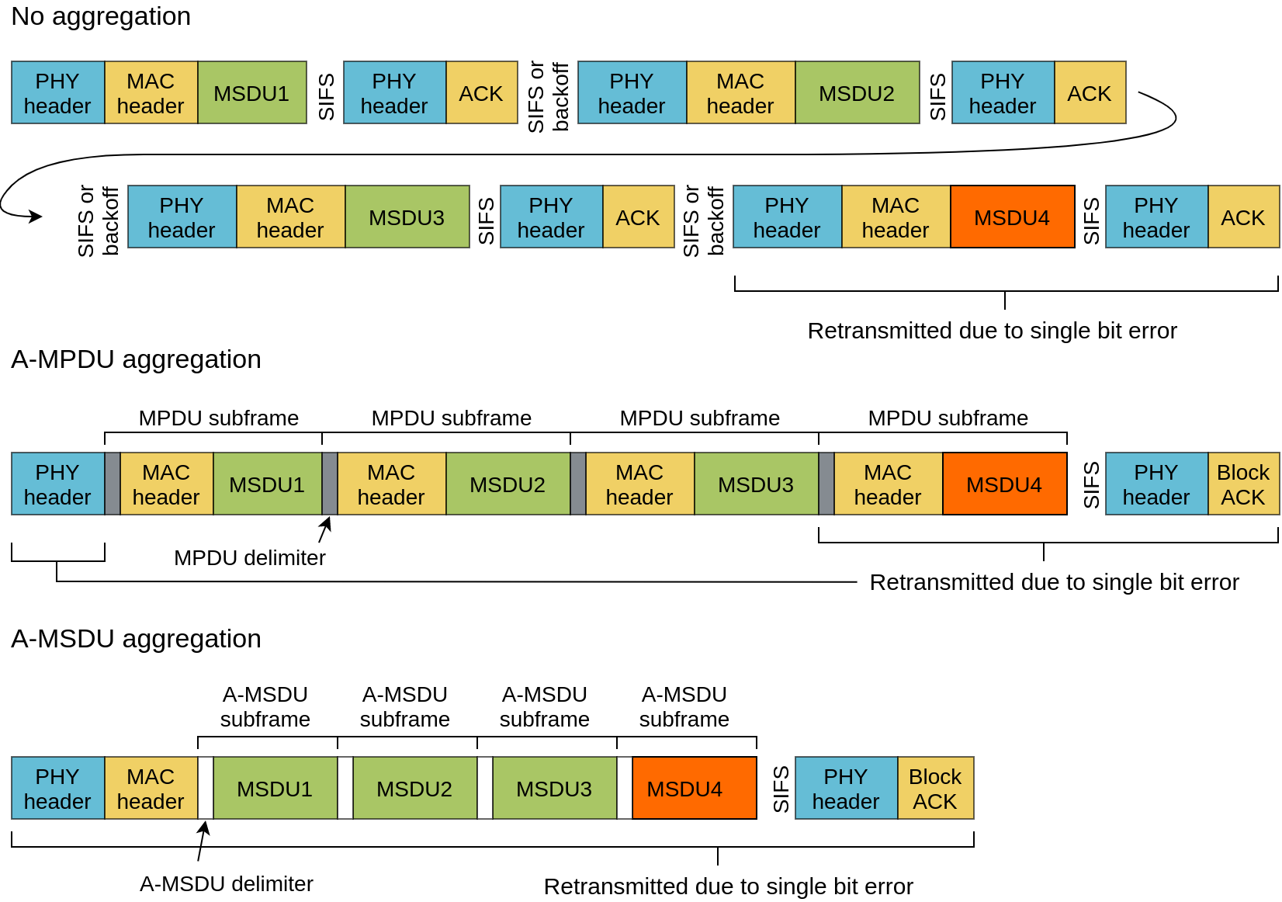
IEEE 802.11n frame aggregation
MSDU – MAC service data unit
MPDU – MAC protocol data unit
MSDUs in orange corrupted by channel errors
Content retransmitted marked below
Notes:
Without aggregation, frames are followed by an acknowledgment and either separated by back-off or SIFS (if TXOP bursting is used). Every packet is preceded by a PHY and MAC header.
Frame aggregation seeks to maximize the time used to transmit user data, by grouping frames together and using a single PHY header (A-MPDU aggregation). MAC header is not eliminated for the subframes, but this allows retransmission of exactly the corrupt portion when needed that is signaled through a block ACK. A-MSDU aggregation eliminates the MAC header of individual subframes, further reducing overhead, but in case an aggregate is affected by channel errors, everything must be retransmitted. Thus, the effectiveness of the different approaches is dependent on the PHY rate and channel quality.

Slide 15
IEEE 802.11ac enhancements
Deployed in the 5GHz frequency band
Channels with up to 160MHz bandwidth
Even more spectrally-efficient modulation and coding schemes supported, e.g., 256-QAM (433Mb/s over a single 80MHz channel), but better channel conditions needed
Up to eight spatial streams
Downlink multi-user MIMO (MU-MIMO) – transmit a combination of packets intended for different clients, based on estimate channel state; each client decodes only the message intended for it (Gb/s total throughput)
Whether such high data rates are needed in IoT is questionable; one application that can benefit may be virtual/augmented reality
Notes:
802.11ac adds new features to further enhance throughput performance. For instance, channels up to 160MHz can be used. Given this spectral width, only the 5GHz becomes suitable and as such 802.11ac a reserved tot his band. Up to eight MIMO streams are supported (effectively multiplying the date rate eight times as compared to the traditional 802.11) and the new modulation schemes enable transmitting up to 16 bits per symbol.
In addition, a new MU-MIMO technique is adopted that allows an AP to transmit to multiple stations at the same time (spatial multiplexing). This requires accurate channel state information that in turn implies sounding and estimation techniques.

Slide 16
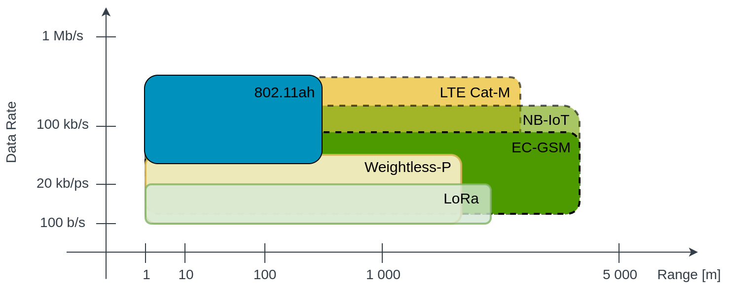
Low-power Wide Area Networks (LPWAN)
Mostly long-range wireless communications suitable for battery powered devices
Particularly suitable for low rate IoT applications
Notes:
As we shift attention to long range networking (WANs) for IoT, the radio frequencies employed need to be lowered. This inherently expands the collision domains that limits the data rates that are supported. This is to some degree an advantage for IoT, because infrequent messaging brings low power consumption.
There are a number of competing technologies in the LPWAN space, including:
IEEE 802.11ah (HaLoW) – operates in the 900MHz band, typically on 2MHz channels (wider channels possible) where data rates between 0.65 and 8.67Mb/s, depending on modulation scheme
Weightless-P deployed in sub-GHz band on 12.5kHz channels and supporting rates between 0.2 and 100kb/s; cognitive medium access with centralized controller
LoRa/LoRaWAN – chirp spread spectrum, 125KHz, typical data rates < 6kb/s; decentralized access
Extended coverage GSM (EC-GSM) – based on cellular GPRS; centralized inherits security of cellular systems
Narrow-band IoT (NB-IoT) – meant to co-exist with LTE; low data rates, deterministic latency
LTE Cat-M – similar to NB-IoT but higher data rates, mobility support; requires more bandwidth and must be in the same band (more expensive)

Slide 17
Low-power Wide Area Networks (LPWAN)
Multitude of factors influence the choice of LPWAN for an application
Coverage-throughput trade-off: low frequency narrow bandwidth vs. higher frequency and larger bandwidth
Deployment cost and interference: licensed vs. unlicensed spectrum
Complexity: centralized vs. decentralized access
Compatibility with existing wireless/cellular systems
Support for mobility (e.g., automotive IoT)
Latency: guaranteed scheduled air-time vs. contention-based multiplexing
Security
Notes:
Based on the description of the different technologies we enumerated previously, it is clear that there are several factors that drive the choice for a particular technology, including coverages, data rates, cost, channel access paradigm, ease of integration with other technologies (e.g., 3G/LTE), or the latency guarantees it can sustain.
Security is now a key factor in all LPWAN solutions.

Slide 18
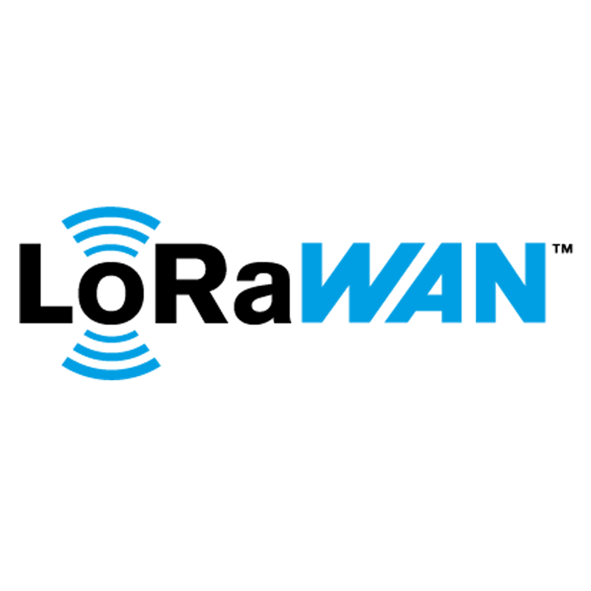
Long Range Wide Area Networking (LoRaWAN)
Deployed in unlicensed frequency bands: 433MHz, 868MHz (Europe), 915MHz (Australia and North America), 923MHz (Asia)
Access subject to duty-cycle and TX power regulations, e.g., 0.1% to 10% per duty-cycle depending on the channel used
Transmission range over 10km in rural areas
Access to eight different frequencies at a time allowed
Protocol stack works on top of a proprietary chirp spread spectrum PHY layer (LoRa) – rates between 0.3 and 5.5kb/s
Two additional “high speed” frequency shift keying (FSK) modulated channels (support 11 and 50Kb/s data rates)
Notes:
We will examine more closely two LPWAN technologies, one that is deployed in an unlicensed spectrum and adopts a decentralized medium access paradigm, namely LoRaWAN, and another that is compatible with cellular systems, and thus operates in licensed bands and follows a scheduled access scheme, namely NB-IoT.
LoRaWAN is deployed in different frequency bands depending on geographic location and regulations that apply in each. Given the long range supported (as also indicated by its name), the channel time a device can occupy is restricted via duty-cycle regimes that vary with the carrier frequency.
A proprietary PHY layer that follows a chirp spread spectrum modulation underpins LoRaWAN and data rates in the order of kb/s are supported. In some regions higher rates are facilitated through FSK modulation.

Slide 19
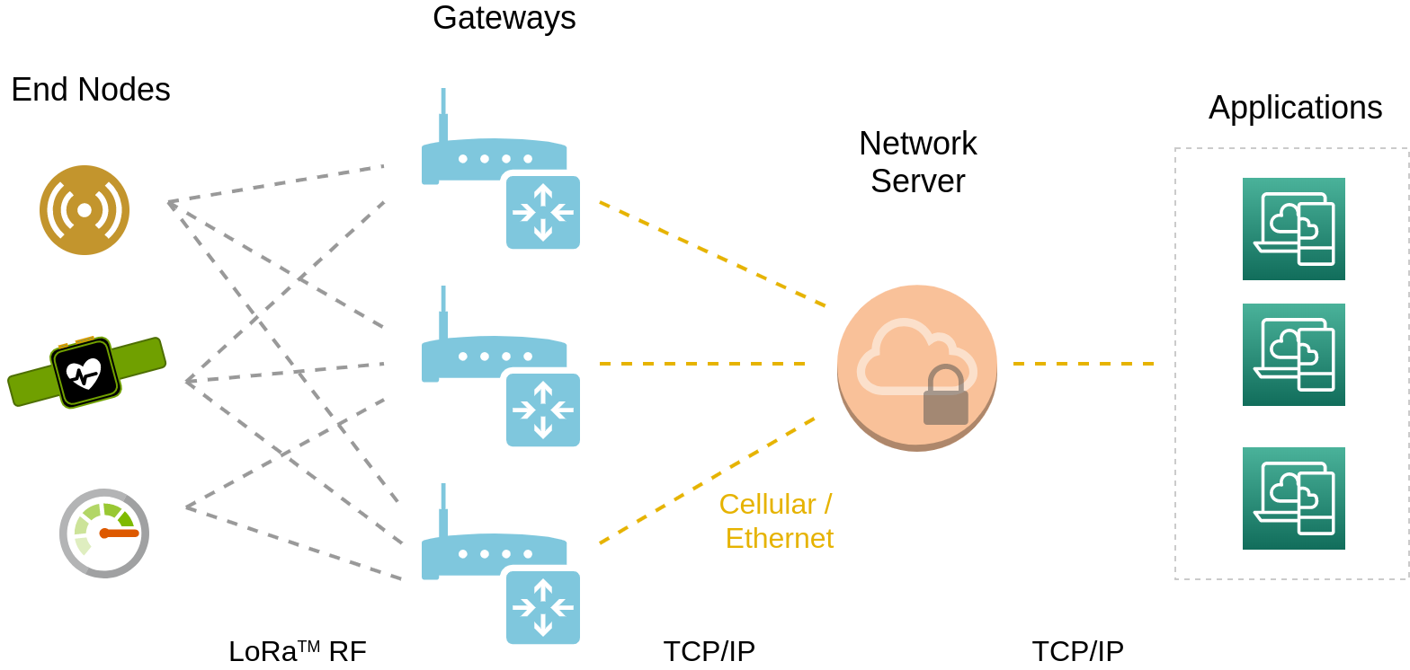
LoRaWAN architecture
Notes:
LoRaWAN networks comprise of end nodes (IoT devices) that connect wirelessly to Gateways. In turns, these relay information from end nodes to network servers, where different applications consume the data received, and vice versa. The communication over the wireless link uses LoRa modulation, whereas the backhaul links transport TCP/IP traffic over virtually any networking technology. The communication between end nodes and applications is secured end-to-end.

Slide 20
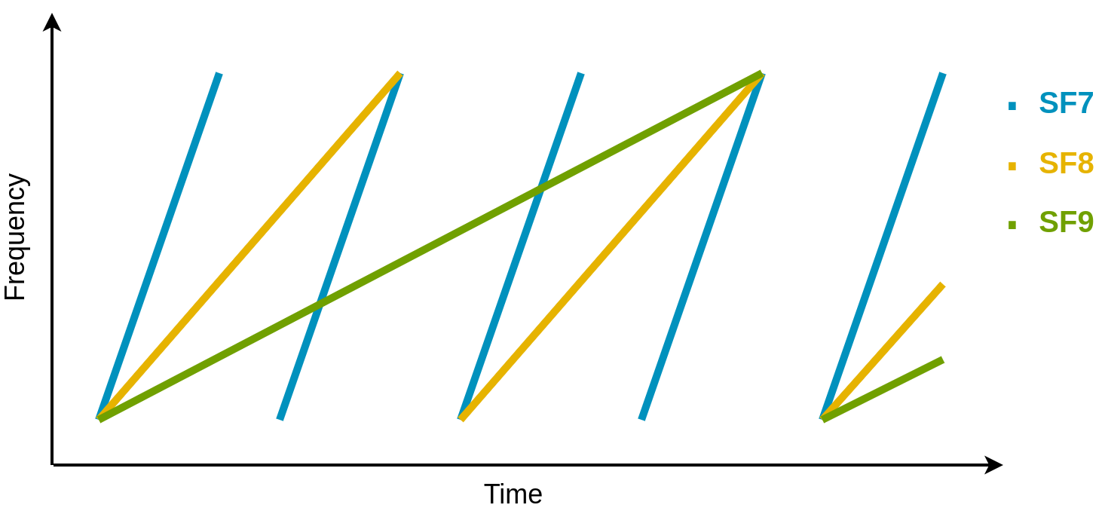
LoRa PHY layer
Chirp spread spectrum modulation
Key idea
Illustration
Moving a radio frequency (RF) tone through time linearly
Different symbols (0/1 bit sequences) break signal in different places in terms of time and frequency - chirping
Spread Factors (SF) 7 to 12
Signal spread across the entire band used
Robust to multipath fading and Doppler shift (due to movement)
Possible to demodulate signals 20dB below noise floor
Notes:
The LoRa PHY layer is quite distinct. To encode information, a RF tone is move through time and signal breaks delimit symbols.
Multipath fading occurs when copies of the same signal reach a receiver via many paths with different strengths and phases.
Different spread factors can be used thatch effectively influences the signal power across the entire bandwidth and robustness to channel fading. Higher SF yield lower rates but are more robust and it is possible to decode signals even 20dB below the noise floor.

Slide 21
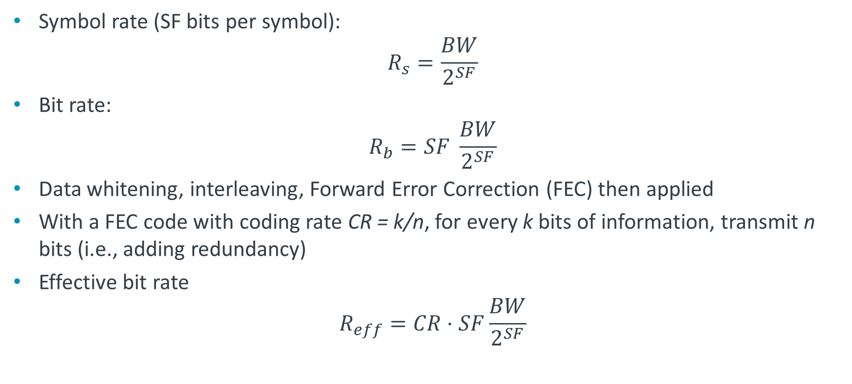
LoRa bit rate
Symbol rate (SF bits per symbol):
$$R_{s}=\frac{BW}{2^{SF}}$$
Bit rate:
$$R_{b}=SF \frac{BW}{2^{SF}}$$
Data whitening, interleaving, Forward Error Correction (FEC) then applied
With a FEC code with coding rate CR = k/n, for every k bits of information, transmit n bits (i.e., adding redundancy)
Effective bit rate
$$R_{eff}=CR⋅SF\frac{BW}{2^{SF}}$$
Notes:
Computing the symbol rate is straightforward, as this is simply the ratio between bandwidth and 2 to the spread factor. The bit rate is then obtained by multiplying the symbol rate with the SF.
FEC can be also applied to improve robustness to channel errors, but this will reduce the effective bit rate.

Slide 22

LoRa bit rate vs. spread factor
BW = 125KHz, default code rate CR = 4/5
Higher rates
SF | Chirps/symbol | Bitrate
7 | 128 | 5.469kb/s
8 | 256 | 3.125kb/s
9 | 512 | 1.758kb/s
10 | 1024 | 977b/s
11 | 2048 | 537b/s
12 | 4096 | 293b/s
Wider channels (250 and 500kHz) permitted in some geographic regions (with certain SF)
Example: BW = 500KHz, SF = 7,
$R_{eff}=\frac{4}{5}7\frac{500}{2^{7}}=$ 21.875Kb/s
50Kb/s achievable with FSK modulation instead of CSS
Notes:
LoRaWAN networks largely operate on 125kHz-wide channels and allow six spread factors, as shown in this table. Higher data rates are possible if wider channels are used, but this depends on geographic restrictions. For instance, a 500KHz channel may sustain bit rate.

Slide 23
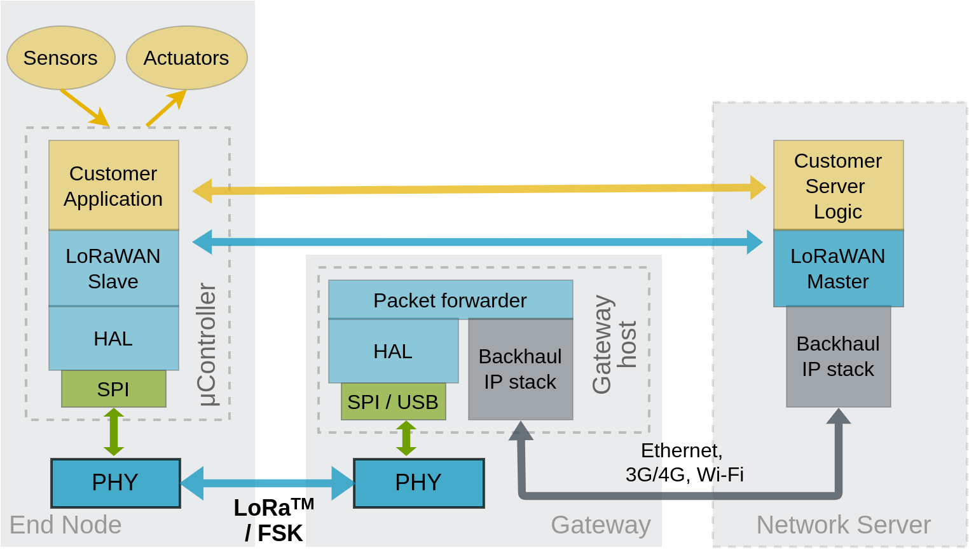
LoRaWAN protocol stack
Lightweight and secure stack layered on top of PHY
Access to the medium regulated by gateway; slotted channel, different operating regimes configurable
Payload encrypted at end node; only application can decrypt (message hidden to gateway)
Notes:
LoraWAN is effectively the protocol stack layered on top of the LoRa PHY. As we discussed, gateways have the primary role of forwarding packets between end nodes and network servers, but they are also in charge of end node activation, authorizing access, and securing the links.
The channel is slotted and multiplexing follows an ALOHA-like protocol.
The data transmitted by end nodes (e.g., sensor readings) is encrypted as well and only the intended application can decrypt this. In the same way, potential commands issued by an application running on a cloud-based network server to control an actuator are encrypted.

Slide 24
LoRaWAN device types
Three classes of the devices defined in LoRaWAN specification
Different channel’s access behaviors and reliability offered with each class
Class A: Slotted channel, ALOHA-style access; each uplink transmission followed by two short downlink receive windows; any device must support Class A operation
Class B: Additional receive windows available to end nodes at scheduled times → downlink with deterministic latency
Class C: Continuously open receive widow, except when transmitting → network server can initiate transmission any time (low latency, but continuous power required)
No acknowledgement of receipt, unless explicitly requested by sender
Notes:
Three classes of devices are defined by the LoRaWAN specification, all of which mandate bidirectional communication between end nodes and applications. Any device must implement Class A functionality, whereby a node can transmit within duty-cycle limits and each transmission is followed by two short windows for receiving downlink traffic.
Class B devices can work with additional receive windows that are precisely scheduled, hence ensuring controlled latency.
Lastly, Class C devices listen continuously, unless they are engaged in a transmission. This limits the possibility of running on batteries.

Slide 25
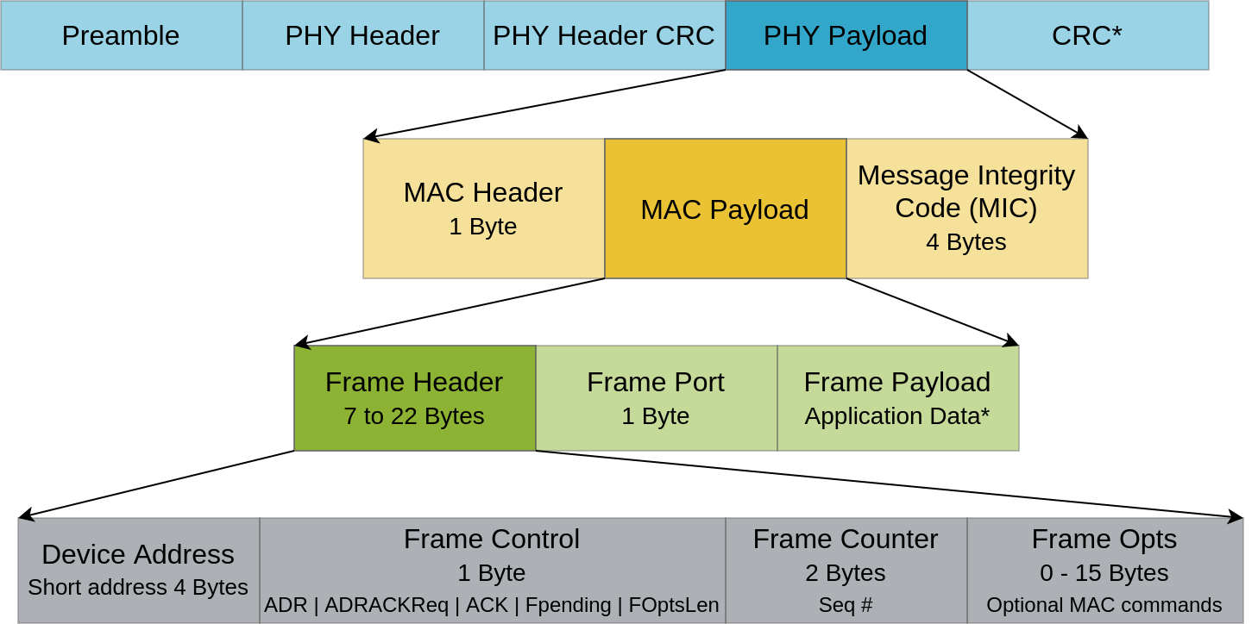
LoRaWAN packet structure
CRC available only for uplink messages
MAC header indicates protocol version and message type (management, uplink/downlink, ACK required)
Application payload between 51 and 222 bytes, depending on data rate.
Notes:
The application data is preceded by a frame port (used for multiplexing) and header (that indicates the device address, frame control features, and optional commands). This payload is then augmented with a MAC header and a message integrity code, thereby forming the PHY payload. Like other networking technologies we discussed so far, PHY frames start with a preamble and header, and in the case of LoRaWAN a PHY header CRC follows. A CRC on the payload is only computed in the uplink direction.
Given the low-rate constraints, the size of the application payload is restricted to 222 bytes.

Slide 26
LoRaWAN security
Two layers of security
Network Security Key (nwkSkey) – secures link between end node and gateway
MIC calculated over the “network” part of the message – works as a signature
Application Security Key (appSkey) – end-to-end confidentiality between end device and application → network operator cannot inspect data; only service provider can
Symmetric encryption (AES-128) secures both link and end-to-end communication
Notes:
As already mentioned, two layers of security exist in LoRaWAN:
Links are secured with AES-128 encryption using a network key known to the end device and gateway
The payload is AES-128 encrypted with an application key that is known to the end node and the service logic consuming data from/controlling the end device. The advantage is that the network entity along the path cannot inspect the content of the messages (confidentiality)

Slide 27
Device activation
Over The Air Activation (OTAA)
Activation by Personalization (ABP)
End device follows a join procedure
Device can attach to any LoRaWAN network
Network keys updated on a per session basis
Roaming possible
Network server must respond to join requests each time a device (re)starts that adds overhead
End device pre-registered to the network
DevAddr and keys stored in end device (must be secured) and network server
End node tied to a particular network
Simpler from application server point of view
Notes:
To be able to attach to a network, devices require activation. Two methods exist: OTAA and ABP. The former provision/updates network keys on a per session basis that enables device roaming. On the other hand, NS must respond to join requests frequently that generates more downlink traffic.
With ABP, devices are provisioned with keys offline before joining the network. The gateway needs to store the devices’ address and key pairs, whilst the end node must implement a secure way of storing the key that shouldn’t be accessed by unauthorized applications or malicious actors with access to the physical device. This approach, however, simplifies the tasks of applications servers, but the device remains tied to a specific gateway.

Slide 28
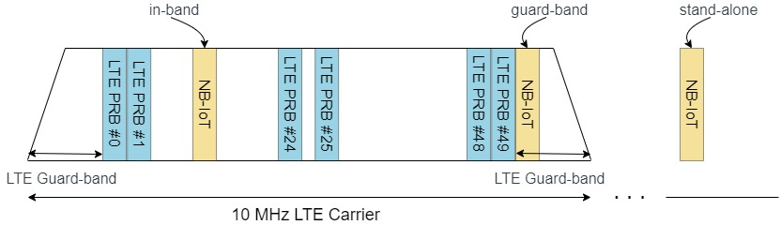
Narrow-band IoT (NB-IoT)
Extension to cellular networks to support IoT applications
Standardized by 3GPP (Release 13)
Particular focus on reliability (licensed spectrum deterministic transmissions)
Applications: smart cities (fault diagnostics and control), eHealth
Deployment types:
Notes:
NB-IoT may be seen as a competitor to LoRaWAN, although its properties makes this technology more suitable for different applications, especially those requiring strict delay guarantees and reliability and where cost is not a critical issue.
As such NB-IoT can be deployed alongside existing LTE systems, either in the same band, in the guard band left adjacent to a LTE carrier for adjacent channel interference protection, or stand-alone, i.e., in a completely different license band.

Slide 29
NB-IoT characteristics
Bandwidth: 180kHz
Data rates: 25kb/s (downlink) and 64kb/s (uplink, multi-tone)
Latency: < 10ms (transmissions aligned with LTE frames)
Reliability: Hybrid ARQ scheme
Energy efficiency: base station controls transmit power and sleep modes via signaling
Notes:
The bandwidth of NB-IoT is comparable to that of LoRaWAN (180KHz), but the data rates supported are higher (due to the more spectrally efficient modulation employed)
Since transmissions are aligned with LTE frames that repeat every 10ms, the latency can be kept below this limit.
A hybrid automatic repeat request (HARQ) scheme ensures reliable communications.
As the cellular infrastructure is used, where functionality for device power control and sleep scheduling exist, NB-IoT benefits from these to save energy in IoT applications with limited power budgets.

Slide 30
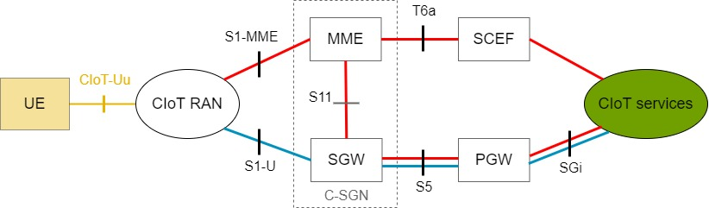
Cellular IoT (CIoT) architecture
Apart from a new radio interface, service capability exposure function (SCEF) added
UE – User Equipment
RAN – Radio Access Network
SGW – Serving Gateway
PGW – Packet gateway
MME – Mobility Management Entity
Red path: control plane
Blue path: user plane
Notes:
The architecture of cellular IoT follows closely that of any other cellular system, since only a new radio access interface is introduced to cater for NB-IoT devices and a new SCEF entity controls the interaction with cloud services and mobility management entities.
The data path is identical to that of existing LTE traffic.

Slide 31
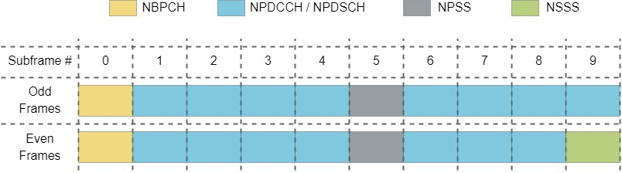
NB-IoT downlink
Each NB-IoT subframe spans one physical resource block (PRB)
One PRB spans 12 subcarriers in the frequency domain and one time slot (1ms)
Frame duration: 10ms
Data transmitting in Narrow-band Physical Downlink Shared Channels (NPDSCH)
Notes:
In LTE, resources are multiplex in space and time. Channel is divided into frames of 10ms, each containing 10 subframes of 1ms duration. Multiple subcarriers are grouped over a subframe to form a physical resource block. NB-IoT traffic may occupy such a PRB. Data and signaling messages are multiplexed in time on to logical channels, namely Narrowband Primary Synchronization Signal (NPSS), Secondary Synchronization Signal (NSSS), Physical Broadcast Channel (NPBCH), Physical Downlink Control Channel (NPDCCH), and Physical Downlink Shared Channel (NPDSCH). Downlink data traffic is transported in the latter.

Slide 32
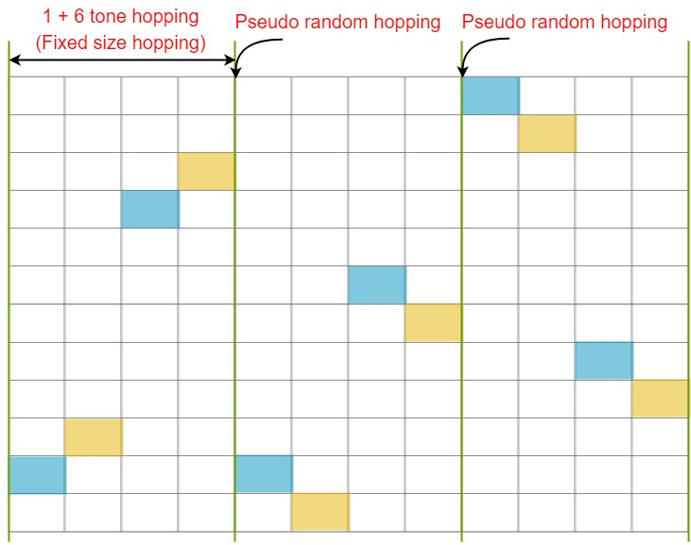
NB-IoT uplink
Up to 48 subcarriers can be configured
New single tone signal with frequency hopping used on Narrow-band Physical Random Access Channels (NPRACH)
UE randomly select one subcarrier to transmit preamble
  Hops one subcarrier between symbols 1–2 and 3–4 and 6 subcarriers between 2–3
  Then pseudo-random hopping
Base station responds instructing which uplink resources to be utilized for TX
Notes:
The uplink design is meant to accommodate a very large number of devices. Therefore, nodes willing to transmit follow a random channel access procedure, whereby they transmit a single tone signal on different subcarrier, following determined and pseudorandom hopping sequences. If there was no collision, the bases station receiving a tone from a transmitter will decide what resources to allocate to the initiator and respond accordingly. The node must acknowledge the reservation, before commencing transmission.

Slide 33
Coming next
Module | Contents
The Cloud | Virtual Machines and Containers Protocols Big Data Processing Device Management Platform
IoT Security | Importance of security in IoT Threat modeling Encryption
Current and Future IoT Trends | Machine learning Edge computing Platform Security Architecture Research topics
Notes:
In the following modules, we will look at cloud computing aspects that are relevant to IoT, discuss IoT security aspects, and finish off with an overview of current and future IoT trends.

