Slide 1
IoT Security

Slide 2
Syllabus
This module will cover the following
Importance of security in IoT
Threat modeling
Code signing
Encryption
Wireless security
Notes:
We will discuss the importance of security in the IoT domain and examine different threat modeling methodologies and possible attacks against IoT ecosystems. We will then overview threat mitigation techniques and delve deeper into code signing, encryption algorithms, and implementation of security provisions over wireless communication links.

Slide 3
Why security is critical in IoT
Context:
Billions of connected devices already deployed, used increasingly more to collect personal information (medical IoT, wearables, smart homes) or serve critical services (automotive IoT, energy distribution)
Challenges:
System heterogeneity (sensing, computation, communication),
Complex interactions (systems of systems)
Hundreds of new types of devices appear monthly
Software evolving continuously
Many device in use after vendors discontinued support/went into liquidation
Notes:
This IoT paradigm has huge potential to improve productivity across multiple sectors, including manufacturing and transportation, medical IoT, and smart homes. Unfortunately, the potential comes at the cost of security and privacy risks. Cyber threats have been reported that affect connected cars, smart door locks, or home automation ecosystems. Personal data has been exfiltrated from fitness trackers, and it’s been shown that the smart TVs may leak information about user habits.
Security threats stem from a combination of factors, including the heterogeneous nature of IoT ecosystems in terms of computation, communication, and sensing abilities; the often unstructured way in which they interact using a mix of protocols; the fact that IoT devices are continuously diversifying and software is evolving that brings new risks; and nonetheless, the fact that many devices continued to be online after their end-of-life, i.e., when the manufacturer either has discontinued support or filed for bankruptcy that in turn may lead to thousands of devices for which any new vulnerabilities discovered cannot be patched.

Slide 4
Identifying vulnerabilities
Gather detailed knowledge about end-to-end system architecture and the key building blocks
Identify potential breaching points of each building block
Understand how information flows between blocks, in what order, and based on what conditions
Establish trust boundaries that is the component most likely to be compromised first
Reflect on plausible attack scenarios and incentives an attacker may have to tamper with a system
Notes:
Several key steps should be followed to identify potential security vulnerabilities of an IoT system. To begin with, the complete architecture of the IoT system (including firmware, mobile app, cloud, and protocols) should be well understood. Although this may seem obvious, it is often the case that vendors outsource part of the development process and lose some control over the different building blocks.
Provided that the system is well understood, it is essential to assess how information flows between different entities and what events can trigger certain message flows.
With this knowledge base, a designer can start identifying the potential weaknesses of the different components (attack surface). At the same time, it is possible to establish trust boundaries. Given that components with more computational resources are easier to secure, the IoT device is typically considered the easiest to compromise. The trust boundary is often pushed, e.g., to the gateway, if string security guarantees can be provided there.
Nonetheless, a security analysis must consider the most likely attack scenarios and appreciate the motives of an adversary to seek to compromise a component or entire system. For instance, attackers can try multiple means to intercept, spoof, or disrupt messages sent from devices back to the server (communication); use different ways to try to observe the chip to gain information (physical); find ways to access restricted resources, e.g., via software bugs or call sequences that are open to exploits (software); and weaknesses that arise due to lack of maintenance or changes (lifecycle). Such analysis is often based on previous experience and curiosity, but formal threat modeling methodologies exist, which we will discuss next.

Slide 5
Threat modeling
Structured analysis of a system’s vulnerabilities from an attacker’s perspective
Goals:
  Identify security risks
  Quantify their severity
  Estimate likelihood of occurrence
  Reason for counteraction and prevention mechanisms
  Prioritize implementation of such mechanisms
Different threat modeling methodologies can be adopted:
  Open Threat Taxonomy
  ENISA IoT
  OWASP IoT
  ITU-T X.800
  Others
Notes:
Threat modeling refers to the process of analyzing the potential parts and behavior of a system that an attacker may seek to exploit or compromise. Identification of risks is only one facet of threat modeling. Other aspects to be considered are the actual implications of a potential attack and how likely is a specific attack to occur. This is naturally influenced by the complexity of the building block/interface that may be under threat and the level of expertise/tools required to mount the attack.
Threat modeling also deals with devising strategies for counteracting and preventing the security threats identified, and depending on the perceived severity, prioritizes the implementation of the solutions identified as necessary.
Different organizations have worked on defining threat modeling methodologies and threat taxonomies, some of which are listed on this slide. We will discuss several of them in what follows.

Slide 6
Open Threat Taxonomy
The confidentiality, integrity, availability (CIA) triad applied across different threat groups
Physical threats (incidents or actions that could lead to system damage, destruction, or theft – e.g., natural disaster, cooling/ventilation failure, vandalism)
Resource threats (failure of information system due to disruption of resources required for operation – e.g., communication services, external storage, power supply)
Personnel threats (deliberate or accidental actions of humans involved in the management/interactions with a system that may harm the system; damage as a result of social engineering that leads to system authentication compromise)
Technical threats (actions by an attacker that could harm the information system)
Multiple threats (each with their ID) can be classified in each of these groups, the severity of each being rated from 1 to 5 (the higher the rating, the more likely that threat).
Notes:
The Open Threat Taxonomy project is a joint initiative by Enclave Security together with the SANS Institute and the Center for Internet Security on the Critical Security Controls. The project catalogs a range of known cyber security threats and groups them together into four categories: physical, resource, personnel, and technical. The severity of each individual threat within a group was rated between 1 and 5, in terms of likelihood.

Slide 7
Open Threat Taxonomy
Technical threats
Credential discovery, e.g., via sniffing (TEC-007), brute force (TEC-008), pre-computational attacks (TEC-011)
Escalation (TEC-013) or abuse (TEC-014) of system privileges
Cryptanalysis (TEC-019)
Denial of Service (DoS) (TEC-021)
Manipulation of data in transit (TEC-023) or capture of data in transit via different methods (TEC-024 – TEC-026)
App exploitation via input manipulation (TEC-031), code injection (TEC-033), fuzzing (TEC-037), reverse engineering (TEC-038), etc.
Notes:
From a systems perspective, the technical threats are worth a closer look. All threats identified relate to the three pillars of information assurance, i.e., confidentiality, integrity, availability (CIA). The most important ones include credential discovery, abuse of privileges, cryptanalysis (the process of deciphering coded messages without knowing the key), denial of service, data manipulation, and application exploitation, each of these through different mechanisms/methods.

Slide 8
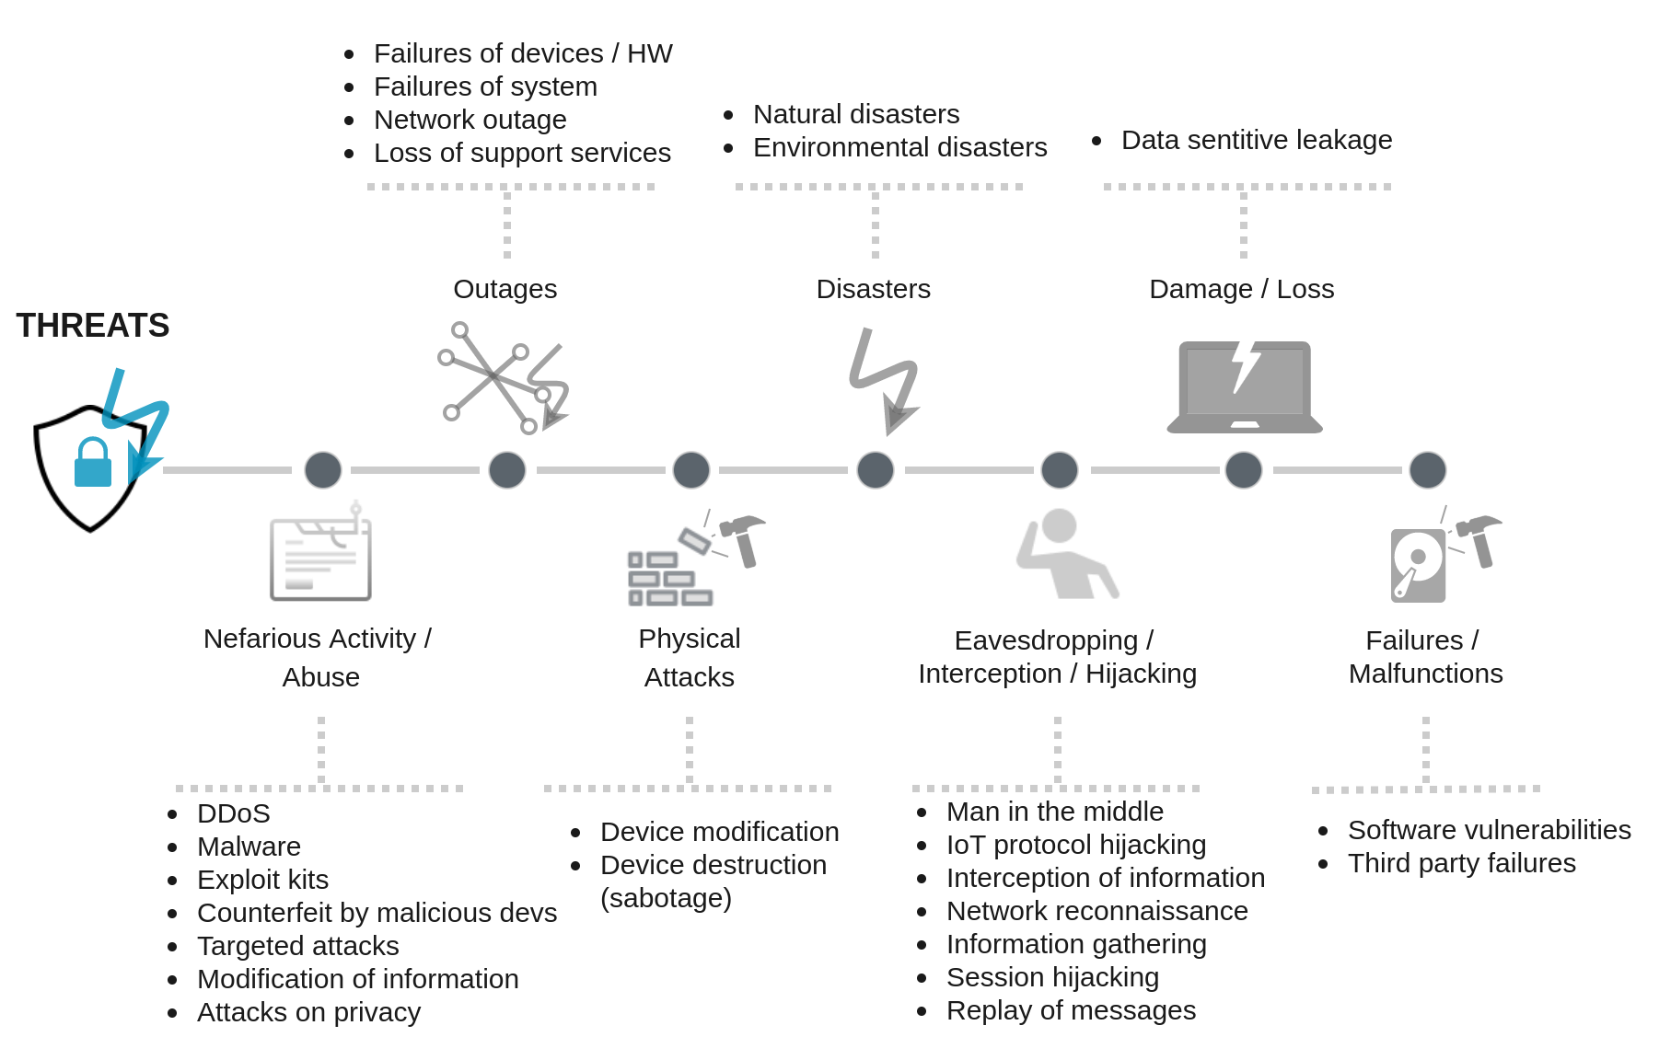
ENISA IoT threat taxonomy
Part of a broader Baseline Security Recommendations for IoT in the context of Critical Information Infrastructures
Aligned with the general ENISA threat taxonomy, but specifically focused on IoT
Notes:
The European Union Agency for Cybersecurity (ENISA) has also put together an IoT threat taxonomy, part of a security recommendation document released in 2017. This extends the ENISA threat taxonomy defined previously for general networked systems and considers seven main groups of threats: nefarious activity/abuse, outage, physical attacks, disasters, eavesdropping/interception, damage of IT assets, and failure/malfunctioning. Different specific threats are identified for each category, some of which may be due to deliberate adversarial actions, others due to external phenomena beyond human control, and others due to poor design/durability issues. The complete landscape is illustrated above.

Slide 9
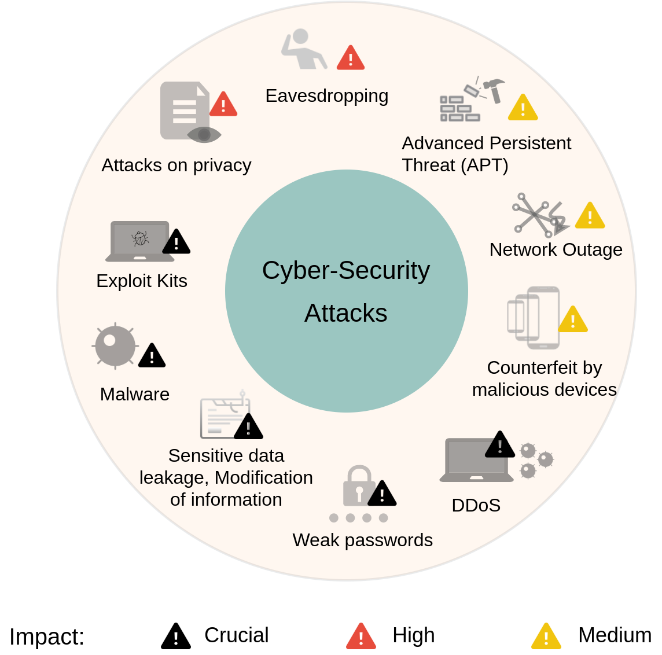
Impact assessment of IoT threats
The severity of different threats ranked as Medium, High, or Crucial, based on interviews with IoT experts
Weighted average of responses, based on a five-step scale (0 – no importance; 5 – crucial importance)
Impact may vary depending on the IoT use case scenario
Notes:
ENISA also ranked the severity of the threats identified, based on interviews with experts. A scale between 0 and 5 was used. Severity values between 3 and 3.5 out of 5 correspond to medium-importance threats, values between 3.5 and 4 out of 5 represent high-importance threats, while values over 4 are attributed to threats with crucial importance. None of the threats considered were ranked below 3. The figure above illustrates the severity of the different threats considered in this methodology.

Slide 10
OWASP Internet of Things
OWASP – Open Web Application Security Project
Helping stakeholders understand security
Top 10 things to avoid
OWASP IoT project groups different community-led initiatives to strengthen security into three categories: Seek & Understand, Validate & Test, and Governance.
Identifies ten key things to avoid from a security perspective when building, deploying, or managing IoT systems.
Weak, guessable, or hardcoded passwords
Insecure network services
Insecure ecosystem interfaces
Lack of secure update mechanism
Use of insecure or outdated components
Insufficient privacy protection
Insecure data transfer or storage
Lack of device management
Insecure default settings
Lack of physical hardening.
Notes:
OWASP is a not-for-profit initiative, primarily focused on improving software security through community-led projects. One such project is the OWASP IoT project that was designed to help manufacturers, developers, and consumers understand the security issues associated with IoT ecosystems, and enable making sound security decisions when building, deploying, or assessing IoT technologies.
The most recent effort is that of compiling a list of 10 most important things to be avoided from a security standpoint when designing and operating IoT systems. Unsurprisingly, this relate to threats of compromising credentials, communication secrecy, and access. Other aspects focus on the lifecycle of systems, including software updating, secure storage, and device management.

Slide 11
OWASP IoT Attack Surface
Ecosystem Access Control (implicit trust, enrolment security, lost access procedures, etc.)
Device memory (cleartext usernames/passwords, encryption keys, etc.)
Device physical interfaces (firmware extraction, privilege escalation, reset to insecure state)
Device web/admin/cloud web interface (SQL injection, XSS, account lockout, 2FA, etc.)
Device firmware (hardcoded credentials, sensitive info disclosure)
Device network services (injection, DoS, poorly implemented encryption, buffer overflow, etc.)
Notes:
OWASP formally defines an extensive attack surface specific to IoT. Some of the attacks identified and listed here are self-explanatory, others require some clarification. In particular,
Cross-site scripting (XSS) refers to techniques whereby attacks inject client-side scripts into web pages, subsequently launching unauthorized code that can exfiltrate data, enable access to other components of a device, etc.
Two-factor authentication (2FA) is a method of confirming a user’s identity through two different channels, e.g., password and out-of-band number sent by authentication service (for instance via SMS)
DoS refers to Denial of Service attacks that may manifest in a multitude of ways, but ultimately all of them target compromising the availability of a system

Slide 12
OWASP IoT Attack Surface
Local data storage (unencrypted data, lack of integrity checks)
Update mechanism (updates encrypted/unsigned, update location writable, etc.)
Mobile application (implicitly trusted by cloud, user enumeration, transport encryption, etc.)
Third parties (device information/location leaked, unencrypted PII)
Backend APIs (inherent trust, weak authentication, weak access control)
Ecosystem communication (health checks, heartbeats, deprovisioning)
Notes:
Personally identifiable information (PII) is any data that could identify a person or help in deanonymizing a user.

Slide 13
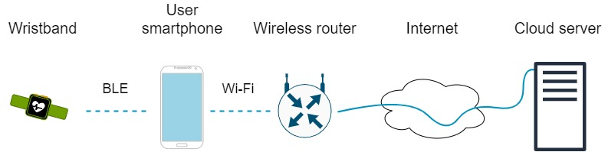
Example: Fitness tracking system
Notes:
To exemplify how threat modeling can be applied in practice, let’s consider a fitness tracking ecosystem, whereby the IoT device (wristband) communicates with a smartphone via BLE that acts as a mediator between the device and the cloud logic. In this scenario, we assume the user mostly interacts with the device when connected to a Wi-Fi network.

Slide 14

Example: Fitness tracking system
Packet sniffing,
DoS, code injection
Notes:
An attacker may attempt to sniff the traffic between the device and smartphone (especially if knowing the BLE hopping system that is agreed upon at connection set up); or impersonate the user’s smartphone and attempt to inject code without authorization.

Slide 15
Example: Fitness tracking system
Packet sniffing,
DoS, code injection
Packet sniffing,
protocol reverse
engineering
Notes:
Packet sniffing is much simple over Wi-Fi, since the channel frequency remains the same. An attacker may also seek to gain control to the wireless router, where sniffing would become much easier and man-in-the-middle attacks could be launched to seek to bypass encryption or reverse the communication protocol between IoT device and cloud.

Slide 16
Example: Fitness tracking system
User impersonation,
fake measurements injection, exfiltration
Packet sniffing,
DoS, code injection
Packet sniffing,
protocol reverse
engineering
Notes:
Another possible threat is that whereby an attacker impersonates the device and seeks to connect to the cloud and exfiltrate personal data associated with a victim’s account. At the same time, the users themselves can act maliciously and seek to forge data (e.g., fitness records) and present this to the cloud (e.g., for financial gains associated with third parties).

Slide 17
Example: Fitness tracking system
User impersonation,
fake measurements injection, exfiltration
Packet sniffing,
DoS, code injection
Packet sniffing,
protocol reverse
engineering
Service impersonation,
malware injection
Notes:
Nonetheless, an attacker that is able to impersonate the vendor’s cloud could potentially seek to mislead a device into flashing new firmware with malicious functionality (malware).

Slide 18
Mitigating risks
Strengthen security across the entire end-to-end system
Hardware (attackers should not be able to compromise device via direct physical access)
Code (signed and tested firmware/software, integrity checks)
Encrypted channels (data never exchanged in plaintext)
Service semantics (communication robust to DoS, replay attacks, account hijacking, etc.)
Notes:
Fortunately, technical solutions exist to mitigate such risks, spanning the entire IoT ecosystem. For instance, it is possible to disable read/write pins after device testing, so that attackers with physical access to the hardware cannot inspect or modify the memory contents. For a device that permits over the air updating, the firmware code should be signed, and the device should perform integrity check prior to updating.
Clearly IoT devices often exchange sensitive data and thus encryption should be enforced end-to-end. The state machine of the protocols used for communication should be also strengthened against attacks, for e.g., unauthorized over the air commands or payloads that can cause buffer overflows and subsequently device reboot, escalation of privileges, and so on.

Slide 19
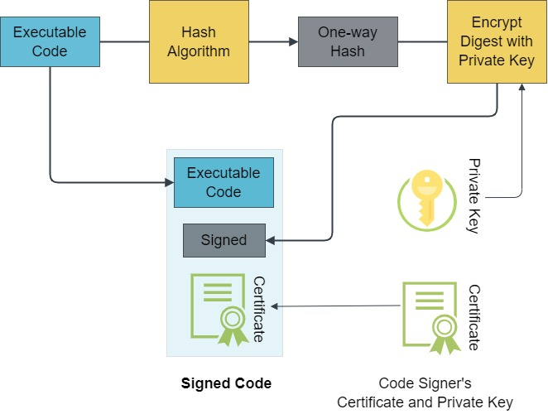
Code signing
Enables devices to verify whether, e.g., a firmware update can be trusted
Cryptographic hash generated to confirm code authenticity and integrity
Key idea: map data of any size to a fixed “digest,” using a one-way function (i.e., operation that is difficult to invert).
Public-key-infrastructure (PKI) used to provide assurance about who signed code.
Signature embeds a certificate issued by a certificate authority (CA).
Notes:
Code signing is a method that enables a device to verify the authenticity of a software artifact and its author. For this a hash function is used to map data of any size onto a fixed-size string. The signature then consists of the signed hash, along with the signer’s certificate and private key.
PKI binds public keys with the identities of entities (people, businesses) through registration with a certificate authority (CA) that issues a certificate. The X.509 standard for public key certificates is commonly used. The certificate includes a public key, digital signature, and information about the identity associated with the certificate and its issuing certificate authority (CA). Additional information includes a serial number, the certificate version, and the validity period. When an X.509 certificate is signed by a trusted CA, the certificate can be used by a third party to verify the identity of the entity that presents it. X.509 certificates are typically combined into chains for validation. The root CA certificate with its public key is included in the end user’s operating system. Certificates are also used to verify the ownership of a public key presented by a server to which a user/device connects. We will discuss this in more detail shortly.

Slide 20
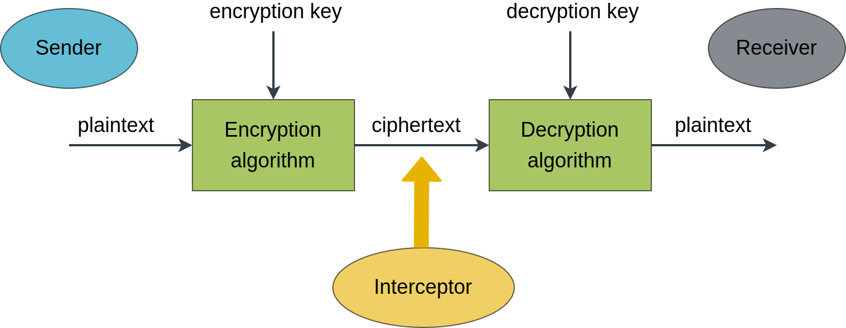
Network security
Encryption
Encryption: Process of transforming plaintext message into cipher-text using a key and encryption algorithm
Algorithm involves a set of mathematical operations, permutations, substitutions, etc.
Difficult for an attacker intercepting messages to figure out the key
Notes:
Network communication security is typically implemented through encryption, i.e., a mathematical process by which plaintext messages are transformed into ciphertext by means of an algorithm and a “key.” The typical operations involved are relatively simple (permutations, substitutions, XOR), but difficult to reverse by an interceptor seeking to guess the key. We will discuss different algorithms that are commonly used to encrypt/decrypt messages.

Slide 21
Encryption principles
Secrecy
Length of encryption key directly influences level of secrecy
Key design is particularly critical, e.g., only 100 combinations exist for 2-digit pad locks → not so difficult to brute-force (exhaustive search)
Work factor: Effort or time required by an attacker with given resources to infer an encryption key
Work factor for breaking a key by exhaustive search is exponential in key length
→ the longer the key, the higher the work factor
Notes:
There are three fundamental principles behind encryption: secrecy, redundancy, and freshness. Secrecy refers to how difficult it is to decipher an encrypted message and guess the encryption key. This type of effort is effort as work factor. The size of the encryption key plays a crucial role in guaranteeing secrecy. Intuitively, you can think about the difficulty of guessing the combination set on a padlock with 2 vs. 6 digits. The number of possible combinations are 10^{n}, where n is the number of digits. In this example we are looking at 100 vs. 1 million combinations.

Slide 22
Encryption principles
Redundancy
Problem: When the ciphertext is short, an attacker may generate random fake messages of the same length to figure out even a key that is long
Solution: Add information to encrypted messages that is not needed to understand the original message
Redundancy may decrease the likelihood of generating a valid message
Possible approach: Pad messages with data derived from messages, e.g., a modified copy or hash of the original message
Hash functions map data of arbitrary size onto a fixed-size string
Notes:
Another important aspect, especially when the plaintext messages to be enciphered are small, is redundancy. In such cases, an attacker could attempt to generate many random messages until some of these prove valid. To avoid this, short messages are usually passed through a function that artificially inflates the length of the original useful message. Such functions could be as adding paddings derived from the original message, for instance via hashing.

Slide 23
Encryption principles
Freshness
Problem: How to verify that a message was not already sent
(replay attacks)
Possible solution: Include a “token” in every message that is valid only for a limited duration T (e.g., 10 seconds)
Receiver keeps a message for T seconds, compares new messages to previous ones, and discards any duplicates
Messages with a known token that are older than T seconds will be ignored
Notes:
Nonetheless, to avoid that an attacker intercepting a valid encrypted message replays that to tamper with the operation/logic at a receiver, we need a way to verify that a message is fresh. To avoid this, the messages could include a unique token that expires after a specified duration. This would enable the recipient to identify any messages that have an expired token (because of a potential replay attack) and ignore these to preserve the integrity of the system.

Slide 24
Symmetric key encryption
Use the same key for both encrypting and decrypting messages
Key provisioned at device manufacturing
Common approach:
Block ciphers (take n-bit blocks of plaintext and convert to n-bit blocks of ciphertext)
Multiple stages divide input into groups and perform a set of operations
- Substitutions and permutations;
- Split, pass through round functions, XOR
Notes:
There are two approaches to encryption: 1) symmetric, whereby the same key is used for enciphering and deciphering messages, and 2) asymmetric, in which each party keeps a private key and releases a public key that senders can use to encipher messages, but only the receiver can decrypt these with the private key.
In the former case, most of the time the key is provisioned at manufacturing. This has some limitations, for e.g., if a key becomes compromised and needs to be refreshed. Another approach is to use a key establishment protocol by which a shared secret key is generated by each party over an adversarial channel, without an interceptor being able to guess this key. We will discuss this approach shortly.
Given the same key exists at both communication end-points, different encryption algorithms can be used. The most popular ones are block ciphers, whereby a message is divided into blocks of fixed length and converted into ciphertext of the same length.
The conversion process involves a set of simple mathematical operations that are however difficult to reverse engineer. This includes substitutions and permutations, as well as manipulations through dedicated round functions where the key is applied to hide the manipulated blocks, and exclusive or operations that have the useful property (from the perspective of decryption) of restoring the original content of XOR twice with the same value (e.g., sub-key).

Slide 25
Feistel ciphers
Same circuitry used for encryption and decryption
Messages split into blocks
Each block processed iteratively
  A “round” function F operates on one half of a block and uses round sub-keys
  Round function does not need to be invertible
  The other half of the block is swapped at the input of the following round
Feistel ciphers used in multiple symmetric encryption schemes:
  Data Encryption Standard (DES) and
  eXtended Tiny Encryption Algorithm (XTEA)
Notes:
One example of block ciphers is the Feistel cipher that is used by a range of symmetric encryption schemes, for instance in the eXtended Tiny Encryption Algorithm (XTEA) that is suitable for very constrained devices.
The principle of Feistel structures is to process each block iteratively with a round function that operates on one half of each block and swaps the other half for the input to the next round. A round sub-key is used with the round function.
An advantage of this approach is that the same structure can be used for both encryption and decryption by only reversing the order of the sub-keys.

Slide 26
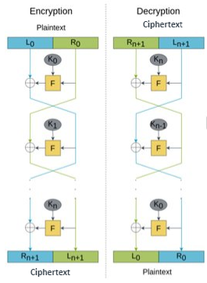
Feistel ciphers
Operation
Divide block into two parts of equal size (L₀, R₀)
At each round i
L_{i+1} = R_{i}
R_{i+1} = L_{i} ⊕ F(R_{i},K_{i})
Ciphertext is
(R_{n+1}, L_{n+1})
Decryption process uses the same sub-keys, but in reverse order
Notes:
Above is an illustration of the encryption and decryption process in Feistel ciphers. At each round the left half of the output simply loads the right half resulting from the previous round. In contrast, the right half takes the left half of the previous round and XORs this with a function of the previous right half and the round key.

Slide 27
Example
Plaintext: 0xFACCBF0D
Round function: F(R_{i},K_{i}) = K_{i} ⊕ (R_{i} << 4)
⊕ is the exclusive OR operator
<< is the circular shift left operator
16-bit key, sub-keys K₀ = 0x1010, K₁ = 0xAB2F, …
L₀ = 0xFACC R₀ = 0xBF0D
L₁ = R₀= 0xBF0D R₁ = L₀ ⊕ (K₀ ⊕ (R₀ << 4))
R₁ = 0xFACC ⊕ (0x1010 ⊕ 0xF0DB)
R₁ = 0xFACC ⊕ 0xAF1D = 0x55D1
L₂ = R₁ = 0x55D1 R₂ = L₁ ⊕ (K₁ ⊕ (R₁ << 4))
R₁ = 0xBF0D ⊕ (0xAB2F ⊕ 0x5D15)
R₁ = 0xBF0D ⊕ 0xF63A = 0x4937
…
Notes:
Here is an example where the round function involves an XOR between the round key and a left shifted version of the right half taken from the previous round.

Slide 28
Advanced Encryption Standard (AES)
Based on Rijndael cipher (substitution-permutation network)
Works with 128-bit blocks arranged in 4x4 column-major order matrixes of bytes
Multiple rounds, whose number is determined by key size
Key expanded into round keys through a Rijndael key schedule
(byte rotation, exponentiation of 2 to user-specified value, S-box)
Notes:
A more robust symmetric encryption algorithm that is widely used in today’s devices, especially where the hardware provides cryptographic extensions (i.e., dedicated circuitry for crypto operations), is AES.
AES is based on a Rijndael cipher that is effectively a substitution and permutation network. More specifically, blocks of 128 bits are arranged in 4x4 matrices that store the bytes by first populating each column (column-major order). These matrices are then passed through multiple rounds of operations, the number of rounds being determined by the key size. The key itself is expanded into round keys, by performing byte rotation, power of 2 exponentiation, and substitutions based on look up tables.

Slide 29
AES operation
At each round (except the last) perform the following:
SubBytes: Non-linear byte substitution using a lookup table (S-box)
  First 4 bytes indicate row,
  Last 4-bytes indicate column
  Operations in Galois Field with 2⁸ elements
ShiftRows: Rotate left bytes on each row i with i - 1 positions
MixColumns: Multiply in GF(2⁸) a matrix with each column
(diffusion – obscure connection between key and ciphertext)
AddRoundKey – XOR between source columns and columns of round key matrix
Columns not mixed at last round.
Notes:
At all rounds except the last one, AES splits each value in the matrix into two parts, each indicating the row and respective column in a substitution table, from where the corresponding value is taken to replace the current content of the original matrix cell. At the second step, the bytes of each row are rotated left with a number of positions indicated by the row number. Then each column is multiplied with a pre-defined invertible matrix. Lastly, the subkey for the next round is computed by XORing the state with the current round key. In the final round, the MixColumns and AddRoundKey are not executed.

Slide 30
Diffie-Hellman key agreement
Secure establishment of cryptographic key over an untrusted channel
Two parties agree publicly on two prime numbers (generator g, and modulus p)
01
First selects a secret prime number a, computes
A = gª mod p, then sends A
02
Second picks a secret number b, computes
B = g^{b} mod p, and sends B to first party
03
Second party computes A^{b} mod p, first party calculates
Bª mod p.
04
Both results will be the same, i.e.
g^{ab} mod p.
This is the shared secret
05
Notes:
The Diffie-Hellman (DH) key agreement protocol circumvents the problem of provisioning keys at manufacturing. The goal is to establish a shared secret between two communicating parties, that can be used to encipher subsequent communication, for e.g., using AES. DH does this over a channel that can be insecure, exploiting the unique properties of prime numbers and modulo operations. In particular, two parties that wish to communicate agree on a generator and modulus number, both of which are prime. Each of them selects a secret prime number and raises the generator to the power of that number, modulo p. The result is sent over the air by both. Based on this, each raises the message received to the power of their private number. By this both obtain a shared secret g^{ab} mod p that they can use as key.

Slide 31
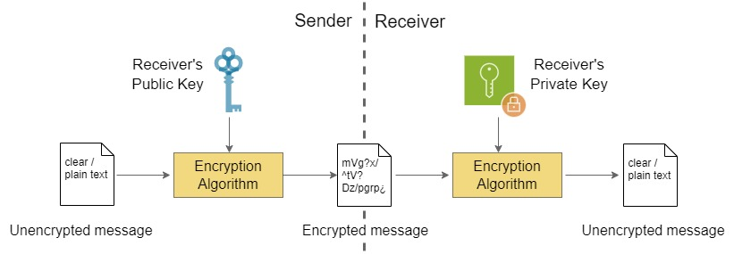
Asymmetric encryption
Also known as public key encryption
Sender uses public key of recipient to encrypt messages
Recipient uses own secret private key to decipher messages
The approach addresses the challenges of key distribution
Easy to generate public key from private key
Extremely difficult to guess private key
Notes:
Asymmetric encryption is also referred to as public key encryption because the public key of each party that wishes to receive enciphered messages is available to anyone. In particular, a sender will use the public key of the intended receiver to transmit an encrypted message, and the recipient uses a private key to decrypt the ciphertext. The public key is generated from the private key, but inferring the private key from the public key should be hard.

Slide 32
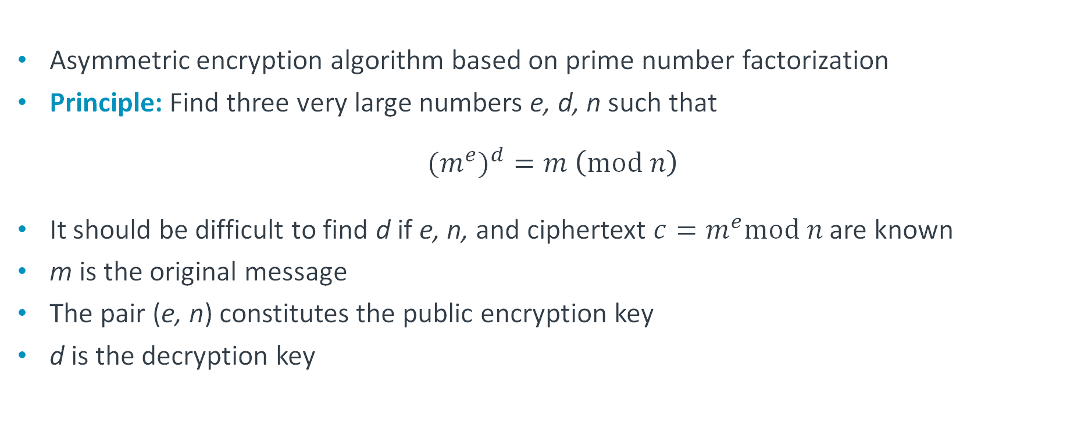
The Rivest–Shamir–Adleman (RSA) algorithm
Asymmetric encryption algorithm based on prime number factorization
Principle: Find three very large numbers e, d, n such that
$${{(m}^{e})}^{d}=m \left(\text{mod} n\right)$$
It should be difficult to find d if e, n, and ciphertext $c=m^{e}mod n$ are known
m is the original message
The pair (e, n) constitutes the public encryption key
d is the decryption key
Notes:
One example of asymmetric encryption algorithm is RSA that is based on prime number factorization. The idea is to find a public encryption key e and a private decryption key d that satisfies the expression showed above, whilst it should be difficult for an attacker to derive d if e and the modulus n are known.

Slide 33
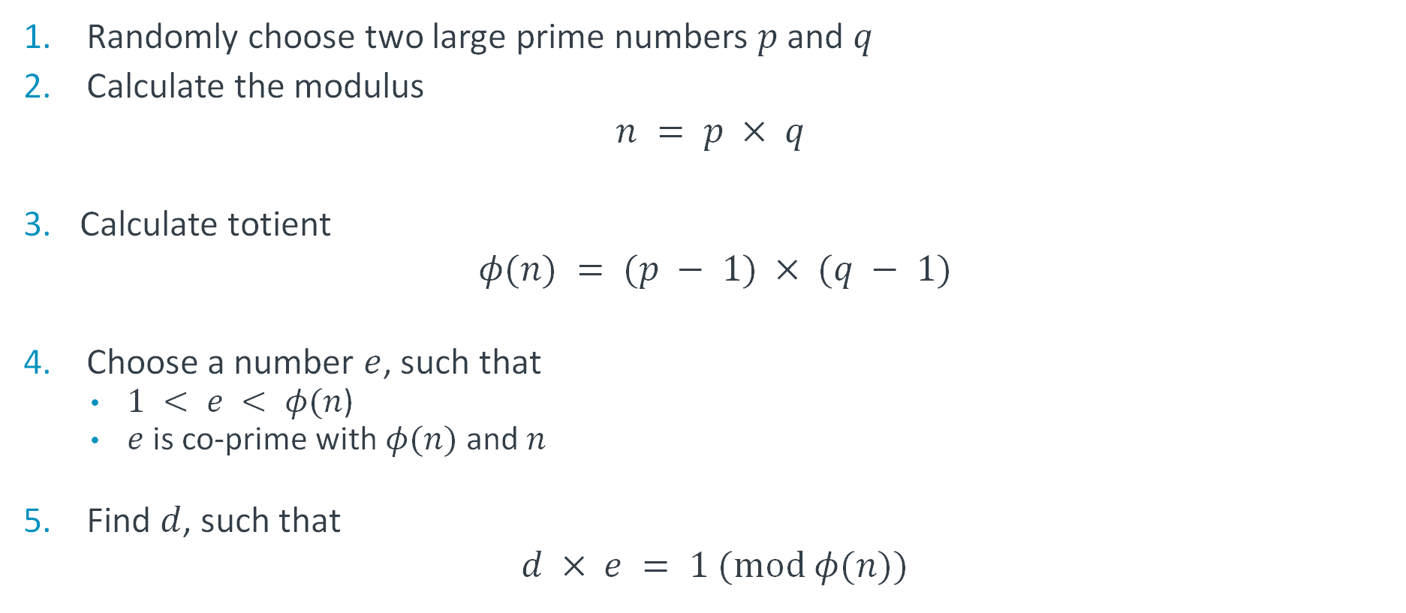
RSA operation
Randomly choose two large prime numbers $p$ and $q$
Calculate the modulus
$$n = p × q$$
Calculate totient
$$φ(n) = (p − 1) × (q − 1)$$
Choose a number $e$, such that
  $1 < e < φ(n$)
  $e$ is co-prime with $φ(n)$and $n$
Find $d$, such that
$$d × e = 1 (\text{mod} φ(n))$$
Notes:
To design these keys, the following procedure is followed: two large prime numbers p and q are chosen and the modulus is computed as their product. The totient is computed as the product p - 1 and q - 1. Then e is chosen between 1 and the totient, such that it co-primes with both the totient and modulus, i.e., the only positive factor that divides them is 1.
Then d is selected such that the product of d and e modulo totient is 1.

Slide 34
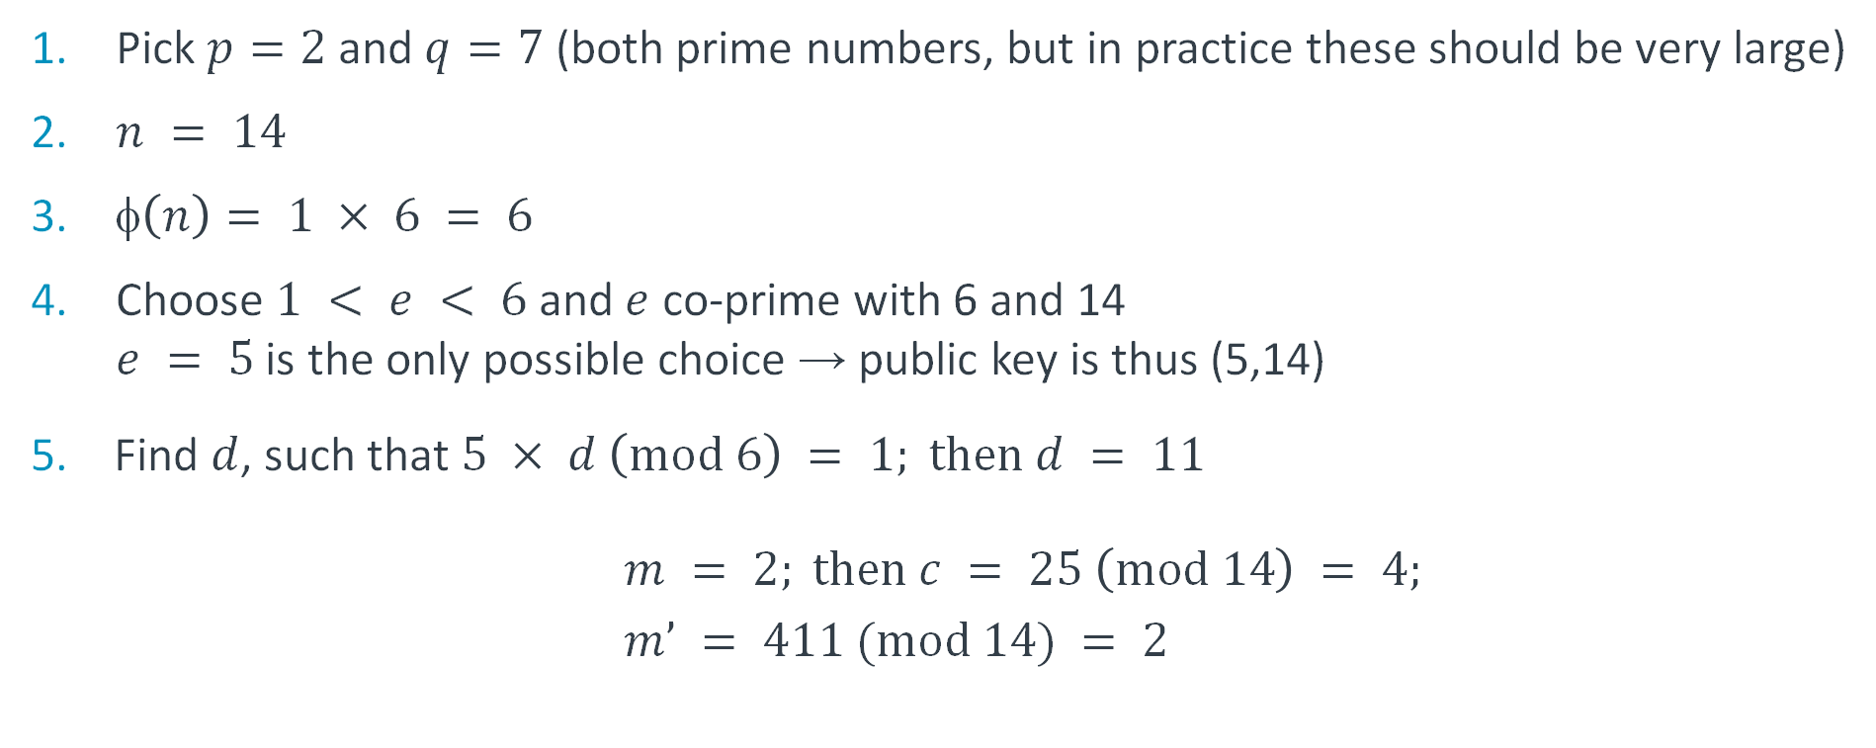
Example
Pick $p=2$ and $q=7$ (both prime numbers, but in practice these should be very large)
$n = 14$
$\left(n\right)= 1 × 6 = 6$
Choose $1 < e < 6$ and $e$ co-prime with 6 and 14
$e = 5$ is the only possible choice → public key is thus (5,14)
Find $d$, such that $5 × d \left(\text{mod} 6\right) = 1; \text{then} d = 11$
$m = 2; \text{then} c = 25 \left(\text{mod} 14\right) = 4;$
$m’ = 411 (\text{mod} 14) = 2$
Notes:
Let’s take a simplified example, noting that in practice p and q must be substantially larger. In this case the only number between 1 and 6 that is co-prime with 6 and 14 is 5, hence the encryption key is (5,14). d = 11 is the smallest value that solves 5 x d (mod 6) = 1, hence will be used as the decryption key.

Slide 35
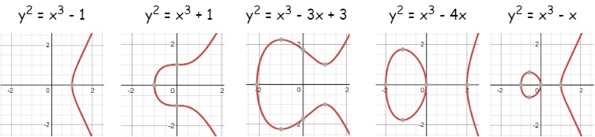

Elliptic curve cryptography (ECC)
Based on the algebraic structure of elliptic curves (i.e., $y2 = x3 + ax + b$) over finite fields, on which group operations are performed
Main advantage: Can provide equivalent level of security as with RSA, but with much smaller key size
Notes:
Another approach to encryption builds on the properties of elliptic curves defined over finite fields (i.e., Galois fields), where basic operations such as addition and multiplication are defined and satisfy certain rules. Elliptic curves can sustain similar level of secrecy as RSA, but require smaller keys.

Slide 36
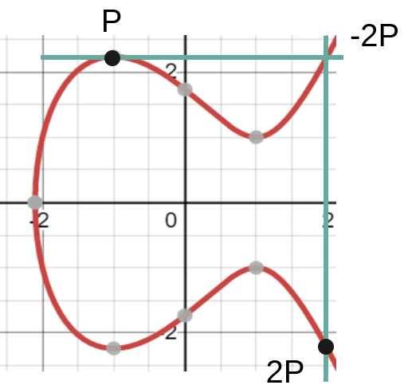
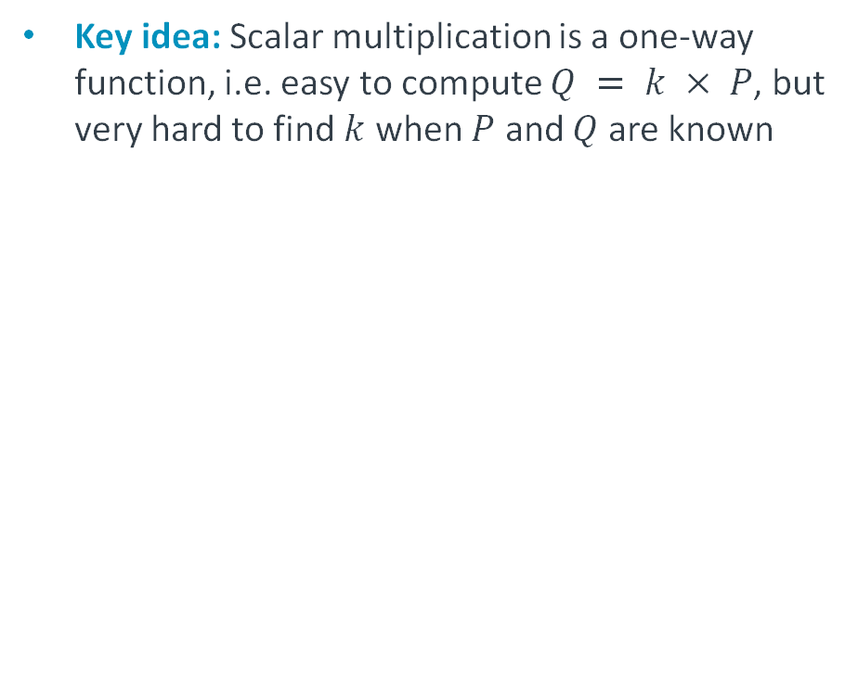
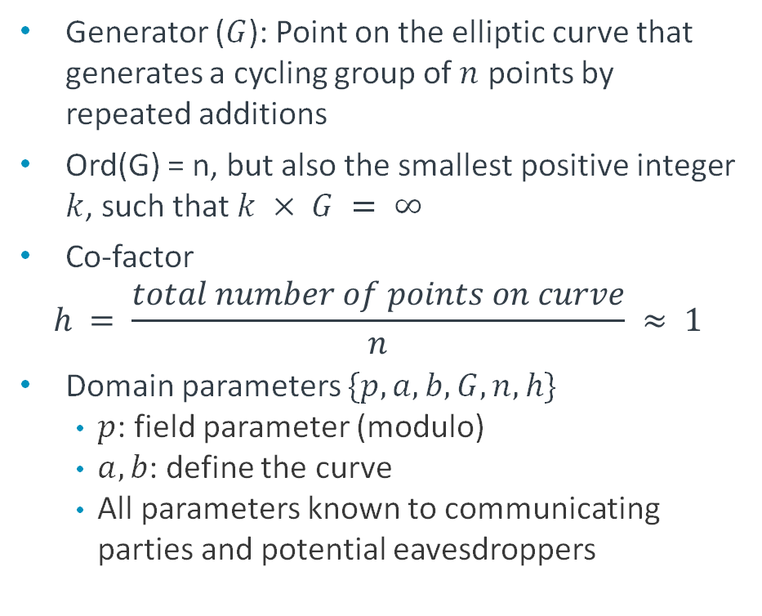
ECC key agreement
Key idea: Scalar multiplication is a one-way function, i.e. easy to compute $Q = k × P$, but very hard to find $k$ when $P$ and $Q$ are known
Generator ($G$): Point on the elliptic curve that generates a cycling group of $n$ points by repeated additions
Ord(G) = n, but also the smallest positive integer $k$, such that $k × G = ∞$
Co-factor
$$h = \frac{total number of points on curve}{n} ≈ 1$$
Domain parameters $\{p, a, b, G, n, h\}$
  $p$: field parameter (modulo)
  $a, b$: define the curve
  All parameters known to communicating parties and potential eavesdroppers
Notes:
ECC is mostly used for key agreement (in combination with the DH approach). The idea stems from the properties of scalar multiplication on elliptic curves. In particular, it is easy to compute the multiple of a number on a curve through multiple additions (tangent to the point and projection of the intersection point with the curve onto –y), but if the result of a multiplication is known, it is difficult to find the multiplying factor.
Several parameters define an EC to be used for encryption. The generator (or base point) generates a cyclic group, where each point in the group can be reached by repeated additions of the generator. The order of G, ord(G) = n, indicates the number of points that it generates. The order is also the smallest positive integer k, s.t. kG is the point at infinity. The co-factor is the ratio between the total number of points on the curve divided by the order of G. If the curve is appropriately designed, the co-factor should be as close to 1 as possible.

Slide 37
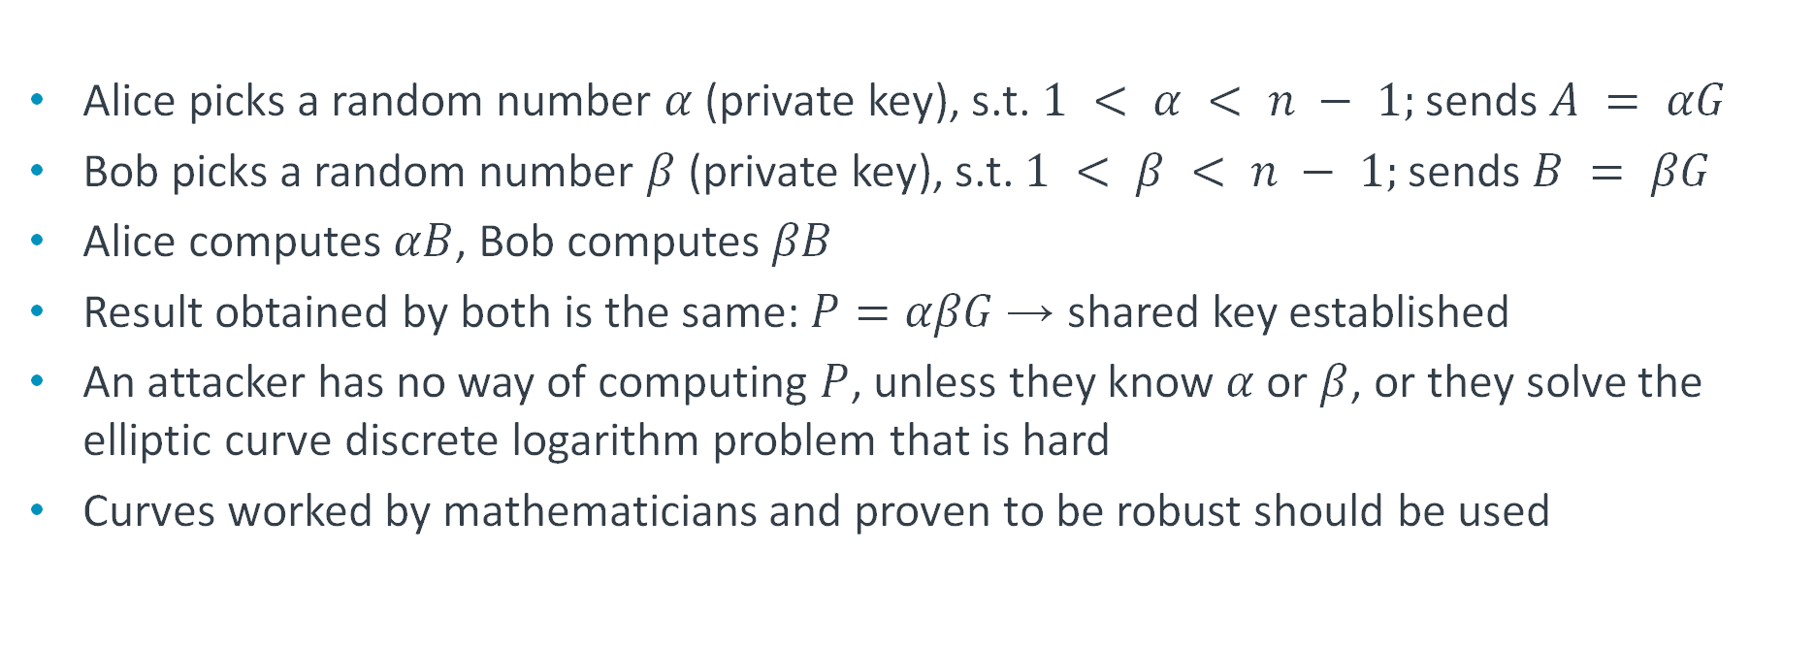
Elliptic Curve Diffie-Hellman (ECDH) key establishment
Alice picks a random number $α$ (private key), s.t. $1 < α < n − 1;$ sends $A = αG$
Bob picks a random number $β$ (private key), s.t. $1 < β < n − 1;$sends $B = βG$
Alice computes $αB$, Bob computes $βB$
Result obtained by both is the same: $P=αβG$ → shared key established
An attacker has no way of computing $P$, unless they know $α$ or $β$, or they solve the elliptic curve discrete logarithm problem that is hard
Curves worked by mathematicians and proven to be robust should be used
Notes:
ECDH works similar to classic DH, but points are picked randomly on the EC instead of taken as primes. The point chosen by each party is multiplied by the generator and the results sent in both directions. The parties then multiply the result received with their own secret random number initially chosen on the curve, and both obtain the same shared secret.

Slide 38
Securing wireless communications
Data confidentiality is particularly important in wireless communications, since the transmission medium is inherently broadcast (anyone can listen)
Wired Equivalent Privacy (WEP) and Temporal Key Integrity Protocol (TKIP) used historically, but shown to have flaws and replaced with Wi-Fi Protected Access II (WPA2)
Wi-Fi is the most popular wireless technology and employed in a range of IoT scenarios.
The latest Bluetooth specification relies on an ECDH key agreement protocol and connections are subsequently secured with AES
Notes:
Having studied different approaches to data encryption, let us now examine how wireless communication can be secured. This is particularly important given the broadcast nature of wireless channels that enables anyone within transmission range to overhear the messages exchanged between any pair of nodes. Security enhancements for Wi-Fi are specified in the IEEE 802.11i amendment.
We consider the Wi-Fi technology, where security provisions are specified in the IEEE 802.11i amendment. Historically WEP and TKIP (WPA) have been used, but due to their provably weak secrecy properties, WPA2 was adopted.

Slide 39
WPA2
Two protocols defined for initial authentication:
  Via Pre-shared key (PSK) or
  Using an authentication server and the Extensible Authentication Protocol (EAP) with different authentication options (TLS, Protected EAP, etc.)
After authentication, a shared secret key, known as Pairwise Main Key (PMK) is generated that is derived from a password that is cryptographically hashed
In PSK mode, the PMK is the PSK
Four-way handshake used to
  enable the access point and client to prove to each other that they know the PSK/PMK, without disclosing the key
  establish a Pairwise Transient Key (PTK) that is used to encrypt the traffic
AES then used to encrypt payload
Notes:
WPA 2 works with an initial authentication phase that is followed by a generation of a shared secret key and derivation of a PTK that is used to encrypt the message payload with a robust flavor of AES.
Authentication is either based on a pre-share key (or Wi-Fi passphrase) in personal networks or in enterprise settings using an authentication server and the EAP protocol that supports different authentication options, such as transport layer security (TLS), or username/password and certificate-based inner authentication.
The PMK is generated by each party by hashing a password (either PSK or received following authentication with server).

Slide 40
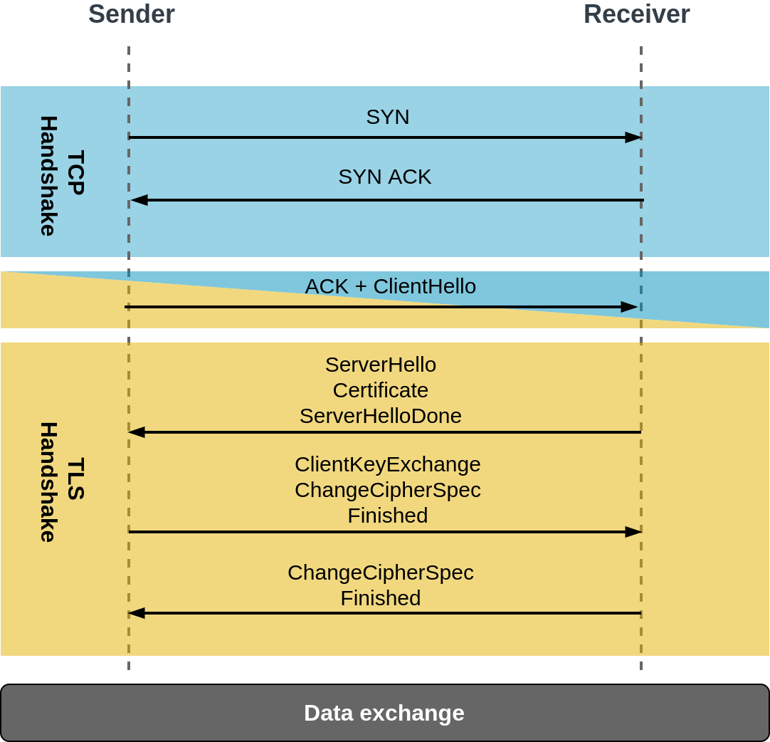
Transport layer security (TLS)
Provides encryption, authentication, and data integrity to applications
Shared secret negotiated between peers
Peers agree on TLS protocol version and choose cipher suites via three-way handshake
Both authenticate their identity based on established chain of trust
32-byte session identifier sent as part of ServerHello message during TLS negotiation
Chain of trust used to verify the identity of parties (via certificate authority)
Once a shared secret is established, this is used as a symmetric key to encrypt all TLS records.
Each message signed with a Message Authentication Code (MAC)
Notes:
Different options can be used for shared secrete negotiation, but DH with an ephemeral key is increasingly used, i.e., this is periodically re-negotiated.
The cypher suite is a set of algorithms that specifies details for securing a particular session.
Session ID used to store previously negotiated parameters and reuses them following a shorter handshake.
The MAC algorithm is a one-way cryptographic hash function, where keys are negotiated by peers in advance. A MAC is generated and appended to each TLS message. The receiver verifies the sent MAC to ensure message integrity and authenticity.

Slide 41
Coming next
Module | Contents
Current and Future IoT Trends | Machine learning Edge computing Platform Security Architecture Research topics
Notes:
In the final module, we will look at current and future trends in the IoT domain.

