Slide 1
Current and
Future IoT
Trends

Slide 2
Syllabus
This module will cover the following
Current state of IoT landscape
Machine learning
Edge computing
Platform Security Architecture
Research topics
Notes:
We will give an overview of the IoT landscape and highlight key factors that stimulate future advances in IoT. As data driven automation is increasingly important, we will present AI and machine learning concepts relevant to IoT and examine recent advances in edge computing including machine learning deployment on embedded devices. In light of the growing importance of security in IoT, we will investigate the Arm Platform Security Architecture (PSA) and finish with a couple of IoT research topics.

Slide 3
Current state of IoT landscape
Faster growth than previously anticipated
Growth driven by expansion of connected consumer market, fast penetration of voice-controlled personal assistants (e.g., Alexa), and increase in mobile machine-to-machine connections
Most businesses start with systems that serve a single application → rapid return of investment, but not maximizing full potential of IoT
More investment in medical IoT, industrial IoT, and intelligent transportation
Evidence of security vulnerabilities continue to affect consumer trust and limit adoption
21bn
Internet-connected devices at the end of 2019
Notes:
At the end of 2019, the number of Internet-connected devices exceeded by 1 billion the number anticipated by industry forecasts two years before. This growth was fuelled by several key factors, including an explosion in the number of smart-home products, personal assistants such as Alexa becoming mainstream, the deployment of more M2M connections, and rapid IoT adoption in China.
From an industry perspective, most businesses, however, appear to start by considering the use of IoT with a focus on a single specific application. On one hand, this is to minimize risk and develop projects with clear immediate rate of investment. On the other hand, the potential of IoT to create higher value remains untapped with this approach.
Coupled with data analytics, IoT is now seeing strong adoption in the medical, industrial, and transportation domains. According to ICON, the Industry 4.0 market was expected to exceed $240 bn by 2024, according to MarketWatch.
Unfortunately, security concerns still hamper IoT adoption. On the positive side, more and more companies are building internal expertise and resources required to ensure IoT security and user data privacy.

Slide 4
More value created from data
Data still largely used for process monitoring and optimization
Additional value created from forecasts based on IoT data collected, e.g., in predictive maintenance (automotive IoT)
Feeding data into the operation of other systems, e.g., interconnecting distribution and manufacturing (value chain)
Increasing appetite to use machine learning (ML) and artificial intelligence (AI) to extract hidden knowledge from massive amounts of data collected by sensors
Hardware is mature → new edge computing methods needed
Essential to build AI capabilities to increase the value of the data gathered
Notes:
As IoT devices continue to diversify and their number is increasing sharply, the massive amounts of heterogeneous data they produce become valuable if mined appropriately. Up to now, sensor data has been largely used to monitor and optimize the performance of different processes or applications. With the rise of machine learning, additional value can be created if predictions are made based on patterns observed in historical measurements. For example, in the automotive IoT domain, a vendor could anticipate based on measurements collected by sensors when a particular component/sun-system might fail or need replacement and notify the user to bring the car for maintenance, outside of a fixed periodic maintenance schedule.
Further value can be created when the data collected from the operation of one system is fed into the optimization of another, e.g., manufacturers collecting data from delivery trucks, to anticipate any delays that may influence production.
While extracting value from data using AI and machine learning has been dealt with by powerful computing servers equipped with graphics processing units (GPU), the embedded hardware ecosystem has matured and current microcontrollers are now optimized to solve complex problems. Adapting and deploying machine learning to embedded devices and running inference at the edge becomes appealing.

Slide 5
AI and ML
Teaching computers to solve problems and learn like humans
AI paradigm aims to develop computing capabilities that mimic human cognitive functions
Machine learning (ML) is a subset of AI by which artificial processes learn from data and make decisions without having been explicitly programmed
  Supervised learning: relies on training examples
  Unsupervised learning: discovers new patterns without human supervision
  Reinforcement learning: agents learn actions in an environment to maximize some reward
Deep learning is a family of ML that seeks to mimic the biological nervous systems
Notes:
Since we mentioned AI and ML, it is worth to formalize these concepts and understand why these techniques are particularly well suited to handle big data. The AI paradigm refers to computing mechanisms that aim to reproduce the cognitive functions of humans. AI is a vast area that includes rule engines, expert systems, machine learning, etc. Among these, ML is particularly interesting in the context of processes that generate vast amounts of data, since this technique aims to solve problems by acquiring some knowledge from data instead of being explicitly programmed.
Machine learning algorithms are typically categorized into supervised, unsupervised, and reinforcement learning. Supervised learning requires substantial domain knowledge and quality labeled data for training that can take months or even years to produce. Unsupervised learning instead seeks to learn unique patterns without human expert control, for instance in clustering together data points with similar properties. In reinforcement learning an agent learns over time to take actions by interacting with an environment and seeking to maximize long-term reward.
Deep learning is a family of machine learning techniques that seek to replicate biological nervous systems and perform representation learning through multi-layer transformations. Deep learning algorithms can also be classified in the same way as traditional ML ones.

Slide 6
Deep learning
Neural network architecture resembles the perception process in a brain, with specific neurons activated depending on the input and leading to some inference
Goal: Approximate complex functions through simple operations performed by layers of “neurons” (or units)
Examples: Classification (assigning labels to different input), regression (computing future time series values based on historical data), and control (board game moves)
Operations: Weighted combinations of groups of hidden units with a non-linear activation function
Model weights learned by minimizing a loss function, through back-propagation of its gradient
Notes:
Deep learning is achieved through neural networks structures that approximate complex functions through a composition of simple and predefined operations of units (or neurons). Objective functions can be a mapping between images and their class labels (classification), computing future temperature values based on historical data (regression), and deciding the next move in a game of Go given the situation on the board (control).
The operations performed are usually defined by a weighted combination of a specific group of hidden units with a non-linear activation function. Such operations along with the output units are named “layers.”
The weights (or parameters) of the model can be learned by minimizing a loss function using gradient-based methods through back-propagation, following a chain rule.

Slide 7
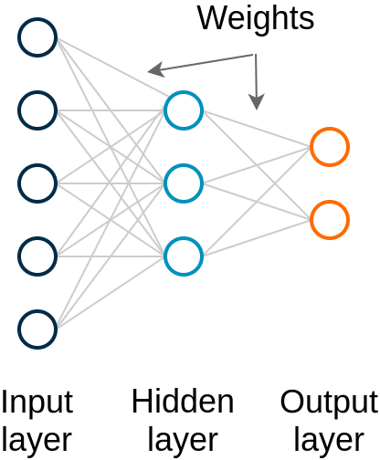
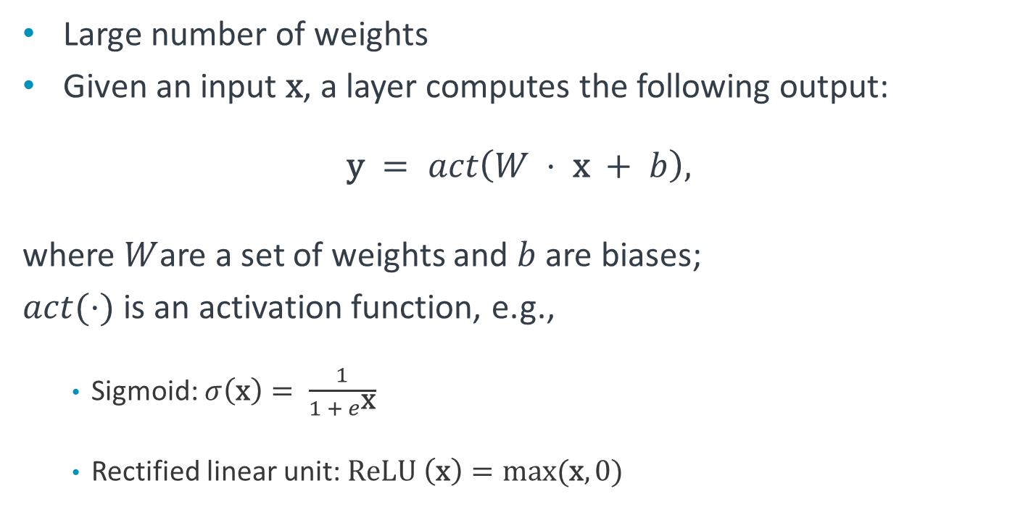
Multi-layer Perceptron (MLP)
Densely connected layers
Large number of weights
Given an input $\text{x}$, a layer computes the following output:
$$\text{y} = act\left(W ⋅ \text{x} + b\right),$$
where $W$are a set of weights and $b$ are biases;
$act(⋅)$ is an activation function, e.g.,
  Sigmoid: $σ\left(\text{x}\right)= \frac{1}{1 + e^{\text{x}}}$
  Rectified linear unit: $\text{ReLU} \left(\text{x}\right)=\max{(\text{x}, 0)}$
Notes:
The most basic deep learning model is the MLP. This is a fully-connected neural network. Because of this, the number of weights grows sharply with the number of units.
Given an input vector/matrix x, each layer of an MLP outputs a value of an activation function of the input to that layer, the weights of each input connection, and some bias values.
Typical activation functions used are the sigmoid and rectified linear unit, as shown above.

Slide 8
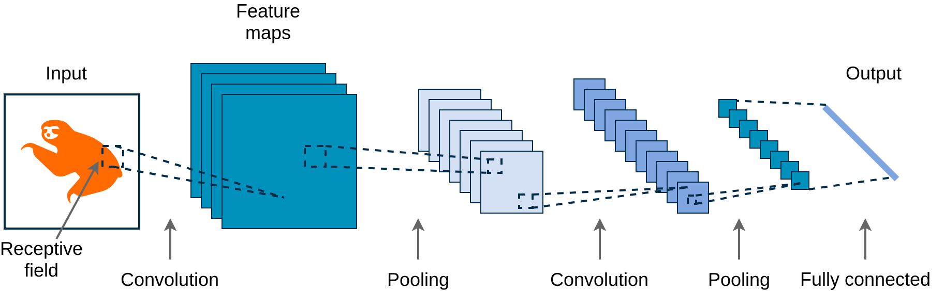
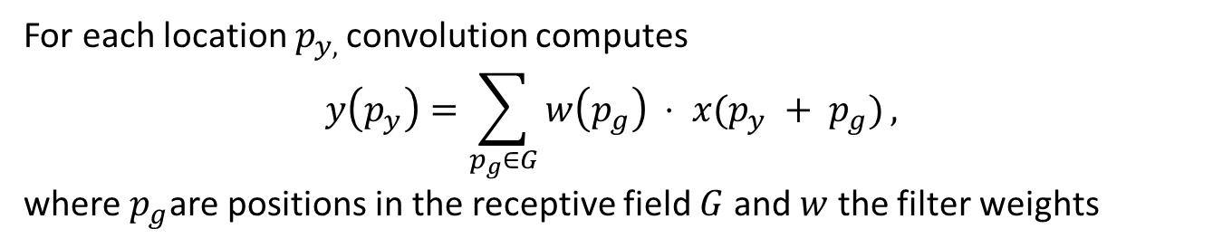
Convolutional Neural Network (CNN)
Powerful in (image) classification tasks
Replace dense connections with filters (kernels) that share weights across small receptive fields
Pooling layers reduce the feature dimensions (avg/max of all values)
For each location $p_{y, }$convolution computes
$$y\left(p_{y}\right)=\sum_{p_{g}∈G}{w\left(p_{g}\right) ⋅ x(p_{y} + p_{g})},$$
where $p_{g}$are positions in the receptive field $G$ and $w$ the filter weights
Notes:
Another popular neural model, especially for imaging application tasks such as classification or object detection are the CNNs. CNNs have significantly fewer number of parameters as they replace dense connections typical to MLP with small filters (e.g., 3x3 matrices) that scan the input and share the same weights. In particular, the convolution operation computes feature maps as weighted sums of shifted positions in the receptive field (smaller area of the input). Convolution layers are often followed by pooling (sub-sampling) that reduces the feature dimensions. This can be done through averaging the values (pixel intensity) or keeping the maximum one and discarding the rest. Increasingly abstract features are extracted through multiple hidden layers. For instance, in image recognition tasks, the first layer may discover different edges, the second one contours, the third objects, and so on.

Slide 9
The rise of edge computing
Deploying advanced computing, storage, and applications on devices
Goals: Reduce application latency, conserve bandwidth, offload cloud computation, and improve privacy
Advances in hardware:
  High-performance and power-efficient processors, e.g., Arm Cortex-A55
  Embedded Graphics Processing Units (GPUs), e.g., Arm Mali-G77
  Micro Neural Processing Units (NPUs), e.g., Arm Ethos-U55
  Nano solid-state drives (gigabytes of storage per mm²)
Software libraries:
  Neural network kernels optimized for constrained CPUs, e.g., Cortex Microcontroller Software Standard Neural Network (CMSIS NN)
  Lightweight ML inference frameworks, e.g., TensorFlow Lite Micro
Notes:
Edge computing refers to moving more intelligence closer to the point where data is produced (e.g., on the device), with the goals of reducing the latency introduced by device-cloud communication, cutting the networking costs associated with data transfers, releasing cloud resources to other applications, or enhancing user privacy as personal data is not required to leave the device.
Machine learning becomes a prime candidate for edge computing, especially due to dramatic hardware advances and emergence of software libraries that optimize complex algorithms to meet the constraints of embedded devices. In particular, new microprocessor designs that achieve high performance at a low power consumption cost have been developed and it is possible to perform parallel computations required for deep learning directly on constrained devices. Dedicated high efficiency ML inference processors, e.g., Arm Ethos-U55, further simplify such tasks, as we will discuss next. Nonetheless, hardware advances in terms of storage (nanoSSD) are also worth mentioning, as ML requires large amounts of data for training.
We will also overview software frameworks that reduce the effort required from developers to deploy intelligence at the edge.

Slide 10
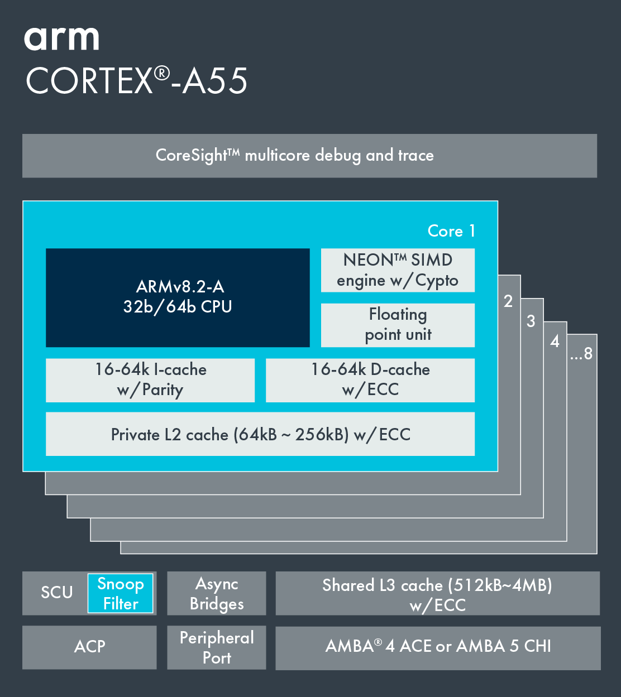
Arm Cortex-A55
Delivers best combination of power efficiency and performance in its class.
Part of the first generation of application CPUs based on DynamIQ technology (single cluster design with a mix of up to eight big.LITTLE processors)
Armv8-A architecture extensions, with dedicated machine learning instructions
Cryptography extensions
Target applications: Mobile augmented/virtual reality (AR/VR), automotive
Notes:
The Cortex-A55 implements the latest Armv8.2 architecture and builds on the success of its predecessor, Cortex-A53, achieving higher performance while maintaining the same levels of power consumption. The L2 cache has also been designed to run at the same frequency as the CPU. This, combined with the lower latency, offers a sizeable increase in performance across a wide range of benchmarks.
New L3 cache shared across all the Cortex-A55 CPUs within the cluster.
The improved NEON (advanced Single Instruction Multiple Data [SIMD] architecture extension – registers are considered as vectors of elements of the same data type, with instructions operating on multiple elements simultaneously) pipeline of the Cortex-A55 and the addition of the 8-bit integer architectural instructions can deliver significantly more ML performance in matrix multiplication operations.
ECC - Error Correct Codes

Slide 11
Ethos-U55 microNPU
32x ML performance boost
Integrates fully with a single Cortex-M toolchain
Allows acceleration of neural networks in an extremely low-area with 90% lower power consumption
Ideal for AI applications in cost-sensitive devices
In combination with Cortex-M55, delivers up to a 480x higher performance on ML workloads, compared to previous Cortex-M generations
MAC engine handles 16-bit Multiply-and-Accumulate instructions relevant to neural networks (e.g., convolution); up to 512 GOP/s
Notes:
- The industry’s first microNPU designed to work with the Cortex-M, including the Cortex-M55, Cortex-M33, Cortex-M7, and Cortex-M4 processors.
Best paired with the Cortex-M55 processor, delivering up to a combined 480x uplift in ML performance over existing Cortex-M processors.
Provides an extra 32x uplift in performance over the Cortex-M55.
Highly configurable, supporting implementations from 32 to 256 Multiply-and-Accumulate units (MACs)
A single toolchain for Ethos-U55 and Cortex-M eases developer use and creation of AI applications.

Slide 12
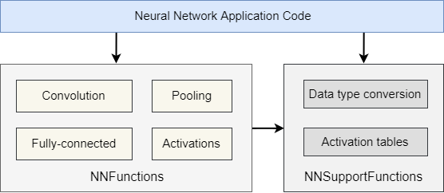
CMSIS NN software library
Neural network kernels optimized for Cortex-M cores
Utility functions can be used to construct more complex neural structures, e.g., Long Short-Term Memory (LSTM)
Fixed-point quantization used to reduce memory footprint
Notes:
Recall that the Cortex Microcontroller Software Interface Standard (CMSIS) is a vendor independent hardware abstraction layer for microcontrollers that have different components. One of these is the CMSIS NN that is a collection of efficient neural network kernels developed to maximize the performance and minimize the memory footprint of neural networks on Cortex-M processor cores. The library covers convolution, activation, fully-connected layer, pooling, and soft-max functions. In addition, it encompasses a set of NN support functions including utility functions for data conversion and activation function tables that can be used to construct LSTM and Gated Recurrent Unit (GRU) neural models.
Traditionally, NN models are trained using 32-bit floating point data representation. However, such high precision is generally not required during inference. Fixed-point quantization is thus adopted to avoid the costly floating-point computation and reduces the memory footprint for storing both weights and activations.

Slide 13
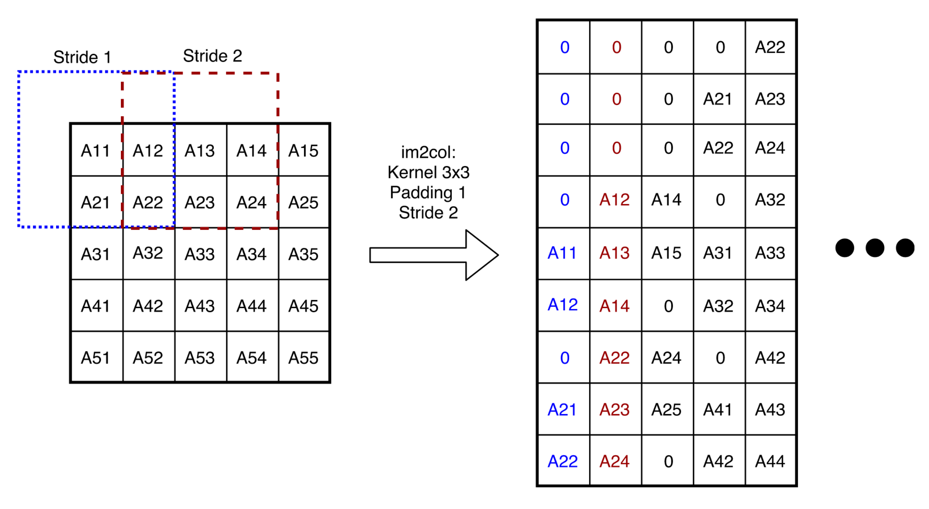
CMSIS NN software library
Convolution
In NNs, a convolution layer extracts a feature map by computing a dot product between filter weights and a small receptive field in the input
im2col transforms image-like input into data columns required by each filter
Partial im2col used to expand only a limited number of columns (e.g., 2) to reduce memory footprint, while ensuring a performance boost
Notes:
One example of optimization implemented by CMSIS concerns the convolution operation. Typically, a CPU-based implementation is decomposed into input reordering and expanding (i.e., im2col, image-to-column) and matrix multiplication operations. im2col is a process of transforming the image-like input into columns that represent the data required by each convolution filter, as exemplified above. This typically has a considerable memory footprint. To mitigate this problem partial im2col is implemented, whereby the kernel only expands a limited number of columns.

Slide 14
Tiny Machine Learning (TinyML)
Machine learning at the edge
Running ML on low-power (mW range) embedded devices
Requires only few kilobytes of memory to run the ML model on microcontrollers
Focus on inferencing
Processing raw sensor data at edge
Useful in battery powered IoT applications
Applications: Recognizing speech commands, detecting vibration pattern, gesture recognition
Notes:
Tiny Machine Learning (TinyML) is a field of study that explores techniques for running machine learning algorithms on low-power embedded devices, i.e., microcontrollers. It was inspired by voice assistants on smartphones. Unlike traditional ML models, TinyML models consumes only a few kilobytes of memory in microcontroller. The major focus of TinyML is enabling inferencing at edge, i.e., to process raw sensor data, rather than training the model. Model training can be done at cloud-end or on a more powerful computer. It can be very useful in battery powered IoT applications that deals with messy sensor data.
Some of the applications of TinyML are:
Recognizing speech commands (for e.g., ‘yes and ‘no’)
Detecting anomaly in vibration pattern (from accelerometer & gyroscope sensor data)
Gesture recognition (e.g., hand-waving)

Slide 15
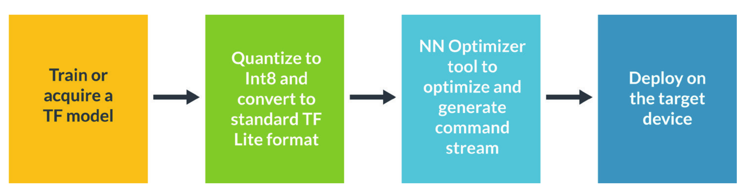
TensorFlow Lite Micro
Machine learning at the edge
Resulted from a merger of TensorFlow Lite and Arm microTensor
uTensor – One of the first open-source frameworks for converting ML models to self-contained C++ source files, to enable deployment on embedded devices
TensorFlow Lite – Open-source deep learning framework for on-device inference
Notes:
The final piece of the puzzle that enables to deploy machine learning models on mobile and IoT devices is TensorFlow Lite Micro that has resulted from the merger between TF Lite and uTensor. TensorFlow Lite Micro doesn’t require operating system support, standard C or C++ libraries, or dynamic memory allocation. The core runtime fits in 16KB on a Cortex-M3 processor. It enables on-device machine learning inference with low latency and a small binary size.
The figure above illustrates the flow when using TensorFlow Lite Micro to deploy a model on an embedded platform with the Ethos-U55 microNPU. A neural model can be selected from an existing collection or a new one can be designed. Then the TF models is quantized by converting 32-bit floats to more efficient 8-bit integers and subsequently converted into a compressed flat buffer with the TensorFlow Lite Converter. The optimizer takes the model and generates a modified flat file that can be deployed on the MCU.

Slide 16
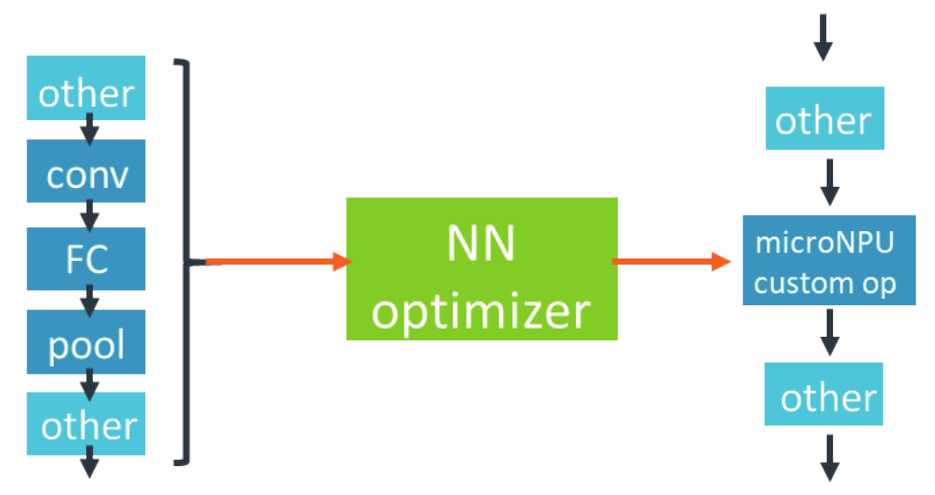
NN optimizer
Tool to format a neural network for the Ethos-U55 microNPU.
Takes trained NN in a TensorFlow Lite flat file as input and formats that to output a modified flat file deployable on target
Identifies subgraphs that can execute on the Ethos-U55 microNPU and optimizes the scheduling of these subgraphs
Compresses weights to reduce SRAM and Flash footprint
Notes:
After reading the flat file, the tool identifies the subgraphs that can execute on the Ethos-U55 microNPU and optimizes the scheduling of these subgraphs.
Several factors are taken into consideration for this optimization:
Fusing of multiple operators
Balancing available bandwidth vs. compute
Prefetching certain parameters from Flash
Scheduling across several layers to reduce SRAM footprint
Next, the tool compresses the weights to reduce the SRAM and Flash footprint thereby improving the performance of the memory bandwidth bound layers. The compression is extremely important as it allows the execution of bigger networks that wouldn’t fit in the available memory before. Finally, a command stream is generated for the microNPU and the modified flat file is written.

Slide 17
Platform Security Architecture (PSA)
Security challenges
Success of the IoT depends on the trust and security built into connected devices
Security can be expensive to implement and there is a shortage of experts
Difficult to manage secure devices at scale
Lack of confidence in data to/from sensors/actuators
New vulnerabilities appear all the time
Notes:
As we discussed security is a major roadblock towards wider IoT adoption. Implementing secure systems can be expensive and the fact that the number of security experts is small further complicates this endeavor. In addition, managing secure devices at scale is not straightforward.
At the same time, the industry lacks confidence in the data being passed to and from sensors and actuators. It is, therefore, unable to realize the full economic benefits of the IoT. The security landscape is ever evolving, with new vulnerabilities emerging all the time.
The Platform Security Architecture (PSA) that we discuss next aims to tackle these challenges.

Slide 18
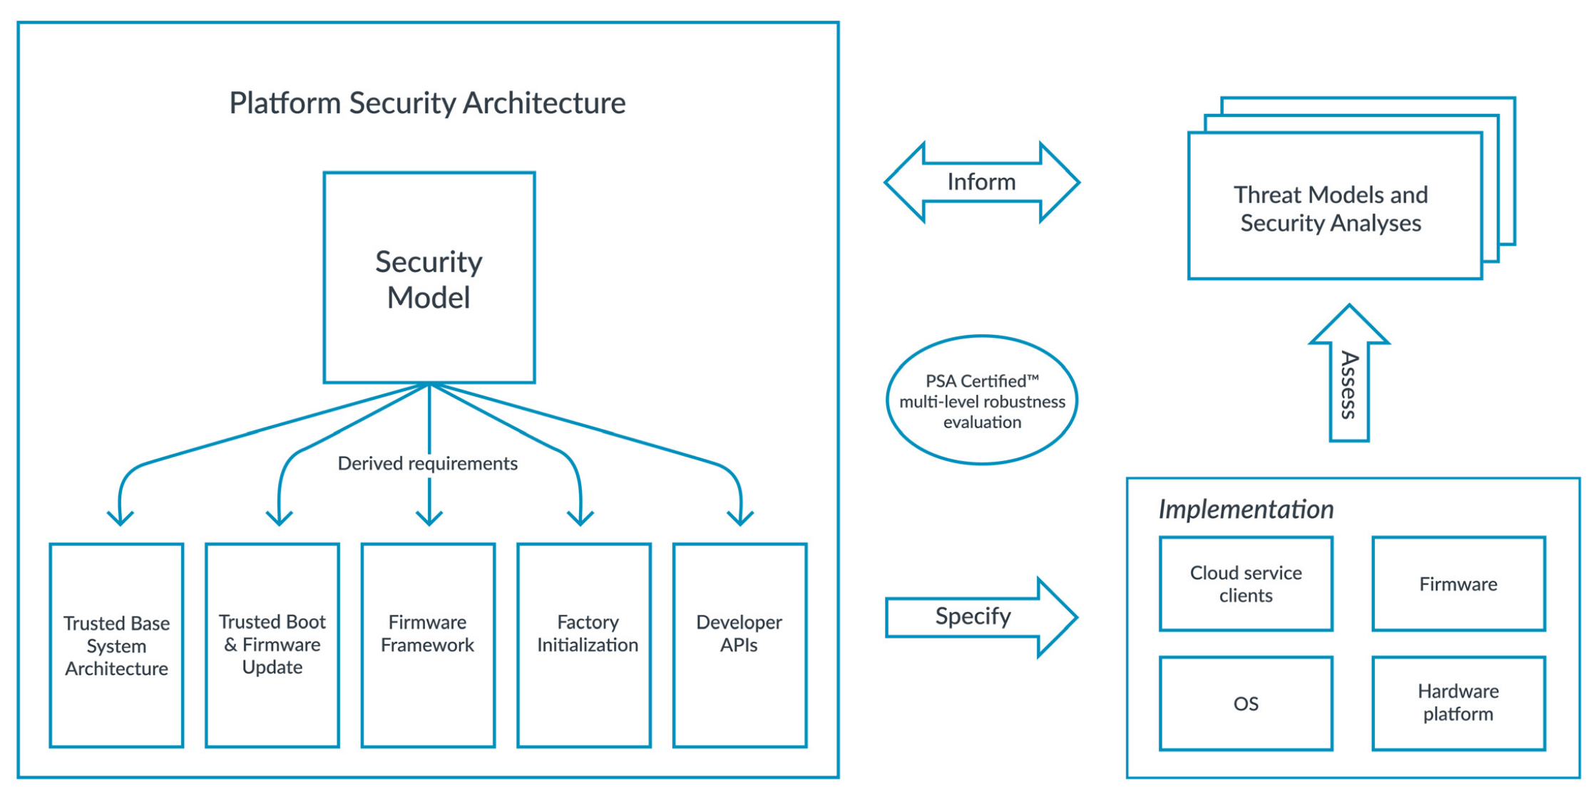
Platform Security Architecture (PSA)
Framework for securing connected devices
Analyze: Threat Models and Security Analyses, derived from IoT use cases.
Architect: Specifications for FW and HW.
Implement: Open-source reference implementation of FW architecture.
Certify: PSA Certified scheme – independent evaluation
Notes:
PSA is a framework for securing connected devices. It includes a holistic set of deliverables, including Threat Models and Security Analyses documentation, hardware and firmware architecture specifications, APIs and an API test suite, and an independent security evaluation and certification scheme – PSA Certified. It builds upon best practice from across the industry and is aimed at different entities throughout the supply chain, from chip designers and device developers to cloud and network infrastructure providers and software vendors.
Applying PSA consists of four key phases as listed above.

Slide 19
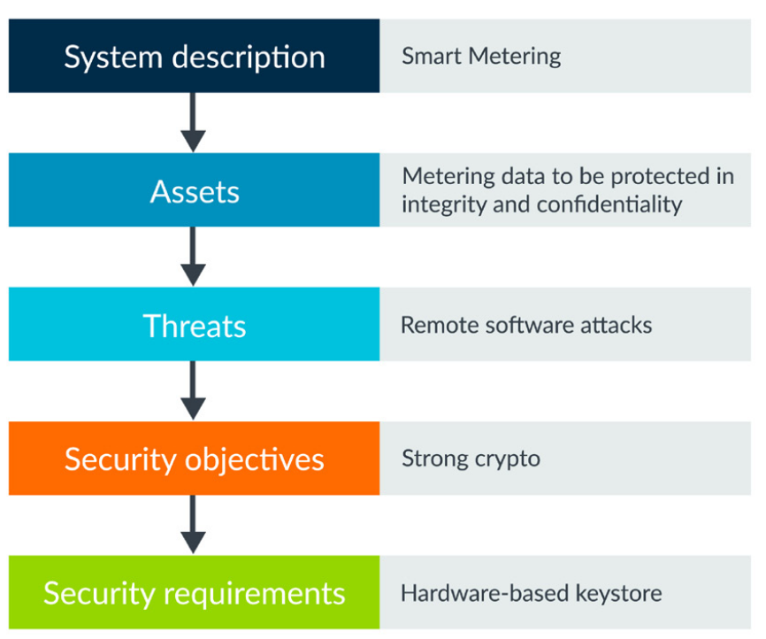
Platform Security Architecture (PSA)
Phase 1: Analyze with threat models and security analyses
Three threat models created using an English Language Protection Profile-style approach, to establish a set of Security Functional Requirements (SFR) for Target of Evaluation (TOE)
Each profile considers the functional description, the TOE, and the security requirements
Documentation makes threat modeling more useable by engineers, regardless of prior security expertise.
Example: smart meter
Notes:
Risk analysis and threat modeling are required to secure a system, including identifying assets that need protection, potential threats, their severity, and potential attack methods that may be used to exploit vulnerabilities. PSA has developed three example threat models based on IoT use cases.
The hardware and software security building blocks, as described in the PSA architecture specifications, provide the primitives needed to meet the security requirements, also highlighted in the threat modeling documentation.

Slide 20
Platform Security Architecture (PSA)
Phase 2: Architect with architecture specifications
Factory Initialization (PSA-FI) – Requirements for initial secure device programming and configuration
Trusted Base System Architecture (TBSA-M) – Hardware platform requirements
Trusted Boot and Firmware Update (TBFU) – System and FW technical requirements for ensuring MCU boot integrity
Firmware Framework (PSA-FF) – Firmware interface definition of a Secure Processing Environment (SPE) for constrained IoT platforms, including PSA Root of Trust APIs
Developer APIs – Interfaces to security services for application developers
PSA Security Model (PSA-SM) – Foundational trust models and patterns
Notes:
Following the analysis of a device, security recommendations are generated based on the value of the device assets and the list of potential attacks that threaten those assets. Phase two focuses on creating a system architecture that is capable of delivering the security requirements and describes this architecture in the PSA specifications.
The security model covers cache coherence interconnect, generic interrupt controller, and system memory management unit.
Factory initialization – The security and Root of Trust (RoT) models are only effective if root secrets and device firmware are provisioned in the context of secure manufacturing processes. The manufacturing process extends into device management for robust distribution of device attributes and properties, firmware updates, etc.
Trusted Base System Architecture (TBSA) is a set of SoC hardware requirements for Cortex-M processing elements (Pes). Encapsulates a set of principles that support the design of a number of features rooted in the hardware (e.g., root of trust, protected keystore, secure firmware updates, isolation of trusted/untrusted components, crypto acceleration, etc.)
TBFU specification covers the authenticated boot process to establish secure runtime services; a secure firmware update agent; description of authentication and authorizing of firmware updates with cryptographic certificates and device keys; recommendations and best practice are described, to help make implementations robust.
PSA-FF provides architecture that describes isolated runtime environments (partitions) for trusted and untrusted firmware; a standard model for describing the functionality and resources in each partition; a secure IPC interface to request services from other partitions; and a model that describes how the partitions can interact with one another

Slide 21
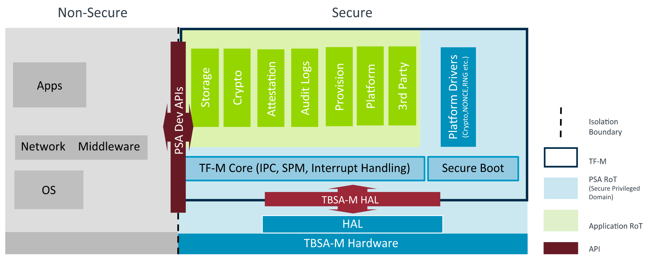
Platform Security Architecture (PSA)
Phase 3: Implement with Trusted Firmware-M (TF-M)
TF-M is an open source, open governance project, providing:
Bootloader for authenticated boot
Implementation of PSA Firmware Framework
Secure Services for Storage, Crypto, Attestation, etc.
Multiple OS support
Integration guide
Notes:
Trusted Firmware-M (TF-M) is a reference implementation of the PSA specifications for IoT devices based on M-Profile platforms. The TF-M aims to provide:
A bootloader for authenticated boot, for both secure and non-secure images, and secure upgrade of images.
Implementation of the PSA Firmware Framework specification, including the IPC framework used for communication between different isolated secure partitions, SPM to manage isolation between the partitions, and Secure Interrupt Handling.
Set of Secure Services that can be used by secure and non-secure applications, such as Secure Storage, Cryptography, Audit Logs, and Attestation
Implementation of the PSA Developer APIs to invoke Secure Services from non-secure applications
Easy to use infrastructure to create additional Secure Services
High configurability, ease of porting and integration
Multiple OS support: (Mbed OS 5.12, FreeRTOS, Zephyr support)
Guide on how to integrate TF-M with other hardware platforms and operating systems
Cross-platform build system based on CMake and GNU toolchain
GCC and ArmCLANG compiler and Keil MDK support

Slide 22
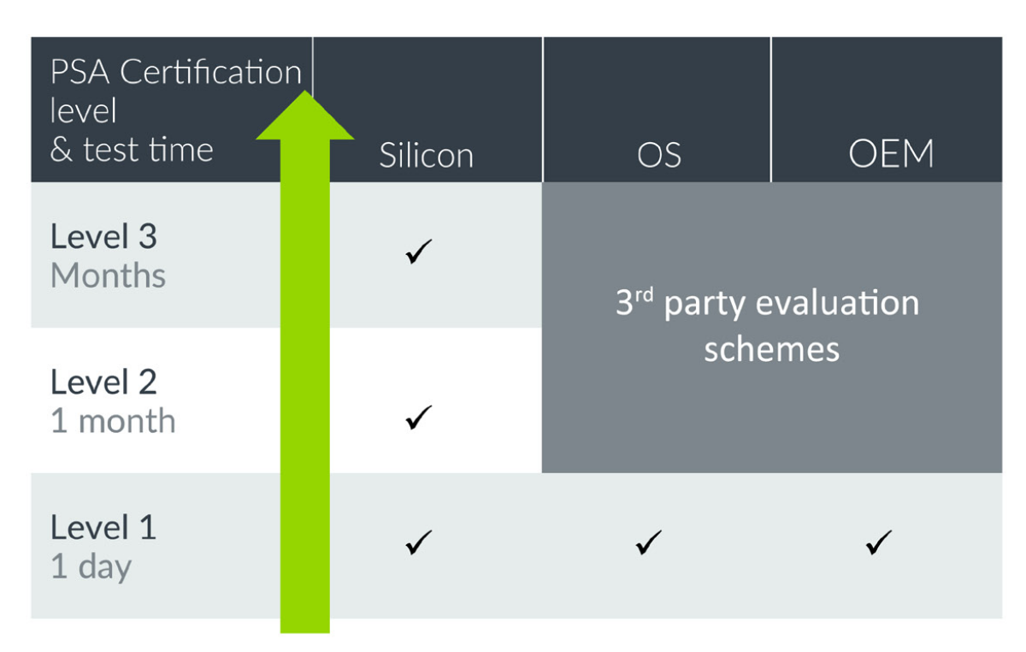
Platform Security Architecture (PSA)
Phase 4: Certify with PSA Certified and PSA Functional API Certification
Enables testing IoT chipsets and devices to be tested in laboratory conditions, to evaluate their level of security
Multi-level assurance for devices, depending on the security requirements established through analysis of threats for a specific use case.
Three progressive levels of security certification: foundation, lab-based evaluation, and extensive attacks testing (under development)
Notes:
PSA Certified enables IoT chipsets and devices to be tested in laboratory conditions, to evaluate their level of security, and to help developers and customers trust that they can achieve the level of security they need. Working with leading test labs, PSA Certified provides multi-level assurance for devices, depending on the security requirements established through analysis of threats for a specific use case. There are two types of certification: Multi-level Security Certification and Functional API Certification. PSA Certified provides a multi-level assurance and robustness scheme, to meet the security needs of specific use cases. The certification scheme uses independent test labs to review the security requirements of the generic parts of IoT platforms and system-on-chips.
There are three progressive levels of security certification:
Level 1: The foundation of PSA Certified. Achieving the first level of PSA Certified requires completion of a critical security questionnaire, based on PSA security model goals and IoT threat models. There are different forms depending on if you are a chip maker, OS provider, or device maker and, once complete, the questionnaire is reviewed alongside a PSA Certified lab check of your product.
Level 2: Lab-based evaluation. This level is aimed at chip makers and includes a 25-day lab-based evaluation against the PSA Root of Trust (PSA-RoT) protection profile. This time-limited evaluation makes the scheme affordable and efficient, and tests for both software and light-weight hardware attacks.
Level 3: This is still under development and will support more extensive attacks, such as side channel and physical tamper.

Slide 23
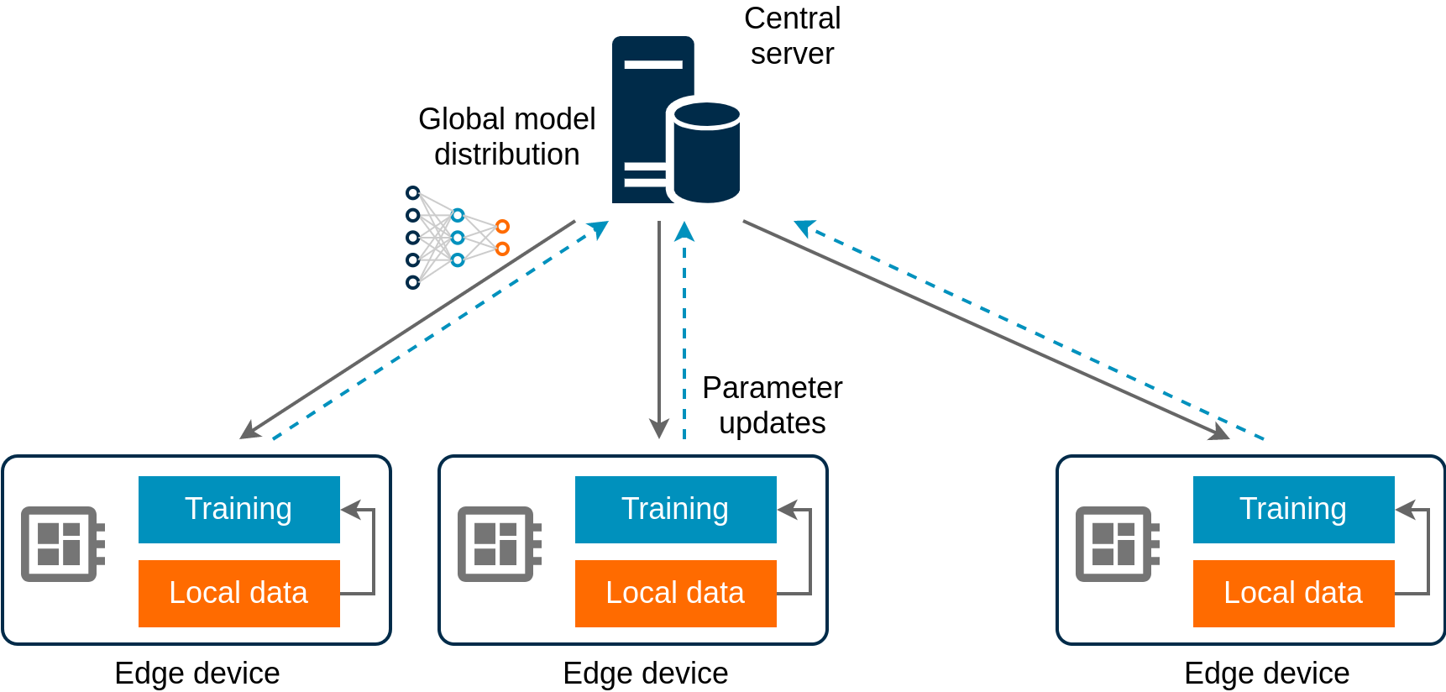
Research topics: Federated learning
Training neural models across decentralized edge devices
Training global model on local data samples
Edge nodes exchanging parameter updates with central server
Server aggregates updates and refines model
Notes:
We close this module by highlighting two research topics in the area of edge intelligence. One is the concept of federated learning, whereby the training of a neural model is shared among many edge devices. Specifically, a central server periodically distributes a neural network model to distributed devices, each of which perform training based on locally available data and return the computed parameters to the central server. This aggregates the updates, refines the model, and sends the new version to the edge devices. The process is repeated until training converges.

Slide 24
Research topics: Federated learning
Challenges
How to reduce communication overhead between central server and edge devices?
How to handle conflicting parameter updates?
How to ensure model updating is robust to link failures?
How to ensure global model updates are not influenced by malicious updates?
How to personalize model for location-specific inference?
Notes:
A number of challenges arise with the FL paradigm. These have to do with the communication overhead incurred by period model distribution and parameter updating and how the central node should handle any parameter updates that are grossly conflicting. In IoT settings where the links to wireless routers are subject to loss, another challenge that arises is how to perform model updates when some of the training results are lost. At the same time, the central node must be also robust to adversarial model updates, whereby a malicious device may try to compromise convergence. Nonetheless, the paradigm distributes the same model to all devices that in turn use the models also for making inferences. The challenge is how to permit modified versions of the model that can offer some degree of personalization depending on the context specific to each device.

Slide 25
Neural model compression and acceleration
Inference performance tends to grow with neural model “depth” (number of layers)
This also increases memory requirements and poses challenges to deployment on IoT devices → model compression becomes necessary
Parameter pruning: Remove model parameters that are not critical to performance
Knowledge distillation: Train a compact model to behave like a large network (teacher)
Convolution operations are computationally expensive → certain applications (e.g., autonomous vehicles, robotics) require real-time recognition
Factorization of convolutional kernels: Decomposition of matrices into products of smaller ones to speed up inference
Notes:
In terms of inference, it is also vital that the models stored on embedded devices are compact to meet memory constructs, but also sufficiently precise. One approach to reconciling these two objectives is model compression. Model compression is achievable through a number of methods, including pruning, whereby parameters that are less useful to the inference process are discarded, or knowledge distillation that refers to the concept of training smaller models that work almost as good as a large neural network.
Another critical aspect is the inference time, especially for applications like automotive IoT and assisted-living robotics. This is bounded by the complexity of the operations involved that in many scenarios are matrix multiplications. One approach to improving runtime efficiency is to decompose convolutional kernels into products of smaller matrices (factorization).

Slide 26
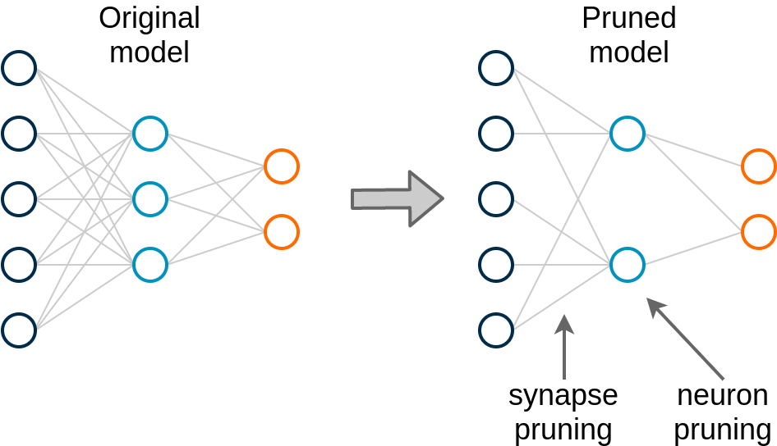
Model pruning
Supported in hardware to improve efficiency
Many weights have small values after training (low importance), hence can be removed (synapse pruning)
Hidden units with no input connections can be removed (neuron pruning)
Retraining necessary to preserve accuracy
Pruning usually an iterative process
Notes:
Model pruning is already supported in hardware. The idea stems from the observation that many of the weights of a model are zero or have small values that indicates the connections between two neurons may have little importance to the output of a layer. Hence, a threshold-based approach can be taken to remove such synapses. If units without any input connections are removed after this process, these can be removed as well.
After such pruning, the model should be retrained; otherwise, the performance may be compromised.

