Slide 1
The Cloud

Slide 2
Syllabus
This module will cover the following
What is the cloud
Virtualization
Cloud interfacing protocols
Big data processing
Device management platform
Notes:
We will begin with a definition of the “cloud” concept, look at the difference between virtual machines and containers, and examine the MQTT and CoAP protocols that allow messaging and management in IoT ecosystems. We will cover big data processing aspects, including data pipelines, distributed data storage, and workflow schedulers. We will finish with an overview of a simple device management platform.

Slide 3
What is the Cloud?
Definition
“A network of remote servers hosted on the Internet and used to store, manage, and process data in place of local servers or personal computers.”
(Lexico)
The role of the cloud in IoT
Management and configuration of IoT devices
Aggregating, processing, storing, analyzing, and visualizing data
Sharing of computing infrastructure
Service customization
Notes:
The term cloud is now widely used to refer to collections of high-availability servers that store and process large volumes of data, allowing developers to focus more on software development and data analytics, without worrying about system administration.
In the context of IoT, cloud infrastructure can support a number of key tasks, such as the remote management and configuration of devices (including connectivity, firmware updates, etc.), manipulating big data and visualizing key insights extracted from that, allowing multiple “tenants” to share physical computation resources without interfering with each other’s processes, and offer a customized version of the same service to different users, based on the same operating system/software libraries.

Slide 4
Virtualization
In general, virtualization is the process by which a virtual version of a platform/process is created based on a single physical resource
Virtualization can be applied to hardware, networks, storage, or operating systems
In cloud computing, virtualization enables running separate workloads under strict partitioning of resources
Resource separation allow to utilize the CPU and memory more efficiently, and also offers certain security guarantees
Two main approaches adopted: Virtual Machines and Containers
Notes:
A key concept in cloud computing is that of virtualization. This refers to the process of creating logical partitions or copies of a physical resource, to enable sharing and customization between different tasks/users.
In theory, almost anything can be virtualized, from hardware (down to microprocessor level), networks (through mechanisms such as virtual LANs, virtual private networks – VPNs, or software defined networking – SDN), storage (e.g., virtual memory stored on secondary disks), or operating systems (via virtual machines that run on a host hardware platform).
Usually a hypervisor/orchestrator is in charge of coordinating access to the shared resources and ensuring strict partitioning between different processes. The logical separation inherently offers safe execution environments (i.e., different workloads/processes cannot corrupt others running on the same physical entity, especially when harnessing hardware security extensions increasingly available on modern computing platforms, e.g. Arm TrustZone).
Next, we will discuss the two main approaches to virtualization, namely Virtual Machines and Containers.

Slide 5
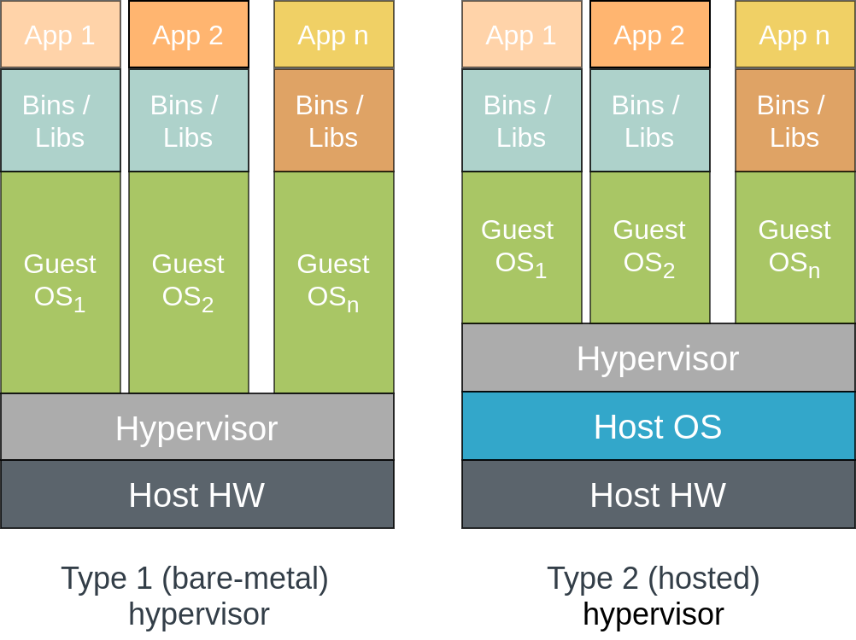
Virtual Machine (VM) based virtualization
Infrastructure as a Service (IaaS)
Multiple instances of (potentially different) operating systems running on the same physical computing platform
VMs created, run, and monitored by a (software/hardware) hypervisor
Two types:
  Type 1 (bare-metal) – runs directly on the host hardware (HW), e.g., Microsoft Hyper-V
  Type 2 (hosted) – runs on the OS of the host, e.g., VMWare, VirtualBox
Notes:
Virtual machines are software, hardware, or hybrid structures that emulate a computer system, replicating its complete functionality. This paradigm enables to run concurrently multiple operating system on the same physical platform, each of these with its own kernel, libraries, and set of applications, potentially following different “flavors” (e.g., Linux, macOS, Windows, etc.)
A hypervisor (or virtual machine monitor) runs on the “host” machine and is in charge of creating, running, and monitoring the hosted VMs, as well as managing resource sharing.
Depending on the level at which the hypervisor operates, two types of hypervisors are encountered in practice: Type-1, also known as native or bare-metal hypervisors, that do not require to be hosted within an operating system, but instead run directly on top of the hardware. Some examples include the Microsoft Hyper-V and the Xbox One system software. Type-2 hypervisors that run on a host OS are more widespread. By this approach, a user can easily create, run, manage, and destroy a guest VM via a graphical console. Sometimes the distinction between the two types is less clear, as the kernel of the host OS may be tuned to function as a type-1 hypervisor if the processor has hardware virtualization extensions. This is the case of the Linux Kernel-based VM (KVM).

Slide 6
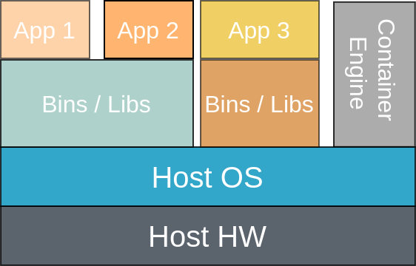
Containers
Platform as a Service (PaaS)
OS-level virtualization – different applications running on isolated user space partitions
OS can control access to peripherals or certain CPU/network resources
Kernels can run even applications with security issues (execution safe)
Notes:
An alternative approach to virtualization is offered by containers. These are isolated user space instances that can run on the same operating system. From the application perspective, the OS is still in charge of managing the access to peripherals and computing/networking resources. The OS kernel is the one managing the partitioning between the different containers.
A container engine is used to create and destroy containers (somewhat similar to a hypervisor, but multiple OS instances are not required)
From a code execution the kernel remains shielded from any program bugs or potential security issues overlooked by the software running with containers.

Slide 7
Advantages of virtualization through containers
Fast to instantiate
Can be destroyed as needed
Hypervisor not required
Possible to share OS libraries among containers
Easy to scale
Notes:
One key advantage of the containers approach to virtualization is the speed with which containers are created (creating logical disk partitions and installing a guest OS no longer required).
Containers are also easy to destroy and re-create on an as-needed basis that makes the approach scalable.
A hypervisor is no longer required that frees up some resources to be used directly by the applications running in the containers.
It may be possible for some containerized apps to share not only the kernel resources, but also libraries that are of use to the same apps.

Slide 8
Example: Running a web server in a Docker container
Dockerfile
# Use an official Python runtime as a parent image
FROM Python 3.6
# Set the working directory to /app
WORKDIR /app
# Install app dependencies
RUN pip install -r requirements.txt
# Bundle app source
COPY src /app
# Make port 80 available to the world outside this container
EXPOSE 80
# Run app.py when the container launches
CMD ["python", "app.py"]
Notes:
Here is a simple example where a web server is run within a container. The Docker engine is used here and the application to be run is written in Python.
Observe that the Python 3.6 runtime environment is imported and the necessary packages are fetched prior to execution (that is specified in the requirements.txt file).
The container will expose port 80 as an endpoint to which external applications can connect.
When launching the container, the app.py application is executed.

Slide 9
Example: Running a web server in a Docker container
Dependencies and App
requirements.txt (load Flask micro web framework to be able to serve HTML pages)
src/app.py (listen on port 80, respond with custom message to any connection)
flask
from flask import Flask
# Define app variable:
app = Flask(__name__)
# Set app route and define what to return on connection
@app.route("/")
def hello():
return "Arm IoT Education Kit - Module 10. The Cloud"
# Listen on port 80
app.run(host='0.0.0.0', port=80)
Notes:
The requirements in this example are simple. Namely, we install the Flask micro web framework that can host a web server and dispatch RESTful requests, which we will discuss in more detail shortly.
The app code is very simple. The app will listen on port 80 for HTTP requests and return a page with a custom message – the hello () function.

Slide 10
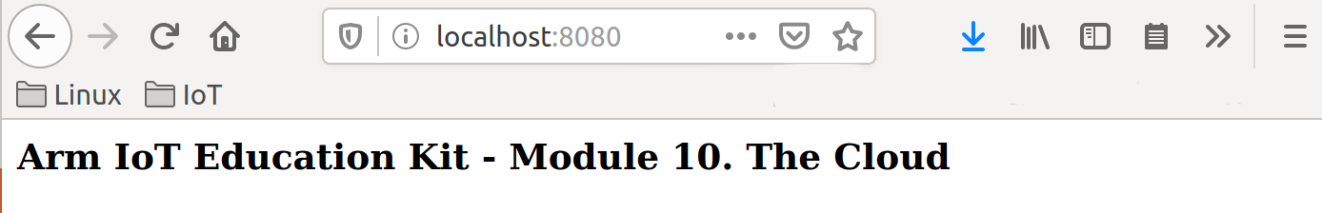
Example: Running a web server in a Docker container
Building and running the app
Build
Running the app
App listens on port 80 → –p maps port 80 of the container to port 8080 of the localhost
In browser:
$ docker build -t python-docker-example
$ docker run -p 8080:80 python-docker-example
Notes:
Here is how to build the container. “docker build” examines the current folder (.) and builds an artifact named “python-docker-example” based on the docker file written previously.
When launching the container (thereby starting the app within), we will map port 80 exposed by the container, to port 8080 on the host operating system.
This allows us to browse http://localhost:8080 and verify that the custom message is returned by the Flask server.

Slide 11
Serverless computing
Function as a Service (FaaS)
Applications broken up into functions, each of these hosted by a cloud provider
Developers do not need to worry about backend infrastructure (servers)
No specific machine assigned to a function
Faster to deploy even than containers
Charging based on the amount of time each function runs
Key advantages: low cost, fast to instantiate, high scalability
Notes:
Serverless computing refers to a new virtualization technique that can be seen as a way of combining the advantages of both VMs and containers. The term “serverless” is misleading, since server infrastructure is still required, but the application developers do not have to manage it. Instead, the applications developed are broken up into functions that run in the cloud, possibly on different machines.
There are many similarities between serverless computing and containerization, but containers are running all the time and are required to configure libraries upon deployment. Instead, functions that make up applications and are stored in the cloud can be instantiated much faster and the tenant only pays for the amount of time the function is running (similar to VMs).

Slide 12
Putting the “things” online
By now, you would have learned how to:
Program embedded devices
Connect devices to a gateway using different wireless technology
Instantiate apps in the cloud that could handle data produced by IoT devices
Question to be answered: How to integrate embedded devices with cloud logic?
Notes:
So far, we covered aspects of programming embedded devices, a range of wireless connectivity options that enable an IoT device to exchange data with the first hop (e.g., gateway), and we have seen how it is possible to create applications hosted in containers that accept HTTP requests.
What remains is establishing a “language” that allows the IoT devices to “talk” to the cloud-based service logic. We refer to such languages as end-to-end communication protocols, of which HTTP (which we just discussed briefly) is one.

Slide 13
Cloud communication protocols
HTTP-based RESTful API
Set up a lightweight HTTP service that follows the REpresentational State Transfer (REST) architectural style, i.e.,
  Resources are accessible via Uniform Resource Identifiers (URIs)
  A set of standard methods is used to exchange representation of resources (e.g., POST, GET, etc.)
  Resources are decoupled from representations; content can be accessed as HTML, XML, JSON, etc.
  Interactions with resource are stateless
Example:
  IoT device measures heart rate and represents values sampled in JavaScript Object Notation (JSON)
record={
“date”: “2020-02-28”,
“time”: “09:05:32”,
“heart-rate”: 67
}
Notes:
To enable IoT devices to communicate with HTTP endpoints in a structured way, developers usually adopt a REpresentational State Transfer (REST) architectural style in defining an application programming interface (API) for a specific service. This is also referred to as a RESTful API and satisfies a number of constraints. To begin with, a client-server communication model is adopted, whereby the server exposes a uniform interface to guide the manipulation of its resources. As such the resources that can be interacted with are accessible via URIs and the interactions with them are stateless, i.e., requests must contain all of the information needed by the server to understand the request, without any stored context. Interacting with resources is only possible through a well-defined set of standard methods, such as HTTP GET, POST, PUT, DELETE, etc.
Resources are also decoupled from their representations. Content stored by resources can be accessed in a multitude of formats, including plain text, eXtended Markup Language (XML), JPEG, etc. Representations are negotiated through the metadata exchanged.
Below is an example of a heart rate record transmitted by a wearable device represented in JSON format.

Slide 14
Cloud communication protocols
HTTP-based RESTful API
Example (continued):
  Representations sent to the server end-point using HTTP POST method
  Python code snippet:
import requests
import json
…
url = “http://<uri_of_server_end_point>”
requests.post(url, data=json.dumps(activity))
Notes:
At the server side, logic is written to monitor interactions with the end point identified by the “url” variable. In case a POST request is received, the content stored in the “activity” object received is saved into the “data” variable for further processing.

Slide 15
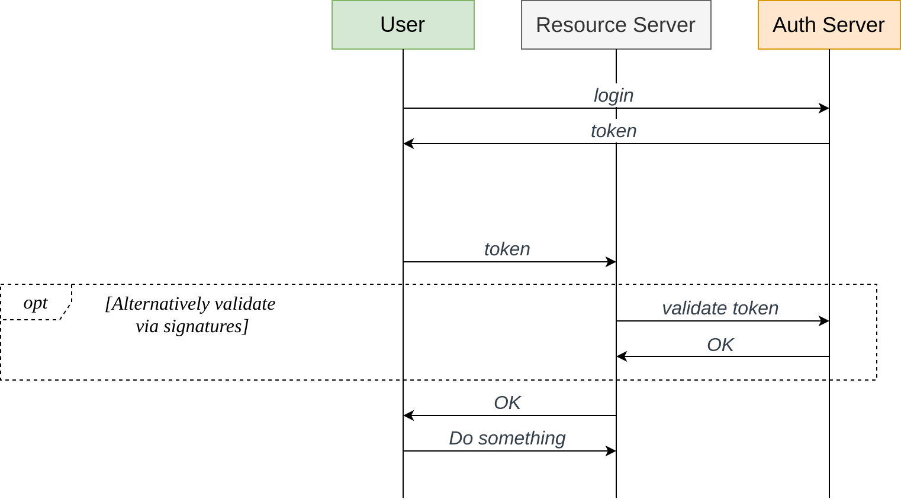
Authorization
Only devices that have permission should be able to exchange data
OAuth authorization framework (RFC 6749, 6750)
User never passes their ID/password to the resource server
IoT devices operate unattended, often no keyboard → token-based access useful
Additional step required to be able to authenticate to AS
Notes:
An important aspect in this interaction is how to ensure that only authorized users/devices can interact with a resource server. A common approach to addressing this issue is via access delegation. That is an authentication server is used to enable the device to share information with 3rd parties. The OAuth open standard implements this paradigm, enabling the user to access a service without sharing their username and password.
Instead, the user authenticates to the Auth Server and receives a token that is then used to authenticate against the resource server that may optionally check the validity of the token independently against the Auth server. Alternatively, the validity of a token can be checked via digital signatures. Transactions between user/resource servers can then proceed.
Some challenges arise in IoT as devices often operate without user intervention. Additional cryptographic certificates may need to be installed on the device to resolve this.

Slide 16
MQTT
MQ Telemetry Transport (MQTT) is a publish/subscribe protocol that enables short message distribution between (IoT) devices
Standardized by the Organization for the Advancement of Structured Information Standards (OASIS) and the International Organization for Standardization (ISO)
Operates on top of TCP/IP
Transport Layer Security (TLS) encryption may be used to protect connections
Particularly suitable for low bandwidth, high latency networks
Protocol currently at version 5
Notes:
Another protocol used to exchange information in IoT ecosystem is MQTT. This follows a publish/subscribe paradigm, whereby certain devices would publish information to a central location based on some topics, to which in turn interested devices/user would subscribe, so as to be able to act on that information.
MQTT operates on top of TCP/IP that makes it an application layer protocol (much like HTTP). As any other protocol that relies on TCP for message transport, communication can be secured through TLS encryption.
Given the short size of the packets exchanged with MQTT, the protocol is particularly suitable for low bandwidth network deployments.
Two mainstream versions of the protocol exist, namely versions 3.1 and 5. The latter introduces new features such as session and message expiry, shared subscriptions, ability to specify the maximum packet size supported, enhanced authentication, etc.

Slide 17
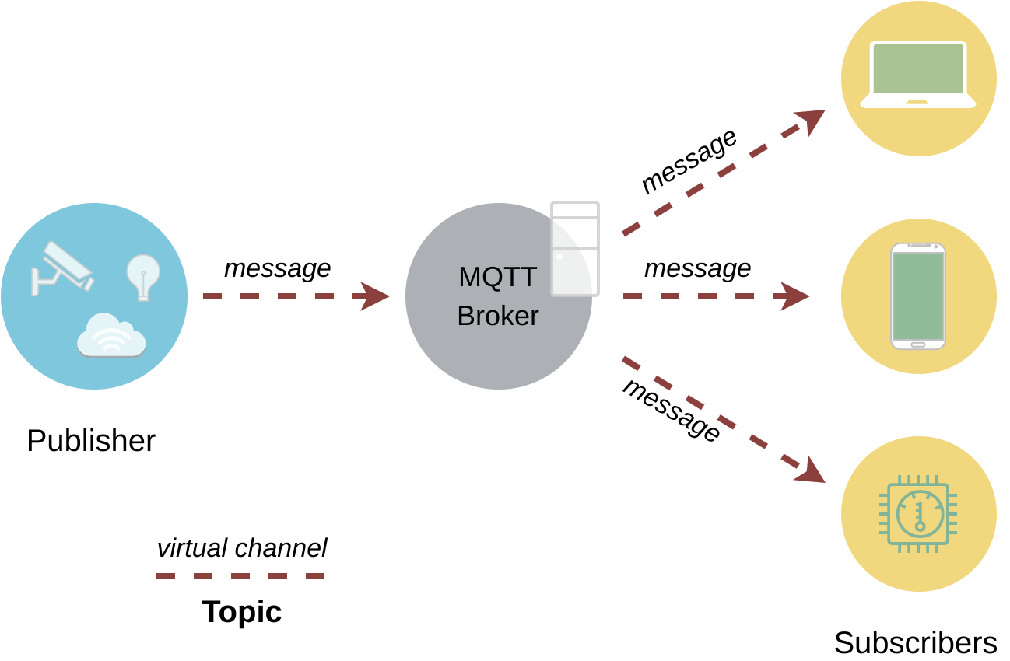
MQTT architecture
Broker-centered → clients do not know each other’s IP addresses
Broker dispatches to subscribers messages received from publishers (different IoT devices)
Message distribution based on topics that act as filters
Publishers decoupled from subscribers by topics that create “virtual channels”
Scalable solution, but broker is a single point of failure
Multiple topics can be combined into topic levels
Notes:
MQTT nodes are interconnected in a star topology, whereby a central entity called “Broker” mediates between publishers and subscribers. Despite the risk of network collapse due to Broker failure, this approach has two main advantages: clients do not need to know each other’s addresses (privacy) and more clients can be always added (scalability).
Message distribution between publishers and subscribers is governed by the concept of topics that act as virtual communication channels.
Multiple topics could be combined under the same topic level to improve efficiency. For instance all the temperature/humidity sensors in a room can be grouped under a “roomX” topic, and all the rooms themselves under a higher level topic named “home.”

Slide 18
Quality of Service (QoS)
Three levels defined, strictly from the perspective of message delivery guarantees
QoS 0
Each message transmitted at most once
Best-effort delivery → message not acknowledged by broker
Message not stored and delivery not reattempted if message lost in transit to broker
QoS 1
Each messages guaranteed to be delivered at least once
A message may be delivered more than once
Messages stored by sender until acknowledged by broker via a PUBACK
QoS 2
Each message received by broker exactly once
Highest delivery guarantee but longest delivery time
Four-way handshake for each message
Notes:
Publishers are able to choose different QoS levels for each message transmitted to the broker, based on network reliability. Three QoS levels are defined as shown above, with a lower number indicating fewer delivery guarantees, but faster delivery in the absence of packet loss.
The highest QoS level (2) employs a four-way handshake to guarantee a message was delivered exactly once. Specifically, a PUBLISH message with QoS 2 must be first acknowledged with a PUBREC packet. If the sender does not receive this, it resends the PUBLISH message (with a duplicate flag set). Otherwise it responds with a PUBREL message. A broker receiving a PUBREL message discards all stored states and responds with a PUBCOMP packet. When PUBCOMP is received by the sender, the transaction is considered complete.
Packets with QoS 1 are faster to deliver and equivalent reliability can be guaranteed if the service can handle duplicates.

Slide 19
Retained messages
QoS applies to publisher-broker communication → publisher has no guarantees that message was received by subscriber
Subscriber has no knowledge about when the first message on a topic will be received → this depends strictly on publisher
MQTT messages with the “retain” flag set address these issues
Broker stores the last message with a retain flag set, together with the QoS for the corresponding topic
Clients receive the retained messages immediately after subscribing
Notes:
The QoS feature allows publishers to obtain certain guarantees about the delivery of their messages to a broker but offers no guarantee about delivery to subscribers. Similarly, a subscriber to a topic where, e.g., messages are published once a day would have a hard time distinguishing between a publisher failure and a late join. Retain messages seek to address these problems.
Specifically, brokers will store messages that have the retain message set. New subscribers will thus immediately receive the latest message published on a topic, even if this has been long before they subscribed.

Slide 20
Retained messages
A subscriber will receive a message also if subscribed to a relevant topic level (not necessarily to an exact topic)
Example:
Client A publishes a retained messages to /home/living-room/temperature
Client B receives the last temperature reading for that room as soon as it subscribes to /home/#
A publisher must send a new retained message with zero payload to delete an earlier retained message
Notes:
The hierarchical structure of message topics enables a subscriber to receive all relevant messages grouped under a higher level topic to which it subscribed, without requiring them to explicitly subscribe to each individual topic. Returning to the smart home example, a client (B) that subscribed to all topics under /home/# will receive the temperature measurement published by a sensor under /home/living-room/temperature.
To delete a retained message stored by the server, the publisher must send a new message with the “retain” flag set and with a null payload.

Slide 21
Constrained Application Protocol (CoAP)
Specified by RFC 7252 – similar to HTTP → works with URIs (coap://), but specialized for constrained devices and low-power, lossy networks
UDP-based transport
  faster
  asynchronous messaging, establishing a session not required
  reliability left to application layer
Low-overhead 4-byte packet header
Ability to cache requests and responses
Support for sending messages to groups of recipients (multicast)
Incorporates mechanism for resource discovery
Notes:
An alternative to MQTT is the Constrained Application Protocol (CoAP) that is a specialized application protocol that works similarly to HTTP, but targets IoT environments, in particular constrained devices and low-power, lossy networks.
Given the constraints CoAP aims to accommodate, different choices had to be made in terms of protocol stack. In particular, CoAP work on top of UDP that does not involve setting up and tearing down connections and carries smaller message overhead as compared to UDP. This, however, comes at the cost of reduced reliability, since UDP does not handle retransmissions or packet reordering. Thus, CoAP needs to handle this on an application by application case.
To further reduce the message size, CoAP packets only have a 4-byte header. Some constraints to the message body apply as well. For instance, when the communication relies on IPv6 over Low-power Wireless Personal Area Networks (6LoWPAN), the messages should fit into a single IEEE 802.15.4 frame.
Being expected to operate over lossy links, CoAP nodes have the ability to cache request and response messages.
Unlike HTTP, CoAP also has multicast support that can be useful in machine-to-machine (M2M) communication scenarios, and a mechanism for resource discovery. In particular, a constrained server may use a Constrained RESTful Environments (CoRE) Link Format to describe the resources hosted by the server.

Slide 22
CoAP features
Device can act both as client and server – no need for a central coordinator
Tokens inside packets used to match responses to requests
“Observe” option can be used with a request to register interest in receiving updates on a specific resource; useful for monitoring when the state of a device has changed
Block-wise transfers used to transmit large payloads, e.g., firmware updates
Datagram TLS (DTLS) used to protect communication from eavesdropping
Notes:
Unlike in MQTT where a clear separation between clients and broker exist, with CoAP a device can act both as a client and a server.
To be able to match a request to a response in the context of lossy links, CoAP messages embed a token that helps with the said matching.
A number of options can be enclosed in a packet as well. For instance, the “observe” option is particularly useful to monitor a specific resource (e.g., when a new firmware was published) or the state of a device (for remote management purposes). A value of zero in the “observe” option is used to register interest in receiving updates about a target resource. This effectively sets up a notification mechanism, by which the volume of network traffic can be reduced.
Sometimes it may be required to transfer larger content that does not fit inside the small CoAP messages. Instead of relying on IP fragmentation, CoAP defines a block-wise transfer mode extends that introduces a pair of “Block” options for transferring multiple blocks of information comprising a resource representation through multiple request-response pairs.
Datagram TLS can be optionally added to guarantee high level communications security.

Slide 23
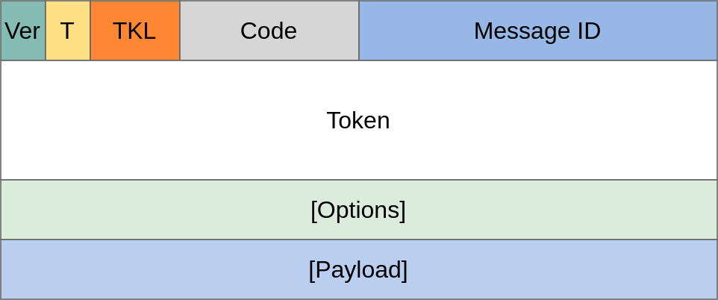
CoAP packet format
Version – 2 bits, indicating protocol version
T – Type, 2 bits, indicating if request is confirmable (0) or non-confirmable (1); or response is an acknowledgement (0) or reset (1)
TKL – 4 bits, token length
Code – 8 bits, similar to HTTP status code (e.g., 404 – not found, 503 – service unavailable, etc.)
Message ID – 16 bits, used to detect duplicates
Token – optional 0–8 bytes, request/response matching
Notes:
CoAP supports four types of messages: Confirmable, Non-confirmable, Acknowledgment, Reset. A response with the reset message indicates that the node has received a message but could not process it.

Slide 24
Lightweight Machine-to-Machine (LwM2M)
An IoT device management protocol
Application layer communications protocol
Simple resource model → set of objects defined for interacting with clients
Used together with CoAP, optimized bandwidth consumption
Transport agnostic (UDP, TCP, and SMS)
Support for end-to-end security (via Object Security for Constrained RESTful Environments – OSCORE)
Used for device bootstrap, configuration, firmware update, and diagnostics
Notes:
LwM2M is a device management protocol designed for Internet-connected low-power devices that can potentially operate without human intervention (machine-to-machine). Being an application layer protocol, it can operate with a range of connectivity options, including LoRaWAN, CIoT, and cellular networks. It features an architectural design based on REST and defines an extensible resource and data model. Secure data transfer is enabled via DTLS (when used with UDP transport) SIM-card based security. In addition, E2E security can be implemented via the OSCORE method that is specifically designed for application-layer protection of the Constrained Application Protocol (CoAP).

Slide 25
Data processing pipelines
Series of elements that act on data, with the output of one being the input to another
On-device/edge pre-processing – noise removal, averaging, summarization
Distributed storage (e.g., Hadoop DFS) and offline analysis (e.g., MapReduce)
Data warehousing, query, and analysis engines (e.g., Apache Hive)
Workflow scheduling (e.g., Apache Oozie)
Real-time computation on multiple data stream (e.g., Storm), stream processing (e.g., Kafka), or aggregation into non-relational distributed databases (e.g., HBase)
Notes:
Data processing pipelines consist of sequences of computing elements that process or perform some computation on the data collected by sensors/IoT devices or data derivatives. The term pipeline is used to reflect the fact that the output of one such module is the input to another.
In IoT settings, data sources are effectively the output of different sensed phenomena that is converted into a digital signal. The device may act on the raw data or some level of pre-processing would be performed close to the device (at the edge), for instance on an IoT hub. Such pre-processing includes the removal of noise or converting the raw data into higher level representation summaries. For instance, a wearable device might not transmit accelerometer/gyroscope readings, but step counts computed on the device based on these
data streams coming/arriving to the cloud from different IoT devices may be subject to real-time computation, such as online machine learning or real-time analytics facilitated by platforms such as Apache Storm. Several systems may need to be fed with data streams, each of which will act on this independently. Platforms such as Apache Kafka facilitate such stream processing and topic-based publishing. When real-time analytics is not desired, the challenge is how to store big data for later processing. One solution consists of non-relational distributed databases that allow for rapid query and selection among huge numbers of records. Apache Hbase offers this capability and is open-source.
Dig tables go hand in hand with distributed storage solutions, such as the Handoop distributed file system (HDFS), where clusters of nodes are used to store large amounts of data, and split-apply-combine strategies programming models for data analysis act on the stored data (e.g., MapReduce).
Data is also stored longer term and combined with different sources (warehousing), to serve more complex query and analytics engines. One relevant example is Apache Hive that offers an SQL-like interface to interrogate data stored in different databases and file systems that integrate with Hadoop.
When multiple processes/pipelines are expected to run in parallel, workflow scheduling tools are beneficial. The core idea of workflow scheduling is to combine multiple complex jobs and specify their order of execution, so as to achieve a bigger task.

Slide 26
Distributed data storage
Scaling storage to big data
Distributed file systems have been developed to deal with vast volumes of data (that may be also generated by millions of IoT devices)
The idea is to use a network protocol to coordinate access to storage and locate files
Clients remain unaware of the exact location of the content accessed, but see DFS just as regular storage (access transparency)
The namespace used covers both local and remote file, but does not give a file’s location (location transparency)
Clients reading/modifying content have the same shared view of the file system (concurrency transparency)
Notes:
Distributed file systems have been developed to handle the storage of large data volumes and fast retrieval of the information of interest. Unlike conventional storage, data in DFS resides on different internetworked machines and/or sites, and the DFS offers a unified transparent view to the client (access transparency).
A namespace augmented with metadata enables locating the content of interest fast, without disclosing to the client where it is stored. All of this is possible without requiring an application and database to manage the metadata.
Given that the data is physically stored into blocks that may be replicated on multiple machines/sites, concurrency is very important to ensure all clients have the same view of the data.

Slide 27
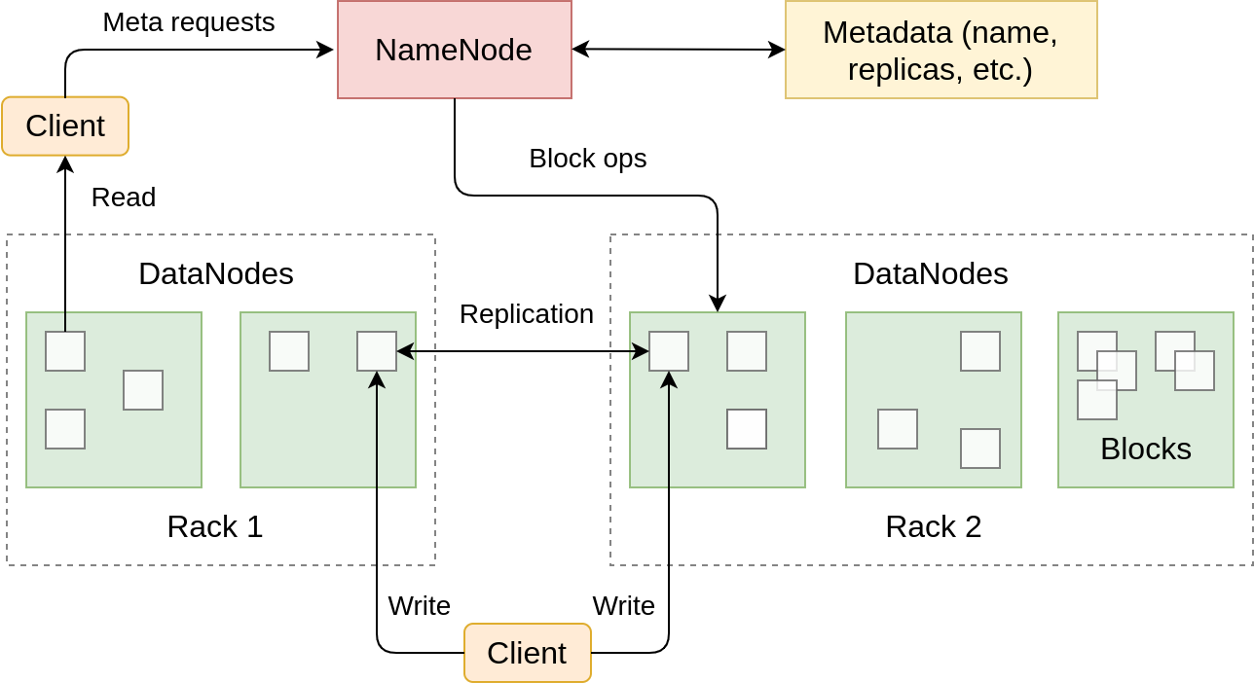
The Hadoop Distributed Files System (HDFS)
NameNode: tracks files, manages FS, and stores metadata
DataNode: stores actual data in blocks
TCP/IP sockets used for communication
Client-NameNode interaction via a JobTracker
Notes:
A popular distributed files system is HDFS, where a NameNode is used to respond to meta requests and coordinate the block replication. The entities storing the actual data are referred to as DataNodes. The replication and interactions between DFS node is performed over TCP/IP.
To allow interaction between clients and a NameNode, the NameNode incorporates a so-called JobTracker. This is responsible for determining the location of the data requested by a client and manages MapReduce execution (e.g., deciding at which location to execute a specific task).

Slide 28
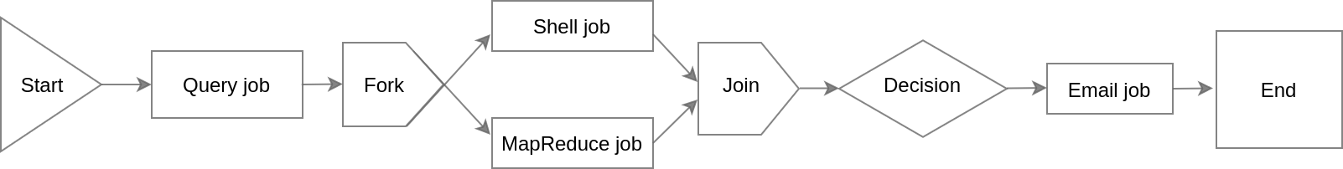
Workflow schedulers
Workflows can be seen as directed acyclic graphs (DAGs) comprising control flow and action nodes.
Control flow nodes specify the start/end of workflows and mechanism to control execution paths
Action nodes trigger the execution of processing and computation tasks
Possible to run multiple jobs in parallel
Example: Apache Oozie
Notes:
Workflows are essential DAG representation of sequences of flow control and action blocks. Flow control blocks indicate the start and end of a bigger process, as well as where it is appropriate to run some tasks in parallel (fork) and merge the results of different branches (join).
The action nodes can be seen as sub processes wherein a batch of operations are performed, as for instance a MapReduce job.
Apache Oozie is one example of a workflow scheduler that is tightly integrated with Hadoop and can incorporate different types of Apache jobs.

Slide 29
Device management platform
Abstracting away IoT complexity
Enables connecting a wide range of trusted IoT devices easily
Devices administration (including updating)
Ingest real-time data from devices and extract insights that can be acted upon
Flexible cloud-based/on-premises deployment
CMSIS-RTOS
Arduino
Other RTOS
Other Linux
Notes:
The device management platform provides a secure and flexible foundation of IoT services for connectivity, device, and data management, seeking to abstract away IoT complexity and make it easier for users to focus on data processing.
It can be deployed in the cloud for higher scalability, but also on premises, when tighter security and full-control of isolated environments is desired, while preserving the capabilities of a cloud-based solution. The latter approach has the advantage of easier integration with external applications and platforms, such as proprietary billing/payment solutions and dashboards. Different administrative consoles can also be integrated via REST APIs.

Slide 30
Connectivity management
Automating connectivity lifecycle
Rapid activation of SIM cards and virtual eUICC profiles to bootstrap connectivity.
Integration with mobile network operators to allow real-time monitoring
RESTful APIs to permit integration with other systems
Use cases: smart metering, asset tracking, industrial IoT
Notes:
A Connectivity Management tool simplifies the connectivity lifecycle irrespective of the number of networks used in an IoT deployment. This includes automated bootstrap via batch SIM and Embedded Universal Integrated Circuit Card (eUICC) activation. The latter removes the need for a SIM card and enables changing the network connectivity provider over the air, without physical access to a device.
Additional features include near real-time monitoring of large deployments (at subscriber or protocol level), security and subscription management, and exporting reports for further offline processing.

Slide 31
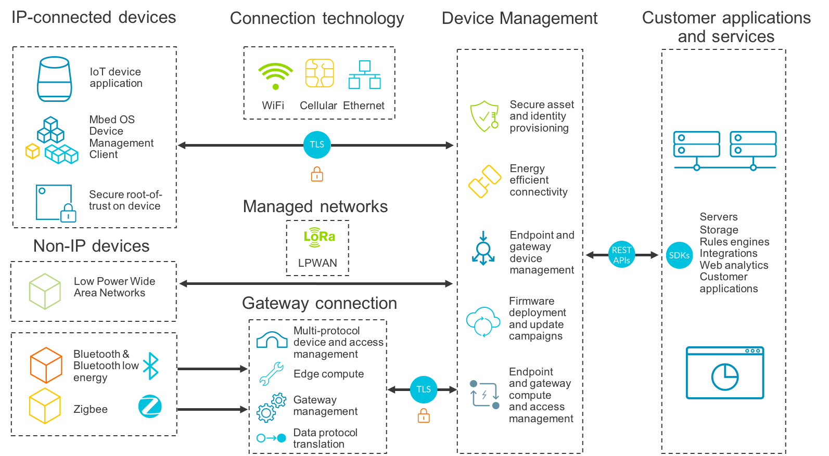
Device management
Provisioning, deployment, and remote updating of devices
Supports diverse device profiles
Enables configuring devices with unique cryptographic identities
Facilitates the distribution of firmware updates to devices and recovery in case of failure
Notes:
The Device Management provides simple, secure, and flexible IoT management capabilities for a range of device profiles. It facilitates deployment and remote software updating of devices, as well as provisioning of security mechanism to increase their robustness. This includes
the ability to configure millions of devices with unique cryptographic identities at manufacturing (that are used to authorize device access to various system services);
create, inject, and securely store private keys, certificates, server URLs and certificates, connection parameters, and firmware update keys;
provisioning industry-standard X.509 certificates that facilitate mutual authentication and establishment of encrypted DTLS or TLS sessions between devices and the device management server;
full end-to-end orchestration of firmware updates and recovery in case of failure.

Slide 32
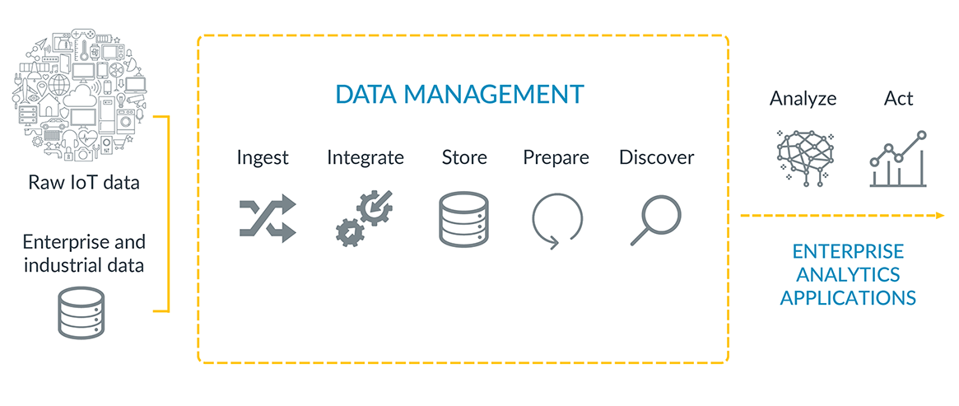
Data management
Access, integrate, and action insights derived from IoT data
Collect and unify structured/un-structured data from heterogeneous devices, enterprise, and 3rd party data
Machine learning and query engine to extract insights from data
Orchestration of workflows integrated with customized services
Notes:
The data management services make it easy to access, integrate, and action insights derived from IoT data. This includes
ingesting and unifying data from heterogeneous IoT devices, enterprise data (e.g., mobile network), and 3rd party sources;
leverage machine learning and query engines to uncover insights from the collected data; and
create workflows to create custom services, such as customer audience profiling.

Slide 33
Coming next
Module | Contents
IoT Security | Importance of security in IoT Threat modeling Encryption
Current and Future IoT Trends | Machine learning Edge computing Platform Security Architecture Research topics
Notes:
In the following modules, we will discuss IoT security aspects and take a look at current and future IoT trends.

