Slide 1
IoT Connectivity
Part 1

Slide 2
Syllabus
This module will cover the following
Introduction to Bluetooth
Bluetooth Low Energy (BLE)
BLE profiles
New features in Bluetooth 5
Zigbee
Notes:
We will first introduce the Bluetooth technology and then examine the low energy version of this wireless protocol. We will explain BLE profiles and take a look at the most recent features introduced with the most recent revisions of the specification. We will then study Zigbee that is another connectivity option for low-power short-range communications.

Slide 3
Bluetooth technology
Wireless technology working in the 2.4GHz band, initially targeting serial communication between devices without cables
First short-link wireless prototypes in the 1990s, standard later managed by the Bluetooth Spatial Interest Group (SIG), which currently has more than 35,000 members
Standard advanced to version 5.2 in January 2020, but many devices still follow Bluetooth 2.0 specification (also known as Bluetooth classic)
Core functionality: enable a range of embedded devices to connect (and pair) with each other and exchange data (securely)
Example applications: Wireless speakers, wearables, Internet-connected blood pressure monitors
Notes:
Bluetooth started as a late 1980s project where the initial goal of streaming music to headphones wirelessly was pursued. Eventually, it first materialized as a technology for serial communication without cables and the first consumer product that had Bluetooth capabilities was launched in 1999 that was a hands-free mobile headset.
A consortium of industry stakeholders was formed to standardize Bluetooth that, over the years, has amassed more than 35,000 members of different levels that perhaps is also why certain security and privacy issues have not been fully thought through.
The term Bluetooth is inspired by the Scandinavian King Harald Blåtand (Bluetooth), who united the Danish tribes, hence a metaphor for uniting communication standards.

Slide 4
Bluetooth architecture
Wireless Personal Area Network (WPAN)
Central ↔ Peripheral architecture
  Central can have up to seven active peripheral devices
  Up to 255 “parked” devices – low-power state, only respond to activation from central controller
A Bluetooth network set-up by a central controller is called a piconet
Some devices can act as peripherals in one piconet and as a central controller in another piconet → scatternet
Four classes of devices: communications range between ~0.5m and ~100m
Notes:
Bluetooth networks follow a star architecture (piconet), that is, the communication is coordinated by a Central device that can communicate simultaneously with up to seven active peripheral devices, and enumerate up to 255 inactive devices (parked).
Some devices may be configured to act as central controllers in one piconet and at the same time as a peripheral in a different piconet. This effectively forms a “scatternet.”
Depending on their communication range, devices can be grouped into 4 classes: class 1: 100m; class 2: 10m; class 3: 1m; and class 4: 0.5m. Bluetooth 5.0 introduces new PHY features that enable to extend the range up to 400m, as we will discuss shortly.

Slide 5
Bluetooth architecture
Centralized communications paradigm
Channel time slotted; Time Division Duplex (TDD) multiplexing, i.e., uplink and downlink separated by different time slots
Central controller polls peripherals for transmissions
Central controller also controls the piconet clock and maintains synchronization of the peripherals
Peripheral devices can be simple that reduces implementation costs
Peripheral-to-peripheral communication not allowed

Slide 6
Bluetooth protocol stack
Bluetooth 5.2 core specification exceeds 3,000 pages.
Unlike OSI or TCP/IP reference models, separation between different layers not precise
Different applications (profiles) may implement different protocol stacks (36 profiles available with Bluetooth Classic)
Some layers encountered in all profiles
Certain profiles act as building blocks for other profiles – e.g., the Generic Access Profile (GAP) is responsible for connection establishment between central controller/peripheral
Notes:
The Bluetooth core specification exceeds 3,000 pages in its latest iteration (5.2), encompassing the features of all previous versions. Many characteristics remain the same, including the protocol stack (to ensure some degree of interoperability), but a new one is added with each release (e.g., to improve energy efficiency, security, localization, etc.)
The protocol stack is not fully allied with models used in other networking technology, such as the OSI or TCP/IP models. A certain degree of layering exists, but some functions cut across multiple layers. What is unique to Bluetooth is the definition of profiles that essentially define the scope of a particular application of functionality. Thirty-six distinct profiles are defined in Bluetooth classic, while Bluetooth Low Energy adds more.
Some of these profiles have a fundamental role, as they allow building other profiles on top. Such is the case of the Generic Access Profile that handles connection establishment.

Slide 7
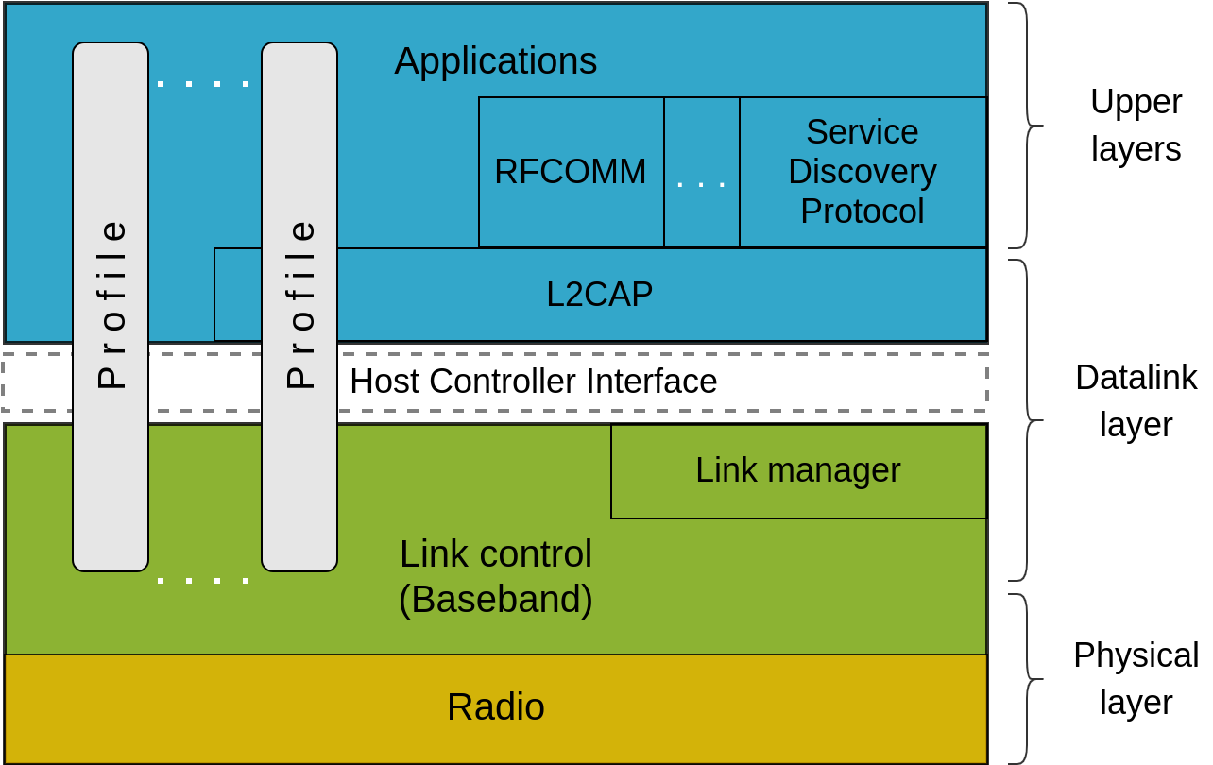
Bluetooth protocol stack
Low level functionality on chip, applications in software → HCI enables mutual interaction
Physical layer is quite unique (frequency hopping and Gaussian Frequency Shift Keying)
Link control encompasses both physical and medium access control functions, including slot timing and grouping
Link manager establishes “logical” channels
Notes:
Low level functionality that involves precise timing and is critical to the operation of applications is implemented in the hardware, and a host controller interface (HCI) entity interfaces between the hardware and functions implemented on the host. However, with the embedded device, this separation is less clear, as more functionality could be deployed on the chip.
One essential component is the link manager that implements a link manager protocol that enables over the air configuration commands, as well as securing a link through pairing, key establishment, and encryption of the communication between peers.

Slide 8
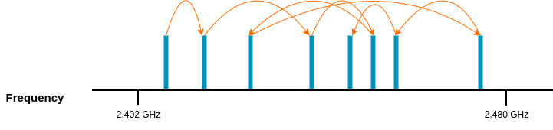
Radio layer
Bluetooth operates in the 2.4GHz Industrial, Scientific, and Medical (ISM) band
Unlicensed spectrum shared with other technologies (Wi-Fi, Zigbee, microwave ovens)
Signals are transmitted using a technique called Frequency Hopping Spread Spectrum (FHSS) that mitigates cross-technology interference → each transmission on a different channel, peers switch pseudo-randomly between channels (hopping)
Data modulated using Gaussian Frequency Shift Keying (GFSK) at 1Mb/s (Basic Rate – BR) or using Differential Quadrature Phase Shift Keying (DQPSK) at 2Mb/s or 3Mb/s (Enhanced Data Rate – EDR)
Notes:
Bluetooth operates in the 2.4GHz frequency band that is license exempt. This requires Bluetooth to share the radio frequency (RF) spectrum with other technologies. To minimize the interference on such technologies, while mitigating interference towards Bluetooth, frequency hopping spread spectrum is adopted, i.e., the communication channel is not fixed, but changes periodically, in an order agreed between the master and slave. This also offers some degree of confidentiality.
To further increase robustness to channel errors, before transmission, data is modulated using GFSK. This is similar to frequency modulation (where the frequency is changed with each symbol period), but a Gaussian filter is applied to data pulses to make the transitions smoother and reduce side-band power (i.e., less interference to adjacent channels). The default data rate is 1Mb/s, but 2 and 3Mb/s are also supported. However, for enhanced data rates (EDR) the modulation employed is differential, namely differential quadrature phase-shift keying is used (symbols differentially encoded using phase shift).

Slide 9
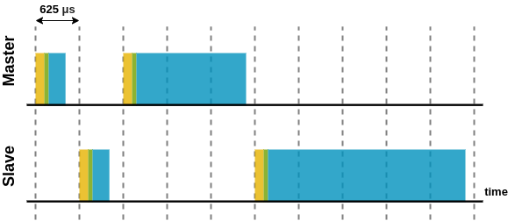
Radio layer
Spectrum divided into 79 channels of 1MHz width
Pseudo-random hopping sequence derived from part of the central controller’s address (through a set of XOR and permutation operations)
Adaptive frequency hopping (AFH) may be used to reduce interference from other devices operating in the same band
Devices hop 1,600 times/sec → the duration of a slot is 625μs
Packets can occupy 1, 3, or 5 slots
Carrier frequency does not change during a packet transmission
Notes:
The RF spectrum used by Bluetooth is portioned into 79 non-overlapping channels, each with a 1MHz bandwidth.
Once a connection is set-up, a central controller and peripheral agree on a pseudo-random hopping sequence that is computed using part of the central controller’s physical address and a set of exclusive or/and permutation operations.
Adaptive frequency hopping (AFH) can be used to avoid channels occupied by other devices operating in the same band.
A peripheral can only transmit when polled by the central controller and the frequency does not change during a packet transmission.

Slide 10
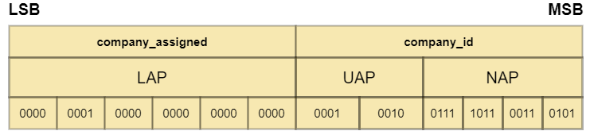
Link layer
Bluetooth device address (BD_ADDR)
Each device has a 48-bit extended unique identifier (EUI-48)
Most significant 3 bytes assigned to the manufacturer by IEEE Registration Authority is divided into
  Non-significant access part (NAP): 2 bytes
  Upper address part (UAP): 1 byte
Least significant 3 bytes specifically assigned to each single device by manufacturer
  Lower address part (LAP)
  Sixty-four of these reserved (1 for general, 63 for dedicated inquiry messages)
Notes:
Bluetooth devices are uniquely identified by 6-byte addresses that can be logically divided into a lower address part (LAP), an upper address part (UAP), and a non-significant address part (NAP). The LAP of the central controller is present in all the packets transmitted within a piconet.

Slide 11
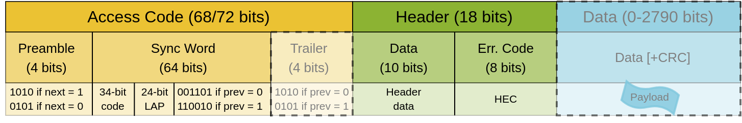
Link layer
Frame format
Data and control information encapsulated into frames that start with an “Access Code” and a “Header”
Payload is optional (some frames used for device discovery, connection establishment, etc.) and 16-bit Cyclic Redundancy Check (CRC) computed on payloads
Notes:
Data transmission in Bluetooth is preceded by an access code and a header. In fact, Bluetooth frames do not necessarily contain a payload, for instance when they are used for control purposes.
The access code is further divided into a preamble that allows a receiver to detect the start of a frame, a sync word that identifies the piconet, and optionally a trailer. A header follows that contains various control information, as we explain next.

Slide 12
Access Codes
Consisting of preamble, sync word, and optionally trailer
Sync words
Types of access codes
Generate information sequence
  The LAP (most of the time of the central controller)
  Append 6 bits to form together with the LAP MSB a 7-bit Barker sequence
XOR with part of a known 64-bit PN sequence
Generate 64-bit codeword using encoded info and known block code generator polynomial
XOR codeword with the same PN sequence
Channel Access Code (CAC) – used to identify piconet
Device Access Code (DAC) – used for signaling (e.g., communicate central controller clock to peripherals)
Inquiry Access Code (IAC) is of two types:
  General (0x9E8B33 used for device discovery)
  Dedicated
Access code is not encoded further and is always transmitted at 1Mb/s → LAP appears in clear
Notes:
To generate a sync word, the following procedure is followed: first an information sequence is produced based on the LAP and a 6 bits chosen such that a Barker sequence is generated (essentially, the purpose of including a Barker sequence is to improve the auto correlation properties and further improve packet decoding abilities at the receiver); the information sequence is then passed through a series of XOR and concatenation operations.
Different types of access codes exist. Most of the time packets contain a CAC that identifies the piconet, while other access codes are used for device discovery (inquiry) or signaling (DAC).
The Access Code is not always transmitted at 1Mb/s and is not subject to any forward error correction (FEC) encoding, unlike other parts of the frame, as we will show.

Slide 13
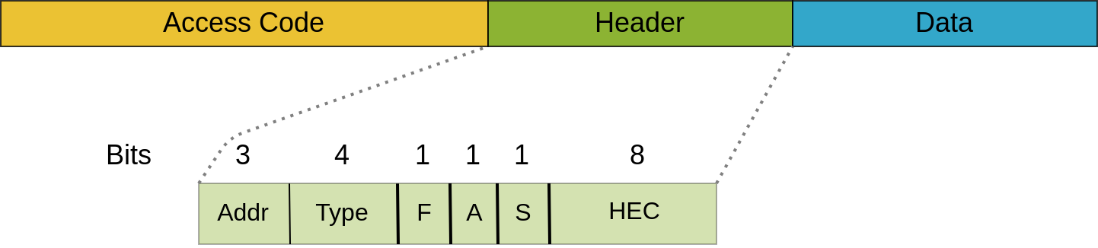
Bluetooth header
Addr identifies to which of the seven active peripherals the frame is addressed (Access Code contains central controller’s LAP)
Type identifies the frame type, the Forward Error Correction (FEC) mechanisms used to encode the payload, and how many slots will be used to transmit the frame
F (flow) signals if the peripheral’s buffer is full
A (acknowledgement) is used to piggyback acknowledgement onto a data frame
S (sequence bit) is used for detecting retransmissions
Notes:
The header seeks to discriminate between the different active peripherals and indicates what type of FEC encoding is applied to the payload (if any) to improve robustness to the errors. Other flags are used for reliability purposes (acknowledgement and sequence).

Slide 14
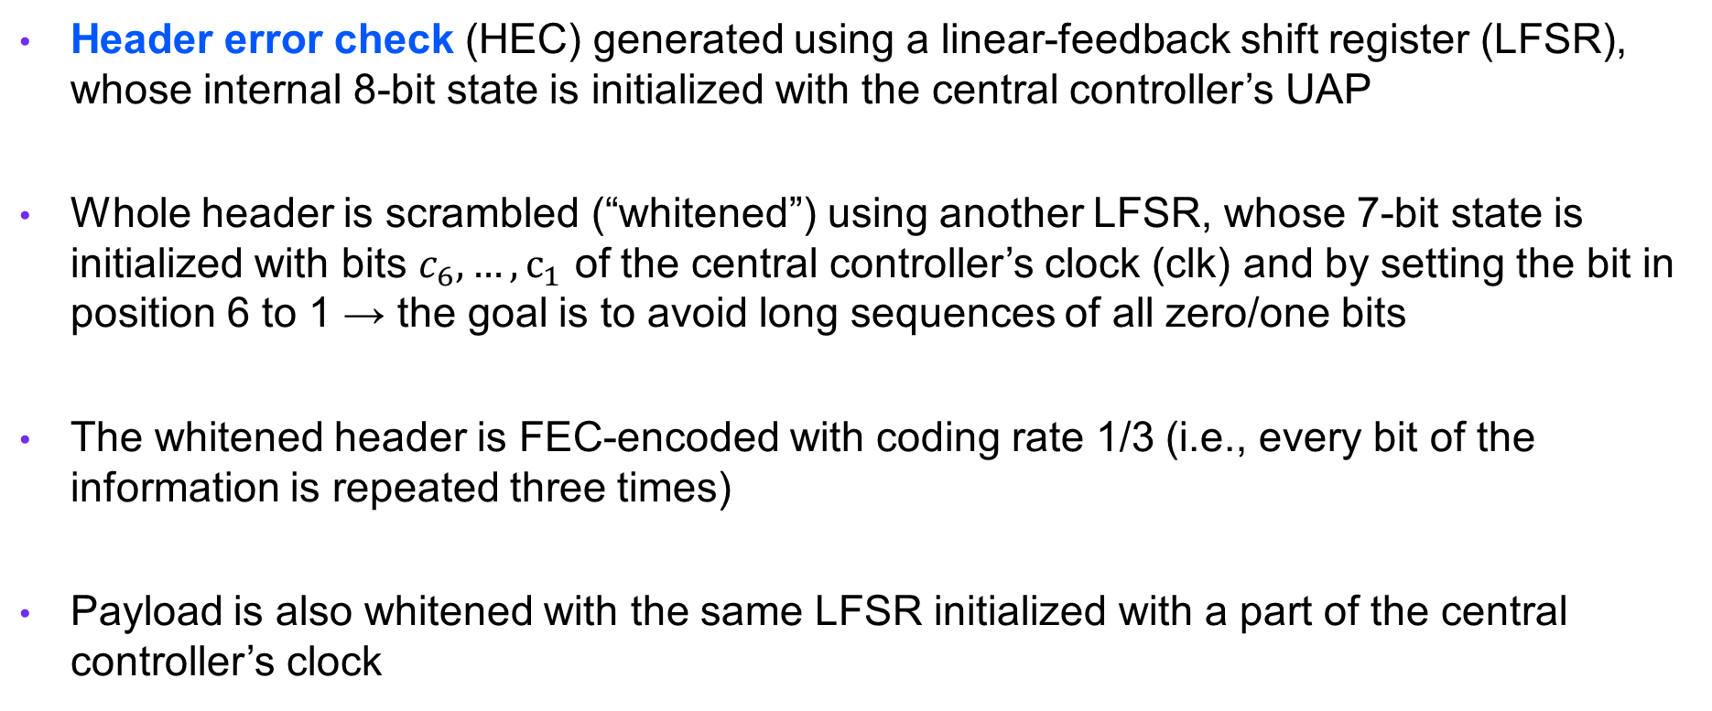
Bluetooth header
Header error check (HEC) generated using a linear-feedback shift register (LFSR), whose internal 8-bit state is initialized with the central controller’s UAP
Whole header is scrambled (“whitened”) using another LFSR, whose 7-bit state is initialized with bits $c_{6},…,c_{1}$ of the central controller’s clock (clk) and by setting the bit in position 6 to 1 → the goal is to avoid long sequences of all zero/one bits
The whitened header is FEC-encoded with coding rate 1/3 (i.e., every bit of the information is repeated three times)
Payload is also whitened with the same LFSR initialized with a part of the central controller’s clock

Slide 15
Error detection and correction
Cyclic Redundancy Check (CRC) computed on the payload using a 16-bit LFSR, initialized with the UAP, and the eight right-most bits set to zero.
CRC recomputed at receiver to detect if the packet transmission experienced errors.
Forward error correction (FEC) is applied on the header and can be also applied to payload, to increase information redundancy and robustness to errors
FEC with rates 1/3 and 2/3 supported, that is each information bit is repeated three times and respectively the packet is encoded with a polynomial that on an average produces one redundant bit for every 2 bits of information.

Slide 16
Logical Link Control Adaptation (L2CAP)
Determines to which protocol to pass the packets (multiplexing)
Configures payload sizes between 48 bytes and 64 kilobytes (default MTU is 672 bytes)
Segmentation of large packets and reassembly
Can perform CRC checks and retransmissions when required
Not all applications may need to use L2CAP (e.g., audio streaming applications that transmit samples continuously)
Notes:
L2CAP allows applications to configure packets payloads up to 64KB. Forty-eight bytes is the minimum mandatory supported MTU.
The core functionality is that of deciding to which application to pass packets received (i.e., multiplexing)
L2CAP can be also configured for reliable or asynchronous data transmissions, as it handles CRC checking and retransmission in case some packets fail to pass these checks.

Slide 17
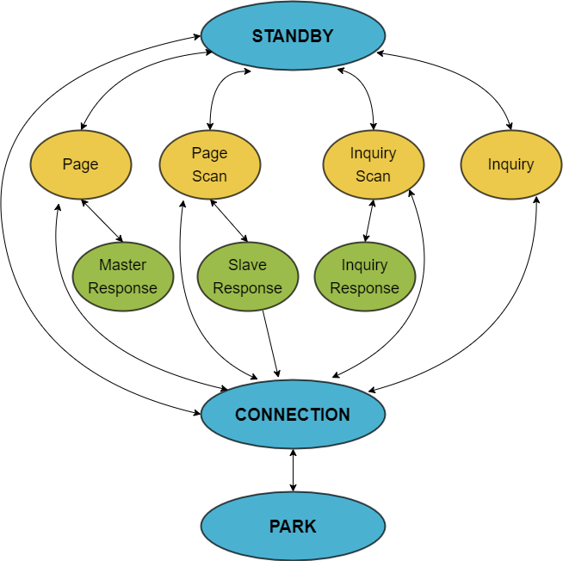
Link management protocol (LMP)
Connection set-up
Central controller aiming to discover devices it wants to be connected to (peripherals) enters the “inquiry” substate.
Sends inquiry packets to over 32 wake-up carriers, equally distributed over the 79MHz range, hopping following a pseudo-random sequence.
Discoverable device enters the “inquiry scan” substate every 1.28 seconds → listens for inquiries for 11.25ms, while hopping according to own sequence
Central Response
Peripheral Response
Notes:
Recall that the link manager controls the link establishment between devices. The sequence of (sub)states through which a central controller and peripheral pass to establish a connection are shown in this diagram, and a number of conditions need to be met for transitions to happen until the connection is set up. First, central controllers send periodic inquiries, while devices that wish to be discovered and are available for connection listen on a set of wake-up carriers for such messages. This happens periodically, once every 1.28s, to allow a device already engaged in other communication to participate in that.

Slide 18
Link management protocol (LMP)
Connection set-up
Device receiving inquiry packet remains on the same channel and starts back-off, suspending activity for a random number of time slots, uniformly distributed in [0, 1024) range
Then returns to “inquiry scan” substate
When receiving a second inquiry from the peripheral device, it responds with a Frequency Hopping Synchronization (FHS) packet that contains its address and clock offset
Then enters “page scan” substate.
Central controller that wishes to connect enters “page” substate when receiving FHS.
Central Response
Peripheral Response
Notes:
A device receiving a first inquiry first enters a back-off state before responding. This is to reduce the probability that two devices receiving the same inquiry packet do not respond at the same time and neither of their response can be decoded due to collision. Only when receiving a second inquiry a potential peripheral responds immediately. This is followed by a paging procedure, during which the hopping sequence is agreed between the two peers.

Slide 19
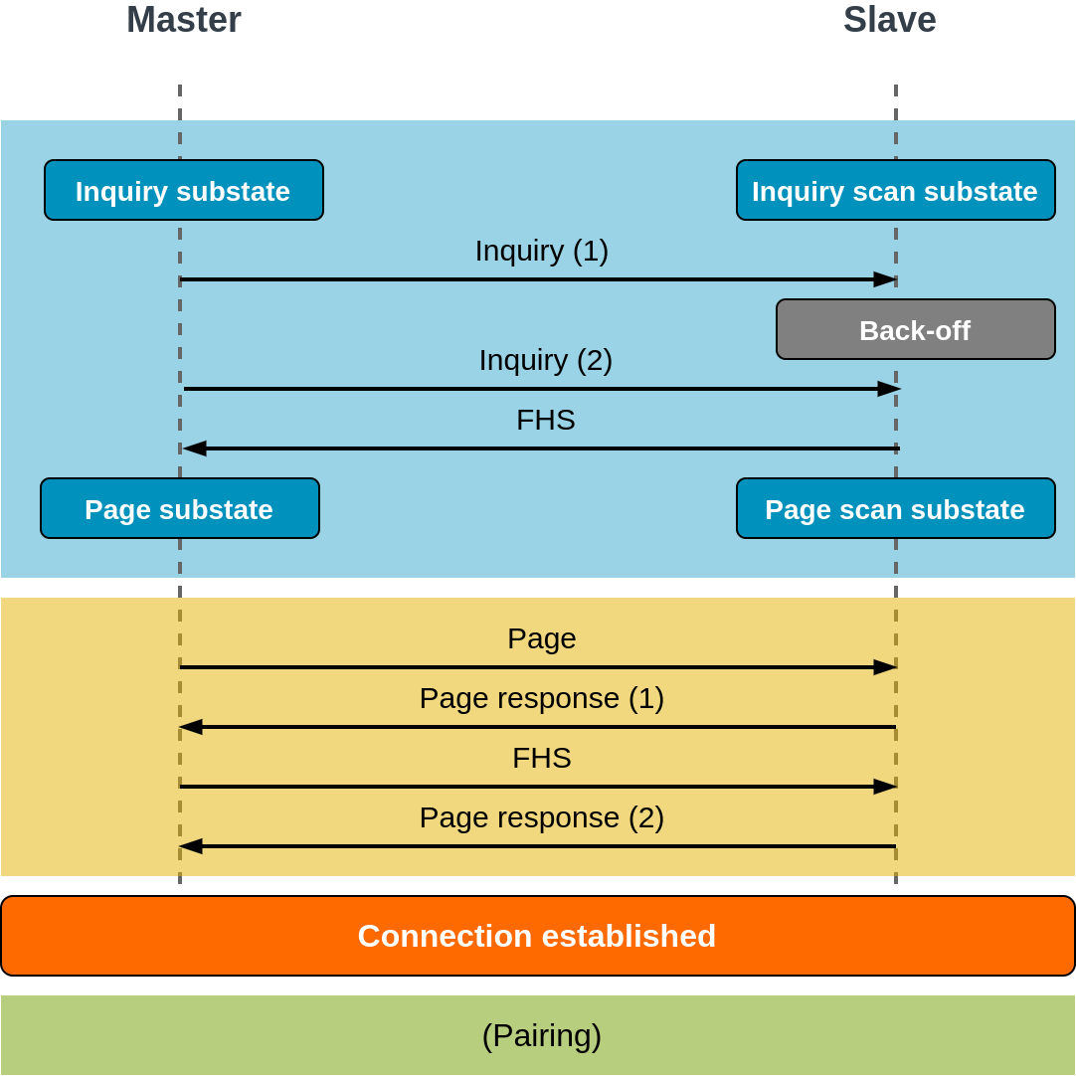
Link management protocol (LMP)
Connection set-up
Central controller hops on the sequence derived from the peripheral’s address; sends “page” messages to connect
Page messages contains 24-bit Device Address Code (DAC) derived from the peripheral’s address
Peripheral responds with a “page response” in the next slot that contains a peripheral ID
Central controller sends FHS; peripheral uses a part of the central controller’s address and clock to derive the hopping sequence; confirms with second “page response”
Central controller assigns 3-bit Active Member Address (AMA); both move into “CONNECTION” state
Pairing will follow if link needs to be secured
Central Controller
Peripheral
Notes:
The central controller first hops on a sequence derived from the peripheral’s address and sends a page message through which it seeks to establish whether the peripheral is indeed available for connection. A FHS packet from the central controller conveys the hopping sequence both should use to communicate after the connection is established. A page response from the peripheral then concludes the link set-up and the central controller assigns an identifier to the peripheral, to be able to discriminate packets from different sources.
A pairing procedure may follow, through which the peer authenticates and a common link key is established that can be used as a basis for a trusted relationship or a (single) secure connection.

Slide 20

Bluetooth Low Energy (BLE)
Also known as Bluetooth Smart
A number of revisions to the Bluetooth protocol introduced with Core v4.0 specification to facilitate adoption on constrained low-powered devices (including IoT)
Changes introduced include the following:
  Faster procedure to set up a connection
  Shorter transmission range (and therefore lower transmit power)
  Number of peripherals can be attached to central controller implementation dependent (no longer limited to seven)
  More applications (profiles) supported and user-defined profiles allowed
Radio interface more power efficient
Notes:
Provision for low energy consumption in Bluetooth has been introduced with revision 4.0 of the specification. This is particularly relevant for battery powered devices such as IoT. Although the main features of the previous standard are maintained, the hardware is optimized to consume between 10 and 50% of that of Bluetooth classic transceivers. In addition, the inquiry mechanism is modified to allow for faster connection set-up and the transmission power is reduced (that further improves energy efficiency but reduces the communication range).
A master can support more active peripherals that can be supported in BLE and new application profiles are introduced, e.g., for medical and fitness tracking purposes.

Slide 21
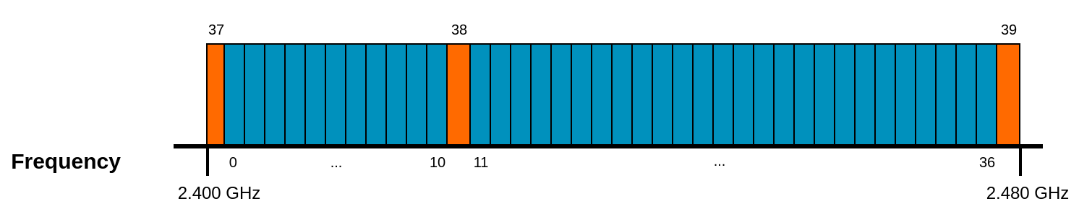
Bluetooth Low Energy (BLE)
Physical layer is largely the same (FHSS, GFSK modulation), but the spectrum is divided into 40 channels, each with 2MHz bandwidth
Channels 37, 38, and 39 are used to continuously advertise a device’s presence (numerology is logical; these channels are not adjacent in the frequency domain)
Notes:
While GFSK modulation and frequency hopping are still used, BLE channels are wider (2MHz) and fewer (40). Instead of listening for inquiries on pseudo-random hopping sequences and transmitting inquiries randomly, three dedicated channels are used to advertise the presence of devices.

Slide 22
BLE connection set-up
Rapid device discovery
  Dedicated advertisement channels
  Periodic advertisement interval between 20ms and 10.24s plus a random delay chosen by each device between 0 and 10ms to avoid collisions
Four types of advertisement packets:
  ADV_IND – Used by the peripheral to request connection to any central device
  ADV_DIRECT_IND – Connection request directed at a specific central device
  ADV_NONCONN_IND – Used by non-connectable devices (BLE beacons) that advertise some information to any device listening in proximity
  ADV_SCAN_IND – Similar to ADV_NONCONN_IND, with optional additional information that can be retrieved via scan responses
Notes:
Advertisements are still periodic and a random delay is introduced to mitigation collisions. The use of dedicated channels, however, raises privacy concerns that are later addressed through address randomization.
Depending on the type of device, different types of advertisement packets are used to help with device discovery.

Slide 23
BLE connection set-up
Hopping sequence agreement much simpler
If a connection request is accepted, a hop increment is agreed and the two peers use that to compute the next channel index from the current one, modulo 37
A channel map can also be agreed between peers, i.e., some channels can be avoided
The central also assigns an address to a connecting peripheral that is generated randomly (thereby ensuring identity privacy)
This access address will uniquely identify the physical channel between two devices
Hopping interval can also be renegotiated after connection set-up, e.g., to save energy

Slide 24
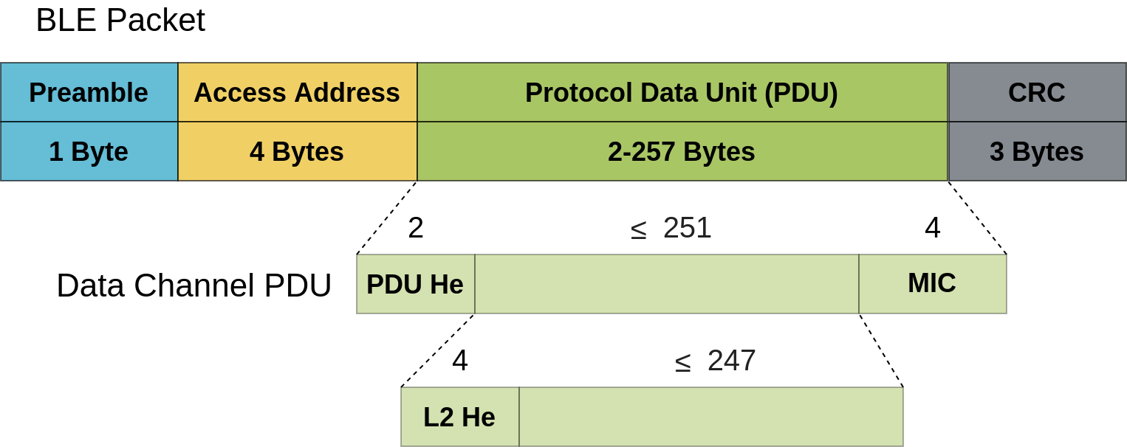
BLE data frame format
Preamble much shorter
4-byte access address (AA) identifies recipient
24-bit CRC
Notes:
BLE packets are also much simpler and have smaller MAC overhead. Specifically, the preamble is 8-bit long and destinations are directly identified with a 4-byte access address.
The payload will, however, contain a header and a message integrity check (MIC), and in case L2CAP is employed, an additional L2 header is included with the data. The whole payload is limited to 257 bytes
The whole PDU is protected by a 3-byte cyclic redundancy check.

Slide 25
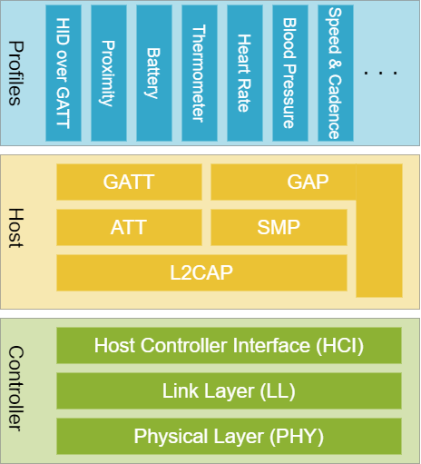
BLE stack
Several new profiles introduced
Generic Attribute Profile (GATT) – set of procedures for discovering and accessing attributes (service specific)
Attribute Protocol (ATT) – mandatory for all data transfers
Generic Access Profile (GAP) controls advertisement and connections, device roles (central/peripheral)
Notes:
The BLE stack is very similar to that of the Bluetooth classic. A clearer separation between application profiles and host profile/services are however made. The host introduced a new generic attribute profile (GATT) that handles device and capability discovery.
The role of a device is managed by the Generic Access Profile (GAP).
New application profiles are introduced in BLE and the user is allowed to defined custom profiles.

Slide 26
Profiles
Used to describe an application and collection of services offered (blood pressure monitoring, device information service, etc.)
Services are collections of characteristics that define the behavior of part of a device
Characteristics are attribute types that have a name, uniform type identifier, and assigned number (UUID)
From an application perspective, profiles extend across the protocol stack, as they select relevant features from host protocols/profiles
Each profile makes use of a particular set of GATT services – it is possible for a user/developer to define custom profiles
Notes:
Characteristics can be seen as user data containers and include at least two attributes: a declaration (metadata about actual user data) and value (holds the actual user data). The characteristic declaration includes three fields: properties, value handle, and UUID. Among others, the property can specify whether it allows clients to read a characteristic using ATT read operations (read) and write to a characteristic using Write Request/Response ATT operations.
Additionally, the characteristic value can be followed by descriptors that further expand on the metadata contained in the characteristic declaration. The declaration, value, and any descriptors together form the characteristic definition that is the bundle of attributes that make up a single characteristic.
All standard BLE profiles are based in GATT that ensures interoperability between devices from different vendors. Common to all profiles, GATT provides profile discovery and description services.

Slide 27
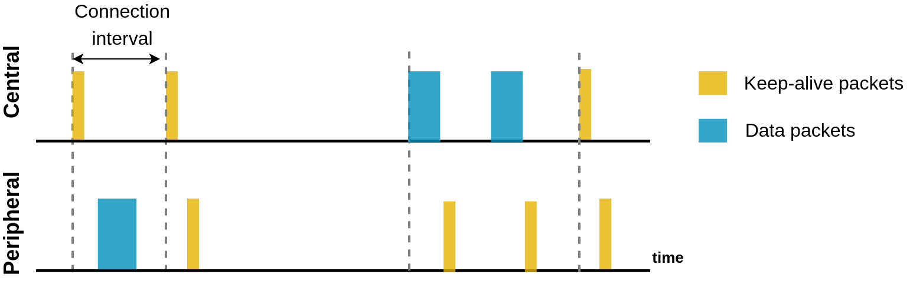
BLE data transfer and power saving
Data exchange always initiated by the central controller
Last packet during a connection always sent by the peripheral
Central controller can instruct peripheral about next connection interval to allow sleep
Notes:
A central controller can instruct the peripheral about the frequency of connection keep-alive messaging that enables both peers to switch of their radio interfaces and thereby save energy.

Slide 28
LE pairing
Known as LE legacy pairing in Bluetooth 5
If the communication is meant to be secure (i.e., have data confidentiality guarantees), the connection set-up is followed by a pairing procedure to establish link encryption
Three phases: I/O capabilities exchange, association, key distribution
Devices first exchange I/O capabilities to determine what association method to use
Three association modes:
  Just Works (all zero sequence, suitable for devices with no display or input)
  PassKey entry (6-digit PIN shown on one device, typed on the second)
  Out of band (e.g., Near Field Communication)
Notes:
Pairing is used to secure a link though data encryption.
In the first phase, devices exchange information about their I/O capabilities:
No input (no ability to indicate yes/no)
Yes/No (at least two buttons that can be mapped to yes/no)
Keyboard (numeric input can be typed)
No Output (no ability to display or communicate a number)
Numeric output (ability to display 6 digit number)
Based on these capabilities, three different association modes are possible. Among these out of band (OOB) is the most secure, but also the most expensive, as it requires additional hardware, e.g., a NFC transceiver.

Slide 29
Securing connections
Irrespective of the association method, a temporary key (TK) is generated, from which a short-term key (STK) is then derived
Knowing the numbers used during pairing does not help an attacker decrypt the data exchanged later, but
Intercepting the initial communication may allow an attacker to brute force the TK
The STK may be computed as the other data is sent in clear and the methodology is known
On the link secured using STK, a key distribution protocol is used to transmit a Long-Term Key (LTK) that will be used to encrypt all communication, along with
An Identity Resolving Key (IRK) to support private device addresses, and
A Connection Signature Resolving Key (CSRK), to support data signing.
Notes:
IRK resolves private to public device address mapping. This allows a trusted device to determine another device’s public device address that may be changing (to improve privacy). The use of a periodically-changing private address (an IRK-encrypted form of the public address) mitigates the threat of identity tracking through advertisements.
The CSRK is used to verify cryptographically signed data frames. Data signing provides integrity and authentication.

Slide 30
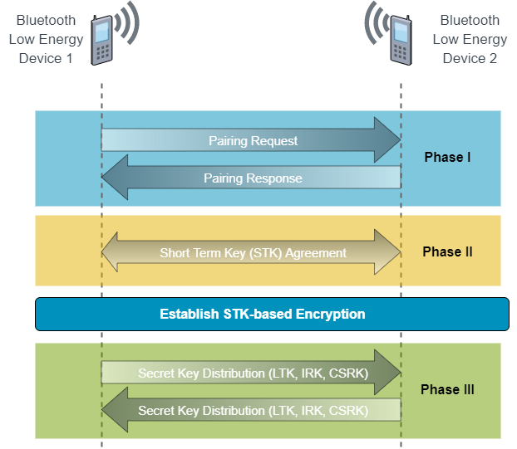
Securing connections
After the IO capabilities are exchanged, a temporary key (TK) is generated; the Short-Term key (STK) is derived
On the link secured using STK, a Long-Term Key (LTK) is transmitted, to be used for securing all communication, along with
An Identity Resolving Key (IRK) to support private device addresses, and
A Connection Signature Resolving Key (CSRK), to support data signing
Intercepting the initial communication may allow an attacker to brute force the TK
The STK may be computed as the other data is sent in clear and the methodology is known
LTK could be compromised
Notes:
Irrespective of the association method, a temporary key (TK) is generated, from which a short-term key (STK) is then derived. Knowing the numbers used during pairing does not help an attacker decrypt the data exchanged later, but intercepting the initial communication may allow an attacker to brute force the TK. The STK may be computed as the other data is sent in clear and the methodology is known.
Given the above, the LTK can be compromised. To address this problem, Diffie-Hellman key exchange was (re-)introduced in the later revisions of the Bluetooth.

Slide 31
Bluetooth 5
Specification released in August 2018; two new subversions released since then
Four physical layer modes (all GFSK based)
  LE Uncoded 1M – symbol rate: 1Msym/s, data rate: 1Mb/s
  LE Uncoded 2M – symbol rate: 2Msym/s, data rate: 2Mb/s
  LE Coded S = 2, symbol rate: 1Msym/s, data rate: 500Kb/s
  LE Coded S = 8, symbol rate: 1Msym/s, data rate: 125Kb/s
Coded packets can increase the range, as parts of the frames are FEC encoded to combat bit error due to signal fading; this also diminishes the effective data rate

Slide 32
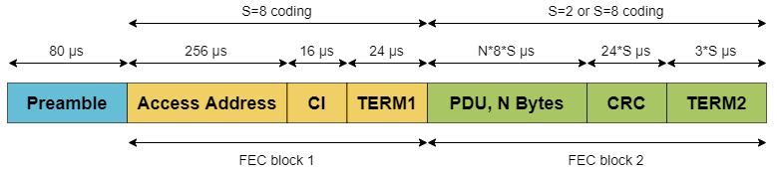
BLE coded packets
Preamble is never coded; the packet is split into two blocks
Access address, coding indicator (CI), and first terminator (TERM1, 3 bits) are always coded in S = 8 mode
CI indicate the type of encoding used in the second part of the packet (S = 8 or S = 2)
Notes:
Coded packets mainly separate and may offer different protection to the access address and payload. Specifically, the first block contains the access and a new coding indicator field that specifies what type of encoding is used for the second block, plus a block delimiter (TERM1). This is always S = 8 encoded – essentially this means more redundancy and hence more error protection, as we will show next.
The second block contains the PDU and CRC and may be either S = 2 or S = 8 encoded.

Slide 33
LE coding
Both blocks FEC encoded with rate ½. Two polynomials used:
G₀ (x) = 1 + x + x² + x³
G₁ (x) = 1 + x² + x³
Bit coming from G₀ transmitted first, then bit coming from G₁
Pattern mapper is then used to convert each bit from the encoder into P symbols, depending on whether S = 2 or S = 8 scheme used
Bit from FEC encoder | Output sequence (S = 2) | Output sequence (S = 8)
0 | 0 | 0011
1 | 1 | 1100
Notes:
For LE encoding, the packet bits are always encoded with a FEC code with rate ½, i.e., 1 redundant bit for each bit of information. The bit streams are fed to two different polynomials, whose output is selected alternatively.
A pattern mapper is used to add more redundancy and thus add further improved robustness to errors (and increase range). In the case of S = 2, there is a 1 to 1 mapping between the output of the FEC encoder and the output of the mapper. In case of S = 8 mapping, each 0 bit is converted to a “0011” sequence and a 1 bit into an “1100” sequence.

Slide 34
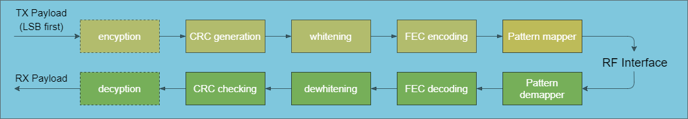
Bitstream processing
Notes:
The entire transmission and reception chain is illustrated above. The data payload is optionally encrypted, then a CRC is produced, the (encrypted) payload and CRC are whitened, and the FEC encoding is applied, followed by pattern mapping. The same procedure is replicated at the receiver in reverse order.

Slide 35
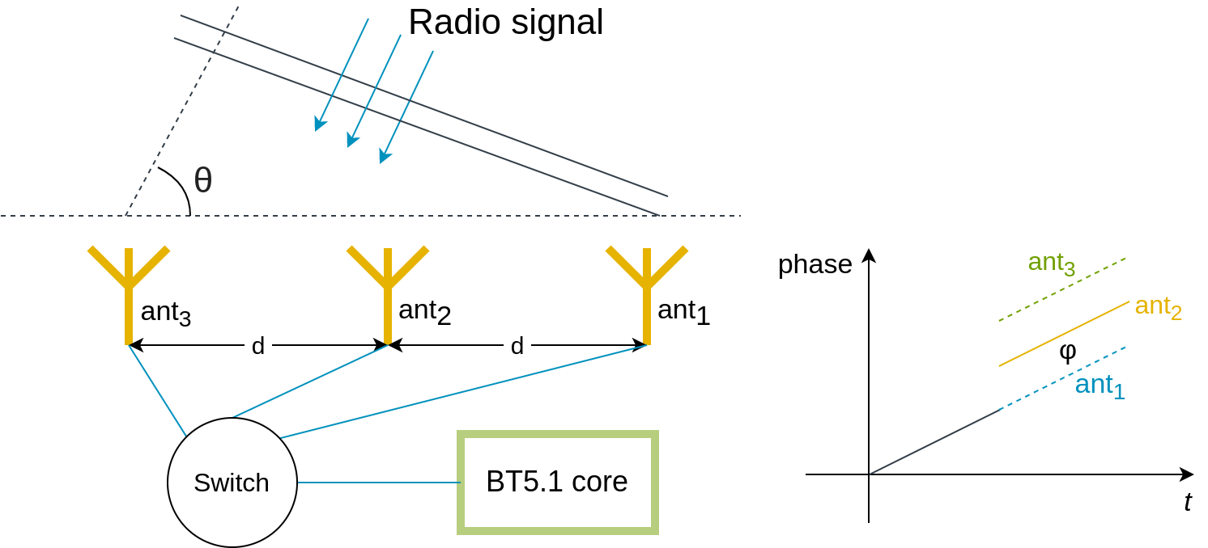
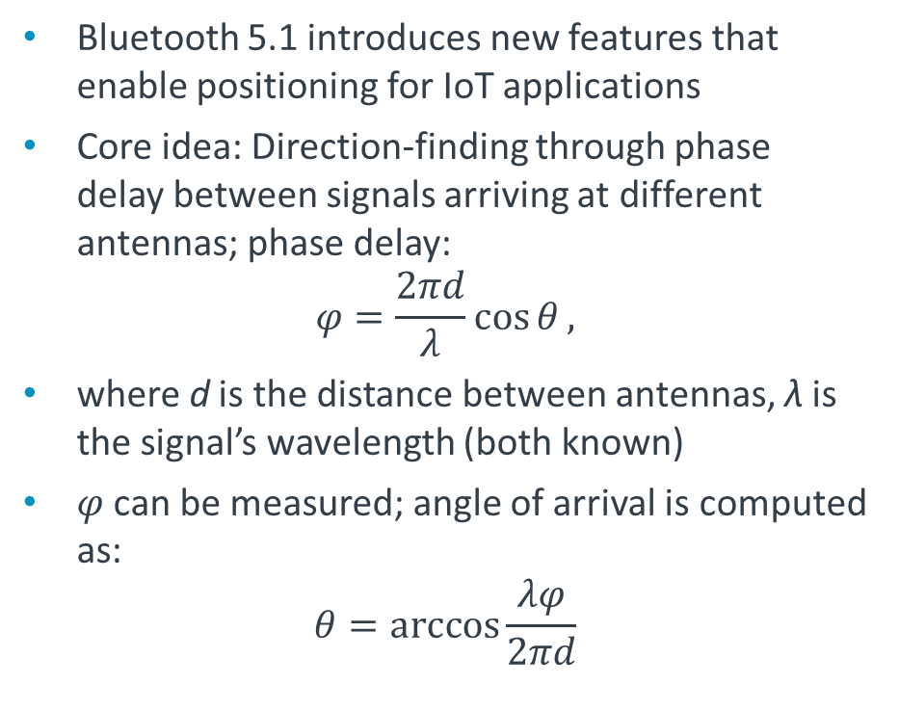
Bluetooth 5.1 positioning
Bluetooth 5.1 introduces new features that enable positioning for IoT applications
Core idea: Direction-finding through phase delay between signals arriving at different antennas; phase delay:
$$φ=\frac{2πd}{λ}\cos{θ},$$
where d is the distance between antennas, λ is the signal’s wavelength (both known)
$φ$ can be measured; angle of arrival is computed as:
$$θ=\arccos{\frac{λφ}{2πd}}$$
Notes:
Lastly, we discuss a new feature introduced in Bluetooth 5.1 to facilitate precise localization that can be useful in IoT. The underlying idea is that of determining the angle of arrival (AoA) of a packet. This can be done by simply computing the phase delay difference at different antennas. Hence, devices that implement Bluetooth 5.1 should have at least two antennas. However, to keep the cost low and preserve energy efficiency, a single receiving chain is used, together with a digital switch. The direction of arrival can be obtained by measuring the delay between signal arrival at different antennas, and simple trigonometric operations.

Slide 36
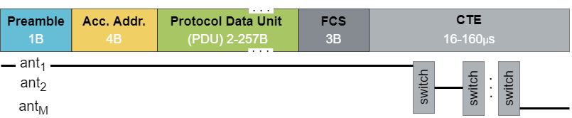
Bluetooth 5.1 positioning
Given energy efficiency requirements, single receiver chain is used;
Solution: Switch rapidly between antennas
Constant Tone Extension (CTE) follows CRC to indicate switching pattern
Problem with this approach: CTE not protected by CRC, hence switching pattern may be affected by channel errors
Notes:
To instruct a receiver how to switch between antennas, to serve a positioning service, BLE packets are extended with a constant tone extension (CTE) that follows after the FCS. This is a 0/1 sequence that instructs the receiver how long it should listen on one antenna.
The problem with this approach is that the CTE is not protected against channel errors.

Slide 37
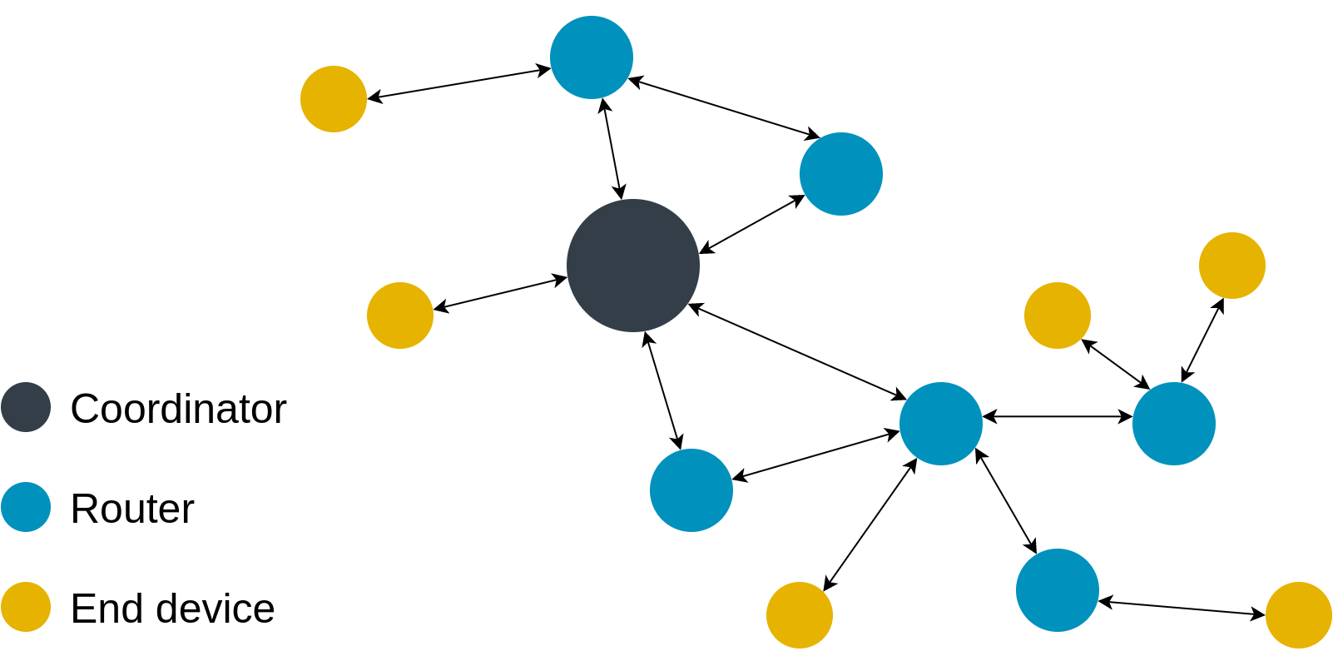
Zigbee
Low power low rate personal area networking technology
Zigbee operates in the 868MHz band in Europe (915MHz in the US and Australia)
Multiple channels in the 2.4GHz band are also allowed
Data rates: 20kb/s in the 868MHz band, 250kb/s in the 2.4GHz band
Applications: Home/building automation, industrial control
Three types of device:
  Zigbee coordinator (ZC) – sends beacons that manage network-specific addresses
  Zigbee router (ZR) – runs some application and can also forward packets between other ZigBee nodes
  Zigbee end device (ZED) – reduced functionality, communicates only with ZC/ZR
Star or peer-to-peer network topologies
Notes:
One technology that may be regarded as a competitor to Bluetooth is Zigbee. Zigbee has the same low power characteristics of Bluetooth, but the data rates supported are much lower. This makes Zigbee more suitable for a different set of applications where messages are less frequent and shorter, for instance home automation. Zigbee also uses the 2.4GHz band but the channel does not change, whilst it is possible to transmit at lower frequencies as well when the communication range required is relatively long.
Three types of devices exist, as show here, each with different capabilities.

Slide 38
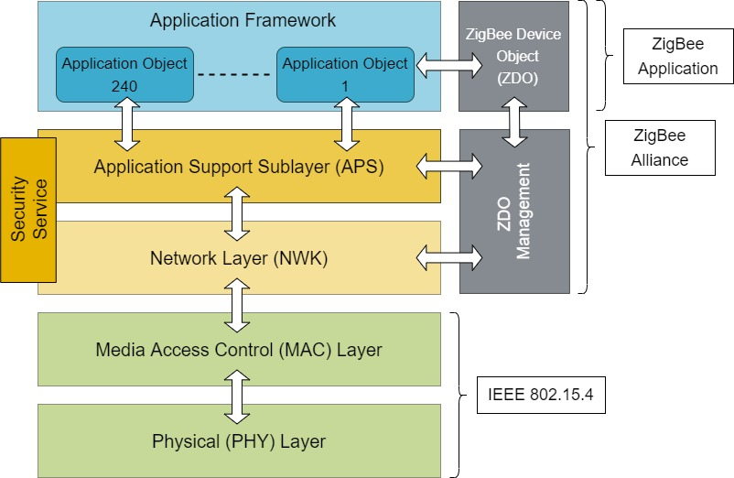
Protocol stack
PHY and MAC layers follow IEEE 802.15.4 standard
Network layer, application support sublayer, and application framework are specified by the Zigbee alliance
Zigbee application
Zigbee alliance
Notes:
Zigbee has a well-structured protocol stack that follows the OSI reference model to a large degree. The PHY and MAC layers are effectively specified by the IEEE 802.15.4 standard, whereas the other layers are specified by the Zigbee alliance.
Applications running on Zigbee devices are also referred to as Zigbee Device Objects (ZDO). These are managed by the network and application support sublayers that sit on top of the MAC.

Slide 39
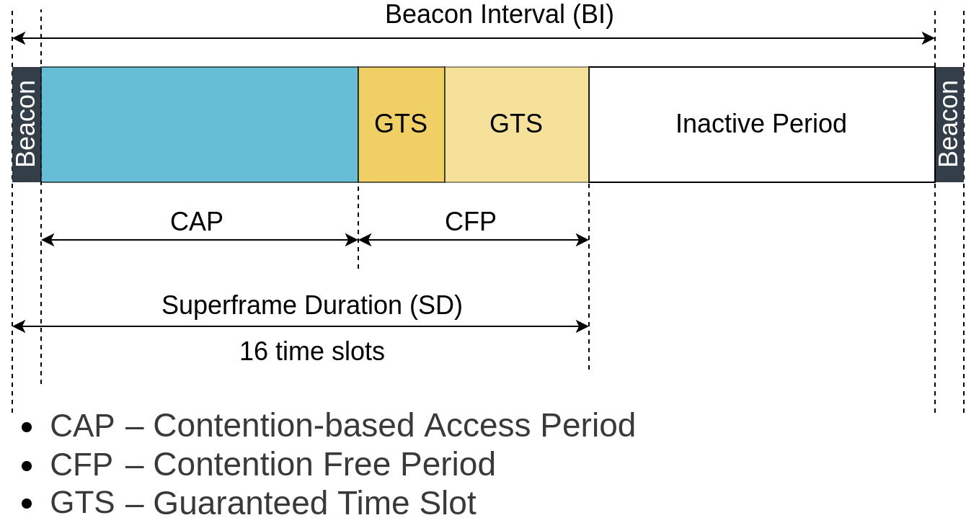
PHY and MAC layers
Transmission using Direct Sequence Spread Spectrum (DSSS) – robust to noise.
Multiple access modes
CSMA/CA
  If channel is busy, then it waits for random time(back-off factor) frame before transmission
  if channel is idle, then transmit;
  otherwise repeat back-off factor;
  Once the data is received it sends back an ACK
Beacon mode
  time divided into 16 equal slots;
  coordinator sends beacon;
  attached devices may contend but need to align transmission to slot boundaries;
  up to seven guaranteed time slots (GTS)
Notes:
Protection against interference is ensured through DSSS modulation, whereby the data to be transmitted is multiplied with a pseudo random noise spreading code (PN sequence).
The access to the channel can be regulated either through carrier-sense multiple-access with collision avoidance (CSMA/CA), whereby each transmission attempt follows a random back-off duration, or a (pseudo) scheduled beacon mode, during which the time is divided into slots of equal length. Such a super frame can itself be divided into a contention based period (CAP), during which stations contend for the channel but transmit within the permitted slot, and a contention free period (CFP), where stations transmit in pre-assigned non-conflicting slots (GTS). The latter is particularly useful for low latency applications

Slide 40
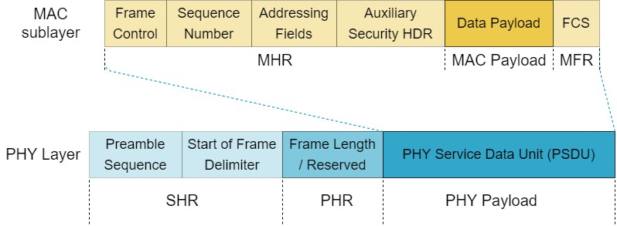
Data frame structure
SHR – synchronization header
PHR – physical layer header
MHR – MAC layer header
MFR – MAC footer

Slide 41
Network layer (NWK)
Handles
Network start up
Neighbor discovery
New device configuration
Topology specific routing
Security
  Links encrypted using AES-128 (128-bit symmetric encryption)
  Key assumed known by all parties (e.g., provisioned at device manufacturing)
  A device may not have a pre-configured key → key sent over the air in clear (Security issues: short window when this can be eavesdropped)
Notes:
The network layer (NWK) is in charge of network bootstrap, device discovery, address assignment, and, in the case of ZC and ZR devices, of forwarding packets to/from other nodes.
Security can also be implemented at the network layer to ensure data transmission confidentiality. Symmetric encryption is used with keys provisioned either at manufacturing or transmitted over the air at bootstrap. The latter approach allows for more flexibility in deployment but also presents security risks.

Slide 42
Application Support Sublayer (APS)
Maintains binding and groups tables
Responsible for discovering devices and application services
Provides communication end-points for Zigbee applications
Initiates and responds to binding requests between end-points
Filters packets intended for non-registered end-points
Also performs message fragmentation and reassembly
Ensures reliable data transport, i.e., frame error checking, retransmissions
Notes:
The application support sublayer largely provides the service points necessary for building and running applications on top of a Zigbee stack. It can also ensure reliability, but performing frame error checking and retransmissions, and in case the data received from applications is too large to fit in a single frame, it handles fragmentation and respectively fragment reassembly at the receiving end.

Slide 43
Coming next
Module | Contents
IoT Connectivity, Part II | WLAN and LPWAN IEEE 802.11 LoRaWAN NB-IoT
The Cloud | Virtual Machines and Containers Protocols Big Data Processing The Arm Pelion Platform
IoT Security | Importance of security in IoT Threat modeling Encryption
Notes:
In the following modules, we will study other connectivity solutions for IoT, discuss cloud computing features that enable IoT, and examine security aspects relevant to IoT.

