Slide 1
Introduction to
Embedded Systems

Slide 2
Syllabus
This module will cover the following aspects
An overview of embedded systems
Examples of embedded systems
Features of embedded systems
Software for embedded systems
Embedded systems programming and debugging
Notes:
We will start with a definition and a high-level overview of embedded systems, discuss some representative example, as well as the functions, attributes, and constraints of embedded systems. We will then look at embedded systems-specific software, and programming debugging techniques.

Slide 3
Embedded systems
Internet of Things (IoT)
  Application-specific computer system
  Built into a larger system
  Often with real-time computing constraints
Adding embedded systems to larger systems
  Better performance
  More functions and features
  Lower cost, e.g., through automation
  More dependability
Examples: smartphones, smart watches, printers, gaming consoles, wireless routers
Environment
Embedded system
Software
Hardware
Input
Output
User interface
Other systems
Notes:
An embedded system is a specialized computing system with chip-embedded hardware. There is no ultimate definition for embedded systems, but largely these are considered to have hybrid (pre)processing and computation capabilities, a task specialized (internal) design that interacts with the surrounding environment, and are usually subject to timing constraints.
Embedded systems are typically designed to perform a well-defined task that repeats either periodically or spontaneously upon a trigger, have low cost, a low power budget, and relatively high performance.
A real-time system is a system that guarantees a meaningful output is produced within a defined short period of time or interval.

Slide 4
CPUs → MCUs → Embedded Systems
Microprocessor or Central Processing unit (CPU)
Defined typically as a single processor core that supports at least instruction fetching, decoding, and executing
Used for general purpose computing, but needs to be supported with memory and Input/Output (I/O) interfaces
Memory interface
Instruction fetcher
To memory blocks
Instruction decoder
Register banks
ALU
Microprocessor
Notes:
The microprocessor is the central core of an embedded system. It is a multipurpose, clock driven, programmable electronic device designed to perform arithmetic and logic operations (using an arithmetic logic unit – ALU). It usually performs at least the instruction cycle of fetching, decoding, and executing.
The microprocessor also communicates with other external components, at least with a memory unit, via a memory interface, and can perform I/O operations based on specific instructions. In an embedded system, there are many more components that communicate, such as timers, interrupt handlers, analog-to-digital converters (ADCs), etc.

Slide 5
CPUs → MCUs → Embedded Systems
Microcontroller Unit (MCU)
Microprocessor
Program memory
Data memory
System Bus
Digital I/O
Analog I/O
Timers
Other peripherals
MCU
Typically has a single processor core
Has memory blocks, digital I/Os, analog I/Os, and other basic peripherals
Used for basic control purposes, such as embedded applications
Notes:
MCUs consist of a CPU plus additional peripheral components.
This means that the microprocessor is usually optimized for its task with regards to power and cost efficiency. Hence, it is usually a single core CPU. On-chip memory components are designed and selected for the target application. This includes low-cost standard random-access memory (RAM) and read-only memory (ROM), optimized for speed, cost, durability, and energy efficiency.
Additional hardware components are selected according to the controller’s final purpose. They can include a variety of input and output components, timers, interrupt structures, external buses, etc.
All components within a microcontroller communicate via an internal system bus.
Interfacing with peripherals is possible via a range of protocols. This includes the Universal asynchronous receiver-transmitter (UART) protocol, the Inter-integrated Circuit (I2C) protocol, and the Serial Peripheral Interface (SPI). We will discuss in more detail later, when we will cover the I/O aspects.

Slide 6
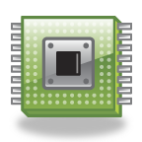
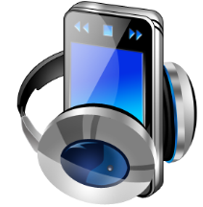

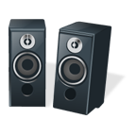
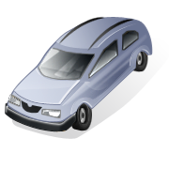

CPUs → MCUs → Embedded Systems
Embedded system
Typically implemented using MCUs
Often integrated into a larger mechanical or electrical system
Usually has real-time constraints
Embedded system
Notes:
An embedded system usually contains one or more MCUs that are interconnected.
For example, a smartphone integrates a wireless connectivity capability. It can work without it, but usually an application relies on this capability to virtually extend the smartphone system, so as to control headphones, printers, or other devices. Such virtual systems establish on-the-fly connections to the other components depending on the software, context, and peripherals’ properties.
Most parts of an embedded system are electrical components. An elementary part of an embedded system can also be the mechanical structure or the housing of the sensor, providing a key functionality of the embedded system.
Real-time constraints (i.e., guaranteed response times) may be an important feature of an embedded system.

Slide 7
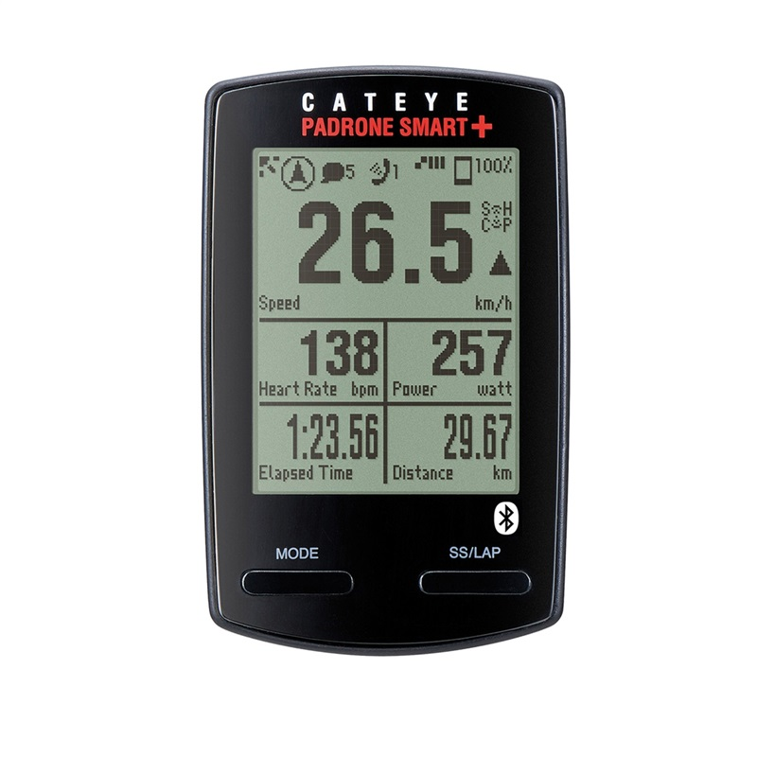
Embedded system example: Bike computer
Inputs:
Wheel rotation
Mode key
Functions
  Speed, cadence, distance, heart rate (HR) measurements
Constraints
  Size, weight, and cost; power and energy
Inputs
  Wheel rotation sensor and mode key
Output
  Liquid crystal display (LCD), BLE interface to smartphone
Uses low performance microcontroller
Outputs:
Display (current speed, heart rate, etc.)
Notes:
A bike computer is an example of a small embedded system.
The bike computer senses wheel rotation, mostly magnetically, and outputs the calculated values such as speed, distance, and time. Additional sensors such as a heart rate monitoring sensor could be connected to such a system.
The constraints defined by the user are primarily size/weight and cost, as well as battery lifetime that translate into power consumption. This means that the total system must be very cost and power efficient. Fortunately, size, weight, and cost are usually proportional, and the only counteracting variable may be the processor performance.
The bike computer, as a weak real-time system, should be able to process the input between two sensor impulses.
This means that if the computer is designed for a non-professional cyclist, it should at least be able to measure speeds up to 60km/h = 16.7m/s, for a racing bike. The circumference of a wheel of a racing bike is about 2m that means 8–9 rotations/s.
Consequently, the system should be able to measure a frequency of 10Hz without any complicated processing algorithms (time difference measurement, division, display, etc.).
This means that a very simple, low cost, microcontroller can be selected for this application.

Slide 8
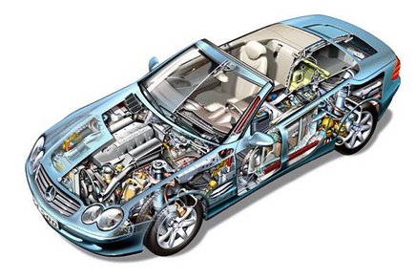
Embedded system example: Gasoline engine control unit
Functions
  Fuel injection
  Air intake setting
  Spark timing
  Exhaust gas circulation
  Electronic throttle control
  Knock control
Constraints
  Reliability in a harsh environment
  Cost
  Weight
Many inputs and outputs
  Discrete sensors and actuators
  Network interface to rest of the car
Uses high performance microcontroller
  E.g., 32-bit, 3MB flash memory, 150–300MHz
Notes:
Another example of an embedded system is an engine control unit for a car:
In this example, the functional requirements and the constraints are much greater than those of a bike computer. Requirements such as spark and fuel injection timings need real-time calculations, to ensure appropriate operation of the engine. That is every computation must finish at a defined point in time; otherwise, the engine will run sub-optimally and may even become damaged.
Additional constraints are high reliability under harsh environments, for relatively low cost. Furthermore, limited installation space requires a small device footprint.
Many sensors and actuators have to be networked to the rest of the car and operated by the microcontroller. Consequently, a powerful, reliable, and high performance microcontroller is needed.

Slide 9
Options for building embedded systems
Implementation | Design Cost | Unit Cost | Upgrades & Bug Fixes | Size | Weight | Power | System Speed
Discrete Logic | low | medium | difficult | large | high | ? | very fast
ASIC | high ($500K/ mask set) | very low | difficult | very small | very low | low | extremely fast
Programmable logic: FPGA, PLD | low to medium | medium | easy | small | low | medium to high | very fast
Microprocessor + memory + peripherals | low to medium | medium | easy | small to medium | low to medium | medium | moderate
MCU (int. memory & peripherals) | low | low to medium | easy | small | low | medium | slow to moderate
Embedded PC | low | high | easy | medium | medium to high | medium to high | fast
Dedicated Hardware
Software Running on
Generic Hardware
Notes:
Although the term “embedded system” is mostly used for microcontroller-based systems, it is not restricted to just those. Instead it encompasses systems with as much functionality as possible, embedded into few components. This covers systems ranging from discrete hardware components to fully embedded PCs. In between are microprocessors with dedicated hardware elements and microcontrollers with chip-embedded hardware.
The table above shows the pros and cons of different types of embedded systems, with the main advantages of each implementation highlighted in green.

Slide 10
Benefits of embedded systems
Greater performance and efficiency
More sophisticated control through software
Lower cost
Cheaper components
Reduced manufacturing costs
Reduced operating and maintenance costs
More features
Many not possible or impractical using other approaches
Better dependability
Adaptive systems that can compensate for failures
Better diagnostics to improve repair time
Notes:
Microcontroller-based embedded systems bring numerous advantages.
For instance, software-based applications provide better flexibility than pure hardware, and can be adapted more easily to changes in system requirements.
By partitioning the system into hard- and software components, the total system cost can be minimized.
The number of features implemented by a system can be easily extended in microcontroller-based designs. Through system optimization, memory and on chip-components redundancy can also be reduced.
Failures can be detected, debugged, and compensated for with a microcontroller-based embedded system.

Slide 11
Functions of embedded systems
Closed-loop control system
Monitor a process, adjust an output to maintain the desired set point of operation (temperature, speed, direction, etc.)
Sequencing
Step through different stages based on environment and system conditions
Signal processing
Remove noise, select desired signal features
Communications and networking
Exchange information reliably and quickly
Notes:
The range of embedded systems applications and functions they could perform is infinitely large. For instance, monitoring and pre-processing in closed loop control systems are very common functions of embedded systems, as they are very small, inexpensive, and can be deployed nearly everywhere.
Digital signal processing is another common use of embedded systems, in which audio/electromechanical/other signals are processed or transferred according to the scope of the application.
When setting up and managing small local networks, simple protocols are usually used to reduce memory and power consumption. Examples include Bluetooth Smart (i.e., Bluetooth Low Energy) and ZigBee.

Slide 12
Attributes of embedded systems
Interfacing with larger systems/
environment
Concurrent, reactive behaviors
Analog signals for reading sensors
Use voltage to represent a physical value
Power electronics for driving motors and solenoids
Digital interfaces for communicating with other digital devices
Simple: switches
Complex: displays
Must respond to sequences and combinations of events
Real-time systems have deadlines on responses
Typically must perform multiple separate activities concurrently
Notes:
Many attributes characterize an embedded system.
Given their interaction with the environment, an important aspect is the nature of that interface. Specifically, an interface is selected based on whether the signals to be read are analog or digital. The voltage range of a system’s inputs and outputs is also important, as well as the amount of power needed by the system itself and by its peripherals. Interfacing with other digital devices or users is another important attribute.
Finally, timing and multi-tasking/multi-threading behaviors are key attributes of embedded systems that seek trying to execute more than a single task concurrently, usually within a specific time period.

Slide 13
Attributes of embedded systems
Fault handling
Diagnostics
Many systems must operate independently for long periods of time that requires them to handle likely faults without crashing
Often, the fault-handling code is larger and more complex than the normal-case code
Help systems developer and service personnel determine problems quickly
Notes:
It is also important to know whether the system is allowed to crash, or whether fail-safe modes are required, especially for systems that run independently for a long periods of time. Usually, fault-handling code is complex compared to normal-case code, and this may pose further memory requirements.
Additionally, embedded systems should have diagnostic mechanisms to detect and debug system problems, in order to identify and localize problems quickly. This makes fault handling more efficient and serious system crashes less likely.

Slide 14
Constraints specific to embedded devices
Cost
Competitive markets penalize products that do not deliver adequate value for money
Size and weight limits
Mobile (aviation, automotive) and portable (e.g., handheld, wearable) systems
Power and energy limits
Battery capacity,
cooling limits
Environment
Temperatures may range from -40 degrees C to 125 degrees C, or even more.
Notes:
Embedded systems come with benefits, but they are also subject to constraints.
Cost is very important in high volume production, especially in today’s competitive markets. There is a balance to be struck in embedded systems manufacturing, between design and production cost.
Application size and weight can also be a constraint, especially for portable and wearable systems.
Battery capacity is another constraint, since batteries cannot offer unlimited energy. In turn, this impacts on the power consumption profile affordable to embedded devices.
Equally important are the effects of any heating issues that may arise due to the system’s operation or induced by the external environment.

Slide 15
The impact of constraints
MCUs used (rather than microprocessors)
Programming language
Operating system (OS)
Include peripherals to interface with other devices and respond efficiently
On-chip RAM and ROM reduce circuit board complexity and cost
Programmed in C rather than in Java, which results in smaller and faster code, so less expensive MCU
Some performance-critical code may be in Assembly
(a lower-level language)
Typically no OS, but instead simple scheduler, or even just interrupts + main code (foreground/background system)
If OS used, likely to be a lean real-time one (RTOS).
Notes:
The constraints specific to microcontroller-based embedded system lead to difficulties in handling their operation and interfacing. For instance, as peripherals are already integrated on the chip, they are usually operated in a way that is unique to every controller type. Although this reduces manufacturing costs, it increases the engineering costs for design, development, and debugging. In other words, the board and design complexity is reduced, but the chip-and-coding complexity is increased.
Programming is mostly done in C or Assembly language, due to inherent code efficiency and low programming overhead. C++, with all the benefits of object-oriented programming, is sometimes used in larger embedded systems with a major focus on algorithm centered applications. However, task-, interrupt-, and time-slice-based applications work best if written in C and Assembly, because these languages allow controlling the required clock cycles per operation more easily. Although some systems are also programmed in interpreting languages such as Basic or Java, this is the exception because code optimization is nearly impossible.
Operating systems have been less common for embedded system, although this is changing in the IoT era. Arm Mbed OS is one such example. However, it should be noted that despite simplifying development, the RTOS overhead extends code size and reduces transparency around what is really happening inside the MCU.

Slide 16
Embedded software
Software incorporated into/aiming to control machines or devices
Usually specialized for a specific hardware platform
Simple, limited memory requirements
Often does not require OS support → firmware
Subject to timing constraints
Many control functions not tied to human interaction
Notes:
The type of software running on embedded systems is very different than that written for personal computers. Embedded software is much simpler, as it specializes in one or small number of tasks, while being tailored to the unique characteristics of the underlying embedded hardware platform.
Given its simplicity and small memory footprint, embedded software frequently runs without an operating system and is also referred to as firmware.
Embedded software typically serves applications with tightly bounded timing requirements, such as automotive IoT or avionics.
In addition, embedded software may not require a human interface (e.g., buttons, keyboard, etc.) to provide the intended functionality, but instead have interfaces with software running on other devices, for e.g., via a Control Area Network (CAN) bus that allows different microcontrollers within a vehicle to communicate.

Slide 17
Embedded software constraints
Lack of abstraction developer directly exposed to underlying hardware
Responsiveness system needs to react to external triggers in a timely manner
Concurrency multiple physical events happening at the same time must be handled
Reliability
code errors can have catastrophic events in practice
Efficiency
given energy & timing budgets, optimization is required
Notes:
Many of the constraints posed on embedded software stem from the stringent requirements that the embedded systems (hardware + interfaces + software) must fulfill.
As developers write code in C and Assembly and must optimize the code for a specific platform, there is no room for abstracting away hardware specifics and working with high level data structures.
By their nature, embedded systems interact with physical processes, hence they are expected to guide their operation by inputs received from the environment. Such events often happen at the same time, so the system must be able to prioritize and handle them accordingly, or parallelize processing where possible.
Naturally, to optimize energy and execution efficiency, embedded software must be optimized that sometimes requires significant domain knowledge and manual optimization.
Fixing bugs in the production phase may be impossible and could have catastrophic consequences (e.g., bricking a device during a firmware update). Therefore embedded code should be well tested and have fail-safe mechanisms.

Slide 18
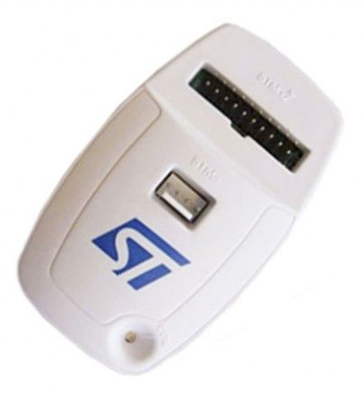
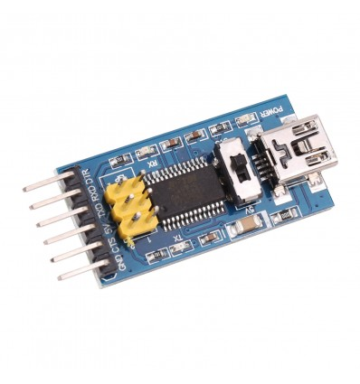
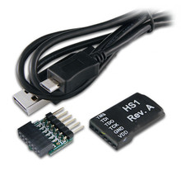
Embedded systems programming and debugging
Different option to upload/debug code on a microcontroller
A range of interfaces are used to program embedded systems, including Joint Test Action Group (JTAG), Serial Wire Debug (SWD), Single Wire Interface Module (SWIM), etc.
Programming consists of writing program code to non-volatile memory (e.g., Electrically Erasable Programmable Read-Only Memory (EEPROM)) and configuring the system via fuses.
Configuration bits (fuses) control key behavior of embedded hardware, e.g., clock rate, power-up timer, etc.
Notes:
Depending on the embedded hardware platform, developers use a particular type of interface to program an embedded device, e.g., JTAG, Serial, etc.
Programming consists of writing the code into memory, typically electronically erasable programmable ROM (EEPROM) and configuring the device
Other ROM memory bits are used to configure core functionality such as the clock source and rate, and timers.

Slide 19
Embedded software debugging
Much more complicated than debugging regular software and involves some hardware interface
Challenging to debug code involving interactions with peripherals
Debug pins could be made available for programming and testing during manufacturing
Integrated Development Environments (IDEs) frequently used to simplify debugging
Sometime convenient to implement a command-line interface (CLI) that can enable real-time inspection of registers and memory contents
Notes:
Debugging embedded software is not as easy as debugging regular software, primarily due to the constrained nature of the device and limited human control interfaces. It is particularly difficult to debug parts of code that involve some interactions with peripherals.
To simplify the debugging process during manufacturing, debug pins are exposed and sometimes it is convenient to implement a CLI that allows the developer to read from the memory and registers. Such features should be however disabled before product release, to prevent hardware security attacks.
IDEs that contain tools for inspecting the functionality of the device are often used to simplify debugging.

Slide 20
Over-the-air programming
Sometimes possible for embedded devices equipped with a wireless interface
Over-the-air (OTA) programming is particularly useful for firmware updating after product release.
A risk of rendering the device unusable exists, if programming is interrupted or inappropriate software is uploaded → some recovery mechanism should be implemented if OTA is desired.
Ideally, a separate chip would handle OTA programming, but this increases the footprint and cost of the device.
More often, memory is reserved for a bootloader that handles the OTA programming and, in case of update failure, this can revert the application to the previous version.
Notes:
When physical access to an embedded device is problematic, either during manufacturing or after product release, OTA can be a convenient way to reprogram/update the software running on an embedded device.
However, if the programming is interrupted before the process finishes or the software uploaded was not originally designed for the target device, OTA can brick the device. To avoid this problem, separate dedicated circuitry can be embedded to handle firmware updating, though this will increase the cost and size of the device that can be less desirable for some applications. Therefore, more often a separate piece of software called bootloader, co-located in the memory with the core application, is implemented. This will check if the operation of the device is appropriate after an update and otherwise attempt to roll back the software to the previous working version.

Slide 21
Coming next
Module | Contents
Hardware Platforms for IoT | What is a hardware platform Types of memory Power saving techniques Types of sensors
The Arm Cortex-M4 Processor Architecture | Processors vs. architectures Cortex-M4 features Cortex-M4 registers
Interrupts and Low Power Features | What are interrupts Exception handlers Timing analysis Program design with interrupts
Notes:
In the following modules, we will study hardware platforms for IoT, introduce the Arm Cortex-M4 processor architecture, and discuss interrupts and low power features.

