Slide 1
Sharing Data in CMSIS-RTOS2

Slide 2
Previous
CMSIS-RTOS2 Thread and Time Management
Notes:
In the previous module we learnt about CMSIS-RTOS2 Threads and time management.

Slide 3
Inter-Thread Communication
Inter-thread communication primitives are of crucial importance to OS design
Several mechanisms or primitives are provided by CMSIS-RTOS2
Events
Mutex
Semaphore
Mailbox
The first three provide synchronization
The last one provides data communication
We will have a close look at each one of them one by one.
Notes:
Inter-Thread communication mechanisms in CMSIS-RTOS2 are:
Events
Mutex
Semaphore
Mailbox
Events, mutex and semaphore provide synchronization of Threads.
Mailbox provides data communication between Threads.

Slide 4
Events
An effective alternative to busy-waiting
Trigger Thread A when event X happens (event flag set by other threads)
Each Thread can wait for event flags managed via osEventFlags_t object
Thread state will change to Blocked while waiting.
Once the required event flags are set, the thread will be put back to the READY state and wait for the scheduler to dispatch it
Flags can also be cleared by other threads by using osEventFlagsClear();
Notes:
Instead of busy waiting for a flag, “Events” can be used by Threads to signal to other Threads.
Each Thread has 16 private event flags (stored in TCB register).
Wait for events can be a WAIT_AND or WAIT_OR event.
Once the required event flags are set, the Thread will be put back to the READY state and wait for the scheduler to dispatch it.
Flags can also be cleared by other Threads.

Slide 5
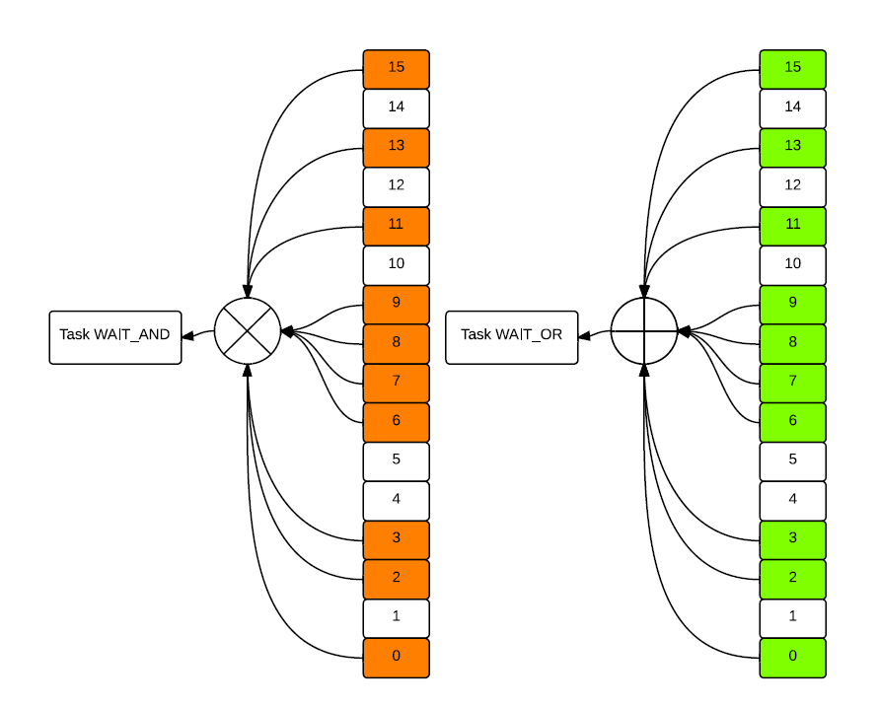
And & Or Events
Self-explanatory function definitions
uint32_t osEventFlagsWait(osEventFlagsId_t ef_id, uint32_t flags, uint32_t options, uint32_t timeout);
Where options can be:
osFlagsWaitAll — (AND behavior)
osFlagsWaitAny — (OR behavior)
Thread will only monitor the flags specified by flags
If osFlagsWaitAll is used: all specified flags must be set to release the thread
If osFlagsWaitAny is used: any one flag can release the thread
You can set timeout as well, Thread will be put back to READY after timeout period even if flags are not set
As usual, based on timer tick value
osWaitForever (0xFFFFFFFFU) means infinite timeout
Notes:
WAIT_ALL (And Events) Threads waiting for all event flags to be set. When all required flags are set, the Thread moves to READY. Use osEventFlagsWait() with osFlagsWaitAll option.
WAIT_ANY (Or Events) Threads waiting for any one event flag to be set. When any monitored flag occurs, the Thread moves to READY. Use osEventFlagsWait() with osFlagsWaitAny option.
READY Threads ready to run. Once the running thread completes or blocks, the scheduler picks the highest-priority READY Thread to run.
Timeout A timeout can cause the Thread to return to READY even if no event flags are set (based on ticks or infinite wait).

Slide 6
After Event
Set the event flags by osEventFlagsSet(event_flags_id, flags); in another Thread.
If event is triggered,
The thread is released from waiting
osEventFlagsWait() returns the triggered flags
To determine which flags were set:
osEventFlagsWait() returns the bit pattern of active flags
Clear flags by calling osEventFlagsClear(event_flags_id, flags); in another Thread before it triggers the blocked Thread.
Notes:
osEventFlagsSet() sets the specified bits for the event flags object.
The waiting Thread is released when the required flags are satisfied.
Example modern usage:
osEventFlagsSet(myEventId, 0x0003);
uint32_t result = osEventFlagsWait(myEventId, 0x0003, osFlagsWaitAll, 500);
if (result & osFlagsErrorTimeout) {
printf("Event wait timeout.\n");
} else {
printf("Event received: 0x%08X\n", result);
}
osEventFlagsWait() both waits and returns the set flags.
Timeout is specified in ticks; use osWaitForever for infinite wait.
Use osEventFlagsClear() if you need to manually clear bits.

Slide 7
Interrupt and Event
As mentioned before, interrupts will “interrupt” the OS if they are not handled properly.
SysTick is a common timer interrupt used by the RTOS scheduler
Rule of thumb:
Use interrupt to set event flags
Then do the lengthy job in a thread!
void osEventFlagsSet(event_id, flags);
Of course, do not forget the IRQ routine stuff (clear interrupt bits for example)
Notes:
ARM7/9 has limited support for nested interrupts; Cortex-M supports nested interrupts well via NVIC
Despite that, always keep ISR execution short
SysTick is a 24-bit system timer that triggers regular RTOS ticks
It counts down from SYST_RVR, reloads, then repeats
Best practice:
In ISR, set a signal or event flag using osEventFlagsSet()
Let a Thread (with proper priority) handle the job
Example ISR (CMSIS-RTOS2):
void EXTI0_IRQHandler(void) {
osEventFlagsSet(event_id, 0x01); // Notify Thread
__HAL_GPIO_EXTI_CLEAR_IT(GPIO_PIN_0); // Clear hardware IRQ flag
}

Slide 8
Mutex
A mutex, in many ways, is a binary semaphore.
Two major purposes in CMSIS-RTOS2:
Synchronize Threads
Protect shared variables or resources
CMSIS-RTOS2 mutexes have the priority inheritance scheme built in but has no priority ceiling protocol, so be really careful if your thread involves more than one mutex.
Remember to release the mutex after use. CMSIS-RTOS2 will not release the mutex on thread deletion – other threads will never be able to acquire it again!
An alternative way: use the lock and unlock functions.
Thread acquired a mutex can still be interrupted and blocked
Whereas a locked thread will not be preempted by the OS (more control over everything)
But in most cases, mutex is what you want.
Notes:
A mutex can be considered a binary semaphore and is used for the synchronization of threads and for protection of shared variables or resources.
In CMSIS-RTOS2, a mutex has the priority inheritance but not priority ceiling property.
Since CMSIS-RTOS2 will not release the mutex bit, it should be cleared after the use or end of the Thread by the program.
One can also use Lock and Unlock functions.

Slide 9
Mutex Routines
Three related functions and one type only
Declare a mutex object first: osMutexId_t mutexID;
Then create the mutex through mutexID = osMutexNew(NULL);
Acquire the mutex through osStatus_t status = osMutexAcquire(mutexID, osWaitForever);
Return values:
osOK: mutex acquired
osErrorTimeout: timeout occurred
osErrorResource: mutex not available
osErrorParameter: invalid ID
osErrorPermission: not the owner (on release)
After the critical section, release the mutex through osMutexRelease(mutexID);
Notes:
CMSIS-RTOS2 mutexes are declared with osMutexId_t and created using osMutexNew().
A mutex must be acquired by a Thread before accessing a critical section.
A Thread cannot release a mutex it doesn’t own — osMutexRelease() returns osErrorPermission.
Replace old os_mut_init, os_mut_wait, and os_mut_release with:
osMutexNew()
osMutexAcquire()
osMutexRelease()
Example:
osMutexId_t mutex1;
void f1(void) {
osMutexAcquire(mutex1, osWaitForever);
// Critical region 1
f2(); // f2 will not block as mutex is already held
osMutexRelease(mutex1);
}
void f2(void) {
osMutexAcquire(mutex1, osWaitForever);
// Critical region 2
osMutexRelease(mutex1);
}
void thread1(void *arg) {
mutex1 = osMutexNew(NULL);
f1();
}
void thread2(void *arg) {
f2();
}

Slide 10
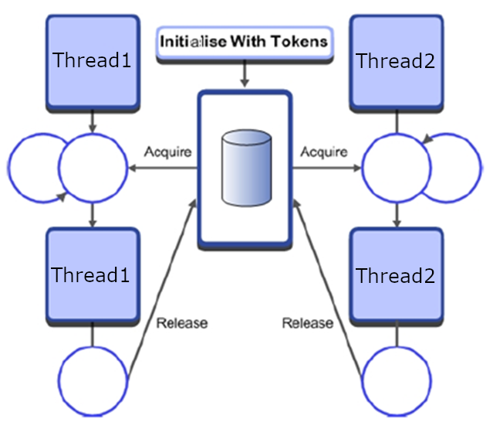
Semaphore
Recall that a semaphore is a container of a number of tokens.
Acquire a token first, then access a resource.
To finish with the resource, return the token.
Also used to synchronize Threads or protect variables and resources.
Very sophisticated and comprehensive ways of using semaphores.
Unlike mutex, you may destroy a thread with unreleased tokens (depends on how you use your semaphore).
Simple routine APIs, but frequently misused!
Notes:
A semaphore is a variable/container of a number of tokens and counting semaphores have a value more than 1 (tokens). Semaphores are used to allocate a resource. Acquire a token from a semaphore to access a resource and then return the token after use of the resource.
Semaphores can be used for both mutually exclusive use of a resource and for the synchronization of Threads. Options for making the Thread which takes a DELETE_SAFE are provided by the mutex, which means the Thread deletion is not possible when holding the mutex. Whereas you may destroy a Thread with unreleased tokens.

Slide 11
Semaphore Routines
Very similar to the mutex. Again, three related functions and one type only.
Declare a semaphore container first: osSemaphoreId_t semID;
Then create the semaphore through semID = osSemaphoreNew(max_tokens, initial_tokens, NULL);
Acquire a token through osStatus_t status = osSemaphoreAcquire(semID, osWaitForever);
Timeout is supported
Return values:
osOK: token acquired
osErrorTimeout: timeout
osErrorResource: no tokens available
osErrorParameter: invalid ID
Return/create a token in the semaphore container through osSemaphoreRelease(semID);
Can a thread return(create) a token even if it has no token?
Semaphore is not a mutex!
Notes:
Semaphores are containers of countable tokens.
In CMSIS-RTOS2, use:
semID = osSemaphoreNew(3, 0, NULL); // max = 3, initially empty
A thread acquires a token:
osSemaphoreAcquire(semID, osWaitForever);
Another thread or ISR can release a token:
osSemaphoreRelease(semID);
This is useful for producer-consumer or signaling from ISR.
Unlike a mutex, any Thread can release the semaphore, even if it didn’t acquire it.
A deleted Thread will not auto-release its acquired tokens — use carefully.

Slide 12
Mutexes vs. Semaphore
Semaphore
Used for signaling from threads or ISRs to waiting threads
Can be initialized to 0, meaning “The event hasn’t happened yet”
Mutex
Used to ensure mutually exclusive access to a shared object
Is a binary semaphore with priority inheritance and some other changes
Is initialized to 1, meaning “The object isn’t being used now”
Common pitfall
Semaphore handles several copies of equivalent resources whereas mutex handles one?
Semaphore does not keep track of the order of access – effectively treating all resources identically! If your multiple copies of equivalent resources are not identical,
Access and release order matters
Use multiple mutexes instead of semaphores!
Notes:
Further discussion by Michael Barr at http://www.barrgroup.com/Embedded-Systems/How-To/RTOS-Mutex-Semaphore
Semaphores can count to more than 1. i.e. they can be used to share multiple common identical resources. A mutex is binary and it can be taken and released; they also give serial mutually exclusive access to a resource.
Multiple mutexes can be used to give access to multiple different type resources. Counting semaphores can only work on multiple identical resources.

Slide 13
Queues and Messages in CMSIS-RTOS2
Pass the Data
Sharing bigger chunks of information between threads
Each queue element (message) is four bytes long, can be used in two ways
Can hold the data itself (up to 32 bits)
Can hold a pointer to larger objects
When passing larger objects, need to dynamically allocate memory per object, free when done processing
Pass a Pointer to the Data
Notes:
The user has to both declare the mailbox and allocate memory for the data.
The mailbox allows sharing data between Threads. It is a queue of user-defined length.
When passing larger objects, need to dynamically allocate memory per object, free when done processing

Slide 14
Create message queue
Create queue
osMessageQueueId_t msgq_id;
msgq_id = osMessageQueueNew(msg_count, msg_size, NULL);
msg_count: number of messages in the queue
msg_size: size (in bytes) of each message
Queue stores fixed-size messages — not just pointers
Notes:
osMessageQueueNew(count, size, attr) allocates and initializes the queue
count: how many messages to store
size: message size (e.g., sizeof(uint32_t) or a struct)
You no longer need to manually declare a mailbox buffer with a macro like os_mbx_declare
Example:
typedef struct {
uint8_t id;
uint16_t value;
} SensorMsg;
osMessageQueueId_t sensorQueue;
void init() {
sensorQueue = osMessageQueueNew(10, sizeof(SensorMsg), NULL);
}

Slide 15
Sending Messages
Prepare message if passing a pointer to the data
May need to allocate memory (if object doesn’t exist)
Send the message
osMessageQueuePut(queue_id, &msg, priority, timeout);
msg is a pointer to the message data
What if queue is full?
If blocking: the sending thread sleeps until space is available or timeout expires
If non-blocking: returns osErrorResource
Return code: osOK, osErrorTimeout, osErrorResource, osErrorParameter
osMessageQueuePut(queue_id, &msg, 0, 0); // non-blocking only!
ISRs use this version
Returns immediately — no blocking in ISRs allowed
Notes:
To send messages, you send the pointer to the data, to the thread.
osMessageQueuePut(queue_id, &msg, priority, timeout);-- This function puts the pointer to a message in the queue, if the queue is not already full.

Slide 16
Receiving Messages
osMessageQueueGet(queue_id, &msg, NULL, timeout);
Provides a pointer to the next message in the specified queue
Must free the message’s memory after using it
Will block if the queue has no message
timeout again
Return code:
osOK: message received
osErrorTimeout: timeout occurred
osErrorResource: queue is empty (non-blocking mode)
osErrorParameter: invalid pointer or ID
osMessageQueueGet(queue_id, &msg, NULL, 0); // Non-blocking only
Provides a pointer to next message
Return value indicates result
Notes:
osMessageQueueGet() retrieves the next message from the queue into a local variable
If the queue is empty:
If blocking: thread is put into the Blocked state and waits until a message arrives
If non-blocking (timeout = 0): returns osErrorResource immediately
Example usage:
SensorMsg msg;
osStatus_t status = osMessageQueueGet(sensorQueue, &msg, NULL, osWaitForever);
if (status == osOK) {
// Process msg
}

Slide 17
Dynamic Memory Allocation
It doesn’t fit anywhere!
Here!
Single pool handling all size requests
Pool for 32-byte requests
Pool for 16-byte requests
Allocating and freeing different sizes of memory can cause fragmentation, so free space is distributed in fragments which are too small to use
Solution is to create a separate memory pool for each size of data to be allocated
Notes:
Allocating and freeing different sizes of memory can cause fragmentation, so free space is distributed in fragments which are too small to use.
The solution is to create a separate memory pool for each size of data to be allocated. i.e. For 32 byte requests keep a pool of memory. For 16 byte requests keep a pool of memory.

Slide 18
Dynamic Memory Allocation in CMSIS-RTOS2
CMSIS-RTOS2 has powerful fixed memory block memory allocation routines - pool
“pool” = memory pool of fixed-size blocks
Thread safe and re-entrant
Functions
_osMemoryPoolId_t poolID;
poolID = osMemoryPoolNew(block_count, block_size, NULL);
void *ptr = osMemoryPoolAlloc(poolID, osWaitForever);
osMemoryPoolFree(poolID, ptr);
Better to use these for fixed size messages
Variable length memory allocation (malloc() and free() from stdlib.h) functions are not re-entrant! Use lock and unlock to disable context switch!
Notes:
In CMSIS-RTOS2, fixed block memory management is done using memory pools
osMemoryPoolNew() creates a pool with a fixed number of same-size memory blocks
Use osMemoryPoolAlloc() to get a block (with optional timeout)
Use osMemoryPoolFree() to return the block
Memory blocks are aligned and thread-safe
Prefer these over malloc() and free() for reliability and timing guarantees

Slide 19
A Working Example
typedef struct {
uint32_t val[2];
} MsgBox_t;
osMessageQueueId_t msgQ;
osMemoryPoolId_t pool;
void rec_Thread(void *arg) {
MsgBox_t *msg;
msg = (MsgBox_t *)osMessageQueueGet(msgQ, NULL, NULL, osWaitForever).value.p;
uint32_t rec_val0 = msg->val[0];
uint32_t rec_val1 = msg->val[1];
osMemoryPoolFree(pool, msg);
osThreadExit();
}
void send_Thread(void *arg) {
MsgBox_t *msg = (MsgBox_t *)osMemoryPoolAlloc(pool, osWaitForever);
msg->val[0] = 0x3215fedc;
msg->val[1] = 0x00000015;
osMessageQueuePut(msgQ, &msg, 0, osWaitForever);
osThreadExit();
}
int main(void) {
osKernelInitialize();
pool = osMemoryPoolNew(16, sizeof(MsgBox_t), NULL);
msgQ = osMessageQueueNew(16, sizeof(MsgBox_t *), NULL);
osThreadNew(rec_Thread, NULL, NULL);
osThreadNew(send_Thread, NULL, NULL);
osKernelStart();
while (1) {}
}
Notes:
Modified from RL-ARM User’s Guide.
An example is shown in the slide.

Slide 20
Sharing Data Safely
Preemption and interrupt could contaminate data:
One writer and at least one reader scenario
Data overwritten partway through being read - Writer and reader might interrupt each other
More than one writer, at least one reader scenario
Data overwritten partway through being read - Writer and reader might interrupt each other
Data overwritten partway through being written - Writers interrupt each other
Is the read/write operation indivisible/atomic?
Yes, then problem solved – but what if not?
Race condition
Anomalous behavior due to unexpected critical dependence on the relative timing of events
Depends on the relative timing of the read and write operations
Critical section
A section of code which creates a possible race condition
Any access to a shared data structure is a critical section of code
Some synchronization mechanism is required at the entry and exit of the critical section to ensure exclusive use
Notes:
When data is shared by Threads, we need to make sure that they are not overwritten and corrupted.
If we allow pre-emption and interruption of Threads, then the overwriting of shared data can happen.
Race condition – one Thread changing the variable in a wrong sequence can corrupt the data.
Any access to shared data can be considered as a critical section of code.

Slide 21
Data Race Bug: Timestamp Data Structure
System
TimerVal structure tracks time and days since some reference event
TimerVal’s fields are updated by periodic timer ISR
Problem
An interrupt at the wrong time will lead to wrong data in DT
Failure Example
TimerVal is {10, 23, 59, 59}
Thread code calls GetDateTime(), which starts copying the TimerVal fields to DT: day = 00, hour = 23
A timer interrupt occurs, which updates TimerVal to {11, 0, 0, 0}
GetDateTime() resumes executing, copying the remaining TimerVal fields to DT: minute = 0, second = 0
DT now has a time stamp of {10, 23, 0, 0}.
The system thinks time just jumped backwards one hour!
void GetDateTime(DateTimeType * DT){
DT->day = TimerVal.day;
DT->hour = TimerVal.hour;
DT->minute = TimerVal.minute;
DT->second = TimerVal.second;
}
Notes:
Data race can lead to wrong data. This can also be due to time stamp error.

Slide 22
Atomicity, ARM ISA and Shared Memory
ARM is a Load/Store architecture – variables can only be modified in registers, not in memory
Any memory-resident variable must be accessed with at least three instructions: load, modify, store.
This creates a critical section from the load instruction to the store instruction (inclusive)
It’s not just multi-element data structures – ANYTHING in memory (even bytes or words) is vulnerable
Threads communicating with shared memory are vulnerable to race conditions
Any variables used in shared memory communication must be protected
Notes:
ARM is a load/store architecture – variables can only be modified in registers, not in memory.
Any memory-resident variable must be accessed with at least three instructions: load, modify, store.
Threads communicating with shared memory are vulnerable to race conditions.
Any variables used in shared memory communication must be protected.

Slide 23
Reentrancy and Data Sharing
A naive implementation itoa() function
Converts an integer to a text string (char array)
Space for only one string is allocated, so itoa() is non-reentrant.
Not ensuring mutually exclusive global resource use makes the function non-reentrant
Various fixes possible
Could change itoa() so that the calling function must allocate space for string
Could change itoa() to store the buffer locally
Could protect the array with a semaphore to ensure mutual exclusion
Could prevent Thread switching (and maybe even interrupts) in critical sections for global data
itoa() is called by multiple Threads and is representative of application library code (math libraries, error handlers, I/O drivers)
Observation: sometimes data sharing problems are hidden in non-reentrant shared functions
Write re-entrant code
Code which can have multiple simultaneous, interleaved, or nested execution instances which will not interfere with each other
This is important for multi-threaded code, recursive functions, and interrupt handling
If each instance has its own data, the code is reentrant (e.g. using own stack frame and restoring all relevant processor state)
Notes:
The itoa () function converts integer to a text string.
Space for only one string is allocated, so itoa() is non-reentrant.
There are many solutions to make it reentrant.

Slide 24
General Solutions Based on CMSIS-RTOS2
Use the primitives introduced to avoid data race
Single Writer
Buffer data so reader and writer don’t access the same copy
Do-it-yourself buffering
Mailbox and message!
Multiple writers
Make sure only one writer accesses the shared variable
Use Mutex
Or disable preemption/interrupt (Disable Cortex-M interrupt or lock/unlock)
Also double check your Threads, better to make them re-entrant unless you have good reasons not to
Notes:
A mailbox has certain disadvantages: handling the memory allocation is trivial; cannot deal with multiple readers easily.
There are solutions based on CMSIS-RTOS2.
Make the Threads re-entrant

Slide 25
Next
Lab
Performance Evaluation and OS-Aware Debugging

