Slide 1
A nested semi-open queuing network model for analyzing dine-in restaurant performance
Arman Jabbari | IEOR-267

Slide 2
The average waiting time of 92.7% of restaurants is at least 23 min.
The average waiting time of 8% of restaurants is more than 40 min.

Slide 3
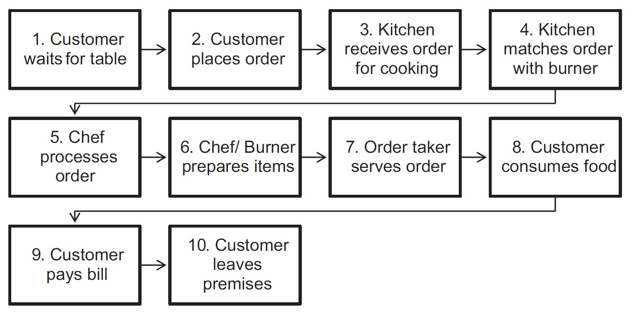

Slide 4
Assumptions
Waiting room has infinite capacity
Customer arrivals have Poisson distribution
Tables are homogeneous
Customer do not have table preference

Slide 6
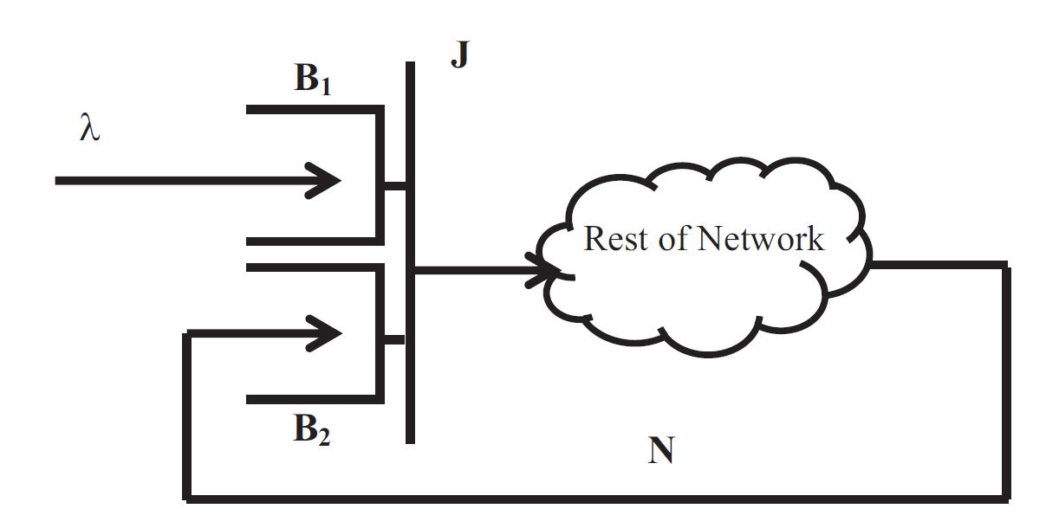
Order Taking
Cooking Process
Eating and Paying

Slide 7
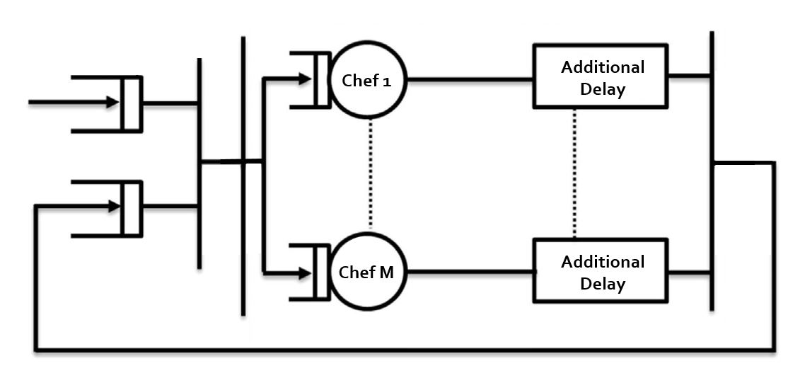
Kitchen

Slide 8
Generalization
λp1
λp2
λp3

Slide 9
Solution to the inner-level kitchen queuing network
Ω

Slide 10
Step 1: Solve Ω for n = 1..N
Step 2: Develop a CTMC for kitchen
Step 3: Solve it ☺

Slide 11
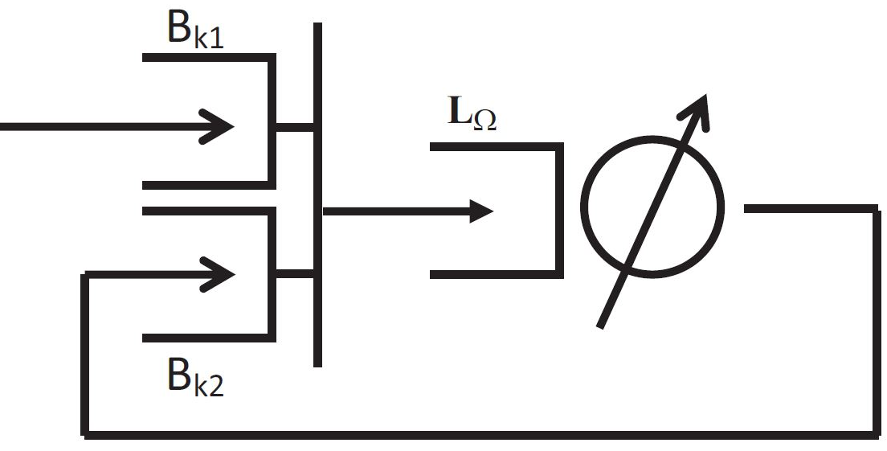
Step 1: Solve Ω for n = 1..N
Using an approximate mean value analysis algorithm based on:
Buitenhek R, van Houtum Geert‐Jan, Zijm H. AMVA‐based solution procedures for open queueing networks with population constraints. Ann Oper Res 2000;93(1–4):15–40.
Replace the sub-network with a load-dependent server

Slide 12
Step 2: Develop a CTMC for kitchen
States: the number of customer orders waiting to be processed in Buffer Bk1 minus the number of ovens idle in Buffer Bk2

Slide 13
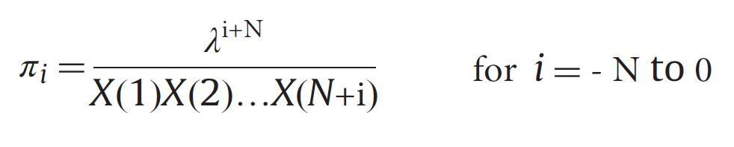
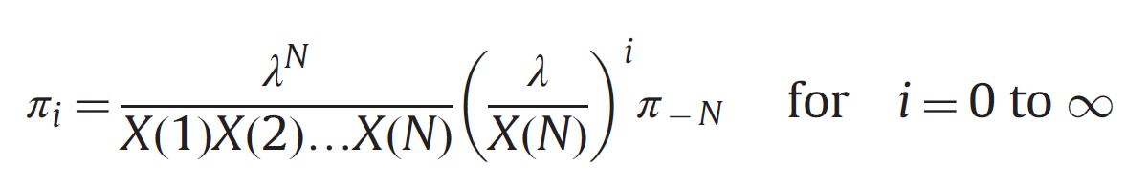
Step 3: Solve it ☺
It is easily solvable because it is reversible.

Slide 14
Convolution distribution
M/G/∞
Order Taking
Cooking Process
Eating and Paying

Slide 15
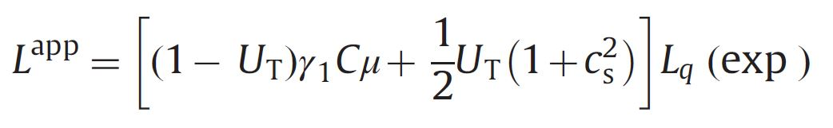
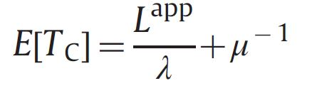



The outer IS-SOQN is equivalence to M/G/c
Based on: Roy D, De Koster R. Modeling and design of container terminal operations, ERIM report series reference no. ERS-2014-008-LIS; 2014
For finding L and Sojourn time, M/G/c is approximated using M/M/c as follow:
Where :
: The square of coefficient variation of service

Slide 16
Generalization
Q1
λp1
λp2
Q2
λp3
Q3

Slide 17
Why should we do this?
This model is appropriate for group arrival with different type of order
This approximation is more realistic
The previous model did not consider the variation of service times
In the restaurants, resources of different dishes are not the same

Slide 18
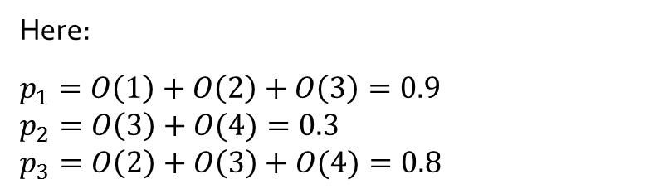
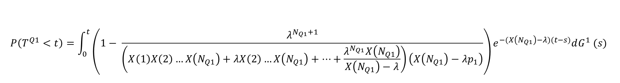
Convolution
$$P\left(T^{Q1}<t\right)=\int_{0}^{t}{\left(1− \frac{λ^{N_{Q1}+1}}{\left(X\left(1\right)X\left(2\right)…X\left(N_{Q1}\right)+λX\left(2\right)…X\left(N_{Q1}\right)+…+\frac{λ^{N_{Q1}}X\left(N_{Q1}\right)}{X\left(N_{Q1}\right)−λ}\right)\left(X\left(N_{Q1}\right)−λp_{1}\right)}\right)e^{−(X\left(N_{Q1}\right)−λ)(t−s)}dG^{1} (s)}$$
Order | Ratio of that order to all order
(1,0,0) | O(1) = 0.2
(1,0,1) | O(2) = 0.5
(1,1,2) | O(3) = 0.2
(0,3,1) | O(4) = 0.1
Here:
$$p_{1}=O\left(1\right)+O\left(2\right)+O\left(3\right)=0.9$$
$$p_{2}=O\left(3\right)+O(4)=0.3$$
$$p_{3}=O\left(2\right)+O\left(3\right)+O(4)=0.8$$

Slide 19
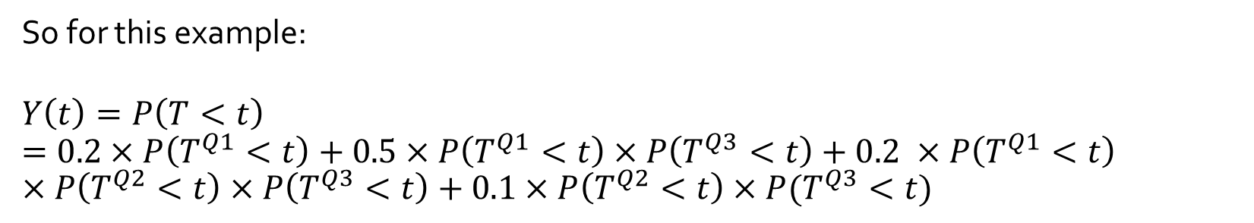
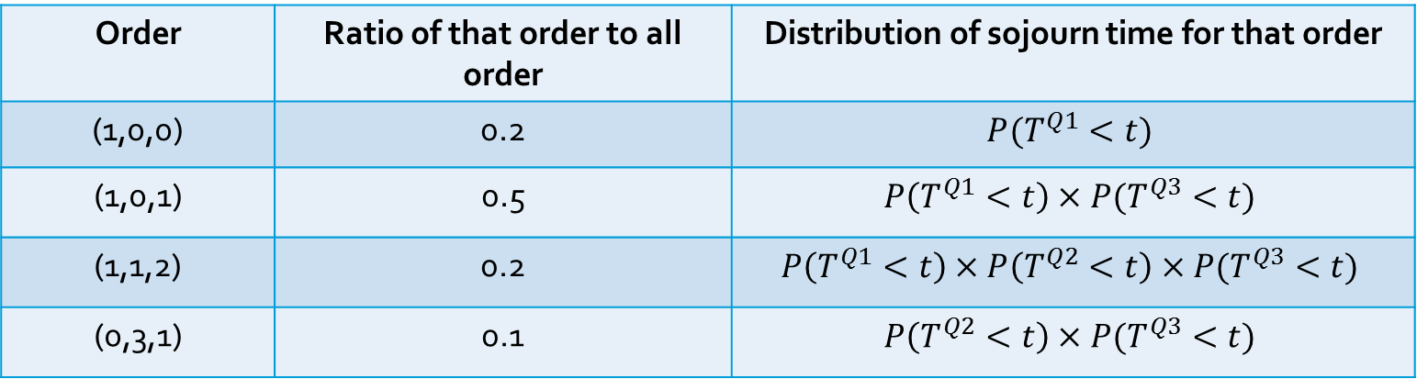
Convolution
Order | Ratio of that order to all order | Distribution of sojourn time for that order
(1,0,0) | 0.2 | $$P(T^{Q1}<t)$$
(1,0,1) | 0.5 | $$P\left(T^{Q1}<t\right)×P(T^{Q3}<t)$$
(1,1,2) | 0.2 | $$P\left(T^{Q1}<t\right)×P\left(T^{Q2}<t\right)×P(T^{Q3}<t)$$
(0,3,1) | 0.1 | $$P\left(T^{Q2}<t\right)×P(T^{Q3}<t)$$
So for this example:
$$Y\left(t\right)=P\left(T<t\right)=0.2×P\left(T^{Q1}<t\right)+0.5×P\left(T^{Q1}<t\right)×P\left(T^{Q3}<t\right)+0.2 ×P\left(T^{Q1}<t\right)×P\left(T^{Q2}<t\right)×P\left(T^{Q3}<t\right)+0.1×P\left(T^{Q2}<t\right)×P(T^{Q3}<t)$$

Slide 20
Convolution
Order | Ratio of that order to all order | Distribution of sojourn time for that order
(1,0,0) | 0.2 | $$P(T^{Q1}<t)$$
(1,0,1) | 0.5 | $$P\left(T^{Q1}<t\right)×P(T^{Q3}<t)$$
(1,1,2) | 0.2 | $$P\left(T^{Q1}<t\right)×P\left(T^{Q2}<t\right)×P(T^{Q3}<t)$$
(0,3,1) | 0.1 | $$P\left(T^{Q2}<t\right)×P(T^{Q3}<t)$$
So for this example:
$$Y\left(t\right)=P\left(T<t\right)=0.2×P\left(T^{Q1}<t\right)+0.5×P\left(T^{Q1}<t\right)×P\left(T^{Q3}<t\right)+0.2 ×P\left(T^{Q1}<t\right)×P\left(T^{Q2}<t\right)×P\left(T^{Q3}<t\right)+0.1×P\left(T^{Q2}<t\right)×P(T^{Q3}<t)$$

Slide 21

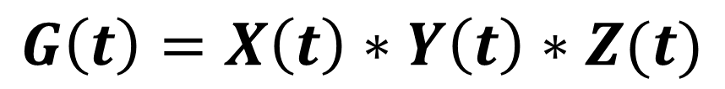


Convolution distribution of M/G/ ∞
M/G/∞
$$G\left(t\right)=X\left(t\right)∗Y\left(t\right)∗Z(t)$$
$$X\left(t\right)$$
$$Y\left(t\right)$$
$$Z\left(t\right)$$
Order Taking
Cooking Process
Eating and Paying

Slide 22
References
Roy, D., Bandyopadhyay, A., & Banerjee, P. (2016). A nested semi-open queuing network model for analyzing dine-in restaurant performance.Computers & Operations Research, 65, 29-41. (Main Reference)
Buitenhek, R., van Houtum, G. J., & Zijm, H. (2000). AMVA‐based solution procedures for open queueing networks with population constraints. Annals of Operations Research, 93(1-4), 15-40.
Roy, D., & De Koster, M. B. M. (2014). Modeling and design of container terminal operations. ERIM Report Series Reference No. ERS-2014-008-LIS.

